Slide 1
The forecast-error experiments
MSc THESIS · EXPERIMENT DESIGN
How one experiment is structured, how we build a case, how forecast errors enter, which bids we compare, and the pipeline that delivers the results.
Carlos Canoyra Calero
Supervisor: Jalal Kazempour · Co-supervisor: Lukas Alfred Stippel

Slide 2

Index: five parts of the experiments
OVERVIEW
Structure
One experiment: a benchmark solved once, a market run per draw
slide 3
1
The case
One dictionary of generators, demand and batteries; every model is built from it
slide 4
2
Forecast errors
slides 5–6
3
Bid families
slide 7
4
The pipeline
slides 8–11
5
Parts 1–4 build the experiment; part 5 is what it delivers.

Slide 3




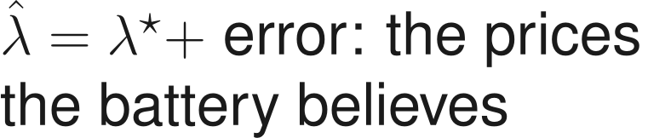
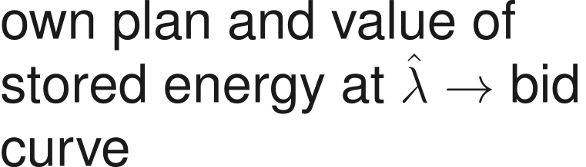
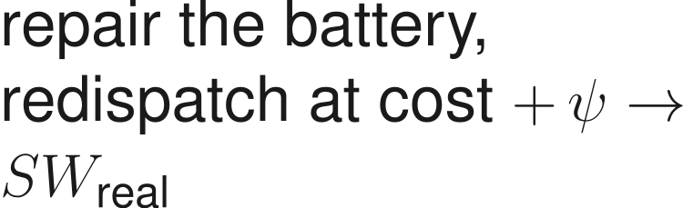
One experiment: a benchmark solved once, a market run per draw
1 · STRUCTURE
ONCE PER CASE
Baldick's design
Benchmark
the ISO schedules the SOC
Case
test system (dict)
EVERY DRAW · 150–500 per setting
1
Forecast
2
Bids
3
Day-ahead
4
Real time
clear today's market: no SOC, so the sold schedule may be infeasible
Only step 1 sees the error: steps 3–4 and the welfare always use the true system.
Same yardstick for both sides: the only difference is what the battery knew when it bid.
Notes:
Baldick's design is solved once per case and gives the yardstick. Every draw then perturbs the prices the battery believes, builds its bids, clears today's market and repairs in real time what the battery cannot deliver. The loss is the welfare gap, as a share of the value storage creates.

Slide 4
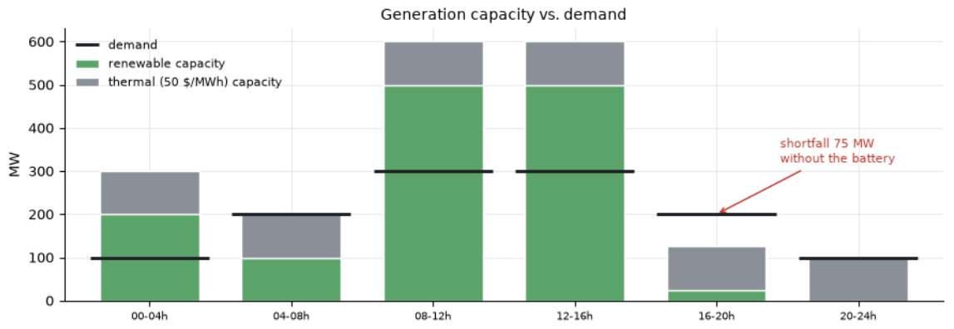
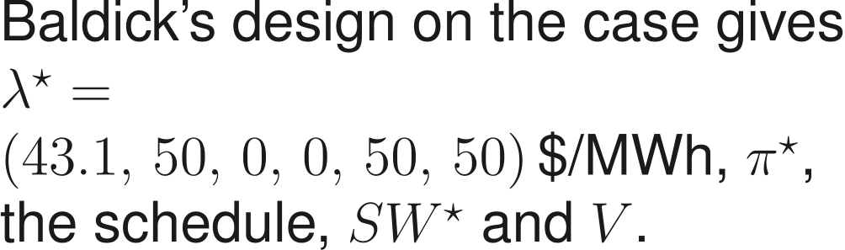
How we build a case: one dictionary, every model built from it
2 · THE CASE
case = dict(
T=6, dT=4.0, # six 4-hour intervals
gens=[renewable, thermal], # cost, capacity
D=[[100,200,300,300,200,100]], # MW
ess=[battery], # θ and w
N=1, lines=[], loads=[]) # one bus
Capacity against demand: without storage, 16–20h is 75 MW short.
Generators
renewable: cost 0, capacity 200/100/500/500/25/0 MW · thermal: 50 $/MWh, 100 MW
Benchmark (once)
Next cases, same format
Demand
inelastic, 100–300 MW; shedding priced at VOLL = 1000 $/MWh
Stage 2: a fleet of 5–20 batteries. Stage 3: a reduced RTS-GMLC area, many days.
Battery
Small and fully checkable first: every number of this case can be verified by hand.
Notes:
A case is a plain Python dictionary: time grid, generators, demand and batteries. There is no model class: each LP (benchmark, bids, clearing, repair) is assembled from the dictionary when needed. Stages 0-1 use Baldick's base case; the fleet and the realistic system of stages 2-3 use the same format.

Slide 5
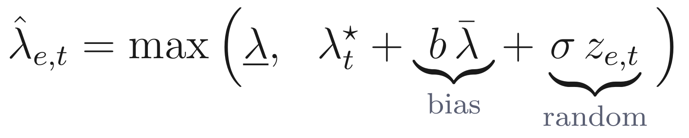
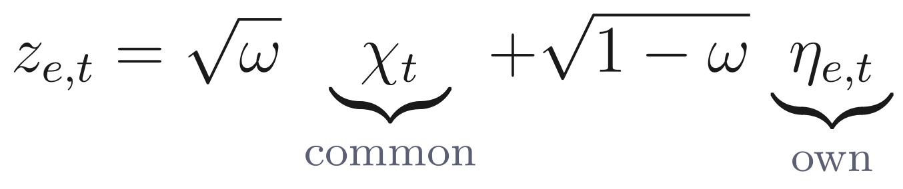
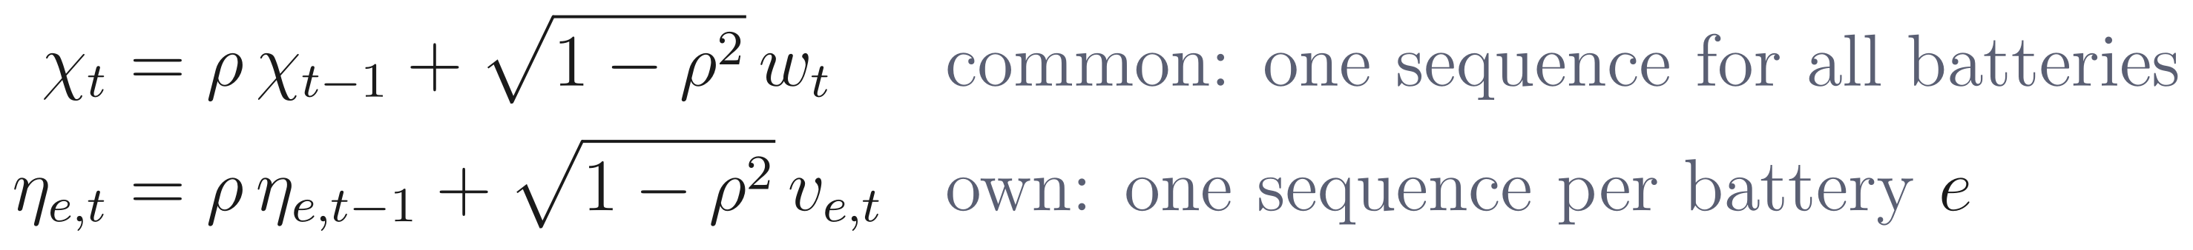




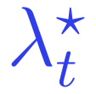

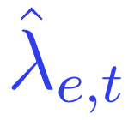




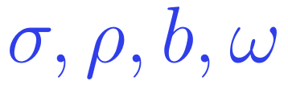
How forecast errors are implemented
3 · FORECAST ERRORS
1
Seed from the draw number
2
Same shape in every setting
3
Floor at 0
a forecast never predicts prices this market cannot produce
4
Inserted in one place
Notation
battery, interval (4 h)
random error, variance 1
size, % of the mean price
persistence hour to hour
bias (level error)
share common to all batteries
true price (benchmark)
common piece, all batteries
price floor (0 $/MWh)
the four knobs (left)
Four knobs on one shared error shape: differences between settings come from the knob alone.
Notes:
Each battery's forecast is the true price plus a bias and a random error, floored at the lowest price the market can produce. The random part mixes a common component and the battery's own; both are unit-variance AR(1). The seed of a draw depends only on the draw number, so every setting faces the same error shapes and settings are compared draw by draw.

Slide 6
Why these error values
3 · FORECAST ERRORS
Knob | Values | Why
 |  | Published day-ahead forecasts (Lago et al. 2021): state of the art ≈ 6–18%, naive ≈ 15–47%. 0 is the control; 40% means no skill.
 | 0, 0.5, 0.9 | Wind forecast errors in the project's RTS-GMLC data: autocorrelation 0.49 at 4 h (our interval), 0.87 at 1 h.
 |  | A systematic level error of the same size as the best random error; symmetric, so sign effects show.
 | 0, 0.5, 1 | Own forecaster vs one shared forecast (vendor or TSO); matters only with several batteries.
floor | 0 $/MWh | This market never clears below 0 (free renewables); a parameter, since real markets do.
 | 0, 10, 50 $/MWh | Frictionless · close to real imbalance penalties · scarcity stress test. To agree with the supervisors.
Every published value sits inside the grid; calibration later says where reality is.
Notes:
The grid is a design, not an estimate: each axis runs from perfect information to a poor forecast, with published or project values inside. Stage 3 replaces it by values calibrated on real Danish prices.

Slide 7
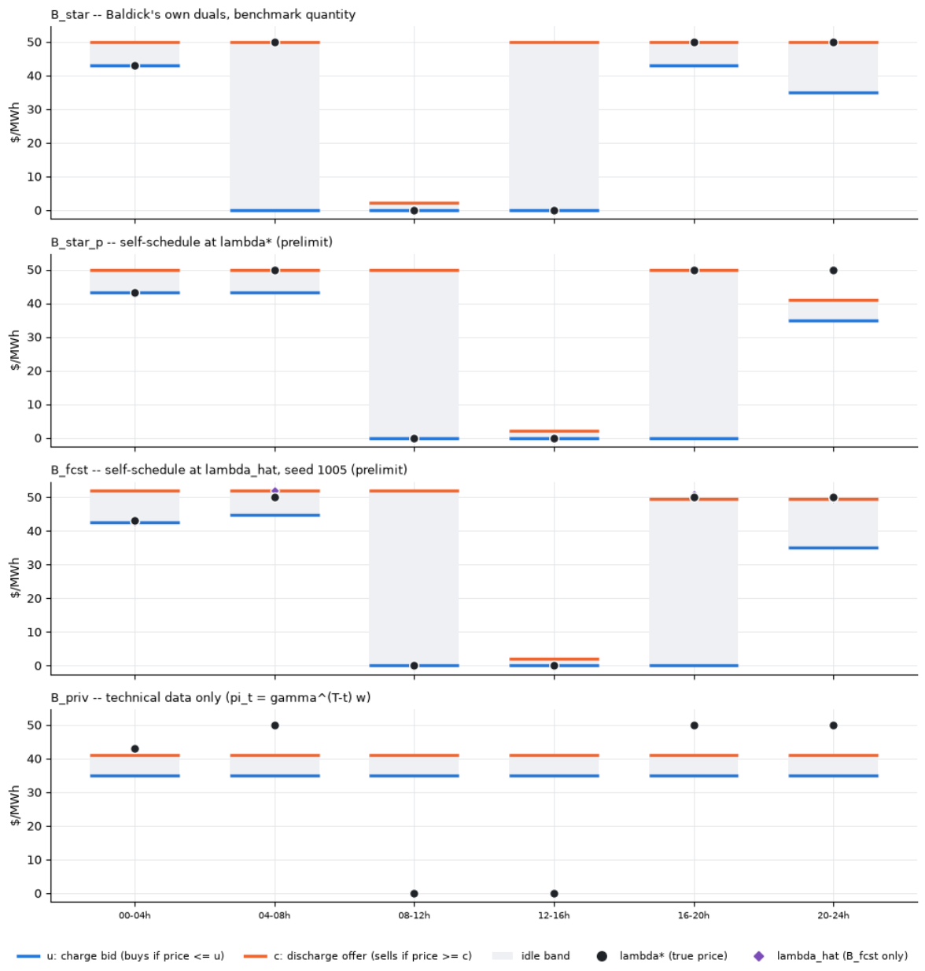





Four bid families, each isolating one piece of information
4 · BID FAMILIES
Prices from
Quantity
What it isolates
true prices, Baldick's duals
Baldick's schedule
gate: must lose 0
true prices, own selection
cost without quantity plan
main experiment: + price forecast
none: technical data only
full capacity
lower bound: is a forecast worth it?
Same pipeline for all four: only the information behind the bid changes.
Notes:
B-star: Baldick's own duals and quantities, a gate that must give zero loss. B-star-p: true prices but the battery's own plan. B-fcst: a forecast, the main experiment. B-priv: technical data only, no forecast. Differences between families separate the cost of the quantity plan from the cost of the price forecast.

Slide 8
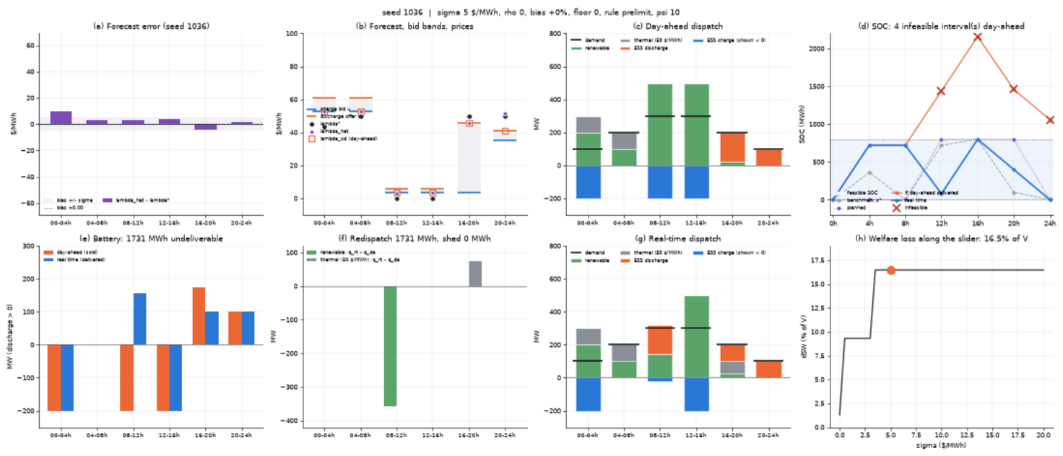
Final deliverable: every draw, every step, on one screen
5 · THE PIPELINE
The eight panels
a
forecast error
b
forecast, bid bands, prices
c
day-ahead dispatch
d
is the SOC feasible?
e
sold vs delivered
f
redispatch and shedding
g
real-time dispatch
h
where the loss comes from
Explorer: change one knob, all eight panels update
Albums: one slider per parameter, standalone HTML
Every number in the results can be traced back to a picture of the step that produced it.
Notes:
The notebook explorer re-solves one draw in about 0.03 s for any seed, sigma, rho, bias, price floor, bid rule and psi, and redraws eight panels: the forecast error, the forecast with bid bands and prices, the day-ahead dispatch, SOC feasibility, what the battery sold versus delivered, redispatch and shedding, the real-time dispatch, and where the loss comes from. The albums pre-render one slider per parameter as a standalone HTML page that opens without Python.

Slide 9
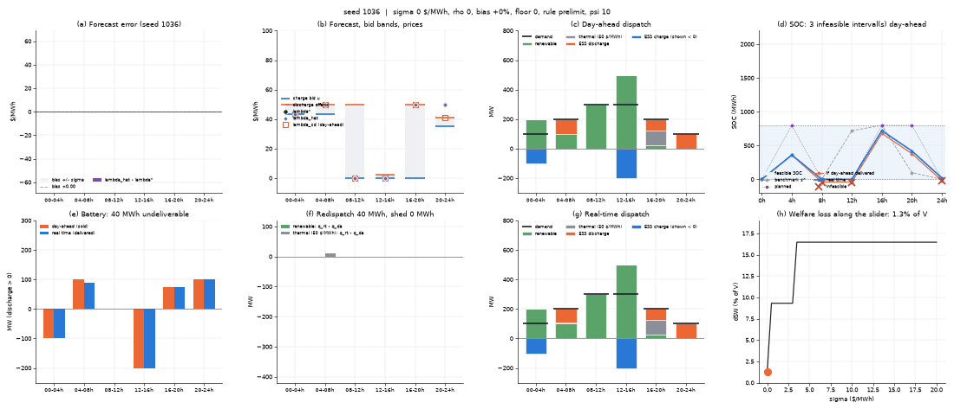
Final deliverable: Sigma´s effect on the error model
5 · THE PIPELINE
The eight panels
a
forecast error
b
forecast, bid bands, prices
c
day-ahead dispatch
d
is the SOC feasible?
e
sold vs delivered
f
redispatch and shedding
g
real-time dispatch
h
where the loss comes from
Explorer: change one knob, all eight panels update
Albums: one slider per parameter, standalone HTML
Every number in the results can be traced back to a picture of the step that produced it.
Notes:
The notebook explorer re-solves one draw in about 0.03 s for any seed, sigma, rho, bias, price floor, bid rule and psi, and redraws eight panels: the forecast error, the forecast with bid bands and prices, the day-ahead dispatch, SOC feasibility, what the battery sold versus delivered, redispatch and shedding, the real-time dispatch, and where the loss comes from. The albums pre-render one slider per parameter as a standalone HTML page that opens without Python.

Slide 10
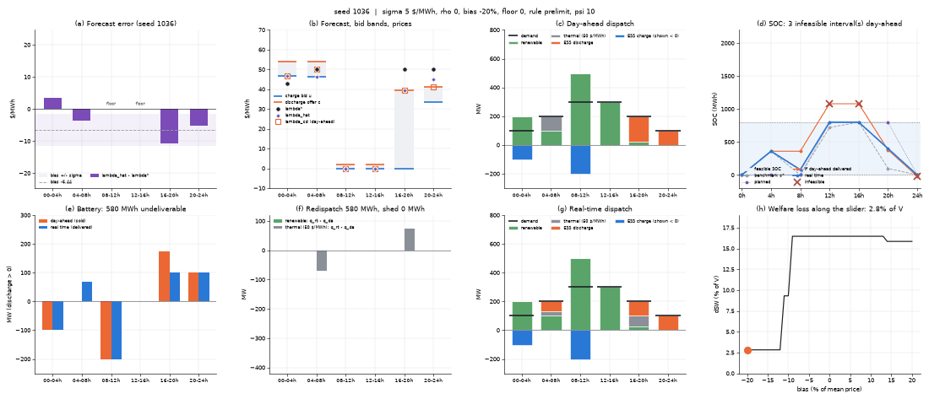
Final deliverable: Bias´ effect on the error model
5 · THE PIPELINE
The eight panels
a
forecast error
b
forecast, bid bands, prices
c
day-ahead dispatch
d
is the SOC feasible?
e
sold vs delivered
f
redispatch and shedding
g
real-time dispatch
h
where the loss comes from
Explorer: change one knob, all eight panels update
Albums: one slider per parameter, standalone HTML
Every number in the results can be traced back to a picture of the step that produced it.
Notes:
The notebook explorer re-solves one draw in about 0.03 s for any seed, sigma, rho, bias, price floor, bid rule and psi, and redraws eight panels: the forecast error, the forecast with bid bands and prices, the day-ahead dispatch, SOC feasibility, what the battery sold versus delivered, redispatch and shedding, the real-time dispatch, and where the loss comes from. The albums pre-render one slider per parameter as a standalone HTML page that opens without Python.

Slide 11
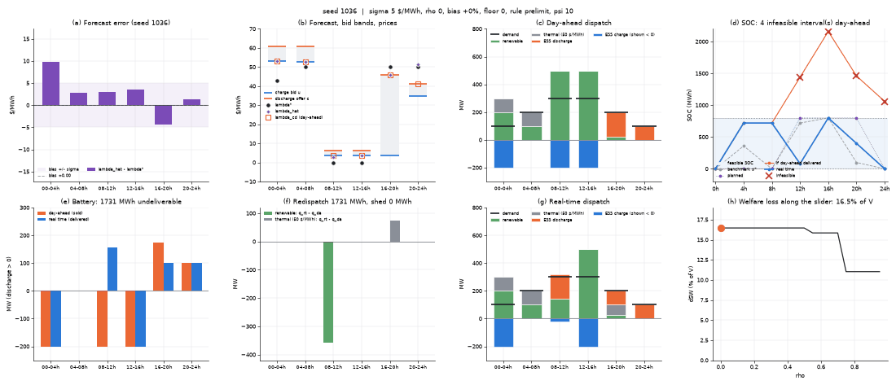
Final deliverable: Rho´s effect on the error model
5 · THE PIPELINE
The eight panels
a
forecast error
b
forecast, bid bands, prices
c
day-ahead dispatch
d
is the SOC feasible?
e
sold vs delivered
f
redispatch and shedding
g
real-time dispatch
h
where the loss comes from
Explorer: change one knob, all eight panels update
Albums: one slider per parameter, standalone HTML
Every number in the results can be traced back to a picture of the step that produced it.
Notes:
The notebook explorer re-solves one draw in about 0.03 s for any seed, sigma, rho, bias, price floor, bid rule and psi, and redraws eight panels: the forecast error, the forecast with bid bands and prices, the day-ahead dispatch, SOC feasibility, what the battery sold versus delivered, redispatch and shedding, the real-time dispatch, and where the loss comes from. The albums pre-render one slider per parameter as a standalone HTML page that opens without Python.

