Slide 1
Recombination

Slide 2
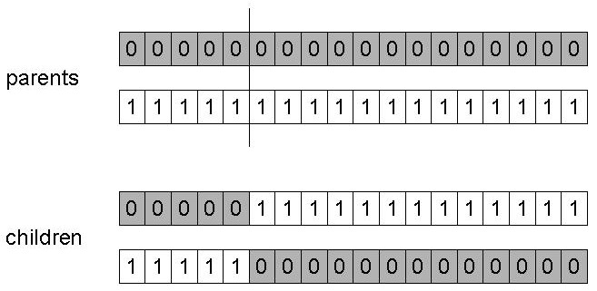
1-point crossover
Choose a random point on the two parents
Split parents at this crossover point
Create children by exchanging tails
P_{c} typically in range (0.6, 0.9)
Positional bias, hitchhikers, disrupt large genes

Slide 3
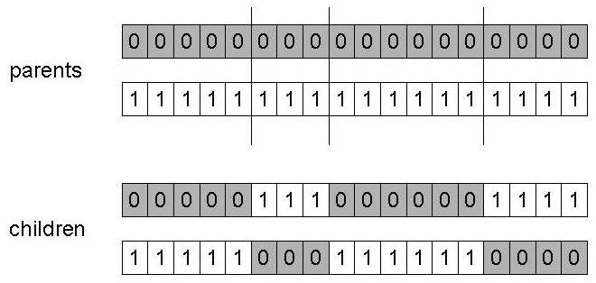
n-point crossover
Choose n random crossover points
Split along those points
Glue parts, alternating between parents
Generalization of 1 point (still some positional bias; note, even # points keeps ends together)

Slide 4
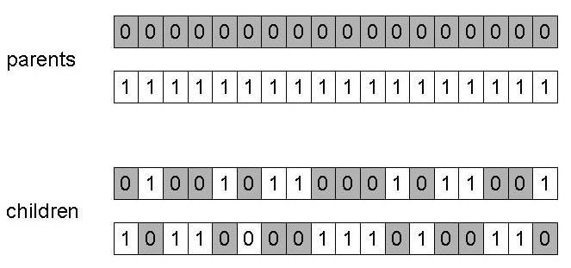
Uniform crossover
Assign 'heads' to one parent, 'tails' to the other
Flip a coin for each gene of the first child
Make an inverse copy of the gene for the second child
Can be viewed as an L-1 point crossover
Inheritance is independent of position (breaks longer genes)
Distributional bias (50/50)

Slide 5
Crossover operators for real valued GAs
Discrete:
  Could use n-point or uniform
Intermediate
  exploits idea of creating children z “between” parents x and y (hence a.k.a. arithmetic recombination)
  z_{i} = α x_{i} + (1 - α) y_{i} where 0 ≤ α ≤ 1.
  The parameter α can be:
    constant: uniform arithmetical crossover
    variable (e.g. depend on the age of the population)
    picked at random every time
    Related to fitness of parents

Slide 6
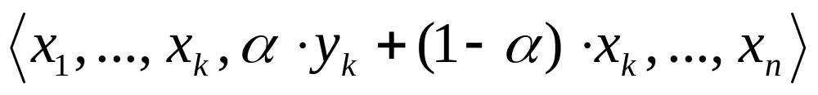
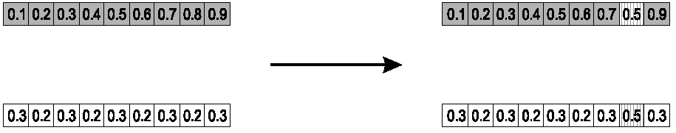
Single arithmetic crossover
Parents: ⟨x₁,…,x_{n} ⟩ and ⟨y₁,…,y_{n}⟩
Pick a single gene (k) at random,
child₁ is:
reverse for other child. e.g. with α = 0.5

Slide 7
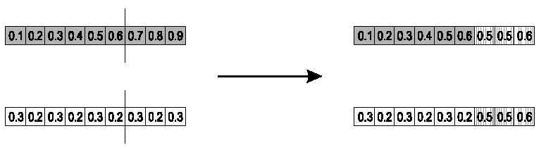
Simple arithmetic crossover
Parents: ⟨x₁,…,x_{n} ⟩ and ⟨y₁,…,y_{n}⟩
Pick random gene (k) after this point mix values
child₁ is:
reverse for other child. e.g. with α = 0.5

Slide 8
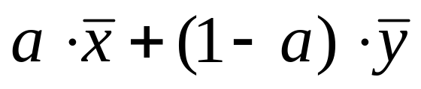
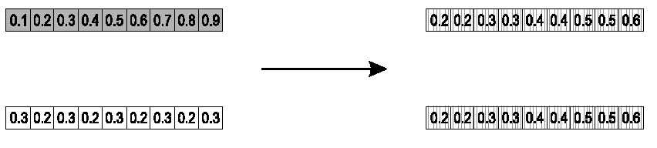
Whole arithmetic crossover
Most commonly used
Parents: ⟨x₁,…,x_{n} ⟩ and ⟨y₁,…,y_{n}⟩
child₁ is:
reverse for other child. e.g. with α = 0.5

Slide 9
Crossover operators for permutations
“Normal” crossover operators will often lead to inadmissible solutions
Many specialized operators have been devised which focus on combining order and/or adjacency information from the two parents
1 2 3 4 5
1 2 3 2 1
5 4 3 2 1
5 4 3 4 5

Slide 10
Order crossover
(preserves relative order)
Idea is to preserve relative order that elements occur
Pseudo-code:
  Choose two crossover points
  Copy segment between them from 1st parent to 1st child
  Copy remaining unused numbers into 1st child in the order they appear in 2nd parent, starting from second crossover point and wrapping.
Analogous for the second child, with parent roles reversed

Slide 11
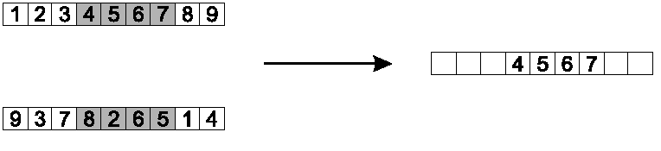
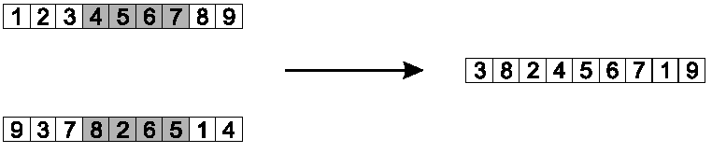
Order crossover example
(preserves relative order)
Copy randomly selected set from first parent
Copy rest from second parent in order 1,9,3,8,2

Slide 12
Partially Mapped Crossover (PMX)
(preserves adjacency 1st, relative order 2nd)
Pseudo-code for parents P1 and P2:
Choose random segment and copy it from P1
Starting from the first crossover point look for elements in that segment of P2 that have not been copied
For each of these i look in the offspring to see what element j has been copied in its place from P1
Place i into the position occupied j in P2, since we know that we will not be putting j there (as it is already in offspring)
If the place occupied by j in P2 has already been filled in the offspring k, put i in the position occupied by k in P2
Having dealt with the elements from the crossover segment, the rest of the offspring can be filled from P2.
Second child is created analogously with parent roles reversed.

Slide 13
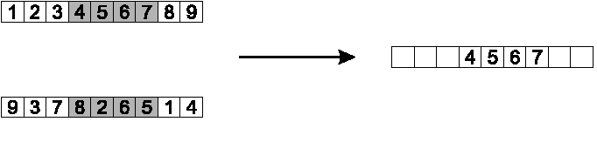
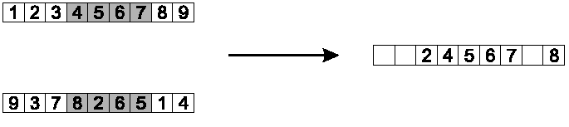
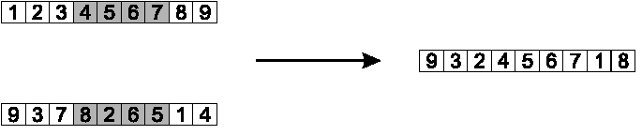
PMX example
(preserves adjacency 1st, relative order 2nd)
P1
Step 1
P2
P1
Step 2
P2
P1
Step 3
P2

Slide 14
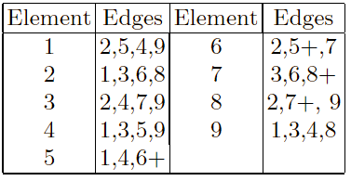
Edge-3 Recombination
(preserves most adjacency, not order)
Works by constructing a table listing which edges are present in the two parents, if an edge is common to both, mark with a +
e.g. [1 2 3 4 5 6 7 8 9] and [9 3 7 8 2 6 5 1 4]

Slide 15
Edge-3 Recombination cont.
Pseudo-code (once edge table is constructed)
1. Pick an initial “current element” at random and put it in the offspring
3. Remove all references to current element from the table
4. Examine edge list for current element:
  If there is a common edge, pick that to be next element
  Otherwise pick the entry in the list which itself has the shortest list
  Ties are split at random
5. In the case of reaching an empty list:
  Examine the other end of the offspring for extension
  Otherwise a new element is chosen at random (only way a “foreign” edge is introduced)

Slide 16
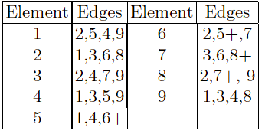
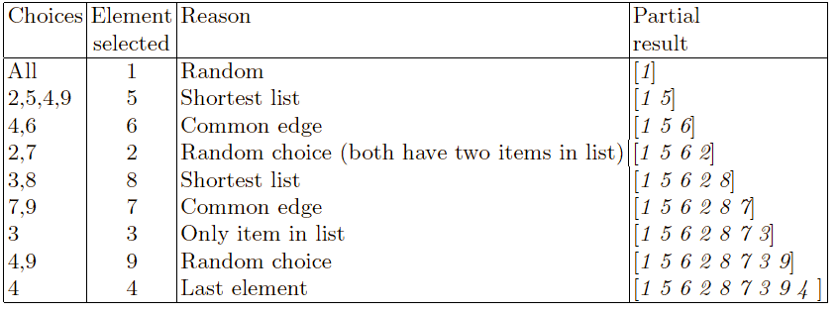
Edge-3 Recombination example (preserves most adjacency, not order)
P1: [1 2 3 4 5 6 7 8 9] P2: [9 3 7 8 2 6 5 1 4]

Slide 17
Cycle crossover
(preserves absolute position)
Basic idea:
Each allele comes from one parent together with its position.
Pseudo-code:
1) Identify all “cycles”
2) copy alternate cycles into the two offspring

Slide 18
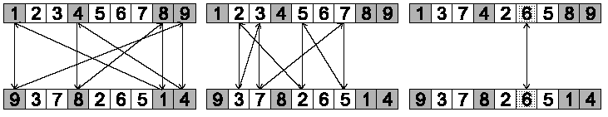
Cycle crossover example
To make a “cycle”:
Loop
  Start with the next unused allele of P1.
  Look at the allele at the same position in P2.
  Go to the position with the same allele in P1.
Repeat until you arrive where you started.
Step 1: identify all cycles
P1
P2
Cycle 1
Cycle 2
Cycle 3

Slide 19
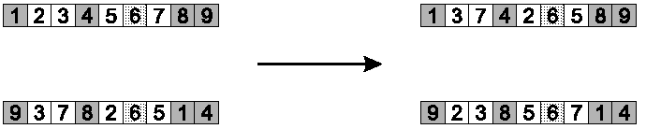
Cycle crossover example (cont.)
(preserves absolute position)
Step 2: Copy alternate cycles into kids
P1
P2
Cycle 1
Cycle 2
Cycle 3
P1
Kid1
P2
Kid2

Slide 20
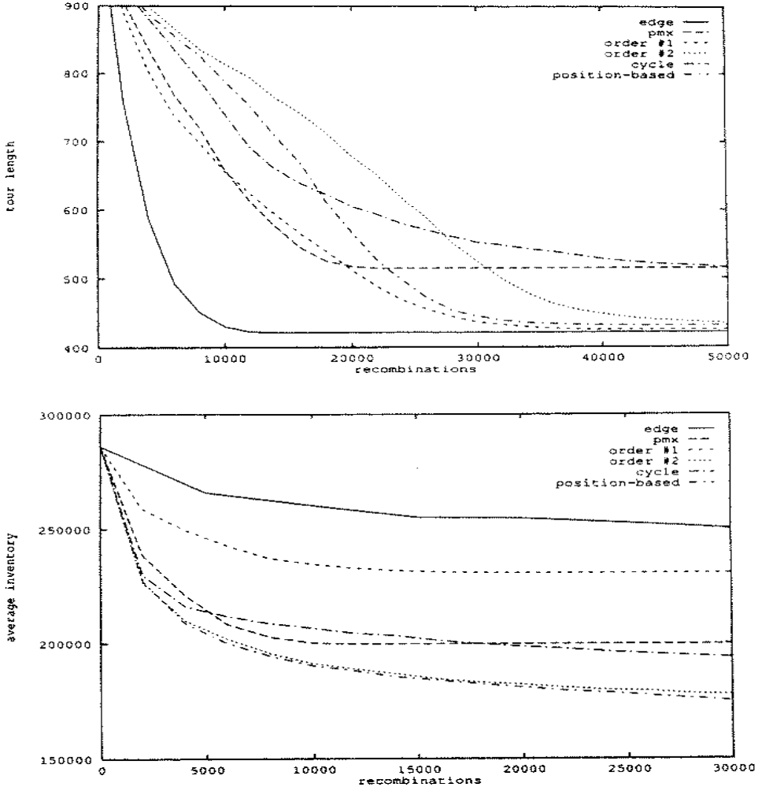
Whitley.pdf (Starkweather et al., 1991) – 30 city TSP

Slide 21
Whitley.pdf (Starkweather et al., 1991) – job-shop scheduler

Slide 22
Crossover vs. mutation?
Which is better? In general,
  it depends on the problem
  but its usually good to have some of both
  mutation-only EA is possible
    Only mutation can introduce new information
    But may be slow and prone to getting stuck in a local optimum
  xover-only EA would not work
    But can help explore more regions of the search space
  Mutation more important for real-valued genomes
    alphabet size is too large to expect all values to occur in all alleles!
  Crossover more important for low-cardinality genomes
    Mix and match existing alleles
    Requires large populations

Slide 23
Crossover vs. mutation? (cont’d)
Exploration: Discovering promising areas in the search space, i.e. gaining more global information on the problem
Exploitation: Optimizing within a promising area, i.e. using local information
Crossover is (initially) more explorative, it can make a relatively big jump to an area that is in some sense “in between” two (parent) areas
Mutation is generally more exploitative, it (should) create relatively small perturbationsdiversions, thereby searching in the region near one parent

