Slide 1
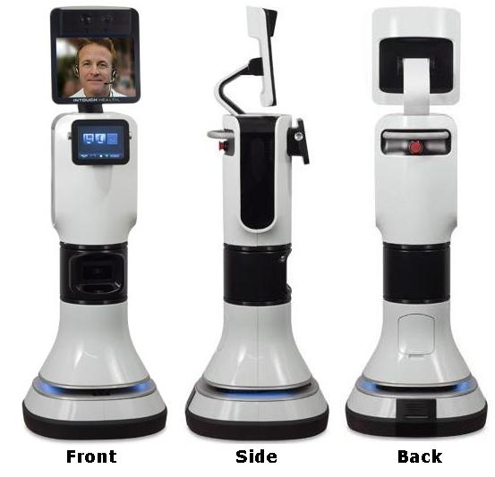
RP-Vita
Characteristics
Remote telepresence
Group conferencing with specialists
Lower chances of errors
Access to medical record database

Slide 2
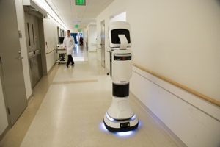
RP-Vita
Autonomous navigation
Send to location by screen press
Obstacle detection and avoidance
Remote diagnosis through sensors
Digital stethoscope
Ultrasound
Otoscope (that thing docs use to look in ur ears)

