Slide 1
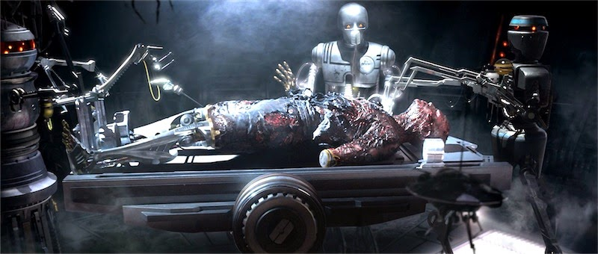
The Perfect Healthcare Robot
Fully automated diagnosis of patients.
Fully automated surgeries.

Slide 2
Observations/Questions Raised
Are we ready?
Will people trust robots to diagnose and treat them?

