Slide 1
Autonomous Navigation
Chris Card
Marshall Sweatt
CSCI598 Term Project
12/1/14

Slide 2
Introduction
Localization and Navigation are fundamental to autonomous mobile robots
  Must be able to locate current position
  Needs to be able to navigate across known environment
  Must be able to navigate safely

Slide 3
Approach
Communication: Custom script to initialize ROS environment for robot and workstation
Control: Uses the ROS keyop topic to control remotely
Sensing: Convert Kinect 3D point cloud to 2D laser
Localization: GMapping, a Simultaneous Localization and Mapping (SLAM) approach using 2D laser
Navigation: RVIZ launcher

Slide 4
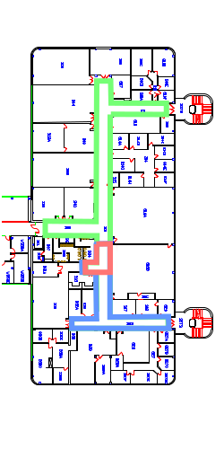
Gmapping
Experiments
Distances
  Short
  Medium
  Long
Cycles
  Single
  Double
  Figure 8

Slide 5
RVIZ Experiments
Navigation Video
Navigation Video 2

Slide 6
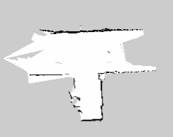
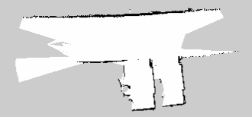
Results
No loop closure

Slide 7
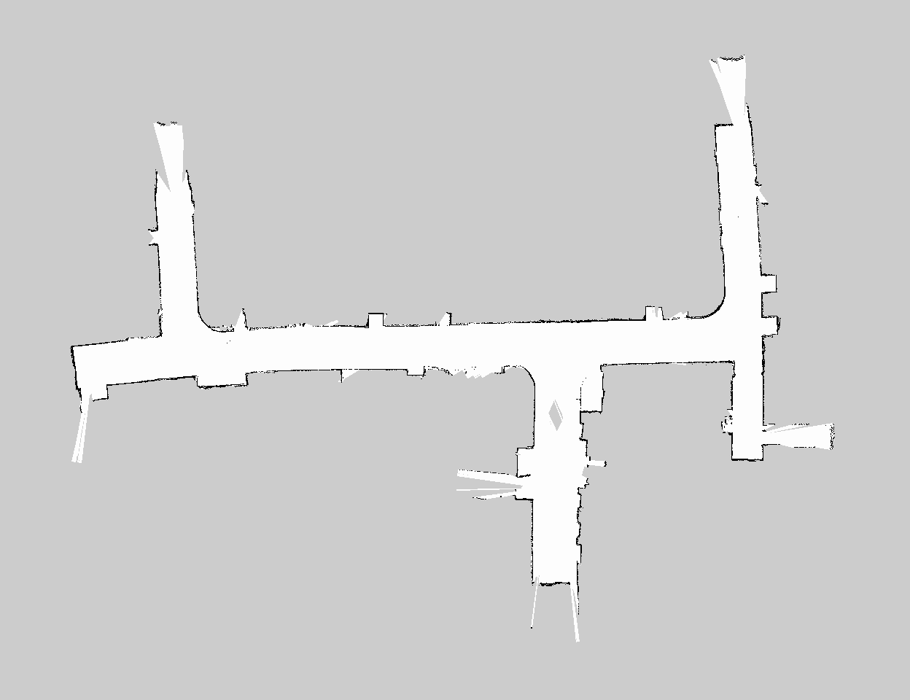
Results Cont..
Map
warps

Slide 8
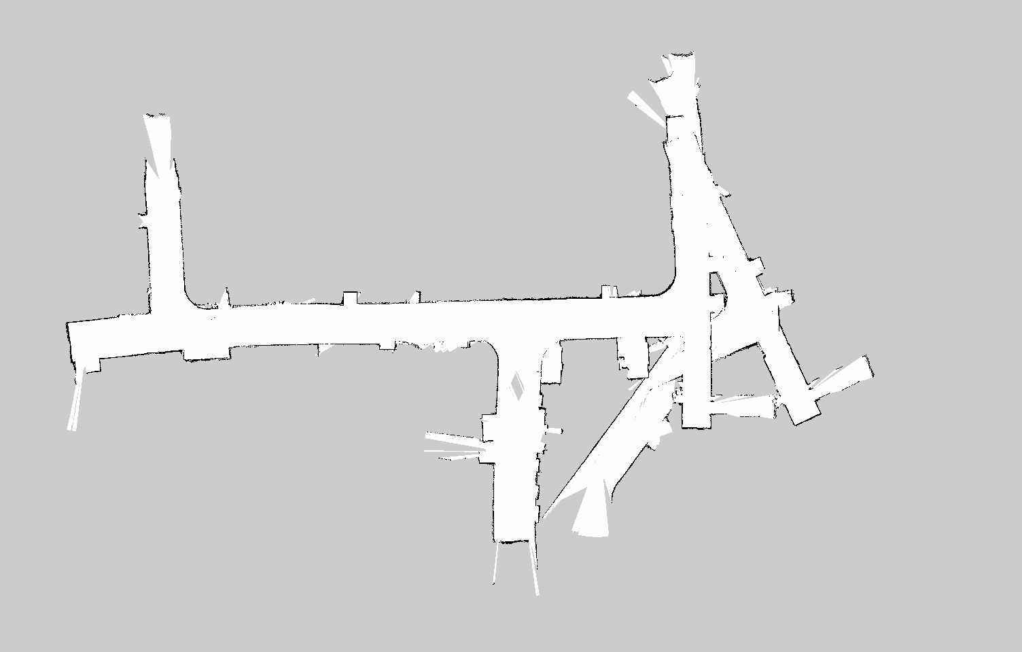
Results Cont..
Need better odometry – angular velocity

Slide 9
Results Cont..
General take-aways:
  Remote operation must have built in kill on mobile robot – i.e., if connection is lost, stop
  Optimize controller to avoid lag between sending a command and command execution
  Fuse localization sensors to obtain better location estimation of mobile robot

Slide 10
Conclusion
Wrote customized control package
Implemented Gmapping package
Implemented RVIZ navigation package

Slide 11
Thanks.

