Slide 1
Predicting NFL Rushing Touchdowns with Random Forest Regression
Presentation Created By:
Christian Carlan

Slide 2

Introduction
Research Analyst at UMD College Park
Received my bachelor's degree in mathematics from the University of North Carolina at Charlotte
Graduate student at Western Governors University with a focus on data analytics

Slide 3
Research Question
In the NFL, the more points you score, the better your chances to win games are.
Two ways to score touchdowns (6 points): Rushing or Passing
This project focuses solely on rushing scores
Our research question:
To what extent do our predictor variables affect the total number of rushing touchdowns

Slide 4
Variables
Predictor Variables:
Age
Games Started
Rushing Attempts
Rushing Yards
First Down Runs
Longest Rush
Yards per Attempt
Yards per Game
Number of Fumbles
Target Variable:
Number of Rushing Touchdowns
Hypothesis:
The predictor variables statistically affect the number of rushing touchdowns

Slide 5
The Random Forest Algorithm
Random Forest is a statistical algorithm using what is referred to as decision trees to make predictions
Each decision tree is a separate “guess” using an inputted number of variables to predict against your target variable
All the “trees” together are combined into a “forest” where a final prediction by the algorithm is made.
After which, you can use several different calculations to determine how accurate your model was

Slide 6
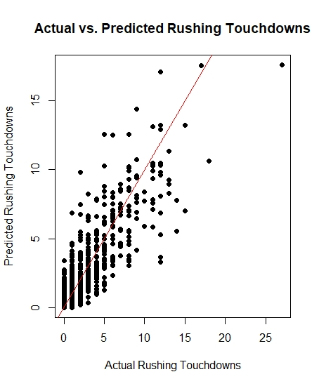
Findings
This plot showcases the actual number of rushing touchdowns in comparison to what the model predicted
The model showcases a good cluster around the red (or linear) line which indicates good predictions

Slide 7
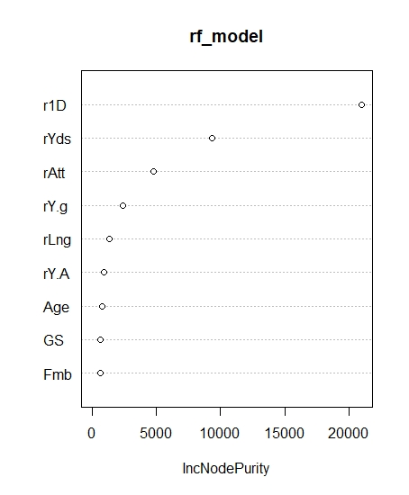
Findings (Continued)
This plot shows each variable and what is known as the increase in node purity
Values further from the left indicate those variables are more significant and contribute more to the number of rushing touchdowns
Based on our model, the number of rushing first downs, followed by rushing yards, and then rushing attempts are the most statistically significant variables, with number of fumbles being the least significant

Slide 8
Limitations
One limitation of this analysis is that the model is outputting continuous variables (or decimals). In a real football game, you cannot score fractions of a touchdown. Additional rounding is something that may be required in future analyses, depending on the ultimate goal (Carlan 2024).
Another limitation is that the algorithm itself is heavily reliant on your computer's memory, often leading to slow loading times.

Slide 9
Proposed Actions
Since the ability to get first downs is the strongest predictor variable in scoring rushing touchdowns, it is recommended that teams focus on their ability to sustain their drives. This can be done with focusing on the play calling as well as offensive line blocking to give your running back the best change of obtaining first downs in non-passing situations (3rd and inches, for example) (Carlan 2024).

Slide 10
Benefits
Player evaluation metrics can be improved, especially when you consider that first downs, yards, and attempts are the most significant predictors
Since first downs are the most significant predictor, teams can game plan more strategically to maximize the number of first downs in a game, either by calling better rushing plays or improving offensive line blocking

Slide 11
Sources
Jadhav, Rishab. “NFL Rushing Statistics (2001-2023).” Kaggle, 4 Mar. 2024, www.kaggle.com/datasets/rishabjadhav/nfl-rushing-statistics-2001-2023.
Carlan, Christian. "Predicting NFL Rushing Touchdowns with Random Forests." MSDA Capstone Topic Approval Form, 4 Apr. 2024.
Carlan, Christian. “Performance Assessment: D214- Capstone Data Analysis.” D214_Task2, 9 April. 2024.

