Slide 1
Angular Upskilling Program
Introduction

Slide 2

Cosmin Cartas
- Ph. D. Candidate;
- Associate professor at CSIE;
- Full Stack Developer;
- Founder of multiple start-ups;

Slide 3

Agenda
Introduction
Components;
Directives;
Services;
Pipes;
Forms + Validation;
Routing;
Best practices;

Slide 4
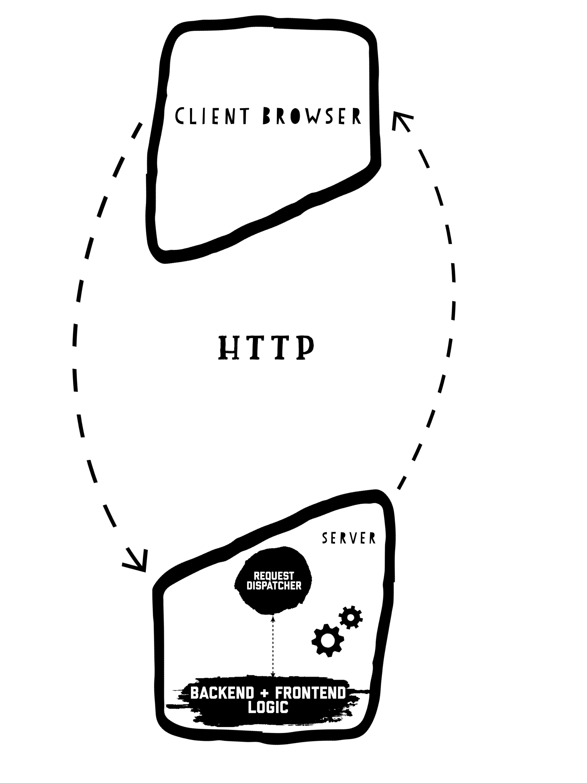
A little bit of history…
Scalability Problems – Multiple clients will create performance issues because all the processing is done on the server-side.
Each change in the user interface would require a new request to the server.
State management of the application will require heavy processing.
If the user connection is not so good, it can create latency issues.
Offline usage;

Slide 5
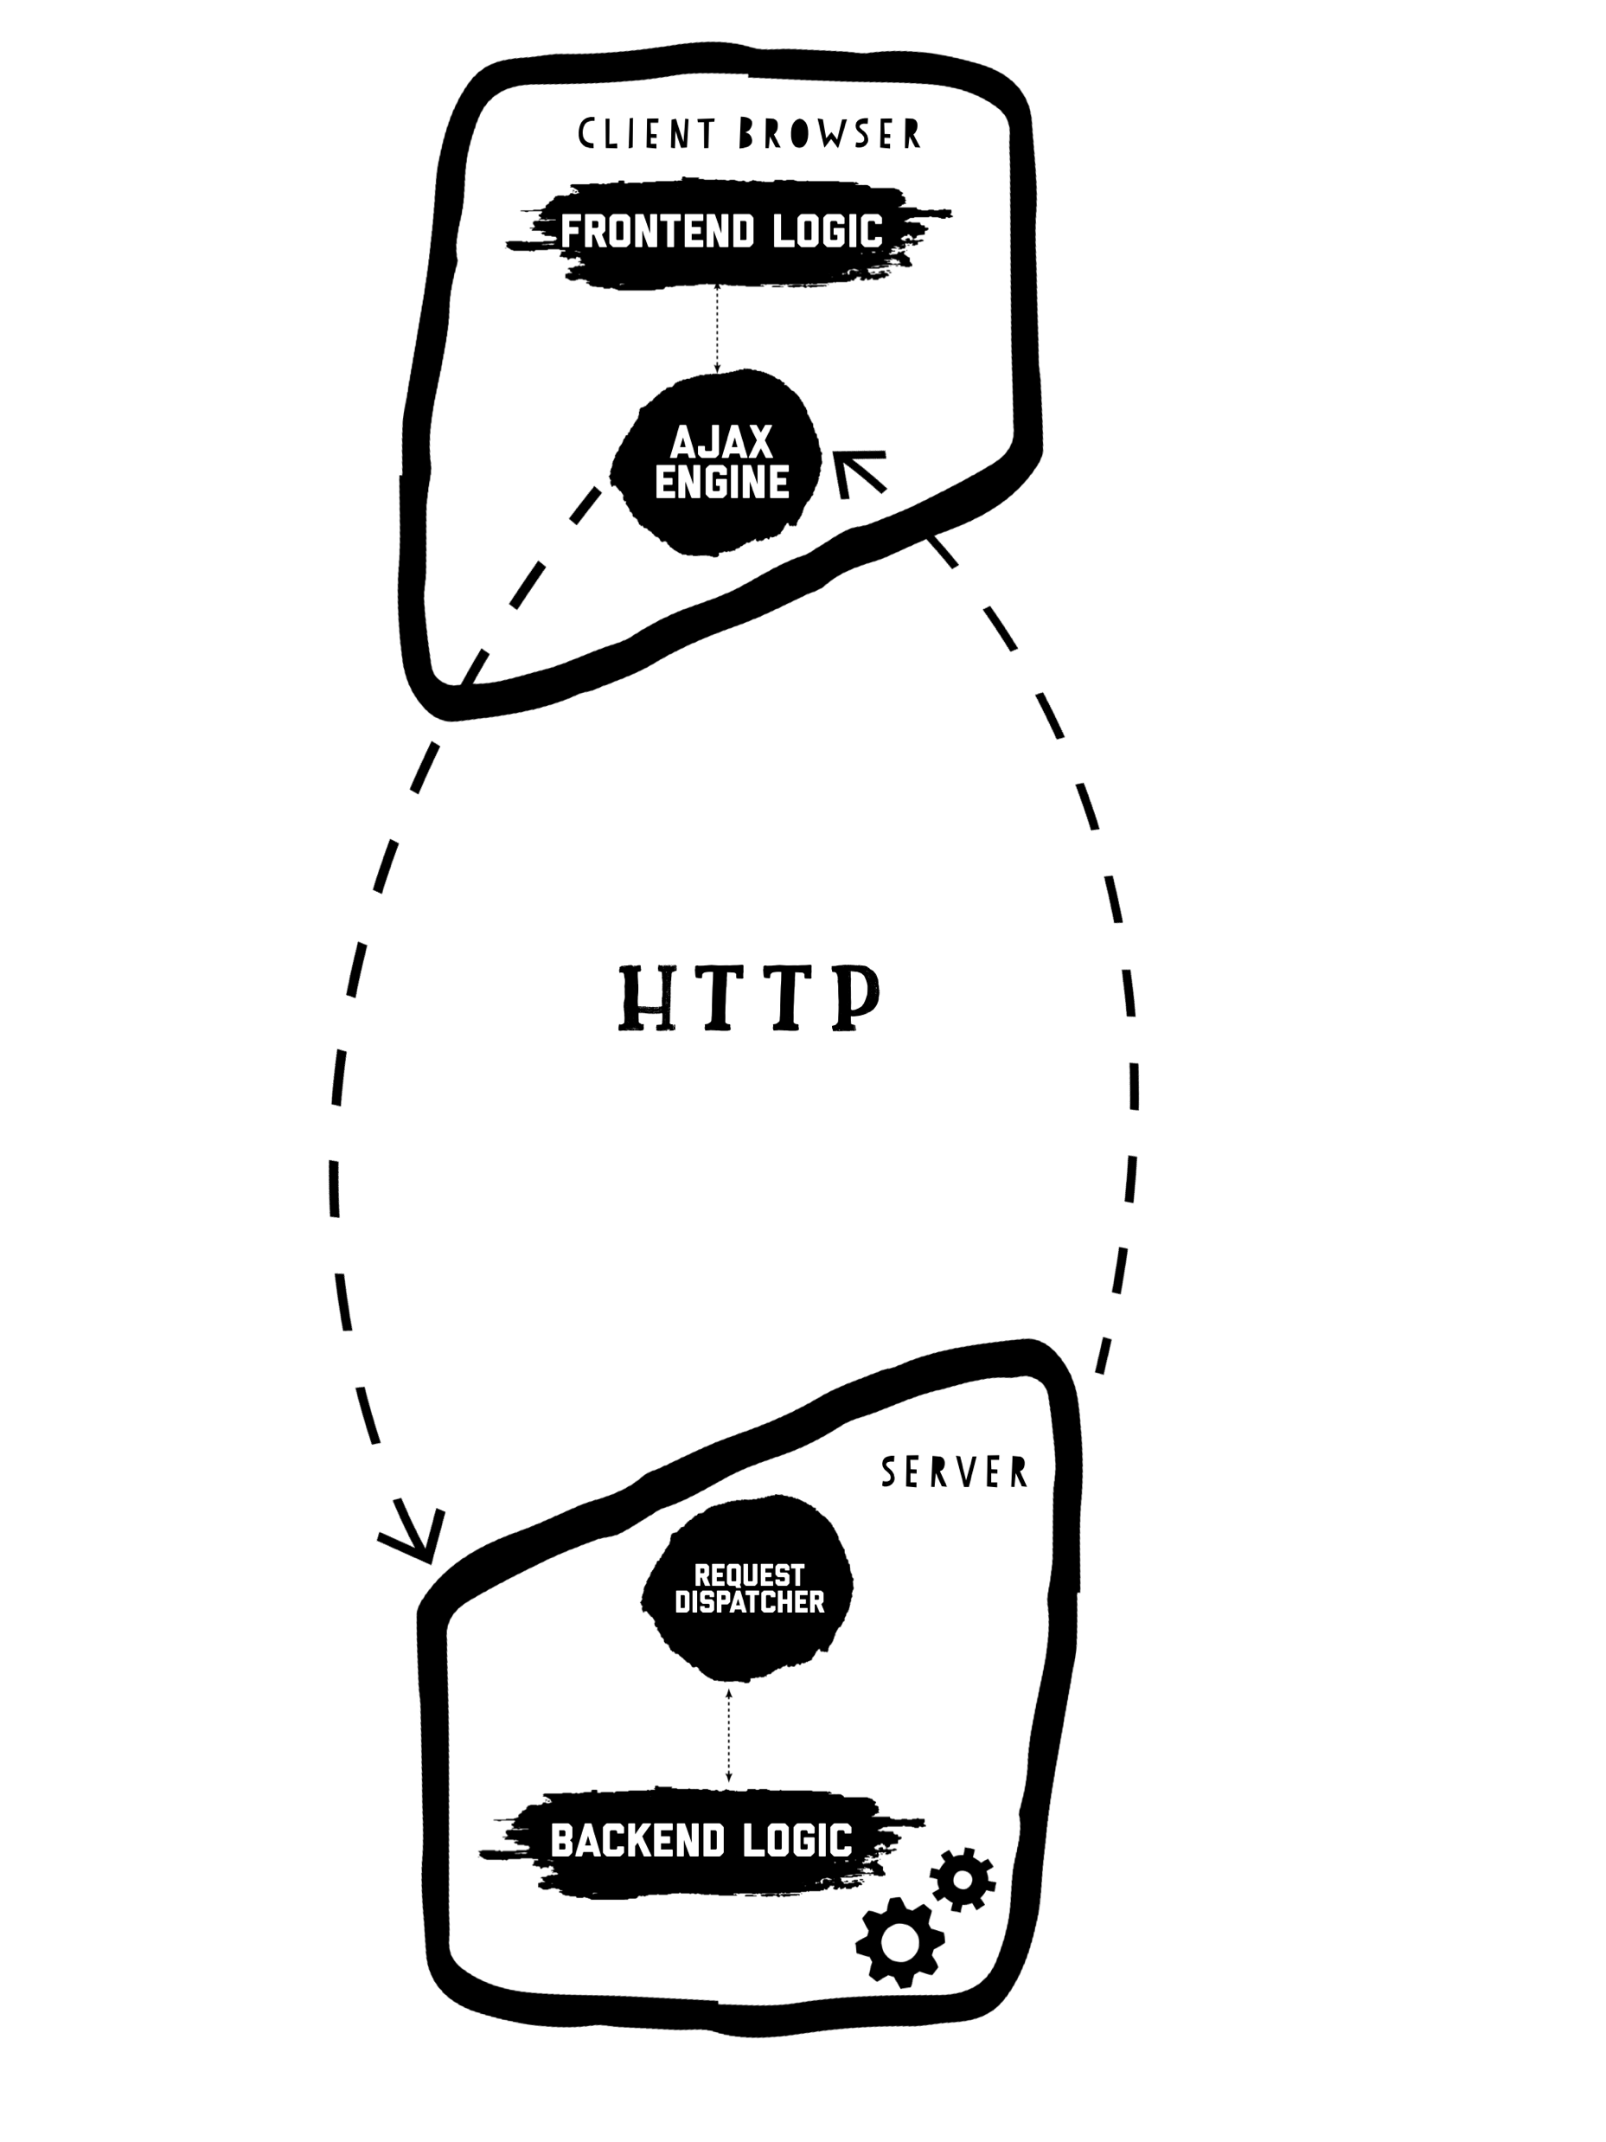
Current State of Frontend Development
Scalability – Frontend processing is done on the client side.
User interface operations updates the view directly without requesting the new rendered HTML from the server.
Separation of concerns – Client-Side logic is separated from the Server-Side logic.
State management – on the client side;
Offline support by using service workers;

Slide 6
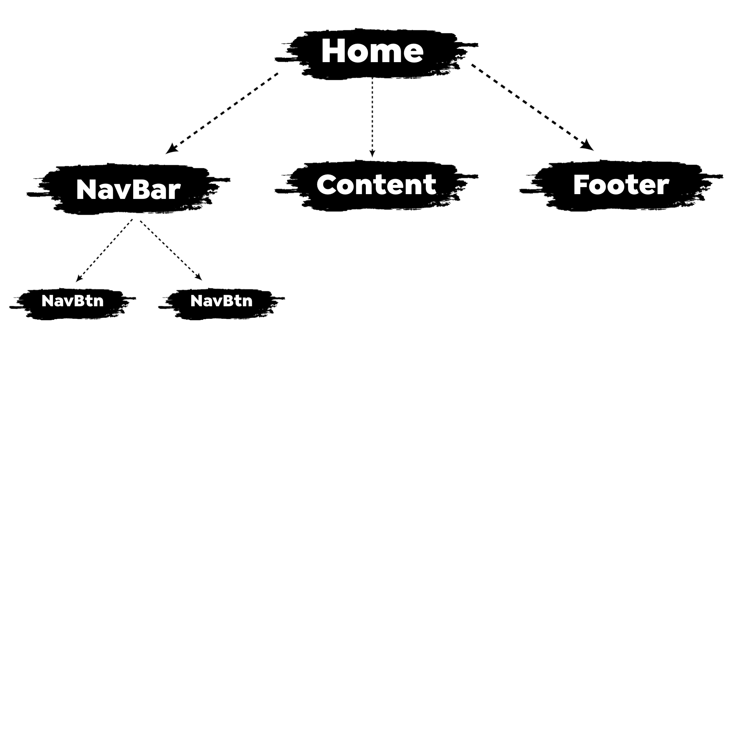
Frontend - Component Based Development

Slide 7
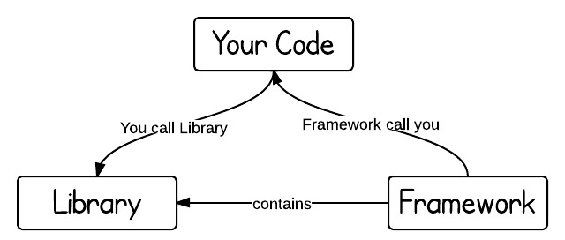
Why to use a framework or a library?
Application state synchronization (you don’t need to remove and render an HTML Element if some data has changed);
Reduces the amount of code of the application. ( might have some downfalls – “Too much magic comes with a cost.”);
Cross browser compatibility (no need to worry about polyfills);
Creates an organized development environment based on some standards. (Javascript is very opinionated and there is no de-facto standard for development of applications).

Slide 8
Framework vs Library
A framework creates a development environment by using a well defined set of rules.
A library offers a set of tools that can be implemented by the choice of the programmer.
By using a library you are in charge of where to use the library and where to call it. When using a framework the framework knows when to call your code and it is in charge of the flow.
FRAMEWORK
PROS | CONS
One stop shop. Includes all the needed features for the development of an application. (e2e testing and unit testing) | Higher learning curve, but once mastered can lead to very fast development.
Well defined development guideline. | Might introduce a lot of complexity.
Already fine tuned for delivering to production. | Bigger Bundle Size.
LIBRARY
PROS | CONS
Smaller learning curve. | Code is harder to mantain without an uniform development guide.
Easier to integrate. | Does not provide all the functionalities needed by a production application.
Smaller footprint. | Harder to test if there is no library created for it.

Slide 9
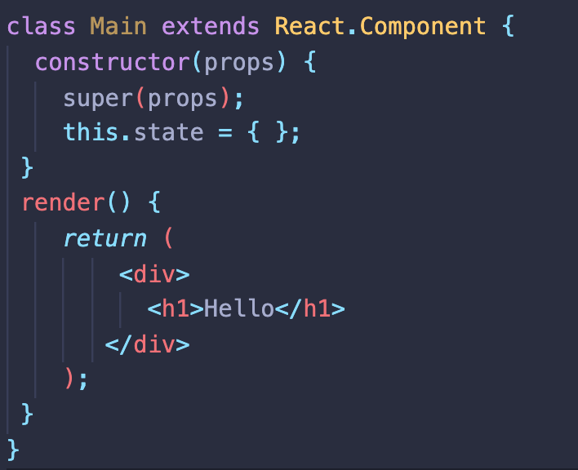
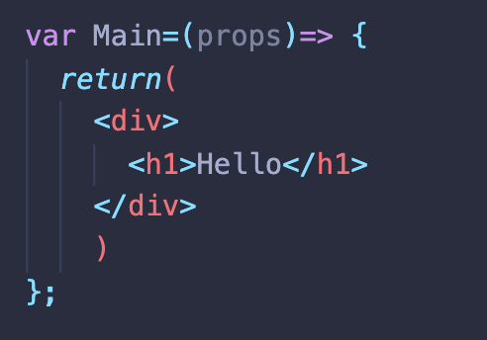
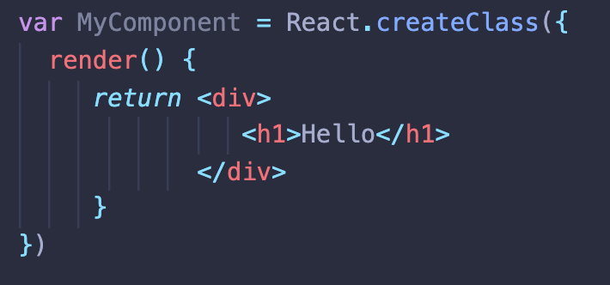
Define Components in React

Slide 10
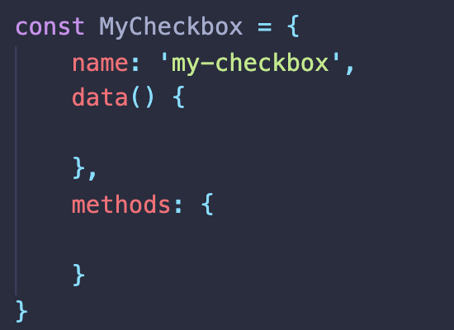
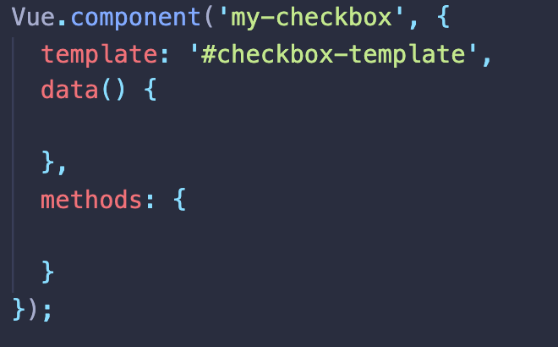
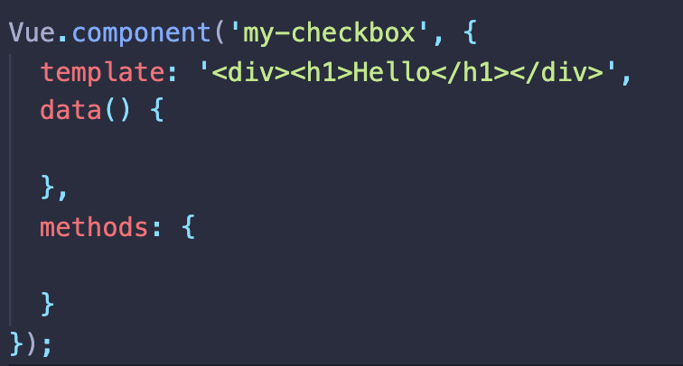
Define Components in VueJS

Slide 11
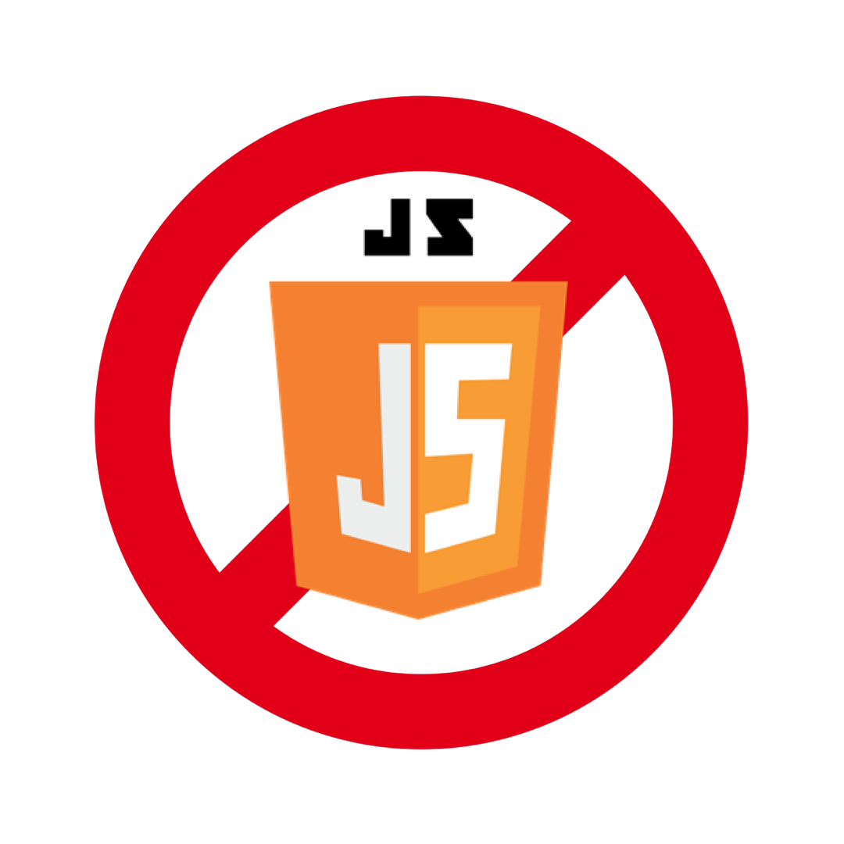
Why we are not using vanilla JS?!
If project complexity grows the code becomes very hard to maintain;
You end up developing you own framework/library;
Harder to synchronize the view with the model;
Does not provide any routing solution or state management.
Testing library is very poor;
There is a chance that browsers does not support the latest ECMA Script features.

Slide 12
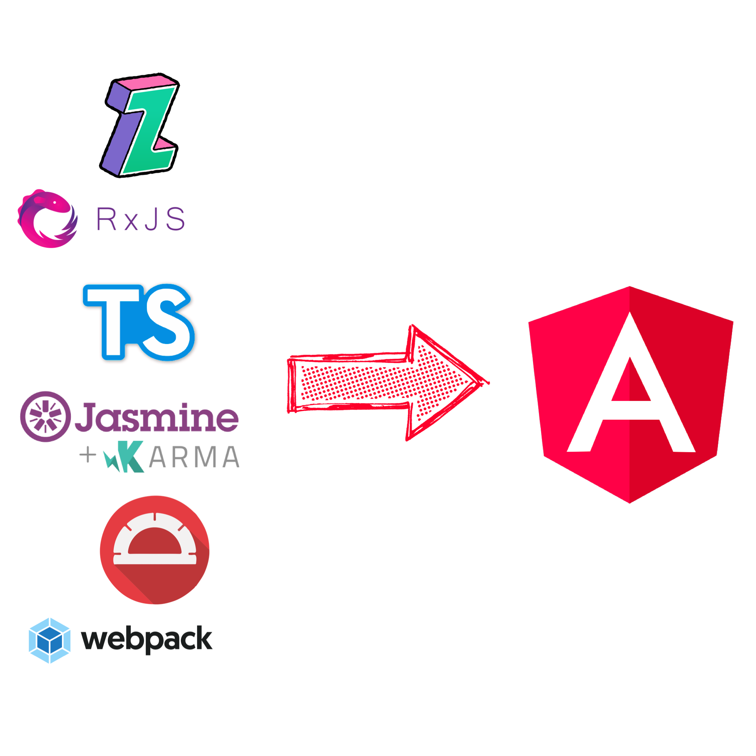
Angular Technology Stack
Angular framework contains a set of tools and libraries that makes possible end to end application development:
ZoneJS;
RxJS;
TypeScript;
Jasmine + Karma;
Protractor;
Webpack;

Slide 13

ZoneJS
An execution context for asynchronous operations
Library written and maintained by the Angular Team;
It encapsulates the logic for intercepting asynchronous operations in a component;
Introduces the concept of zone – an execution context for async operations;
Usually you don’t need to touch zone.js in your Angular application unless you want full control over the change detection mechanism.

Slide 14

TypeScript
A superset of strongly typed Javascript
PROS:
Code is easier to understand;
Compile time errors;
Less bugs;
Easier to debug;
Main reason => Decorators;
CONS:
Longer development timeline;
Higher learning curve;
Code might get Overengineered;

Slide 15
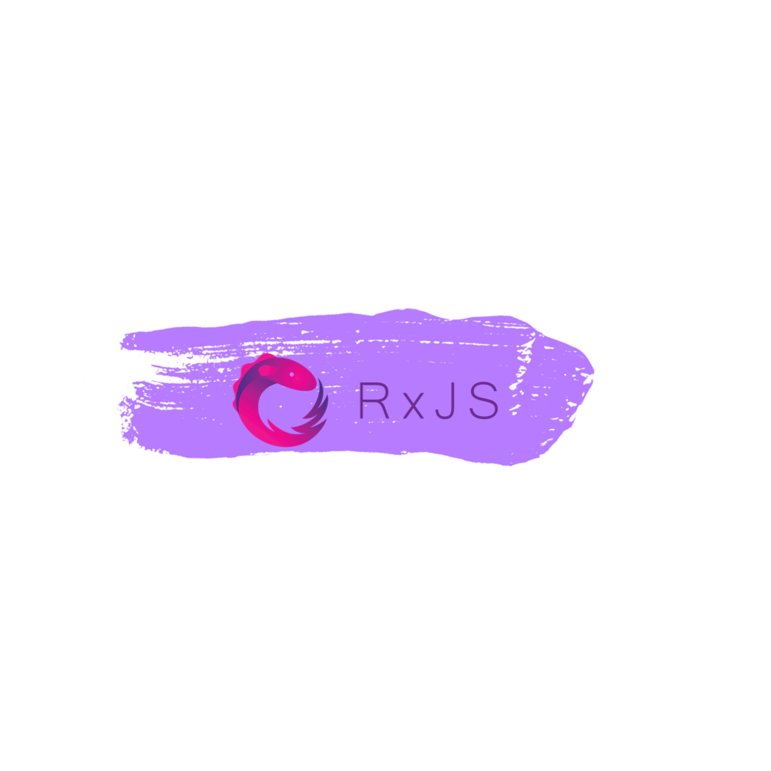
RxJS
Reactive Extensions Library for Javascript
Great abstraction over the complexity of reactive programming principles;
Can wrap existing synchronous code to asynchronous operations;
It is used in the core of Angular HttpClientModule;

Slide 16

Karma and Jasmine
Frontend Unit Testing made Easy
Karma is a test runner for Javascript:
Framework agnostic: can be used with Jasmine or any other framework;
Can provide multiple test environments such as: specific device, specific browser
CI support;
Jasmine is a testing framework that allows testing of Angular Components.

Slide 17

Protractor
E2E Testing Framework
It encapsulates a Selenium Webdriver and a Javascript Testing Framework of your choice;
Can be used with Jasmine or Mocha out of the box;
Very easy to use for testing complex flows;

Slide 18
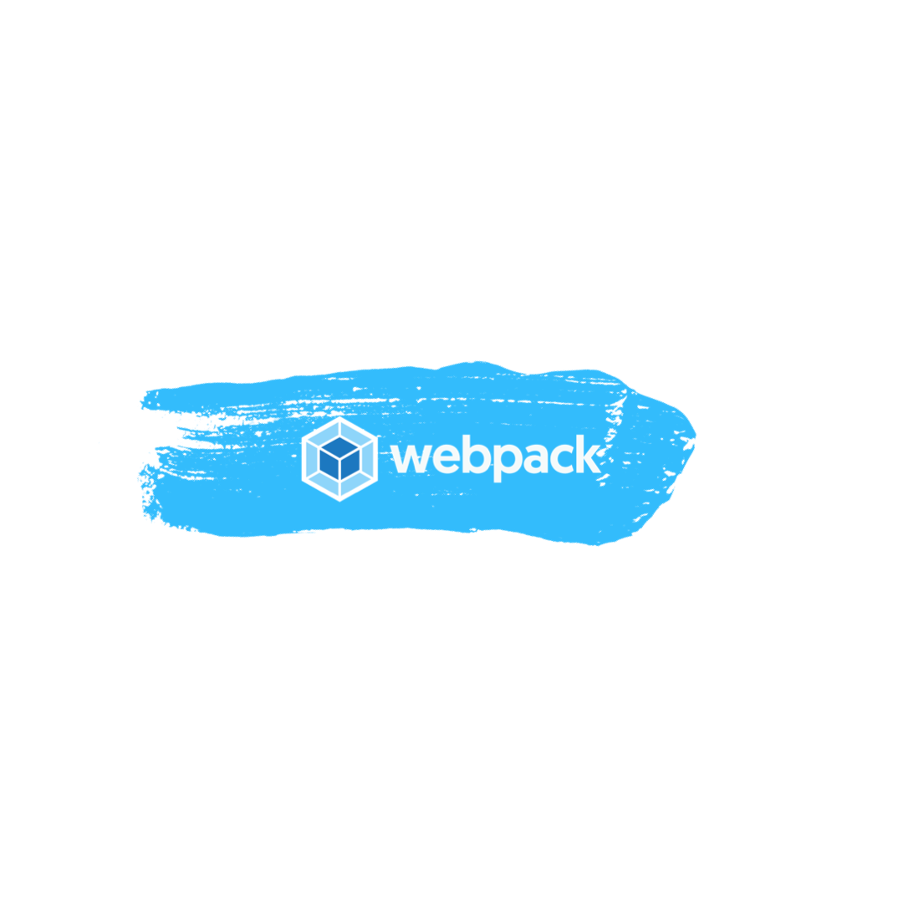
Webpack
The most popular module bundler
It is the most popular module bundler from the Javascript ecosystem;
It is used internally by the Angular CLI in order the bundle the application;
Configurable via angular.json file;

Slide 19
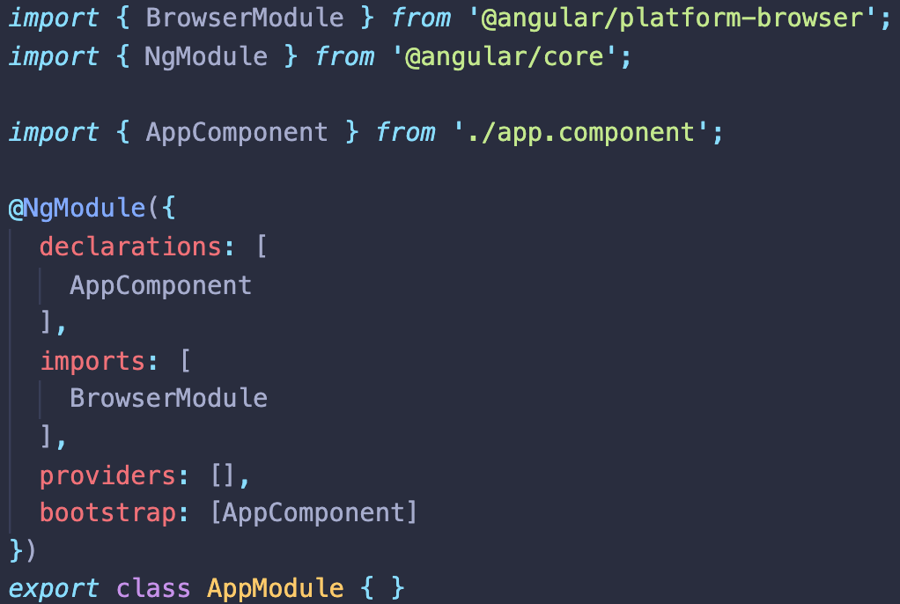
Angular Modules
Angular’s mechanism to organize the structure of an application;
Configures the dependency injector (behaves differently for lazy-loaded modules);
Two types of modules:
Feature Modules;
Shared Modules;
Tells the compiler how to group the declarables:
Components;
Pipes;
Directives;
Each application must have a Root Angular Module;

Slide 20
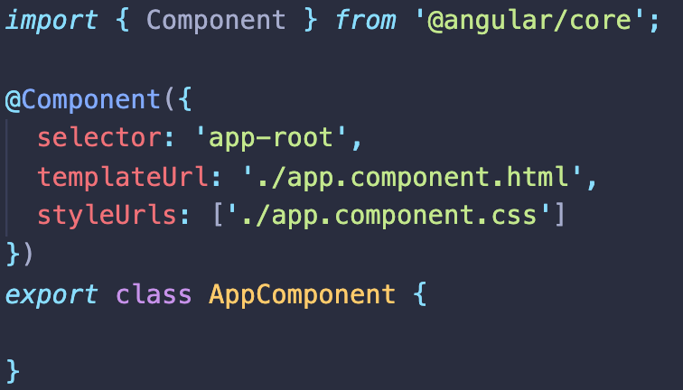
Angular Components
The building blocks of an angular application;
Angular’s mechanism to control and define views;
Organized in a tree hierarchy;
It can contain three elements:
Controller class (.ts file)
Template (inline or separate .html file)
Styles (inline or separate .css file)

Slide 21
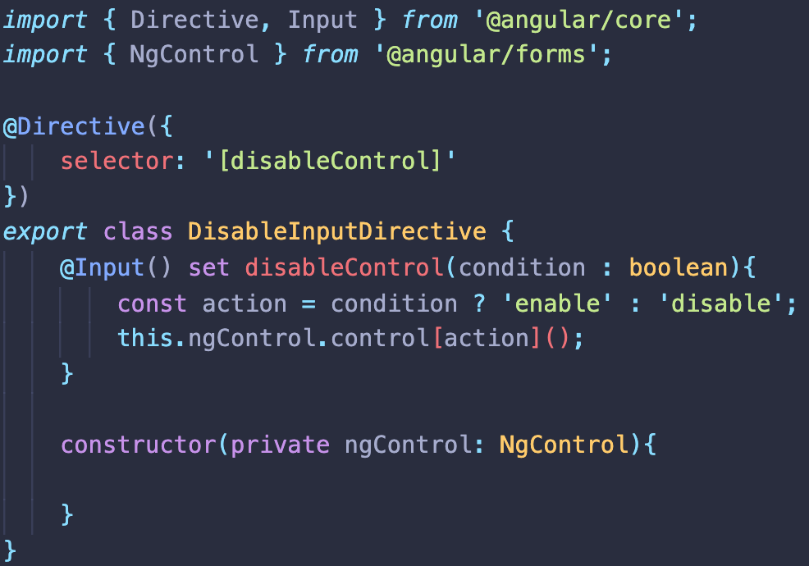
Angular Directives
Logic that applies on the view;
Can be of three types:
Component;
Structural;
Attribute;

Slide 22
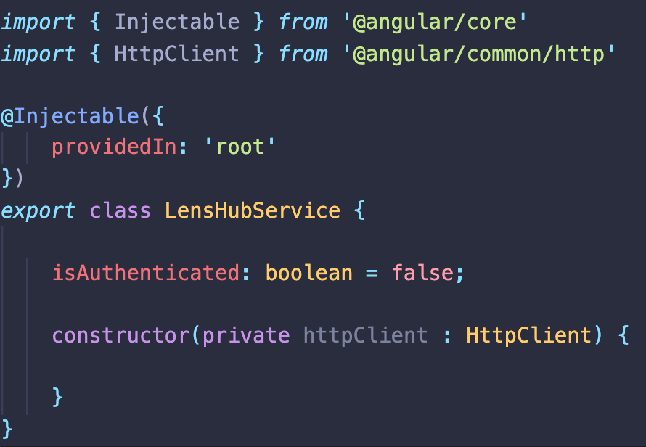
Angular Services
Service layer usually holds the HTTP calls to the Server API;
Instances that holds business logic specific available in a dependency injector;
Each injector holds an instance of a service;
Note: You must be carefull where you declare the service when using lazy loading modules;

Slide 23
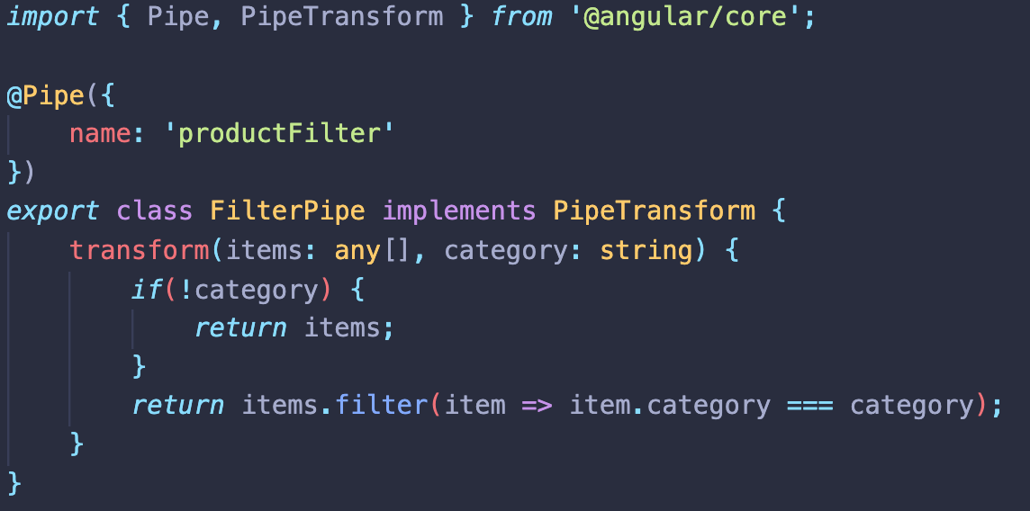
Angular Pipes
Equivalent of computed property mechanism;
It’s very unlikely that the server provides the data in the desired format;

Slide 24
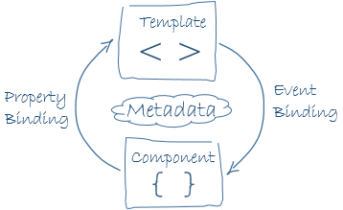
Two Way Data Binding
1. The component binds the property value inside the template which is compiled to a View.
2. The Angular engine will bind the onchange event to the component.
3. When the event is triggered Angular processes all the data bindings from the component tree, from root to children, which will result in updated values for the component’s properties.

Slide 25
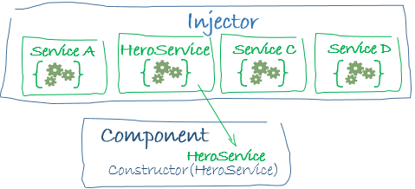
Dependency Injection
Mechanism that provides the needed dependencies of a component;
Angular automatically handles the instances of the services or functions that needs to be injected by its hierarchy of injectors;
A dependency is not necessary a service. It can be an object or a function.

Slide 26
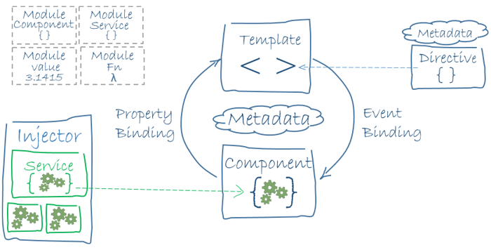
The Big Picture

Slide 27
Angular CLI
Useful for creatining a project;
Upgrading a project from an older version of angular;
Provides the http development server from webpack;
Build for development and production;
Create components/modules/services/directives/pipes;
Uses webpack internally for application bundle;
Analyze bundle files with webpack-bundle-analyzer;

Slide 28
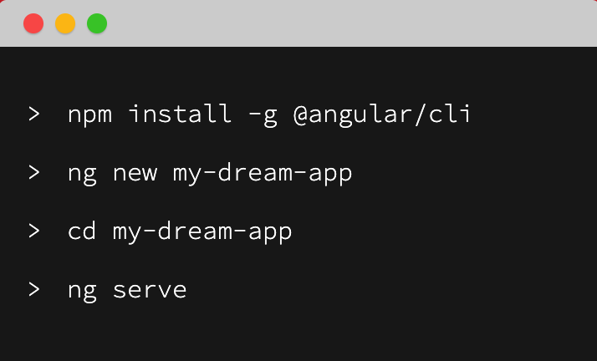
Create your first project using Angular CLI
Requirements:
NodeJS LTS version 8.9 or higher;
npm version 5.5.1 or higher;
https://nodejs.org/en/download/

Slide 29


