Slide 1

Murder Mystery crud website
Charlotte Cartwright

Slide 2
Table of Contents
Planning
Software
Demonstration
Summary

Slide 3

Objectives
Create a crud application with the utilisation of supporting tools, methodologies and technologies that encapsulate all core modules covered during training

Slide 4


My Topic
Murder Mystery
Based on the game Cluedo
Automatic set up on what suspect percentage each suspect has

Slide 5
Planning
Kanban Board
Jira
User stories
Tasks

Slide 6

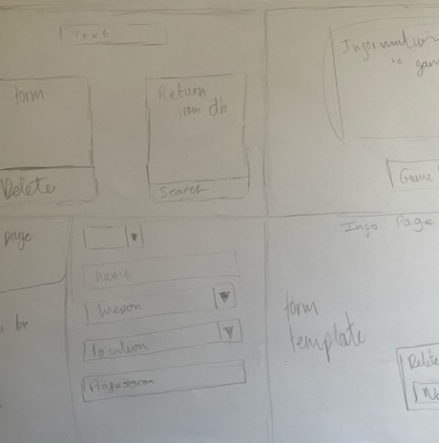

Design planning
Colour schemes
Website outline/design

Slide 7

Software and Technologies Used
Version control
Database
Backend
Frontend
Testing
GitHub
MySQL
Java
Spring Bootstrap
HTML
JavaScript
CSS
Bootstrap
Integration test
MockMVC
Unit test
Mockito

Slide 8

Demonstration

Slide 9
Personal Reflection
Good
Front-end
Back-end
testing
Improvement
Git commits and branch control
Jira user storied being kept up to date
Learnt
GitHub management techniques
Bad
Design
Version control

Slide 10
Continued Development
Order by levels of suspect percentage
1
Add more option to weapon and location options
2
Relocate the update section
3

Slide 11

Any Questions

