Slide 1
Final Year Dissertation Comparing Internet Censorship in Ireland vs Israel
<p> Chris Casey, 20334271
ccasey3@tcd.ie </p>
Dr. Stephen Farrell

Slide 2
Internet Censorship Introduction
01
<p> The practice of restricting the publication or access of information online </p>

Slide 3
Research Motivation
User Perspective
Government Perspective​
Awareness
Digital Rights
Corporate trends
Governmental trust
Rising censorship
New frontier
Legislation
Digital Diplomacy

Slide 4
The Internet Misconceptions
"The Internet is not a public sphere. It is a private sphere that tolerates public speech." ~ Clay Shirky
Operation
Content
Transparent
Decentralised
Meritocracy
Unmanipulated
Permanent
Unbiased

Slide 5
02
Internet Censorship Mechanisms
<p> How is internet censorship conducted? </p>

Slide 6
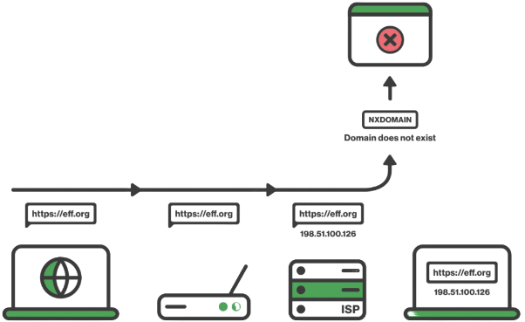
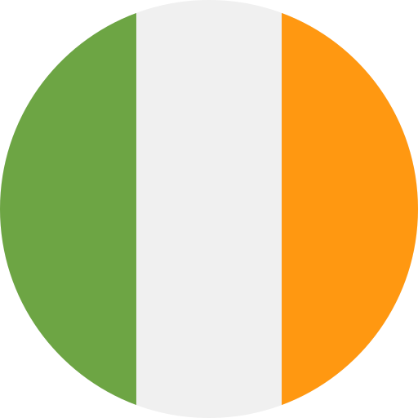

Internet Censorship Mechanisms
Application Layer (5)
DNS Filtering
Keyword Filtering
2. Network Layer (3)
IP Blocking
3. Non-Specific
Deep Packet Inspection
Points of Control
Internet censorship occurs at various levels of the OSI model

Slide 7
Measuring Censorship Methodology
03
<p> How the research is and will be conducted </p>

Slide 8
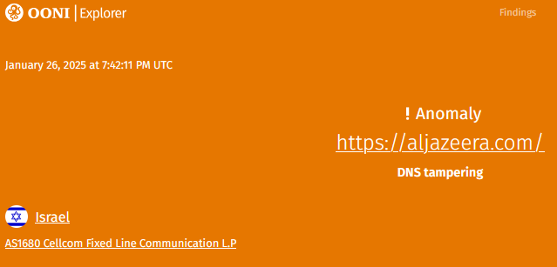
Measuring Censorship Methodology
<p> OONI Probe </p>
A free software project released under TOR
Uncovers censorship around the world
<p> Virtual Machine </p>
A virtual machine will be used to run OONI CLI
Provider: Interhost.co.il
<p> Data Analysis and Comparison </p>
Use ground truth to prove/ disprove notions about both locales

Slide 9
Results Ireland vs Israel
04
<p> Discussing the contrast between the States' approach </p>

Slide 10
Results Ireland vs Israel
Israel
Ireland
Israel
Ireland
Ireland
Ireland
Reactive
Illegality
Non-political
Judicial process
Regulated by the EU
Proactive
National Security; military lead
Political
Targeted, (Al Jazeera)
Arguably authoritarian, surveillance

Slide 11
Ongoing Research
05
<p> An outline of the work to come before April </p>

Slide 12
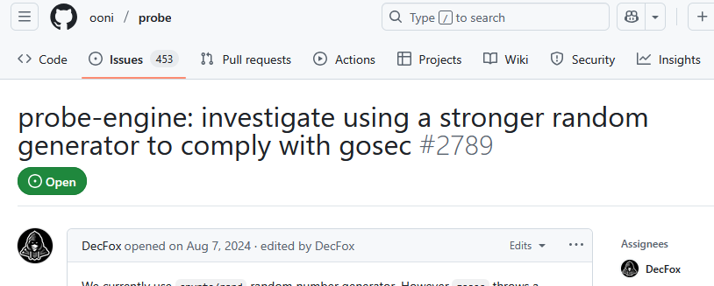
Ongoing Research
Quantify censorship conducted by both governments
Comparison of research to date vs ground truth
Comparison of Ireland & Israel
Contribute to the OONI probe:
- Additional tests
- Solve some GitHub issue

Slide 13
Challenges
Sources in Hebrew
Dated research
Cross validation of OONI
Access to academic papers
Stretch goal
Scope creep
Discussing conflicts
Being non-partisan

Slide 14
THANK YOU!
Chris Casey
Ccasey3@tcd.ie
20334271
Do you have any questions?

