Slide 1
Dimensionality Reduction
Session 3

Slide 2
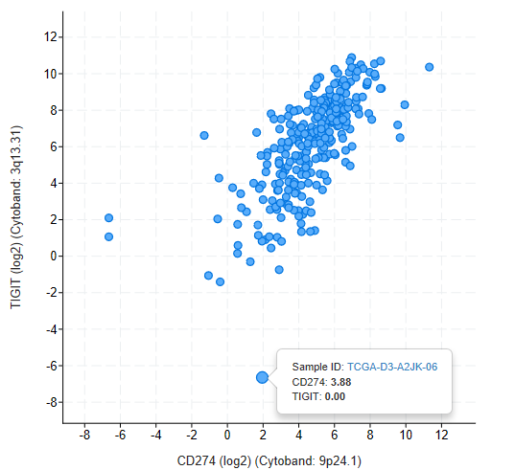
Data as space
In modern biology we often have data with at least thousands of measurements. When analyzing data we view each of these measurements as a dimension.

Slide 3
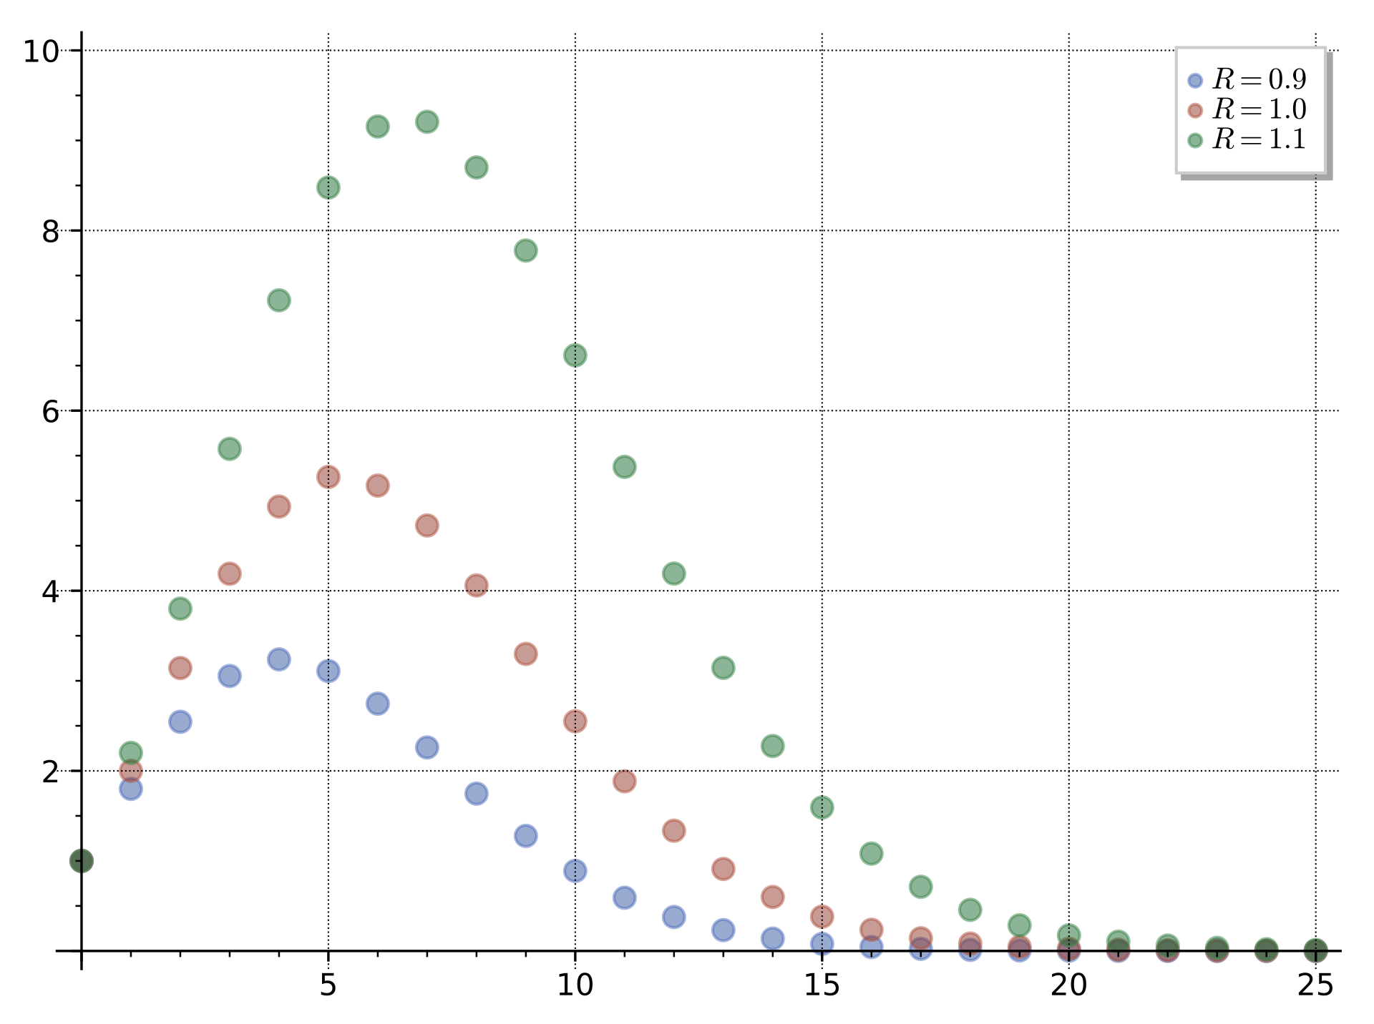
High dimensional data is hard to use
Humans are bad at understanding high-dimensional spaces.
High-dimensional data is computationally expensive to analyze.
Many of a dataset’s dimensions are often not that useful.
“Curse of dimensionality”
Volumes of n-balls (spheres) in different dimensions

Slide 4
Dimensionality Reduction
Goal: Transform data into a lower dimensional space while preserving what is interesting and important in the data.

Slide 5
Dimensionality Reduction
Goal: Transform data into a lower dimensional space while preserving what is interesting and important in the data.
Option 1: Remove dimensions.

Slide 6
Dimensionality Reduction
Goal: Transform data into a lower dimensional space while preserving what is interesting and important in the data.
Option 1: Remove dimensions.
Option 2: Make new dimensions.

Slide 7
Principal Component Analysis (PCA)
Find the straight line where the data is most spread out.

Slide 8
Principal Component Analysis (PCA)
Find the straight line where the data is most spread out.

Slide 9
Principal Component Analysis (PCA)
Side note - this is not linear regression

Slide 10
Principal Component Analysis (PCA)
Side note - this is not linear regression
PCA - Overall Distance
Regression - Distance in terms of target variable

Slide 11
Principal Component Analysis (PCA)
Find the straight line where the data is most spread out.

Slide 12
Principal Component Analysis (PCA)
First principle component

Slide 13
Principal Component Analysis (PCA)
Second principle component
First principle component
For those with linear algebra, it turns out that these are the eigenvectors of the covariance matrix

Slide 14
Principal Component Analysis (PCA)
Principle components can be expressed as how much each dimension contributes to them.
 | PC1 | PC2 | PC3 | PC4
Gene 1 | 17.54 | 1.7505 | 7.34 | 0.1376
Gene 2 | 15.29 | 4.2904 | 2.93 | 1.6249
Gene 3 | 13.06 | 0.3967 | 21.62 | 2.0141
Gene 4 | 9.02 | 11.7716 | 8.79 | 2.5499
Gene 5 | 11.94 | 4.5799 | 6.49 | 22.6509
Gene 6 | 14.16 | 0.0333 | 16.26 | 0.0348

Slide 15
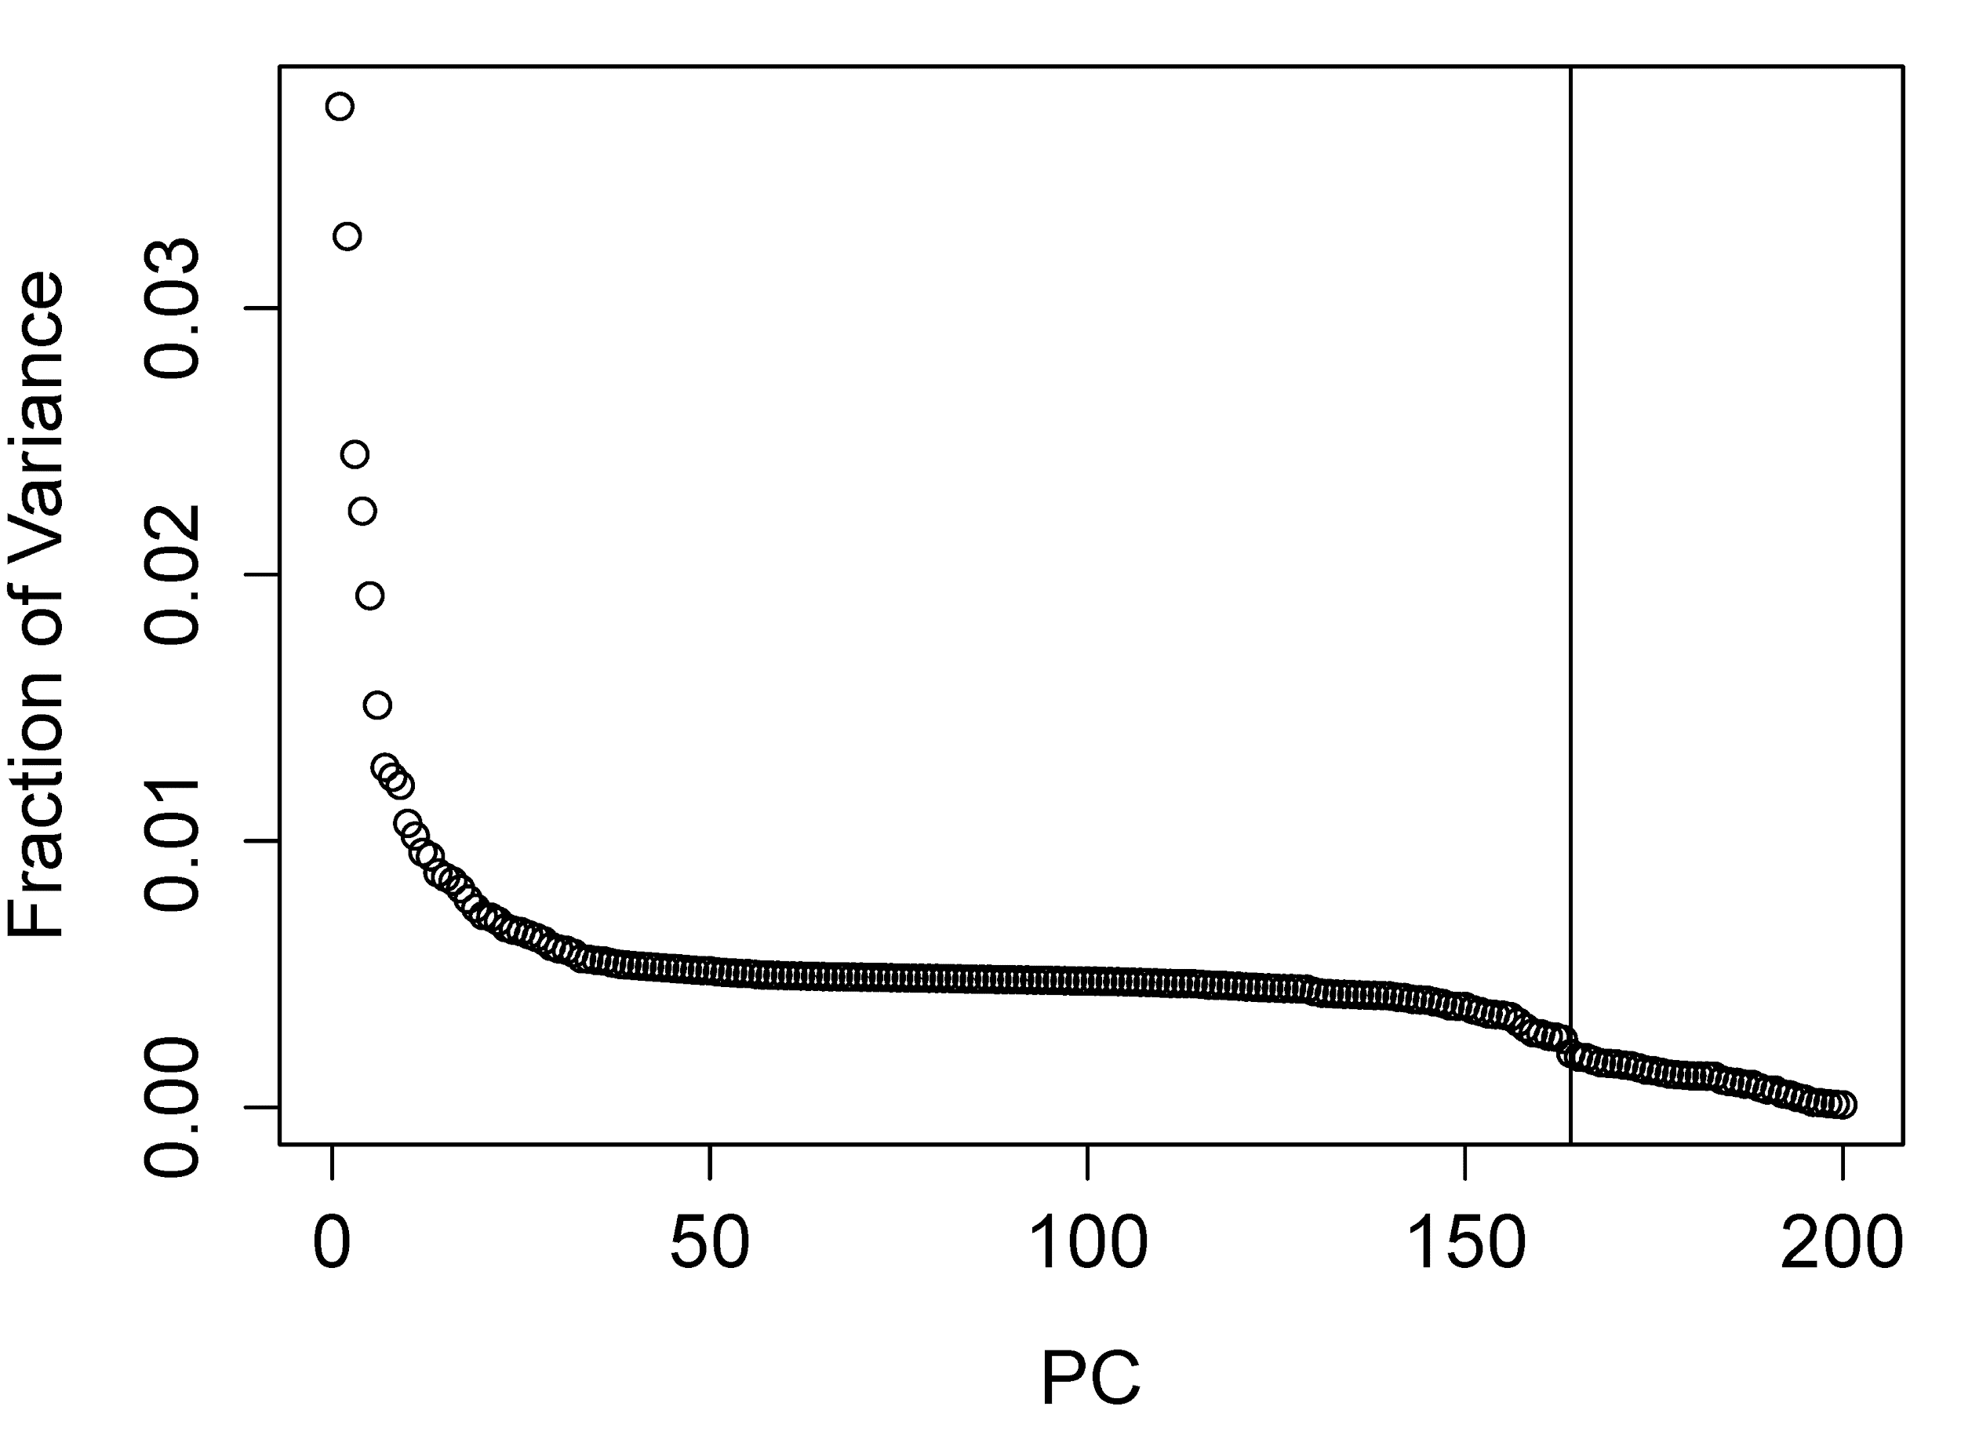
Principal Component Analysis (PCA)
We can also look at how much variance is explained by each PC in a scree plot.

Slide 16
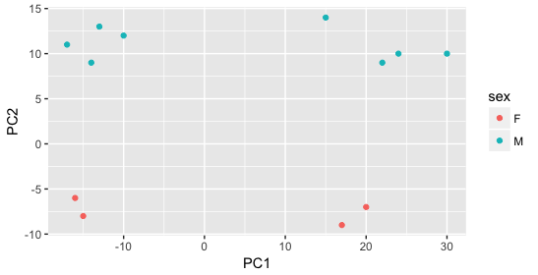
Looking at a PCA plot
Poll everywhere:
What is wrong with this plot?

Slide 17
Looking at a PCA plot
PCA Sins
Always show the variance explained.

Slide 18
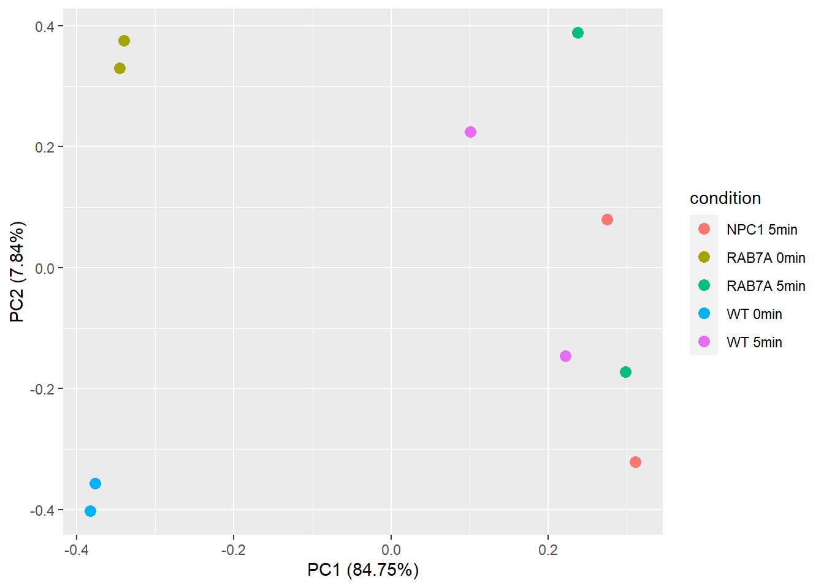
Looking at a PCA plot

Slide 19
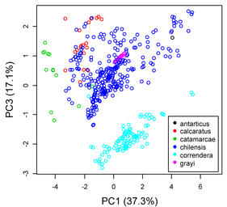
Looking at a PCA plot
Poll everywhere:
What is wrong with this plot?

Slide 20
Looking at a PCA plot
Suspicious
You can’t skip a PC without a very good reason.

Slide 21
UMAP and tSNE
PCA can only perform linear transformations - rotate the data.
Methods like uniform manifold approximation and projection (UMAP) and t-distributed stochastic neighbor embedding (tSNE) can perform complex, nonlinear transformations.
Key Idea: UMAP and tSNE perform a randomized search for a new space where certain properties of the original data - such as which points are closest together - are preserved.

Slide 22
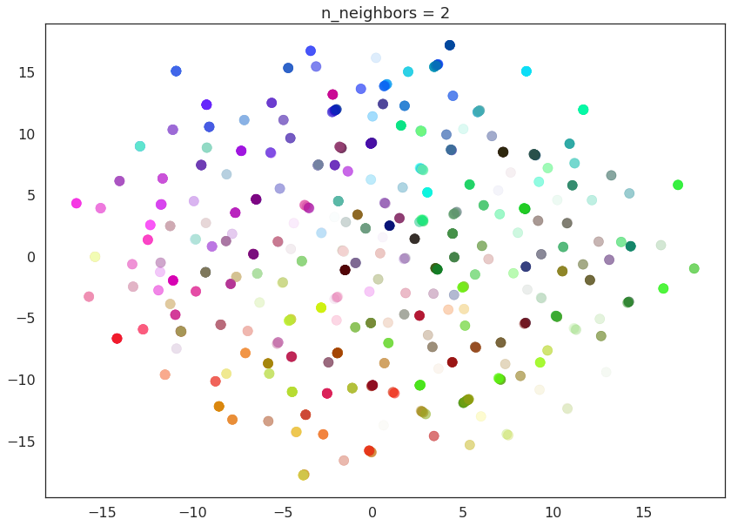
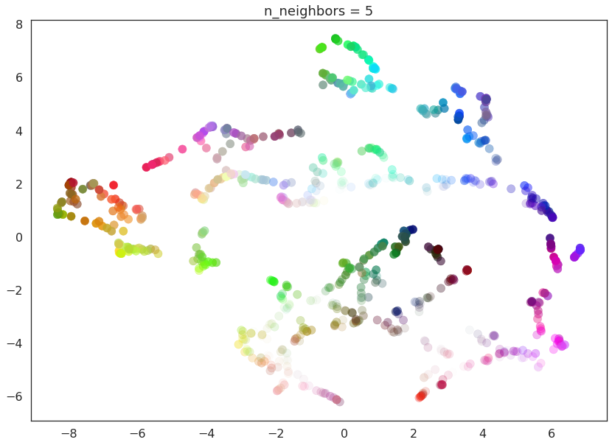
The Dangers of UMAP
UMAP and tSNE are non-deterministic: since their search involves some randomness, you may get different results each time you run it.
UMAP and tSNE have user-chosen parameters: these can greatly affect the transformation.

Slide 23
The Dangers of UMAP
Methods like UMAP are powerful, but abusable.

