Slide 1
TA Training Day 1
Bulk RNA-seq
Session 4

Slide 2
Agenda
Intro/refresher from this morning
Using the SummarizedExperiment object
Running DESeq2
Enrichment analyses
Slides adapted from Ludwig Geistlinger’s workshop: “Bulk RNA-seq data analysis with R/Bioconductor”

Slide 3
Bulk RNA-seq analysis pipeline
Images
Base calling & demultiplexing
Bustard/RTA/OLB, CASAVA
.tif
FASTQC
Raw reads
.fastq
Mapping
STAR, HISAT
MultiQC
RSeQC, QoRTS
Aligned reads
.sam/.bam
Counting
featureCounts
Read count table
.txt/.csv
Normalizing
DESeq2, edgeR
Descriptive plots
Normalized read count table
.Robj
DE test & multiple testing correction
DESeq2, edgeR, limma
List of fold changes & statistical values
.Robj, .txt
Filtering
Customized scripts
Downstream analyses on DE genes
Figure adapted from: https://chagall.med.cornell.edu/RNASEQcourse/Intro2RNAseq.pdf

Slide 4

Bulk RNA-seq analysis pipeline
Images
Base calling & demultiplexing
Bustard/RTA/OLB, CASAVA
.tif
Raw reads
Command Line Tools
.fastq
Mapping
STAR
Aligned reads
.sam/.bam
Counting
featureCounts
Read count table
.txt/.csv
Normalizing
DESeq2, edgeR
Normalized read count table
.Robj
DE test & multiple testing
DESeq2, edgeR, limma
List of fold changes & statistical values
.Robj, .txt
Filtering
Customized scripts
Downstream analyses on DE genes

Slide 5
Bulk RNA-seq analysis pipeline
Images
Base calling & demultiplexing
Bustard/RTA/OLB, CASAVA
.tif
Raw reads
Command Line Tools
.fastq
Mapping
STAR
Aligned reads
.sam/.bam
Counting
featureCounts
Read count table
.txt/.csv
Normalizing
DESeq2, edgeR
What we’re talking about today
Normalized read count table
.Robj
DE test & multiple testing
DESeq2, edgeR, limma
List of fold changes & statistical values
.Robj, .txt
Filtering
Customized scripts
Downstream analyses on DE genes

Slide 6
Normalization: Gene Length
Longer genes obtain more reads.
gene 1
gene 2
Notes:
The plan is to cover any of these normalization types which Martin doesn’t

Slide 7
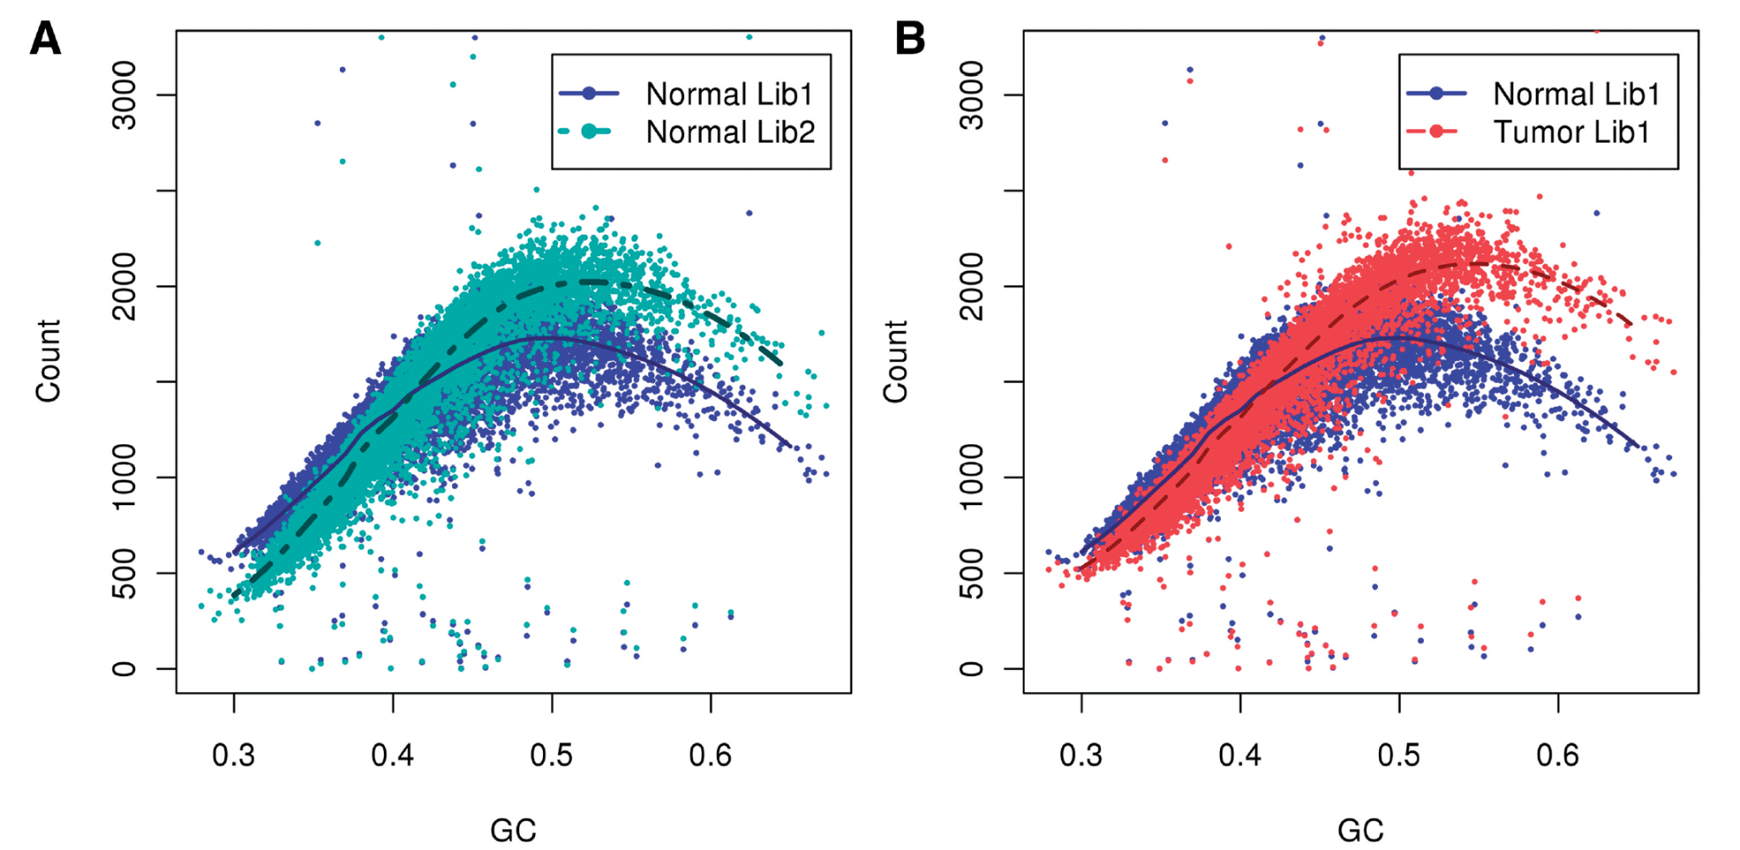
Normalization: GC bias
GC-bias has also been reported for DNA-seq and ChIP-seq
GC-content
GC-content
“Observed fragment counts and loess (locally weighted smoothing) lines plotted against GC of (A) two libraries from the same normal sample, and (B) the tumor library (red) with its matched normal sample library (blue).”
Figure from Benjamini and Speed, 2012.10.1093/nar/gks001

Slide 8
Normalization: sequencing depth (library size)
Some samples might obtain more total reads.
 | Sample 1 | Sample 2 | Sample 3
gene 1 | 8 | 10 | 200
gene 2 | 14 | 15 | 40
gene 3 | 33 | 40 | 70
… | … | … | …
gene N | 100 | 120 | 220
5 million total counts
10 million total counts

Slide 9
Normalization: sequencing depth (library size)
Highly-expressed genes bias scaling normalization.
 | Sample A | Sample B
gene 1 | 50 | 40
gene 2 | 50 | 40
… | … | …
gene 99 | 50 | 40
gene 100 | 10 | 1000
4960 total counts
4960 total counts

Slide 10
Differential Expression Analysis
DE analyses for RNA-seq typically use Poisson or negative binomial distributions
We can consider reads in terms of successes and failures:
Success: read is sequenced from transcript under consideration
Failure: read is sequenced from another transcript
With millions of reads, there is a very low probability of success, which is naturally modeled by the Poisson distribution
Recall that a Poisson distribution is modeled by a single parameter for both mean and variance, so mean = variance
The negative binomial distribution approximates variance being greater than the mean

Slide 11
DE Analysis
edgeR and DESeq2 both use the negative Binomial
Best performers in independent assessments
Different strategies for dispersion estimation
No clear consensus on which of them to prefer
Some considerations: DESeq2 integrates better with SummarizedExperiment, produces more conservative p-values, has longer runtime

Slide 12
Enrichment Analyses
Basic idea: Instead of individual genes, what groups of genes are differentially expressed?
Groups (sets) of genes are
Gene Ontology (GO) terms
Molecular function, biological process, and cellular component
You often only want biological process terms
Biological pathway database membership (KEGG, Reactome, …)
Disease associations
Kinase substrates

Slide 13
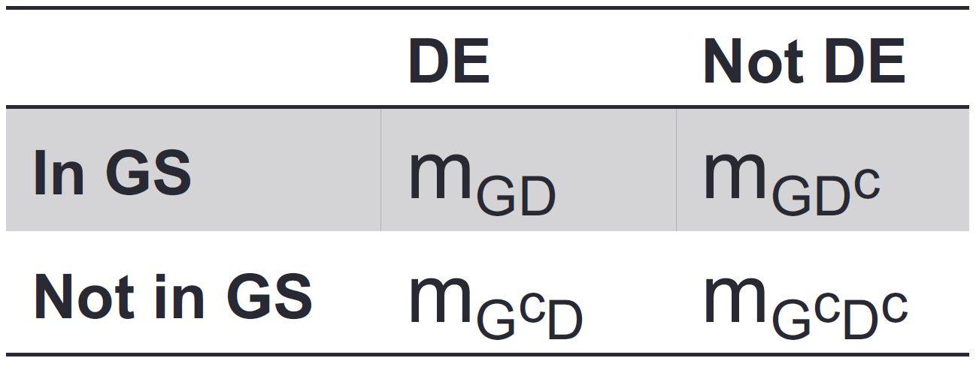
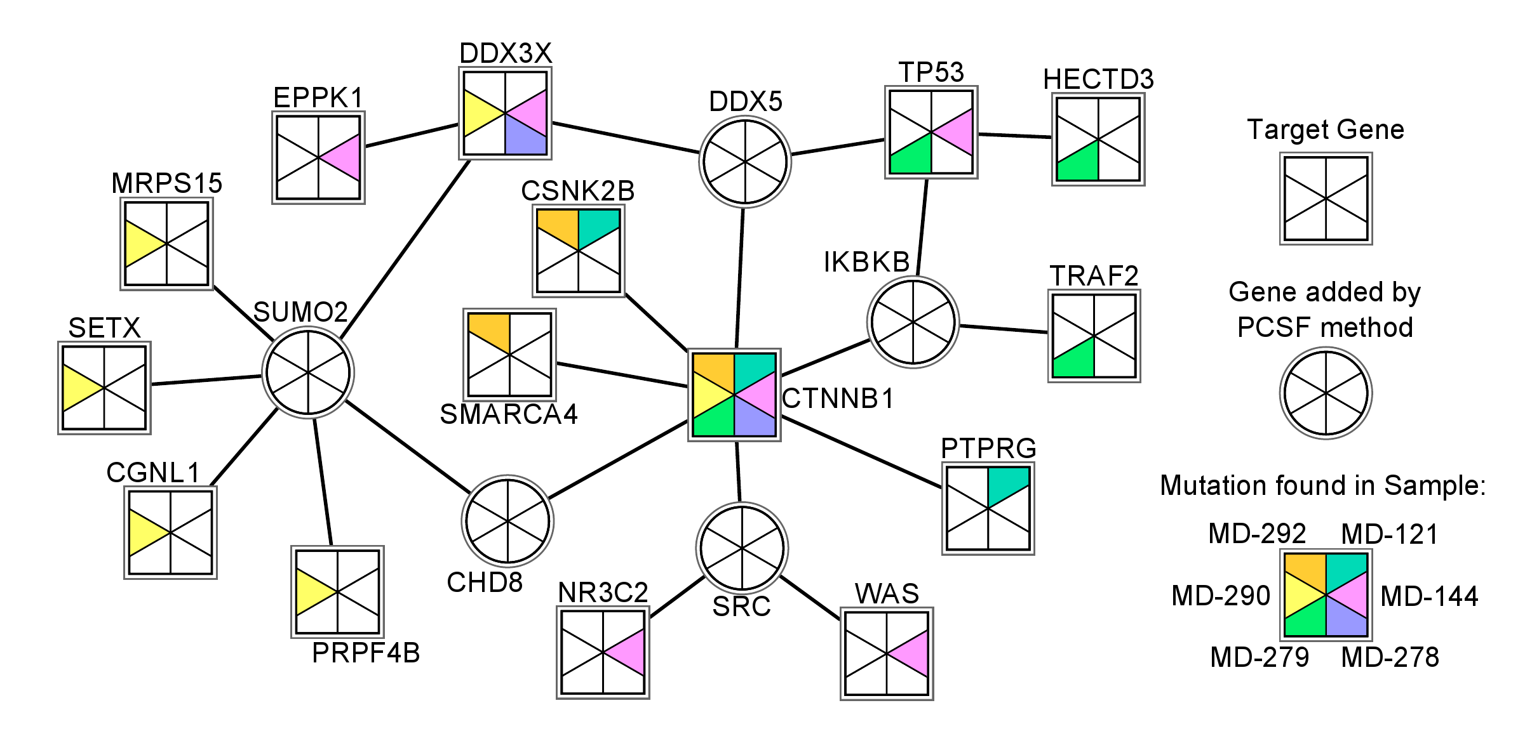
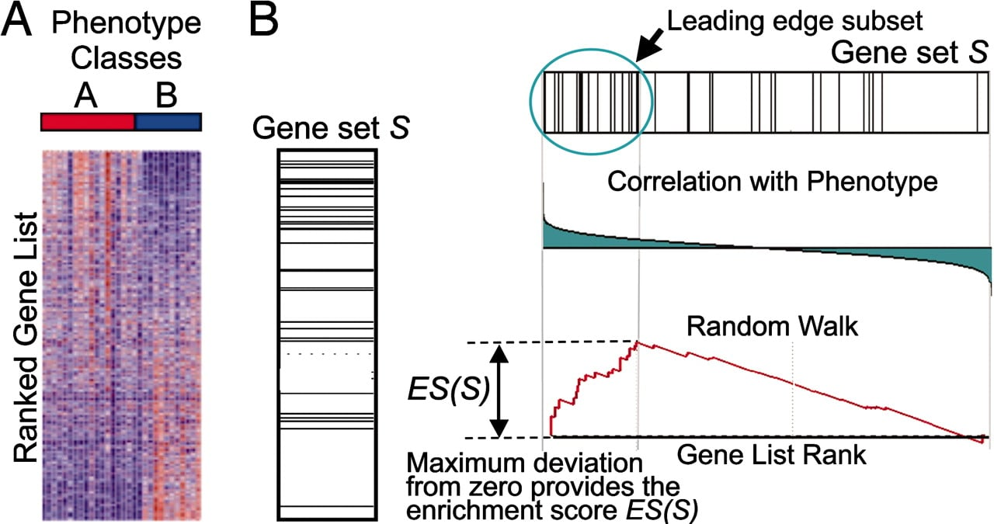
Enrichment Analyses
Khatri et al. Ten years of pathway analysis: current approaches and
outstanding challenges. PLoS Comput Biol 8(2):1002375, 2012.
1st Generation
Overrepresentation of DE genes
3rd Generation
Integration of network topology
2nd Generation
Functional class scoring on all genes
Figure created by Tobias Ehrenberger in Ernest Fraenkel's lab
Figure from Subramanian, Aravind, et al. "Gene set enrichment analysis: a knowledge-based approach for interpreting genome-wide expression profiles." PNAS 102.43 (2005): 15545-15550.

