Slide 1
PerioSigDB: metadata and comparison with BugSigDB
Figures, in the order of the paper draft

Slide 2
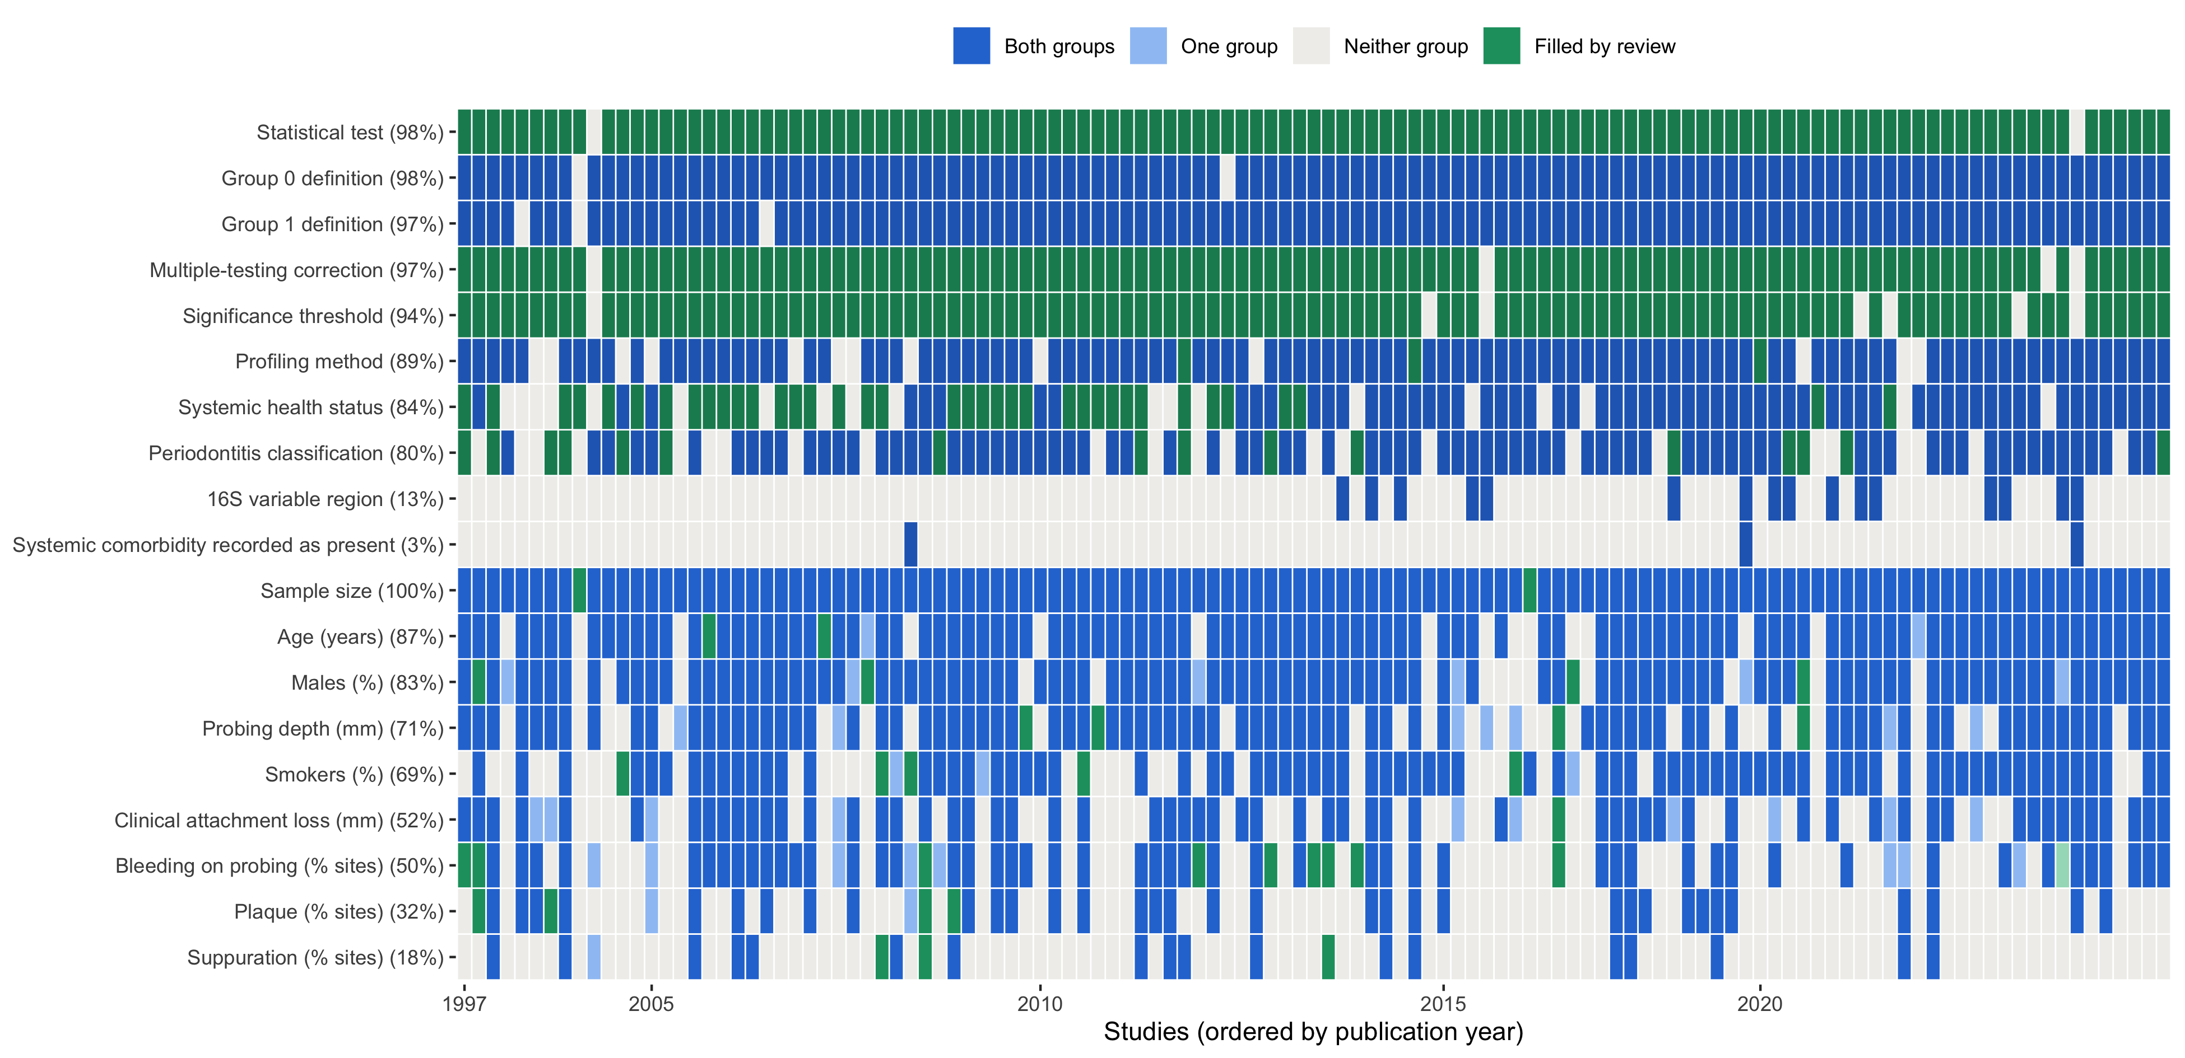
PerioSigDB: Metadata Completeness
Green: added by the full-text review of the papers by Claude Opus 5.5

Slide 3
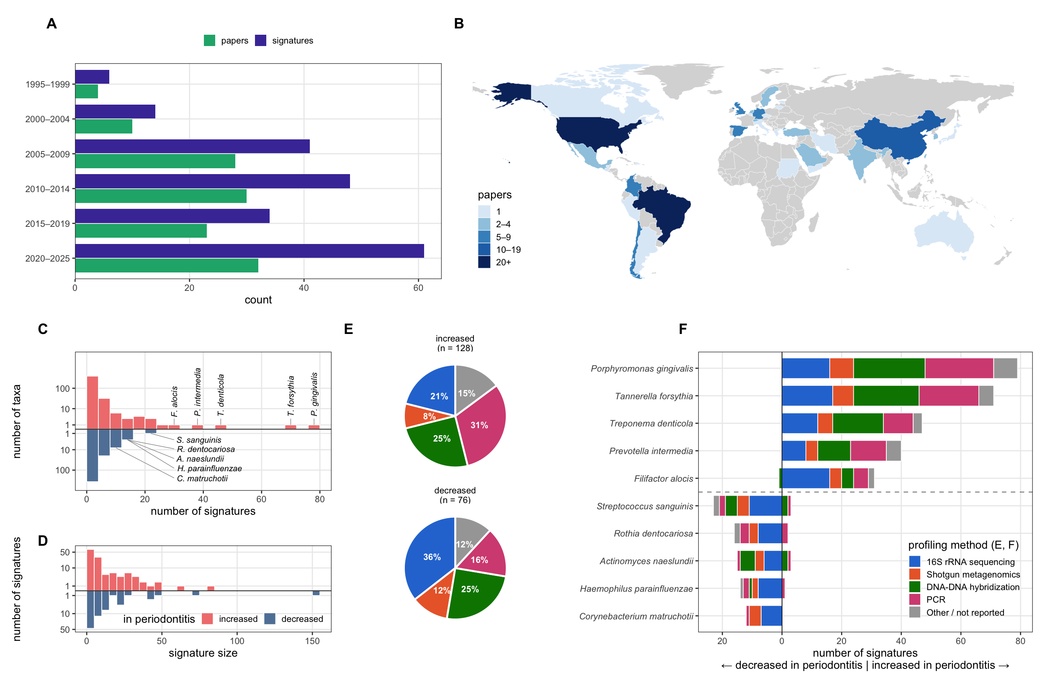
PerioSigDB spans worldwide studies and many targeted assays
Figure 1. How: papers by period and country, taxon frequency, signature size and profiling method

Slide 4
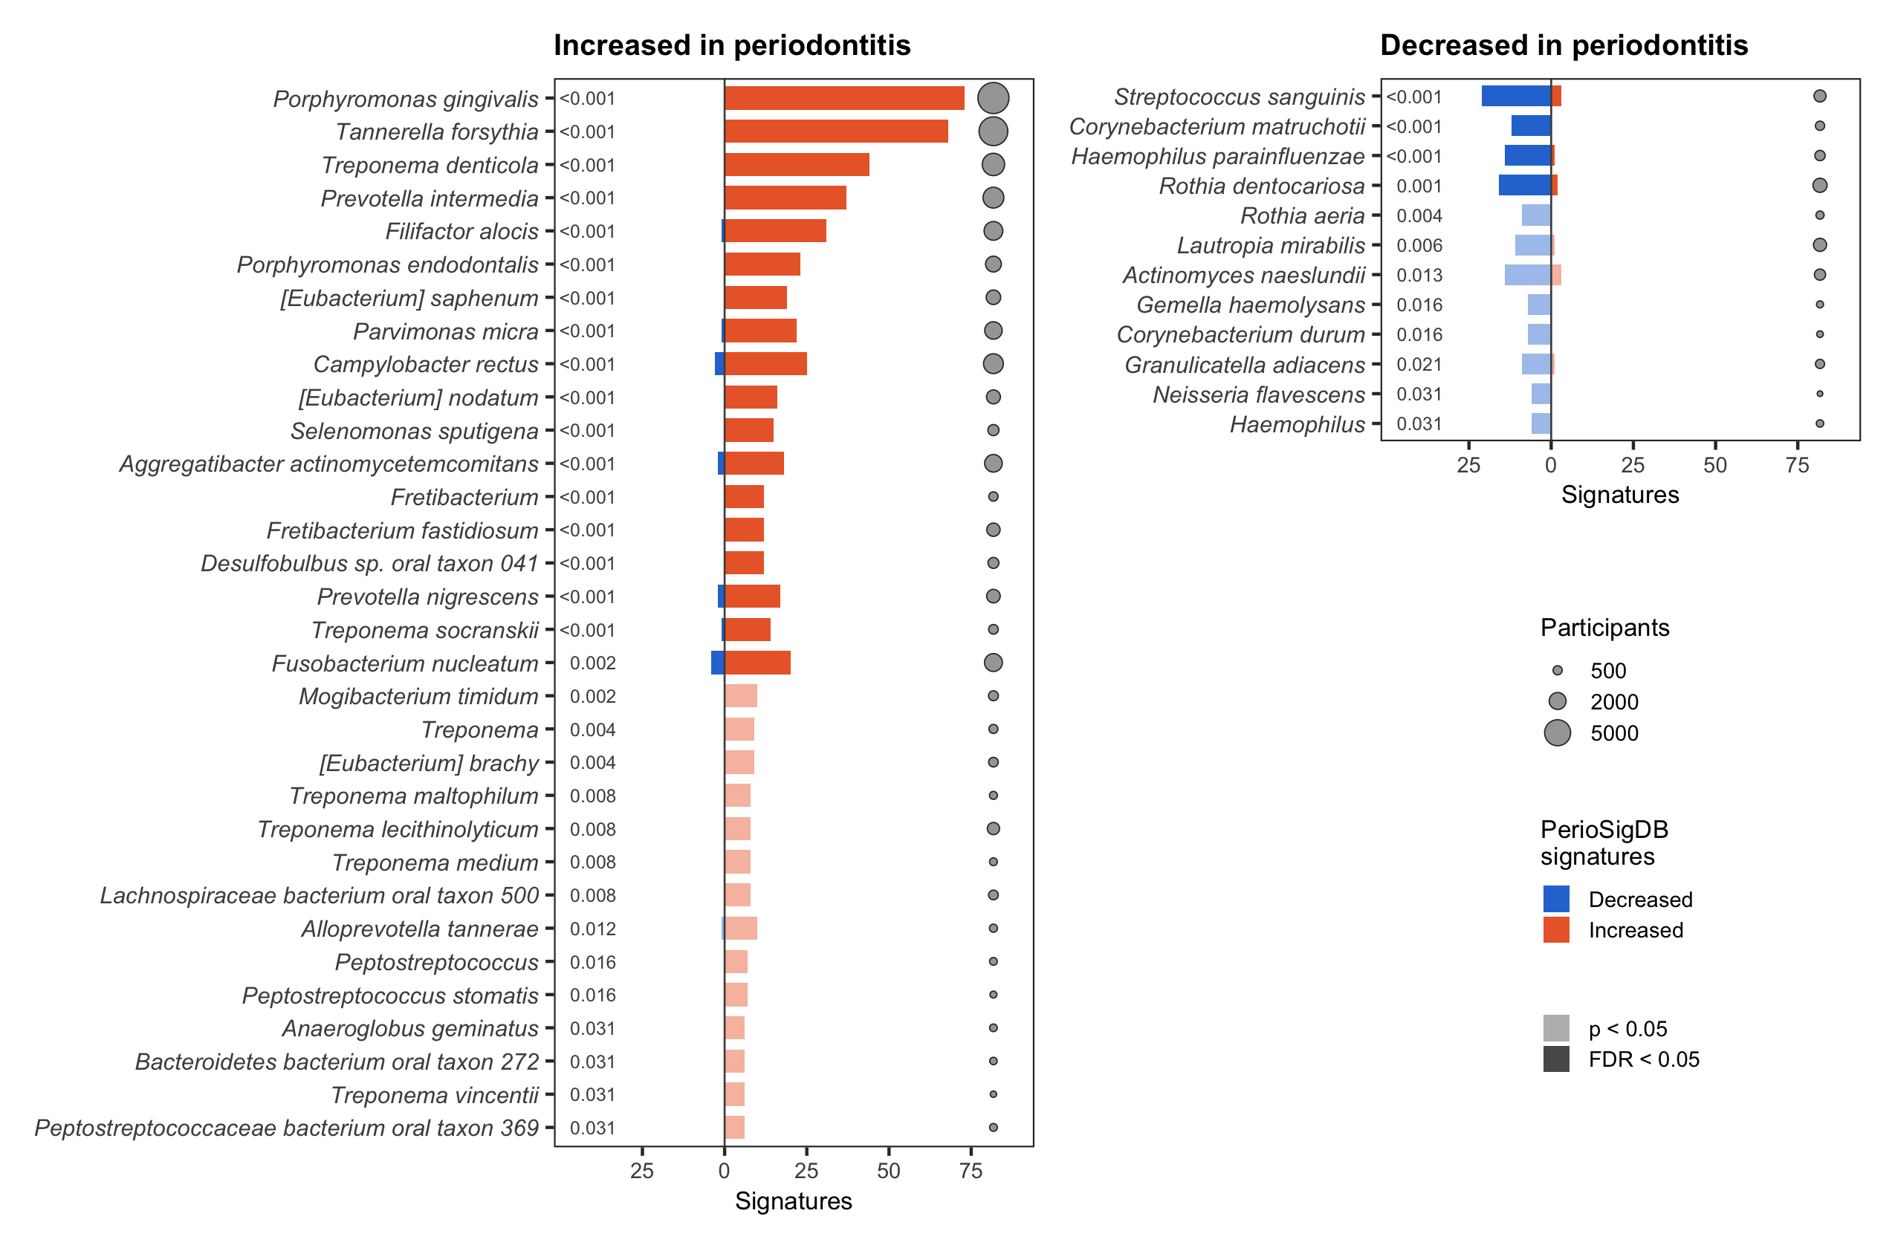
PerioSigDB increased and decreased taxa
Figure 2A. exact binomial test of increased vs decreased signatures, unadjusted p < 0.05; faded: not FDR-significan

Slide 5
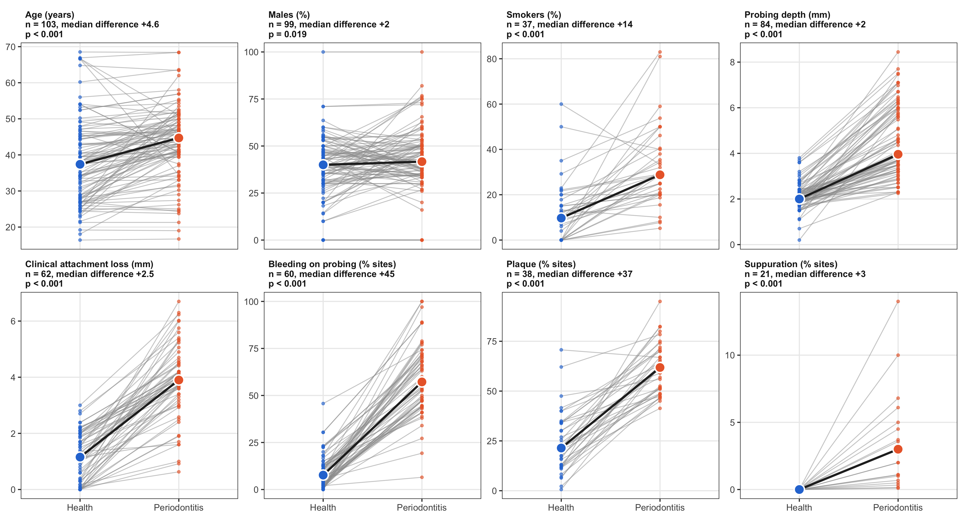
Periodontitis groups are older and include more smokers
Figure 3. paired group means per study; medians across studies; Wilcoxon signed-rank test

Slide 6
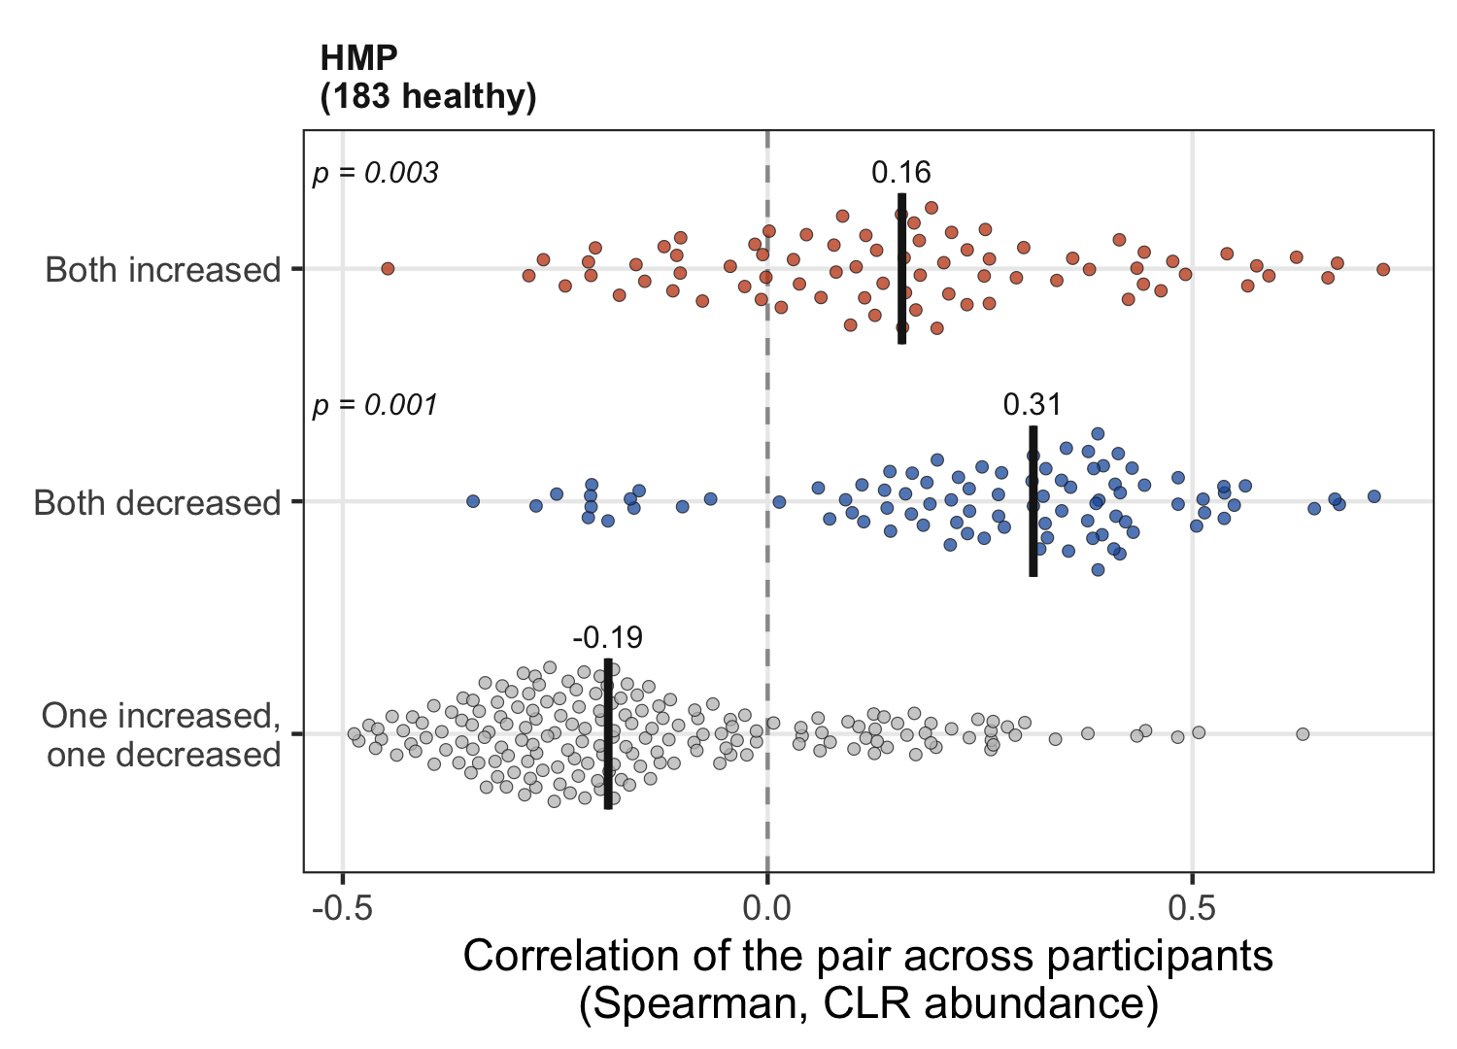
Genera changing the same way in periodontitis co-vary in healthy plaque
Figure 2B. How: Spearman correlation of CLR abundance between genus pairs, HMP healthy subgingival plaque (183 participants)

Slide 7
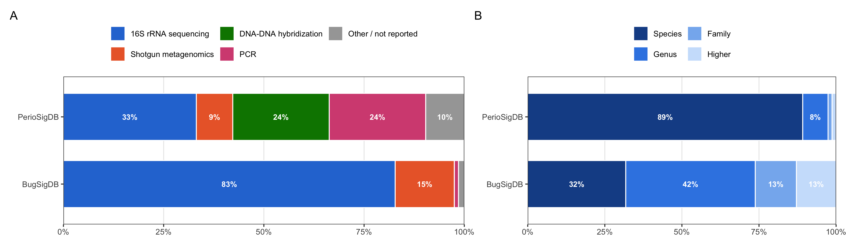
PerioSigDB is species-level and half targeted assays
Figure S2. share of signatures by profiling method (A) and of taxa by rank (B), against BugSigDB
BugSigDB is mostly sequencing and genus-level, so the databases are compared at genus level

Slide 8
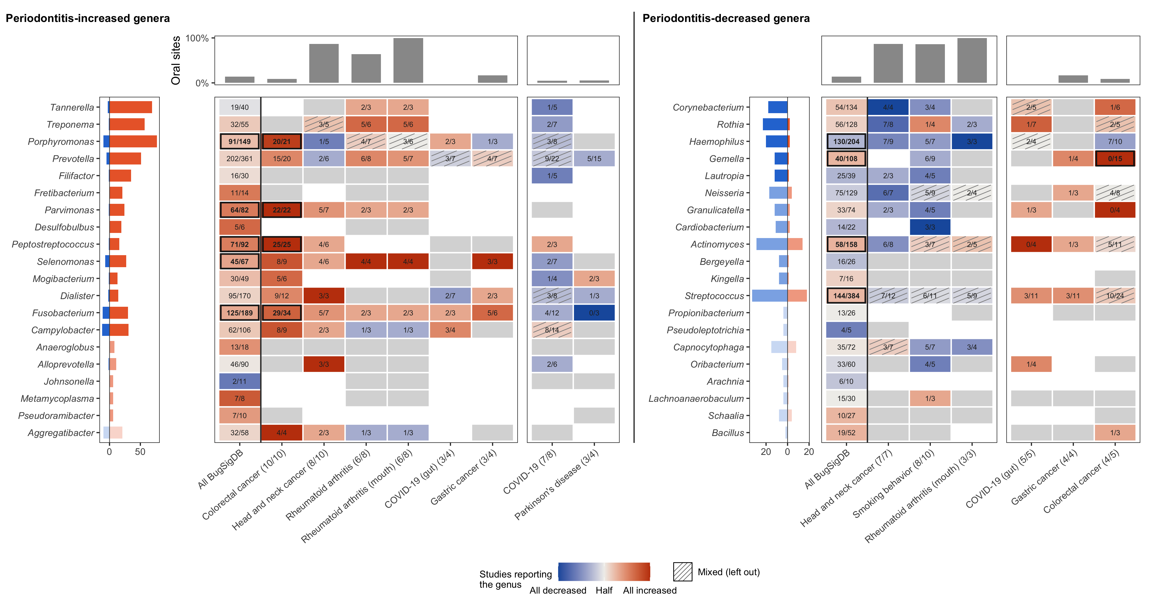
Colorectal cancer reports the periodontitis-increased genera as increased
Figure 5. share of each condition's studies reporting a genus in its periodontitis direction; binomial test vs 50%, BH

Slide 9
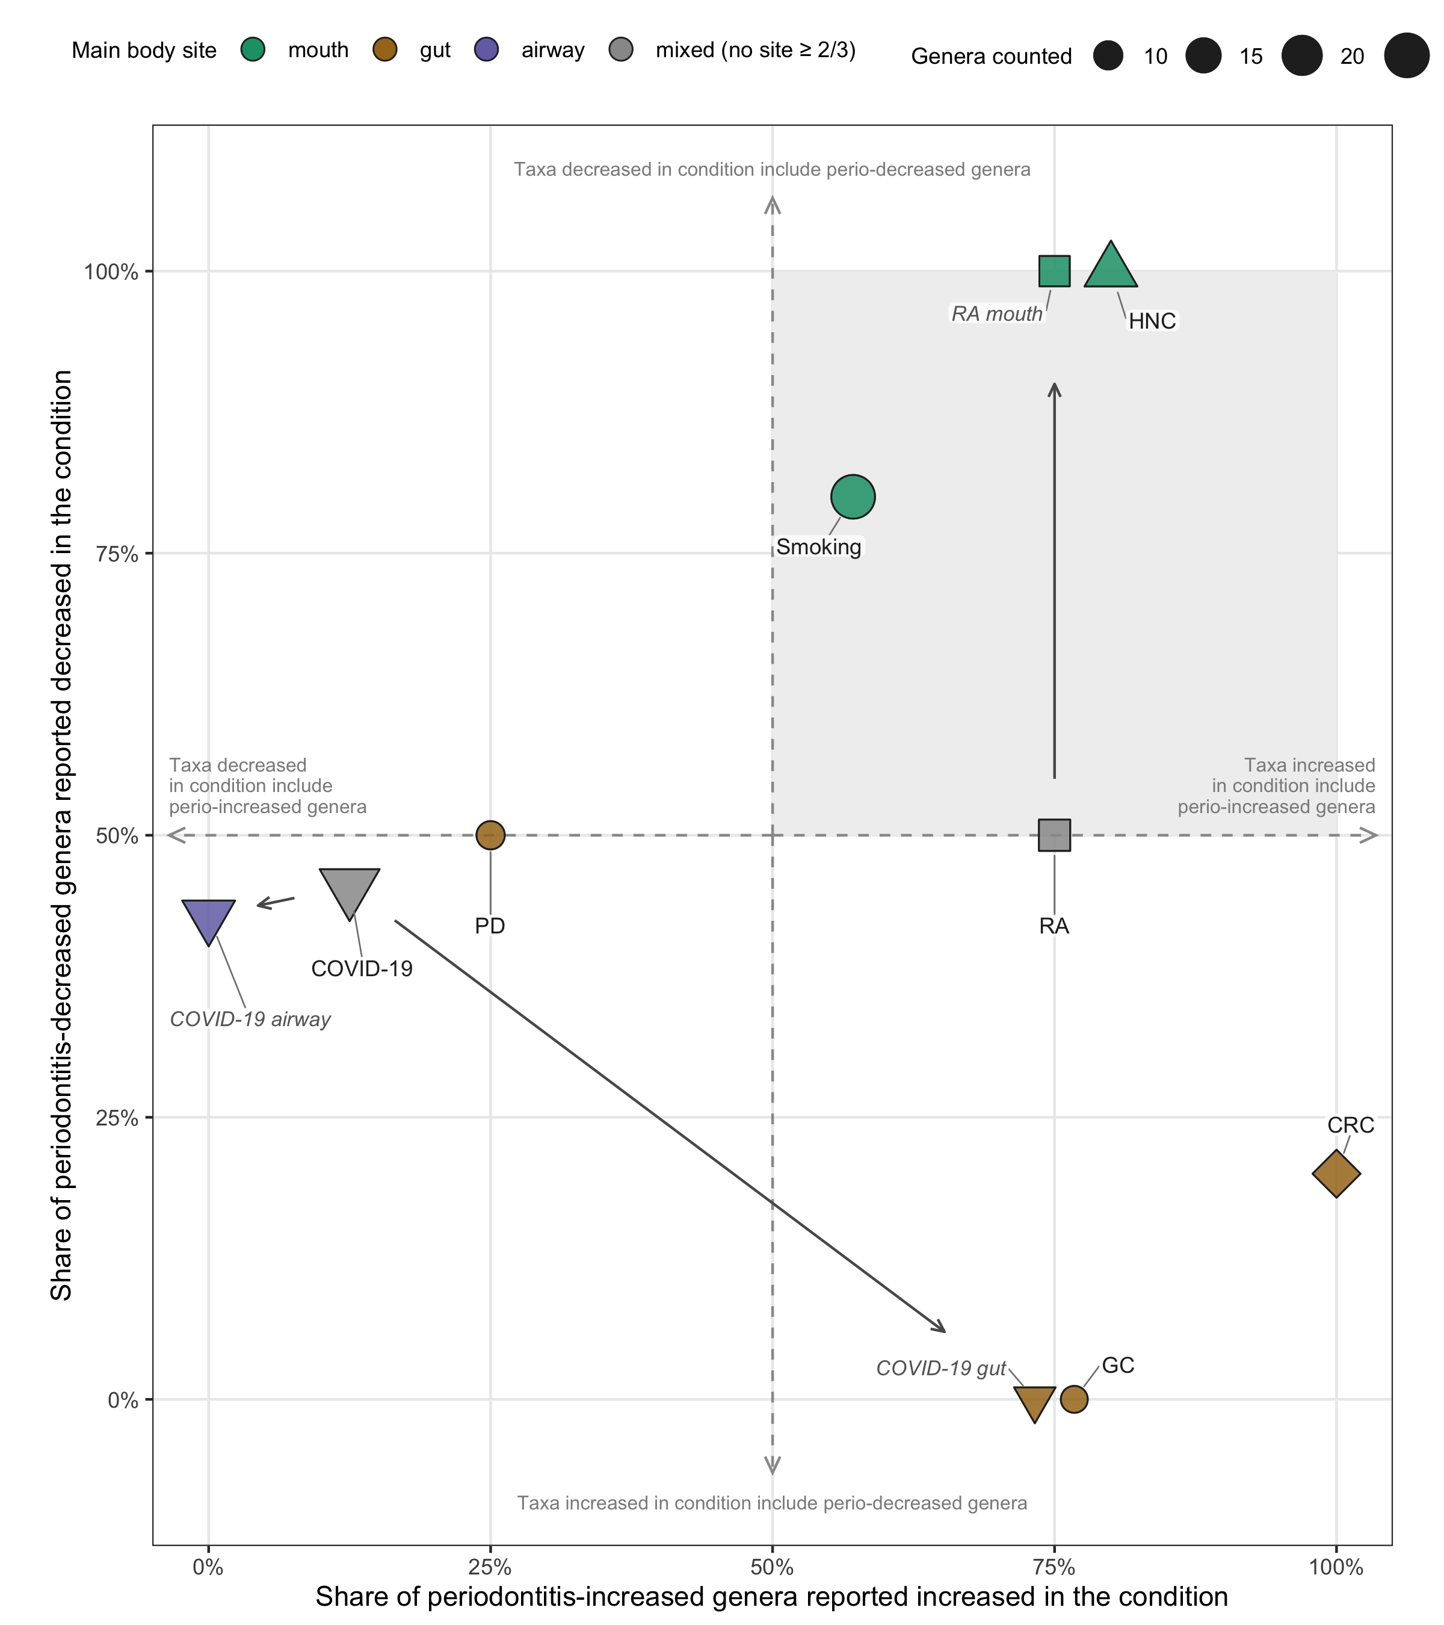
Oral conditions similar to periodontitis for increased and decreased genera
Figure 6A. share of genera with a clear direction that agree with periodontitis: increased (x) and decreased (y) genera

Slide 10
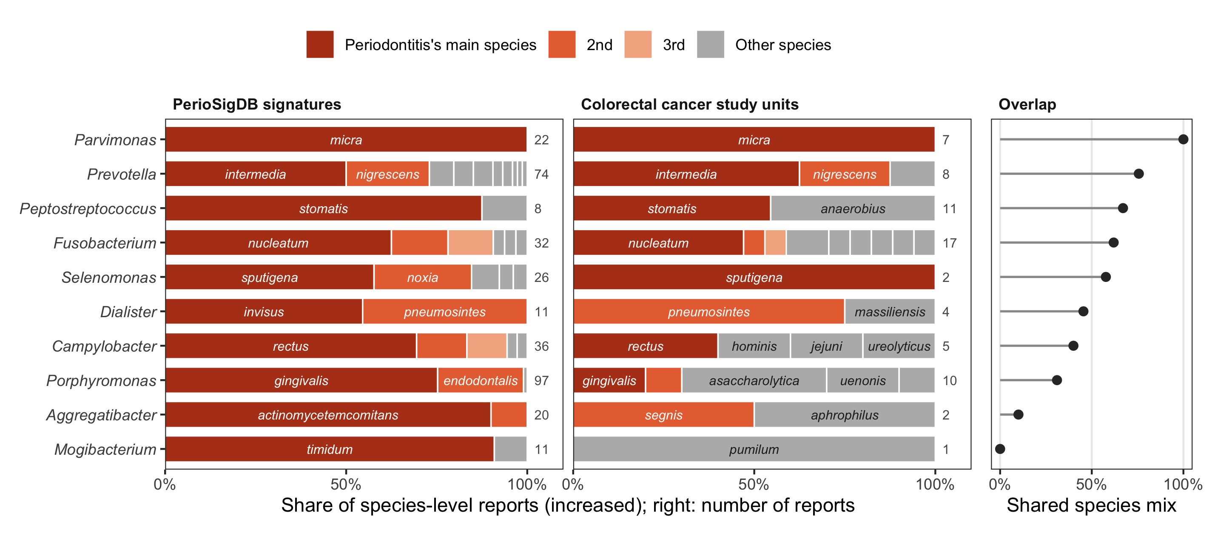
Colorectal cancer shares periodontitis species in most, but not all, genera
Figure S3. How: species mix of increased reports per genus, PerioSigDB vs colorectal cancer; overlap of the two mixes

Slide 11
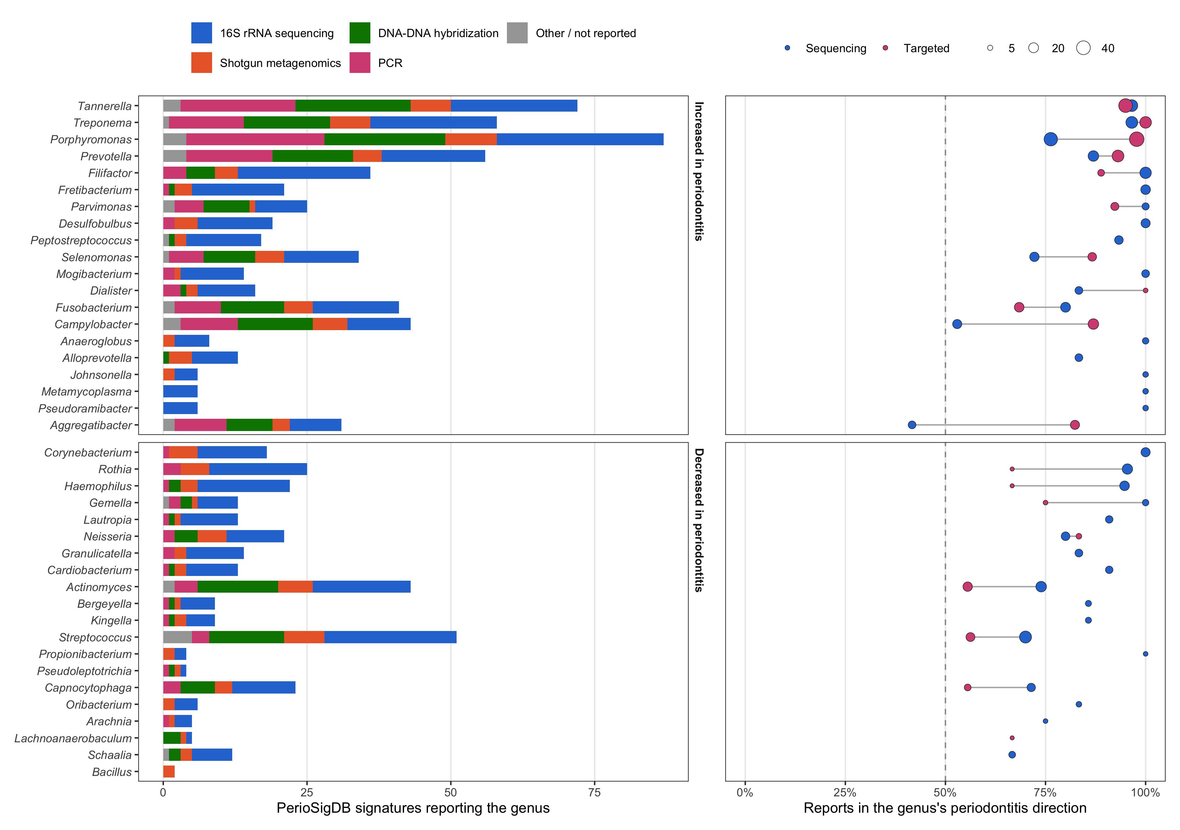
Targeted panels do not create the periodontitis genus sets
Figure S5. How: signatures per genus by method; share in the periodontitis direction, sequencing vs targeted
Sequencing alone keeps 18 of 20 increased and 17 of 20 decreased genera; Aggregatibacter, Campylobacter rely on panels

Slide 12
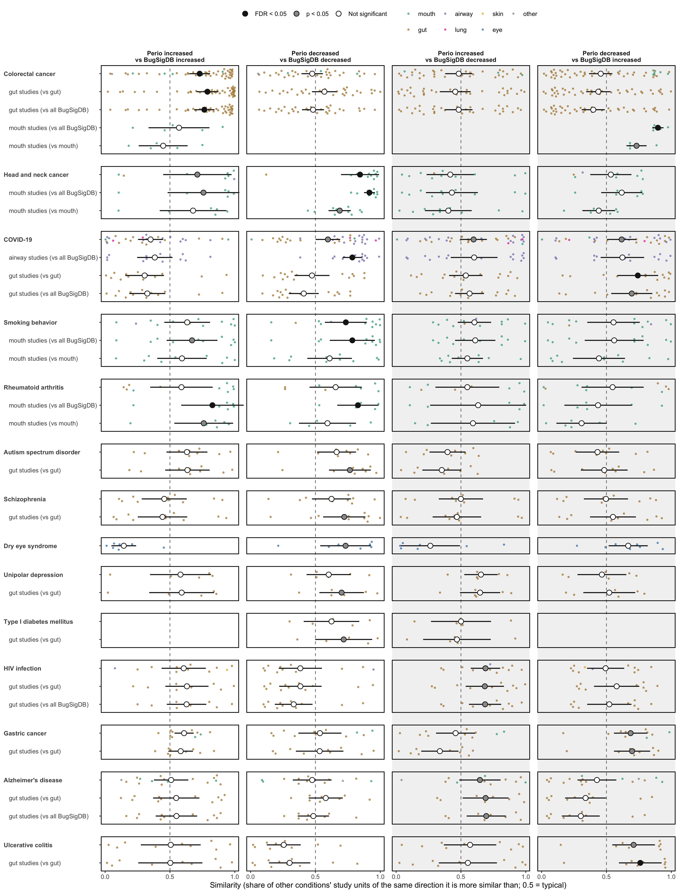
Ranks of semantic similarity to periodontitis consensus signatures
Figure S4. Lin similarity to the consensus, ranked against other conditions' study units; rank-sum test, BH

Slide 13
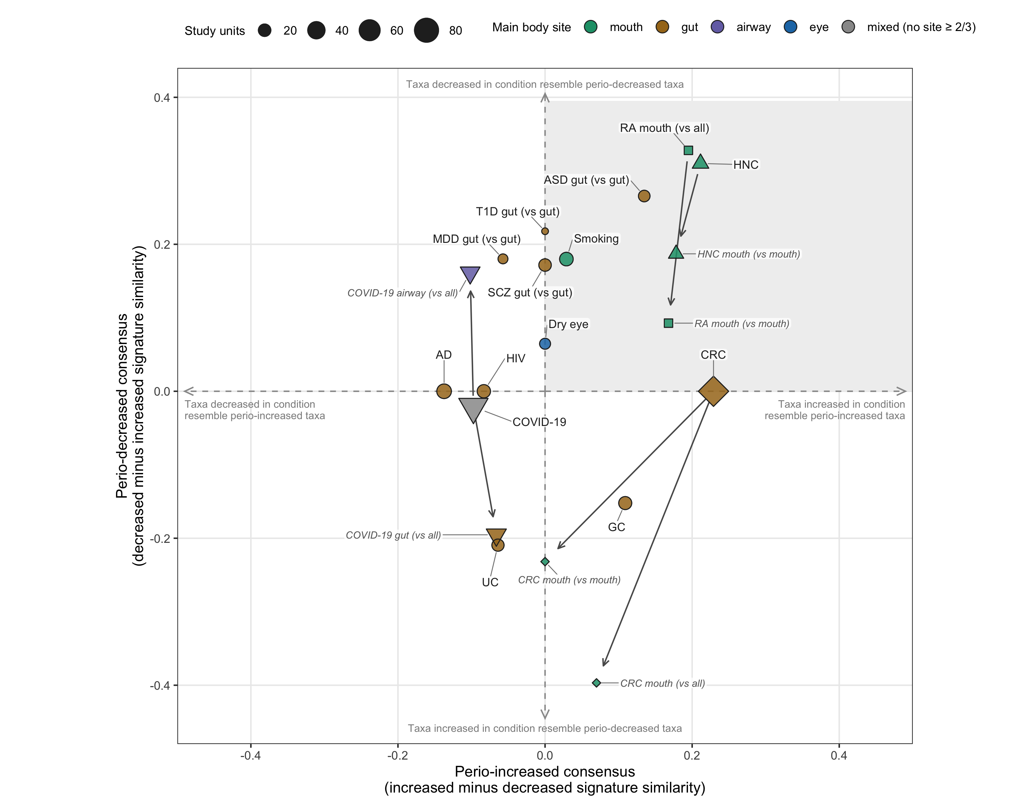
Which way each condition reports the periodontitis consensus taxa
Figure 6B. How: mean similarity rank above 0.5; for each consensus, the condition's increased minus decreased signatures

Slide 14
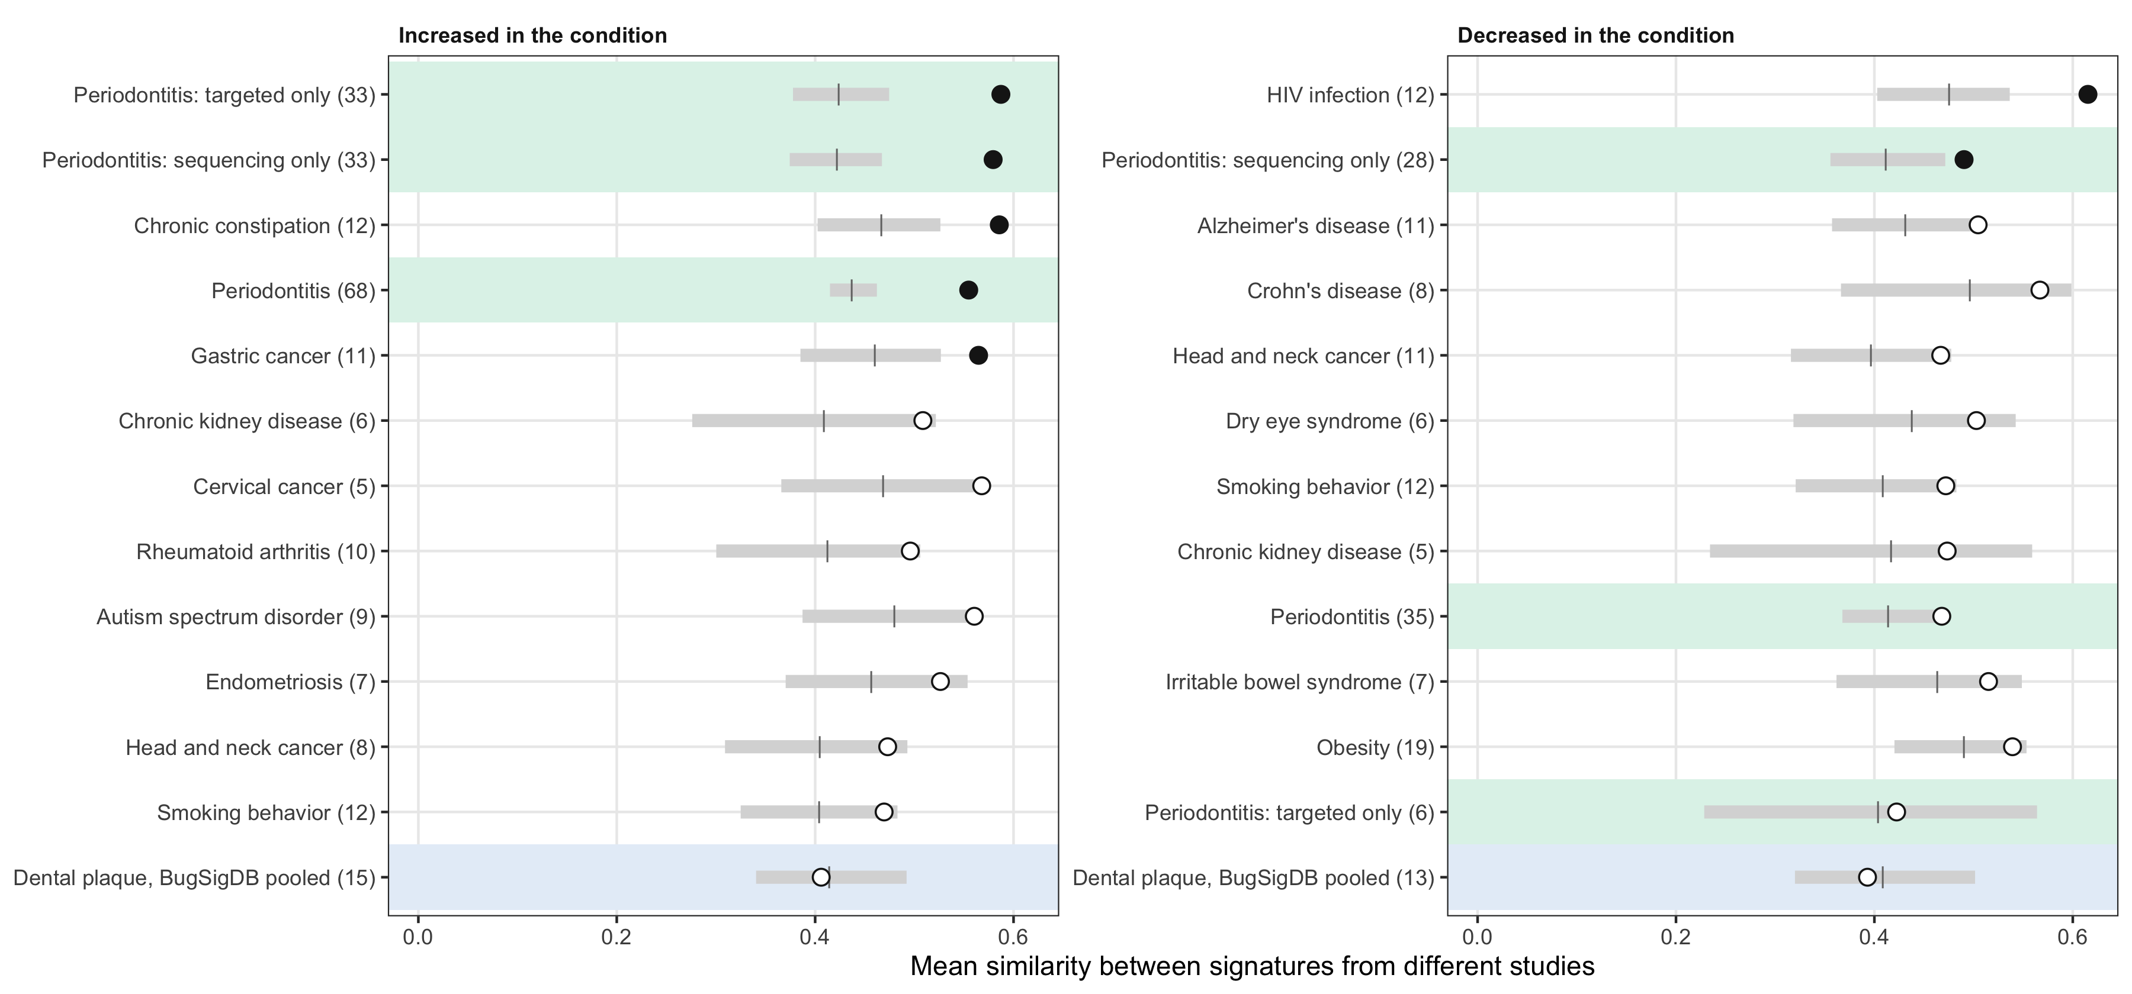
Periodontitis studies agree on increased taxa
Figure 4. How: between-study similarity vs site-matched random sets; green: periodontitis subsets; blue: BugSigDB plaque

Slide 15
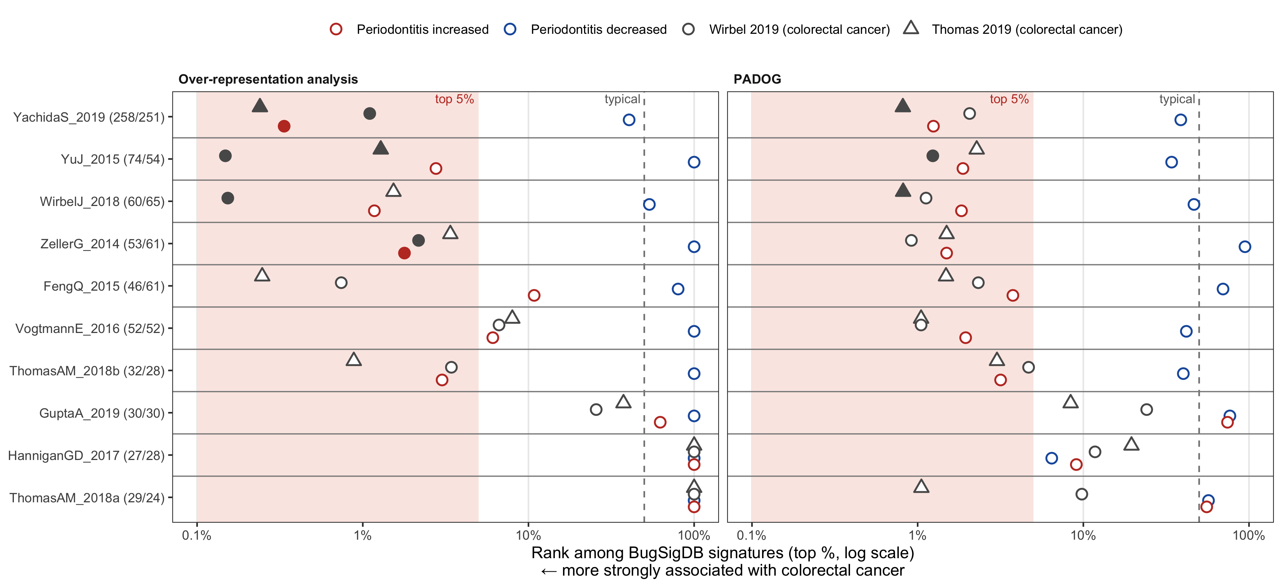
Periodontitis-increased genera over-represented in colorectal cancer stool
Figure S6. How: 10 datasets; limma; ORA and PADOG rank among about 2,000 BugSigDB signatures
Top 5% in 5 of 10 datasets (ORA) and 7 of 10 (PADOG); the decreased signature is not enriched

Slide 16
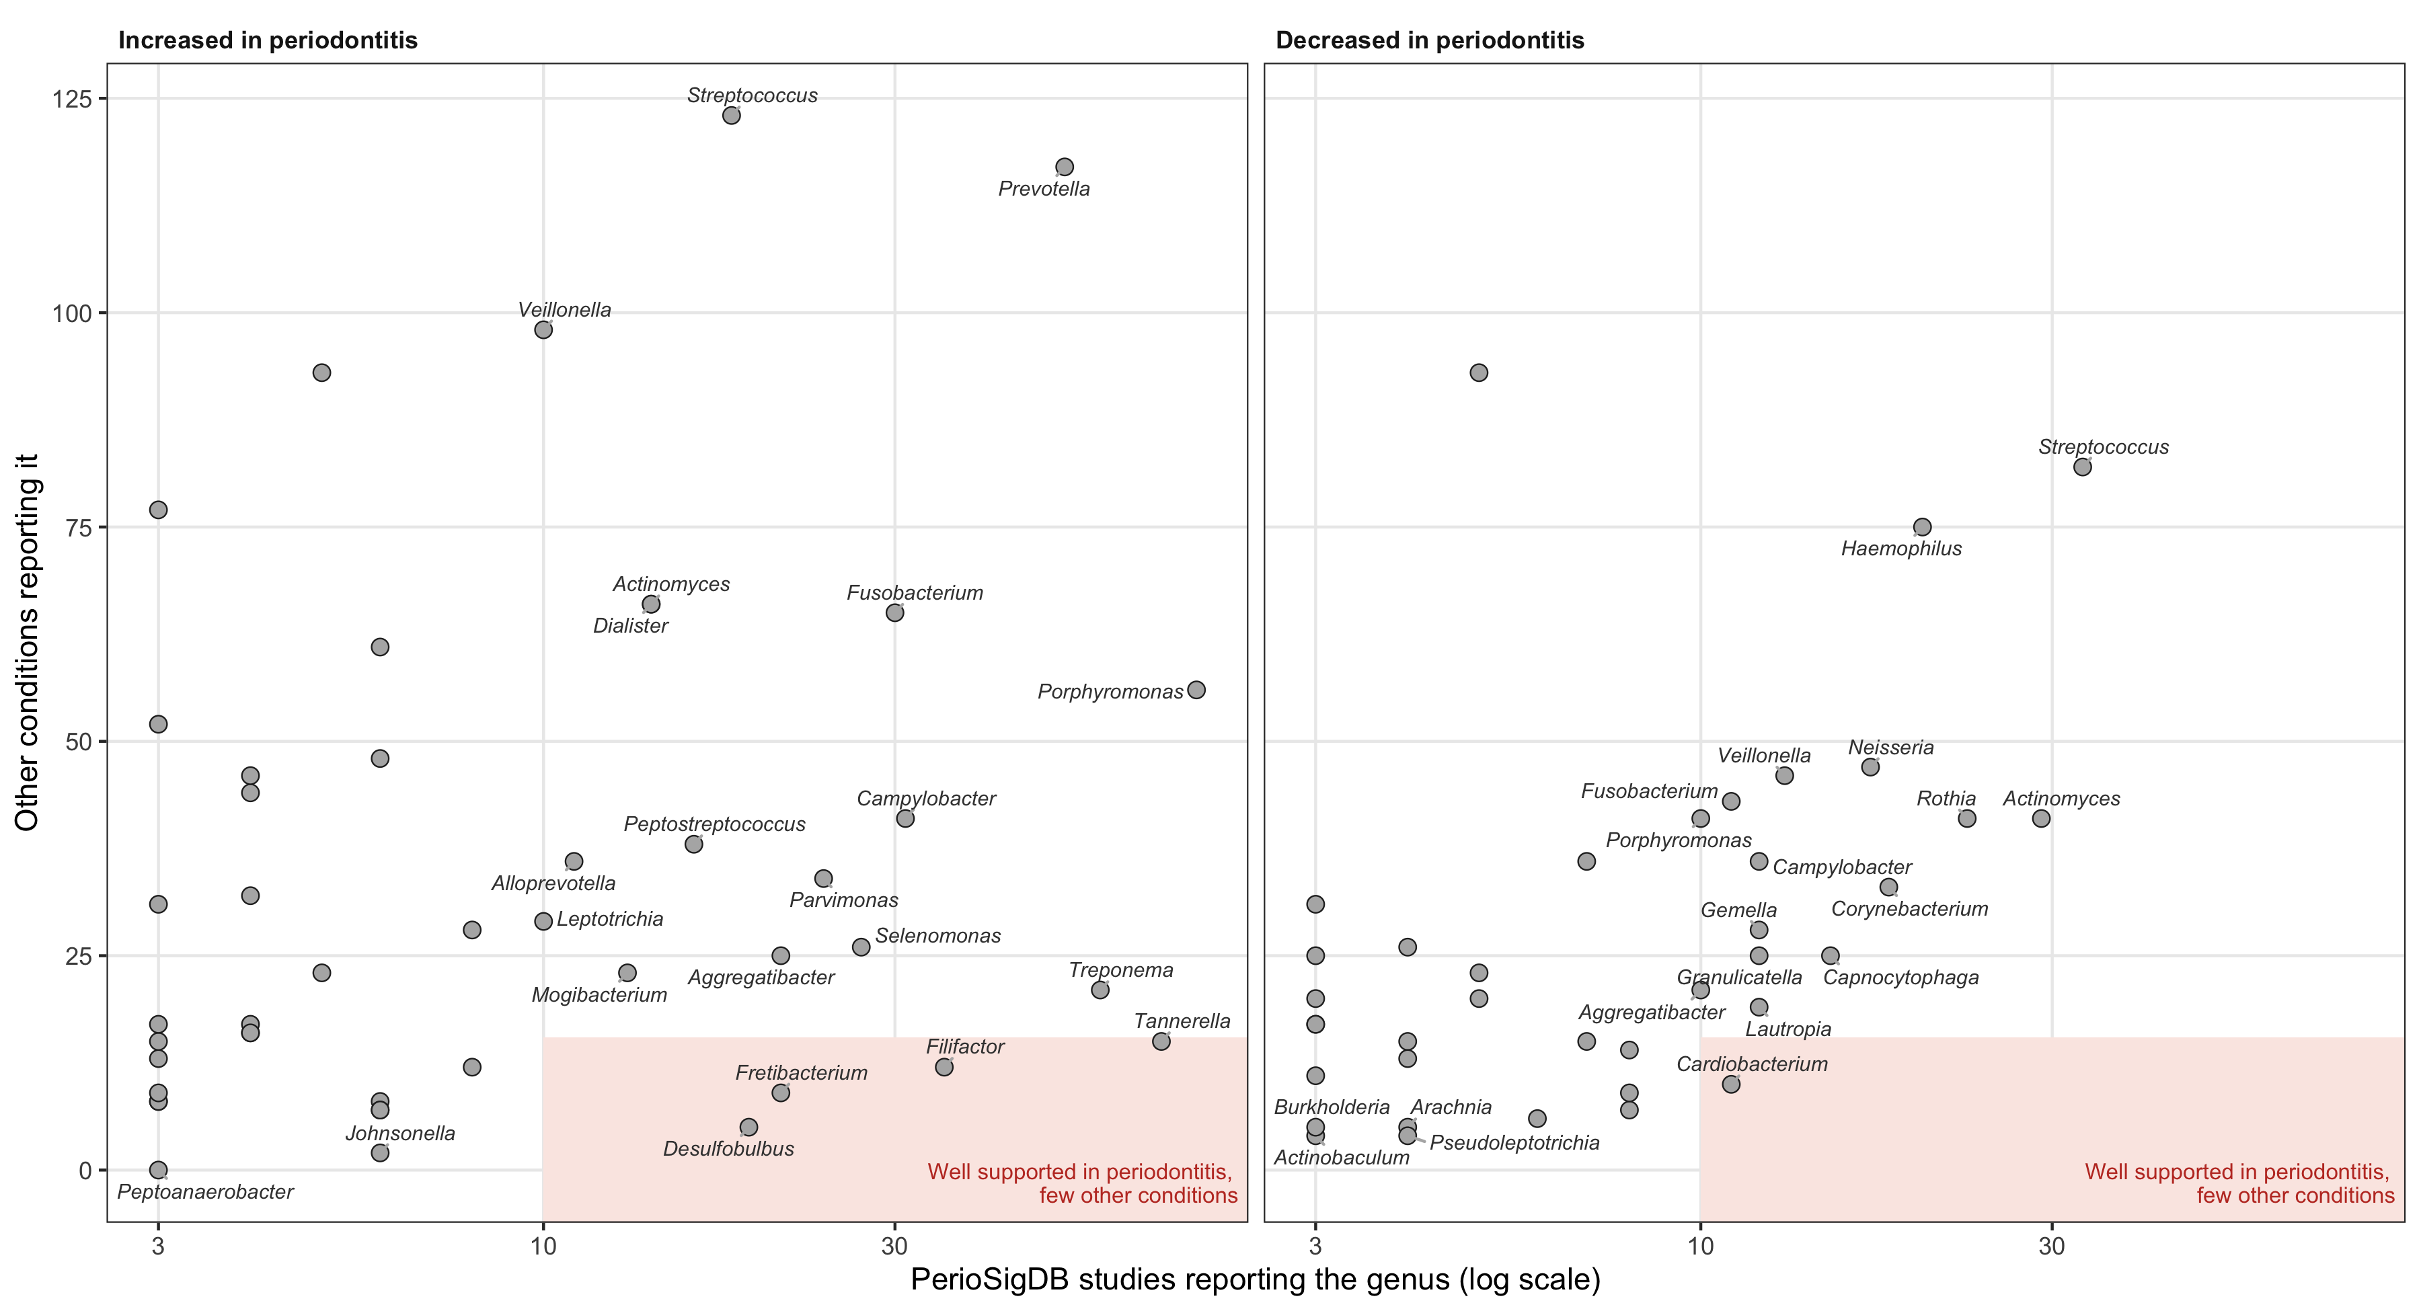
Some periodontitis genera are rarely reported elsewhere
Figure S7. How: PerioSigDB studies vs other conditions, same direction
Porphyromonas, Prevotella widespread; Desulfobulbus, Fretibacterium, Filifactor, Tannerella more specific

Slide 17
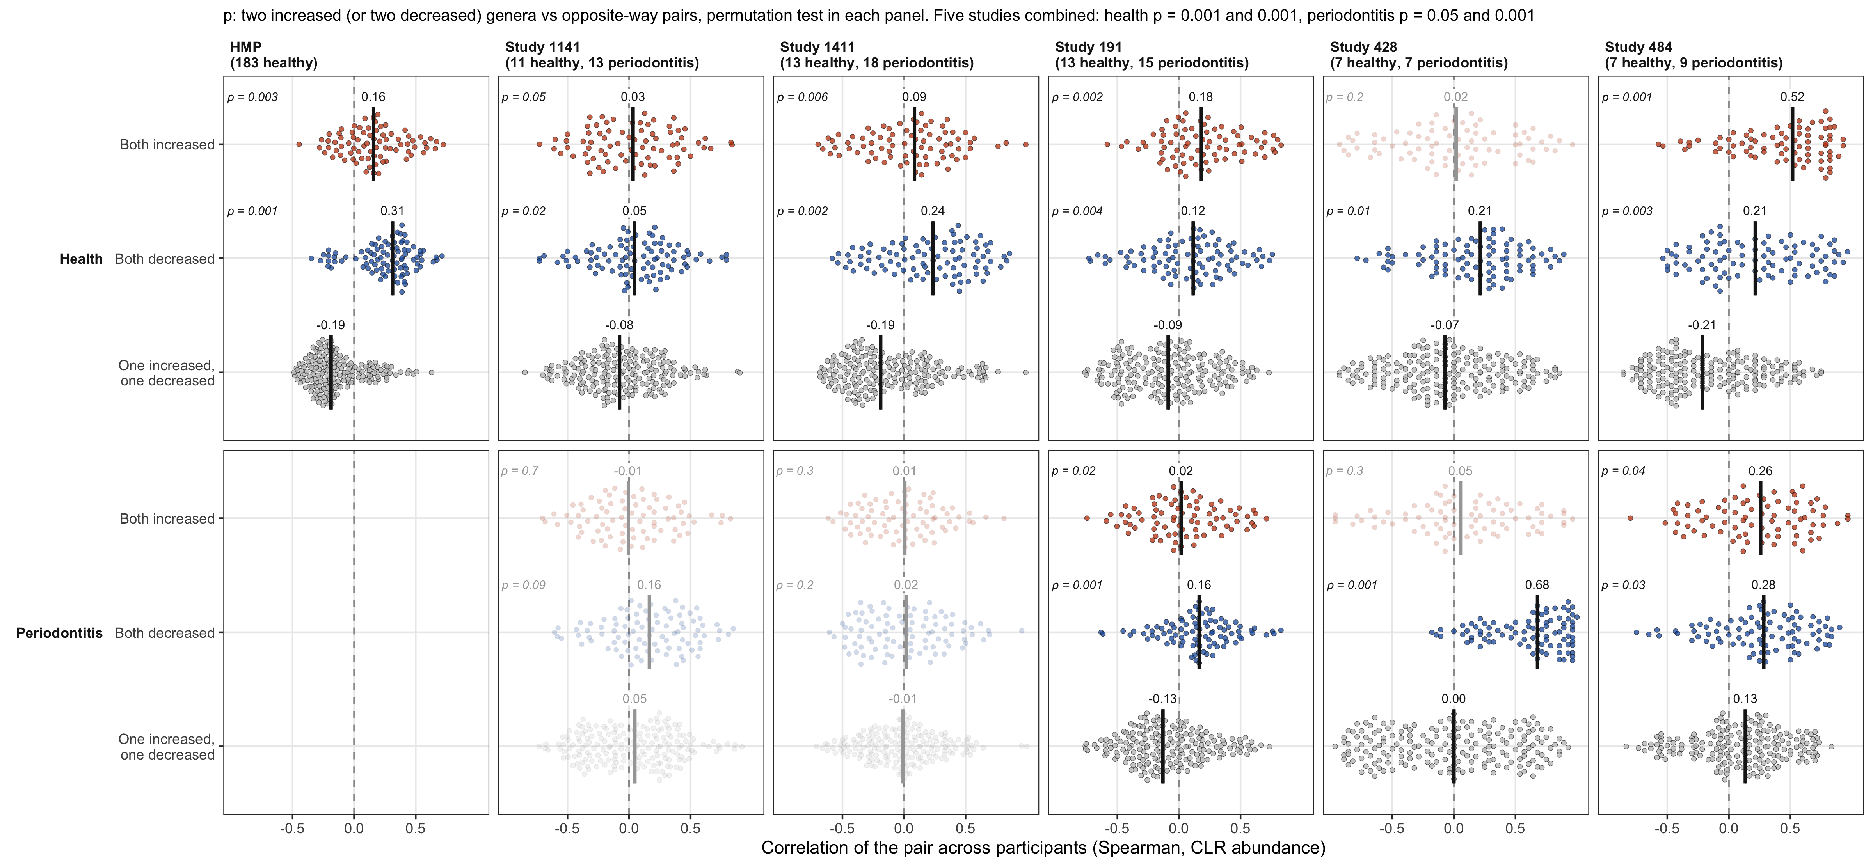
In periodontitis patients, increased genera co-vary less than in health
Figure S1. How: the same correlations in HMP and in the participants of five PerioSigDB studies
Decreased pairs stay correlated (combined p = 0.001); increased pairs weaken (median 0.05 vs 0.18 in health)

Slide 18
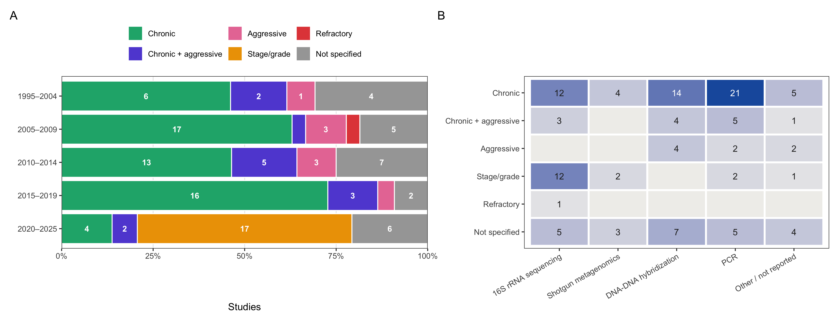
Recent studies classify periodontitis by stage and grade
How: share of studies per period (A); studies by classification and profiling method (B)

Slide 19
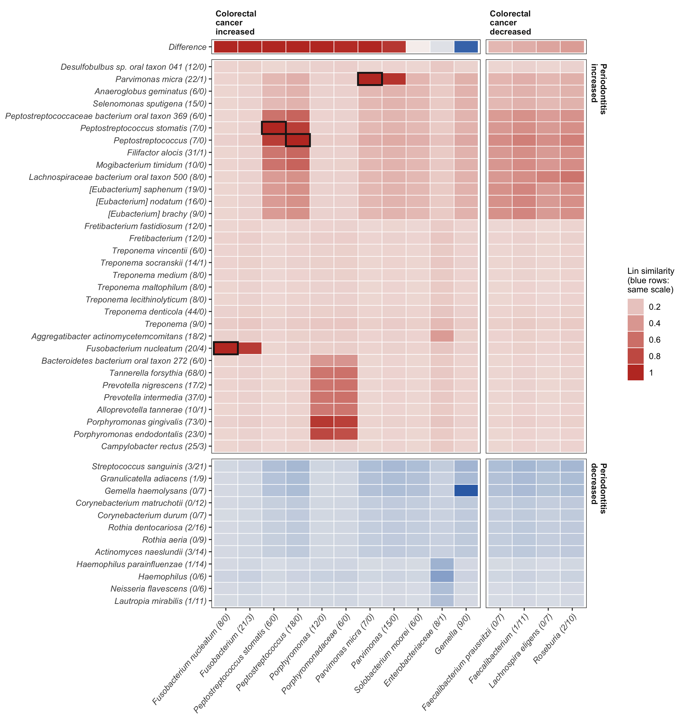
Colorectal cancer consensus resembles only the periodontitis-increased taxa
How: Lin similarity, consensus taxon by taxon

Slide 20
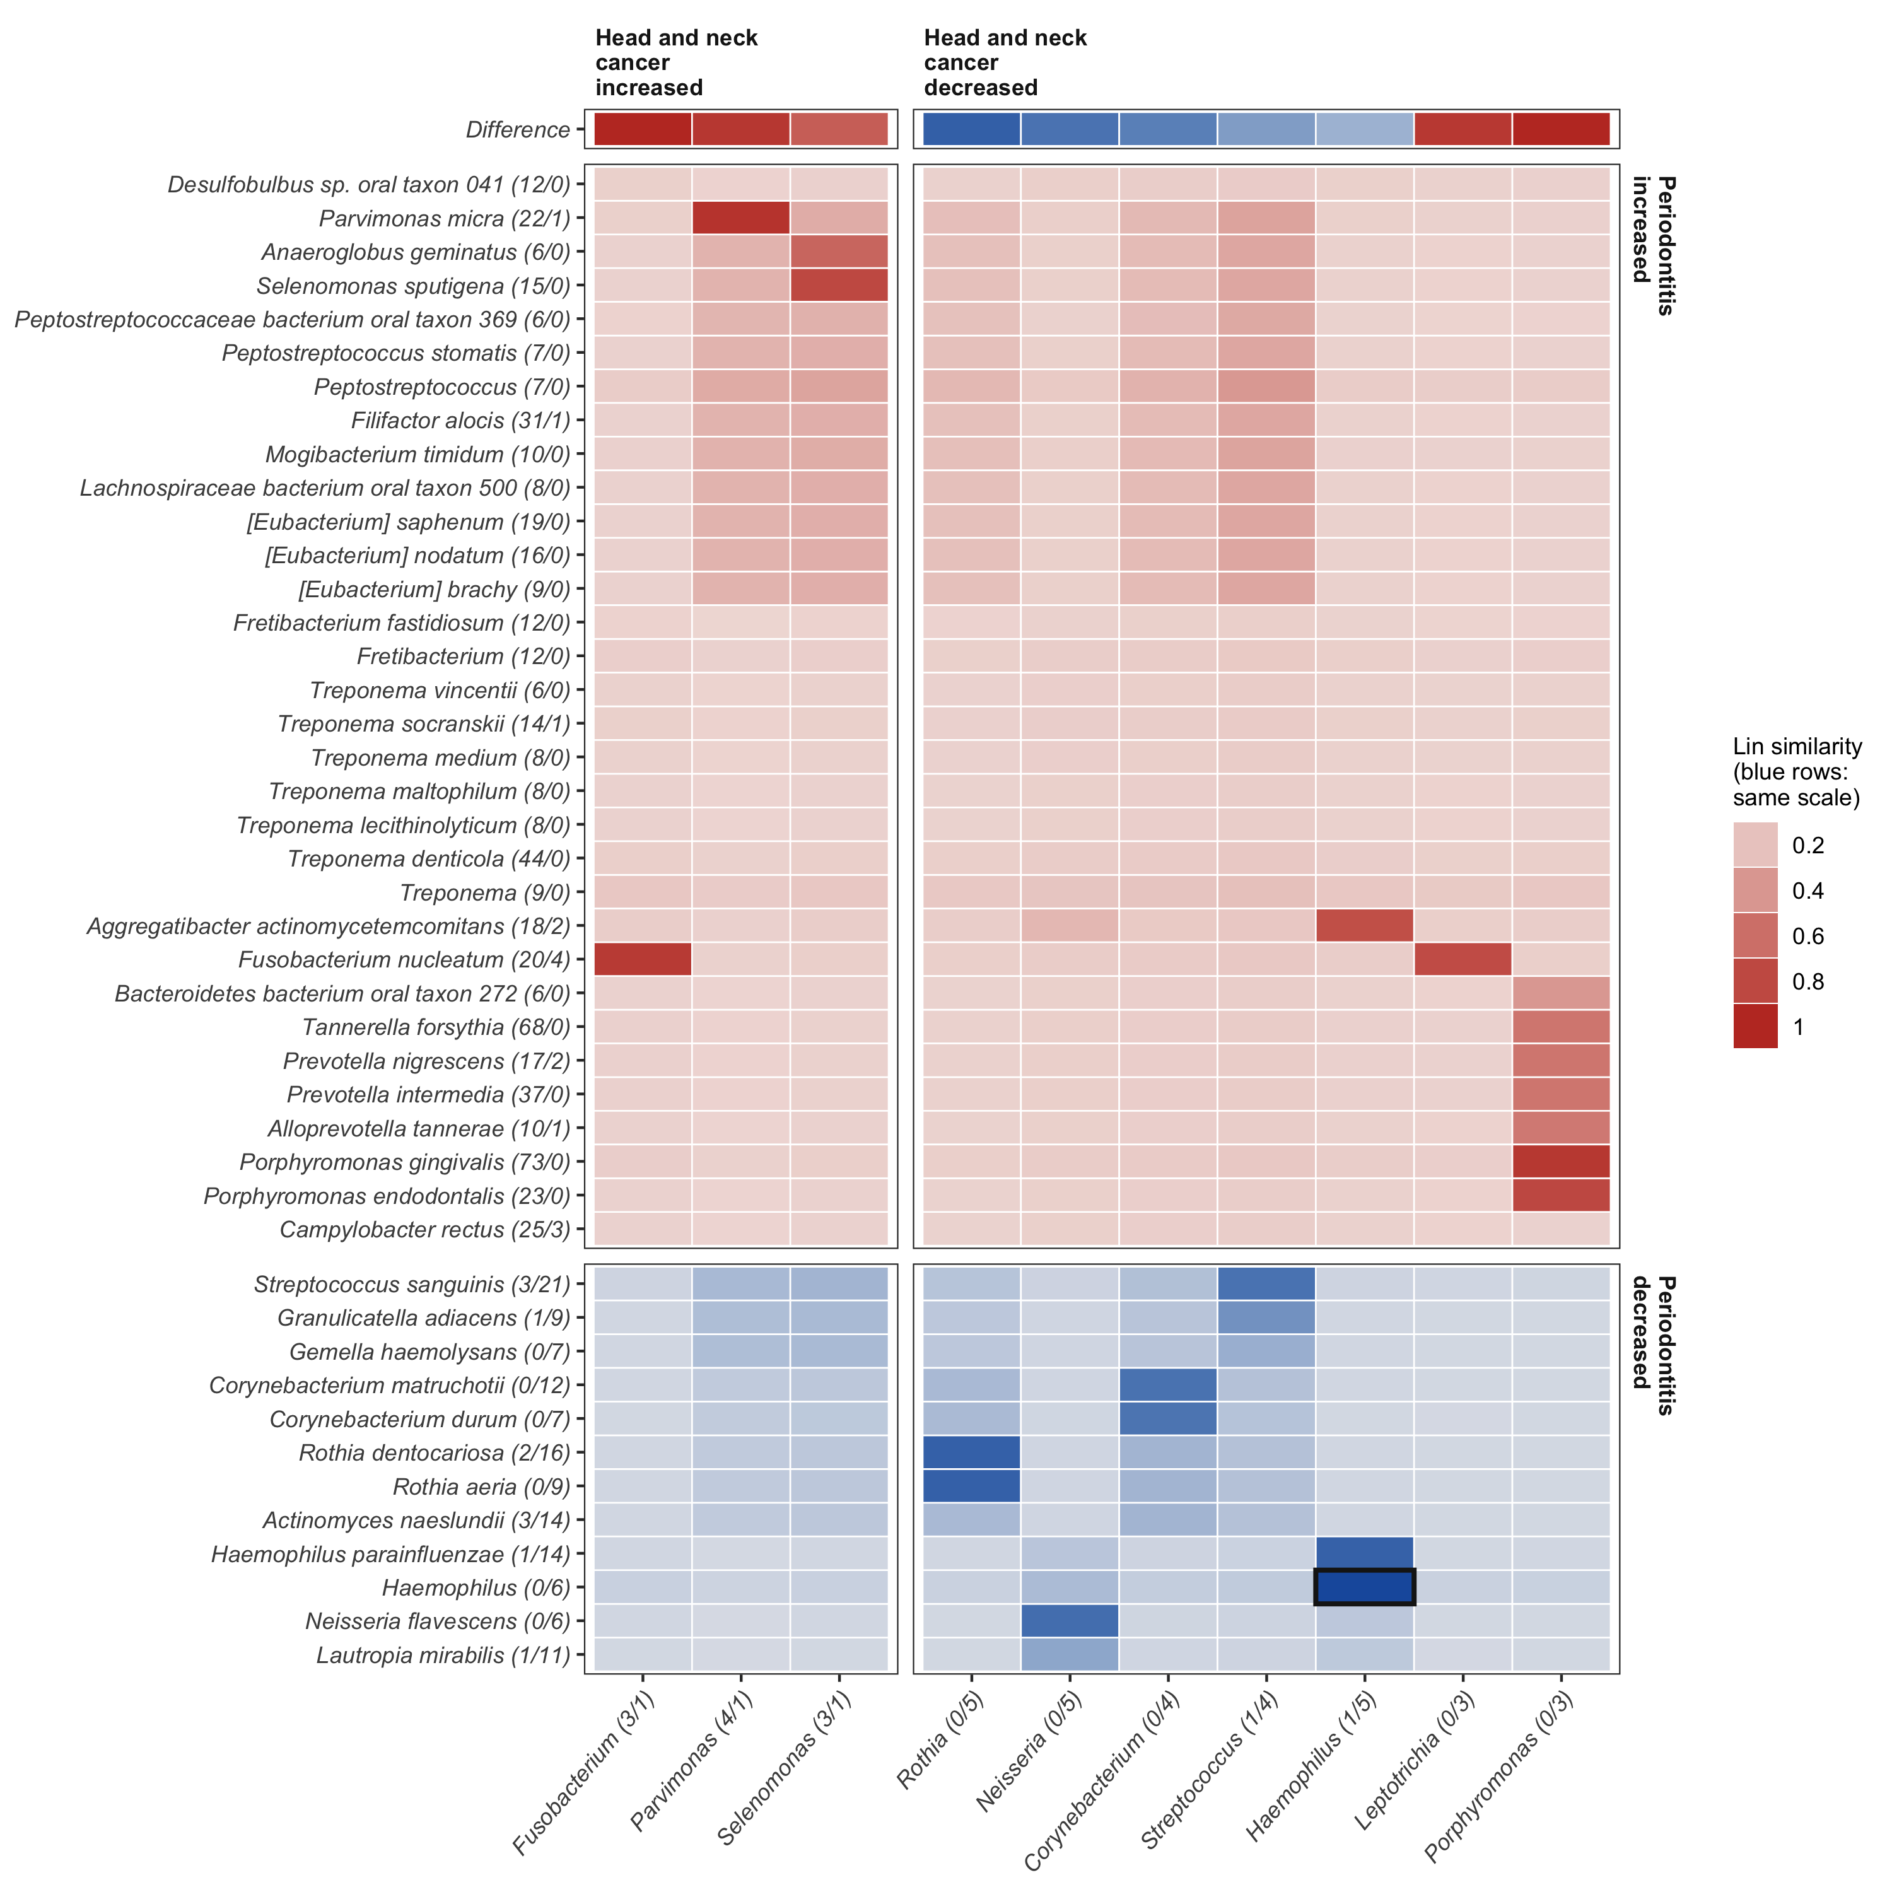
Head and neck cancer matches mainly the decreased taxa
How: Lin similarity to taxa from ≥ 3 studies
Haemophilus, Neisseria, Rothia, Corynebacterium decreased

Slide 21
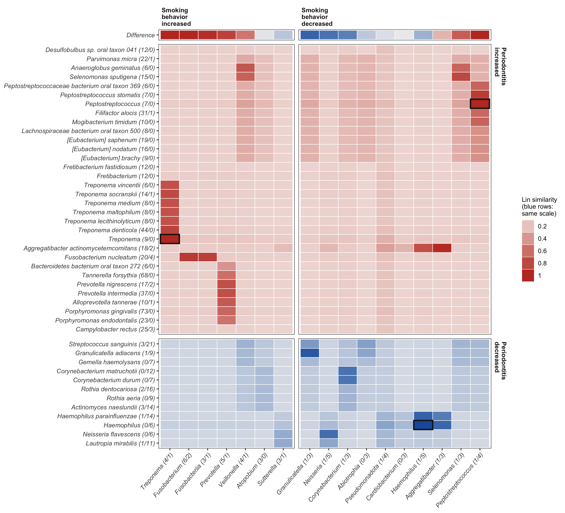
Smoking matches mainly the decreased taxa
How: Lin similarity to taxa from ≥ 3 studies
Peptostreptococcus, Selenomonas in the opposite direction

