Slide 1


CCB-VIB Bioinformatic Platform February 2021
Center for Cancer Biology
Laboratory for Translational Genetics
Theo Killian

Slide 2
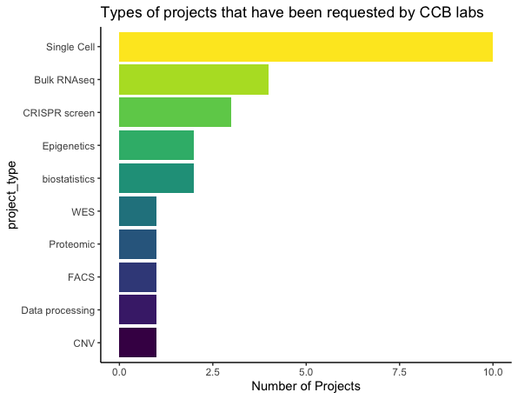
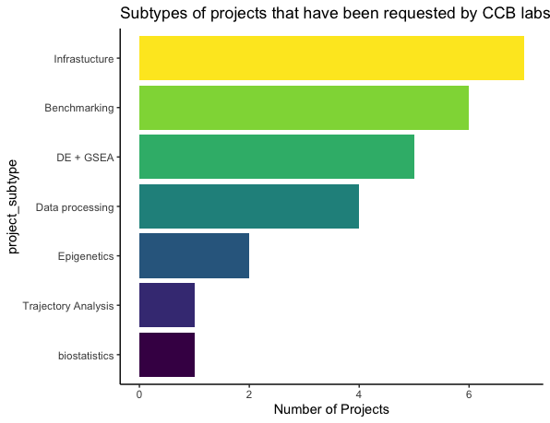
CCB Platform Project Overview
The CCB platform has taken on 26 projects since Aug 2020
Projects are primarily Single Cell RNAseq analysis and bulk RNAseq, but many other types of analyses have been requested
The nature of these projects are commonly infrastructural (i.e. pipelines) development , benchmarking data (TCGA/GEO), differential expression and GSEA, or data manipulation (annotation or other biostatistical tasks)
L and K drives frequently used by labs for data storage. Data storage has become an issue for some labs

Slide 3
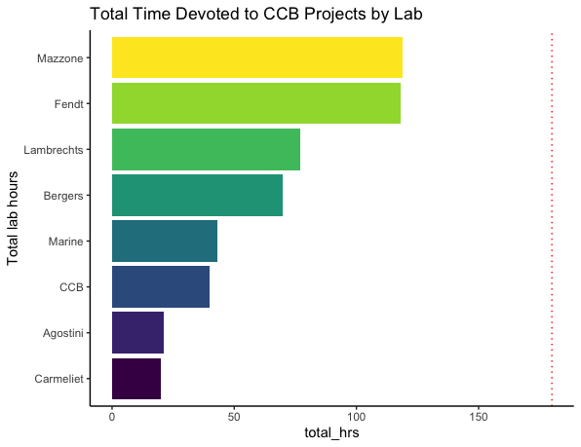
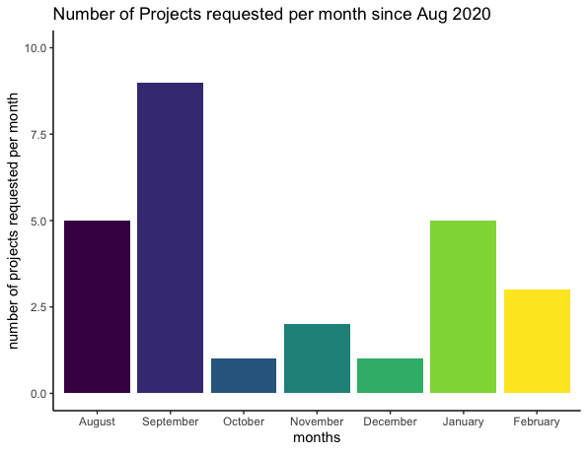
Potential Problems
Many labs have requested services of the CCB platform. Some have requested more than others in terms of number of projects, while several labs have not requested any bioinformatic assistance
Assuming that all labs get an equal share of CCB project time, this equals 180 hrs per lab per year
Sufficient project requests have been received such that working +55hrs a week is not enough to prevent growth of project backlog
Splitting time equally among all open projects means project development is very slow
Difficulty in managing tight deadlines and rush projects with project backlog in addition to building and maintaining reliable infrastructure

Slide 4
Potential Solutions
The CCB Platform will implement a project management system (OpenProject) displaying project hours, providing a transparent format to communicate a deliverable timeline to stakeholders
In the interest of fairness to other labs, newly requested projects from a given lab will typically be addressed after current projects from that lab have been completed
CCB platform intends to develop pipelines and for bioinformatic report templates to be made available for general use (i.e. bulk RNAseq, CRISPR screens, SNP calling, WES CN, etc)
In order to make the best use of bioinformatic infrastructure made available by the CCB Platform, we strongly encourage lab members to enroll in bioinformatic courses and symposia to become familiar with R/Python, bash and Bioconductor
In the interest of time efficiency, it is preferred for data to be presented to the CCB platform rather than requesting the CCB platform to search for the desired data (i.e. please send url links or directory paths to data whenever possible)

