Slide 1


CCB-VIB Bioinformatic Platform March 2021
Center for Cancer Biology
Laboratory for Translational Genetics
Theo Killian

Slide 2
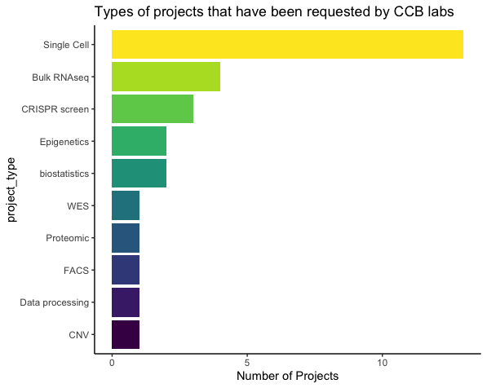
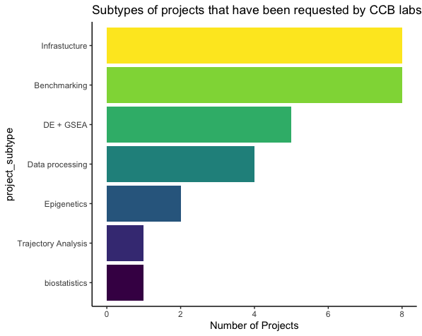
CCB Bioinformatics Platform Project Overview
The CCB platform has taken on 29 projects since Aug 2020
Projects are primarily Single Cell RNAseq analysis and bulk RNAseq, but also CRISPR-Cas screens, WES copy number, proteomic analyses of MS data, FACS, gene coexpression network analysis and bulk RNA cell deconvolution
The nature of these projects are commonly infrastructural (i.e. pipelines), benchmarking data (TCGA/GEO), differential expression and GSEA, or data manipulation (annotation or other biostatistical tasks)
L and K drives frequently used by labs for data storage. Data storage has become an issue for some labs and for the CCB Bioinformatics Platform storing large files for ongoing projects (BAM and large Single Cell datasets, etc)
Action Item #1: a better data storage solution is needed to meet the needs of various labs and the platform

Slide 3
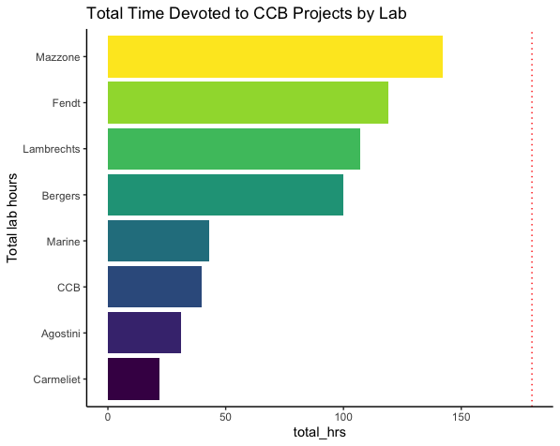
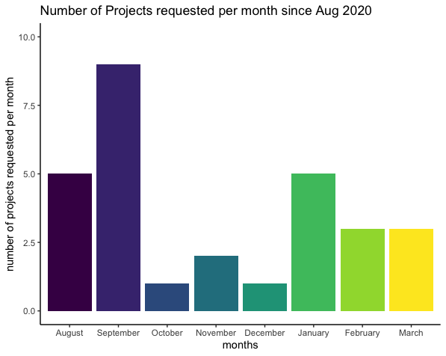
Time and Project Management
Many labs have requested CCB Bioinformatics Platform services more than others. Assuming that all labs get an equal share of CCB project time, this equals 180 hrs per lab per year
Sufficient weekly project requests are received such that working +55hrs a week is not enough to prevent growth of project backlog. This isn’t sustainable in the long term. Invoicing groups based on hours worked may be necessary…
Splitting time equally among all open projects and labs means that project development is very slow
It is very difficult to meet demand for rush projects requested on short notice (< 1 week) with while there is a project backlog in addition to building and maintaining reliable infrastructure (e.g. new pipelines and services)
Action Item #2: strive towards a more equitable distribution of CCB Bioinformatics Platform resources

Slide 4
Types of Platform Requests
The CCB Bioinformatics Platform receives many requests which are difficult to fulfill for various reasons:
“We have a grant deadline in less than a week, can you perform cell deconvolution on bulk RNAseq data on it?” We can usually squeeze in a rush project and deliver results if the project will take only a few hours but we typically can’t perform an analysis using a new technique/package that quickly
“Can you locate and download the right dataset for our research? (usually asked without defining the research question)” We are happy to guide people to appropriate databases and help them access data to meet their research needs but in the interests of time spent, it’s best for biologists to bring data to the platform
“Can you look at the data from the Korean paper?” When referring to datasets, please be exact and provide the GSE accession number, file name and/or path and also be specific about what your hypothesis is when analyzing the data. It may be necessary to implement a request form to reduce misunderstandings
“Isn’t there some ‘statistical’ thing that you can do to look at the expression of my gene of interest in this specific cell type in my bulk RNAseq dataset?” We would like to implement more advanced bioinformatic techniques such as cell deconvolution pipelines and gene coexpression network analysis but the amount of project requests prevents much time being spent to develop this infrastructure
“Can you move these files for me?” Nothing wrong with asking this now and again, but every lab should ideally have at least one individual familiar with bash/command line so that this can be done in-house

Slide 5
Data Storage and Infrastructure
The CCB Bioinformatics Platform intends to develop and maintain pipelines and bioinformatic report templates to be made available for general use (i.e. bulk RNAseq, CRISPR screens, SNP calling, WES CN, etc)
However, it is an open question where these pipelines and infrastructure should be stored and housed (bioinformatic report templates can be stored on GitHub)
The VSC can sometimes be unreliable due to shortages in computational resources or encountering cryptic errors
Some CCB groups are encountering storage issues, however there may be different computational requirements for storing image data vs count data
Urbain Scherpereel and Rinaldo Beck have offered to help in developing a data storage solution but need input from you (the CCB Group Leaders). The caveat is that CCB groups may have less “local” control over compuptational resources if this solution is chosen
Action Item #3: A dedicated CCB Bioinformatics Platform node would be an ideal place for research data and communal infrastructure to be housed. This node should meet the needs of as many groups at CCB as possible. A strategy from the Group Leaders needs to be discussed and outlined address this

Slide 6
Other Potential Solutions
The CCB Bioinformatics Platform will implement a project management system (OpenProject) displaying forecasts of project hours, providing a transparent format to communicate a timeline outline when stakeholders can reasonably expect results
In the interest of fairness to the commitments to other labs, newly requested projects from a given lab will typically be addressed after current projects from that same lab have been completed. Please inform the platform of upcoming deadlines far in advance whenever possible
In order to make the best use of bioinformatic infrastructure made available by the CCB Platform, we strongly encourage lab members such as PhD students to enroll in bioinformatic courses and symposia to become familiar with R/Python, bash and Bioconductor to become more proficient at using bioinformatic tools
In the interest of time efficiency, it is preferred for data to be presented to the CCB platform rather than requesting the CCB platform to search for the desired data (i.e. please send url links, GSE accession numbers or directory paths to data whenever possible)
Lastly, if you use work from the CCB Bioinformatics Platform in a publication, please cite the author!

