Slide 1


CCB-VIB Bioinformatics Platform March 2021
Center for Cancer Biology
Laboratory for Translational Genetics
Theo Killian

Slide 2
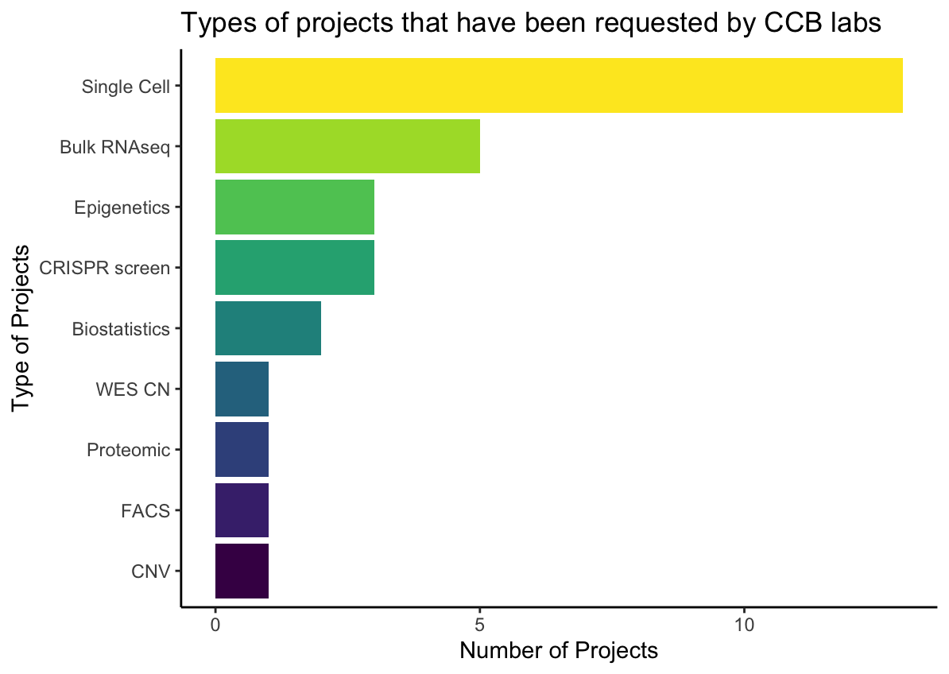
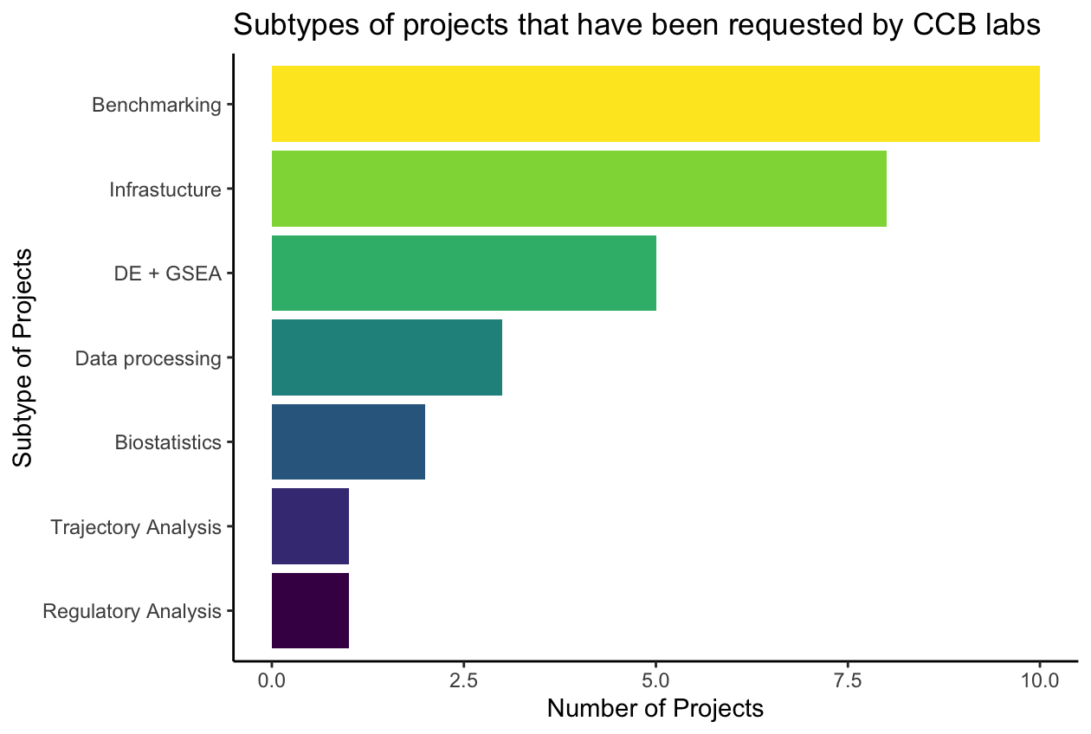
CCB Bioinformatics Platform Project Overview
The CCB bioinformatics platform has taken on 30 projects since Aug 2020. Projects are primarily single cell and bulk RNAseq, but also other many diverse types of data
These projects commonly involve building pipelines, benchmarking TCGA or GEO data, differential expression and GSEA, or data annotation
CCB Bioinformatics Platform statistics can be found at: https://github.com/ccb-vib/ccb_project_management
CCB Bioinformatics Platform has been using the VSC and DILA servers for computational projects and VSC to store large files for ongoing projects (BAM and large Single Cell datasets, references etc)
Action Item #1: A better data storage solution is needed to meet the needs of various labs and the platform

Slide 3
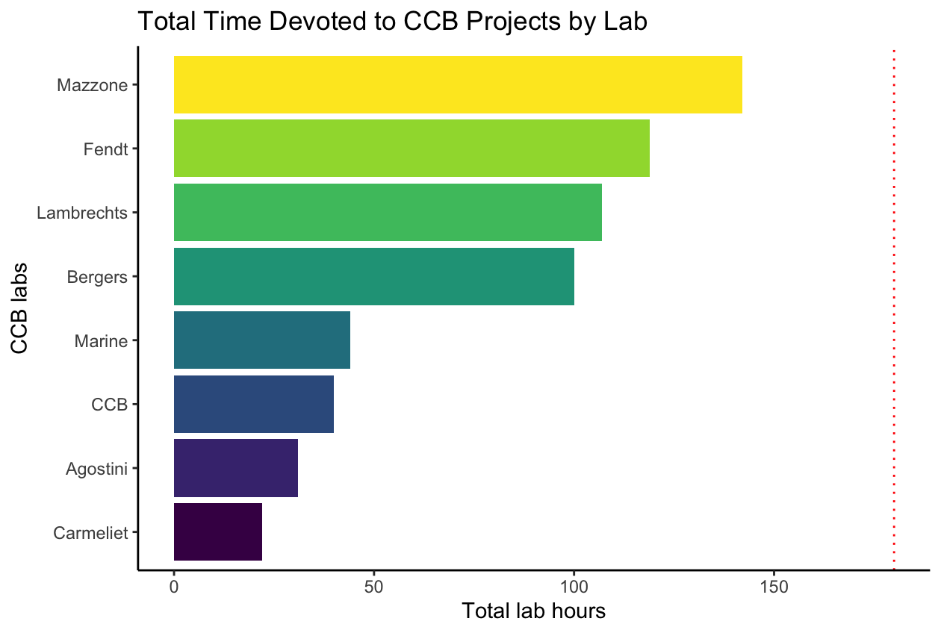
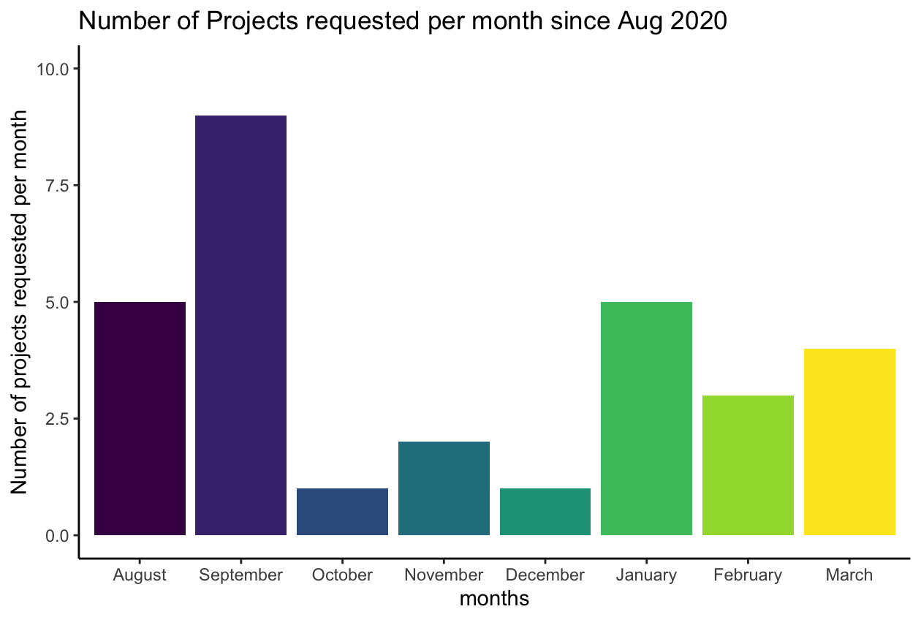
Time and Project Management
Many labs have requested Platform services more than others. If all labs get an equal share of Platform time, this equals ~180 hrs per lab per year
Sufficient weekly project requests are received such that working +55hrs a week is not enough to prevent growth of a substantial project backlog. This isn’t sustainable in the long term. Invoicing groups based on hours worked may be necessary…
Lambrechts project was a one-time training project, will try to spread time across other CCB groups
Splitting time equally among all open projects and labs means that project development is very slow
It is difficult to meet demand for rush projects requested on short notice (< 1 week) while there is backlog of projcts in addition to building and maintaining reliable infrastructure (e.g. new pipelines and services)
Action Item #2: Strive towards an equitable distribution of usage of CCB Bioinformatics Platform resources

Slide 4
Types of Platform Requests
“We have a grant deadline in less than a week, can you perform cell deconvolution on bulk RNAseq data on it?” We can usually squeeze in a rush project and deliver results if the project will take only a few hours but we typically can’t perform an analysis using a new technique/package that quickly
“Do you know of a good dataset for our research? (usually asked without sufficiently defining the research question)” We are happy to guide people to appropriate databases and help them access data to meet their research needs but in the interests of time spent, it’s best for biologists to bring data to the platform
“Can you look at the data from the Finnish paper?” When referring to datasets, please be exact and provide the GSE accession number, file name and/or path and also be specific about what your hypothesis is when analyzing the data. It may be necessary to implement a request form to reduce misunderstandings
“Can you move these files for me?” Nothing wrong with asking this now and again, but every lab should ideally have at least one individual familiar with the command line so that this can be done in-house
Action Item #3: A more formal system of CCB Bioinformatics Platform requests may be necessary. There is no real disincentive for CCB labs to outsource every computational task (no matter how trivial) to the CCB bioinformatics platform

Slide 5
Data Storage and Infrastructure
The CCB Bioinformatics Platform intends to develop and maintain pipelines and bioinformatic report templates that are made available for general use (i.e. bulk RNAseq, CRISPR-Cas9 screens, SNP calling, WES copy number, bulk cell deconvolution and gene co-expression, etc)
However, it is an open question where these pipelines and data should be stored (VSC or some other solution). Bioinformatic report templates are currently stored on GitHub (https://github.com/ccb-vib)
The VSC is used for larger tasks, but can sometimes be unreliable due to shortages in computational resources or encountering cryptic errors. CCB Platform has used DILA servers for some analyses but this is not a long term solution
The VSC is not ideal for setting up pipelines for general CCB use due to steep learning curve and need for interactive sessions
Additionally, some CCB groups have encountered storage issues, using L and K drives, especially labs working with image data
Action Item #4: A dedicated CCB Bioinformatics Platform node would be an ideal place for research data and communal bioinformatic infrastructure to be housed. A strategy needs to be discussed and outlined to address how this node will meet the needs of CCB groups

Slide 6
CCB Node Architecture Pros and Cons
Urbain Scherpereel and Rinaldo Beck have offered to help in developing a data storage and computational solution but require input from the CCB Group Leaders
R65 Linux Server
Microsoft Azure Cloud Solution
Similar to DILA Server #6
Price is ~65K euros
CCB must maintain server (no help from ICTS)
Limited cores available
Easy supports interactive sessions
More “local” control over resources
Ongoing cost is may be less than cloud solution
Scalable (hundreds of cores available per user)
Low latency 99.5% uptime
Azure maintains servers + backups, VIB headquarters will offer guidance
Must pay for all storage and computation (ongoing costs)
If you leave a process running = €€€!
Each lab uses and pays for containers
Action Item #5: Architecture of CCB Bioinformatics Platform node must be selected. There are trade-offs between purchasing a server vs a cloud solution

Slide 7
Closing Remarks
The CCB Bioinformatics Platform will implement the project management system OpenProject displaying forecasts of project hours, providing a transparent format to communicate a timeline outline when stakeholders can reasonably expect results
In the interest of fairness to the commitments to other labs, newly requested projects from a given lab will typically be addressed after current projects from that same lab have been completed. Please inform the platform of upcoming deadlines far in advance whenever possible
In order to make the best use of bioinformatic infrastructure made available by the CCB Platform, we strongly encourage lab members such as PhD students to enroll in bioinformatic courses and symposia to become familiar with R/Python, bash and Bioconductor to become more proficient at using bioinformatic tools
In the interest of time efficiency, it is preferred for data to be presented to the CCB platform rather than requesting the CCB platform to search for the desired data (i.e. please send url links, GSE accession numbers or directory paths to data whenever possible)
Lastly, if you use work from the CCB Bioinformatics Platform in a publication, please cite the author!

Slide 8
Summary of Action Items
Action Item #1: A data storage solution is needed to meet the needs of various labs and the CCB Bioinformatics Platform
Action Item #2: Strive towards an equitable distribution of usage of CCB Bioinformatics Platform resources
Action Item #3: A formal system of CCB Bioinformatics Platform requests may need to be implemented
Action Item #4: What are the requirements of a CCB Bioinformatics Platform node that would best meet the computational and storage needs of the various CCB groups?
Action Item #5: The architecture of CCB Bioinformatics Platform node must be selected (server vs cloud)

