Slide 1


Applying Language Models to Patient Health
Records: Acronym Expansion, Long Document
Classification and Explainable Predictions
Aditya M. Kashyap’s Dissertation Defense
Jan 20th, 2025
Advisers: Chris Callison-Burch, Mary Regina Boland
Committee: Lyle Ungar, Mark Liberman, Li Shen, Ying Ding (University of Texas at Austin)

Slide 2
Clinical NLP
History of Present Illness: 75 yo male, advanced gastric ca recently started on chemotherapy presenting and hypotensiona nd episode of unresponsivenes after diarrhea and narcotics + megace. Pt was seen on [**] by his oncologist where he was determine to be hypovolemic and received a total of 3 IVF between We and Fri but still c/o poor po intake secondary to abdominal pain and fullness, nausea, and decreased appetite. This morning upon awakening pt was lethargic. He took MSO4, Dilaudid and an unspecified dose of Megace. He then became flushed and pale, had copious diarrhea (non-bloody), then became unresponsive. EMS called and he was found withSBP 80. Narcan given with improvement in mental status but in [**] pt was persistently hypotensive requiring 6 IVF and Levophed. Labs notable for ANC 500 and lactate 17. Sep-sis protocol was initiated. Pt given Flagyl, Levofloxacin, and cefepime and sent to [**].

Slide 3
Clinical NLP
History of Present Illness: 75 yo male, advanced gastric ca recently started on chemotherapy presenting and hypotensiona nd episode of unresponsivenes after diarrhea and narcotics + megace. Pt was seen on [**] by his oncologist where he was determine to be hypovolemic and received a total of 3 IVF between We and Fri but still c/o poor po intake secondary to abdominal pain and fullness, nausea, and decreased appetite. This morning upon awakening pt was lethargic. He took MSO4, Dilaudid and an unspecified dose of Megace. He then became flushed and pale, had copious diarrhea (non-bloody), then became unresponsive. EMS called and he was found withSBP 80. Narcan given with improvement in mental status but in [**] pt was persistently hypotensive requiring 6 IVF and Levophed. Labs notable for ANC 500 and lactate 17. Sep-sis protocol was initiated. Pt given Flagyl, Levofloxacin, and cefepime and sent to [**].
Challenges:
Abundant use of acronyms and abbreviations.
Non-standard use of grammar, punctuation and spelling mistakes.
Patients have multiple clinical notes, each spanning between 200 and 20,000 tokens.

Slide 4
Clinical NLP
History of Present Illness: 75 yo male, advanced gastric ca recently started on chemotherapy presenting and hypotensiona nd episode of unresponsivenes after diarrhea and narcotics + megace. Pt was seen on [**] by his oncologist where he was determine to be hypovolemic and received a total of 3 IVF between We and Fri but still c/o poor po intake secondary to abdominal pain and fullness, nausea, and decreased appetite. This morning upon awakening pt was lethargic. He took MSO4, Dilaudid and an unspecified dose of Megace. He then became flushed and pale, had copious diarrhea (non-bloody), then became unresponsive. EMS called and he was found withSBP 80. Narcan given with improvement in mental status but in [**] pt was persistently hypotensive requiring 6 IVF and Levophed. Labs notable for ANC 500 and lactate 17. Sep-sis protocol was initiated. Pt given Flagyl, Levofloxacin, and cefepime and sent to [**].
Challenges:
Abundant use of acronyms and abbreviations.
Non-standard use of grammar, punctuation and spelling mistakes.
Patients have multiple clinical notes, each spanning between 200 and 20,000 tokens.

Slide 5
Clinical NLP
History of Present Illness: 75 yo male, advanced gastric ca recently started on chemotherapy presenting and hypotensiona nd episode of unresponsivenes after diarrhea and narcotics + megace. Pt was seen on [**] by his oncologist where he was determine to be hypovolemic and received a total of 3 IVF between We and Fri but still c/o poor po intake secondary to abdominal pain and fullness, nausea, and decreased appetite. This morning upon awakening pt was lethargic. He took MSO4, Dilaudid and an unspecified dose of Megace. He then became flushed and pale, had copious diarrhea (non-bloody), then became unresponsive. EMS called and he was found withSBP 80. Narcan given with improvement in mental status but in [**] pt was persistently hypotensive requiring 6 IVF and Levophed. Labs notable for ANC 500 and lactate 17. Sep-sis protocol was initiated. Pt given Flagyl, Levofloxacin, and cefepime and sent to [**].
Challenges:
Abundant use of acronyms and abbreviations.
Non-standard use of grammar, punctuation and spelling mistakes.
Patients have multiple clinical notes, each spanning between 200 and 20,000 tokens.
This note excerpt contains 282 tokens, but other notes have up to 20,000 tokens!

Slide 6
Clinical NLP
History of Present Illness: 75 yo male, advanced gastric ca recently started on chemotherapy presenting and hypotensiona nd episode of unresponsivenes after diarrhea and narcotics + megace. Pt was seen on [**] by his oncologist where he was determine to be hypovolemic and received a total of 3 IVF between We and Fri but still c/o poor po intake secondary to abdominal pain and fullness, nausea, and decreased appetite. This morning upon awakening pt was lethargic. He took MSO4, Dilaudid and an unspecified dose of Megace. He then became flushed and pale, had copious diarrhea (non-bloody), then became unresponsive. EMS called and he was found withSBP 80. Narcan given with improvement in mental status but in [**] pt was persistently hypotensive requiring 6 IVF and Levophed. Labs notable for ANC 500 and lactate 17. Sep-sis protocol was initiated. Pt given Flagyl, Levofloxacin, and cefepime and sent to [**].
Challenges:
Abundant use of acronyms and abbreviations.
Non-standard use of grammar, punctuation and spelling mistakes.
Patients have multiple clinical notes, each spanning between 200 and 20,000 tokens.
Wealth of Information can be used for research and education!

Slide 7
Challenges Addressed in this Dissertation
Acronym Disambiguation: [Kashyap et al., 2020]*
(a) Long Document Classification: [Kashyap et al., 2023]#
(b) Structured and Unstructured Patient Electronic Health Record (EHR) Data classification: [Kashyap et al., 2023]#
3. Explainable Inference: Submitted to Bioinformatics (November 2024)
* Kashyap, Aditya, et al. “The CLASSE GATOR (Clinical Acronym SenSE disambiGuATOR): a method for predicting acronym sense from neonatal clinical notes.” International journal of medical informatics 137 (2020): 104101
# [Kashyap et al., 2023] Kashyap, Aditya, Chris Callison-Burch, and Mary Regina Boland. “A deep learning method to detect opioid prescription and opioid use disorder from electronic health records.” International Journal of Medical Informatics
171 (2023): 104979

Slide 8
Challenges Addressed in this Dissertation
Acronym Disambiguation: [Kashyap et al., 2020]*
(a) Long Document Classification: [Kashyap et al., 2023]#
(b) Structured and Unstructured Patient Electronic Health Record (EHR) Data classification: [Kashyap et al., 2023]#
3. Explainable Inference: Submitted to Bioinformatics (November 2024)
* Kashyap, Aditya, et al. “The CLASSE GATOR (Clinical Acronym SenSE disambiGuATOR): a method for predicting acronym sense from neonatal clinical notes.” International journal of medical informatics 137 (2020): 104101
# [Kashyap et al., 2023] Kashyap, Aditya, Chris Callison-Burch, and Mary Regina Boland. “A deep learning method to detect opioid prescription and opioid use disorder from electronic health records.” International Journal of Medical Informatics
171 (2023): 104979

Slide 9
Acronym Disambiguation in Clinical Notes
Kashyap, Aditya, et al. “The CLASSE GATOR (Clinical Acronym SenSE disambiGuATOR): a method for predicting acronym sense from neonatal clinical notes.” International journal of medical informatics 137 (2020): 104101

Slide 10
Motivation
Year old
cancer
History of Present Illness: 75 yo male, advanced gastric ca recently started on chemotherapy presenting and hypotensiona nd episode of unresponsivenes after diarrhea and narcotics + megace. Pt was seen on [**] by his oncologist where he was determine to be hypovolemic and received a total of 3 IVF between We and Fri but still c/o poor po intake secondary to abdominal pain and fullness, nausea, and decreased appetite. This morning upon awakening pt was lethargic. He took MSO4, Dilaudid and an unspecified dose of Megace. He then became flushed and pale, had copious diarrhea (non-bloody), then became unresponsive. EMS called and he was found withSBP 80. Narcan given with improvement in mental status but in [**] pt was persistently hypotensive requiring 6 IVF and Levophed. Labs notable for ANC 500 and lactate 17. Sep-sis protocol was initiated. Pt given Flagyl, Levofloxacin, and cefepime and sent to [**].
Patient
Intravenous Fluids
Wednesday
Friday
Complains of
Per os or by mouth
Patient
Morphine
Emergency Medical Service
Systolic Blood Pressure
Patient
Intravenous Fluids
Absolute Neutrophil Count
Patient
21st Century Cures Act
Help patients better understand their medical conditions, treatment plans
Better equipped to participate in shared-decision making
Increased engagement and trust

Slide 11
What makes this problem hard?
Several Candidate Senses
Variability
hodgkin disease
hypoxic desensitization
Coronary Artery Bypass Graft
heavy drinkers
homeodomain
histologic discrepancy
CABG
Cardiology
Computer-Assisted Brain Guidance
hyperactive disorder
haemodialysis
hypertensive disorders
Computer Assisted Surgery
heart disease
head diameter
hyperkinetic disorder
HD
hyperactivity disorder
high definition
heat denatured
Complexity and Volume
healthy donor
hydatid disease
high density
human development
heavy episodic drinkers
high dose
huntington disease
Patient has Hx of MI, HTN, and DM
Patient has a history of Myocardial Infarction, Hypertension and Diabetes Mellitus

Slide 12
Limitations of Past Work
Using Rule Based Approaches:
  Doesn’t transfer well between domains
Reliance on Manually Annotated Data:
  Expensive: Medical experts required for annotation
    One study spent over $100,000 on annotation*
Additional Challenges:
  No complete list of clinical abbreviations and their expansions exist
    invented in an ad hoc manner by health care providers
    Existing KBs have low coverage
  Lack of task related public clinical datasets
*D. Albright, A. Lanfranchi, A.Fredriksen, et al., 2013: “Towards comprehensive syntactic and semantic annotations of the clinical narrative”. Journal of the American Medical Informatics Association : JAMIA, 20(5), 922–930.

Slide 13
Approach
Data Creation Stage:
  Extract acronyms and candidate expansions from over 1M PubMed Research Papers using regular expressions.
  Clean extracted acronym-expansion pairs using a rule-set.
    1,257 acronyms and 8,287 expansions.
    Average number of expansions per acronym is 6.6 (min=2, max=50)
  Extract context information for each acronym-expansion pair using a window.
Model Development Stage:
  Train Logistic Regression and BioBERT
    Input: acronym + surrounding context
    Output: expansion
  Evaluate on a manually annotated test set of clinical notes
Note: For this task, we focus on the medical domain: Prenatal Exposure

Slide 14

Approach
Data Creation Stage:
  Extract acronyms and candidate expansions from over 1M PubMed Research Papers using regular expressions.
  Clean extracted acronym-expansion pairs using a rule-set.
    1,257 acronyms and 8,287 expansions.
    Average number of expansions per acronym is 6.6 (min=2, max=50)
  Extract context information for each acronym-expansion pair using a window.
Model Development Stage:
  Train Logistic Regression and BioBERT
    Input: acronym + surrounding context
    Output: expansion
  Evaluate on a manually annotated test set of clinical notes
Acronym | Expansion
HS | High School
HS | Hepatic Stenosis
HS | Horse Serum
HS | High Salt
Note: For this task, we focus on the medical domain: Prenatal Exposure

Slide 15
Approach
Data Creation Stage:
  Extract acronyms and candidate expansions from over 1M PubMed Research Papers using regular expressions.
  Clean extracted acronym-expansion pairs using a rule-set.
    1,257 acronyms and 8,287 expansions.
    Average number of expansions per acronym is 6.6 (min=2, max=50)
  Extract context information for each acronym-expansion pair using a window.
Model Development Stage:
  Train Logistic Regression and BioBERT
    Input: acronym + surrounding context
    Output: expansion
  Evaluate on a manually annotated test set of clinical notes
Note: For this task, we focus on the medical domain: Prenatal Exposure

Slide 16
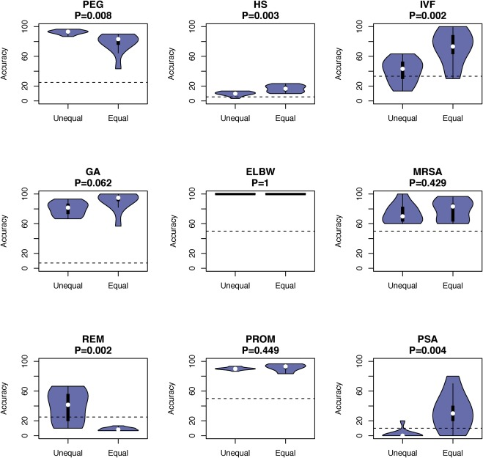
Evaluation on Mimic-III Clinical Notes
Equal vs Unequal class distribution for 9 acronyms on the Mimic-III dataset.
Overall accuracy: 63.04% (dotted line is random acc)
Overall random baseline accuracy: 17.6%
Reasons for some acronyms performing poorly:
Some expansions missing from our PubMed dataset (HS: Heart sounds)
Several misspellings (‘his’, ‘has’ → hs)
Domain mismatch between Research text and Clinical Text
Number of Expansions per acronym:
PEG: 7
HS: 29
IVF: 7
GA: 20
ELBW: 4
MRSA: 2
REM: 5
PROM: 5
PSA: 15

Slide 17
Contributions and Conclusion
Created a dataset of 1,257 acronyms and 8,287 expansions with context information
  Used scientific research papers from PubMed → Previous approaches focused on Wikipedia, Medical webpages (MedlinePlus), and manually annotated clinical notes
Used BioBERT
  Past work used ngram features, word embeddings (word2vec) with CNNs, manually created features, Topic Modelling.
42.19 % acronyms in our dataset do not occur in UMLS and Medline¹.
Cost Effective: Distantly supervised approach removes the need for manually annotated training data.
  Researchers² have spent $100,000 to annotate 13,091 sentences → $7.64 per sentence.
  Moon et al., 2012³ suggested 500 training annotations required per acronym.
  Approximate cost to annotate 8,287 acronyms is ~$32 Million.
1. Wu, Stephen, and Hongfang Liu. "Semantic characteristics of NLP-extracted concepts in clinical notes vs. biomedical literature." AMIA Annual Symposium Proceedings. Vol. 2011. American Medical Informatics Association, 2011.
2. D. Albright, A. Lanfranchi, A.Fredriksen, et al., 2013: “Towards comprehensive syntactic and semantic annotations of the clinical narrative”. Journal of the American Medical Informatics Association : JAMIA, 20(5), 922–930.
3. Moon S, Pakhomov S, Melton GB, 2012 “Automated disambiguation of acronyms and abbreviations in clinical texts: window and training size considerations”. Journal of the American Medical Informatics Association : JAMIA, 20(5), 922–930.

Slide 18
Structured and Unstructured Long Document EHR classification
[Kashyap et al., 2023] Kashyap, Aditya, Chris Callison-Burch, and Mary Regina Boland. “A deep learning method to detect opioid prescription and opioid use disorder from electronic health records.” International Journal of Medical Informatics
171 (2023): 104979

Slide 19
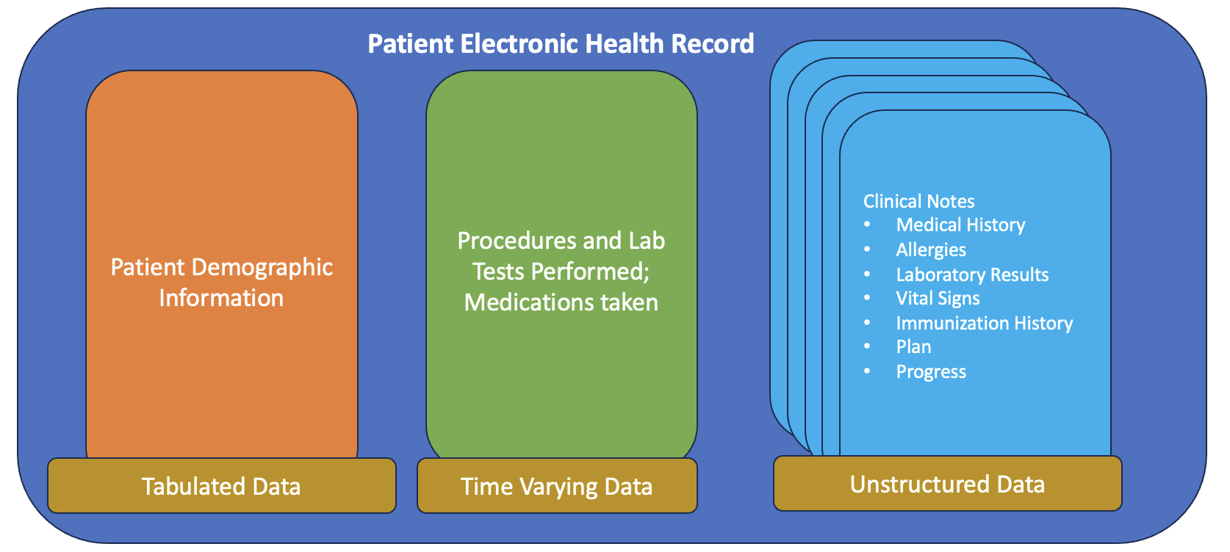
Structured and Unstructured Long Document EHR classification
In this section of my dissertation, I build a deep learning model that attempts to solve the following challenges:
Handle structured and unstructured data
Handle multiple clinical notes, each containing between 200 and 20000 tokens
Note: Patient EHRs also contain images like CT scans, MRI scans, etc. (not shown in the figure)

Slide 20
Past Research on Long Document Classification
Bag of Words, TFIDF
  Disregards word order and context → doesn’t capture meaning over long documents
RNNs and LSTMs
  Suffer from vanishing gradient problem
  Difficulty capturing long-term dependencies
CNNs applied over word embeddings
  Not as effective at capturing long-term dependencies as attention models
Transformer Models like BERT
  Can capture long-term dependencies
  limited by a maximum input size of 512 tokens
Hierarchical Attention Models
  Can handle long documents (> 512 tokens) by analyzing segments and aggregating information across different levels

Slide 21
Past Research on Long Document Classification
Bag of Words, TFIDF
  Disregards word order and context → doesn’t capture meaning over long documents
RNNs and LSTMs
  Suffer from vanishing gradient problem
  Difficulty capturing long-term dependencies
CNNs applied over word embeddings
  Not as effective at capturing long-term dependencies as attention models
Transformer Models like BERT
  Can capture long-term dependencies
  limited by a maximum input size of 512 tokens
Hierarchical Attention Models
  Can handle long documents (> 512 tokens) by analyzing segments and aggregating information across different levels
Inspired by these 2 approaches, we develop a deep learning model that can handle multiple long clinical notes per patient

Slide 22
Task Formulation and Dataset
We formulate 2 binary classification problems given patient EHR data:
  Will the patient be prescribed an Opioid Medication?
  Does the patient have Opioid Use Disorder (OUD)?
Dataset used:
  Mimic III : De-identified health data associated with ~60,000 CCU admissions
Positive Examples
Patient EHRs containing Opioids
Mimic-III
Patient EHRs containing OUD ICD-9 Codes
Positive Examples
Task 1
Opioid Medication Prescription Prediction
Task 2
Opioid Use Disorder Prediction
Negative Examples
Remaining Set of Patients
Remaining Set of Patients
Negative Examples
  Further Preprocessing:
    Remove opioid medication mentions, or ICD-9 diagnoses codes used to automatically label data.
    Remove or combine sparse demographic features to prevent overfitting.

Slide 23
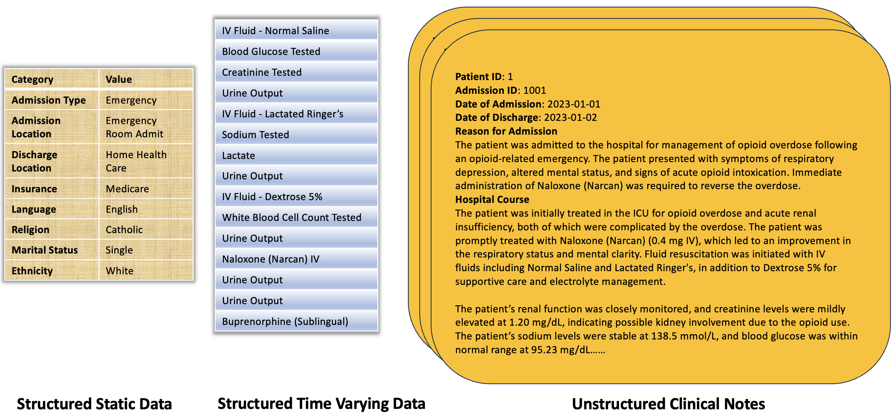
Model Development: Example
*This is a synthetic example created for illustrative purposes

Slide 24
Model Development: Example
Structured Static Embedding Module
Feed Forward Layer
Structured Time Varying Embedding Module
Event Embedding Matrix
Positional Embedding Matrix
Transformer Layer
Unstructured Embedding Module
Hierarchical Attention Model
Clinical BERT
Splice Positional Embedding Matrix
Note Level Transformer Layer
Note Positional Embedding
Patient Level Transformer
Feed Forward Layer
*This is a synthetic example created for illustrative purposes

Slide 25

Results
Opioid Prescription Prediction
Approach | Test Accuracy | AUC ROC
Random Baseline | 0.5 | 0.5
LogReg ngram baseline | 0.88 | 0.92
Our Approach | 0.89 ± 0.003 | 0.93 ± 0.002
ROC: Plot between True Positive Rate and False Positive Rate
AUC ROC: “Area Under the Curve” of the “Receiving Operating Curve”
High score suggests model can different well between different classes across different classification thresholds
Opioid Use Disorder Prediction
Approach | Test Accuracy | AUC ROC
Random Baseline | 0.5 | 0.5
LogReg ngram baseline | 0.82 | 0.84
Our Approach | 0.83 ± 0.035 | 0.94 ± 0.008

Slide 26
Predictive Features for OUD
Used a Global Surrogate LogReg Model to explore most predictive features for OUD
Structured Static Data | Structured Time Varying Data | Clinical Notes
Age_25-35 | Cryoprecipitate | methadone
Age_18-25 | Naloxone | abuse
Age_35-50 | Acetaminophen-IV | pain
ADMISSION_TYPE_EMERGENCY | Epinephrine | artifact
INSURANCE_Medicaid | Narcan | heroin
GENDER_M | Invasive Ventilation | rhythm normal
ADMISSION_TYPE_URGENT | Sandostatin | overdose
According to the literature, age and gender are the most consistent demographic variables in predicting opioid abuse
Similarly, Naloxone, Acetaminophen, Epinephrine, Methadone and Heroin are highly predictive of opioid use disorder
Patients who have a history of substance abuse or who deal with chronic pain have a higher likelihood to develop OUD

Slide 27
Conclusion
Contributions of our approach:
  A Deep Learning model that analyzes EHR data containing structured and unstructured data
  A Hierarchical Transformer Model + ClinicalBERT that can analyze multiple long clinical notes.
    Previous approaches in clinical literature: ngram models, word embedding models (GloVe, word2vec) with LSTMs, CNNs
Limitations:
  Black box model → Global surrogate models may not reflect the true decision-making process

Slide 28
Explainable Predictions using Concept Bottlenecks
Submitted to Bioinformatics (November 15th, 2024)

Slide 29
Explainable Predictions using Concept Bottlenecks
Why is explainability important for clinical NLP and AI?
  Promotes trust and adoption by healthcare professionals
  Improve patient safety and mitigates risk
Potential model improvements:
  Reduce spurious feature correlations with the predicted output
  Can help push model towards correct chain of reasoning
  Reduce gender/racial bias (Not addressed in this thesis but still important)

Slide 30
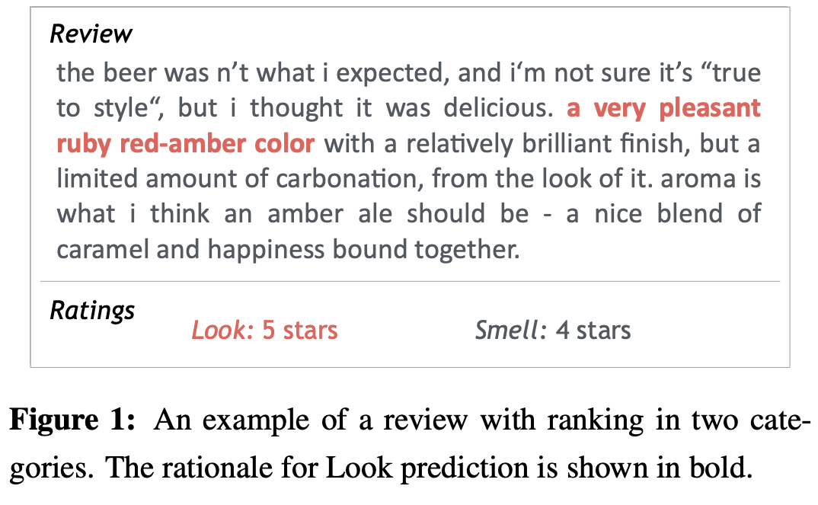
Previous Approaches for Explainable Predictions
Feature Based Approaches: Interpreting outputs based on related input features
  Rationale Extraction: short phrases from the input text (Lei et al., 2018)
  Input Perturbation: Performance change based on swapping/deleting input tokens (Ribeiro et al., 2020; Goodfellow et al., 2014)
  Attention Weights (Luong et al., 2015)
Natural Language Explanation: Models generate explanations for a given prediction
Probing Hidden States: Model’s internal states are examined for certain inputs
  Embedding Probes: What information can be found from distributional word embeddings?
  Model Probes: For example, lower layers of language models contain syntactic information while higher layers contain complex semantic information
*Image credit: Lei, Tao, Regina Barzilay, and Tommi Jaakkola. "Rationalizing neural predictions.”, EMNLP (2016)

Slide 31
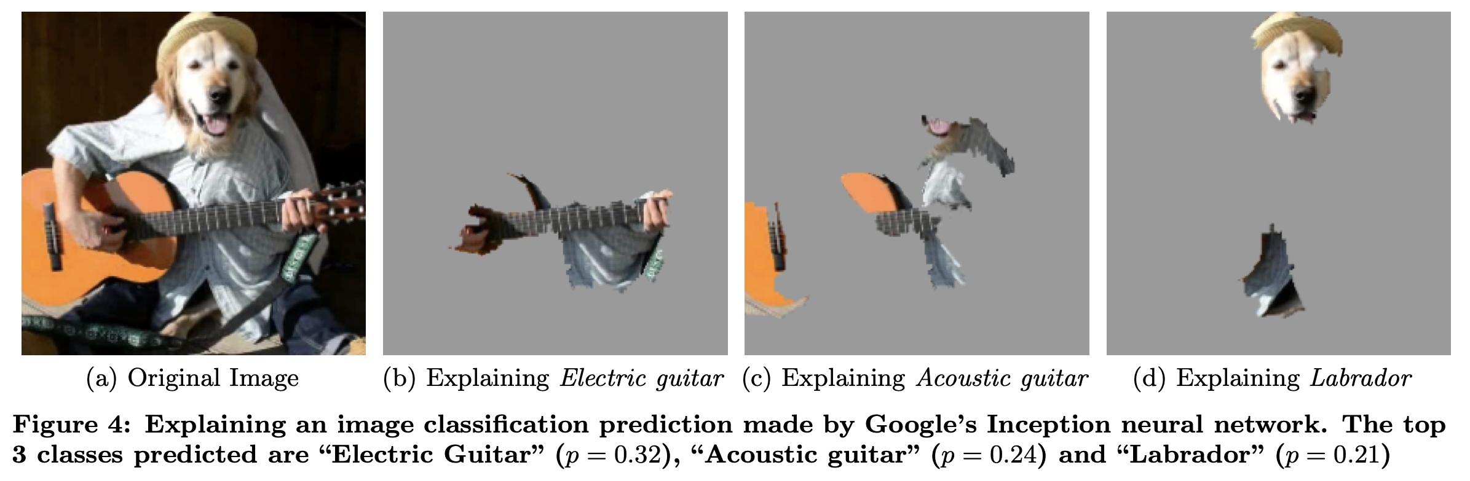
Previous Approaches for Explainable Predictions
Feature Based Approaches: Interpreting outputs based on related input features
  Rationale Extraction: short phrases from the input text (Lei et al., 2018)
  Input Perturbation: Understand predictions based on modifying parts of the input (Ribeiro et al., 2020)
  Attention Weights (Luong et al., 2015)
Natural Language Explanation: Models generate explanations for a given prediction
Probing Hidden States: Model’s internal states are examined for certain inputs
  Embedding Probes: What information can be found from distributional word embeddings?
  Model Probes: For example, lower layers of language models contain syntactic information while higher layers contain complex semantic information
*Image credit: Ribeiro, Marco Tulio, Sameer Singh, and Carlos Guestrin. "" Why should i trust you?" Explaining the predictions of any classifier." Proceedings of the 22nd ACM SIGKDD international conference on knowledge discovery and data mining. 2016.

Slide 32
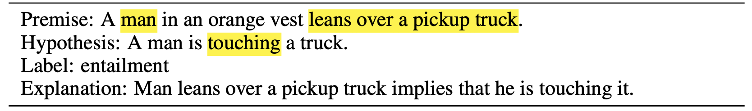
Previous Approaches for Explainable Predictions
Natural Language Explanation: Models generate explanations for a given prediction (Camburu et al., 2018)
*Image credit: Camburu, Oana-Maria, et al. "e-snli: Natural language inference with natural language explanations." Advances in Neural Information Processing Systems 31 (2018).

Slide 33
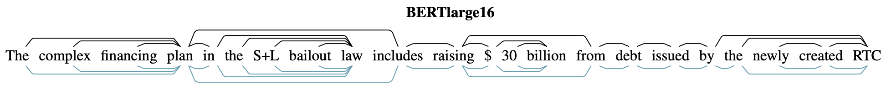
Previous Approaches for Explainable Predictions
Natural Language Explanation: Models generate explanations for a given prediction (Camburu et al., 2018)
Probing Hidden States: Small classifiers trained on hidden representations for a certain linguistic task (Hewitt and Manning, 2019)
*Image credit: Hewitt, John, and Christopher D. Manning. "A structural probe for finding syntax in word representations." Proceedings of the 2019 Conference of the North American Chapter of the Association for Computational Linguistics: Human Language Technologies, Volume 1 (Long and Short Papers). 2019.

Slide 34
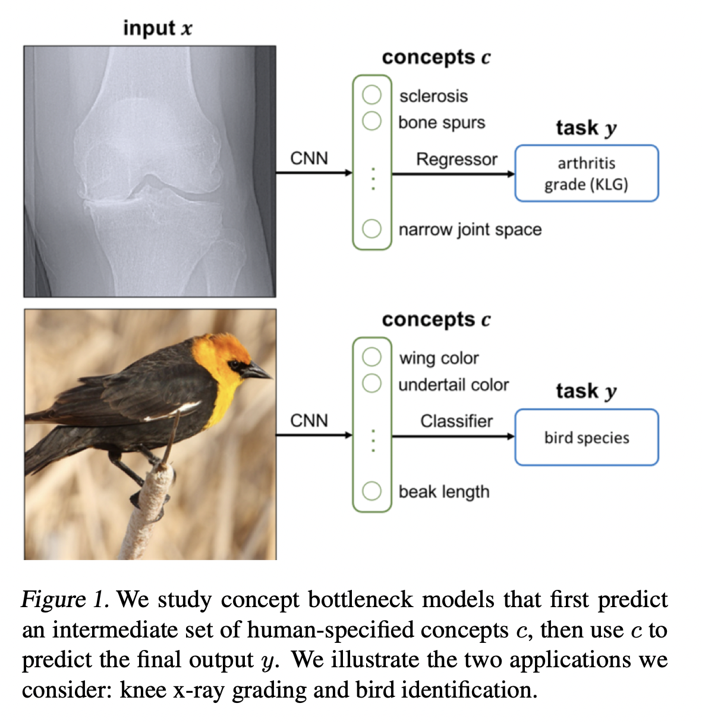
Explainable Predictions using Concept Bottlenecks
Yang et al., 2023 → Language Guided Bottlenecks (LABO)
  GPT-3 → find bottleneck concepts
  CLIP → Aligned concepts to images
  Linear model → Image classification
In this section of my dissertation, I will focus on using Concept Bottleneck models to build robust, explainable clinical diagnosis models.
*Image credit: Koh, Pang Wei, et al. "Concept bottleneck models." International conference on machine learning. PMLR, 2020.

Slide 35
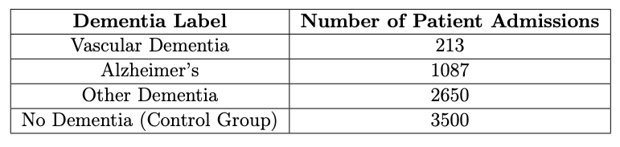
Dementia Dataset
Multi-Classification Task: Dementia diagnosis based on patient notes in their EHRs
For each patient admission, we only select the discharge summary note.
Additionally, we remove phrases such as “dementia”, “alzheimer’s”, “vascular dementia” and other variants from the notes to prevent information leakage.

Slide 36
How does GPT-4 Perform on Patient Dementia Diagnosis?
GPT-4 Prompt
For the given patient clinical note, choose one of the following diagnosis labels:
no dementia
dementia
alzheimer's dementia
vascular dementia
You should only reply with the diagnosis label and nothing else.
Approach | Dementia Accuracy | Dementia F1
Random Baseline | 0.29 | 0.34
Majority Baseline | 0.48 | 0.34
GPT-4 | 0.48 | 0.40

Slide 37
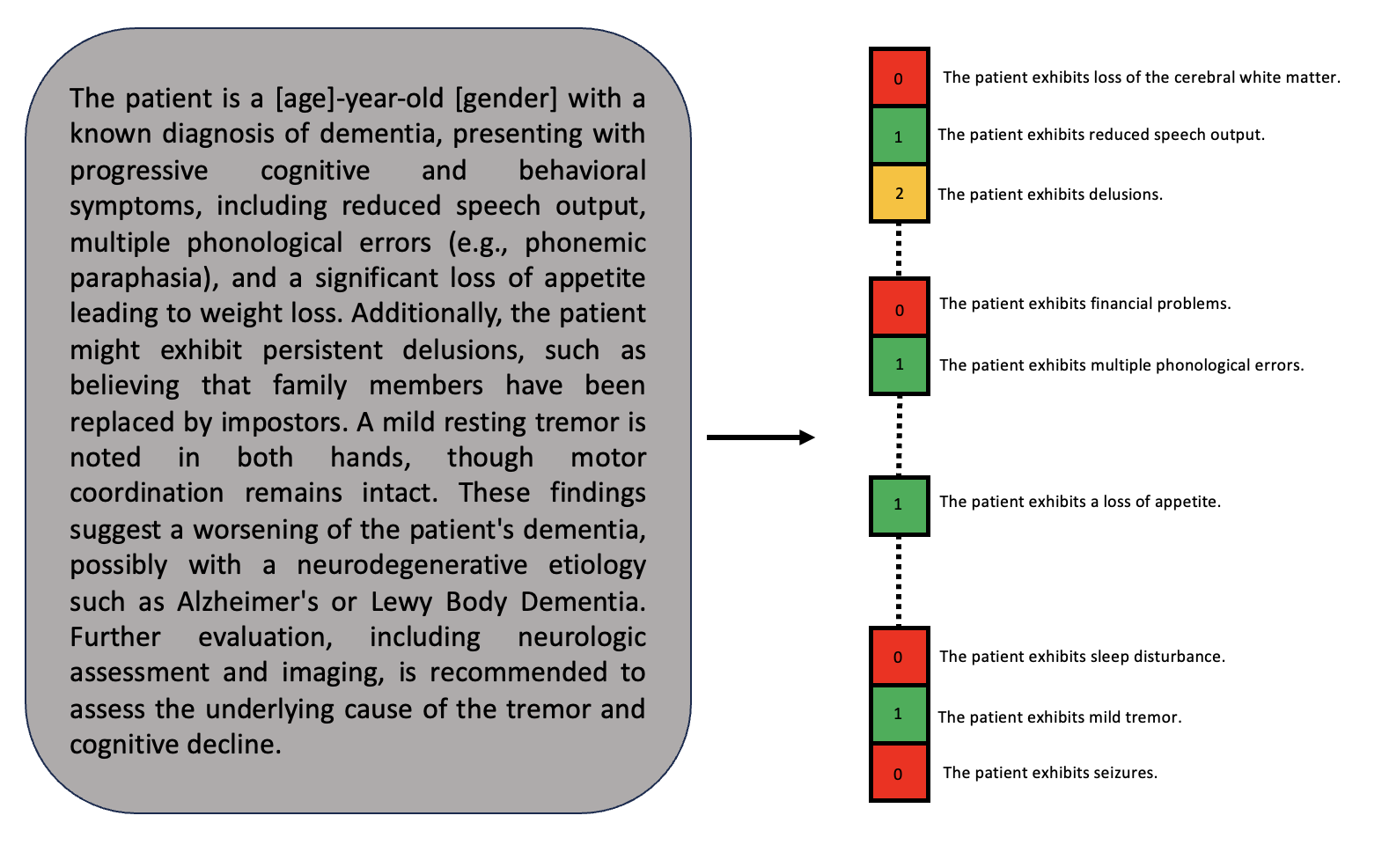
Example of a Concept Vector from a Patient Note
LEGEND
0
Feature is absent
1
Feature is present
2
Presence of feature is uncertain

Slide 38
Example of a Concept Vector from a Patient Note
LEGEND
0
Feature is absent
1
Feature is present
2
Presence of feature is uncertain
How do we obtain this set of concept features?

Slide 39
Obtaining Concepts related to Dementia
We use the Oxford Textbook of Medicine – 4th Edition and GPT-4
  The chapter on Dementia is first identified
  GPT-4 is instructed to extract clinical features of dementia
    Alzheimer’s Dementia
    Vascular Dementia
    Lewy Body Dementia
    Frontotemporal Dementia
    Alcohol related Dementia
    Pseudodementia
    Subcortical Dementia
GPT-4 Prompt:
Rewrite the following description about {condition} as multiple bullet points in the format “The patient exhibits _____”. Be as exhaustive as you can.
{textbook description of clinical features}

Slide 40
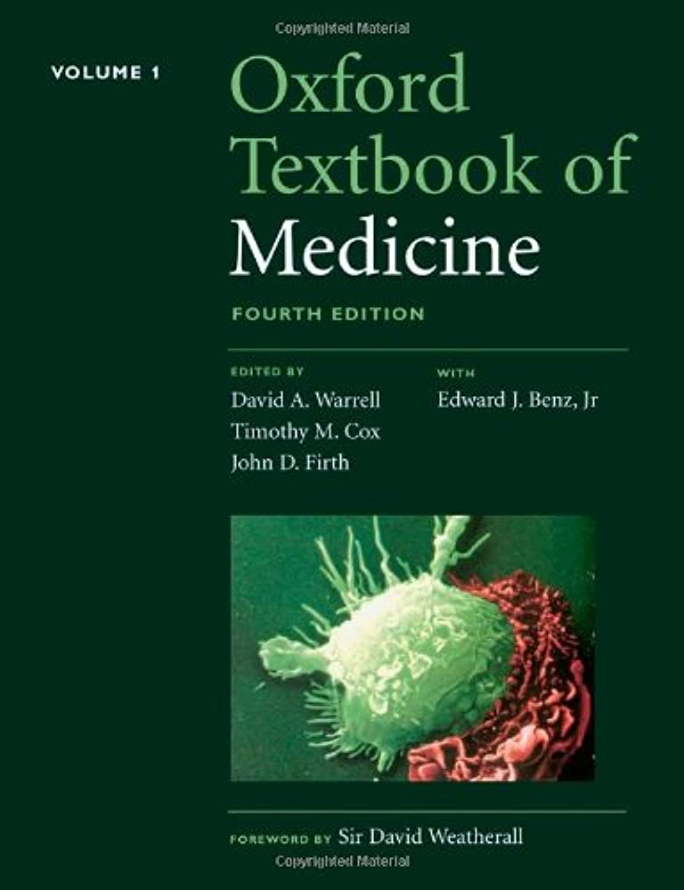

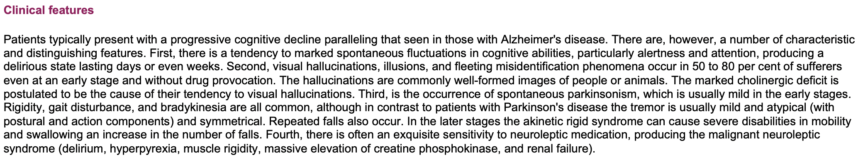
Obtaining Concepts related to Dementia
The patient exhibits marked spontaneous fluctuations in cognitive abilities, particularly alertness and attention, producing a delirious state lasting days or even weeks.
The patient exhibits visual hallucinations, illusions, and fleeting misidentification phenomena.
The patient exhibits spontaneous parkinsonism, with rigidity, gait disturbance, and bradykinesia.
The patient exhibits exquisite sensitivity to neuroleptic medication, producing the malignant neuroleptic syndrome.
*Oxford Textbook of Medicine – Fourth Edition
GPT-4 Output

Slide 41
Obtaining Concepts related to Dementia
Each sentence extracted by GPT-4 contains multiple clinical features
Break them into separate atomic clinical features
The patient exhibits marked spontaneous fluctuations in cognitive abilities, particularly alertness and attention, producing a delirious state lasting days or even weeks.
The patient exhibits visual hallucinations, illusions, and fleeting misidentification phenomena.
The patient exhibits spontaneous parkinsonism, with rigidity, gait disturbance, and bradykinesia.
The patient exhibits exquisite sensitivity to neuroleptic medication, producing the malignant neuroleptic syndrome.
*Oxford Textbook of Medicine – Fourth Edition
GPT-4 Output

Slide 42
Breaking Complex Concepts Into Atomic Concepts
The patient exhibits agitation
The patient exhibits restlessness
The patient exhibits agitation, restlessness, wandering, and disinhibition.
The patient exhibits wandering
The patient exhibits disinhibition
This is achieved using GPT-4 with 2-shot prompting.

Slide 43
Clinical Features Extracted
After manual annotation for quality control, we end up with 254 clinical features.
Each cell in the table contains a phrase that completes the sentence “The patient exhibits ___.”
Example Features Extracted from the Oxford Textbook of Medicine
diminished vibration sense | impaired judgement
difficulty answering questions | neuropsychiatric symptoms
repetitive questioning | gait apraxia
large infarcts | giving bizarrely wrong answers to questions
obsessive–compulsive behavior | ventricular enlargement
optic atrophy | inconsistency in test performance
dependence | sleep disturbance
indifference to domestic responsibilities | spontaneous parkinsonism
increased reflexes | impairment in job performance
greatly increased rigidity | impaired attention

Slide 44
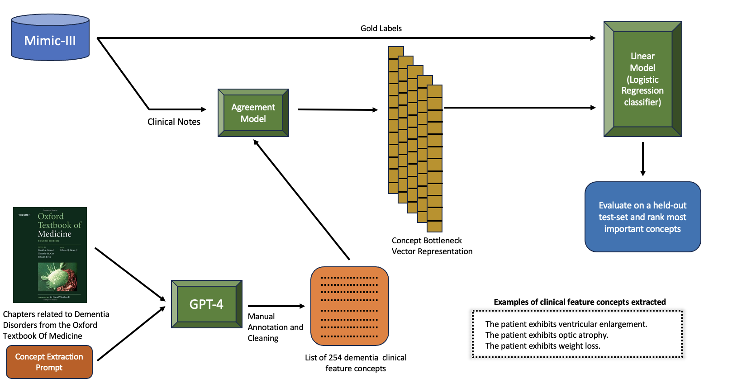
Pipeline Overview

Slide 45
Pipeline Overview

Slide 46
Pipeline Overview

Slide 47
Pipeline Overview

Slide 48
Agreement Model
Agreement model predicts concept presence in a clinical note.
  Input: (Clinical Note, Concept Feature)
  Output: Either “Yes”, “No” or “Uncertain”
How do we evaluate the Agreement Model?
  Manually annotate a subset of 200 (clinical note, concept feature) pairs.
    10 random concept features with 20 clinical notes each.

Slide 49
Agreement Model: Example Input and Output
CLINICAL NOTE
CONCEPT FEATURE
Admission Date: [**2158-1-29**] Discharge Date: [**2158-2-3**] Date of Birth: [**2083-9-9**] Sex: M
Service: MEDICINE Allergies: Patient recorded as having No Known Allergies to Drugs
Attending:[**First Name3 (LF) 1055**]
Chief Complaint: cough and congestion
History of Present Illness: 73 year-old man with history of stomach/bladder cancer s/p recent chemo at [**Hospital1 1474**] VA, DM, CAD presentes wit 2-3 days of productive cough with green sputum and sob with exertion, fatigue and lethargy. Per girlfriend, patient had decreased PO intake and mild confusion during that time. Patient with witnessed fall day prior to admission without head trauma. Patient denied dysuria, fevers, frequency. In ER patient noted to have bilateral pneumonia, UTI, hyperglycemia. Patient was started on insulin drip, IVF levaquin and transferred to the ICU for management of hyperosmolar ketoacidosis. No recent med changes.
Past Medical History: bladder ca stomach ca DM2 on insulin CAD s/p MI recent admit for chemo tx 6 weeks ago impotence MRSA HTN anemia lacunar CVA CRF glaucoma cognitive decline urinary incontinence, chronic
Social History: history of alcohol abuse in past no drugs, no smoking
Physical Exam:
VS: temp: 102.4 bp: 170/91 HR: 93 RR: 20 99% rm air, general: somnolent but AAOx3, HEENT: MMM, no JVD, no Virchow's node, no nuchal rigidity, neuro: CNII-XII intact, [**6-1**] stregnth in upper extremities, DTR’s intact
Pertinent Results: Admit labs: [**2158-1-29**] 12:12AM WBC-9.5 RBC-2.85* HGB-8.5* HCT-27.3* MCV-96
…………
Followup Instructions:
Please follow-up with your primary care physician [**Last Name (NamePattern4) **] [**1-29**] weeks.
Does the patient exhibit confusion?
OUTPUT
Yes
Uncertain
No

Slide 50
Agreement Model: Example Input and Output
CLINICAL NOTE
CONCEPT FEATURE
Admission Date: [**2158-1-29**] Discharge Date: [**2158-2-3**] Date of Birth: [**2083-9-9**] Sex: M
Service: MEDICINE Allergies: Patient recorded as having No Known Allergies to Drugs
Attending:[**First Name3 (LF) 1055**]
Chief Complaint: cough and congestion
History of Present Illness: 73 year-old man with history of stomach/bladder cancer s/p recent chemo at [**Hospital1 1474**] VA, DM, CAD presentes wit 2-3 days of productive cough with green sputum and sob with exertion, fatigue and lethargy. Per girlfriend, patient had decreased PO intake and mild confusion during that time. Patient with witnessed fall day prior to admission without head trauma. Patient denied dysuria, fevers, frequency. In ER patient noted to have bilateral pneumonia, UTI, hyperglycemia. Patient was started on insulin drip, IVF levaquin and transferred to the ICU for management of hyperosmolar ketoacidosis. No recent med changes.
Past Medical History: bladder ca stomach ca DM2 on insulin CAD s/p MI recent admit for chemo tx 6 weeks ago impotence MRSA HTN anemia lacunar CVA CRF glaucoma cognitive decline urinary incontinence, chronic
Social History: history of alcohol abuse in past no drugs, no smoking
Physical Exam:
VS: temp: 102.4 bp: 170/91 HR: 93 RR: 20 99% rm air, general: somnolent but AAOx3, HEENT: MMM, no JVD, no Virchow's node, no nuchal rigidity, neuro: CNII-XII intact, [**6-1**] stregnth in upper extremities, DTR’s intact
Pertinent Results: Admit labs: [**2158-1-29**] 12:12AM WBC-9.5 RBC-2.85* HGB-8.5* HCT-27.3* MCV-96
…………
Followup Instructions:
Please follow-up with your primary care physician [**Last Name (NamePattern4) **] [**1-29**] weeks.
Does the patient exhibit confusion?
OUTPUT
Yes

Slide 51
Agreement Model Approaches
Three different agreement model approaches:
  GPT-4 (Closed Source)
  Llama 2 (Open Source)
  GPT-4 with Text Embeddings (Closed Source)

Slide 52
Input for GPT-4 as Agreement Model
System Prompt
You are a clinical research assistant. For the given clinical note, answer the question ("Concept Question") provided in the dictionary. Use "Definition", "Possible Responses", "Response Guide" and "Additional Response" to help better answer the question. Your response should be of the following format:
{"Response": Either 'Yes', 'No' or 'Uncertain',
"Supporting Information": If "Response" is either "Yes" or "Uncertain", provide supporting sentences from the clinical note. If "Response" is 'No', this should be "None"}
Chat History
User Message
Clinical Note
Feature Name: <>
Concept Question: <>
Definition: <>
Possible Responses: <>
Response Guide: <>

Slide 53
Input for GPT-4 as Agreement Model
"Feature Name": "Binswanger's disease",
"Concept Question": "Can the following sentence be inferred from the clinical note?: 'The patient exhibits Binswanger's disease.’”,
"Definition": "Binswanger's disease, also known as subcortical vascular dementia, in a clinical setting refers to a form of dementia caused by damage to the white matter of the brain resulting from chronic, small blood vessel disease. The damage leads to progressive memory loss, decline in cognitive skills, and changes in mood or behavior. It is often associated with hypertension, diabetes, and other risk factors for vascular disease. Symptoms can also include slow, unsteady gait, urinary symptoms, and mood changes. Although the disease is progressive, managing the underlying vascular conditions can help slow its progress.",
"Possible Responses": "Yes, No, Uncertain",
"Response Guide": "Yes: The clinical note explicitly mentions that the patient has the clinical feature.\nNo: The clinical note does not explicitly mention that the patient has the clinical feature and there is also no information that might suggest the patient has the clinical feature.\nUncertain: The clinical note contains some information that might suggest the patient has the clinical feature (through correlations), but it is not explicitly stated."

Slide 54
GPT-4 as Agreement Model: Results
Dementia dataset: 7,450 patient notes + 254 clinical features.
1.9 million (7,450 x 254) patient note – concept feature pairs containing 7.9 billion tokens.
Agreement Model | Concept Accuracy | Concept F1
Random Baseline | 0.31 | 0.35
Majority Baseline | 0.65 | 0.51
GPT-4 | 0.86 | 0.84
Technical Challenges of using GPT-4 to annotate all pairs:
  Time: It took over 40 days for GPT-4 to annotate all pairs!
  Cost: The cost of using the synchronous GPT-4 API as of June 2024 for our dataset was $240,540.
    7.9 billion input tokens ($30/1M input tokens)
    59 million output tokens ($60/1M output tokens)
More efficient agreement models?
Open-Source Model: Llama2
GPT4 with Text Embeddings

Slide 55
Llama-2 as Agreement Model
Although GPT-4 performs well across different tasks, high costs and limited accessibility makes it less attainable for individuals and smaller organizations.
Finetune Llama-2 using Knowledge Distillation
  First, GPT-4 is used to create a training set of 125,000 (patient note, clinical feature) pairs with Yes, Uncertain and No labels.
  We finetune a 7B and 13B Llama2 model using LoRA, 4-bit precision and gradient accumulation.
Agreement Model | Concept Accuracy | Concept F1
Random Baseline | 0.31 | 0.35
Majority Baseline | 0.65 | 0.51
GPT-4 | 0.86 | 0.84
Llama2 – 7B | 0.43 | 0.38
Llama2 – 13B | 0.47 | 0.50
Can we use the GPT-4 agreement model more efficiently?

Slide 56
GPT-4 with Text Embeddings as Agreement Model
Reduce number of (patient note, concept feature) pairs that GPT-4 must label.
Some concepts are less common than others, occurring in only a fraction of the patient notes.
Text Embeddings → identify pairs where the patient notes are likely to have the corresponding concept feature activated.

Slide 57
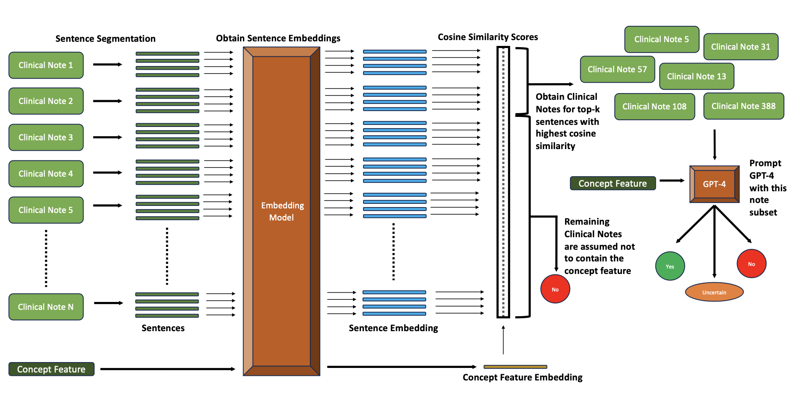
GPT-4 with Text Embeddings as Agreement Model: Pipeline Overview

Slide 58
GPT-4 with Text Embeddings as Agreement Model: Pipeline Overview

Slide 59
GPT-4 with Text Embeddings as Agreement Model: Pipeline Overview

Slide 60
GPT-4 with Text Embeddings as Agreement Model: Pipeline Overview

Slide 61
GPT-4 with Text Embeddings as Agreement Model: Pipeline Overview

Slide 62
GPT-4 with Text Embeddings as Agreement Model
  Clinical Note Segmentation:
    1,2,3,4,5-sentence chunks of the clinical notes.
    2-sentence chunks work best.
  Text Embedding Model:
    OpenAI models (text-embedding-ada-002, text-embedding-3-small, text-embedding-3-large) and INSTRUCTOR models.
    text-embedding-3-large works best.
  Top-k Sampling: Extrapolation
    Randomly select 300 patient notes from our dementia dataset
    Use GPT-4 to annotate the presence of each of the 254 concept features.
    Based on concept-frequency in the 300-note subset, extrapolate to 7,450 notes
      For example, if the concept feature “The patient exhibits multiple lesions” occurs 60 times in the 300-note subset, then roughly 1,500 patient notes will contain it in the entire 7,450 dementia dataset.

Slide 63
GPT-4 with Text Embeddings as Agreement Model: Results
While the GPT-4 + text embedding approach shows slightly lower performance, the following advantages are seen:
Total time required was 2 days (compared to over 40 days without text embeddings)
Total cost was $7,276 (compared to $240,540 without text embeddings)
Agreement Model | Concept Accuracy | Concept F1
Random Baseline | 0.31 | 0.35
Majority Baseline | 0.65 | 0.51
GPT-4 | 0.86 | 0.84
GPT-4 + Text Embeddings | 0.82 | 0.78
This approach makes it more efficient to scale up to larger datasets and other clinical outcomes while keeping cost and runtime low.

Slide 64
Additional Advantage of using Text Embeddings with GPT-4
With our Text Embedding + GPT-4 approach, we can additionally find note sentences that correspond to an activated concept.
This provides an additional layer of transparency that makes it easier to control for quality.
Concept Feature | Sentence in Clinical Note
infarcts involving multiple main arterial territories | Head CT showed multiple old infarcts but no new lesion.
 | Past Medical History: Right temporal \& left parietal infarcts
history of atherosclerotic risk factors | Past Medical History: Idiopathic peripheral neuropathy (per family), HTN...
 | Past Medical History: - hypertension. Social History: She is a former smoker
decreased reflexes | Her reflexes revealed she was hyporeflexic in the lower extremities and hyperreflexic in the upper extremities.
 | Reflexes: Brisk in the upper extremities, normal at patellae and reduced at achilles. The plantars are mute bilaterally.

Slide 65
Pipeline Overview

Slide 66
Pipeline Overview

Slide 67
Dementia Prediction using Patient Concept Vectors
Every patient note → Concept Vector using the Agreement Model.
  each vector index corresponds to one of 254 unique concepts features
We divide the 7,450 notes in our dementia into train-val-test (0.90/0.05/0.05)
Finally, we train a linear model (Logistic Regression) to predict dementia type.
We also compare our approach to 2 baselines: GPT-4 and ngram-logistic regression.

Slide 68
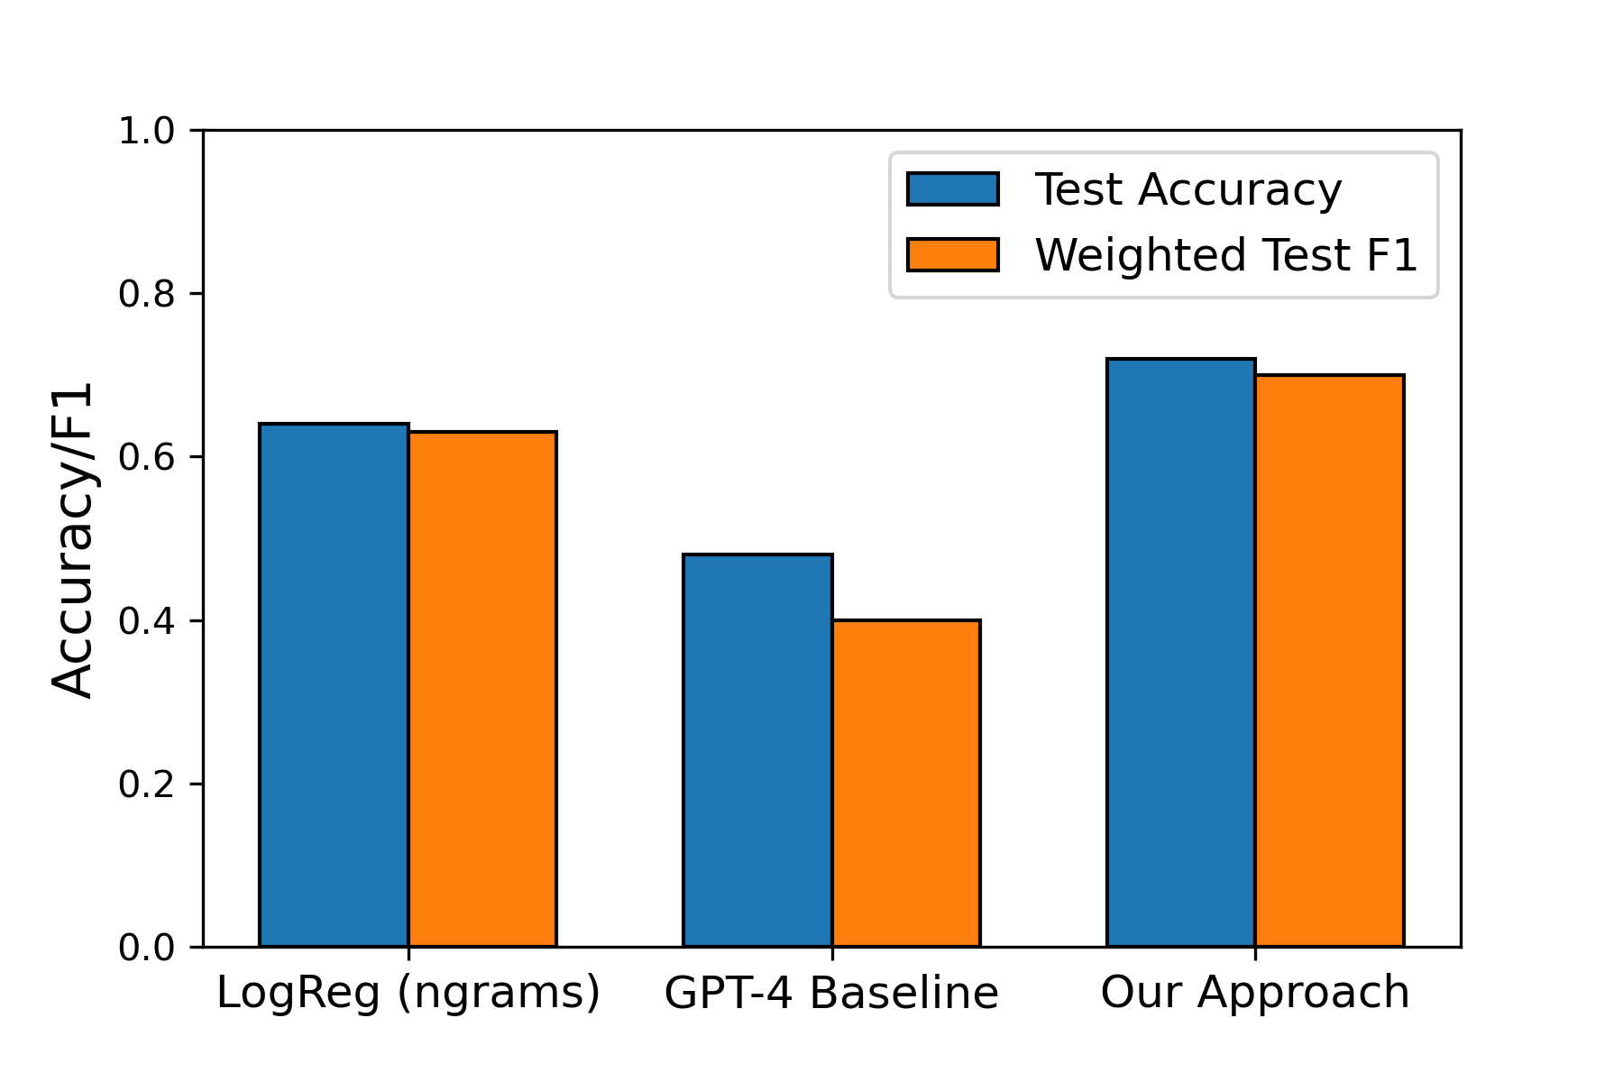
Dementia Prediction: Results
Our approach achieves a higher accuracy and F1 score compared to the baselines.
Our approach also utilizes high level clinical concepts to predict dementia type.

Slide 69
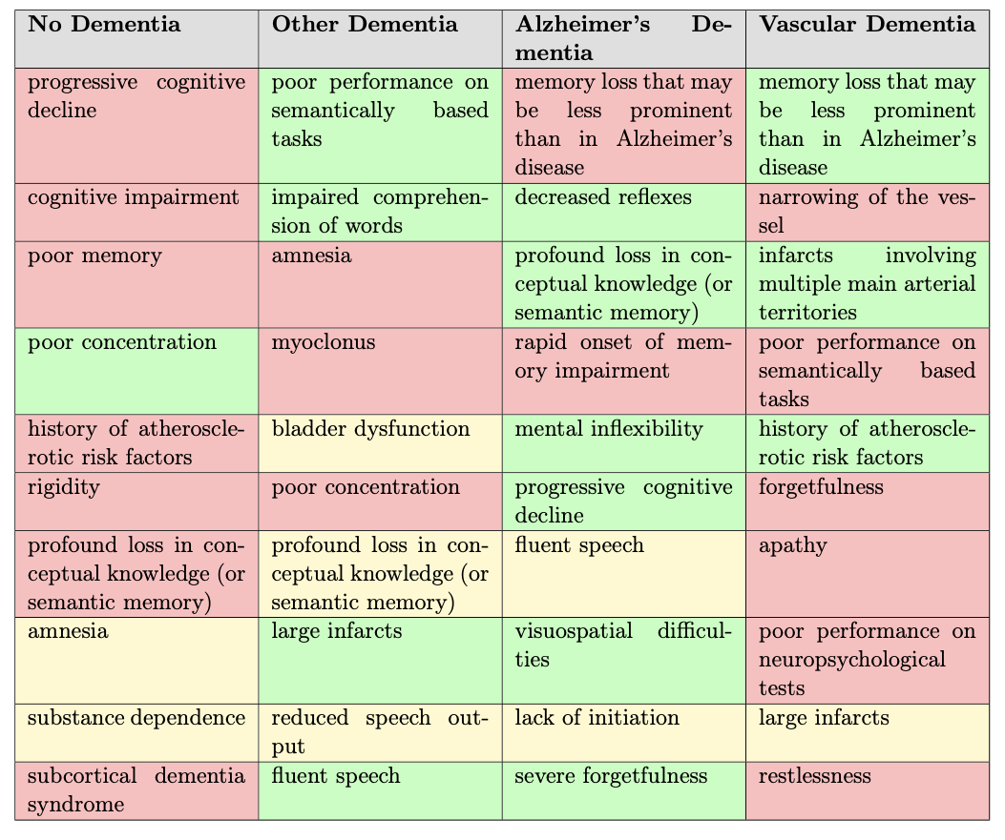
Top Predictive Features of our Concept Bottleneck Approach
Each cell in the table contains a concept of the form “The patient exhibits ____.”
LEGEND
Feature is absent
Feature is present
Presence of feature is uncertain

Slide 70

Exploring Gradient Tree Boosting as Final Classification Model
Disadvantage of Logistic Regression as the final classification layer:
  Cannot handle interacting features automatically
Gradient Tree Boosting as final layer:
  Can automatically handle interacting features (up-to a maximum depth of the Decision Tree weak learner used)
Final Classifier | Test Accuracy | Test F1
Logistic Regression | 0.71 | 0.70
Gradient Tree Boosting | 0.72 | 0.71

Slide 71
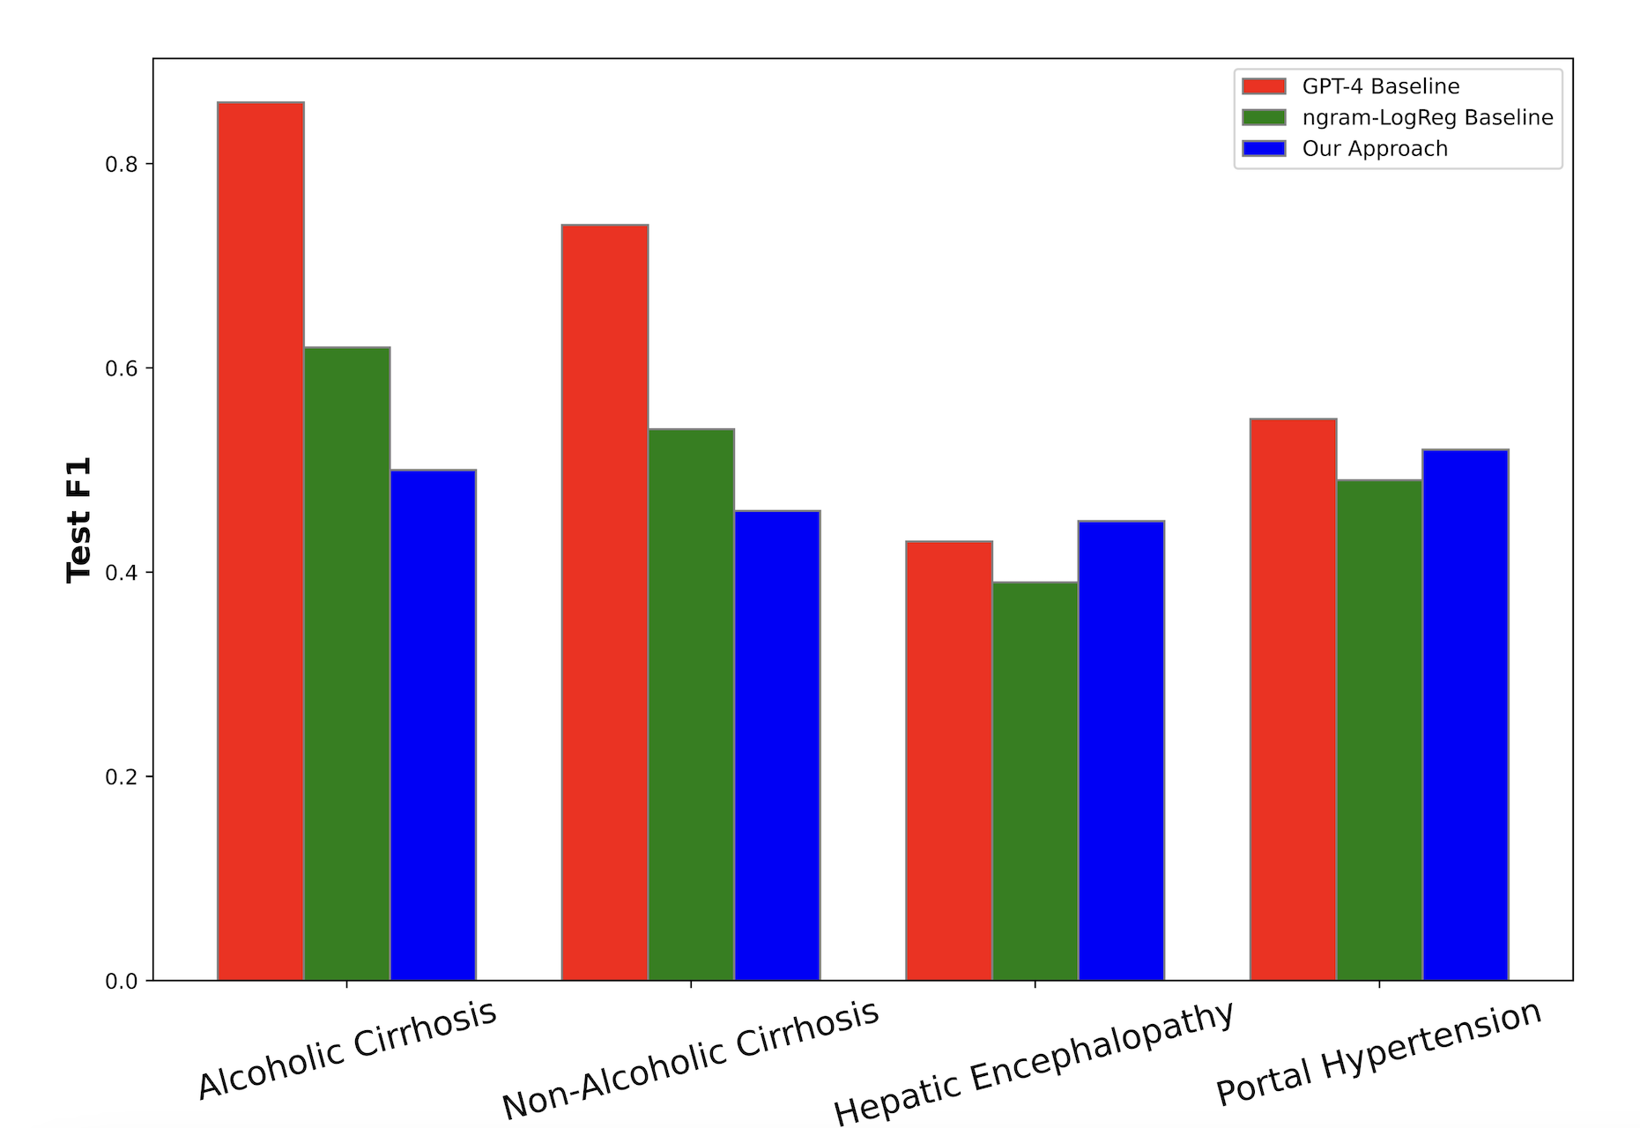

Liver Disorder Prediction
How well does our approach work for other Clinical Outcomes?
Choose liver disorders and rerun the entire pipeline:
Liver Disorder Type | Number of Patient Admissions
Alcoholic cirrhosis of the liver | 1202
Liver cirrhosis without alcohol mention | 1287
Hepatic Encephalopathy | 666
Portal Hypertension | 1007
No Liver Disorder | 1500
Our Approach achieves the highest F1 score for only 1 of 4 Liver Disorders
Why is our approach not performing as well?

Slide 72
Limitations
GPT-4 fails to identify certain concepts in patient notes with high accuracy
  Could be a potential flaw in our prompting approach – forcing the output to satisfy the template “The patient exhibits ____”.
Our atomic concept features do not contain all possible modifiers
  For example, “big” vs “small” lesion or “frequent” vs “occasional” memory loss.
We only consider clinical features but ignore non-clinical features.
  Non-Clinical Features: Environmental Exposures, Demographics (age, gender), lifestyle (active vs sedentary).
We only consider clinical features related to dementia.
  The 254 clinical features related to dementia might not be expressed by a majority of the control group → poor modeling of the negative examples

Slide 73
Conclusion
We provide a novel approach for extracting 254 dementia concepts from the Oxford Textbook of Medicine. For example:
  The patient exhibits memory loss.
  The patient exhibits ambulatory difficulties.
We explore different agreement models for converting patient notes to concept vector representations.
Our Concept Bottleneck approach forces the model to focus on high level clinical concepts, reducing the extent of spurious correlations.
  Performs well for patient dementia diagnosis
  Liver disorder performance → highlights limitations and potential areas for future work

Slide 74
Future Work
Using LLMs for end-to-end patient diagnosis
  Unreliable, as model maybe be right for the wrong reasons
  Blackbox model → almost impossible to find true reasoning of the model
Breaking the diagnosis pipeline into smaller steps
  Better interpretability
  Domain knowledge integration
  Debugging and troubleshooting
As a result, my future work will focus on improving diagnostic clinical models using the Concept Bottleneck approach

Slide 75
Future Work: Standardize Concept Features
Fever
Pyrexia
Fever vs Pyrexia
Vomiting vs Emesis
Shortness of breath vs Dyspnea
Reduces the dimensionality of the feature space
UMLS (Unified Medical Language System)
  Integrates multiple health and biomedical terminologies
    SNOMED CT (Systematized Nomenclature of Medicine – Clinical Terms)
      Database for consistently describing symptoms, diagnoses, procedures, etc.
      350,000 clinical concepts
    LOINC (Logical Observation Identifiers Names and Codes)
      Standardization of test results, vital signs and more
    ICD-10
      Global standard for classifying diseases and health conditions
C0015967
Shortness of Breath
Dyspnea
C0013404
Vomiting
Emesis
C0042963

Slide 76
Future Work: Concept Feature Modifiers
Create a set of modifiers for each concept feature
  Size modifiers: large, small, tiny, huge
  Frequency modifiers: frequent, occasional, intermittent, rare
  Severity modifiers: mild, moderate, severe, excruciating
  Time modifiers: chronic, acute, recent, persistent
  Other clinical modifiers: bilateral, symmetrical, right-sided
Concepts with modifiers → concept feature representation
Resource: SNOWMED CT and the UMLS Metathesaurus
  Can additionally use LLMs to generate a list of modifiers
Size
Duration
Location
Skin Lesion
Type
Severity

Slide 77
Future Work: Non-Clinical Features
Create a set of non-clinical concept features
  Demographic information: Age, Gender, Ethnicity
  Economic Stability: Income Level, Employment Status, Housing Stability
  Social and Community Context: Family Support, Social Isolation
  Neighborhood: Housing Quality, Cleanliness, Food Security
  Behavioral and Lifestyle Factors: Physical Activity, Diet, Substance Use, Sleep
Resource: ICF (International Classification of Functioning, Disability, and Health)

Slide 78
Future Work: Scaling to More Diseases
Scaling up our Concept Bottleneck approach to include a universal set of diseases
  A major hurdle is run time and cost for using LLMs
    Trends of decreasing costs and higher API calls might make this possible in the future!
    Newer open-source models like Llama3 show comparable performance to GPT-4
  Alternatively, improve our Text Embedding approach with GPT-4 to require fewer API calls.
This will result in better modeling of the control group and a more accurate decision boundary

Slide 79

Thank you
Chris Callison-Burch, Mary Regina Boland and Li Shen
Lyle Ungar, Mark Liberman, Ying Ding
Lab mates:
  Delip Rao
  Artemis Panagopoulou
  Yue Yang
  Liam Dugan
  Andrew Zhu
  Alyssa Hwang
  Harry Zhang
  Veronica Qing Lyu
  Mohammad Sadegh Rasooli
University of Pennsylvania
Parents and Partner

