Slide 1
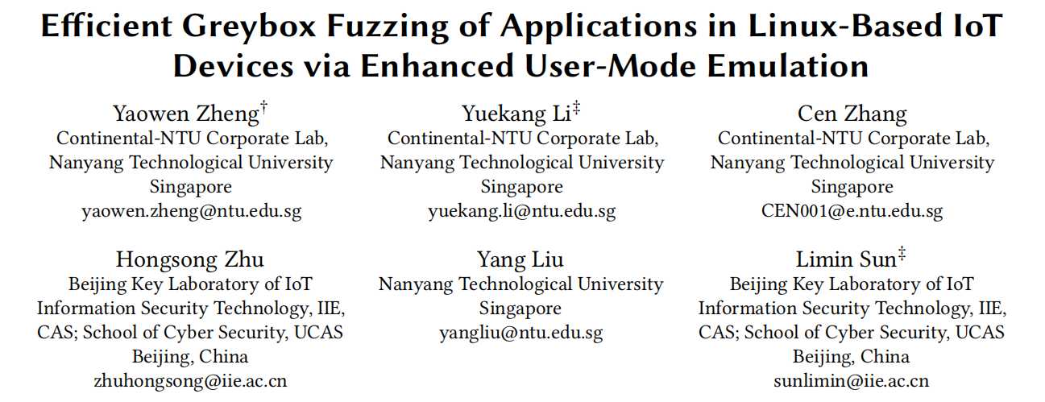
ISSTA ’22

Slide 2
Background - Emulation-Based Fuzzing
full-system emulation vs user-mode emulation
AFL + QEMU user-mode emulation - compatibility
AFL + QEMU full-system emulation - efficiency
AFL + QEMU hybrid emulation(Firm-AFL)
Notes:
firmafl问题：当PUT包含大量系统调用时，对开销的改进就很小
* 用户模式
模拟单个基于linux的应用程序：将系统调用委托给主机
不仿真系统调用和执行上下文
缺乏兼容性（如果需要一些主机不支持的资源or系统调用，就会失败）
* 全系统模式
模拟了整个系统：内核、驱动程序、应用程序
开销大

Slide 3
Background - Emulation-Based Fuzzing
AFL + QEMU user-mode emulation
Wrong launch variables
Missing dynamically generated files
Inconsistent NVRAM configurations
Inconsistent network behaviors
Inconsistent process resource limits
Lack of hardware
Notes:
问题：快速退出而不进入深度程序状态。尽管模糊的过程仍在进行中，但它只测试应用程序有限的代码路径
除了硬件，其他故障问题都可以通过全系统仿真解决

Slide 4
Goals
• High compatibility
Applications should behave the same as in full-system emulation
• High efficiency:
The speed of fuzzing should be as fast as possible

Slide 5
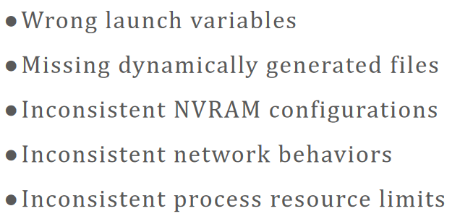
Solution
EQUAFL
AFL based framework through Enhanced QEMU User-mode emulation
observation and replay
observation
execute the PUT with full system emulation and observes
the key behaviors of the system
replay
carry out the replay during the user-mode emulation
Notes:
全系统执行PUT，观察系统的关键行为

Slide 6
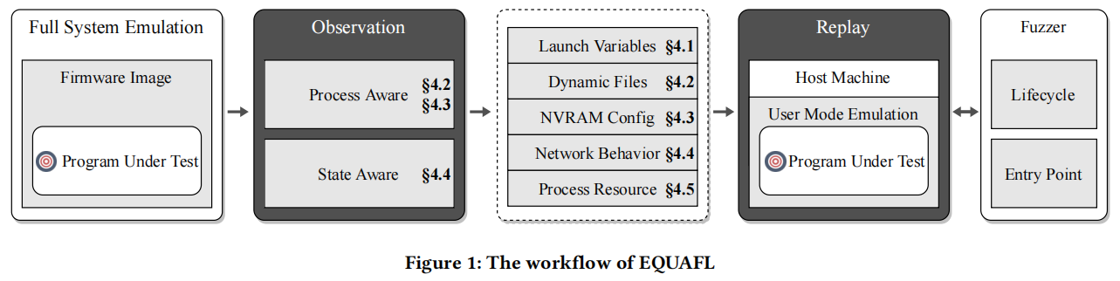
Overview

Slide 7
Contributions
a novel technique
automatically set up the execution environment to emulate embedded programs fully in user-mode
guarantee both high compatibility and high efficiency.
a new system
EQUAFL
a coverage-guided greybox fuzzing framework based on AFL and QEMU
extensive evaluation
ten 0-day vulnerabilities including six CVEs
source code
https://github.com/zyw-200/EQUAFL

Slide 8
Approaches - Launch Variables Settlement
observation
dump of the newly starting program
instrument the kernel function do_execve during the full-system emulation
replay
recognize 𝑝_{𝑣𝑎𝑟𝑠} and 𝑝_{𝑒𝑛𝑣𝑠} as the target 𝑝∗_{𝑣𝑎𝑟𝑠} and 𝑝∗_{𝑒𝑛𝑣𝑠} ,
where 𝑝_{𝑛𝑎𝑚𝑒} equals to 𝑝∗_{𝑛𝑎𝑚𝑒}
Notes:
启动变量：PUT在模拟系统中启动时需要的 参数和环境变量
由内核函数do_execve()创建新进程

Slide 9
Approaches - Filesystem State Synchronization
In full-system emulation, many firmware images mount a temporary filesystem and constantly change the filesystem state during the initialization phase
observe file-related system call execution in the guest machine and re-execute it on the host machine
Accurate Process Identification
identify the current executing process in the guest machine
process collection - PGD, PID, PPID (from task_struct)
process inference - acquire the PGD value of current executing process and match
Process-aware observation
observe the relation of files with process awareness to get file descriptor on the host machine
M：P×FD_{guest} ——> fd_{host}
Notes:
系统调用分两类：a. 直接处理文件路径 b. 处理文件描述符
a类可以直接获得参数（文件路径是一样的），b类需要通过文件间的关系来获得host上对应的描述符

Slide 10
Approaches - NVRAM Configuration
regular files are allocated to store the data of NVRAM configuration
emulation of NVRAM access : redirecting related APIs to the data access in such regular files
observation
achieved in the filesystem state synchronization
replay
redirecting the NVRAM access of the PUT to the NVRAM configuration files on the host machine

Slide 11
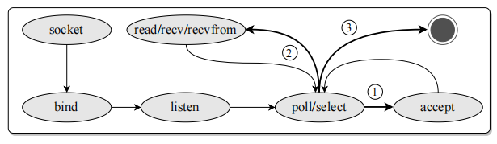
Approaches - Network Behavior
regular files are allocated to store the data of NVRAM configuration
emulation of NVRAM access : redirecting related APIs to the data access in such regular files
state-aware observation
collect network related system call sequences of the PUT during full-system emulation
carry out the state machine to guide the emulation of network behaviors
replay
follow the state machine to emulate the network-related system calls
instrument at the beginning of network-related system calls, and then feed the expected result

Slide 12
Approaches - Process Resource Limits
observation
the Linux kernel provides setrlimit and getrlimit system calls to set or get values of process resource limits
monitor getrlimit during fullsystem emulation
replay
provide the observed values directly to PUT
Notes:
RLIMIT_NOFILE specifies the maximum number of file descriptors that can be opened by the PUT
the setting of large RLIMIT_NOFILE limit value would slow down the execution of the PUT

Slide 13
Implementation - observation
full-system emulation: FIRMADYNE
instrument full-system mode of QEMU at the end system calls execution
firmware executes to a system call
treats it as the starting point of system call execution
record current execution context
firmware executes to the kernel space
instruments at the end of each basic block to detect whether the firmware execution returns back to the user-space
firmware executes to the user-space and the execution context are equal to the previous records
treats it as the end of the system execution
collect the argument and the return value of each system call execution

Slide 14
Implementation - replay
deploy the related resource directly on the host machine
launch variables, filesystem state synchronization, NVRAM configuration
instrument the user-mode mode of QEMU
network behavior, process resource limits

Slide 15
Implementation - fuzzing
PUT lifecycle management
Entry point of fuzzing
AFL: feed the test input as a file to the PUT
EQUAFL: feed the input to the memory buffer that store the network input
 | Fuzzing entry point | Fuzzing iteration end point
Before | main function | PUT executes to end
After | system call that receive the network input | PUT executes to poll or select system call

Slide 16
Evaluation
Benchmarks
standard benchmarks: nbench and lmbench
real-world benchmarks: 70 embedded firmware images(D-Link, TRENDnet and NETGEAR)
Baselines
AFL-User
AFL-Full
Firm-AFL

Slide 17
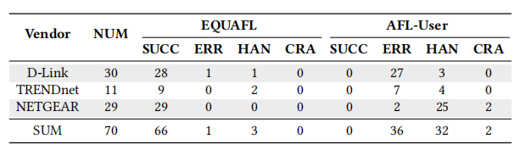
Evaluation - Compatibility
Real-world Dataset
Emulation Accuracy
comparing the execution traces of the same seed with EQUAFL and with AFL-Full
identical: 44 / 66
high similarity: 16 / 66
totally different: 6 / 66 inter-process communication
Standard Dataset
execute all the programs in nbench correctly
Notes:
CRA：fuzzer用初始种子运行时程序崩溃
HAN：fuzzer用初始种子运行时程序挂起
ERR：程序可启动，但在fuzz时报错
SUCC：可以无错误启动

Slide 18
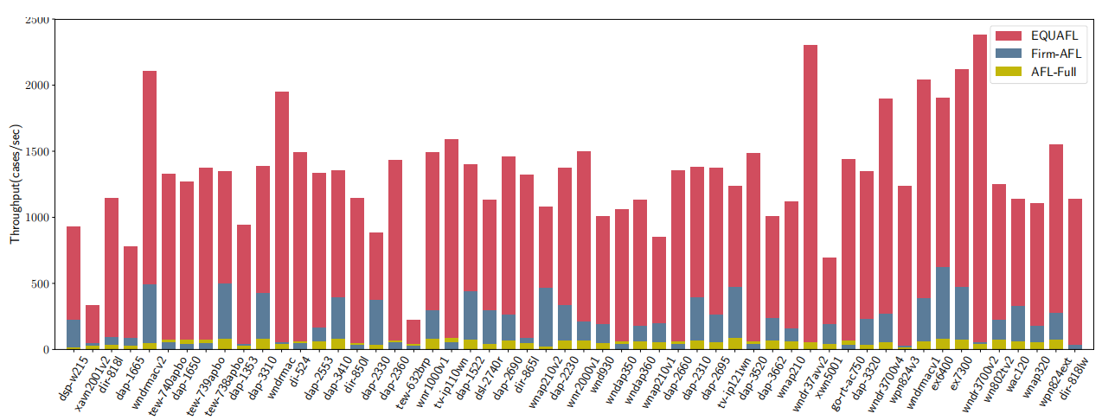
Evaluation - Efficiency
-相比AFL-Full：提高5.1-78倍（平均26倍）
-相比Firm-AFL：提高2.3-48倍（平均14倍）
Real-world Dataset
Notes:
【吞吐量】（1/每个种子的平均运行时间）

Slide 19
Evaluation - Efficiency
Standard Dataset
nbench
CPU and memory capabilities of a system
RESULT: similar to the performance of pure user-mode emulation
lmbench
system call overhead
RESULT: the overhead is for both file-related and network-related system calls
Notes:
【吞吐量】（1/每个种子的平均运行时间）
marginal 最低限度的

Slide 20
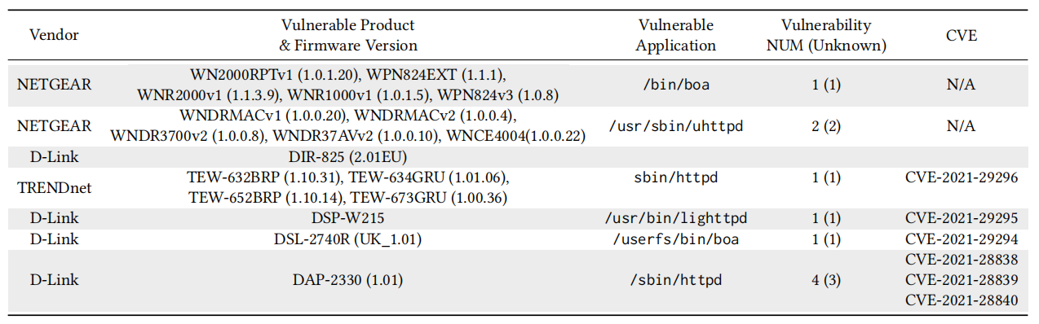
Evaluation - Vulnerability Discovery
9 NULL pointer dereference vulnerabilities
1 integer overflow vulnerability
6 CVEs
Notes:
【吞吐量】（1/每个种子的平均运行时间）
marginal 最低限度的

Slide 21
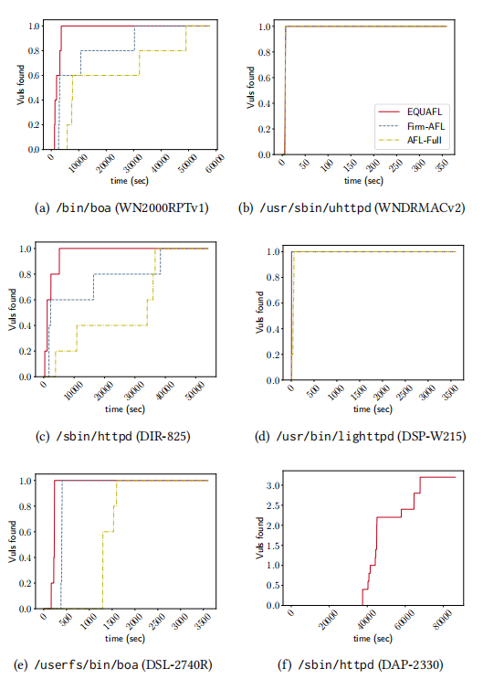
Evaluation - Vulnerability Discovery
the average number of unique vulnerabilities found over time
EQUAFL can find all vulnerabilities faster than
both Firm-AFL and AFL-Full
Notes:
【吞吐量】（1/每个种子的平均运行时间）
marginal 最低限度的

Slide 22
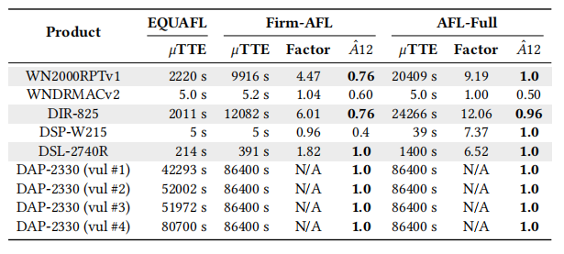
Evaluation - Vulnerability Discovery
the time to expose the first vulnerability for each technique
EQUAFL can find first vulnerability significantly faster than both AFL-Full and Firm-AFL
Notes:
.ˆ𝐴12的意思是，如果我们从五次重复中随机选择一个，EQUAFL有可能比基线表现得更好的概率。

Slide 23
THREATS TO VALIDITY
not support access to customized hardware peripherals
coarse-grained heuristic strategies to bypass the inter-process communication with other applications
vulnerabilities that spread across multiple applications cannot be revealed

Slide 24
QUESTIONS
Filesystem State Synchronization部分：为什么要采用本文的方法？为什么不使用更加简单的方法，直接将full-system mode启动后生成的文件系统dump下来使用？
Network Behavior部分：状态机是如何生成的？具体是如何利用状态机对user-mode下的网络行为进行指导的？
本文方法相比Firm-AFL方法的改进在哪些方面？

