Slide 1
An overview of skills and pipelines for A-Z reproducible manuscripts
Science
Magic
Data
More Magic
Results
Yet More Magic
Manuscript
Madness
Magic
Publication
Juan Manuel Vazquez

Slide 2
AGENDA
What is a reproducible manuscript?
Examples
Tools
Building an interactive, reproducible research website

Slide 3
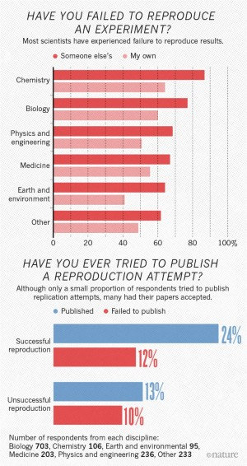
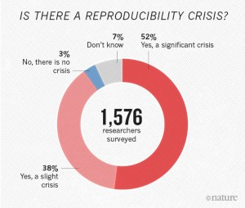
A crisis in reproducibility
2016 Nature survey: 70% of scientists have failed to reproduce either another’s or their own published results

Slide 4
Where do things go wrong?
Science
Data
Results
Manuscript
Publication

Slide 5
Where do things go wrong?
Science
Data
Results
Manuscript
Publication
Could be its own talk

Slide 6

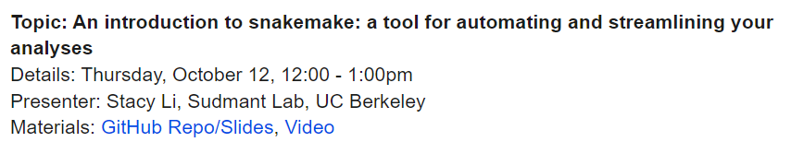



Where do things go wrong?
Science
Data
Results
Manuscript
Publication
Analysis standardization
Facilitate reanalysis
Automate pipelines
Unify & portablize environments

Slide 7
Where do things go wrong?
Science
Data
Results
Manuscript
Publication

Slide 8




Core elements of a reproducible manuscript
Bronze
Silver
Gold
Making code available on GitHub
Making data available

Slide 9


Core elements of a reproducible manuscript
Bronze
Silver
Gold
Making code available on GitHub
Making data available
Pipelines for semi-automated processing
Pipelines for semi-automated figures
Data and metadata available in standardized, open-source formats

Slide 10
Core elements of a reproducible manuscript
Bronze
Silver
Gold
Making code available on GitHub
Making data available
Pipelines for semi-automated processing
Pipelines for semi-automated figures
Data and metadata available in standardized, open-source formats
Fully-automated analysis pipelines
Semi-automated manuscript generation

Slide 11
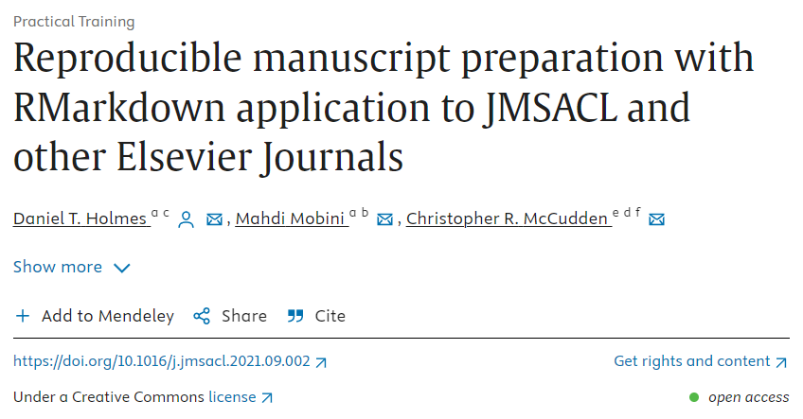

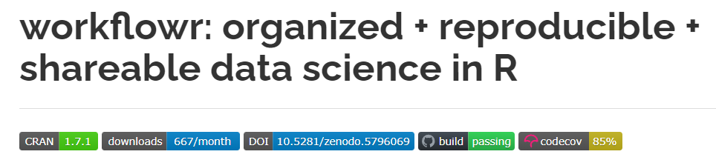



Writing a reproducible manuscript

Slide 12


Go-to packages
Portable & Consistent Packages
Code + Figure Tracking in
Website Form
Reproducible manuscripts
Formatting for Journals

Slide 13
Show and tell time
Example 1: CV
Example 2: Website
Workflowr
Example 3: Divvy bikes
Example 4: Vazquez & Lynch 2021

Slide 14
Interactive demo

