Slide 1


Leveraging R's ggplot for biological data analysis and visualization
CCB Skills Seminar
2 February 2023

Slide 2

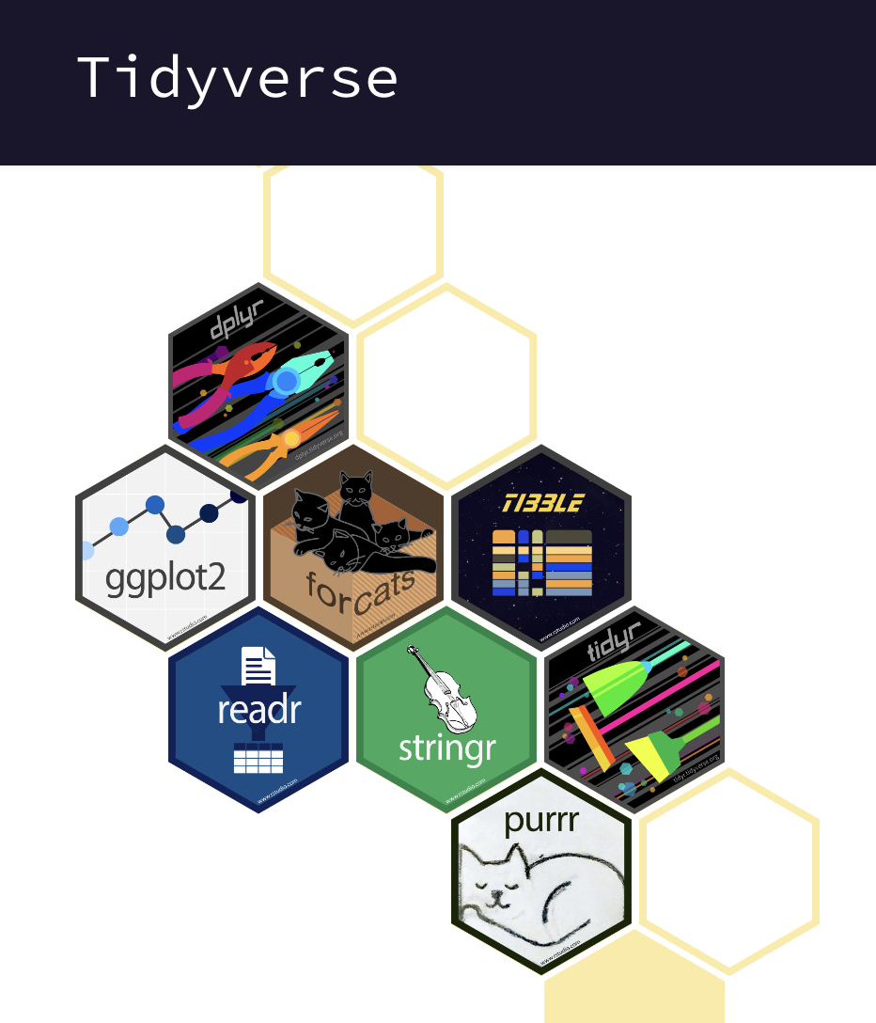
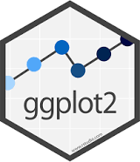
What is ggplot???
*Note “ggplot” refers to the ggplot2 package

Slide 3
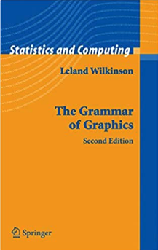
What is ggplot???
“ggplot2 is a system for declaratively creating graphics, based on The Grammar of Graphics.”

Slide 4
What is ggplot???
Plotting package in R that is:
Flexible and customizable
Data-frame based

Slide 5
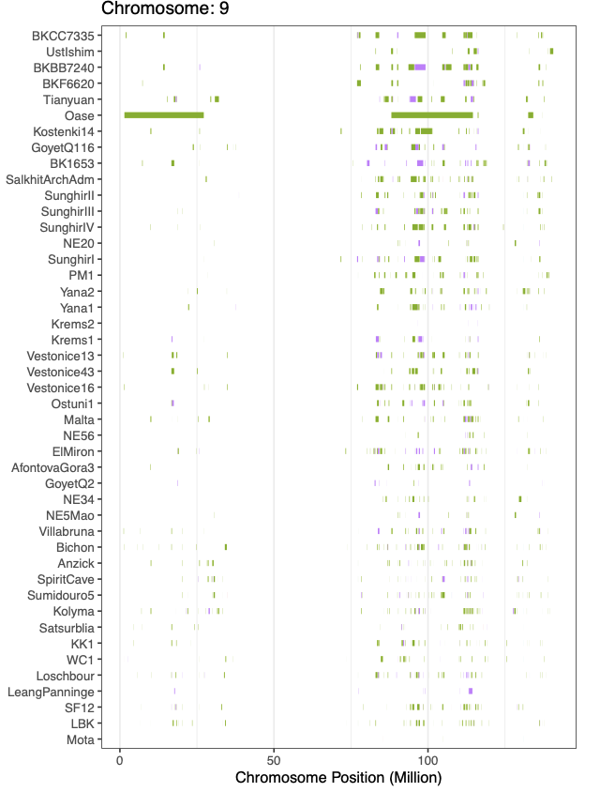
My ggplot Plotting Experience
Genomic regions of Neanderthal ancestry
results of simulations
immune changes over course of clinical trial,
tracking cells over time,
case-control studies

Slide 6
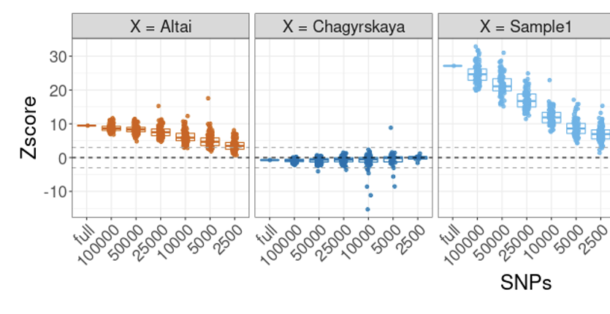
My ggplot Plotting Experience
Genomic regions of Neanderthal ancestry
Results of simulations
immune changes over course of clinical trial,
tracking cells over time,
case-control studies

Slide 7
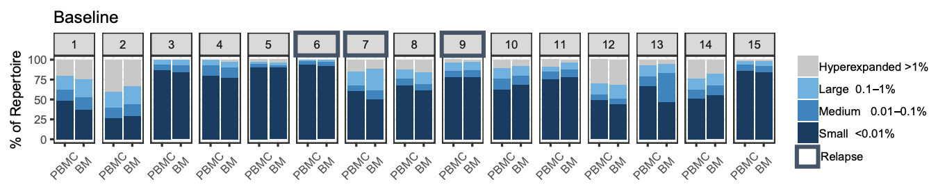
My ggplot Plotting Experience
Genomic regions of Neanderthal ancestry
Results of simulations
Immune repertoire composition
tracking cells over time,
case-control studies

Slide 8
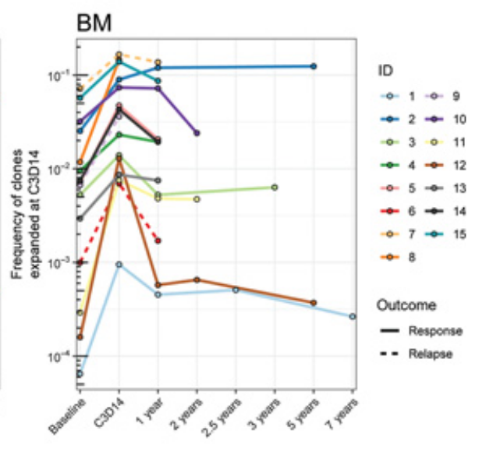
My ggplot Plotting Experience
Genomic regions of Neanderthal ancestry
Results of simulations
Immune repertoire composition
Tracking T cells over time
case-control studies

Slide 9
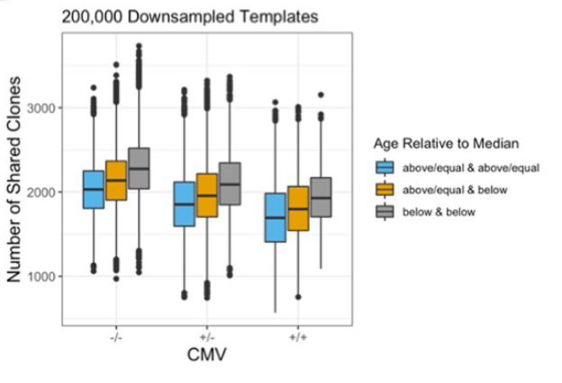
My ggplot Plotting Experience
Genomic regions of Neanderthal ancestry
Results of simulations
Immune repertoire composition
Tracking T cells over time
Case-control studies

Slide 10
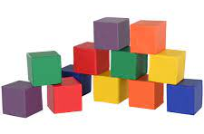
Goals
Introduce the building blocks “grammar” of ggplot
Show examples of the flexibility of ggplot
Plot 2 different biological datasets

Slide 11

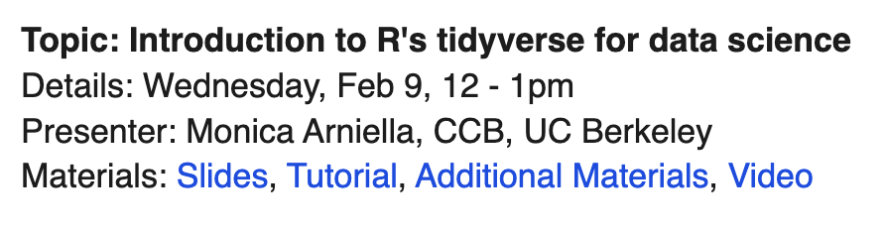
Follow up to Monica’s Introduction to Tidyverse
https://ccbskillssem.github.io/

Slide 12
Layers of a ggplot plot
Geom : geometric mapping, specifies the shape to be drawn
Ie: geom_point specifies scatterplot, geom_line adds lines
Aes : aesthetic mapping, specifies points of the geom (coordinates, size, color)
Theme : specifies text size, font, color, rotation, plot ticks, background lines
Facets : creates panels of plots

Slide 13
Layers of a ggplot plot
Geom : geometric mapping, specifies the shape to be drawn
Ie: geom_point specifies scatterplot, geom_line adds lines
Aes : aesthetic mapping, specifies points of the geom (coordinates, size, color)
Theme : specifies text size, font, color, rotation, plot ticks, background lines
Facets : creates panels of plots

Slide 14
Layers of a ggplot plot
Geom : geometric mapping, specifies the shape to be drawn
Ie: geom_point specifies scatterplot, geom_line adds lines
Aes : aesthetic mapping, specifies points of the geom (coordinates, size, color)
Theme : specifies text size, font, color, rotation, plot ticks, background lines
Facets : creates panels of plots

Slide 15
Layers of a ggplot plot
Geom : geometric mapping, specifies the shape to be drawn
Ie: geom_point specifies scatterplot, geom_line adds lines
Aes : aesthetic mapping, specifies points of the geom (coordinates, size, color)
Theme : specifies text size, font, color, rotation, plot ticks, background lines
Labels : x, y, title

Slide 16
Layers of a ggplot plot
Geom : geometric mapping, specifies the shape to be drawn
Ie: geom_point specifies scatterplot, geom_line adds lines
Aes : aesthetic mapping, specifies points of the geom (coordinates, size, color)
Theme : specifies text size, font, color, rotation, plot ticks, background lines
Labels : x, y, title
Facets : creates panels of plots

Slide 17
Additive Model of Plotting
Every plot needs a dataframe and x-axis column
Most plots need a y-axis column as well
ggplot(data = dataframe, mapping = aes(x = x_column, y = y_column))

Slide 18
Additive Model of Plotting
Every plot needs a dataframe and x-axis column
Most plots need a y-axis column as well
ggplot(data = dataframe, mapping = aes(x = x_column, y = y_column))
ggplot(dataframe, aes(x = x_column, y = y_column)

Slide 19
Additive Model of Plotting
Every plot needs a dataframe and x-axis column
Most plots need a y-axis column as well
ggplot(data = dataframe, mapping = aes(x = x_column, y = y_column))
ggplot(dataframe, aes(x = x_column, y = y_column)
Columns are mapped to their position within the “aesthetic mapping” function

Slide 20
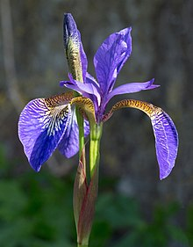
Additive Model of Plotting
Every plot needs a dataframe and x-axis column
Most plots need a y-axis column as well
ggplot(data = dataframe, mapping = aes(x = x_column, y = y_column))
ie: plot the sepal lengths for each species
ggplot(iris, aes(x = Species, y = Sepal Length))
Flower ID | Species | Petal Width | Petal Length | Sepal Width | Sepal Length
1 | virginica | 1.3 | 5.3 | 2.4 | 7.6
2 | virginica | 2.5 | 4.8 | 2.9 | 3.5
3 | setosa | 3 | 2.6 | 1.2 | 4.6

Slide 21
Additive Model of Plotting
Every plot needs a dataframe and x-axis column
Most plots need a y-axis column as well
ggplot(data = dataframe, mapping = aes(x = x_column, y = y_column))
ie: plot the sepal lengths for each species
ggplot(iris, aes(x = Species, y = Sepal Length))
This will not create a plot yet!!!
Needs a geom specified to create a plot shape
Flower ID | Species | Petal Width | Petal Length | Sepal Width | Sepal Length
1 | virginica | 1.3 | 5.3 | 2.4 | 7.6
2 | virginica | 2.5 | 4.8 | 2.9 | 3.5
3 | setosa | 3 | 2.6 | 1.2 | 4.6

Slide 22
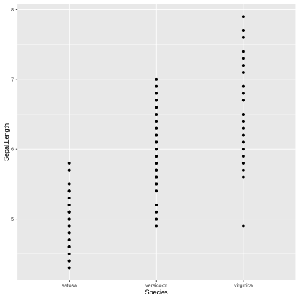
Additive Model of Plotting
Additional “geom” features are added on top of this base using “+”
ggplot(data = dataframe, mapping = aes(x = x_column, y = y_column) +
geom_point()

Slide 23
Geoms we will look at today
geom_bar : bargraph
geom_hist : histogram
geom_point : scatterplot
geom_boxplot : boxplot
geom_violin : violin plot
geom_line : line plot
geom_tile : heatmap

Slide 24
Additive Model of Plotting
Additional “aes” can be added to change the color and shape geom features
ggplot(data = dataframe, mapping = aes(x = x_column, y = y_column, color = any_column)) +
geom_point()

Slide 25
Aesthetic mappings we will look at today
x and y
Color
Fill
Size
Alpha : transparency

Slide 26
Additive Model of Plotting
Themes can be added to change the look of the whole plot
ggplot(data = dataframe, mapping = aes(x = x_column, y = y_column) +
geom_point(aes(color = another_column)) +
theme_bw()

Slide 27
Additive Model of Plotting
Themes can be added to change the look of the whole plot
Labels can be added (x, y, title)
ggplot(data = dataframe, mapping = aes(x = x_column, y = y_column) +
geom_point(aes(color = another_column)) +
theme_bw() +
labs(x = “x-axis”, y = “y-axis”, title = “good title”)

Slide 28
Additive Model of Plotting
Themes can be added to change the look of the whole plot
Labels can be added (x, y, title)
Facets can be added to split the plot into panels
ggplot(data = dataframe, mapping = aes(x = x_column, y = y_column) +
geom_point(aes(color = another_column)) +
theme_bw() +
labs(x = “x-axis”, y = “y-axis”, title = “good title”) +
facet_wrap(~another_column)

Slide 29
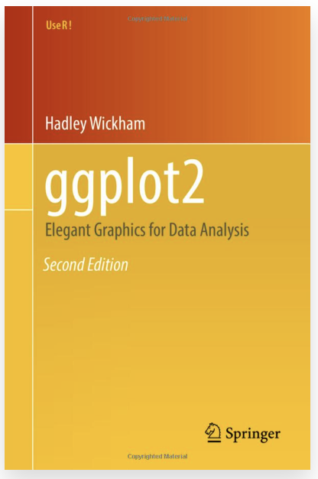
Resources
Official Documentation:
https://ggplot2.tidyverse.org/
Online book:
https://ggplot2-book.org/index.html
Iris tutorial:
https://bio723-class.github.io/Bio723-book/introduction-to-ggplot2.html
RNAseq tutorial
https://uclouvain-cbio.github.io/WSBIM1207/index.html

Slide 30
Goals
Introduce the building blocks “grammar” of ggplot
Show examples of the flexibility of ggplot
Plot 2 different biological datasets

Slide 31
Thank You! Collab tutorial: https://tinyurl.com/CCBskills

