Slide 1
The Certifier Framework for Confidential Computing - status
John Manferdelli
johnmanferdelli@hotmail.com
August, 2026

Slide 2
Overview
Organizational changes
VMWare transitions project to open source but no ongoing work by Broadcom employees
John maintaining and adding features, new participants and companies (Datica) and support
New grants and collaborations (NSF and other USG)
Review of goals
Review of original architecture and goals
New features
Granular access control, VM tools, TPM support, bug fixes, Java
New projects and research
NSF, USC, UVA and other government agencies
Aspirations and gaps
Collaboration for new HW support: CCA, TDX, Google phone, Apple, Raspberry Pi, GPU, accelerators --- we welcome support and collaboration on these, anyone?
Standard VM appliances
Research: side channel protection, automated partitioning and formal method verification …

Slide 3
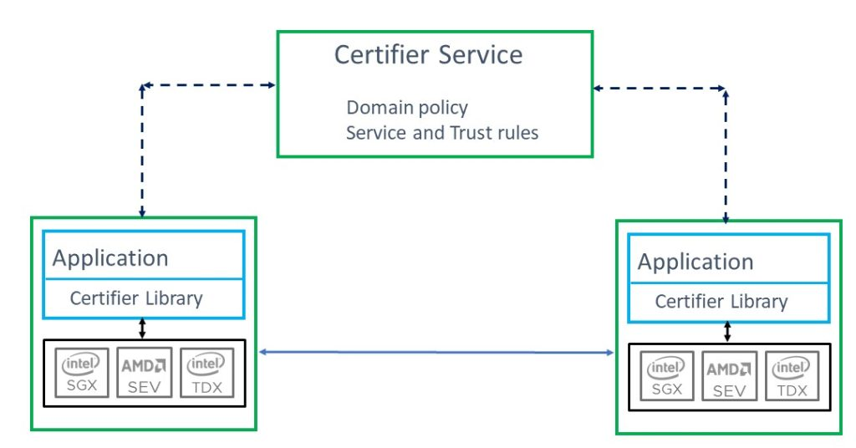
The Certifier Framework
Design goals
Open-source community project
Vastly decreases time to build applications
Platform independent; avoid need to port applications
Already supports SGX (via Open Enclaves or Gramine), AMD-SEV-SNP, Arm CCA (Islet), RISC-V, TPM, Keystone, and soon TDX. Also supports recursive enclaves (applications within VM’s)
Supports VM and application protection
Provides simple API for most applications but complete support for “edge” cases
Avoids dependency on a central authority or differences in deployment models
Secure, high-availability deployment with “embarrassingly parallel” server support
Easy to use infrastructure to support policy management
No deployment changes as policies evolve
Audited, comprehensible, declarative policy and verification
Efficient introduction of new components and upgrades
Scalable management
Enable new services and use models for Data Economy, high security applications and regulatory regimes

Slide 4
Certifier Framework Architecture
Taking the devil out of the details
Application (or VM-wide tools)
with policy enforcement
CC enabled app or service runs everywhere
Certifier Library
Measurement
Sealing
Attest/Verify
Certifier Service
Crypto
Secure Key Exchange
Trust Negotiation
Service runs anywhere:
Under your desk
In the cloud
In a TEE or not
At a “service provider”
Selectable security control
Identity Management
Application Upgrade
Secure Channel
Policy Management
Secure Data Storage
Application Migration
AMD SEV
Intel
SGX
TPM
Arm
CCA
Islet
RISC-V Keystone
. . .
App Enclave

Slide 5
Progress since last review
Major
New ACL library for “granular” resource protection including web API interfaces for secure data sharing
TPM support
Non-CC platforms as on-ramp
For use with cloud providers that restrict CC attestation to firmware (booting trust in v-TPM)
New utilities and tools for VM based applications
Multiple trust domain support
New contributor: Paul England
Plus
Initial Java support (still pending)
Bug fixes, …

Slide 6
Future
More platforms
CCA, Raspberry pi, iOS, Android, Nitro(?), TDX, more “accelerators”
Grants for app/VM appliance development
Research partnerships (USG) --- looking for others
Other possibilities
Rust implementation
Automated container specification, measurement and deployment
Automated formal methods integration
Side channel protection

Slide 7
Certifier Framework Concepts and API
Key Concepts:
Security Domain | Identified by a public key associated with all application code within a trusted environment. Programs are in a primary domain but can certify to secondary domains.
Certification | Refers to the verification of all properties in the security domain (including program identity, involving attestation) resulting in an x509 certificate for trust.
Trust and Policy | Should not be hard-coded in an application which should be able to operate in compliance in different security domains. Don’t complicate program development or deployment.
C++ Classes:
cc_trust_manager | Basic interface to establish keys, policy and manage certification with the Certifier Service.
secure_authenticated_channel | Establishes secure channel with an “authenticated program in security domain
policy_store | Stores policy, keys, communications endpoints securely. Additional helper function APIs for complicated applications.
Additional helper function APIs provided for use by more complicated applications.

Slide 8
Simple API: Most applications will use exactly this (and nothing else)
string public_key_alg("rsa-2048"); string symmetric_key_alg("aes-256-gcm");
cc_trust_manager trust_mgr(“sev-enclave”, “authentication”, “store”);
trust_mgr.initialize_enclave(NULL); // init enclave
trust_mgr.init_policy_key(initialized_cert_size, initialized_cert)
trust_mgr.cold_init(public_key_alg, symmetric_key_alg, …);
trust_mgr.certify_me(); // Get admission certificate
secure_authenticated_channel channel(“client”);
channel.init_client_ssl(host, port, policy-key, auth_key, admissions-cert);
// Your application service_attestation_cert.bin here

Slide 9
Simple API: Most applications will use exactly this (and nothing else)
10 Sept 2025 We’ve introduced a slight API change to handle multiple domains.
// Initialize trust domain
string public_key_alg("rsa-2048"); string symmetric_key_alg("aes-256-gcm");
cc_trust_manager trust_mgr(“sev-enclave”, “authentication”, “store”); trust_mgr.initialize_enclave(n, params); // init enclave
trust_mgr.initialize_store()
trust_mgr.initialize_keys(public_key_alg, symmetric_key_alg, false)
trust_mgr.initialize_new_domain(FLAGS_domain_name, purpose, serialized_policy_cert,
FLAGS_policy_host_url, FLAGS_policy_port))
trust_mgr.certify(FLAGS_domain_name);
// open channel secure_authenticated_channel channel(“client”);
channel.init_client_ssl(FLAGS_domain_name,FLAGS_server_app_host_url,
FLAGS_server_app_port,trust_mgr) // Your application here

Slide 10
Certifier: “Simple Example” App
Running App as server
Client peer id is Measured
8522d8e996e0089b26cb5dde06341c728e3017fa78974e3dce364bef56bdd307
SSL server read: Hi from your secret client
Running App as client
Server peer id : Measured
8522d8e996e0089b26cb5dde06341c728e3017fa78974e3dce364bef56bdd307
SSL client read: Hi from your secret server
You may want to add:
API serialization
ACLs for differentiated access
Standard “distributed programming” primitives like Byzantine agreement
Works on all CC platforms:
Simulated enclave
AMD SEV-SNP
Intel SGX (Gramine and OE)
Arm CCA (Samsung Islet)
RISC-V Keystone
TPM
Application enclave service

Slide 11
Certifier Framework API: Observations
Simple for most applications (and adequate for complex ones)
Abstracts underlying isolate, measure, seal/unseal, and attest primitives
Provides a secure store for save/recovery operations (in one statement!).
Includes mechanism to establish a secure channel within security domain
Encrypted, integrity protected, bi-directional, with authenticated trusted enclave named by their measurements
Almost as simple as “Hello world”

Slide 12
Certifier Service
“Centralized” management for a security domain
Application with Certifier Library
Certifier Service
Policy-driven (rooted in key associated with application)
Admits new components without changing old ones
Application upgrade without changing other applications
Facilitates data migration and sharing in a domain
Enforce security domain wide policy
Machine capabilities
Revocation
Policy example
1. Key[rsa, policyKey, a5fc2b7e629fbbfb04b056a993a473af3540bbfe] is-trusted
2. Key[rsa, policyKey, ... ] says Measurement[a051a41593ced366462caea392830628742943c3e81892ac17b70dab6fff0e10] is-trusted
3. Key[rsa, policyKey, ...] says Key[rsa, platformKey, ...] is-trusted-for-attestation
4. Key[rsa, platformKey, ...] says Key[rsa, attestKey, ...] is-trusted-for-attestation
Scalable, resilient deployment supporting all environments

Slide 13

Join the CCC party
Open-Source project
github.com/vmware-research/ccc-certifier-framework-for-confidential-computing
Apache license
Contributions and new contributors are welcome
Make Confidential Computing an open Universal Platform

Slide 14
Thank you!

Slide 15
Goal
Certifier Service
Configure Security Domain and start the Certifier Service
CCA/Keystone clients starts and gets certified by the Certifier Service.
Any OS
Transcription Client
Any Platform
Keystone SDK
Service host is started and certified without the model. Model loader starts running and ready to download model via the secure channel.
Model Provider is deployed and certified by the Certifier Service. The model server starts serving models to trusted clients.
Certifier Service
RISC-V Keystone
RISC-V Client
Whisper Model
Whisper Models
Transcription UI
Transcription Client
Download model through secure channel setup by the Certifier.
ML Model Server
ML Model Loader
ISLET
Send out transcription requests over secure channel and get results
Gramine SDK
Linux
Arm CCA
Intel SGX
AMD SEV-SNP
Arm CCA Client
Service Host
Model Provider

