Slide 1
The Certifier Framework for Confidential Computing
John Manferdelli
johnmanferdelli@Hotmail.com
October 5, 2023

Slide 2
Barriers to Confidential Computing adoption
Motivating the certifier framework
Hardware diversity
Current software complexity
TEE mechanisms (attestation protocols, core capabilities, interfaces) are not consistent across vendors
Cooperating programs require flexible management infrastructure to support many program providers and different security requirements.
Trust policy often embedded in program (Bad!)
Policy difficult to write, understand or audit
Can make deployment on different platforms difficult
Support code for trust management involves extensive security-sensitive logic and requires deep security expertise
No “hello world” exemplars for end-to-end secure system design that work in an hour.
Most bespoke code is not scalable and requires rewriting between platforms
Gap filled by Certifier: a standard, vendor-independent, easy-to-use framework for CC trust management for developers and deployers

Slide 3
Confidential Computing software tedium
All that work…
Generating, rotating and managing lots of keys
Authoring, managing and enforcing program policy universally understood by all “trusted programs”
Binding security policy to pre-authored program
Verifying policy compliance with absolute assurance
Securely storing and recovering secrets and data
Securely communicating with other unforgeably identified Confidential Computing Programs
Operating on different Confidential Computing platforms without application changes
Rapid CC enablement of existing “well written” programs
Preserving existing deployment models
Providing scalable support managing related distributed components (including upgrade and new components)
Enabling features with secure code and appropriate, agile logging, encryption and authentication primitives
Existing SDKs (Gramine, OE) help the CC developer but largely focus on orthogonal issues

Slide 4
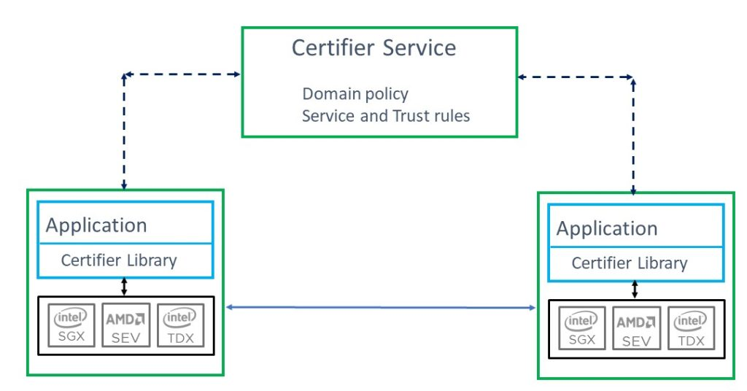
The certifier framework
Design goals
Open-source community project
Vastly decreases time to build applications
Platform independent; avoid need to port applications
Already supports SGX (via Open Enclaves or Gramine), AMD-SEV-SNP, Arm CCA, RISC-V Keystone, and soon TDX. Also supports recursive enclaves (applications within VM’s)
Supports VM and application protection
Provides simple API for most applications but complete support for “edge” cases
Avoids dependency on a central authority or differences in deployment models
Secure, high-availability deployment with “embarrassingly parallel” server support
Easy to use infrastructure to support policy management
No deployment changes as policies evolve
Audited, comprehensible, declarative policy and verification
Efficient introduction of new components and upgrades
Scalable management
Enable new services and use models for Data Economy, high security applications and regulatory regimes

Slide 5
Certifier Framework Architecture
Taking the devil out of the details
Application
with policy enforcement
CC enabled app or service runs everywhere
Certifier Library
Measurement
Sealing
Attest/Verify
Certifier Service
Crypto
Secure Key Exchange
Trust Negotiation
Service runs anywhere:
Under your desk
In the cloud
In a TEE or not
At a “service provider”
Selectable security control
Identity Management
Application Upgrade
Secure Channel
Platform Attestation Service
Policy Management
Secure Data Storage
Application Migration
AMD SEV
Intel
SGX
Intel
TDX
Arm
CCA
Islet
RISC-V Keystone
. . .
App Enclave

Slide 6
Certifier Framework Concepts and API
Key Concepts:
Security Domain | Identified by a public key associated with all application code within a trusted environment. Programs are in a primary domain but can certify to secondary domains.
Certification | Refers to the verification of all properties in the security domain (including program identity, involving attestation) resulting in an x509 certificate for trust.
Trust and Policy | Should not be hard-coded in an application which should be able to operate in compliance in different security domains. Don’t complicate program development or deployment.
C++ Classes:
cc_trust_manager | Basic interface to establish keys, policy and manage certification with the Certifier Service.
secure_authenticated_channel | Establishes secure channel with an “authenticated program in security domain
policy_store | Stores policy, keys, communications endpoints securely. Additional helper function APIs for complicated applications.
Additional helper function APIs provided for use by more complicated applications.

Slide 7
Simple API: Most applications will use exactly this (and nothing else)
string public_key_alg("rsa-2048"); string symmetric_key_alg("aes-256-gcm");
cc_trust_manager trust_mgr(“sev-enclave”, “authentication”, “store”);
trust_mgr.initialize_enclave(NULL); // init enclave
trust_mgr.init_policy_key(initialized_cert_size, initialized_cert)
trust_mgr.cold_init(public_key_alg, symmetric_key_alg, …);
trust_mgr.certify_me(); // Get admission certificate
secure_authenticated_channel channel(“client”);
channel.init_client_ssl(host, port, policy-key, auth_key, admissions-cert);
// Your application service_attestation_cert.binhere

Slide 8
Simple API: Most applications will use exactly this (and nothing else)
10 Sept 2025 We’ve introduced a slight API change to handle multiple domains.
// Initialize trust domain
string public_key_alg("rsa-2048"); string symmetric_key_alg("aes-256-gcm");
cc_trust_manager trust_mgr(“sev-enclave”, “authentication”, “store”); trust_mgr.initialize_enclave(n, params); // init enclave
trust_mgr.initialize_store()
trust_mgr.initialize_keys(public_key_alg, symmetric_key_alg, false)
trust_mgr.initialize_new_domain(FLAGS_domain_name, purpose, serialized_policy_cert,
FLAGS_policy_host_url, FLAGS_policy_port))
trust_mgr.certify(FLAGS_domain_name);
// open channel secure_authenticated_channel channel(“client”);
channel.init_client_ssl(FLAGS_domain_name,FLAGS_server_app_host_url,
FLAGS_server_app_port,trust_mgr) // Your application here

Slide 9
Certifier: “Simple Example” App
Running App as server
Client peer id is Measured
8522d8e996e0089b26cb5dde06341c728e3017fa78974e3dce364bef56bdd307
SSL server read: Hi from your secret client
Running App as client
Server peer id : Measured
8522d8e996e0089b26cb5dde06341c728e3017fa78974e3dce364bef56bdd307
SSL client read: Hi from your secret server
You may want to add:
API serialization
ACLs for differentiated access
Standard “distributed programming” primitives like Byzantine agreement
Works on all CC platforms:
Simulated enclave
AMD SEV-SNP
Intel SGX (Gramine and OE)
Arm CCA (Samsung Islet)
RISC-V Keystone
Intel TDX (when it’s ready)
Application enclave service

Slide 10
Certifier Framework API: Observations
Simple for most applications (and adequate for complex ones)
Abstracts underlying isolate, measure, seal/unseal, and attest primitives
Provides a secure store for save/recovery operations (in one statement!).
Includes mechanism to establish a secure channel within security domain
Encrypted, integrity protected, bi-directional, with authenticated trusted enclave named by their measurements
Almost as simple as “Hello world”

Slide 11
Certifier Service
Certifier Service
“Centralized” management for a security domain
Application with Certifier Library
Platform Attestation Service
Policy-driven (rooted in key associated with application)
Admits new components without changing old ones
Application upgrade without changing other applications
Facilitates data migration and sharing in a domain
Enforce security domain wide policy
Machine capabilities
Revocation
Policy example
1. Key[rsa, policyKey, a5fc2b7e629fbbfb04b056a993a473af3540bbfe] is-trusted
2. Key[rsa, policyKey, ... ] says Measurement[a051a41593ced366462caea392830628742943c3e81892ac17b70dab6fff0e10] is-trusted
3. Key[rsa, policyKey, ...] says Key[rsa, platformKey, ...] is-trusted-for-attestation
4. Key[rsa, platformKey, ...] says Key[rsa, attestKey, ...] is-trusted-for-attestation
Scalable, resilient deployment supporting all environments

Slide 12
Proof from the Certifier Service
Key[rsa, policyKey, ...] is-trusted and Key[rsa, policyKey, ...] says Measurement[a051a41593ced366462caea392830628742943c3e81892ac17b70dab6fff0e10] is-trusted, imply via rule 3, Measurement[...] is-trusted
Key[rsa, policyKey, ...] is-trusted and Key[rsa, policyKey, ...] says Key[rsa, platformKey, ...] is-trusted-for-attestation, imply via rule 5, Key[rsa, platformKey, ...] is-trusted-for-attestation
Key[rsa, platformKey, ...] is-trusted-for-attestation and Key[rsa, platformKey, ...] says Key[rsa, attestKey, ...] is-trusted-for-attestation, imply via rule 5, Key[rsa, attestKey, ...] is-trusted-for-attestation
Key[rsa, attestKey, ...] is-trusted-for-attestation and Key[rsa, attestKey, ...] says Key[rsa, program-auth-key, ...] speaks-for Measurement[...], imply via rule 6, Key[rsa, program-auth-key, ...] speaks-for Measurement[...]
Measurement[...]is-trusted and Key[rsa, program-auth-key, ...] speaks-for Measurement[...], imply via rule 1, Key[rsa, program-auth-key, ...] is-trusted-for-authentication
1.
2.
3.
4.
5.
Proved: Key[rsa, program-auth-key, ...] is-trusted-for-authentication
5 Steps

Slide 13
Platform Policy
Used to verify platform characteristics
Key[rsa, policyKey, a5fc2b7e629fbbfb04b056a993a473af3540bbfe] says Key[rsa, ARKKey, aeb214025256a56863fe9aa9c9f1cca153af4416] is-trusted-for-attestation
Key[rsa, policyKey, a5fc2b7e629fbbfb04b056a993a473af3540bbfe] says platform[amd-sev-snp, debug: no, migrate: no, api-major: >= 0, api-minor: >= 0, smt: no, tcb-version: = 3458764513820573973] has-trusted-platform-property
Supplants the need to use external attestation services and preserves privacy and control.

Slide 14
Certifier Service: Observations
Service provides a policy language, evidence formats, and policy evaluation to determine when a Confidential Computing application should be trusted.
Evidence submitted and evaluated includes platform attestation reports. Other formats converted to “canonical form.”
Utilities to generate keys and write policy.
Checks program and platform policy
Issues “Admissions Certificate for Security Domain”

Slide 15
Feature roadmap
Extended fields in tokens (Done)
Python bindings (Almost done)
GPU support (In progress)
Example of running Certifier Service in TEE and provisioning it. (Done)
Multi-security domain certification (Done)
Encrypted clients (to protect code)
Switch to smphost tools (https://virtee.io/)
Nitro?
Security review
Rust Client
Highly efficient differentiated access control
Community inputs and contributions welcome

Slide 16
Confidential Computing and the Certifier Framework
Verifiably secure operational properties, including confidentiality, integrity and policy compliance, no matter where program runs. Safe against malware and “insiders.”
Before CC: developer/deployer must:
Write applications correctly
Deploy the program safely (no changes)
Configure operating environment correctly
Ensure other programs can’t interfere with safe program execution
Generate and deploy keys safely
Protect keys during use and storage
Ensure data is not visible to adversaries and can’t be changed in transmission or storage
Ensure trust infrastructure is reliable
Audit to verify this all happened
Consequence: App writer/deployer entirely reliant on provider for all security --- unverifiable
With CC: developer / deployer must:
Write the application correctly
For every backend
Manage migration
Support each providers deployment model
Implement all the crypto
Implement secure communications and storage
Make it scalable and upgradable
Implement the trust policy
Maintain trust policy
Different for every app/deployer
Make it scalable
Consequence: You can have safe application but it’s platform dependent and a lot of work
With CC & Certifier Framework: developer/deployer must:
Write the application correctly using Certifier APIs
Write the trust policy
Use Certifier Service to manage it!
Consequence:
You write the application once.
Need only add a few dozen lines of code to enable CC protection.
Trust policy is independent of application.
Can move to another “backend” effortlessly
Thanks to David Wagner

Slide 17
Cross-platform ML PoC
Certifier Service
Configure Security Domain and start the Certifier Service
CCA/Keystone clients starts and gets certified by the Certifier Service.
Any OS
Transcription Client
Any Platform
Keystone SDK
Service host is started and certified without the model. Model loader starts running and ready to download model via the secure channel.
Model Provider is deployed and certified by the Certifier Service. The model server starts serving models to trusted clients.
Certifier Service
RISC-V Keystone
RISC-V Client
Whisper Model
Whisper Models
Transcription UI
Transcription Client
Download model through secure channel setup by the Certifier.
ML Model Server
ML Model Loader
ISLET
Send out transcription requests over secure channel and get results
Gramine SDK
Linux
Arm CCA
Intel SGX
AMD SEV-SNP
Arm CCA Client
Service Host
Model Provider

Slide 18

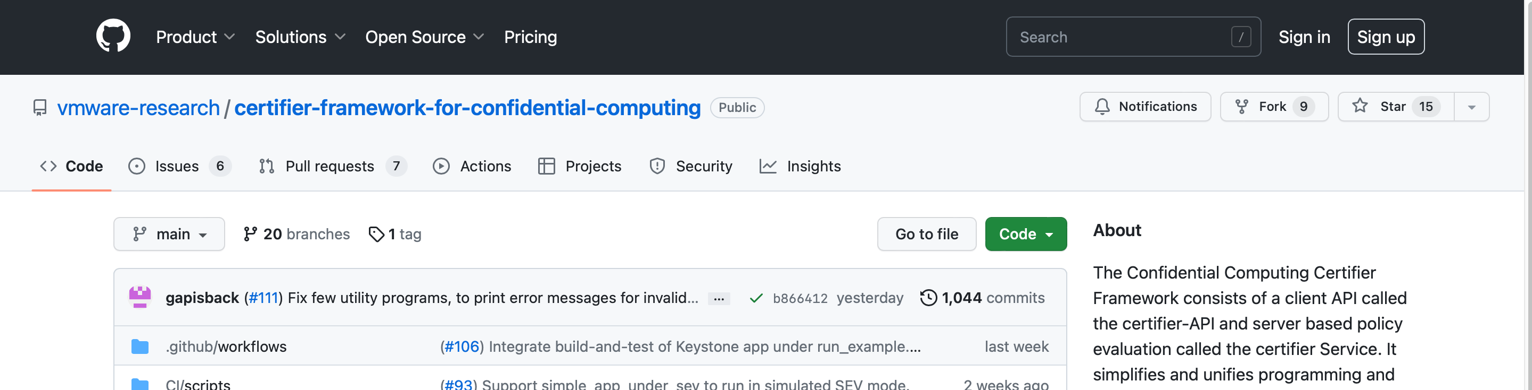
Can we join the CCC party?
Open-Source project
github.com/vmware-research/certifier-framework-for-confidential-computing
Apache license
Contributions and new contributors are welcome
Make Confidential Computing an open Universal Platform

Slide 19
Thank you!
John Manferdelli <jmanferdelli@vmware.com>

Slide 20
Goal
Certifier Service
Configure Security Domain and start the Certifier Service
CCA/Keystone clients starts and gets certified by the Certifier Service.
Any OS
Transcription Client
Any Platform
Keystone SDK
Service host is started and certified without the model. Model loader starts running and ready to download model via the secure channel.
Model Provider is deployed and certified by the Certifier Service. The model server starts serving models to trusted clients.
Certifier Service
RISC-V Keystone
RISC-V Client
Whisper Model
Whisper Models
Transcription UI
Transcription Client
Download model through secure channel setup by the Certifier.
ML Model Server
ML Model Loader
ISLET
Send out transcription requests over secure channel and get results
Gramine SDK
Linux
Arm CCA
Intel SGX
AMD SEV-SNP
Arm CCA Client
Service Host
Model Provider

Slide 21
Overcoming Barriers to Confidential Computing as a Universal Platform
Abstract: Confidential Computing (CC) provides simple, principled confidentiality and integrity for workloads wherever they run. Within multi-cloud infrastructures, it opens the door for a universal distributed computing solution that addresses verifiable program isolation, programs as authenticated security principals, secure key management, trust management, and the ability to prove these security properties cryptographically “over the wire” to relying parties using attestation. Yet the adoption of confidential computing has been slowed by the difficulty of writing CC-enabled programs quickly and securely, and across hardware technologies. Manferdelli will describe issues and requirements for a universal programming platform and introduce the open source “Certifier Framework for Confidential Computing” that provides a step towards overcoming development barriers.

Slide 22
The Promise of Confidential Computing
Security enablement anywhere (cloud or not)
Standard platform components (key store, storage, time, IAM)
Secure shared data access (Regulators: GDPR, Health, Finance)
Safe program execution (“A safe place to stand in the cloud”)
Zero Trust
Secure privacy preserving service enablement (Data Economy)
Secure collaborative machine learning
Secure Motion planning as a service
Secure Auctions
Secure infrastructure management
Secure Kubernetes container management
Secure Document sharing
Platforms for sensitive edge services
Edge sensor collection
Caching services and the “extended internet”

Slide 23
Use or delete
Barriers to Confidential Computing Adoption
“In the future, all programs will be Confidential Computing Programs” -- Intel
Software
Writing or converting programs to CC is difficult!
Different code for different programs
Complicated support code raises a security problem and you can’t start right away
No “copy and paste” to get started with a secure program
Cooperating programs require flexible management infrastructure to support many program providers and different security requirements.
Trust policy often embedded in program (Bad!)
Policy difficult to write, understand or audit
What is the “Linux” for Confidential Computing?
Hardware
TEE availability
Programs are not “portable” across platform technologies

Slide 24
CC Provides a Foundation for Security
Isolation and measurement
Program address space isolated
Program hashed to give non-forgeable identity
Four capabilities of a Confidential Computing:
Isolation. Program address space and computation.
Measurement. Use cryptographic hash to create an unforgeable program identity.
Secrets. Isolated storage and exclusive program access. (aka, “sealed storage”).
Attestation. Enable remote verification of program integrity and secure communication with other such programs.
Secrets
Seal: protect a secret for this measurement
Unseal: restore a secret for this measurement
Attestation
Statement signed by a trusted party (HW) that specifies
Program identity (measurement) program
Hardware protection (isolation, integrity, confidentiality) guarantees
Statement attributable to isolated entity
CC provides principled security wherever your programs run and wherever your data resides even if you don’t operate the computers the programs run on.

