Slide 1
FloodGap
If Houston had funding for 20 new sensors, where are the 20 most ideal places to put them?
A sensor-siting model inspired by Savannah's CEAR Hub, applied to Houston
Georgia Tech VIP · Coastal Georgia Climate Solutions
Notes:
if someone funds 20 new water-level sensors for Houston, where are the 20 most ideal locations?
The idea came from CEAR Hub — they installed sea-level sensors around Savannah to monitor water levels. When I saw this, I thought: this is really powerful for flood control. And my immediate question was — can this transfer to other cities? I live in Houston. Houston gets hit by multiple kinds of flooding — tidal near Galveston, stormwater inland. So the idea of FloodGap started there: bring the sensor idea to a new city.
That's the question the whole project tries to answer.

Slide 2
Starting Simple: Two Layers
NOAA tide data + social vulnerability
Layer 1: NOAA flood days
Layer 2: Social vulnerability (CDC SVI)
High-tide flooding days from NOAA tide stations.
Where flooding is equally likely, vulnerable communities suffer more and recover slower.
First lesson: NOAA stations are so sparse that all 174 coastal Georgia tracts shared ONE flood-day value. No variation = no ranking. The fix: add USGS elevation, which restores real tract-by-tract flood variation.
Notes:
I started simple, with two layers. First, NOAA tide data — flood day. Second, social vulnerability from CDC, because where flooding is equally likely, vulnerable communities suffer more. 1st is NOAA stations are so sparse that every tract on the Georgia coast shared literally the same flood-day number. So I added USGS elevation — low-lying ground floods first — and that restored the local variation NOAA couldn't give.

Slide 3
Then Inspired by the Paper
Tien et al. (2023), sensor siting in the same Savannah network, by a previous PhD student
Parameter
Paper (Savannah)
Houston adaptation
1 · Compound flood
Single FEMA flood zone (tidal)
Tidal + stormwater + riverine combined
Core upgrade
2 · Vulnerability
Local DAPI index
CDC SVI at block-group level + note limits
Refined
3 · Infrastructure
Kernel density of facilities
Same, from OpenStreetMap
Reused
4 · Coverage
Expand existing 30 sensors
Spread 20 from scratch
Re-scoped
5 · Uncertainty
Reduce existing-network error
Simplified (no prior network)
Simplified
Notes:
Then Kait shared a paper with me — by a previous PhD student in the group, on the exact same Savannah network. Their approach: five siting parameters, about 29,000 candidate points, Pareto optimization down to 381 points, and then experts and county officials narrow it down step by step. So I set my plan: borrow their factors, build a weighted-score model, validate it against CEAR Hub's existing sensors — and if it holds in Savannah, apply it to Houston.

Slide 4
Problem 1: the Validation Isn't Valid
The existing sensors are 'where it was feasible', not 'where is ideal'
How the 48 sensors were really placed
What my consistency check found
Installed 6 to 8 years ago, by feasibility: easy access, near a waterway, something to mount on
Many strapped to fence posts; theft & stability were real concerns
Deployment never fully completed (county infrastructure limits)
Scored the 48 sensor sites with my model: they averaged only the 42nd percentile, below random
Model favors flood + vulnerability; the sensors were driven almost purely by tidal feasibility
They can't serve as the 'correct answer' to fit weights against
The reframe: the mismatch isn't a failed validation. It shows the real network is feasibility-limited and systematically misses high-risk, vulnerable places. That gap is what the model exposes, and it's the second meaning of 'FloodGap'.
Notes:
But then problem number one. The current sensors— they were installed 6 to 8 years ago based on feasibility. Easy to reach, near a waterway, something to mount the device on. And the deployment was never even completed. So using them to validate my model isn't actually valid. There is no 'correct answer' to fit against. It shows the existing network is feasibility-limited and systematically misses high-risk

Slide 5
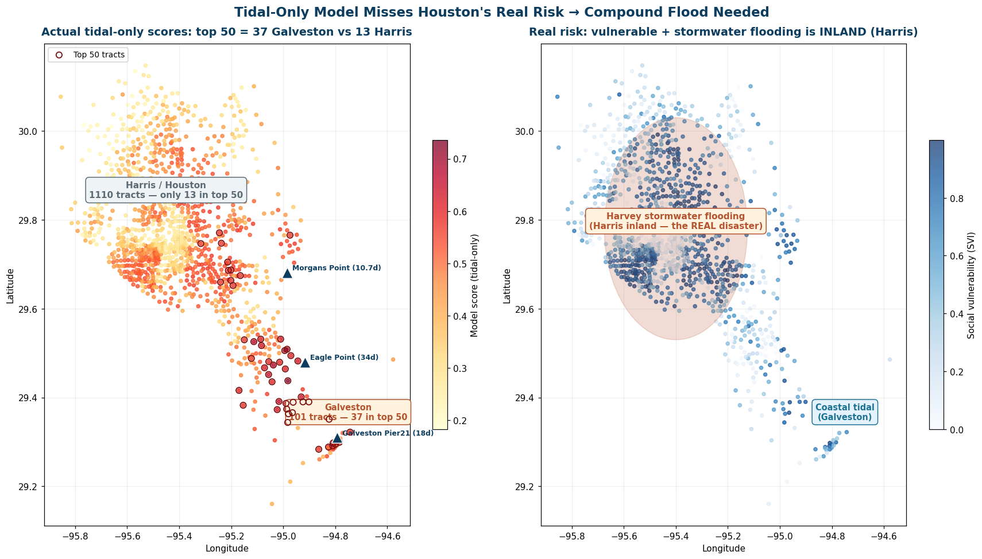
Problem 2: Houston Doesn't Flood Like Savannah
Savannah is 90%+ tidal. Houston floods three ways.
Tidal-only result
30×
Galveston tracts entered the top 50 at 30× the rate of Harris County
But Harvey's flooding was inland: stormwater and bayous. The model was blind to it.
Notes:
Problem number two: transfer. Savannah's flooding is more than 90% tidal. Houston is different — it floods three ways. Tidal near Galveston Bay. Stormwater inland, where rain can't drain out fast enough. And riverine — the bayous like Buffalo Bayou, which back up during storms and flood the areas around them. When I applied the Savannah-style, tidal-only model to Houston — this map — every priority landed on the coast. Galveston tracts entered the top 50 at thirty times the rate of Harris County. But think about Harvey: the disaster was INLAND. The model was blind to exactly the flooding Houston is famous for. So I upgraded the flood factor into a compound flood score with three components. Tidal — same as before. Stormwater — I used NOAA C-CAP impervious surface data, because pavement is what turns rain into street flooding; that's Harvey's mechanism. And riverine — distance to the eleven major bayous.

Slide 6
The Pivot
There is no 'correct' set of weights to validate
If you prioritize tidal risk → these are the top 20 places.
If you prioritize stormwater → those are the top 20.
If you prioritize vulnerable communities → different again.
Weights become policy options. The model shows decision-makers the trade-offs, and finds the places that matter under EVERY priority.
Notes:
(1 min — 转折页,讲清楚) Here's the pivot. I realized nobody has a validated set of weights — not the paper, which deliberately avoided weights using Pareto; not the experts, whose placements were feasibility-driven. So instead of guessing weights and pretending they're correct, I made the weights themselves the research object. I got flexible. If you care most about tidal risk — here are your top 20. If you care about stormwater — different top 20. If you emphasize vulnerable communities — different again. Weights become policy options. And the most valuable output becomes: which places matter under EVERY priority.

Slide 7
Five Weighting Schemes
Each scheme encodes a different priority, and the map changes with it
Scheme
tidal/storm/river
flood/vuln
Harris/Galv
Leading regions
A
Tidal-only
100 / 0 / 0
60 / 40
3 / 47
Dickinson, Texas City, Galveston
B
Equal sub-weights
33 / 33 / 33
60 / 40
45 / 5
Gulfton, East End, Texas City
C
Harvey-informed
25 / 50 / 25
60 / 40
48 / 2
Gulfton, East End, Texas City
D
Flood-dominant
33 / 33 / 33
80 / 20
42 / 8
Gulfton, East End, Texas City
E
Equity-forward
33 / 33 / 33
50 / 50
46 / 4
Gulfton, Texas City, East End
Notes:
(1 min) So I built five weighting schemes. A is tidal-only — the Savannah logic. B treats all three flood types equally. C is Harvey-informed — stormwater gets double weight. D says hazard dominates over vulnerability, 80-20. E is equity-forward — vulnerability equal to hazard, 50-50. Look at the Harris-Galveston split: tidal-only puts 47 of the top 50 in Galveston. Every compound scheme flips the map inland. The weights genuinely change the answer — which is exactly why they should be shown as explicit choices, not hidden inside the model.

Slide 8
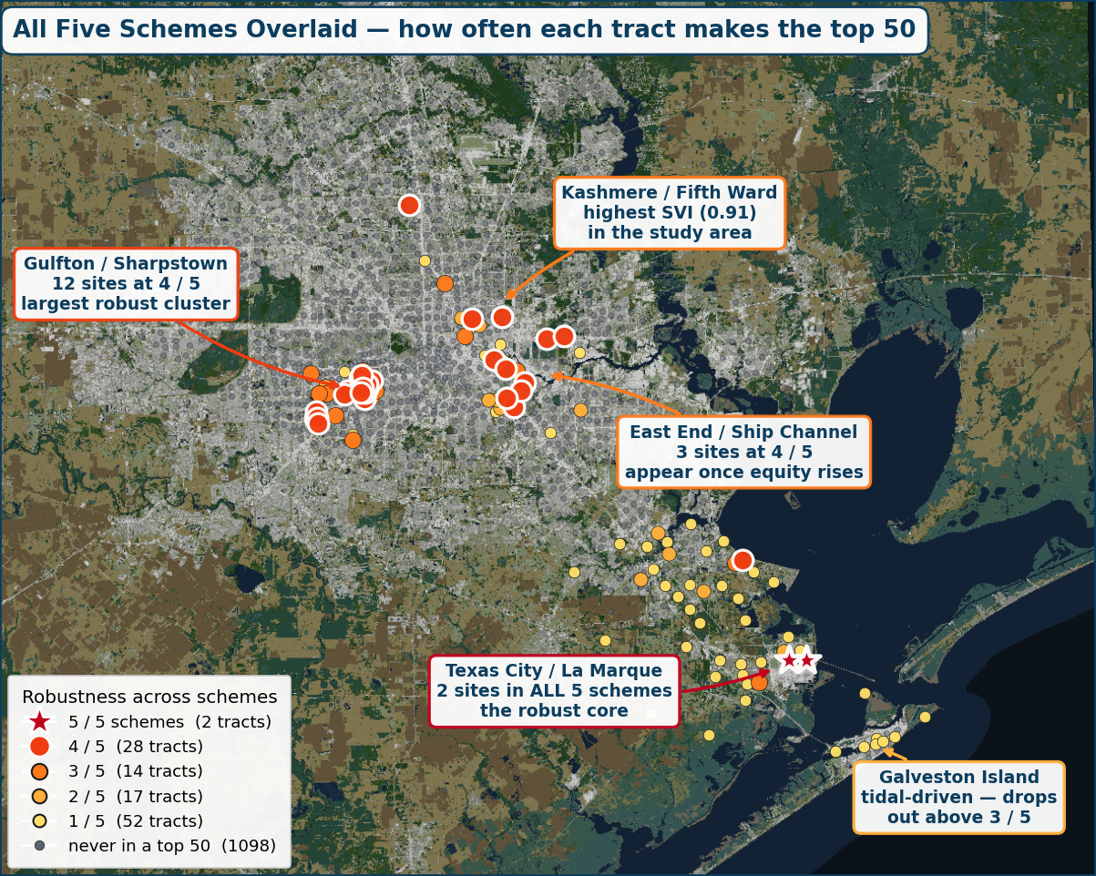
Overlay All Five: the Robust Places Emerge
How many of the five schemes put each tract in the top 50
Robustness tally
5 / 5 schemes
2 tracts
4 / 5
28 tracts
3 / 5
14 tracts
2 / 5
17 tracts
1 / 5
52 tracts
Four robust clusters
Texas City / La Marque: in ALL 5 schemes
Gulfton / Sharpstown: 4 of 5, largest cluster
East End / Ship Channel: 4 of 5
Kashmere / Fifth Ward: highest SVI (0.91)
These are robust: high priority no matter how you weigh.
Notes:
(1.5 min — 结果页) Then I overlaid all five maps. The color shows how many schemes put each tract in the top 50. Only 2 tracts out of 1,211 are chosen by every single scheme — both in Texas City / La Marque. Twenty-eight more appear in four of five. And they organize into four robust clusters: Texas City — the only region in ALL five schemes, tidal surge plus high vulnerability. Gulfton — the largest cluster, four of five. East End on the Ship Channel. And Kashmere / Fifth Ward — the highest social vulnerability in the study area, 0.91. These clusters are the core answer: places that need monitoring no matter which priority you choose.

Slide 9
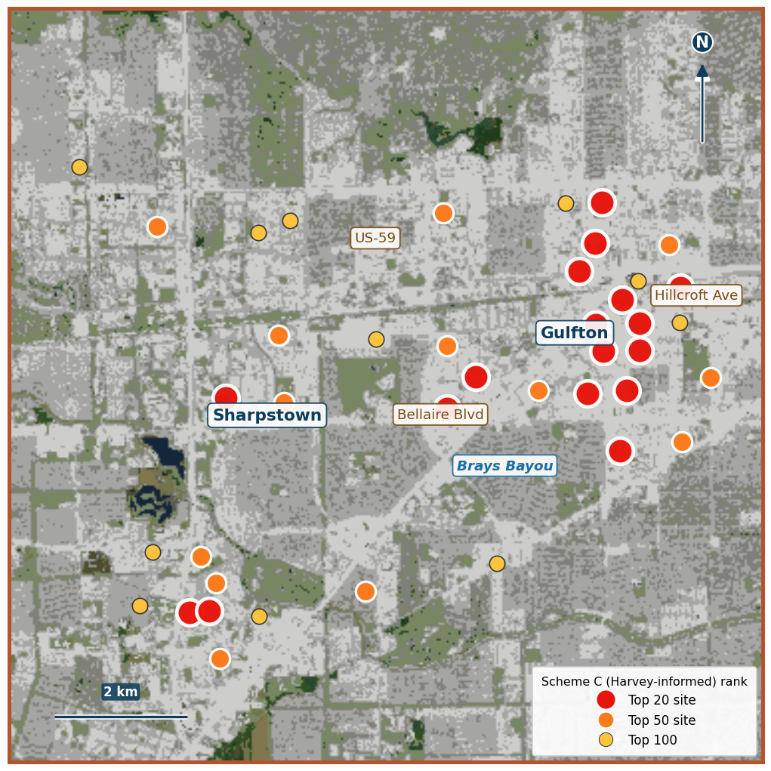
Zooming Into the Clusters
Each cluster has its own character, and its own sensor type
Water-level sensor → tidal / riverine clusters
Texas City, East End, Dickinson. Mounted on bridges, culverts, dike structures over the water, like CEAR Hub's. Needs a waterway and clearance above base flood elevation.
Street-light sensor → stormwater clusters
Gulfton and Kashmere are inland, no waterway. Ultrasonic sensor points down from a light pole and measures street ponding. NYC FloodNet model, a few hundred dollars each.
Gulfton under Harvey-informed weights: 17 of the top 20 sit here
Notes:
(1.5 min) And now the current stage: zooming into these clusters. This is Gulfton — under Harvey-informed weights, 17 of the top 20 tracts in the whole region sit right here. It's a 1960s garden-apartment district, the most impervious cluster in the study area, dense immigrant renter communities near Brays Bayou — it flooded in Allison, Memorial Day, Tax Day, and Harvey. Each cluster's character also tells you WHICH sensor. Tidal and riverine clusters — Texas City, East End — need water-level sensors on bridges and dikes, like CEAR Hub's. But stormwater clusters like Gulfton have no waterway — there, you use street-light sensors: an ultrasonic unit pointing down from a light pole, measuring street ponding. NYC's FloodNet uses these; a few hundred dollars each. Same model output, two different technologies — matched automatically by each site's dominant flood component.

Slide 10
Next Steps: Inside the Clusters
A concrete Houston research plan: from clusters to specific streets and poles
Fine-grain inside each Houston cluster
Re-run the scoring at block-group level inside Gulfton, Texas City, East End and Kashmere, then rank streets and intersections using 311 flooding complaints and HCFCD flood history.
1
Desktop pre-screen of candidate sites
For the top blocks, use Street View plus drainage records to shortlist 3 to 5 exact light poles or bridges per cluster, checking pole ownership (CenterPoint, TxDOT, HCFCD) and cellular signal.
2
Field reconnaissance in Houston
Visit the shortlisted sites with a structured checklist: street low points, stain lines, storm inlets, mounting structures. Site survey is my day job as a landscape architect.
3
Test against known gaps
Compare model picks with areas the team wanted to monitor but could not install in, and share results with Houston emergency management for real-world feedback.
4
Notes:
(1 min)
So what comes next for Houston? Four concrete steps.
First, fine-grain inside each cluster. I will re-run the scoring at block-group level inside Gulfton, Texas City, East End and Kashmere, and rank streets and intersections using 311 flooding complaints and HCFCD flood history.
Second, a desktop pre-screen. For the top blocks, I use Street View and drainage records to shortlist 3 to 5 exact light poles or bridges per cluster, and check pole ownership and cell signal.
Third, field reconnaissance. I visit the shortlisted sites with a structured checklist: street low points, stain lines, storm inlets, mounting structures. And this is home turf for me, site survey is literally my day job as a landscape architect.
Fourth, test against known gaps. The team has areas they wanted to monitor but could not install in. Comparing my model picks against those, and sharing results with Houston emergency management, gives real-world feedback on whether the model finds the right places.

Slide 11
The Bigger Picture
A transferable way to find the places that need protection most
This cluster-finding method isn't Houston-specific. Point it at Florida, or any coastal region, and it can surface the most at-risk counties and communities under any set of priorities.
For students, nonprofits, and agencies, that means quickly understanding a huge region: where to look first, where to protect first, where to measure first.
From one city's sensor question to a reusable screening tool. That is the bigger research direction.
Notes:
(45 sec) And the bigger picture. This cluster-finding method is not Houston-specific. Point it at Florida, or any coastal region, and it can surface the most at-risk counties and communities — under whatever priorities the decision-maker cares about. For students, nonprofits, or agencies, that means quickly understanding a huge region: where to look first, where to protect first, where to measure first. From one city's sensor question to a reusable screening tool — that's where this research wants to go.

Slide 12
FloodGap
The gap between where sensors are, and where they should be.
Thank you
Notes:
(收尾 15 sec) So — FloodGap. The gap between where sensors are, and where they should be. Thank you, happy to take questions. (可能被问的问题: 1. 权重敏感性怎么做的 → 五方案+叠加,只有2/1211全票 2. 为什么不用Pareto → paper输出381个点不是top20;我需要ranked结果;且权重作为政策选项更透明 3. C-CAP数据怎么处理 → 30m栅格,tract中心1km窗口,developed类系数加权 4. 下一步验证 → 实地考察+教授的5个'想装没装成'区域)

