Slide 1
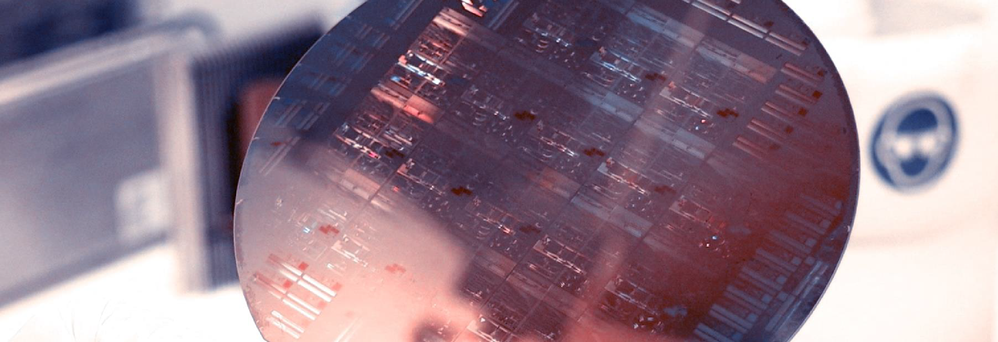
Lab Book 2.0 Couplers
Student:

Slide 2
Instructions
General
SCRIPTS
From GitHub →
  Fork the repo: https://github.com/cccanvas-upv/ipsp-lab2.git
  Clone the repo using VSCode
Run the Jupyter Notebook:
  COUPLERS_Student.ipynb
Cross-Sections to be studied:
w (width)
w (width)
h
(height)
Core
Core
h
(height)
MMI Body
g
(gap)
Cladding
Cladding
Directional coupler (DC)
Multimode Interference (MMI) coupler

Slide 3
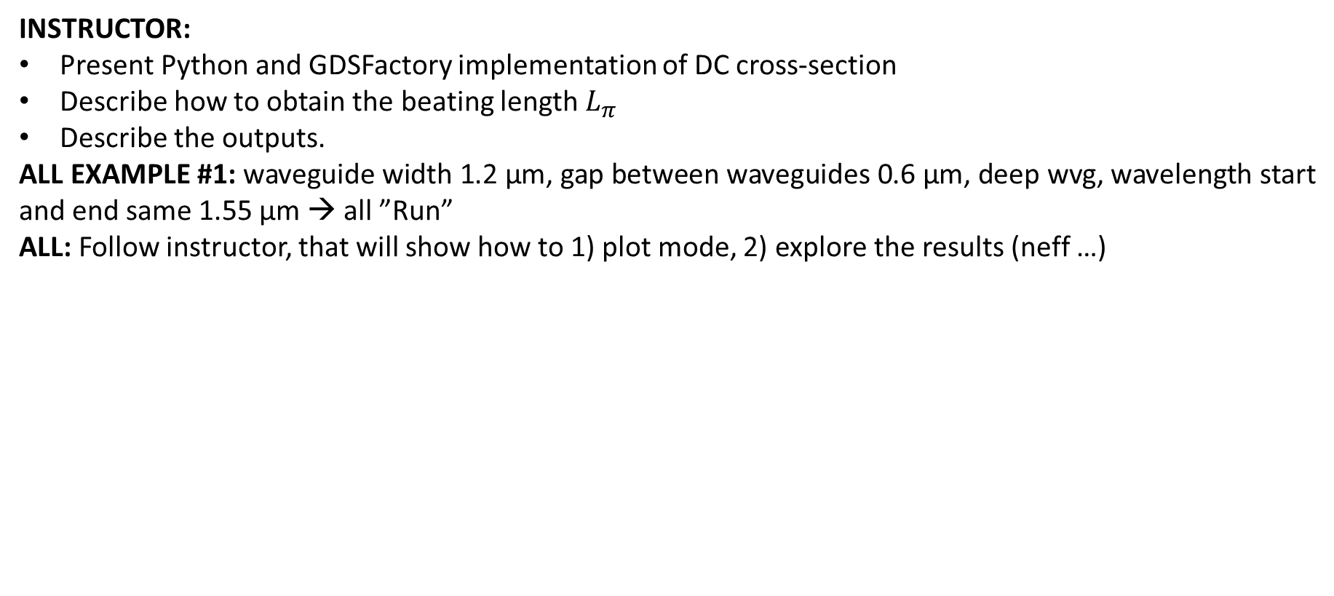
Learning outcome #1 – Directional coupler cross-section in GDSFactory
INSTRUCTOR:
Present Python and GDSFactory implementation of DC cross-section
Describe how to obtain the beating length $L_{π}$
Describe the outputs.
ALL EXAMPLE #1: waveguide width 1.2 µm, gap between waveguides 0.6 µm, deep wvg, wavelength start and end same 1.55 µm → all ”Run”
ALL: Follow instructor, that will show how to 1) plot mode, 2) explore the results (neff …)
Document all your results (neff, plot fields of different modes, comparison between different polarizations…)

Slide 4
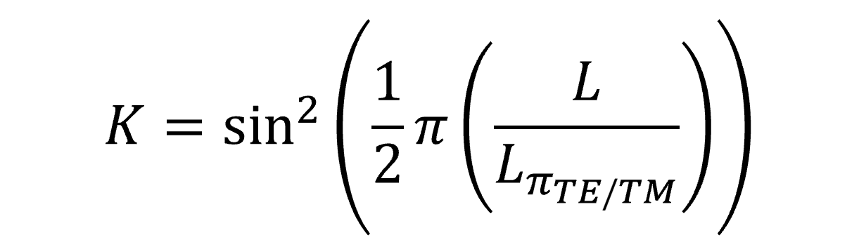
Learning outcome #2 – Directional coupler length and coupling coefficient
Wavelength 1.5 µm – width 1.2 µm – gap 0.6 µm
deep waveguide
Paste L/Lpi vs K plot here
Comment results (distance needed for a complete energy transfer between waveguides, distance needed for splitting power in half.. )

Slide 5
Learning outcome #3 – 2x2 Directional Coupler
Waveguide width 1.2 µm, Gap between waveguides 0.6 µm – Wavelength 1.55 µm
deep waveguide
Paste propagation plots and output text here
Comment results (Coupling relationship, Lpi, losses, … )

Slide 6
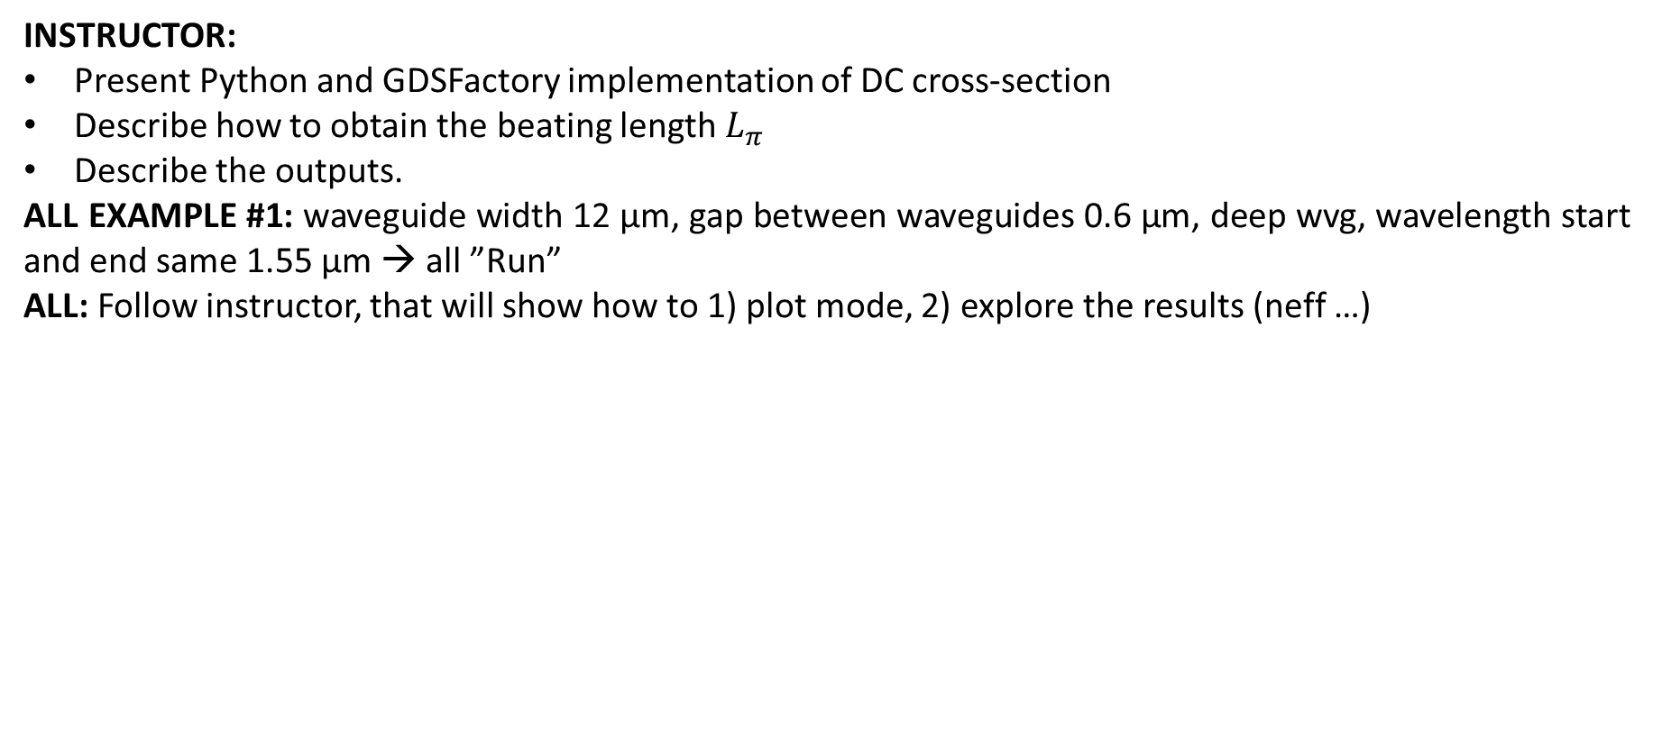
Learning outcome #4 – Multimode Interference (MMI) Coupler cross-section
INSTRUCTOR:
Present Python and GDSFactory implementation of DC cross-section
Describe how to obtain the beating length $L_{π}$
Describe the outputs.
ALL EXAMPLE #1: waveguide width 12 µm, gap between waveguides 0.6 µm, deep wvg, wavelength start and end same 1.55 µm → all ”Run”
ALL: Follow instructor, that will show how to 1) plot mode, 2) explore the results (neff …)
Document all your results (neff, plot fields of different modes, comparison between different polarizations…)

Slide 7
Learning outcome #5 – 2x2 Multimode Interference Coupler
Body width 6 µm and 12 µm – Wavelength 1.55 µm
deep waveguide
Paste propagation plots and output text here
Comment results (Coupling relationship, Lpi, losses, comparison with Directional Coupler… )

Slide 8
Learning outcome #6 – 1x4 Multimode Interference Coupler
Wavelength 1.55 µm, wMMI = ? µm
deep waveguide
Paste propagation plots and console results
Repeat all the design process for a 1x4 MMI Coupler.

Slide 9
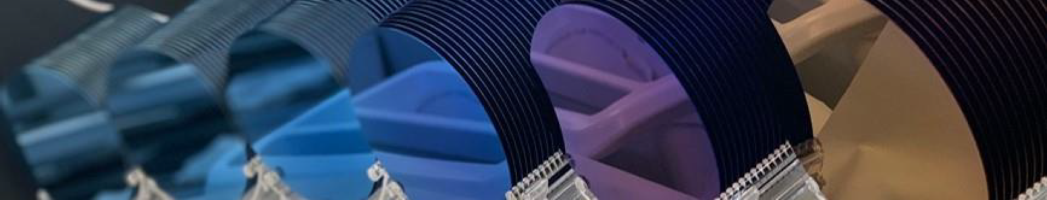
Thank you

