Slide 1
Becoming a Modeler
Carra Carrillo

Slide 2
What to expect
Background
Modeling career
Common modeling difficulties
How to overcome difficulties
Conclusion
Questions

Slide 3
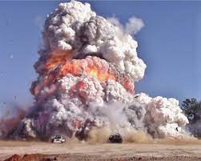

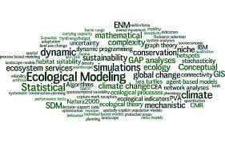
About Me
Student worker testing military explosives in high school/early college
Graduated from Mississippi State University in 2015 in Civil and Environmental Engineering
Began my career at ERDC working on dredging projects and sediment settling tests.
Began modeling in summer 2016

Slide 4
Modeling Career
Began working on a Netlogo model projecting the spread of dreissenid mussels in the western US
Developed a script to calculate elevation differences of lakes to project likelihood of dreissenid mussel invasion
Helped develop a model that calculates the HSI of ecosystems to increase/reintroduce species of freshwater mussels and salmon
Currently a member on a team that is developing a model that generalizes existing photosynthesis-based vegetation models for freshwater aquatic, dune, and crop vegetation communities.

Slide 5
Modeling Difficulty
Computers are only as smart as the user
K.I.S – Keep It Simple
Conceptual modeling and code outlining
When in doubt, take a break
Save……….ALOT!!!!
Make thorough comments throughout code
Explaining out loud

Slide 6
Modeling Difficulty
Computers are only as smart as the user

