Slide 1
Collectives
A Wild Dog Model

Slide 2
Intro
African wild dogs that are endangered and carefully managed in South Africa.
Live in packs that have 1 alpha male and 1 alpha female, which are the only members to reproduce.
After pups grow into adults, they can decide if they want to stay in their natal pack or disperse.

Slide 3
Purpose
Evaluate how the persistence of a wild dog population depends on:
Reserve’s carrying capacity
Ability of dispersing dogs to find each other
Mortality risk of dispersing dogs

Slide 4
Agents & their variables
Agent | Variable
Dog/Dogs | Age Sex status
Pack/Packs
Disperser/Dispersers | Sex Natal Pack ID

Slide 5
Age of dogs in packs
Name | Age (yr)
Pup | 0
Yearling | 1
Subordinate | 2 or greater, but not alpha
Alpha | 2 or greater, dominant individual of sex

Slide 6
Process Overview
Age and social status update
Reproduction
Dispersal
Dog mortality
Mortality of collectives
Pack formation

Slide 7
Age and status
Age of dogs is incremented.
Status is updated according to their age
Pack updates its alpha males and females
If no alpha of a sex, a subordinate of that sex is randomly selected and it’s status is changed

Slide 8
Reproduction
If no alpha female and male, no pups produced.
Pup producing pack probability, P, determined by total number of dogs in population at time step, N.
Based on a logistic function
Carrying capacity of 60
Mean birth rate of 7.9
0.55 probability of male birth

Slide 9
Dispersal
If no subordinates, no disperser group created
If only 1 subordinate of its sex, 0.5 probability of forming a 1-member group
2 of more subordinate of its sex, always form disperser group
Social status is set to “disperser”

Slide 10
Dog mortality
Determined stochastically using following probabilities:
Status | Probability
Disperser | 0.44
Yearling | 0.25
Subordinates | 0.2
Alphas | 0.2
Pups | 0.12

Slide 11
Collectives Mortality
If pack or disperser group has no members, removed from model
If pack contains only pups, pups die and pack is removed

Slide 12
Pack Formation
If groups meet and they are the opposite sex and from a different pack, groups may or may not form new pack.

Slide 13
Group Jobs
Each group will work on 1 of the remaining variables that need to be completed to get the model running.
The code is completed right now to allow each group to run the “setup” procedure in the interface.

Slide 14
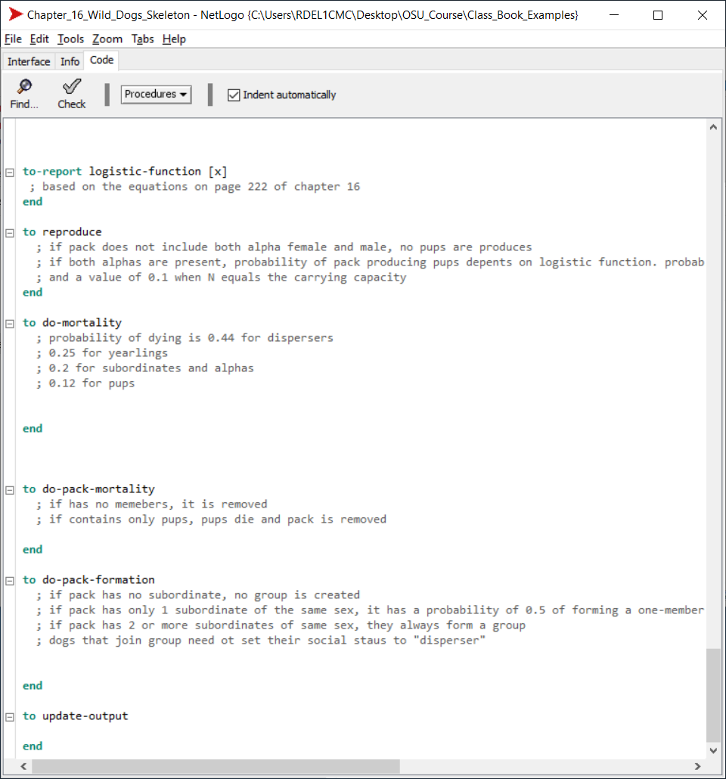
Group 1

Slide 15
Group 2

Slide 16
Group 3

Slide 17
Group 4

