Slide 1
Becoming a Modeler
Carra Carrillo

Slide 2
What to expect
Background
Modeling career
Common modeling difficulties
How to overcome difficulties
Conclusion
Questions

Slide 3


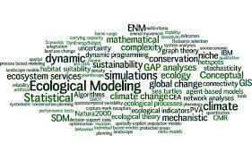
About Me
Student worker testing military explosives in high school/early college
Graduated from Mississippi State University in 2015 in Civil and Environmental Engineering
Began my career at ERDC working on dredging projects and sediment settling tests.
Began modeling in summer 2016

Slide 4
Modeling Career
Began working on a Netlogo model projecting the spread of dreissenid mussels in the western US
Developed a script to calculate elevation differences of lakes to project likelihood of dreissenid mussel invasion
Helped develop a model that calculates the HSI of ecosystems to increase/reintroduce species of freshwater mussels and salmon
Currently a member on a team that is developing a model that generalizes existing photosynthesis-based vegetation models for freshwater aquatic, dune, and crop vegetation communities.

Slide 5
Modeling Difficulty
K.I.S – Keep It Simple
Conceptual modeling and code outlining
When in doubt, take a break
Save……….ALOT!!!!
Make thorough comments throughout code
Explaining out loud

Slide 6
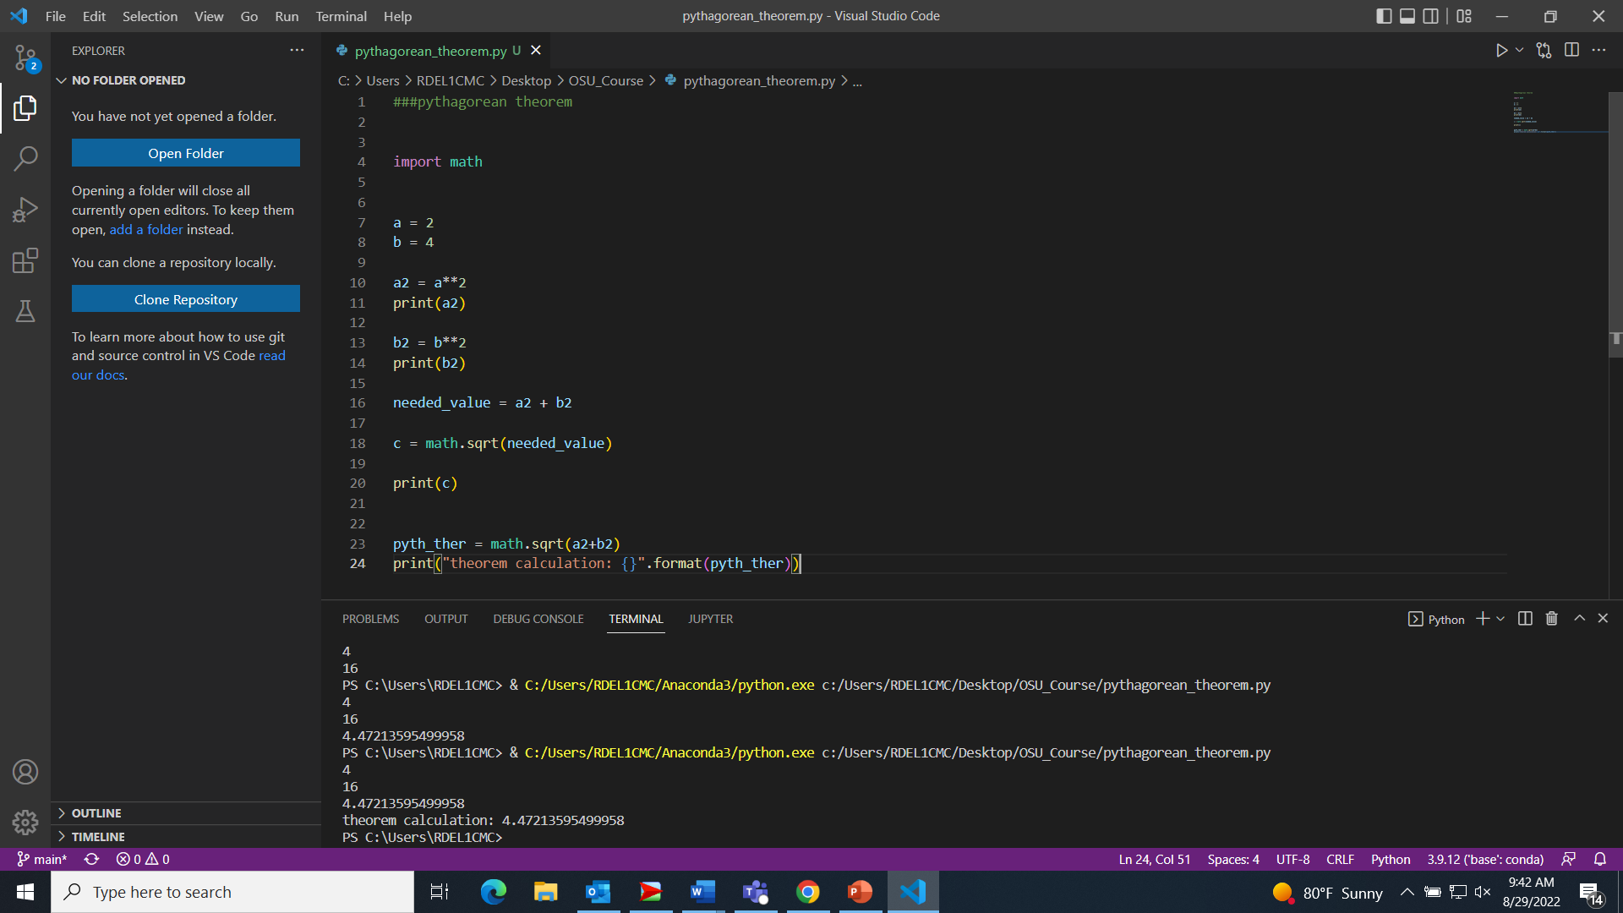
Modeling Difficulty
Keep It Simple
When starting to code, it is better to have multiple small, simple steps
Example: Quadratic Equation
A = 2
B = 4
C = 4.47
Simple
Advanced

Slide 7
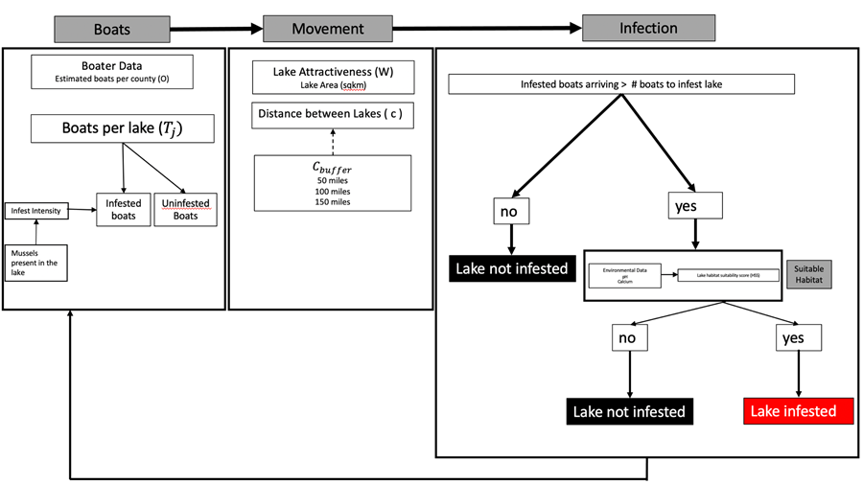
Modeling Difficulty
Conceptual modeling and code outlining

Slide 8
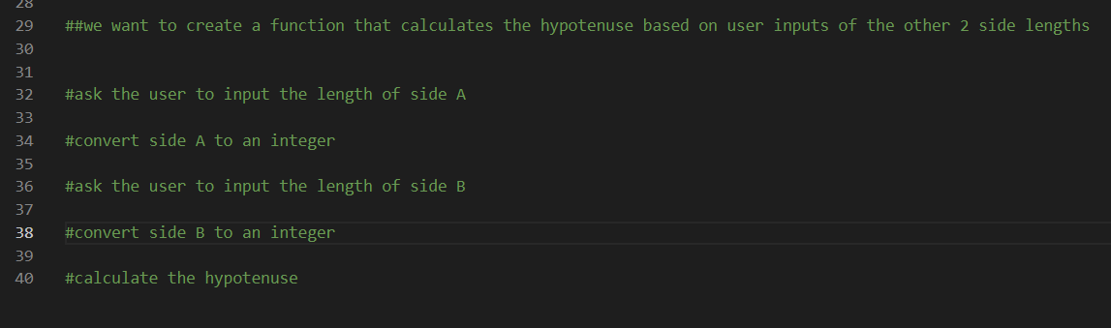
Modeling Difficulty
Conceptual modeling and code outlining

Slide 9

Modeling Difficulty
When in doubt, take a break
Go for a walk
Get a snack
Move to another task

Slide 10

Modeling Difficulty
Save……….ALOT!!!!
After each chunk of code
Set computer to autosave
Won’t lose as much data if computer reboots

Slide 11
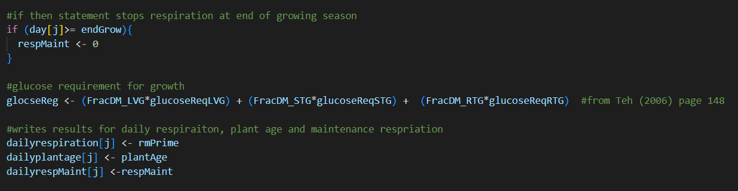
Modeling Difficulty
Make thorough comments throughout code
Helps you remember what the code is doing
Help others know what you are wanting to do

Slide 12
Modeling Difficulty
Explaining out loud
Verbally explaining the conceptual model can help find errors
Fresh eyes and ears can ask questions/make suggestions

Slide 13
Conclusion
Modeling takes practice
Need to work on it many times before fully comfortable
A new language
It’s ok to get frustrated, that comes with the territory

Slide 14

Questions?

