Slide 1
Criteria
Drawdown Definition
A minimum of 1 ft (or user specified) decrease in water level from the day prior.
Water level remains at that lower level, or continue to decrease, for five consecutive days.
Drawdown ends
The water elevation increased by a minimum of 1 ft (or user specified).
The elevation remained constant for a minimum of five days.

Slide 2
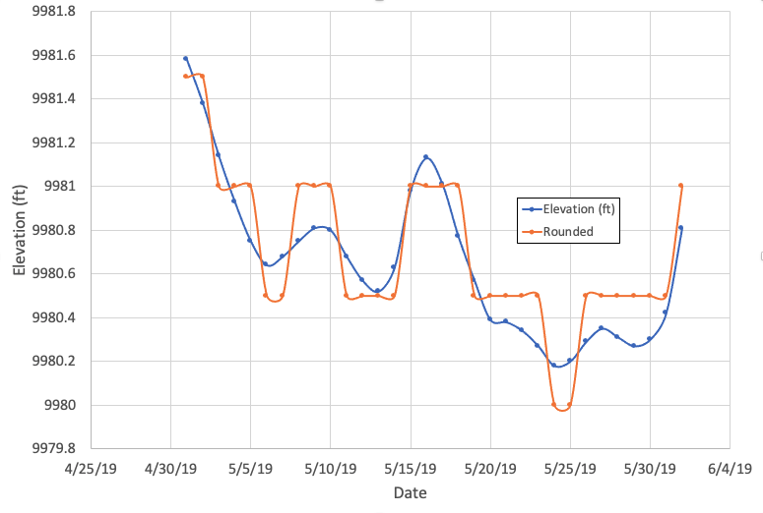
Platoro Reservoir (5/1/19 – 6/1/19)
Note:
This example’s criteria is set at 0.5 ft

Slide 3
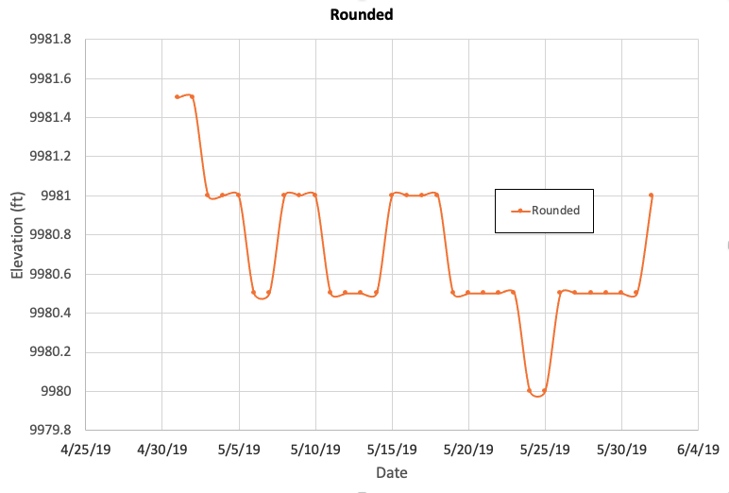

Rounded Comparison
Note:
This example’s criteria is set at 0.5 ft
Version 1
Note:
Version1 meets all definitions as specified previously
Version 2

Slide 4
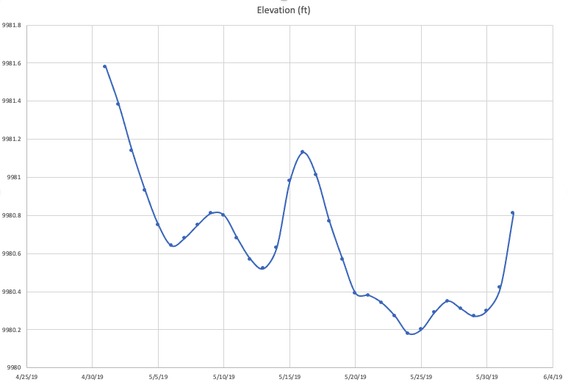
Nonrounded Comparison
Note:
This example’s criteria is set at 0.5 ft
0.24 ft
0.21 ft
Note:
Previous drawdown data does not translate well to non-rounded data
Version 1
0.18 ft
0.11 ft
Version 2

Slide 5
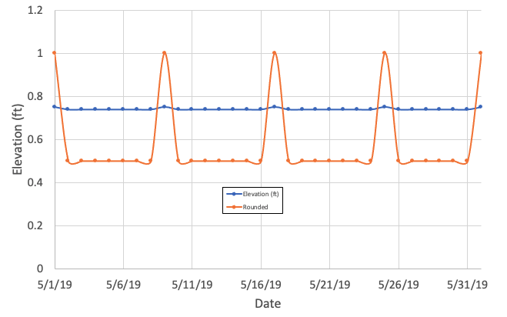
Rounding Concerns
Conclusion:
Criteria >> rounded values

Slide 6
Criteria (Version 3)
Drawdown Definition
A minimum of 1 ft (or user specified) decrease in water level from the day prior.
Water level remains at that lower level, or continue to decrease, for five consecutive days.
Drawdown ends
The water elevation exceeds 1 ft (or user specified) lower level threshold.
The elevation remained within 1 ft (or user specified) or increased for a revolving five day period.

Slide 7
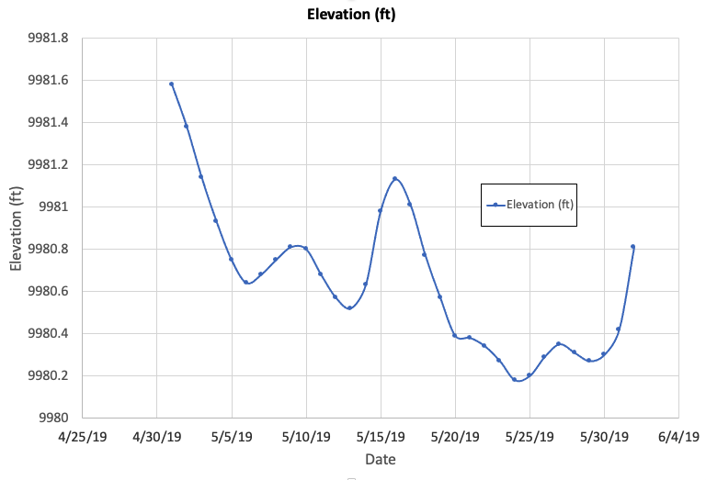
Version 3 (0.5 ft)
Note:
No drawdowns found by definition
0.24 ft
0.21 ft
0.18 ft
0.11 ft

Slide 8
Version 3 (0.2 ft)
Day 5
Although drops, does not drop at criteria level
After 5 days, revolving 5 day period increased
After 5 days, revolving 5 day period less than 0.2 ft
0.12 ft

Slide 9
Results & Metrics

Slide 10
Version 1
1 ft
0.2 ft

Slide 11

Version 1
Version 3
Version 3 results contain longer drawdowns (but makes sense)
Is rate of drawdown and magnitude still calculated correctly / meaningful?

Slide 12
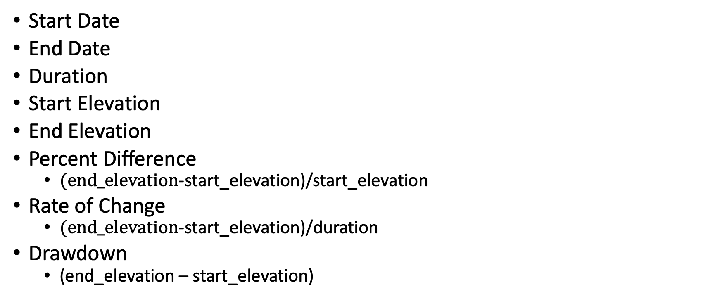
Metrics
Start Date
End Date
Duration
Start Elevation
End Elevation
Percent Difference
$(end_elevation$-start_elevation)/start_elevation
Rate of Change
$(end_elevation$-start_elevation)/duration
Drawdown
(end_elevation – start_elevation)

Slide 13
Version 3 0.2 ft
Version 3 1.0 ft

Slide 14
Lakes with 0 drawdowns
Lake | # of drawdowns Version 1 | # of drawdowns Version 3 | Max daily drop
Taylor Park | 202 | 0 | 0.6 ft
Deer Creek | 291 | 0 | 0.8 ft
Willard Bay | 118 | 0 | 0.25 ft
Platoro Reservoir | 53 | 0 | 0.7 ft
Pactola Reservoir | 327 | 0 | 0.59 ft
Navajo Reservoir | 179 | 0 | 0.64 ft
Lake Elwell | 110 | 0 | 0.33 ft
Lake Powell | 98 | 0 | 0.86 ft
Lake Mead | 413 | 0 | 0.55 ft
Keith Sebelius Reservoir | 150 | 0 | 0.41 ft
Flaming Gorge | 187 | 0 | 0.34 ft

Slide 15
Other future next steps
5 day requirement tied to month and location (i.e. temperature related)

