Slide 1
Criteria
Drawdown Definition
A minimum of 1 ft (or user specified) decrease in water level from the day prior.
Water level remains at that lower level, or continue to decrease, for five consecutive days.
Drawdown ends
The water elevation increased by a minimum of 1 ft (or user specified).
The elevation remained constant for a minimum of five days.

Slide 2
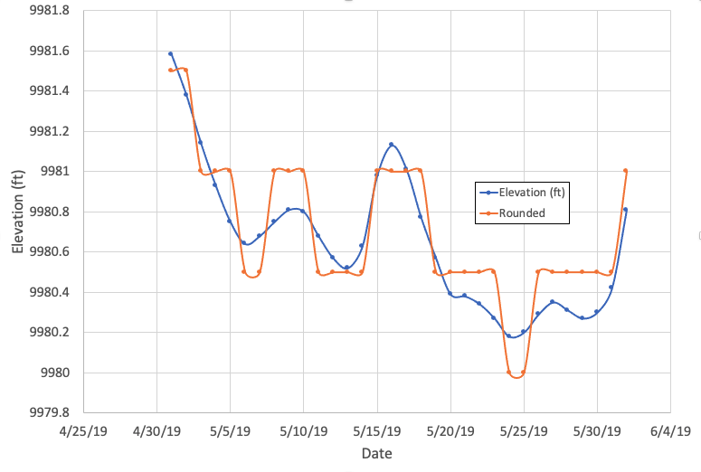
Platoro Reservoir (5/1/19 – 6/1/19)
Note:
This example’s criteria is set at 0.5 ft

Slide 3
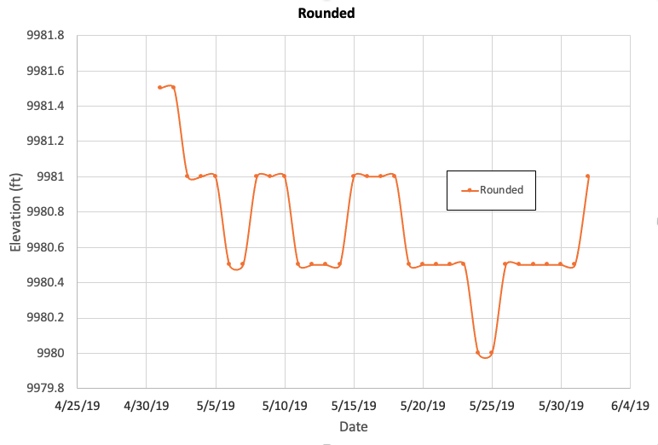

Rounded Comparison
Note:
This example’s criteria is set at 0.5 ft
Version 1
Note:
Version1 meets all definitions as specified previously
Version 2

Slide 4
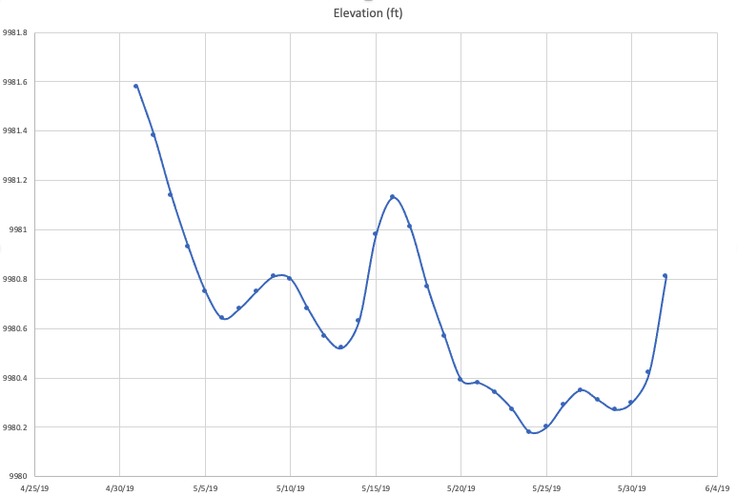
Nonrounded Comparison
Note:
This example’s criteria is set at 0.5 ft
0.24 ft
0.21 ft
Note:
Previous drawdown data does not translate well to non-rounded data
Version 1
0.18 ft
0.11 ft
Version 2

Slide 5
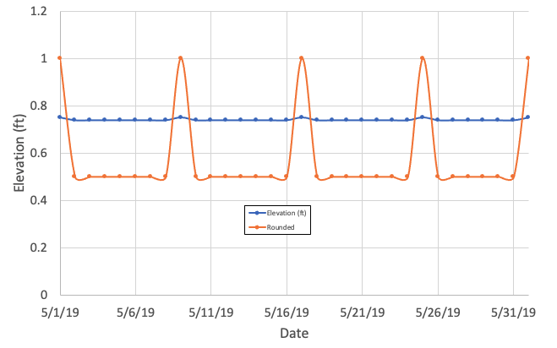
Rounding Concerns
Conclusion:
Criteria >> rounded values

Slide 6
Criteria (Version 3)
Drawdown Definition
A minimum of 1 ft (or user specified) decrease in water level from the day prior.
Water level remains at that lower level, or continue to decrease, for five consecutive days.
Drawdown ends
The water elevation exceeds 1 ft (or user specified) lower level threshold.
The elevation remained within 1 ft (or user specified) or increased for a revolving five day period.

Slide 7
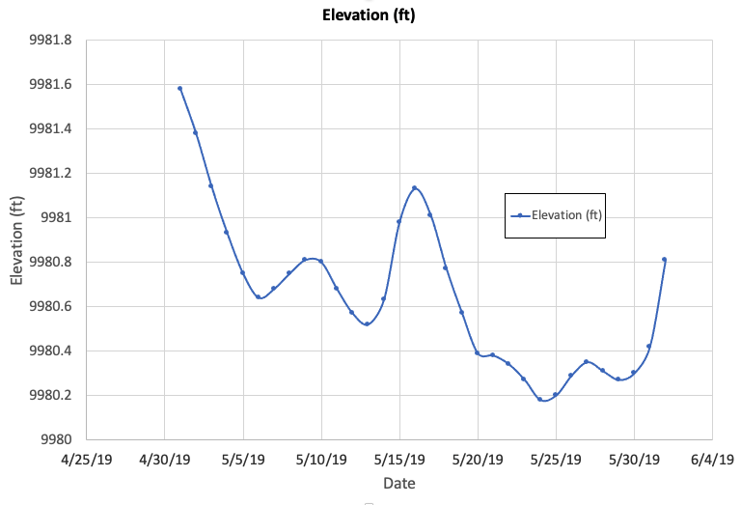
Version 3 (0.5 ft)
Note:
No drawdowns found by definition
0.24 ft
0.21 ft
0.18 ft
0.11 ft

Slide 8
Version 3 (0.2 ft)
Day 5
Although drops, does not drop at criteria level
After 5 days, revolving 5 day period increased
After 5 days, revolving 5 day period less than 0.2 ft
0.12 ft

Slide 9
Results & Metrics

Slide 10

Version 1
Version 3
Version 3 results contain longer drawdowns (but makes sense)
Is rate of drawdown and magnitude still calculated correctly / meaningful?
Notes:
Not saying aren’t different. Difference just isn’t as drastic as appears due to axis.

Slide 11
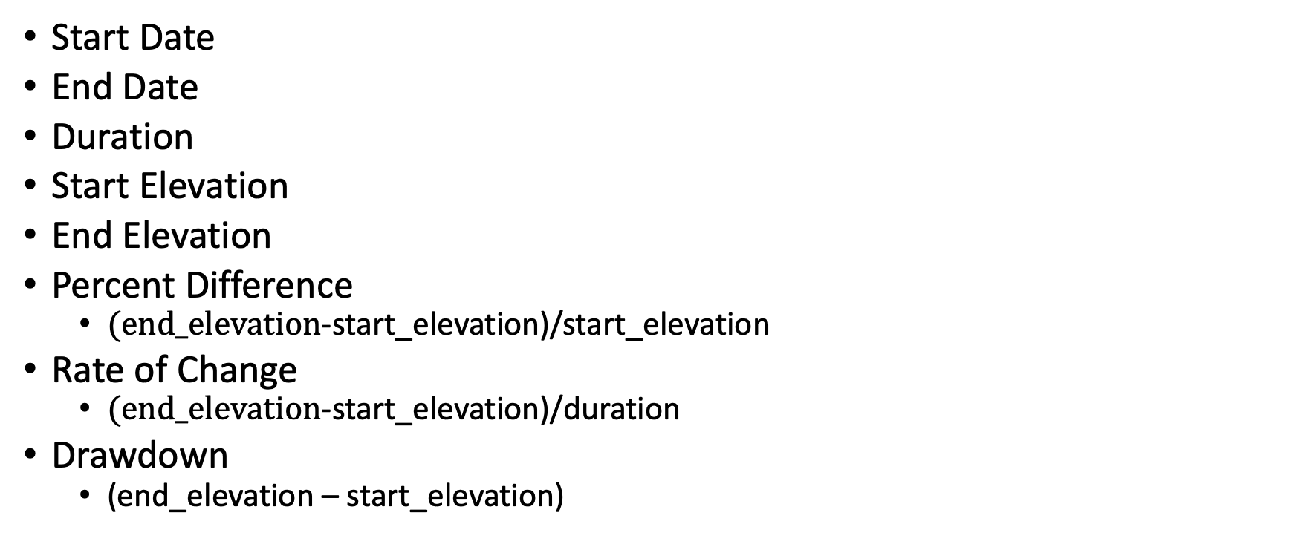
Metrics
Start Date
End Date
Duration
Start Elevation
End Elevation
Percent Difference
$(end_elevation$-start_elevation)/start_elevation
Rate of Change
$(end_elevation$-start_elevation)/duration
Drawdown
(end_elevation – start_elevation)
Notes:
Extended length of drawdown. Instead of start/end, do we want to find where it hit bottom (bottom elevation vs end elevation).

Slide 12
Version 3 0.2 ft
Version 3 1.0 ft
Notes:
1 ft has far less drawdowns than 0.2 ft. % of year in drawdown is very low

Slide 13
Lakes with 0 drawdowns in a 1 ft requirement.
Lake | # of drawdowns Version 1 | # of drawdowns Version 3 | Max daily drop
Taylor Park | 202 | 0 | 0.6 ft
Deer Creek | 291 | 0 | 0.8 ft
Willard Bay | 118 | 0 | 0.25 ft
Platoro Reservoir | 53 | 0 | 0.7 ft
Pactola Reservoir | 327 | 0 | 0.59 ft
Navajo Reservoir | 179 | 0 | 0.64 ft
Lake Elwell | 110 | 0 | 0.33 ft
Lake Powell | 98 | 0 | 0.86 ft
Lake Mead | 413 | 0 | 0.55 ft
Keith Sebelius Reservoir | 150 | 0 | 0.41 ft
Flaming Gorge | 187 | 0 | 0.34 ft

Slide 14
Other future next steps
5 day requirement tied to month and location (i.e. temperature related)

