Slide 1
Wavelet-Based EEG Features for fMRI Network Decoding
DWT Statistical Features Improve Cross-Subject Transfer by 56%
17 subjects • simultaneous EEG-fMRI • neurofeedback task
DMNELF Project • June 2026

Slide 2
Motivation: Why Wavelets?
Current pipeline: Hilbert envelope → 5 fixed bands → per-TR power → HRF
→ Captures only amplitude envelope (power)
→ Misses signal variability, complexity, and transient dynamics
Wavelet transform (most common EEG feature method — Saeidi et al. 2021):
→ Adaptive time-frequency resolution
→ Can extract statistical features beyond power
Key idea from Santaji & Desai (2020):
Wavelet coefficient statistics (mean, std, entropy, energy) per sub-band
achieved 97.8% accuracy for sleep stage classification with Random Forest
Our hypothesis: wavelet statistics capture within-TR dynamics
that instantaneous power amplitude averages out
→ Better features for cross-subject generalization

Slide 3
Methods: 4 Feature Extraction Approaches
1. Hilbert Envelope (baseline)
Bandpass → |Hilbert| → per-TR mean → log → HRF
155 features (31 ch × 5 bands × 1 power)
2. Morlet CWT
Continuous wavelet at band center frequencies
155 features (same shape as Hilbert)
3. DWT (db4, 7 levels)
Discrete decomposition → coefficient energy per TR
155 features
4. DWT + Statistical Features ★
Per channel × band × TR, extract 4 features:
• Energy (Σ coeff²)
• Mean |coeff|
• Std (variability within TR)
• Shannon entropy (complexity)
620 features (31 ch × 5 bands × 4 stats)
All methods share:
→ HRF convolution (canonical double-gamma)
→ CAR (remove spatial mean per band)
→ Per-run z-scoring
Evaluation:
Within-subject: 5-fold contiguous CV, ElasticNet
Cross-subject: LOSO, Ridge α=1000
Targets: GSR'd CEN, PDA
17 subjects
DWT db4 at 500 Hz, 7 levels:
cD7 ≈ δ (2–4 Hz)
cD6 ≈ θ (4–8 Hz)
cD5 ≈ α (8–16 Hz)
cD4 ≈ β (16–31 Hz)
cD3 ≈ γ (31–63 Hz)

Slide 4
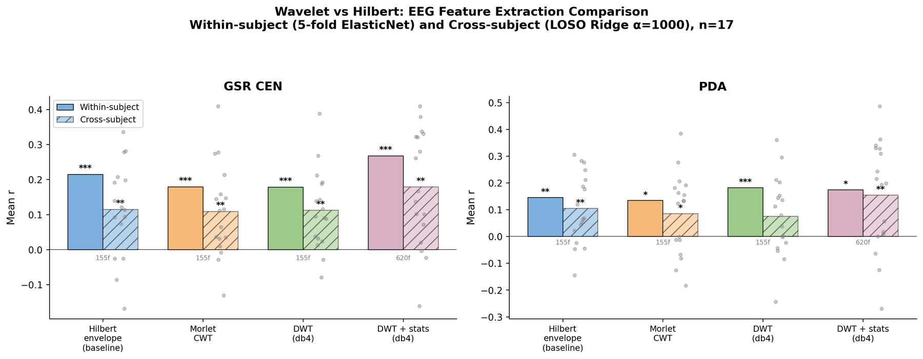
Results: Wavelet vs Hilbert
DWT+stats (620f) beats Hilbert (155f) by 56% cross-subject for GSR CEN (0.179 vs 0.115).
Morlet CWT and DWT power-only match Hilbert — the gain is from statistical features, not the wavelet itself.

Slide 5
Full Comparison Table
GSR'd CEN:
Method Within-subj r Cross-subj r Features
──────────────────────────────────────────────────────────────
DWT + stats +0.268 *** +0.179 ** 620
Hilbert (baseline) +0.215 *** +0.115 ** 155
DWT (power only) +0.179 *** +0.113 ** 155
Morlet CWT +0.179 *** +0.109 ** 155
PDA (CEN−DMN):
DWT + stats +0.175 * +0.155 ** 620
Hilbert (baseline) +0.146 ** +0.105 ** 155
DWT (power only) +0.183 *** +0.075 155
Morlet CWT +0.134 * +0.086 * 155

Slide 6
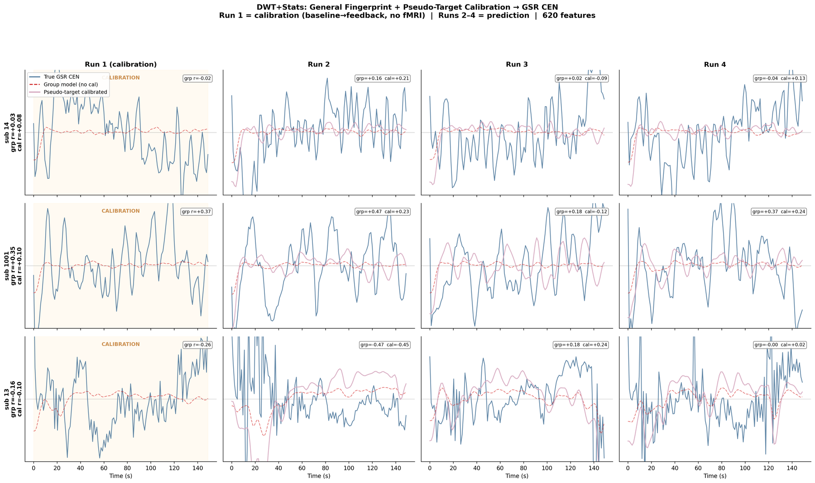
Cross-Subject Prediction + Calibration (DWT+Stats, 3 Subjects)

Slide 7
Full Picture
DWT statistical features are the best EEG features for fMRI network decoding
Cross-subject (no fMRI, no calibration):
GSR'd CEN: r = 0.179 (p = 0.001) — strong, actionable
PDA: r = 0.155 (p = 0.006) — viable for NF
GSR'd DMN: r = 0.099 (p = 0.04) — marginal, needs source space
What works: wavelet stats (std, entropy) > raw power
What doesn't: infraslow bands, PLV connectivity, Morlet CWT
Practical pipeline for EEG-only CEN neurofeedback:
DWT db4 + stats → CAR → group Ridge model
+ 1-run pseudo-target calibration (baseline→feedback block)
→ predict CEN (or PDA) in real-time, no fMRI needed

Slide 8
Next Steps
Combine DWT+stats with pseudo-target calibration
Current best with Hilbert: group r=0.12 → calibrated r=0.16
With DWT+stats group r=0.18 → calibrated expected r ≈ 0.22+?
Test DWT+stats statistical features on source-localized EEG
Wavelet stats may be even more powerful in source space
where topography variability is reduced
Feature selection: which of the 4 stats matter most?
Entropy vs std vs energy vs mean — ablation study
Real-time implementation
DWT is fast (O(n)) — suitable for real-time EEG processing
Unlike CWT which is O(n·m) where m = number of scales

Slide 9
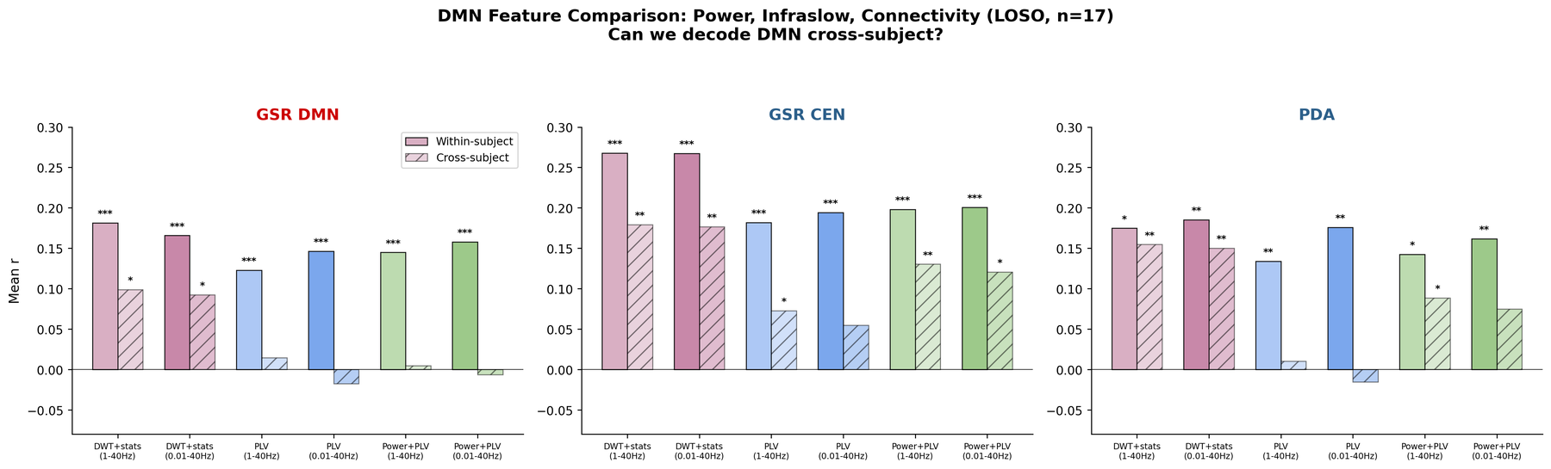
Can We Decode DMN? Infraslow + Connectivity Test
DMN is marginally decodable with DWT+stats (r=0.10, p=0.04) — first positive cross-subject DMN result.
Infraslow (0.01 Hz) does NOT help. PLV connectivity fails cross-subject (too subject-specific).
Adding PLV to power features dilutes the signal. DWT+stats alone remains best for all targets.

Slide 10
DMN Decoding: Full Results Table
GSR'd DMN (the hard target):
Method Cross-subj r p n
─────────────────────────────────────────────────────
DWT+stats (1-40Hz) +0.099 0.04 * 17
DWT+stats IS +0.093 * 17
PLV (1-40Hz) +0.014 n.s. 17
PLV IS −0.018 n.s. 17
Combined +0.005 n.s. 17
Combined IS −0.006 n.s. 17
For comparison — GSR'd CEN with same methods:
DWT+stats (1-40Hz) +0.179 0.001 ** 17 ← still best
DWT+stats IS +0.177 ** 17
PLV +0.073 * 17
Combined +0.130 ** 17

Slide 11
Implications for EEG-Only Neurofeedback
The original NF paradigm feeds back PDA = CEN − DMN
For EEG-only NF, three options:
Option A: EEG-PDA = predicted CEN − predicted DMN
CEN: r=0.18, DMN: r=0.10 → subtraction adds noise from weak DMN decoder
Option B: Decode PDA directly (CEN−DMN as single target)
r = 0.155 cross-subject — the model learns the difference pattern directly
Avoids combining two noisy estimates
Option C: Feed back CEN only
r = 0.179 cross-subject — strongest single decoder
CEN up-regulation is the active component; DMN suppression follows passively
Recommendation: Option B (direct PDA) for parity with fMRI paradigm,
Option C (CEN only) as practical fallback with stronger signal
DMN at r=0.10 is a real but weak signal — needs source localization to improve

