Slide 1
Multivariate EEG Band Power → fMRI Network Decoding
Decoding DMN and CEN from simultaneous EEG
17 subjects • simultaneous EEG-fMRI • neurofeedback task
DMNELF Project • June 2026

Slide 2
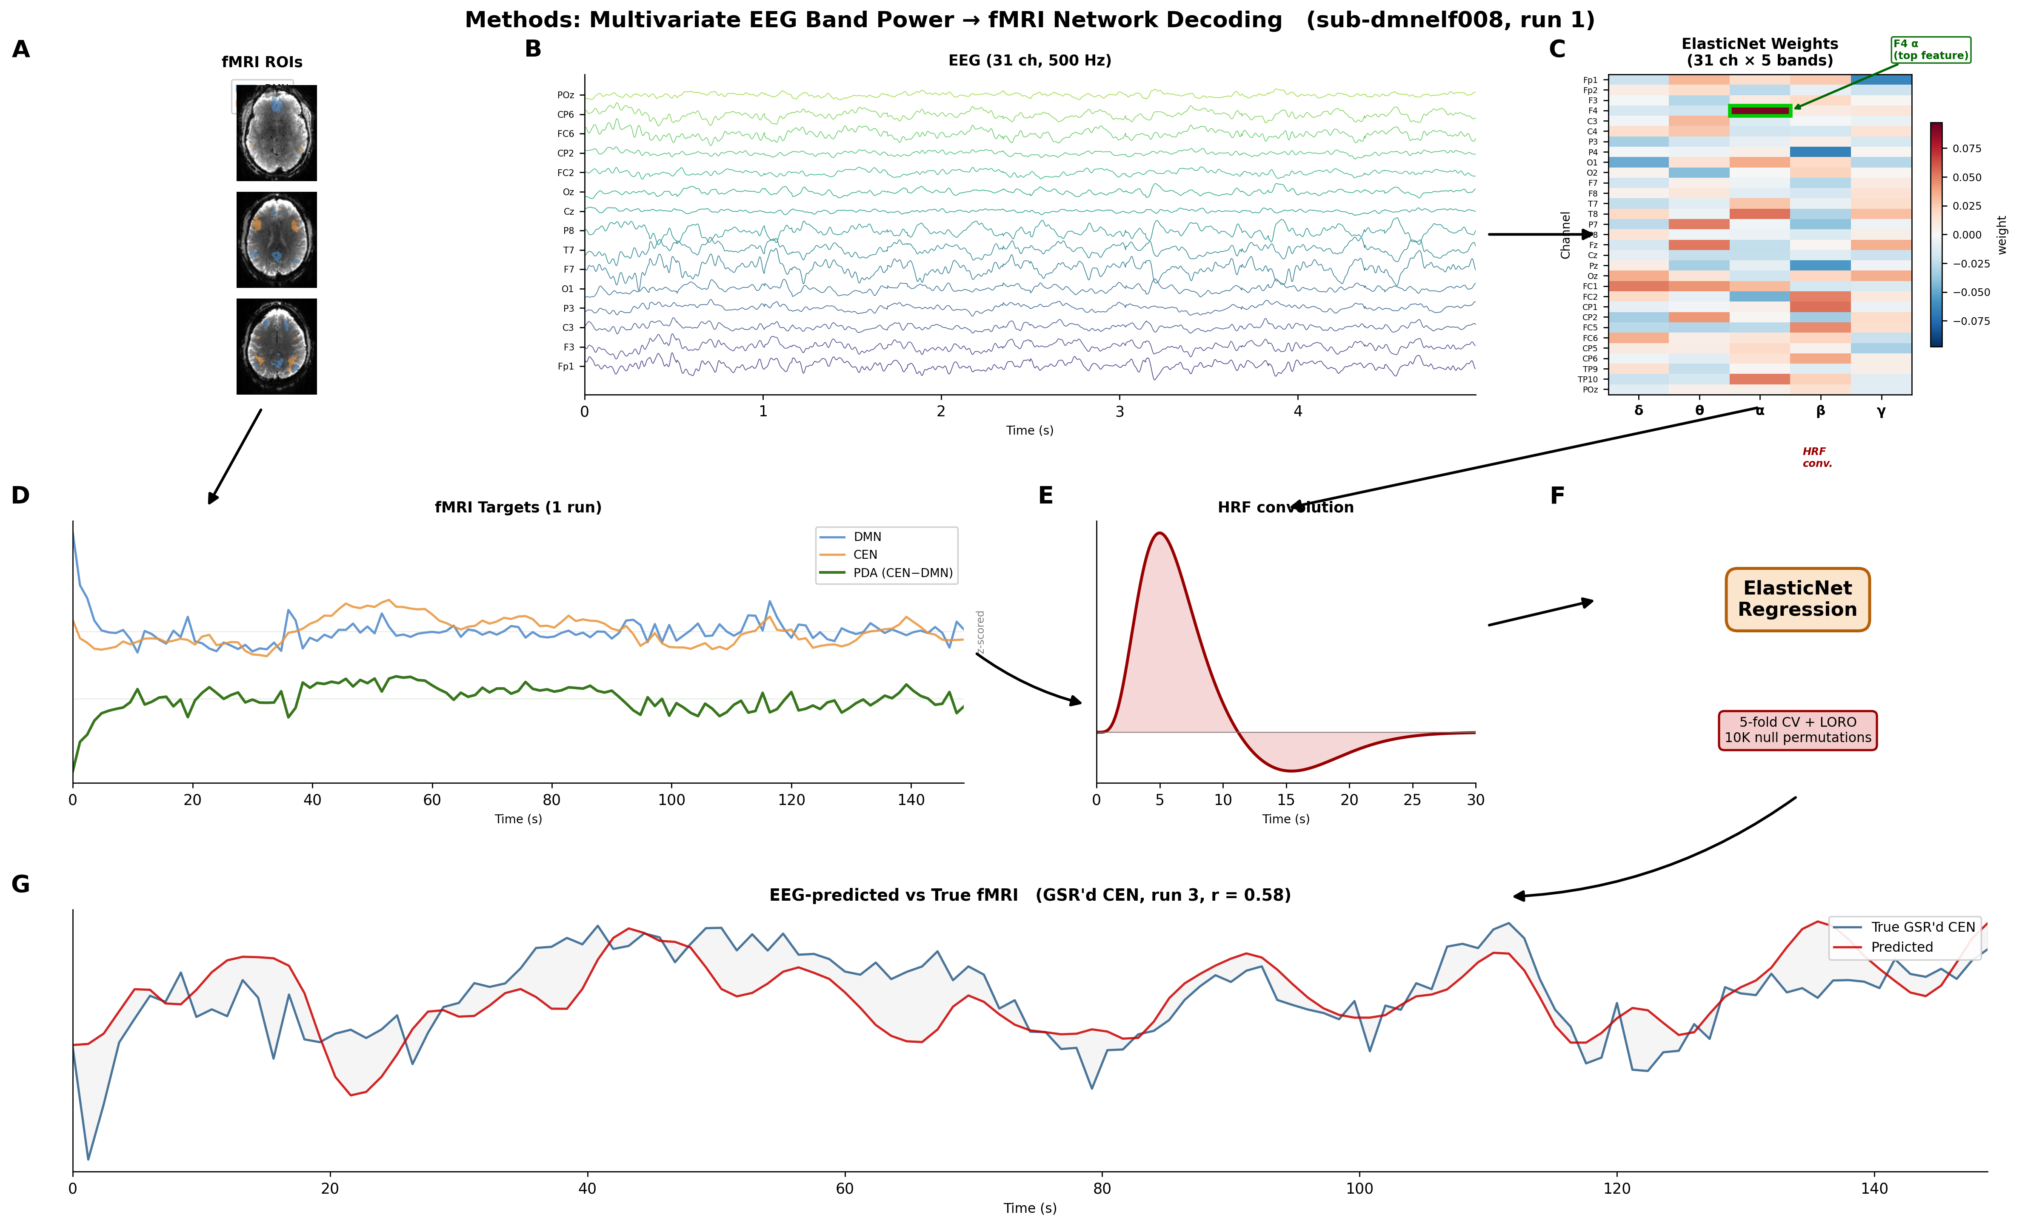
The Goal
Decode fMRI network activity (DMN, CEN) from simultaneous EEG
Why? So EEG alone can drive real-time neurofeedback without the MRI scanner
Data:
• 17 subjects, simultaneous EEG-fMRI
• 4 runs × 125 TRs (TR = 1.2s), neurofeedback task
• 31 EEG channels (10-20), preprocessed at 500 Hz
• fMRI: personalized DMN and CEN ROI timeseries

Slide 3
Methods Overview

Slide 4
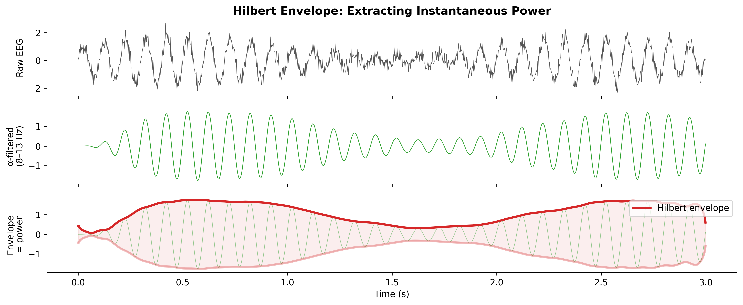
Step 1 — EEG Feature Extraction: Hilbert Envelope
For each TR (1.2s), compute power in 5 bands per channel:
δ (1–4) θ (4–8) α (8–13) β (13–30) γ (30–40 Hz)
1. Bandpass filter → isolate each band
2. Hilbert transform → analytic signal
3. |analytic| = instantaneous amplitude envelope
4. Average per TR → log transform
Result: 31 channels × 5 bands = 155 features / TR
Why Hilbert over FFT?
Preserves temporal dynamics at the TR timescale

Slide 5
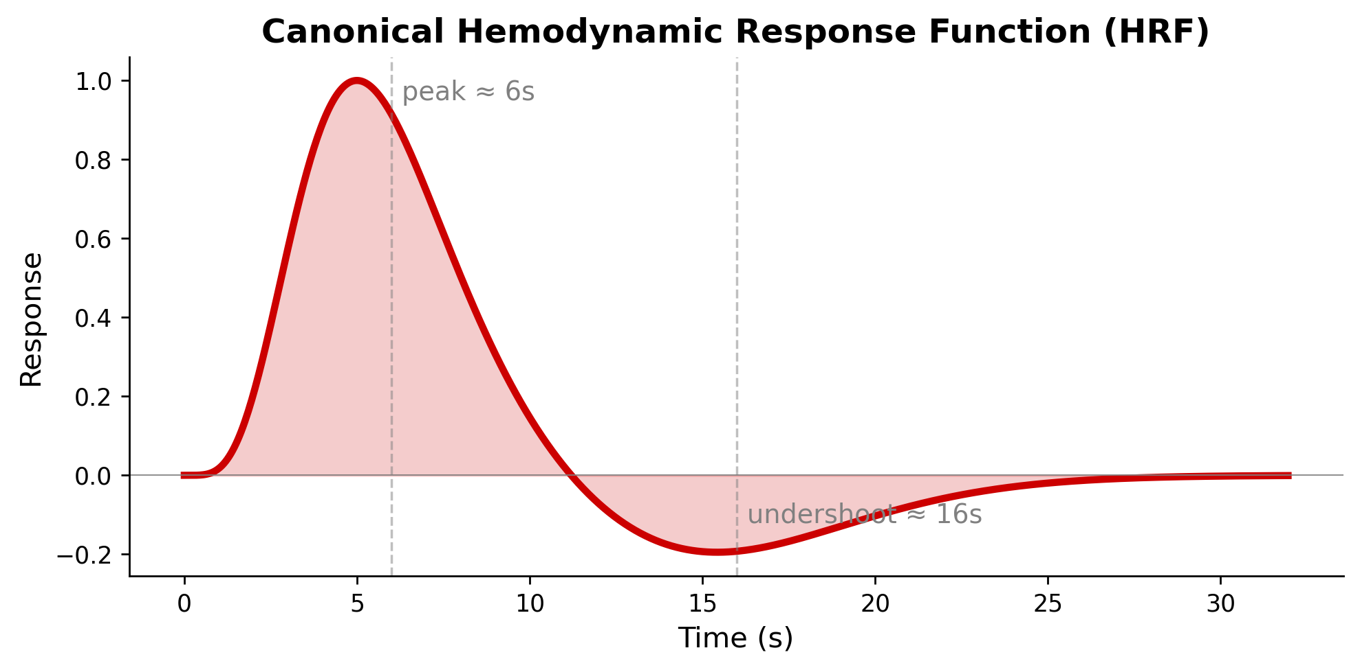
Step 2 — HRF Convolution
EEG is instantaneous, BOLD is delayed ~6s
Convolve EEG band power with the canonical
hemodynamic response function (HRF):
• Double-gamma model, 32s duration
• Peak at ~6s (main response)
• Undershoot at ~16s
This temporally aligns EEG features with
the fMRI signal they should predict

Slide 6
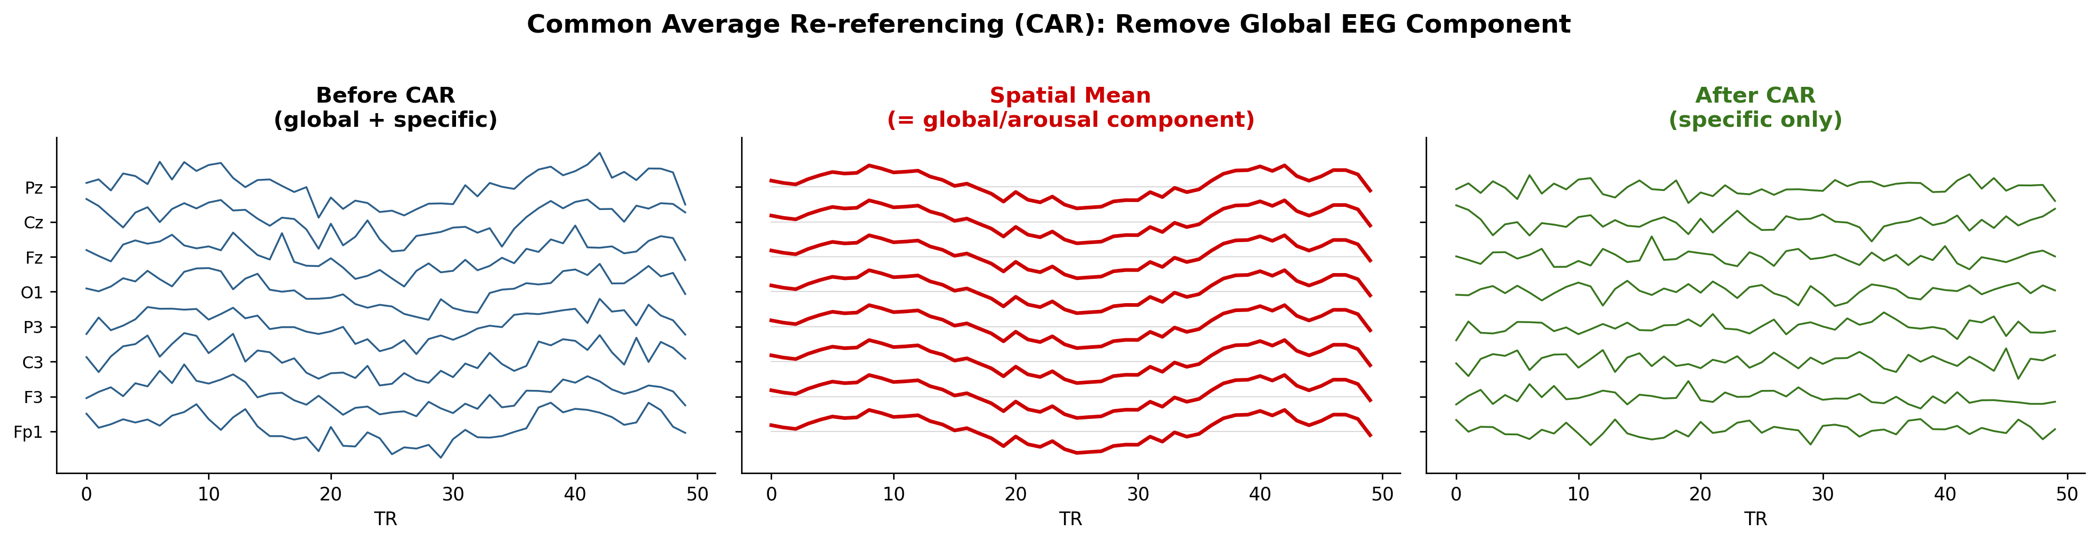
Step 3 — Common Average Re-referencing (CAR)
At each TR, subtract the spatial mean across 31 channels within each band
Removes the global broadband EEG component (= arousal) from the predictor side (X)

Slide 7
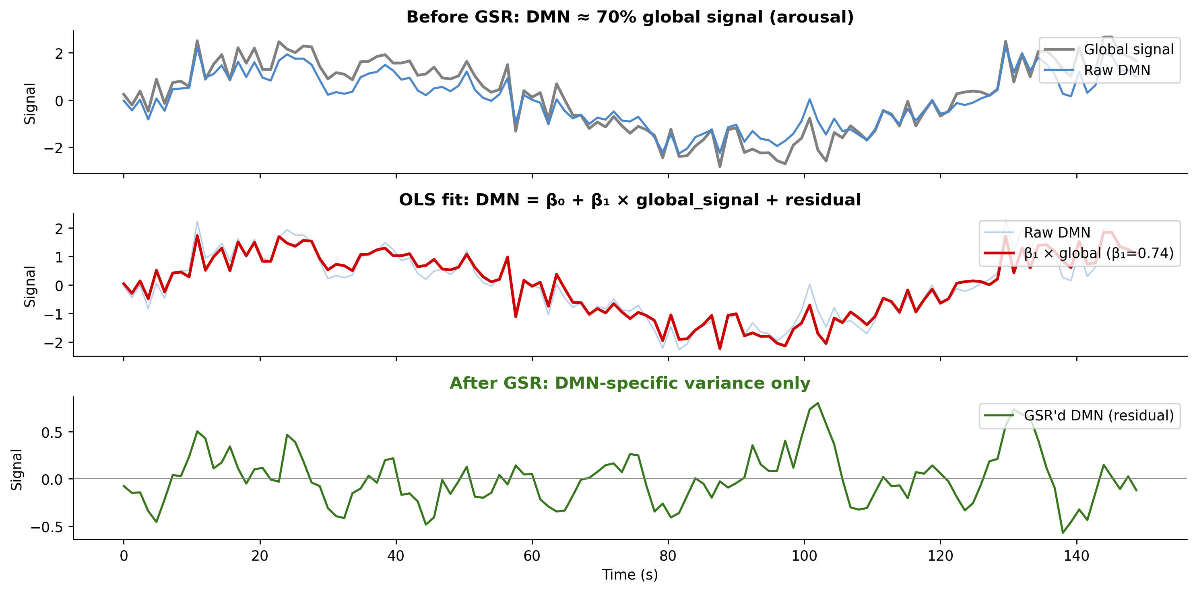
Step 4 — fMRI Targets & Global Signal Regression
Four targets (z-scored per run):
RAW DMN — includes arousal (sanity check)
GSR'd DMN — arousal removed
GSR'd CEN — arousal removed
PDA (CEN − DMN) — intrinsically arousal-free
GSR removes arousal from the target side (y):
DMN(t) = β₀ + β₁ × global_signal(t) + residual
Keep only the residual
DMN loads on global signal at r ≈ 0.70
→ ~50% of DMN variance is just arousal
CAR (EEG) + GSR (fMRI) = arousal removed
from both sides of the equation

Slide 8
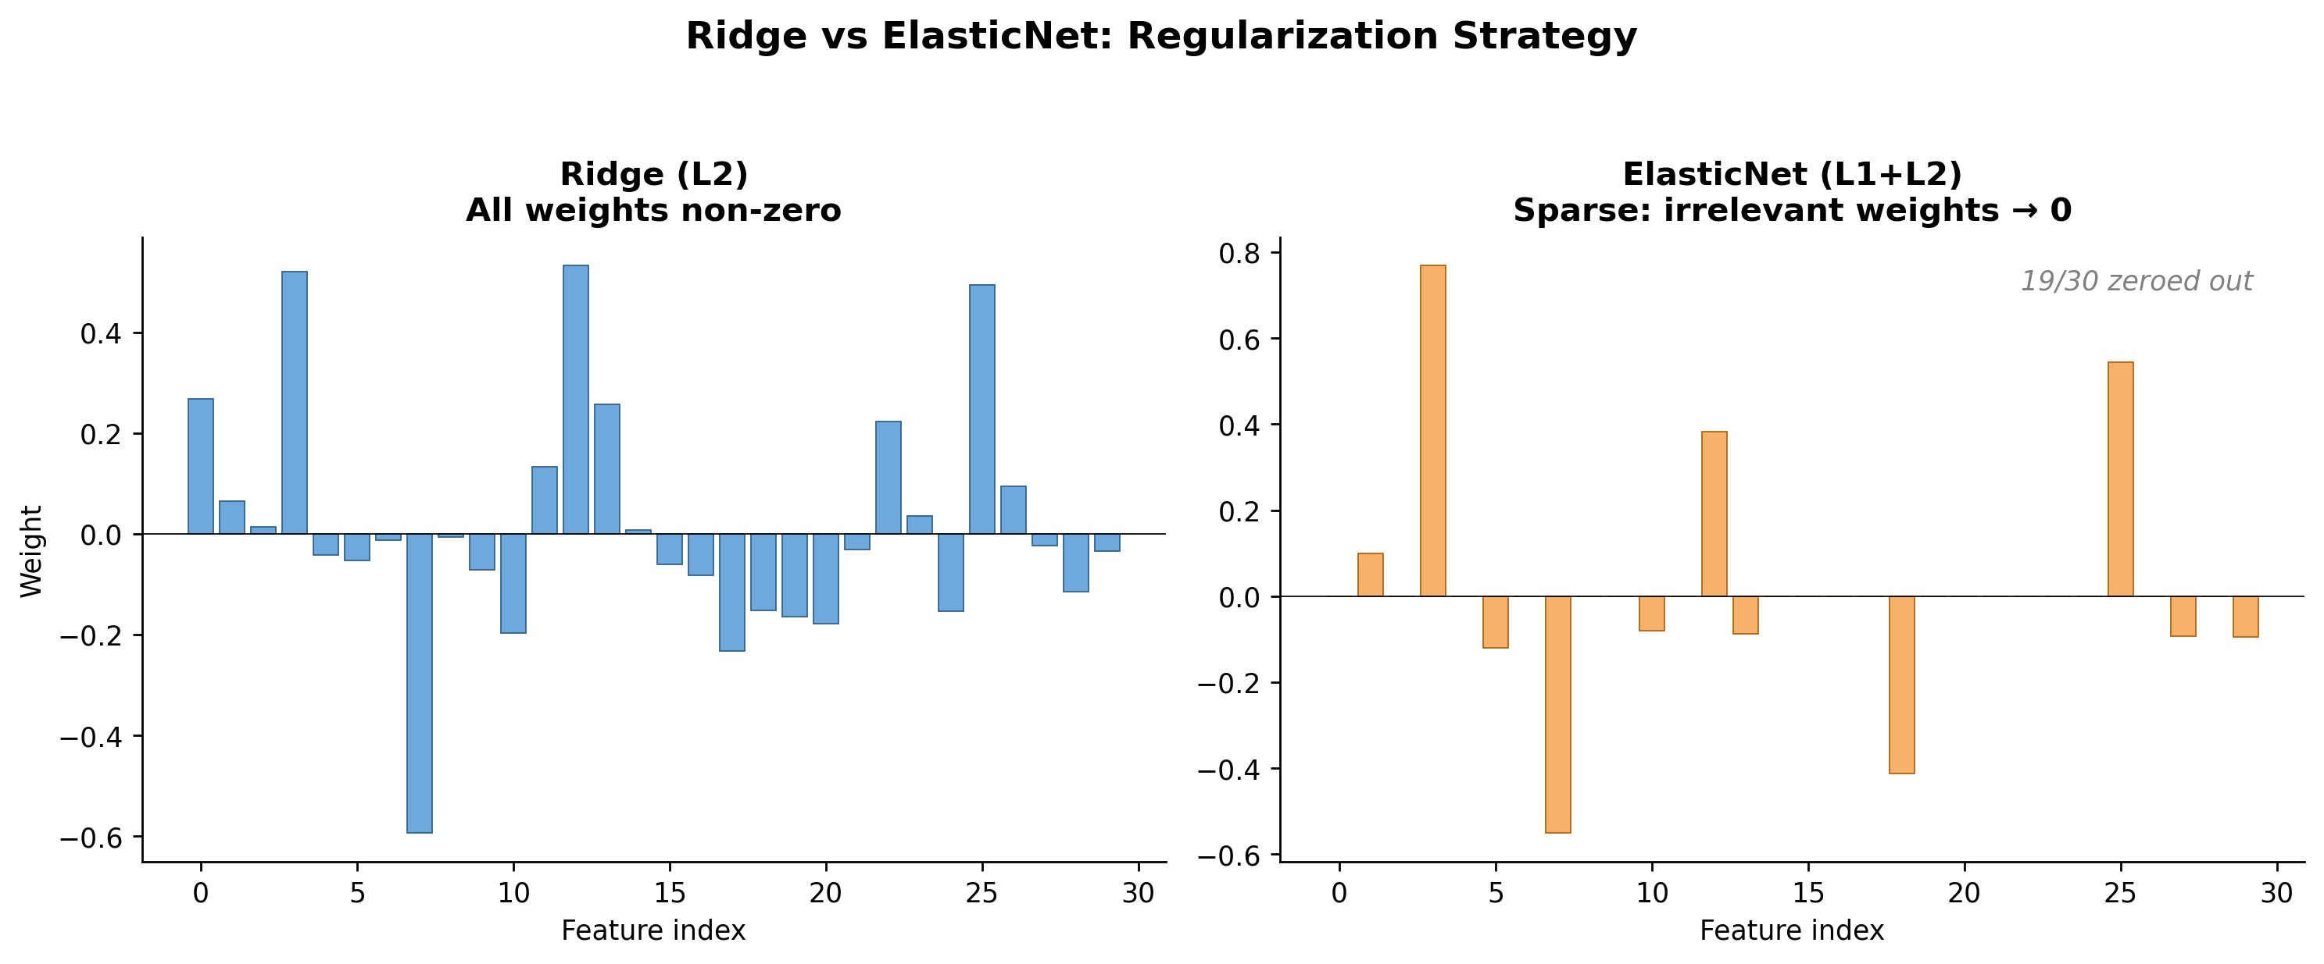
Step 5 — Ridge vs ElasticNet Regression
Both: linear regression + regularization penalty
(prevents overfitting with 155 correlated features)
Ridge (L2): penalty = Σ weight²
• Shrinks all weights toward zero
• Never sets any to exactly zero
• "Use everything, trust nothing too much"
ElasticNet (L1 + L2): penalty = mix of |weight| + weight²
• L1 can push weights to exactly zero → feature selection
• L2 handles correlated features gracefully
• Sparser, more interpretable model
ElasticNet won: zeroed only 6% of features
→ confirms the signal is genuinely distributed
but pruning noise improved generalization

Slide 9
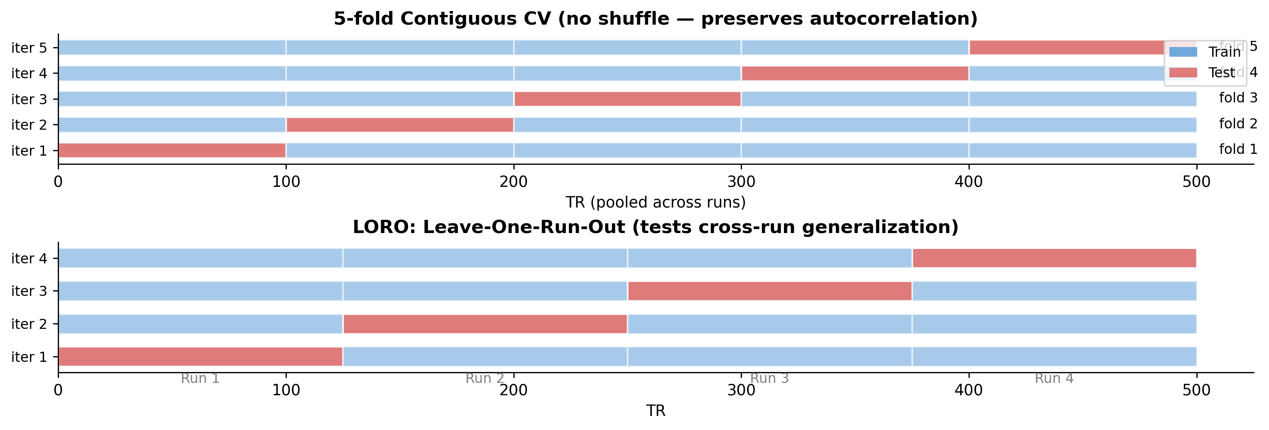
Step 5 — Cross-Validation Schemes
No shuffle — contiguous blocks preserve temporal autocorrelation (shuffled KFold gives spurious r = 0.5–0.75)

Slide 10
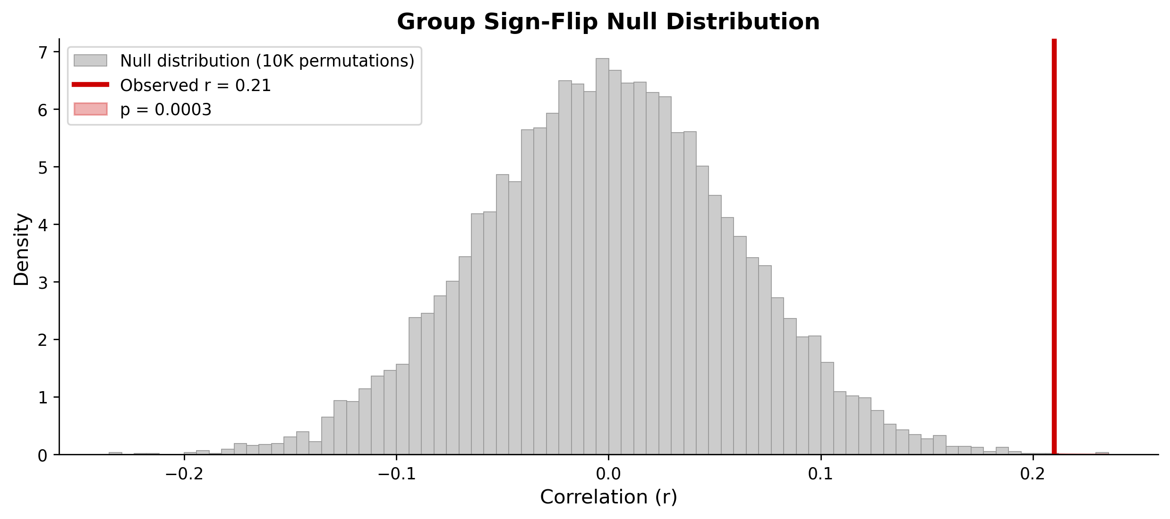
Step 6 — Statistical Testing (Permutation Nulls)
No parametric assumptions — pure permutation tests:
Per-subject: circular-shift null (10K)
• Shift fMRI target by random lag within each run
• Preserves autocorrelation structure
• Refit model → null r distribution
• p = fraction of null r ≥ observed r
Group: sign-flip null (10K)
• Randomly flip sign of each subject's mean r
• Compute null group mean
• Tests cohort-level effect
Both are non-parametric, FWER-controlled

Slide 11
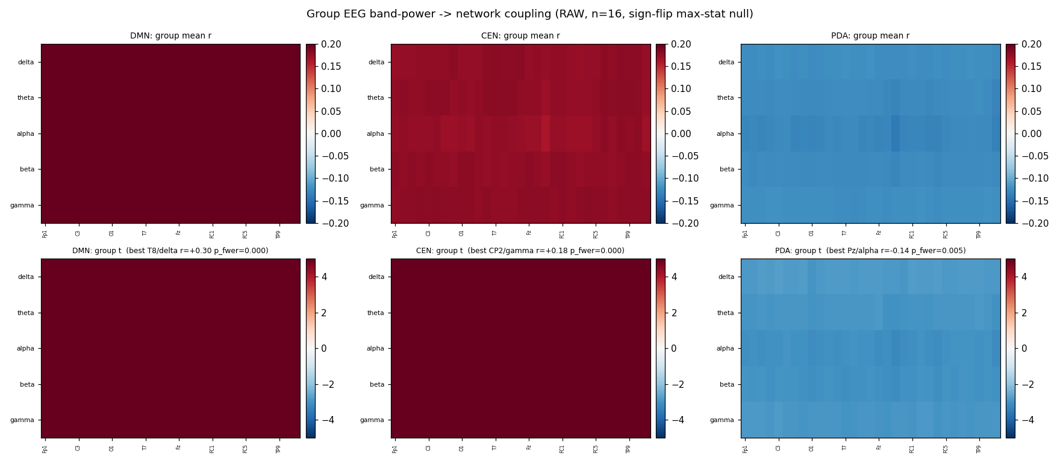
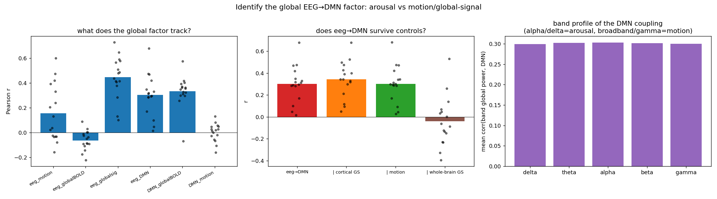
Step A — Univariate Screen: It's All Arousal
Raw EEG band power couples to DMN at r ≈ 0.30
→ pipeline is sound (alignment, HRF, artifacts OK)
BUT: coupling is 100% arousal/vigilance:
• Uniform across ALL channels and bands
• Tracks fMRI global signal at r ≈ 0.45
• Collapses to r = 0 after partialling global signal
• = aperiodic 1/f broadband shift, not oscillatory
After CAR or GSR:
nothing survives group correction
→ Dead end for univariate (single channel) decoding
→ Need multivariate approach (Step B)

Slide 12
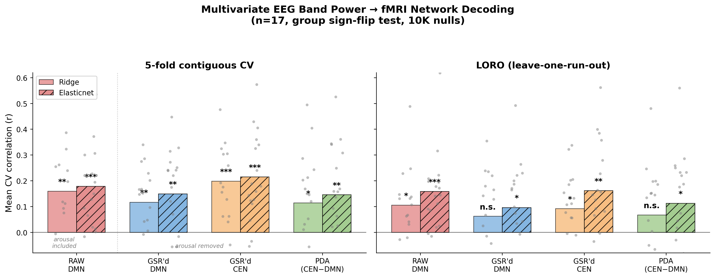
Step B — Multivariate Decoder: POSITIVE RESULT

Slide 13
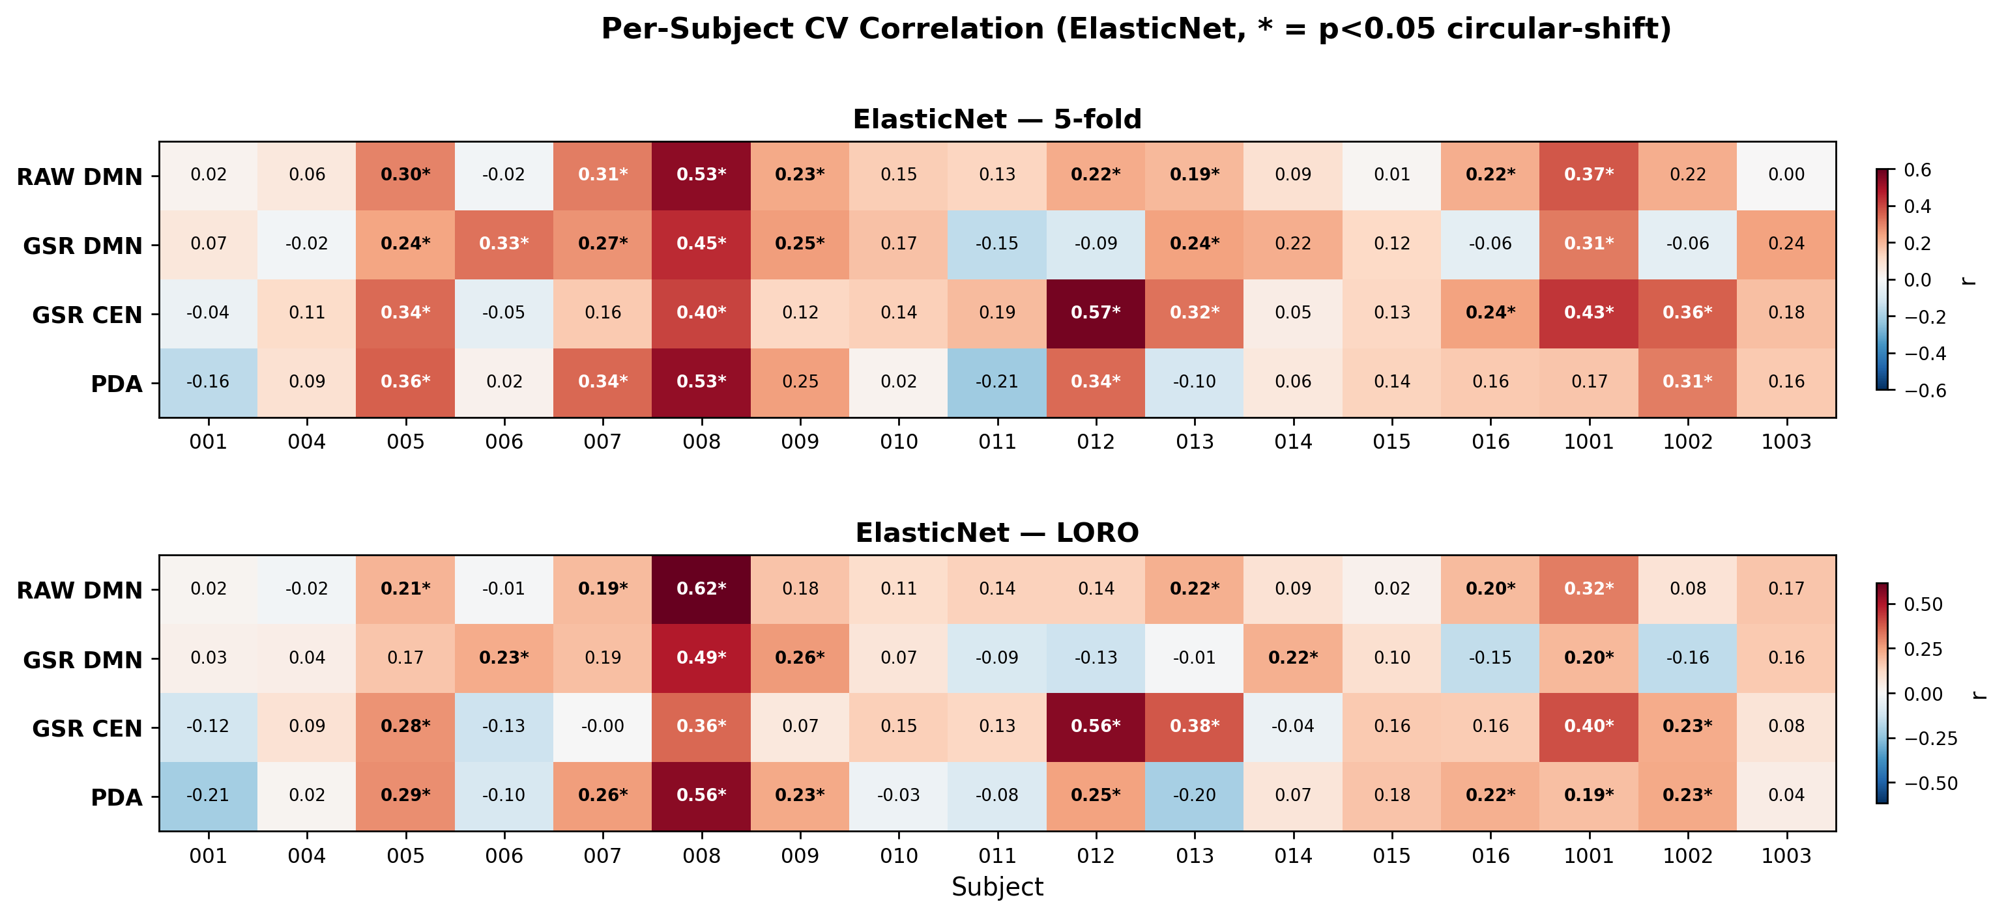
Per-Subject Decoding Performance

Slide 14
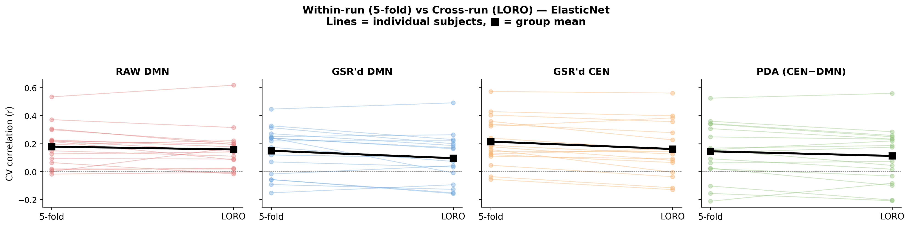
Cross-Run Generalization (5-fold vs LORO)
Signal holds across runs — not just within-run autocorrelation leakage

Slide 15
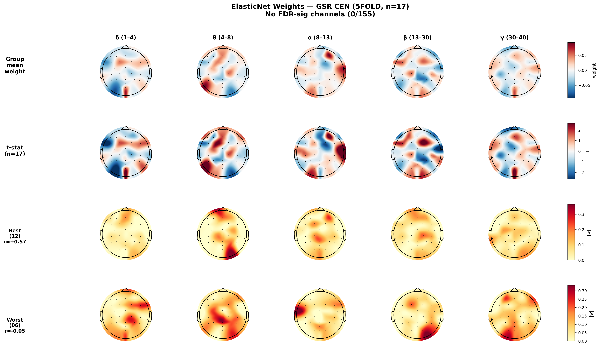
ElasticNet Weight Topography — GSR'd CEN

Slide 16
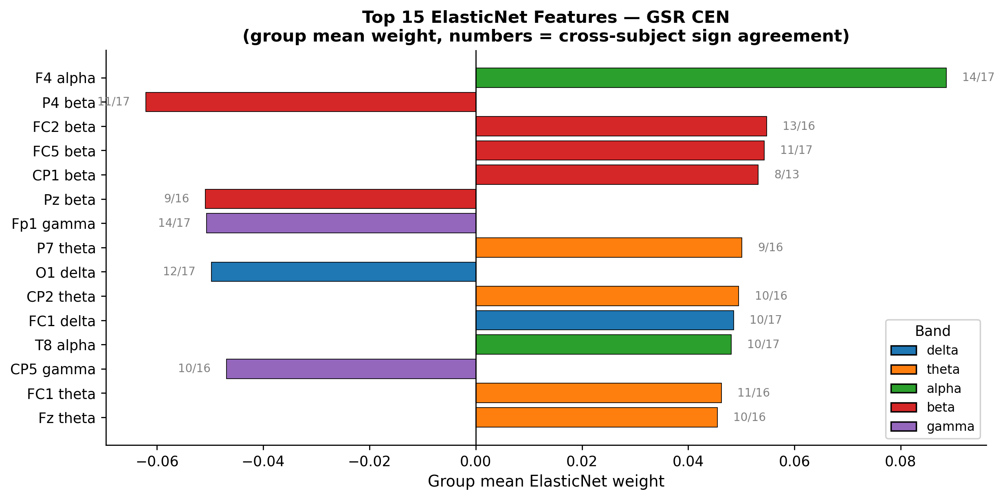
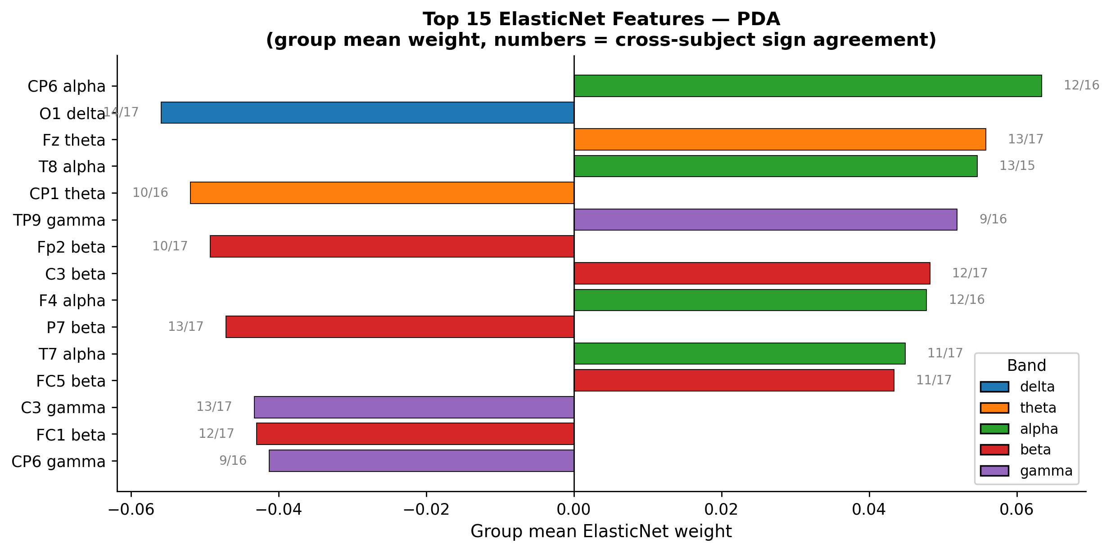
Top Features: What Drives the Decoder?

Slide 17
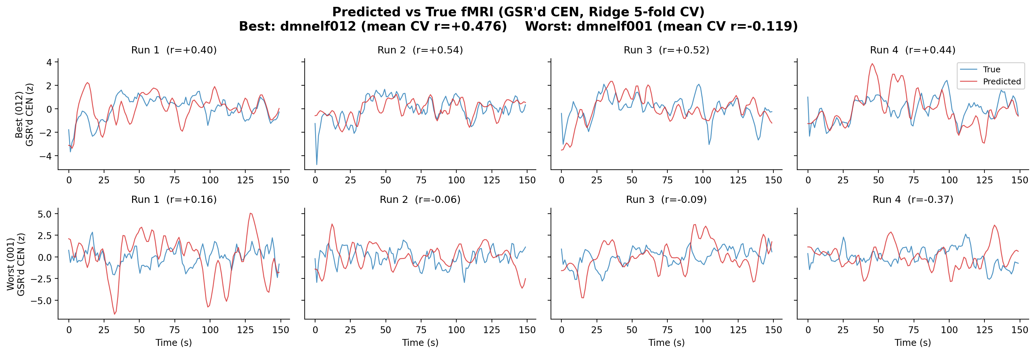
EEG-Predicted vs True fMRI (Best & Worst Subject)

Slide 18
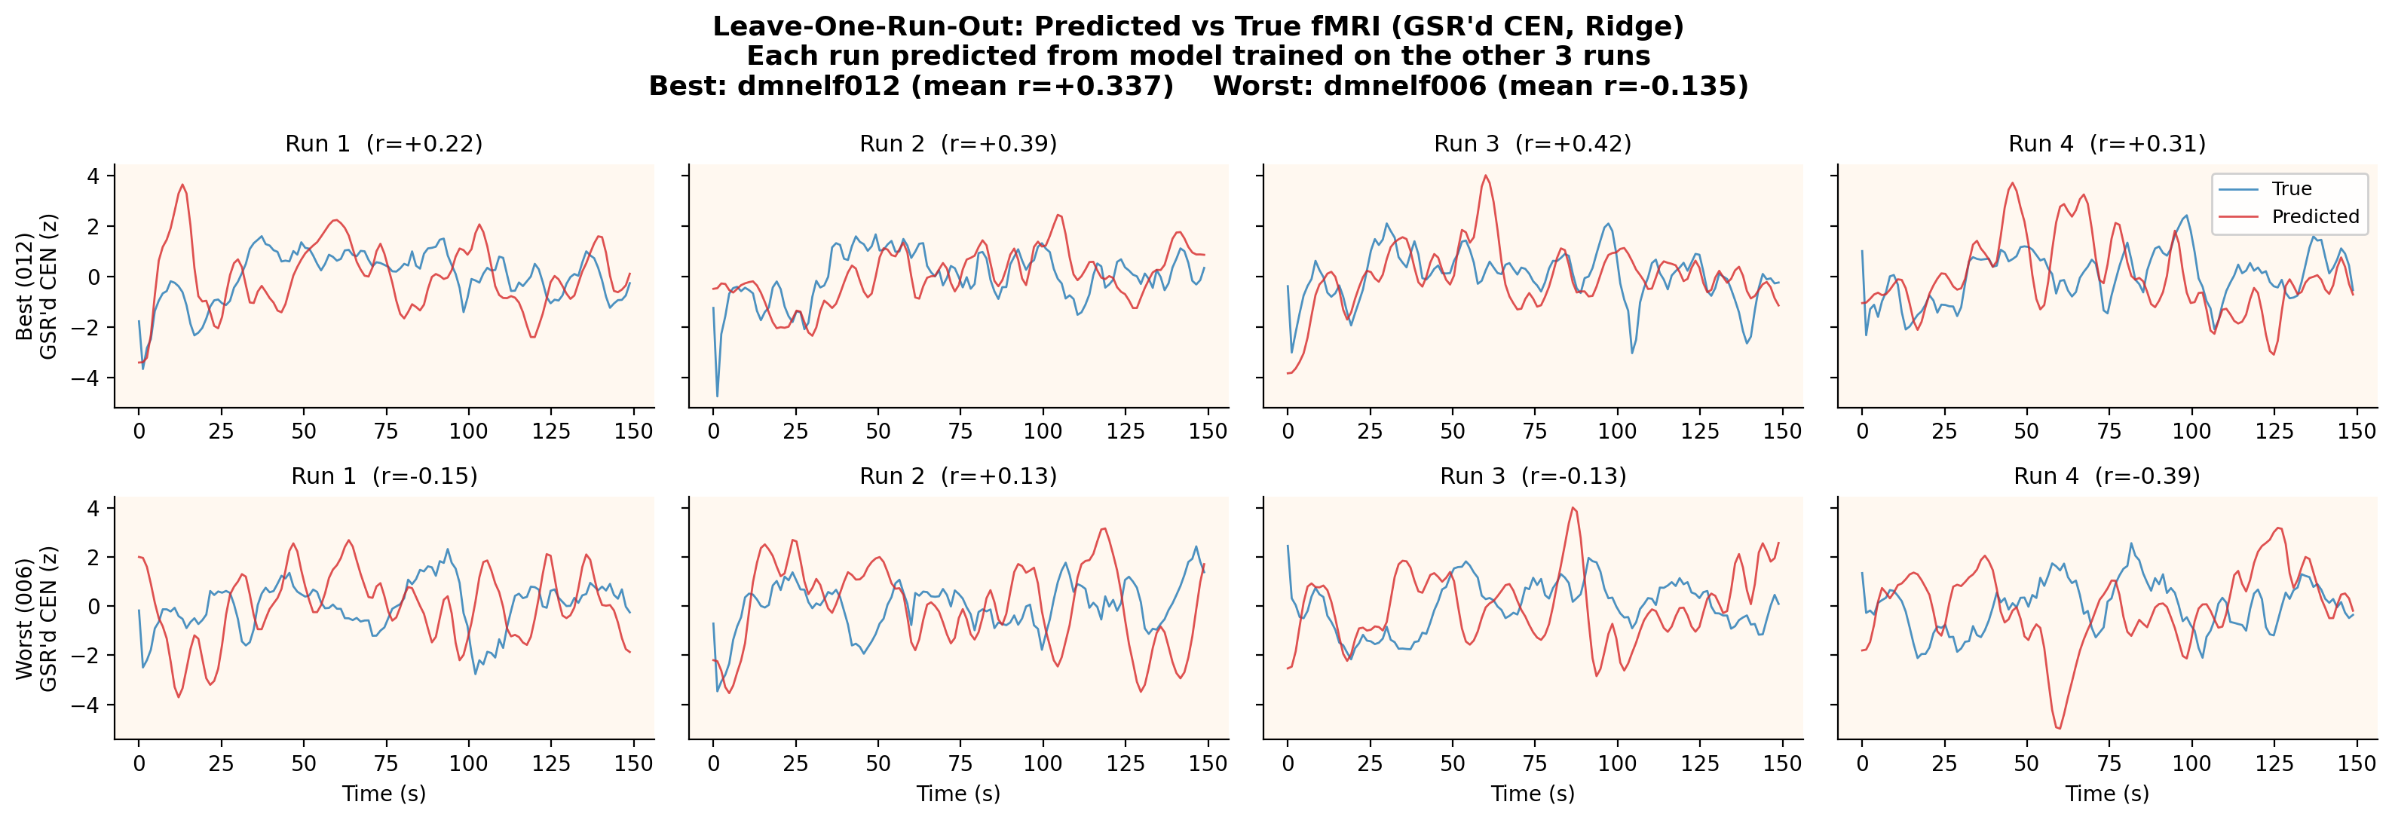
EEG-Predicted vs True fMRI (Best & Worst Subject)

Slide 19
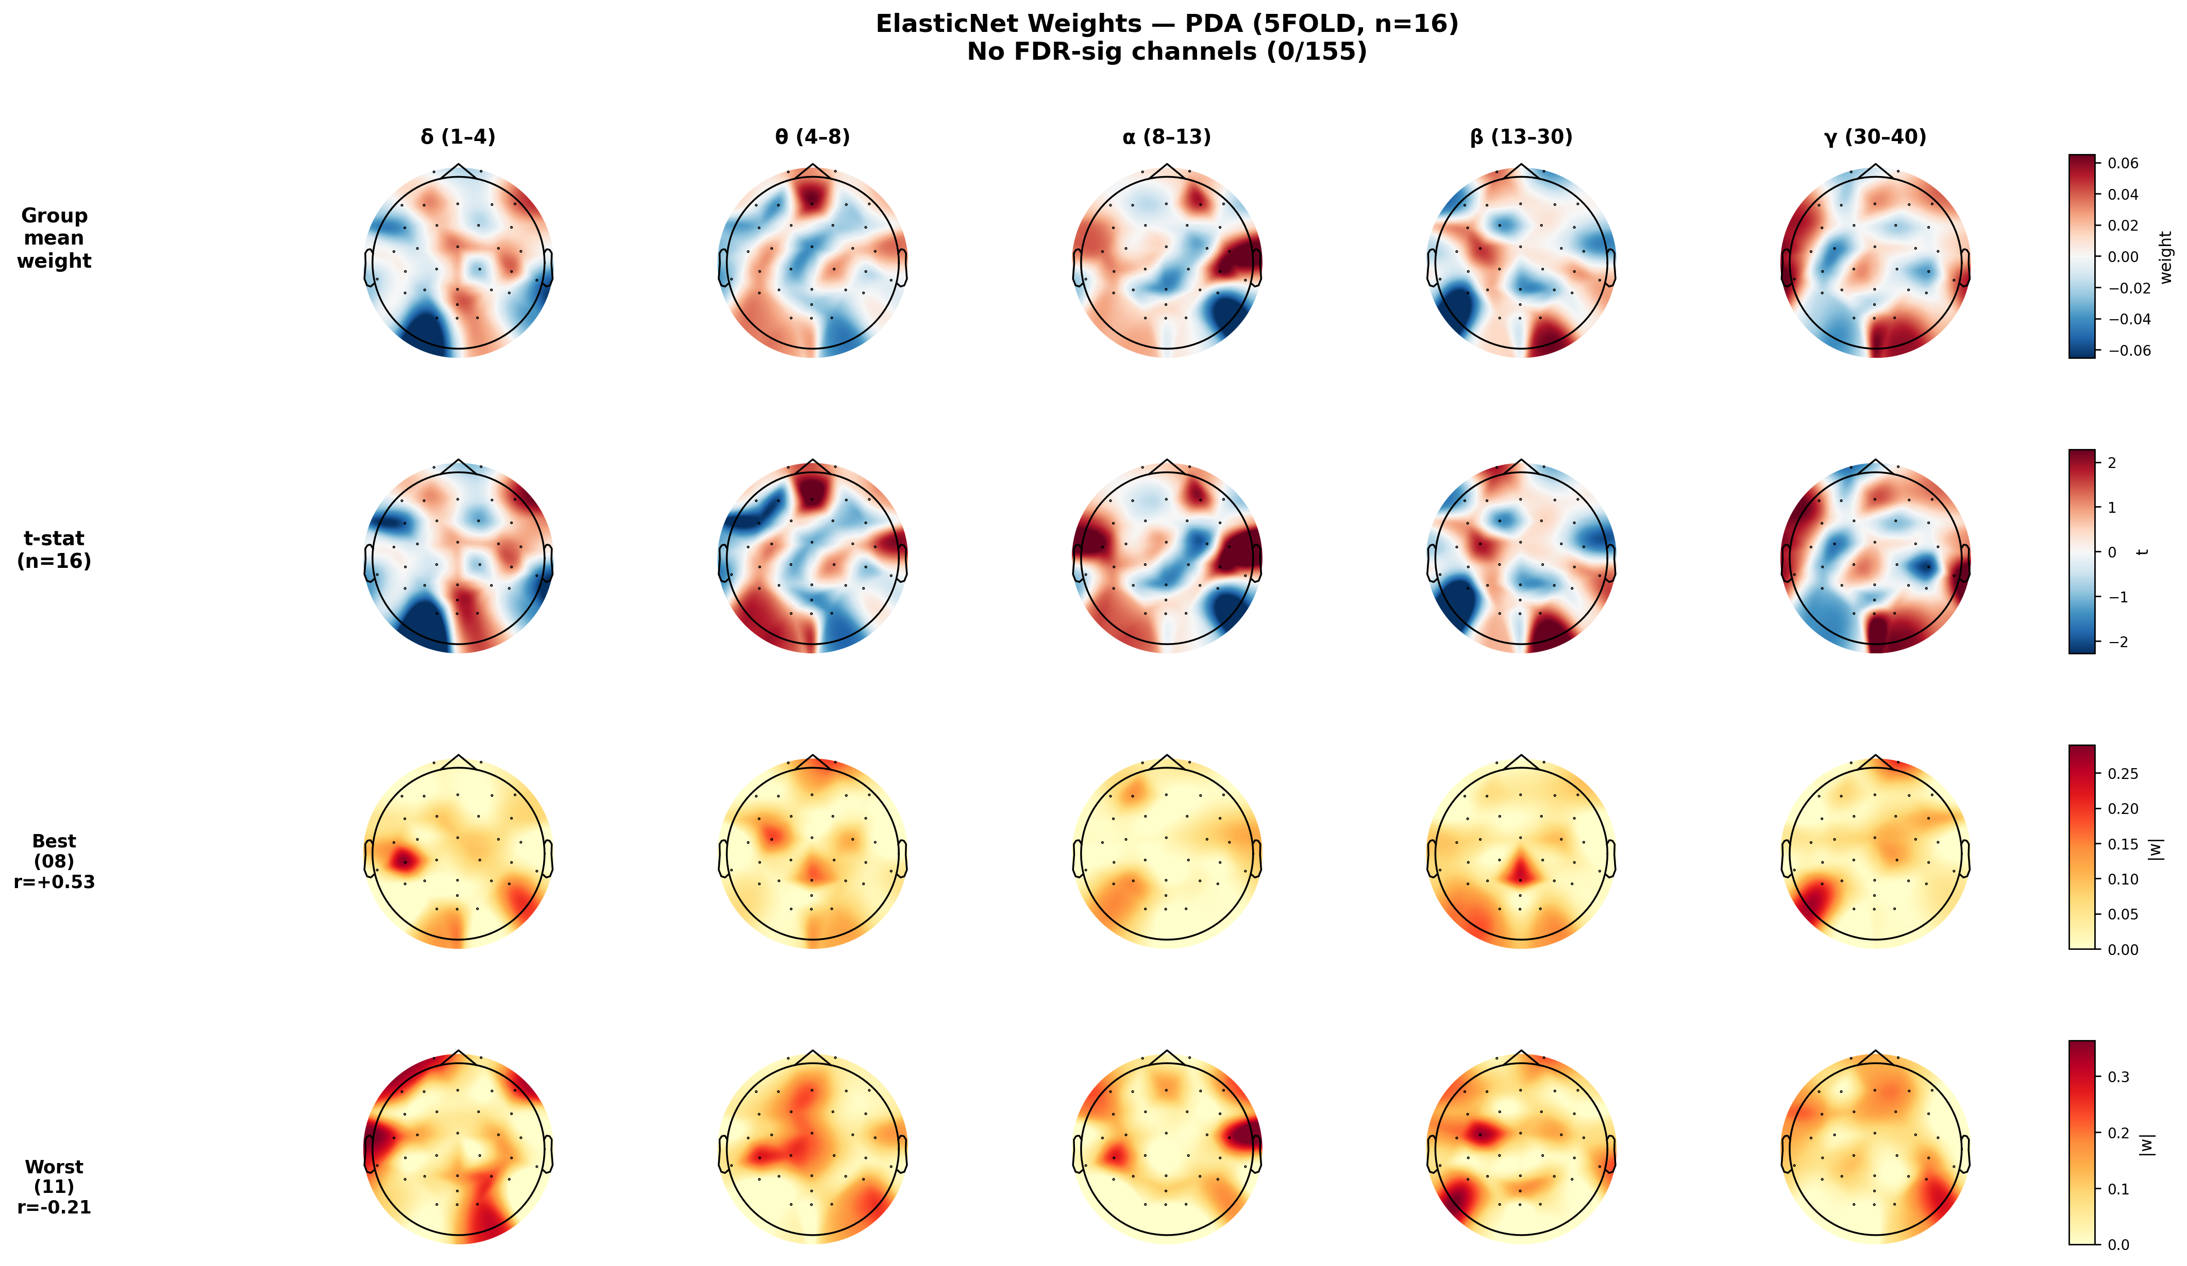
ElasticNet Weight Matrix (Group Mean, GSR'd CEN)
Key findings:
• F4 alpha is the single most reliable feature
(right-frontal alpha → CEN, 13/17 agree)
• Consistent with frontal alpha
asymmetry literature
• Signal is distributed and broadband
— no single band or region dominates
• Only 6% of weights zeroed out
→ truly distributed, not sparse
• Good cross-subject consistency
(10–14/17 subjects agree on sign)

Slide 20
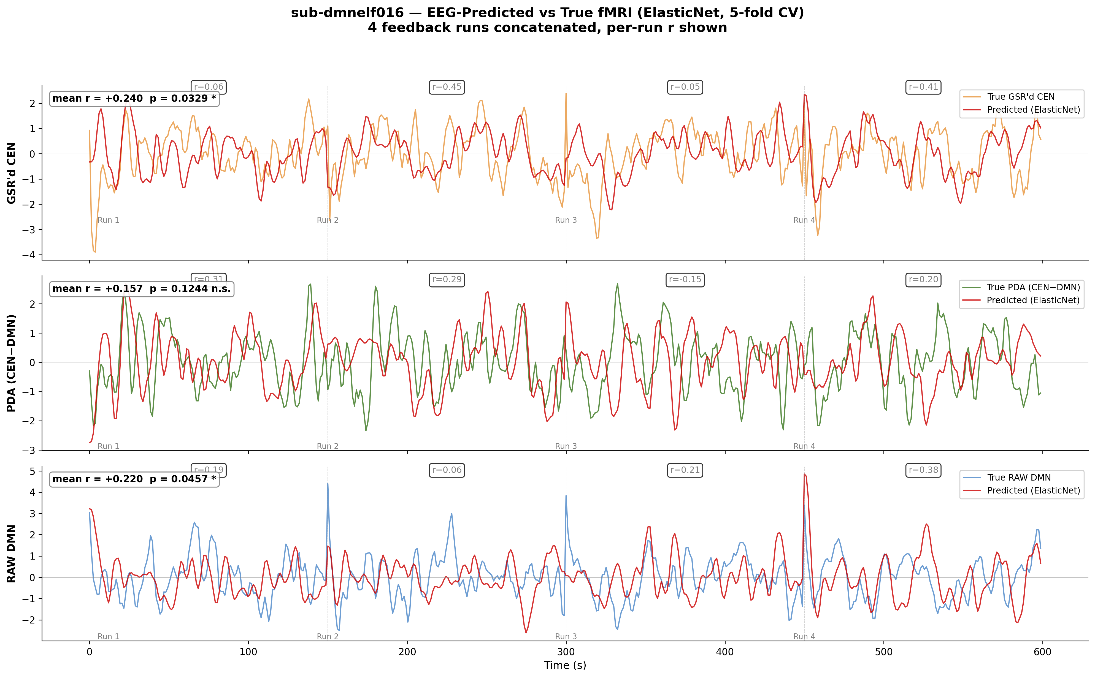
Validation: New Subject dmnelf016
Within-subject decoding (ElasticNet, same pipeline):
5-fold contiguous CV:
GSR'd CEN: r = +0.240 p = 0.033 *
RAW DMN: r = +0.220 p = 0.046 *
PDA: r = +0.157 p = 0.124
GSR'd DMN: r = −0.056 p = 0.784
LORO (cross-run):
PDA: r = +0.219 p = 0.024 *
RAW DMN: r = +0.197 p = 0.034 *
GSR'd CEN: r = +0.156 p = 0.088
GSR'd DMN: r = −0.151 p = 0.926
Signal exists in 016 at group-level performance.
CEN decodable, DMN not — subject-specific pattern.
MURFI real-time PDA vs offline PDA (fMRIPrep):
r = 0.12–0.36 per run — feedback was ~30% true signal
Gap = motion confounds not regressed in real-time

Slide 21
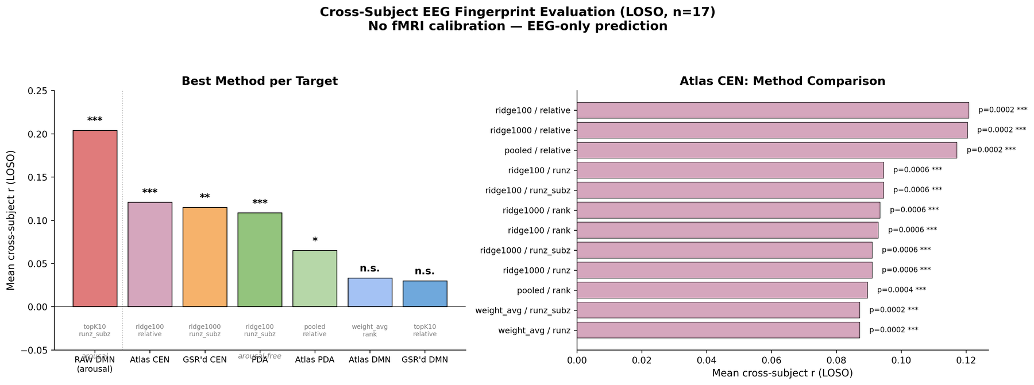
Cross-Subject EEG Fingerprint (LOSO, n=17)
Atlas CEN (r=0.12, p=0.0002) and GSR'd CEN (r=0.11, p=0.003) are decodable cross-subject
with EEG only — no fMRI calibration needed. DMN is never decodable cross-subject.

Slide 22
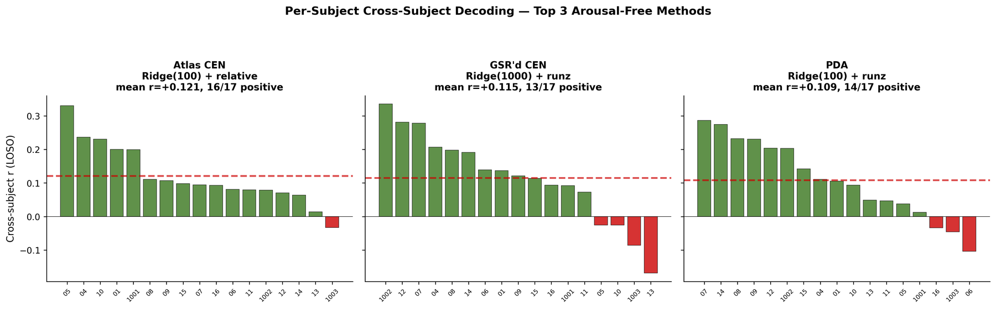
Cross-Subject Decoding: Per-Subject Results
Atlas CEN: 16/17 subjects positive. GSR'd CEN: 13/17 positive. PDA: 14/17 positive.
The cross-subject fingerprint is consistent — not driven by outlier subjects.

Slide 23
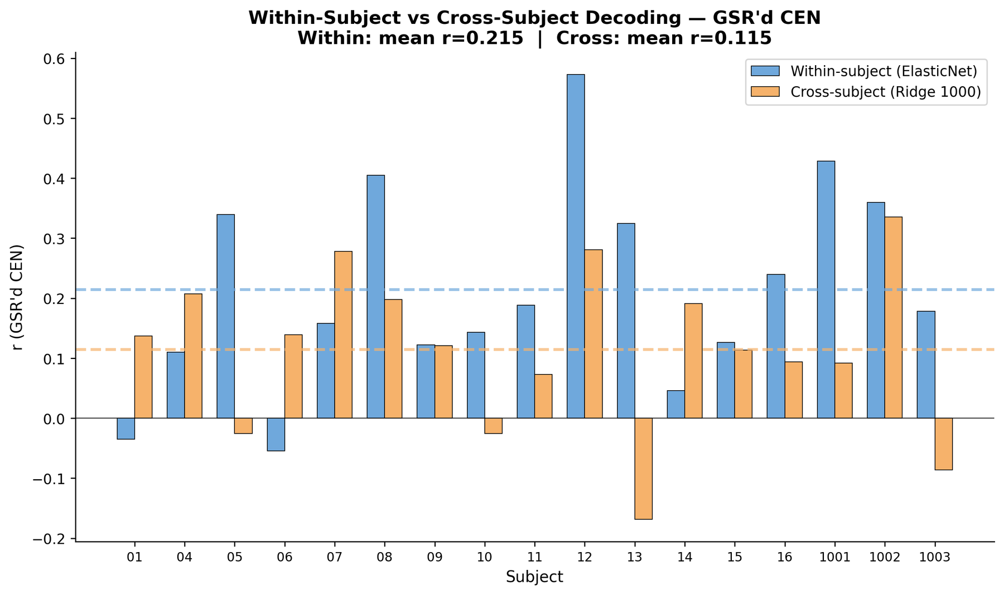
Within-Subject vs Cross-Subject Gap
GSR'd CEN decoding (per subject):
Within-subject: mean r = 0.215
(train on 3 of own runs, test on 4th)
Cross-subject: mean r = 0.115
(train on 16 others, test on held-out)
Cross captures ~50% of within signal.
The gap reflects subject-specific EEG
topography that a group model cannot
adapt to without individual data.

Slide 24
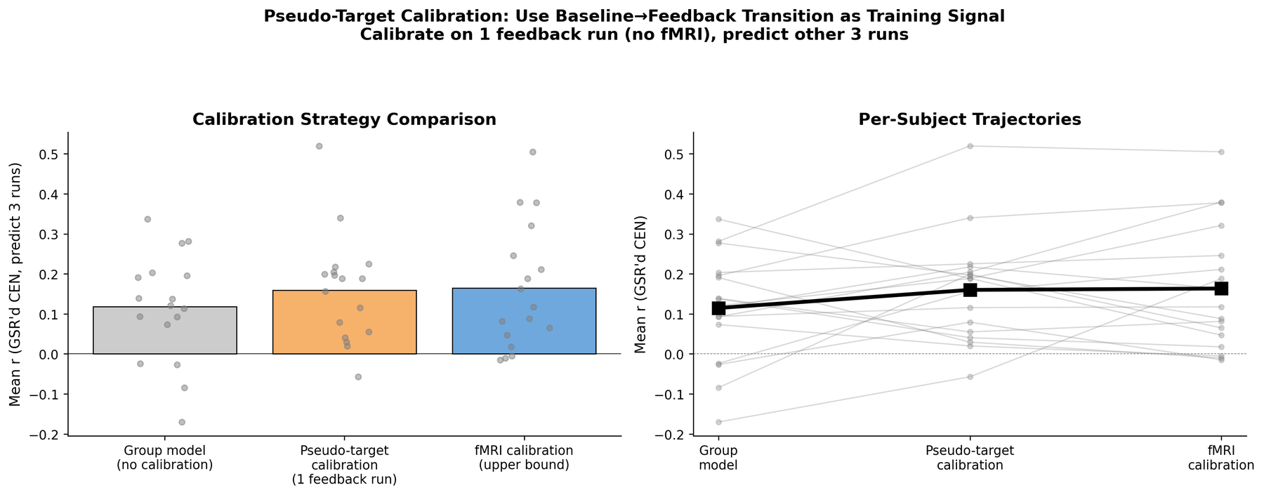
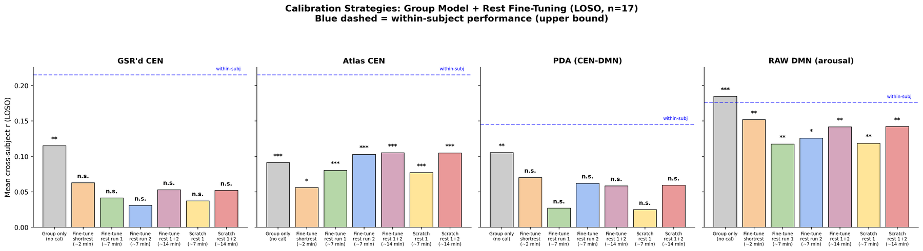
Pseudo-Target Calibration (No fMRI Needed)
Use the baseline→feedback block transition from 1 feedback run as a pseudo-target.
No fMRI needed — just the task timing (20 TRs rest, then feedback onset).
Pseudo-target calibration (r=0.159) matches fMRI calibration (r=0.165)
and beats the group model alone (r=0.118) by 35%.

Slide 25
Updated Bottom Line
Within-subject: EEG decodes CEN (r=0.21) and PDA (r=0.15) — signal exists
Cross-subject: a general EEG fingerprint for CEN works without fMRI calibration
Atlas CEN: r = 0.12, p = 0.0002 (16/17 subjects positive)
GSR'd CEN: r = 0.11, p = 0.003 (13/17 subjects positive)
Pseudo-target calibration (1 feedback run, no fMRI) boosts r from 0.12 to 0.16
— matches fMRI calibration performance using only task timing
The general fingerprint captures ~50% of the within-subject signal
The remaining gap is due to individual EEG topography
F4 alpha (right-frontal) remains the most consistent feature across subjects
Deploy: group Ridge + 1-run pseudo-target calibration for EEG-only CEN NF

Slide 26
Next Steps
Close the within/cross gap:
Source-space features (beamformer) to remove sensor-level topography variability
Domain adaptation / Riemannian alignment across subjects
Improve the general fingerprint:
Add more subjects (current n=17, target n=30+)
Test connectivity features (phase-locking, coherence) alongside power
Microstate dynamics as complementary features
Real-time deployment:
Implement group Ridge model in MURFI for EEG-only CEN feedback
Compare EEG-only NF outcomes vs EEG-fMRI NF outcomes
Task-based calibration (if fMRI available):
Use 1 feedback run with fMRI to calibrate (not rest — rest hurts)
Then switch to EEG-only for remaining runs

Slide 27
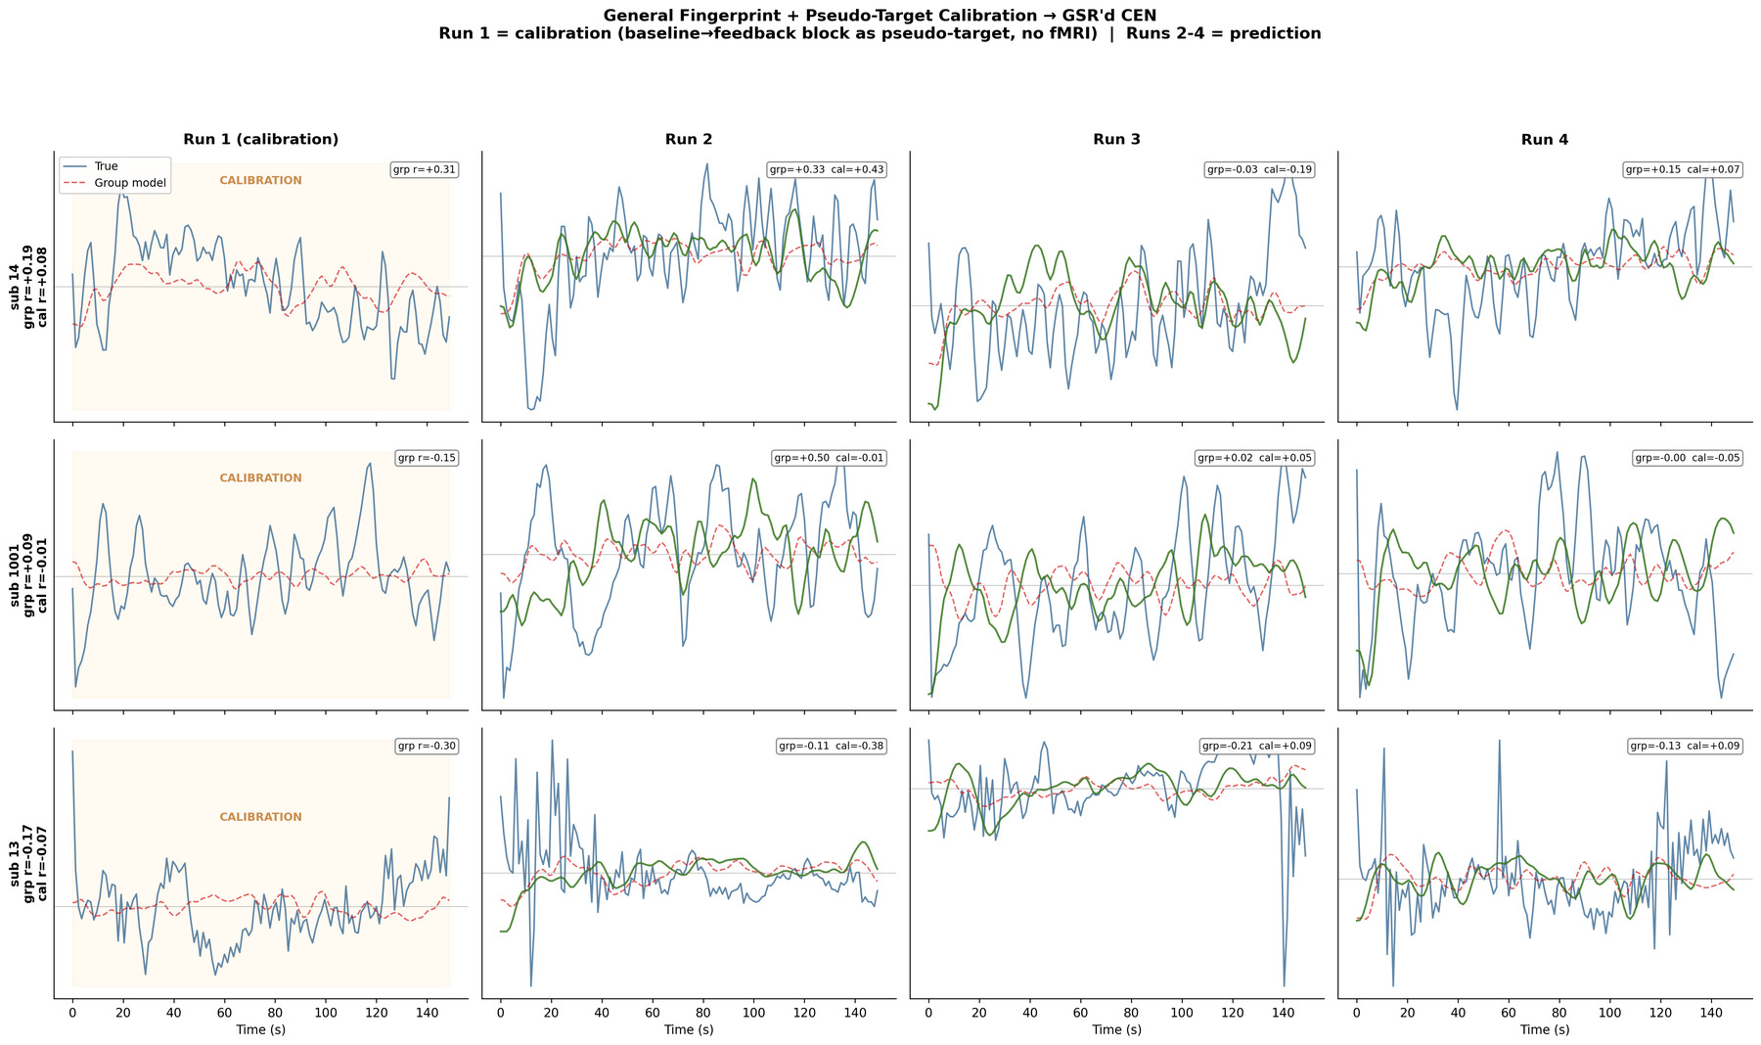
Cross-Subject Prediction + Pseudo-Calibration (3 Subjects)

Slide 28
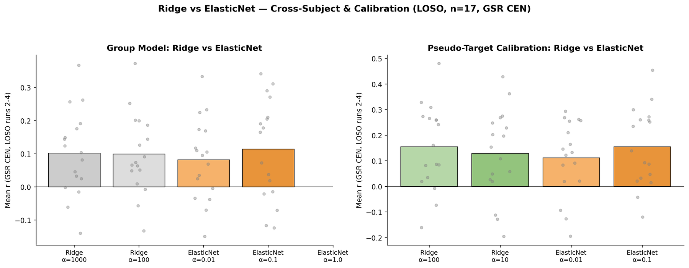
Ridge vs ElasticNet: Cross-Subject & Calibration
ElasticNet (α=0.1) slightly edges Ridge for the group model (+0.114 vs +0.102),
but ties Ridge (α=100) for calibration (both r=0.155). Practically interchangeable.
ElasticNet's within-subject advantage does not transfer cross-subject —
sparse feature selection is subject-specific.

