Slide 1
EEG Finger-Print (EFP) → fMRI Network Decoding
Replicating & extending Meir-Hasson et al. (2014) to DMN / CEN / PDA
Single electrode · Stockwell time-frequency · data-driven bands · sliding-delay ridge
DMNELF simultaneous EEG–fMRI cohort · n=17 · nested cross-validation (v3, bulletproofed)

Slide 2
The Goal
• Decode fMRI network activity (DMN, CEN) and the PDA neurofeedback target from simultaneous scalp EEG.
• Why? So EEG alone — cheap, portable, no scanner — can drive real-time neurofeedback once a mapping is learned.
• PDA = the actual DMNELF neurofeedback target (personalized CEN − DMN differential). GSR'd targets remove the shared global-arousal signal — the hard, network-specific test.
• Meir-Hasson's EFP is a single-electrode, HRF-free time-frequency fingerprint. We ask: does it replicate here, beat standard baselines, and generalize to new subjects & a new cohort?

Slide 3
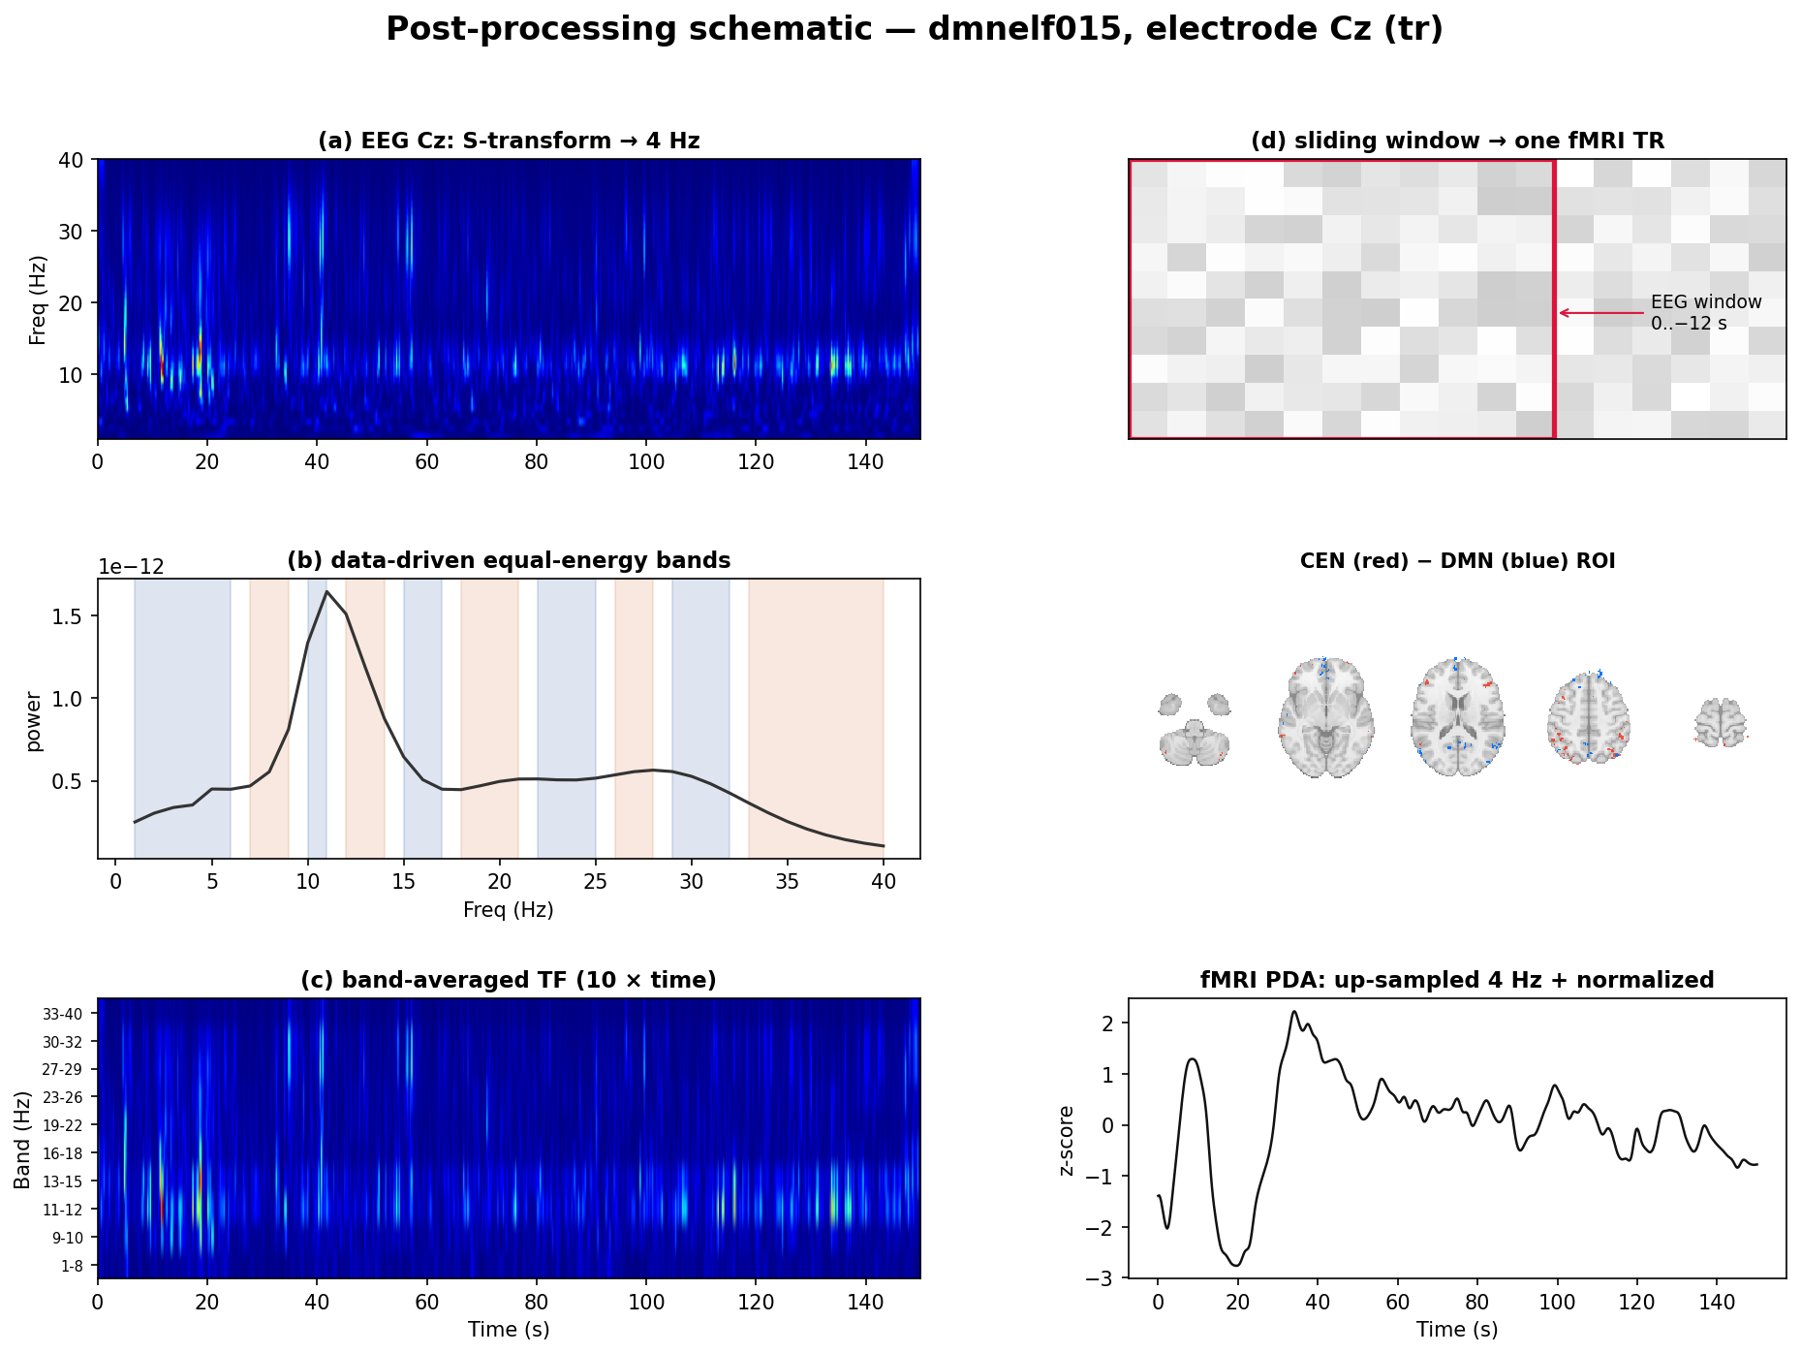
Methods Overview — the EFP pipeline
EEG → S-transform → data-driven bands → [frequency × sliding-delay] design → ridge → fMRI ROI

Slide 4
Step 1 — Single electrode + Stockwell time-frequency
• EFP uses ONE electrode (data-driven), not a multivariate montage — a deliberately minimal, interpretable model.
• Per electrode: Stockwell (S-)transform at 1 Hz resolution (FFT-based, implemented from scratch) → an instantaneous time-frequency power map.
• Contrast with our band-power decoder (eeg_bold_coupling): that used 31-channel Hilbert envelopes; EFP trades spatial breadth for temporal-spectral depth at one site.

Slide 5
Step 2 — Data-driven equal-energy frequency bands
• Instead of fixed δ/θ/α/β/γ, the spectrum is split into 10 bands of equal cumulative log-power — each carries the same energy.
• Bands are learned per subject/electrode from the data, then power is averaged within each band and standardized.
• This adapts the frequency axis to each person's spectral profile — part of why it is a personalized 'fingerprint'.

Slide 6
Step 3 — [frequency × sliding-delay] design (the KEY idea)
• For each of the 10 bands, build lagged copies over a sliding delay window 0 … −12 s (11 delays at TR).
• Ridge then learns a SEPARATE weight per (band × delay) — i.e. a separate temporal response for every frequency. No canonical HRF is assumed.
• The learned weight matrix IS the fingerprint: an HRF-like lag profile that can differ across frequency bands (see Results).
• Design size ≈ 10 bands × 11 delays = 110 features from one electrode.

Slide 7
Step 4 — fMRI targets & global-signal regression
• Seven targets (z-scored per run): CEN, DMN, PDA (CEN − DMN differential), plus a VIS positive-control ROI, each in RAW and GSR'd form.
• RAW targets include global arousal (a sanity check — easy). GSR'd targets remove the shared signal → the stringent, network-specific test.
• VIS = focal 6 mm calcarine sphere (MNI −1,−86,13 ≈ V1): a known EEG-visible ROI used to validate that the blind pipeline localizes correctly.

Slide 8
Step 5 — Nested cross-validation (the honest estimator)
• Outer contiguous block CV (k=5, m=2) preserves temporal autocorrelation; inner RidgeCV (GCV) picks λ over a 30-value log grid.
• Electrode selection is NESTED: the best electrode is chosen on the inner-training folds and scored ONLY on the held-out outer fold.
• Reported r = concatenated out-of-fold Pearson correlation (oof_r) — matches Meir-Hasson's 'select on train, evaluate on test' and removes selection optimism.
• Baselines (HRF, T/A) are nested over the SAME candidate electrodes → a fair comparison.

Slide 9
Step 6 — Baselines & significance
• HRF baseline: same 10 bands convolved with a fixed canonical HRF (assumes one delay).
• T/A baseline: traditional theta/alpha ratio, HRF-convolved (the classic EEG index).
• Group significance: sign-flip permutation on the group-mean r (10k flips).
• Electrode topography: per-electrode sign-flip p with Benjamini–Hochberg FDR — 'mark, don't mask' (significant electrodes dotted, map preserved).

Slide 10
Bulletproofing — two artifacts caught & fixed
Full adversarial audit before write-up (VALIDATION.md). The story SURVIVED honest re-analysis.
• ① Selection bias — v1 picked the best of ~31 electrodes on the same folds it scored on → within-subject r inflated ~0.05–0.15.
– Fix: nested CV (above). Within-subject numbers now de-biased.
• ② Normalization asymmetry — EFP features were raw while HRF/T-A were per-run z-scored, deflating EFP's 110 heterogeneous features.
– Fix: per-run standardize the EFP design too. EFP recovered (CEN 0.089 → 0.159; cross-cohort roughly doubled).
• Net effect: the bulletproofing STRENGTHENED the EFP result — it did not depend on the bugs.

Slide 11
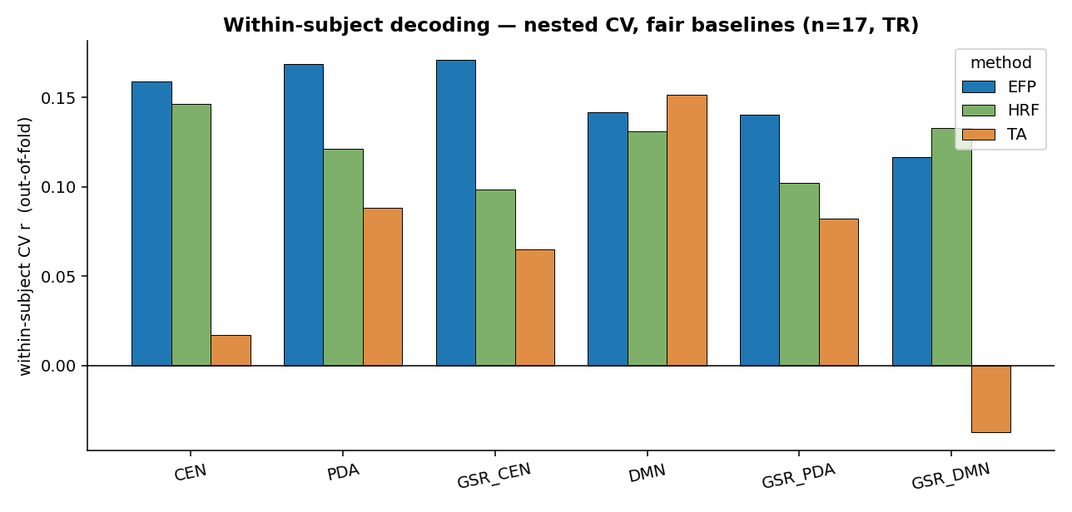
Result 1 — Within-subject: EFP wins the task-relevant targets
• EFP leads on CEN (0.159), PDA (0.169), GSR_CEN (0.171), GSR_PDA (0.141) — including PDA, the neurofeedback target.
• T/A edges DMN; HRF edges the two hardest (VIS, GSR_DMN). Honest, fair, nested numbers.

Slide 12
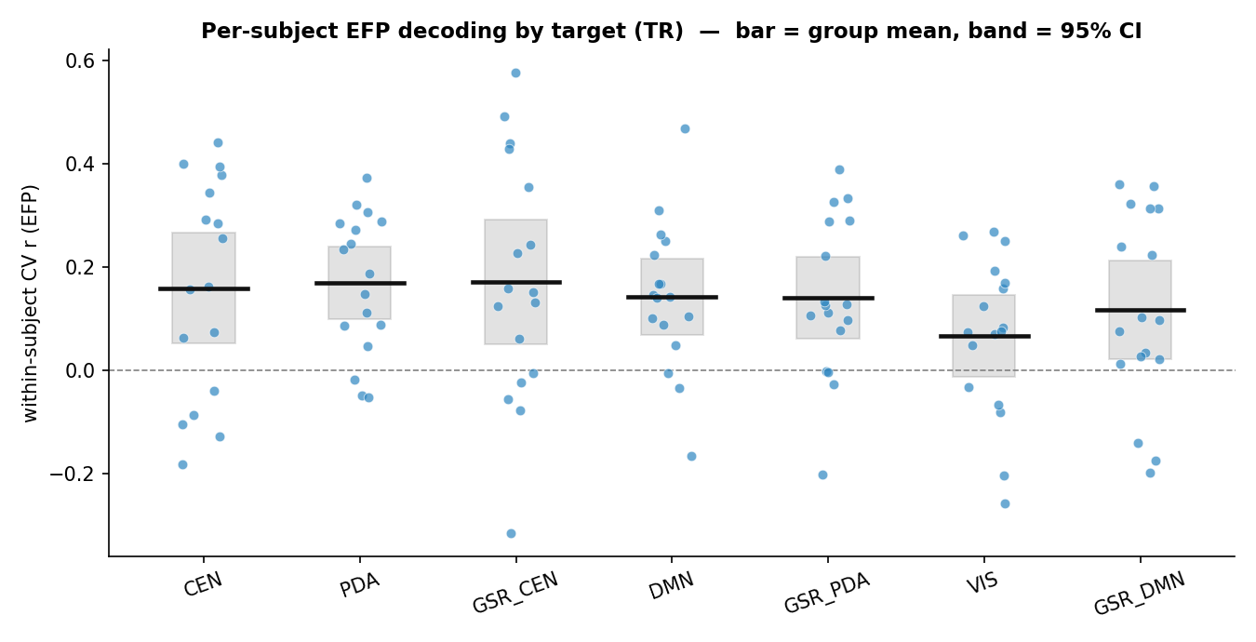
Result 1b — Substantial individual variability
Per-subject EFP r by target (bar = group mean, band = 95% CI). Wide spread motivates the subject-specific electrode/band selection.

Slide 13
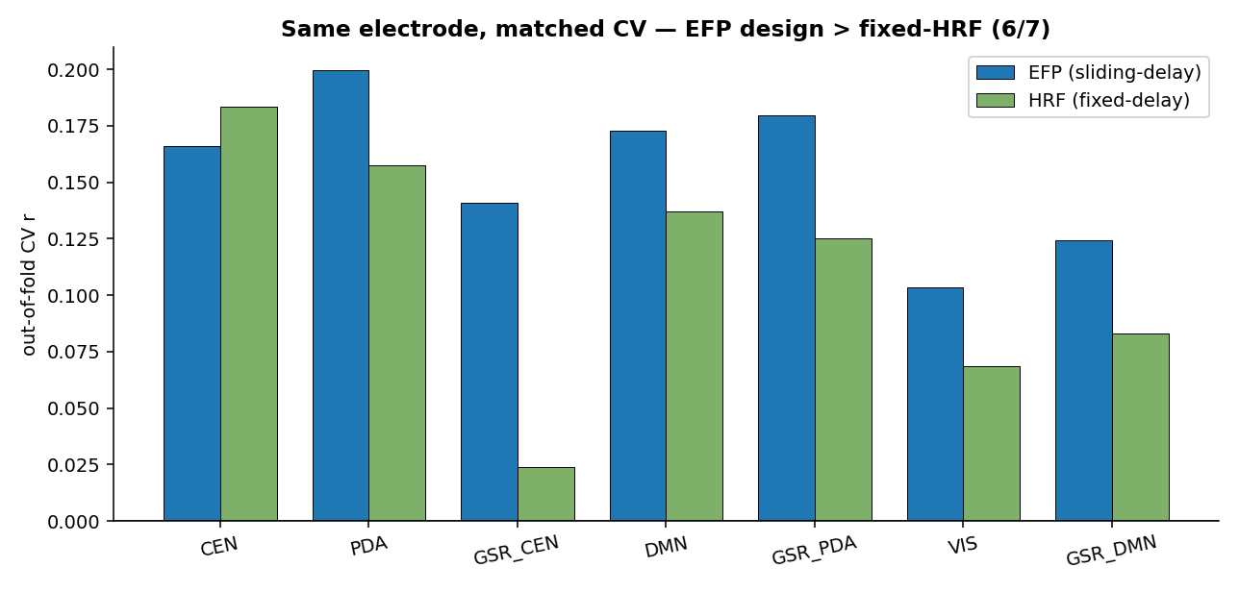
Result 2 — Same electrode, matched CV: the design itself wins
• At each network's group-peak electrode, with identical estimator, the sliding-delay EFP beats the fixed-HRF design on 6 of 7 targets.
• Isolates the [freq × delay] design from electrode selection — HRF only edges CEN.

Slide 14
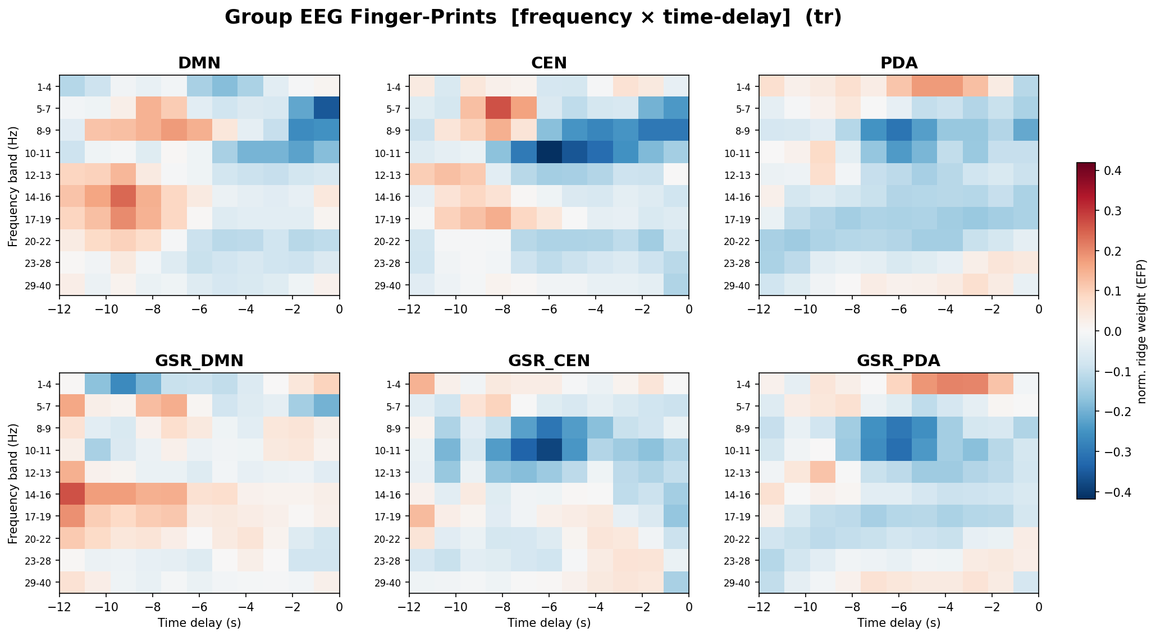
Result 3 — Interpretable fingerprints (a learned HRF per frequency)

Slide 15
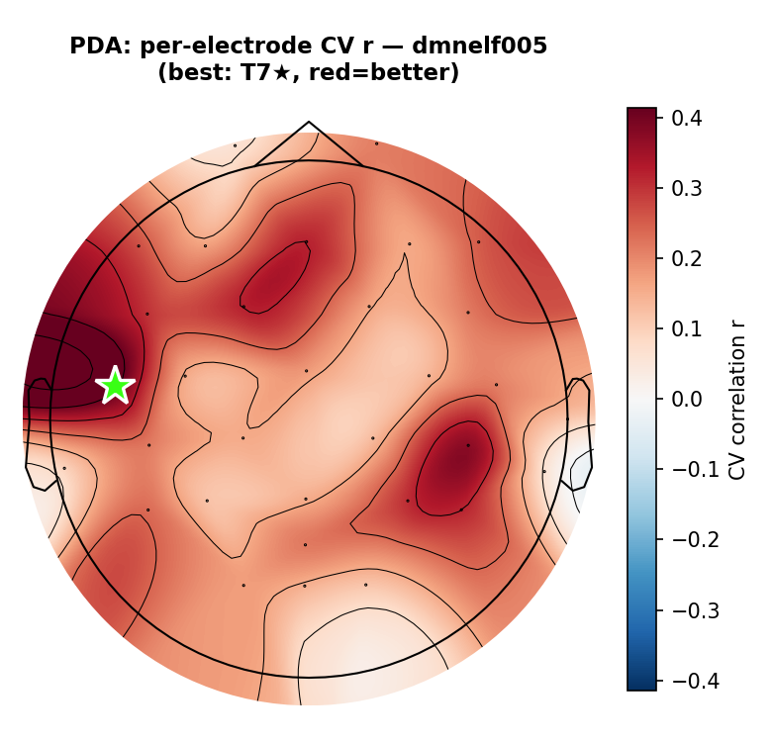
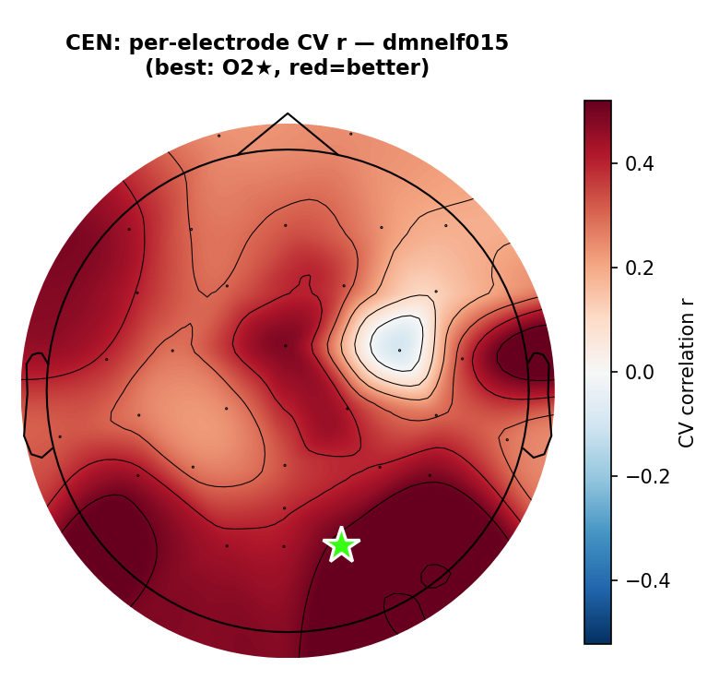
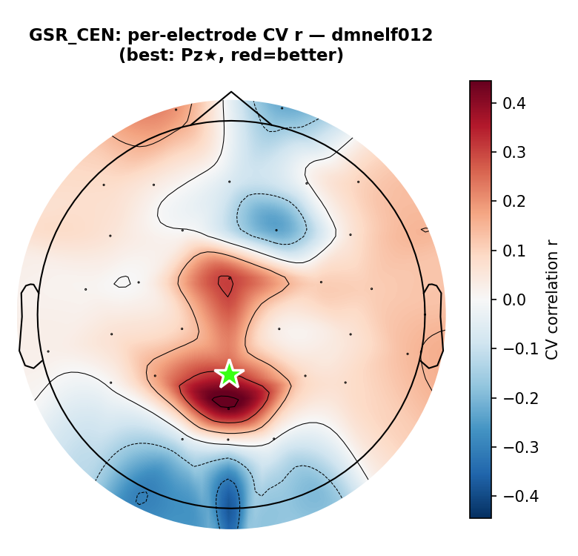
Result 4 — Electrode topography with per-electrode FDR
Per-electrode CV r; black dots = BH-FDR-significant electrodes ('mark, don't mask')
• PDA peaks parietally (Pz); CEN centrally; sensible, spatially-focal topographies survive FDR — not a diffuse everywhere-significant artifact.

Slide 16
Result 5 — Cross-subject generalization (LOSO, n=17)
• General fingerprint: train on N−1 subjects at the group-peak electrode, predict the held-out subject (leak-free electrode selection).
– PDA: r=+0.161 (p=0.008, Pz)
– GSR_PDA: r=+0.161 (p=0.005) · GSR_CEN: r=+0.153 (p=0.011)
– CEN: r=+0.124 (p=0.001) · DMN: r=+0.096 (p=0.011) · VIS: r=+0.050 (p=0.031)
– GSR_DMN: r=-0.012 (p=0.653) — the only target that fails to transfer.
• 6 of 7 targets transfer across subjects — a genuinely general EEG fingerprint.

Slide 17
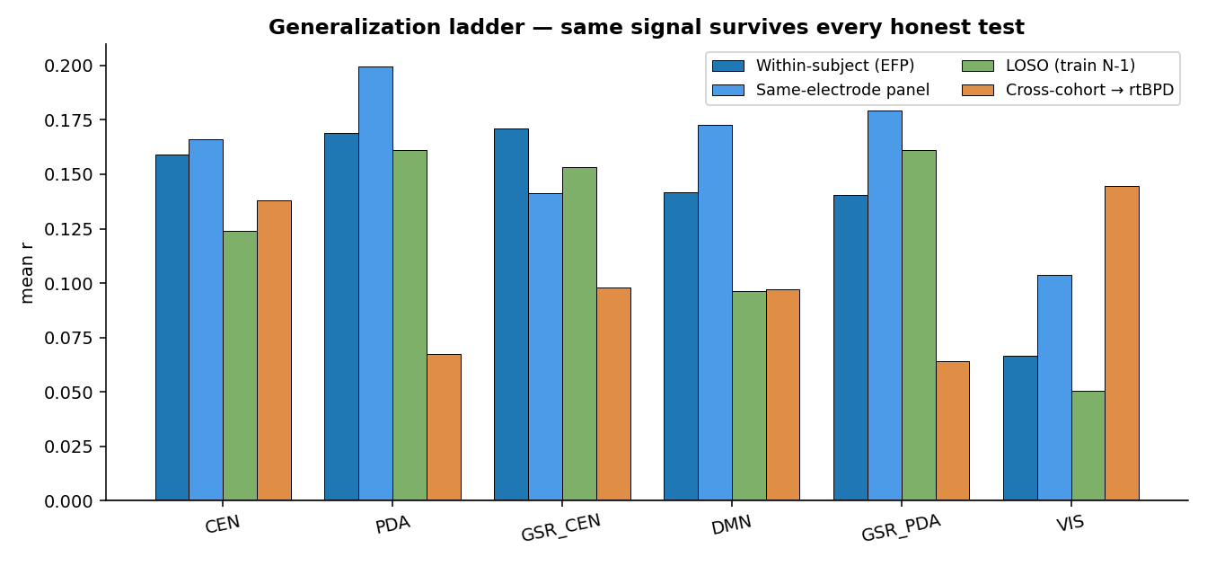
Result 6 — External validation: transfers to an independent cohort
Train the DMNELF general fingerprint (n=17), predict the rtBPD cohort — no rtBPD data in training/selection
• Double replication:
– nf1: 7/7 targets significant
– nf2: 6/7 significant (GSR_DMN only miss)
– CEN +0.138/+0.113
– PDA +0.067/+0.153
– VIS +0.145/+0.121
– GSR_PDA +0.064/+0.136
• Strongest evidence the EFP captures a real, transferable EEG→BOLD mapping.

Slide 18
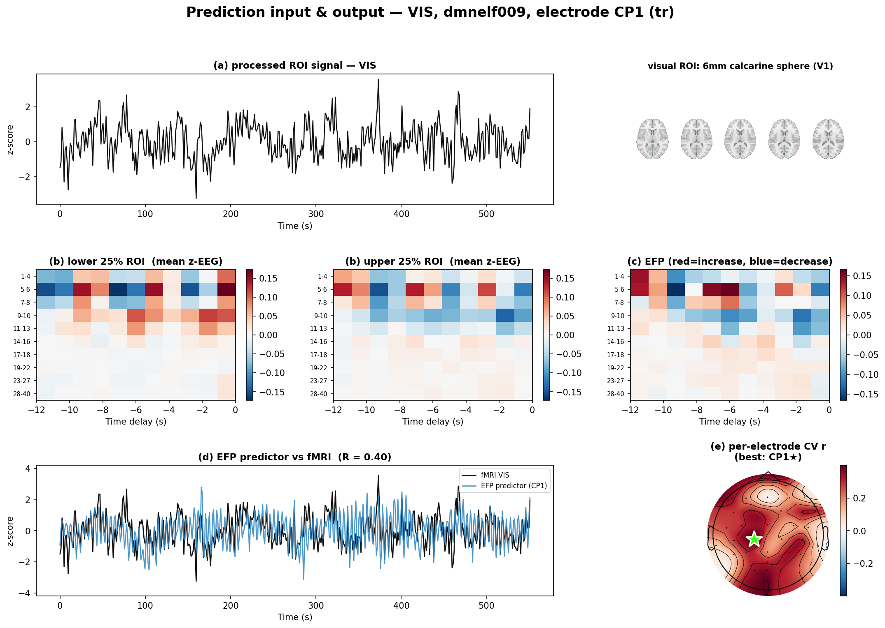
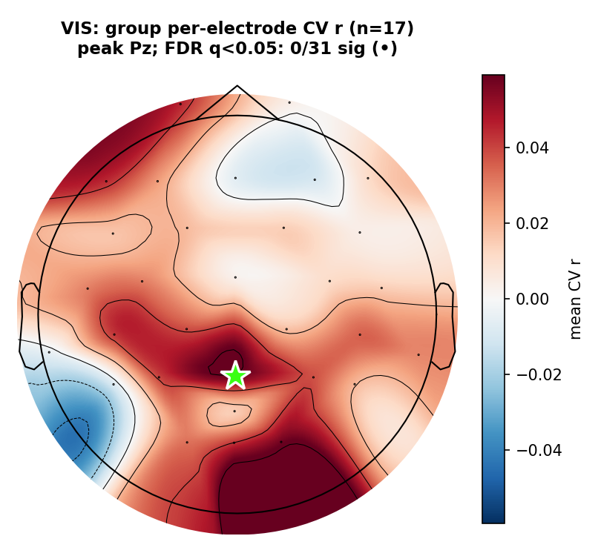
Positive control — visual cortex (Meir-Hasson Fig 5 analog)
Focal 6 mm calcarine sphere (≈V1). The blind EFP localizes posteriorly (peak Oz) with alpha modulation — recovering occipital topography validates the method.

Slide 19
Bottom Line
• A faithful, bulletproofed EFP replication succeeds on DMNELF.
– Within-subject: EFP is our best single-electrode decoder — PDA 0.169, CEN 0.159, GSR_CEN 0.171.
– Same-electrode panel: the sliding-delay design beats fixed-HRF 6/7 — the design, not electrode luck, drives it.
– LOSO: 6/7 targets transfer across subjects (PDA +0.161, p=0.008).
– Cross-cohort: 7/7 (nf1) & 6/7 (nf2) replicate in an independent cohort — a general, transferable fingerprint.
• Rigor
– Two audit artifacts (selection bias, normalization) caught and fixed; the result held on honest numbers. v1 frozen at tag efp-preprint-v1.

Slide 20
Next Steps
• Deferred controls: purged/gapped CV folds; fixed-band group transfer model (removes the band-index-alignment approximation).
• 4 Hz (native rate) as supplementary + null-target upsampling control; motion-regression control on base targets.
• Real-time path: the LOSO/cross-cohort fingerprint is ready to test as an EEG-only neurofeedback signal for PDA.
• Revisit the excluded/miscoded subjects, then extend n before submission.

