Slide 1
From Scanner to Wearable
Scaling Default Mode Network Neurofeedback with a Portable EEG Fingerprint
Clemens Bauer·
Epic Lab Center for Precition Psychiatry·
09.02.2026
Notes:
Title slide. Set the frame for the room: this talk moves from an experiential opening, through the science (replication + cross-cohort validation), to mindwear and a live demo. Fill in your name/lab/date on the slide itself before presenting.

Slide 2
Before we begin: a 3-minute experiment
• Close your eyes (or soften your gaze). We'll do this together, in silence.
• Part 1 — 30 seconds: just breathe. Notice your breath, nothing else.
• Part 2 — 2.5 minutes: bring to mind something unresolved — a decision you're unsure about, an interaction that didn't go the way you wanted, something still bothering you. Don't try to solve it. Just let your mind go there, and stay with it.
• (Speaker: keep time silently — e.g. phone timer, screen turned away from the room. Don't narrate the timing out loud once part 2 starts; let the room sit in it.)
Notes:
Facilitation: ask the room to close their eyes or soften their gaze; say you'll do this together in silence and you'll tell them when it's over -- don't narrate the phases as they happen. Part 1 (30s): just breathe. Part 2 (2.5 min): bring to mind something unresolved -- a decision you're unsure about, an interaction that didn't go the way you wanted, something still bothering you. Don't try to solve it, just stay with it. Keep time silently (phone, not a visible countdown) -- don't narrate once part 2 starts.

Slide 3
What did you notice?
• Ask the room: racing thoughts? Replaying the scenario? Judging yourself? Losing track of the breath entirely?
• That drift — away from the present moment and into self-referential, evaluative, looping thought — has a name in neuroscience: the Default Mode Network (DMN).
• You didn't choose to ruminate just now. For most people, without training, that network runs the show the moment there's nothing else to do.
Notes:
Bring the room back gently. Don't ask 'how was that' yet -- ask 'what did you notice?' and take 2-3 answers before explaining anything. Expect: racing thoughts, replaying the scenario, self-judgment, losing the thread of the instruction. That's the point -- nobody chose to ruminate, it happened automatically. Bridge line: 'What you just experienced -- unprompted, self-referential, looping thought -- has a name in neuroscience: the Default Mode Network. It's called default because, left with nothing else to do, that's where the brain goes.'

Slide 4
Why this matters
• The DMN is most active exactly when we're NOT engaged in an external task — mind-wandering, self-referential processing, autobiographical memory.
• Excessive, hard-to-disengage DMN activity — rumination — is a transdiagnostic feature of depression, anxiety, and chronic stress, not just an occasional annoyance.
• [Add your specific citations/prevalence stats here]
• The question this line of work asks: can people learn to quiet this network on demand?
Notes:
DMN activity rises when we're not engaged in an external task -- mind-wandering, self-referential thought, autobiographical memory; the room just generated some on purpose. When that pattern gets stuck it's rumination, a cross-cutting feature of depression and anxiety, not a niche symptom. Add your own citations/prevalence numbers on this slide before presenting (left as a placeholder deliberately). Land on: can people learn to quiet this network on demand?

Slide 5
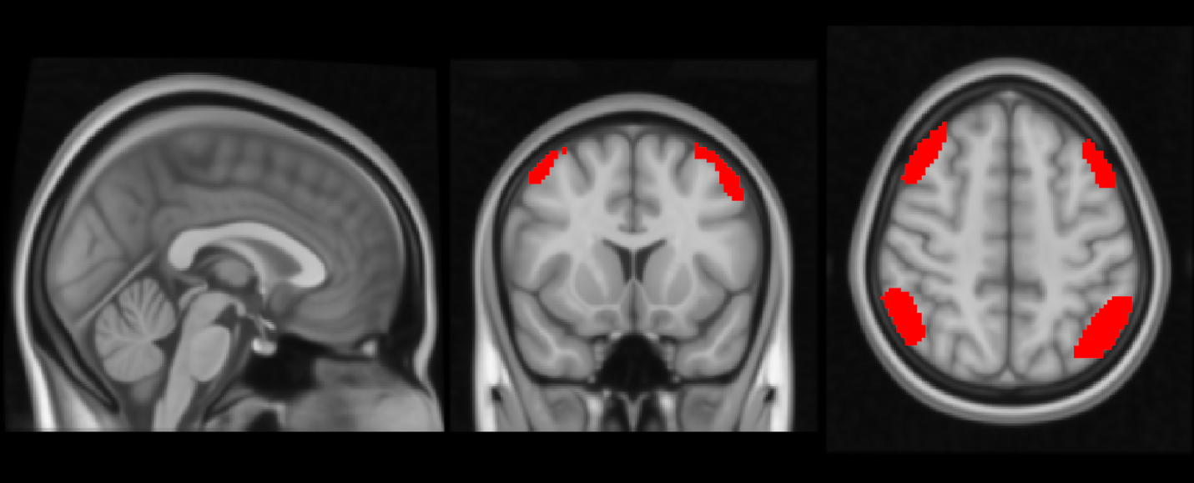
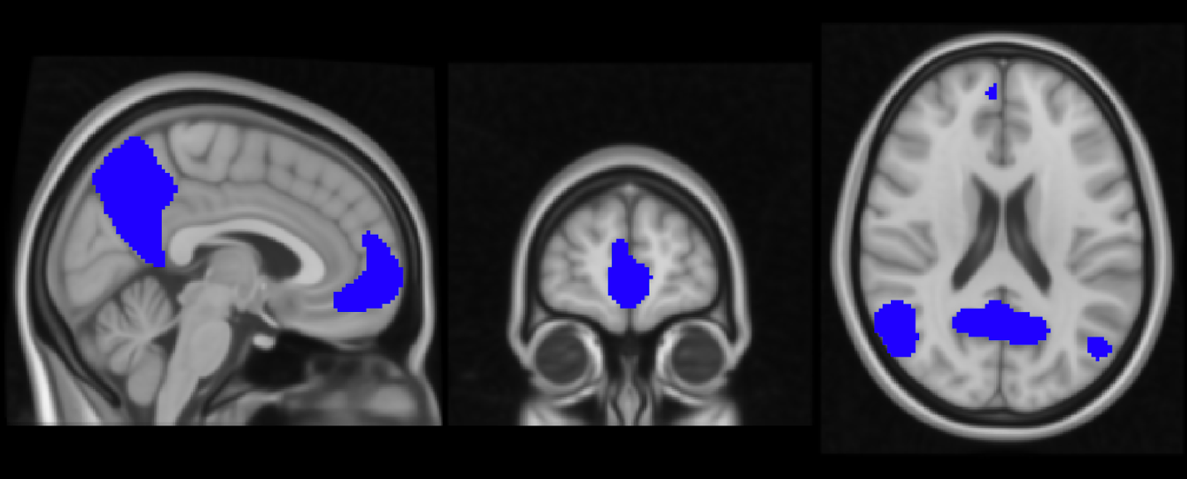
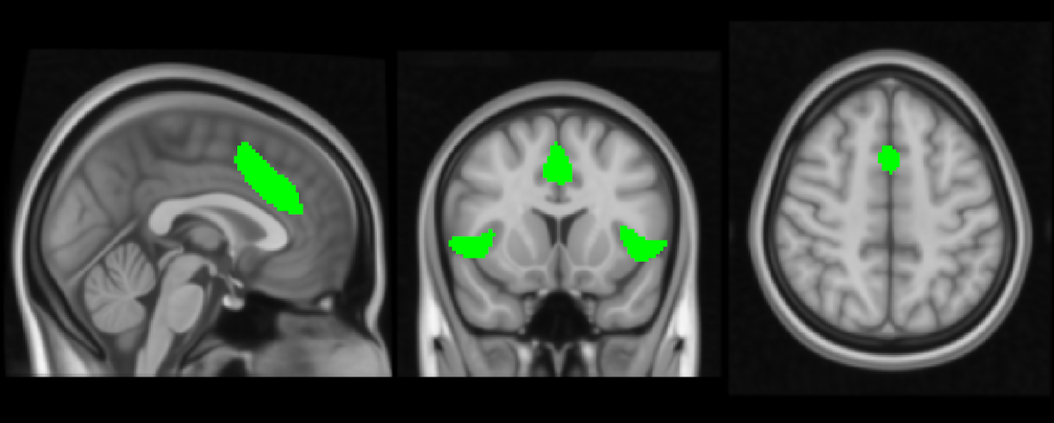
The brain networks behind mindfulness meditation
The Triple Network Model — Fox et al. 2005; Buckner et al. 2008; Menon 2011
• Default Mode Network (DMN) — blue
– mind-wandering, self-referential thought
• Salience Network (SN) — green
– detects what's relevant; switches attention between DMN and CEN
• Central Executive Network (CEN) — red
– sustained, goal-directed, externally-focused attention

Slide 6
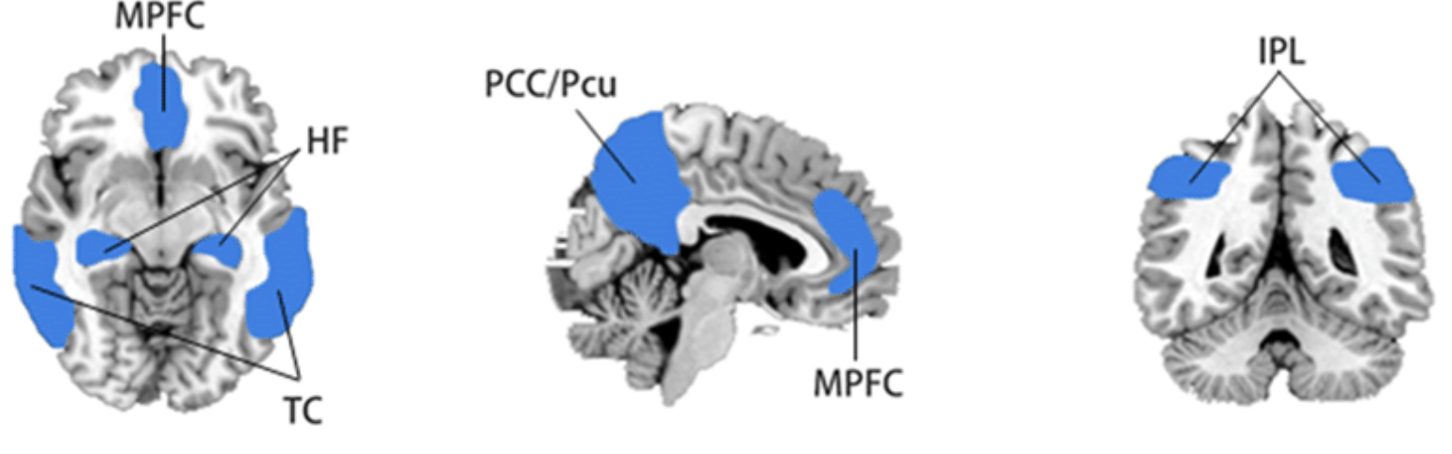
Default Mode Network (DMN)
Raichle et al. 2001; Gusnard & Raichle 2001; Northoff et al. 2006
• Associated with mind-wandering and inattention to the present moment.
• Deactivated during attention-demanding tasks.
• Key regions:
– Precuneus / posterior cingulate cortex (PCC)
– Inferior parietal lobule
– Medial prefrontal cortex (MPFC)
– Hippocampal formations
– Temporal cortices

Slide 7
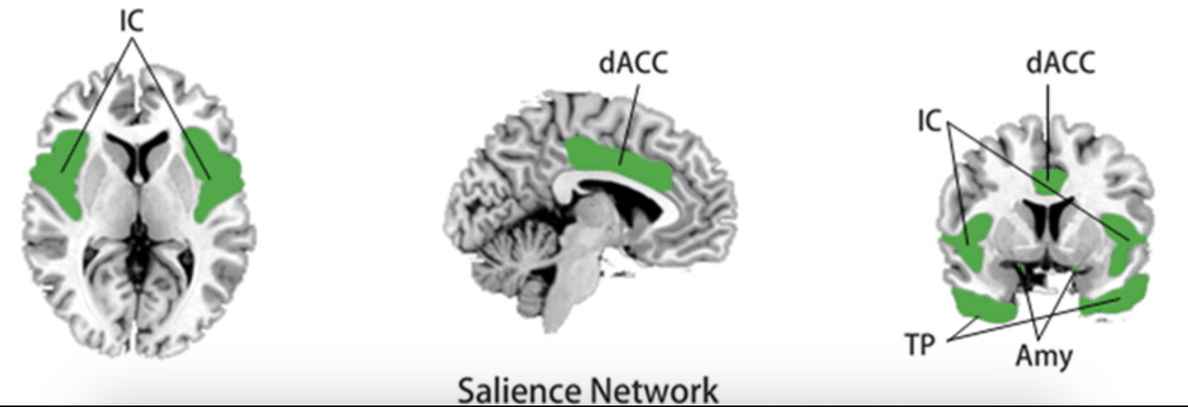
Salience Network (SN)
Seeley et al. 2007; Corbetta et al. 2008
• Involved in stimulus-driven attention and salience detection.
• Thought of as a switch between:
– internally-focused attention, mediated by the DMN
– externally-focused attention, mediated by the CEN
• Composed of:
– Insula
– Mid-dorsal cingulate regions
– Amygdala
– Temporal poles

Slide 8
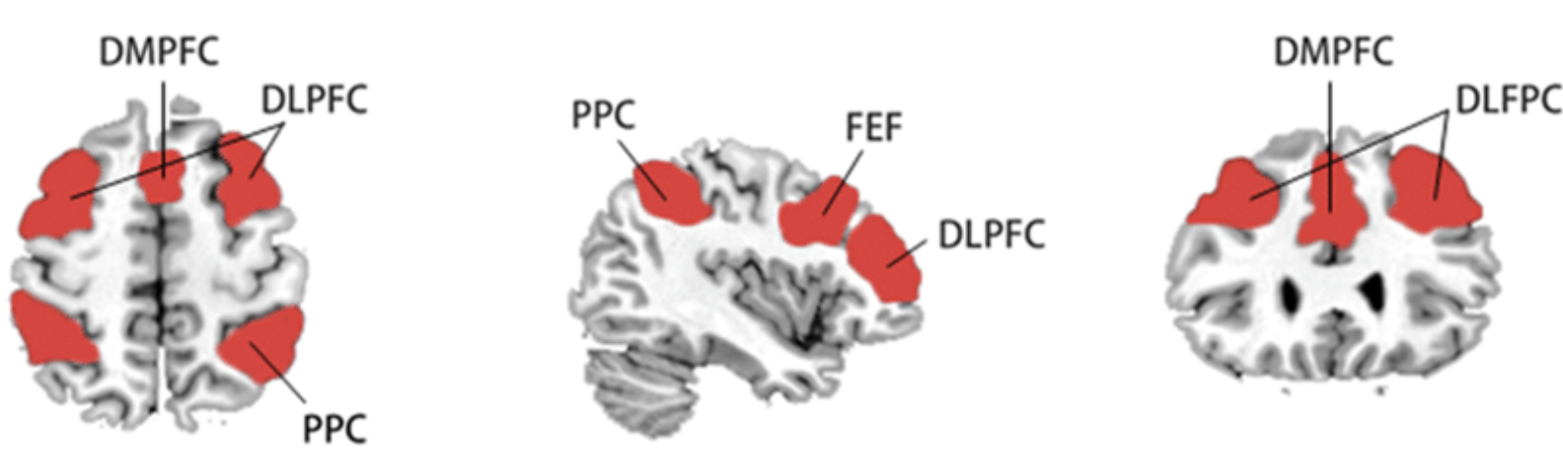
Central Executive Network (CEN)
Seeley et al. 2007
• Involved in sustained, externally-focused, goal-directed attention.
• Composed of:
– Dorsomedial and lateral prefrontal cortices
– Posterior parietal cortices
– Frontal eye field

Slide 9
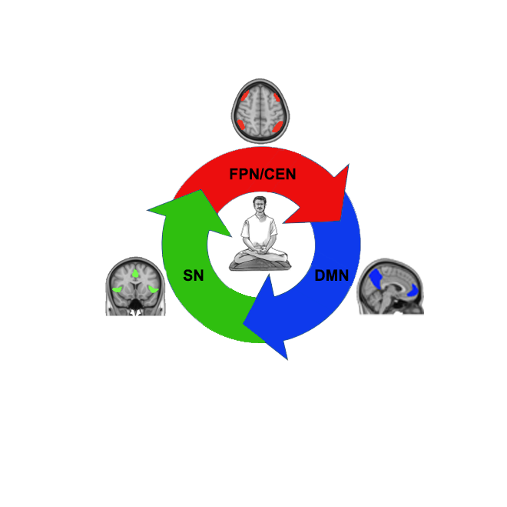
How mindfulness engages these networks
Hasenkamp et al. 2012
• CEN — sustains attention on the object of focus (breath, sensations, thoughts).
• DMN — activates when the mind wanders from that object.
• SN — detects the moment the participant becomes aware of the mind-wandering.
• Reengagement of the CEN — shifts attention back to the object of practice.
• This cycle — focus, wander, notice, refocus — repeated over and over, is the mechanism mindfulness training is thought to strengthen.

Slide 10
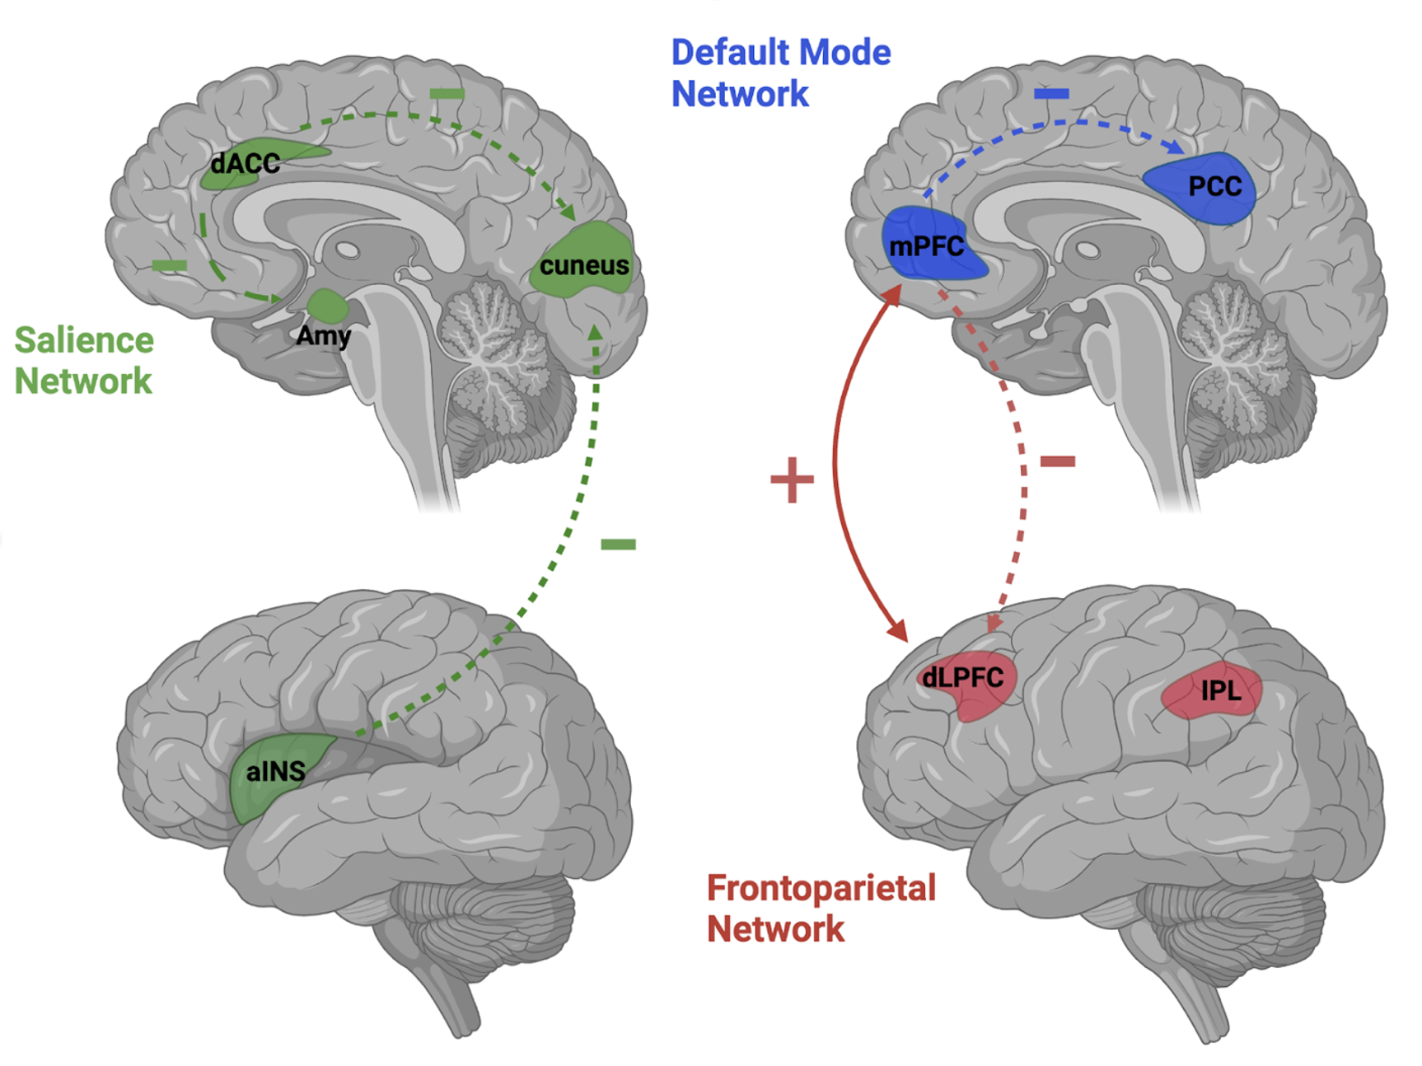
Toward a brain network science of mindfulness
Treves et al. 2023 (Handbook of Mindfulness and Self-Regulation); Rahrig et al. 2022; Sezer et al. 2022
• Reduced within-DMN connectivity — across intervention, trait, and long-term-meditator study designs.
• Increased DMN-CEN connectivity during interventions and active meditation.
• DMN-CEN become MORE anticorrelated in more mindful individuals — likely a nonlinear, expertise-related phenomenon (echoing the intermediate-vs-expert distinction on the next slide).
• Decreased Salience Network connectivity — specifically between rostral ACC and amygdala/insula.

Slide 11
The PDA metric, and why CEN-DMN is a causal target
Bauer et al. (2019a). eNeuro 6(6). "From State-to-Trait Meditation" + Chen et al. (2013). PNAS.
• PDA = CEN activity - DMN activity, introduced to quantify exactly this CEN/DMN relationship in 16 experienced meditators (avg. 1677h Vipassana) vs. 17 controls.
• PDA significantly increased DURING meditation (p=.003) and this increase PERSISTED afterward (state-to-trait, p=.02) -- direct evidence PDA carries over from state to trait.
• The bigger the increase in PDA after meditation, the bigger the reduction in DMN connectivity (MPFC-PCC) afterward (R=-0.70) -- PDA tracks the actual network mechanism, not just a proxy statistic.
• Causal grounding (Chen et al. 2013): using TMS to excite/inhibit CEN nodes while simultaneously imaging with fMRI, they showed the DMN is under DIRECT INHIBITORY CONTROL from a specific CEN node (posterior middle frontal gyrus, BA9/10).
• This is why CEN-DMN (PDA) is a defensible neurofeedback target: it's not an arbitrary contrast, it reflects a demonstrated causal relationship, not just a correlation.

Slide 12
Why mindfulness
• Experienced meditators show reduced DMN activity and altered DMN connectivity, both at rest and during tasks, compared to non-meditators.
• Mindfulness training is, in effect, DMN self-regulation training — learned gradually, through sustained practice.
• [Cite your preferred primary sources here — e.g. Brewer et al. 2011 PNAS]
• The catch: this normally takes months to years of practice before it generalizes.
Notes:
Mindfulness practice is associated with reduced DMN activity and altered connectivity, at rest and during tasks -- meditators have effectively trained themselves to do, at will, something like the reverse of what the room just experienced involuntarily. Add your preferred primary source (e.g. Brewer et al. 2011 PNAS) on this slide. The catch: normally takes months to years of practice before it generalizes -- that's the opening for neurofeedback as a shortcut.

Slide 13
Why neurofeedback
• Real-time neurofeedback gives someone a direct, immediate readout of their own brain state — turning an invisible, internal process into something they can see and steer.
• The hypothesis: if people can SEE their DMN/CEN balance moment to moment, they can learn to shift it far faster than through practice alone — training a muscle you couldn't previously feel.
• Our approach: a visual "ball" task — the ball rises toward a Central Executive Network (CEN) target when task-focused attention dominates, and toward the DMN target otherwise.
Notes:
Real-time neurofeedback gives someone a direct, immediate readout of their own brain state. The hypothesis: seeing your DMN/CEN balance moment to moment lets you learn to shift it far faster than practice alone. Introduce the visual ball task here: it rises toward CEN when task-focused attention dominates, toward DMN otherwise -- this is the exact mechanic used in every result on the following slides.

Slide 14
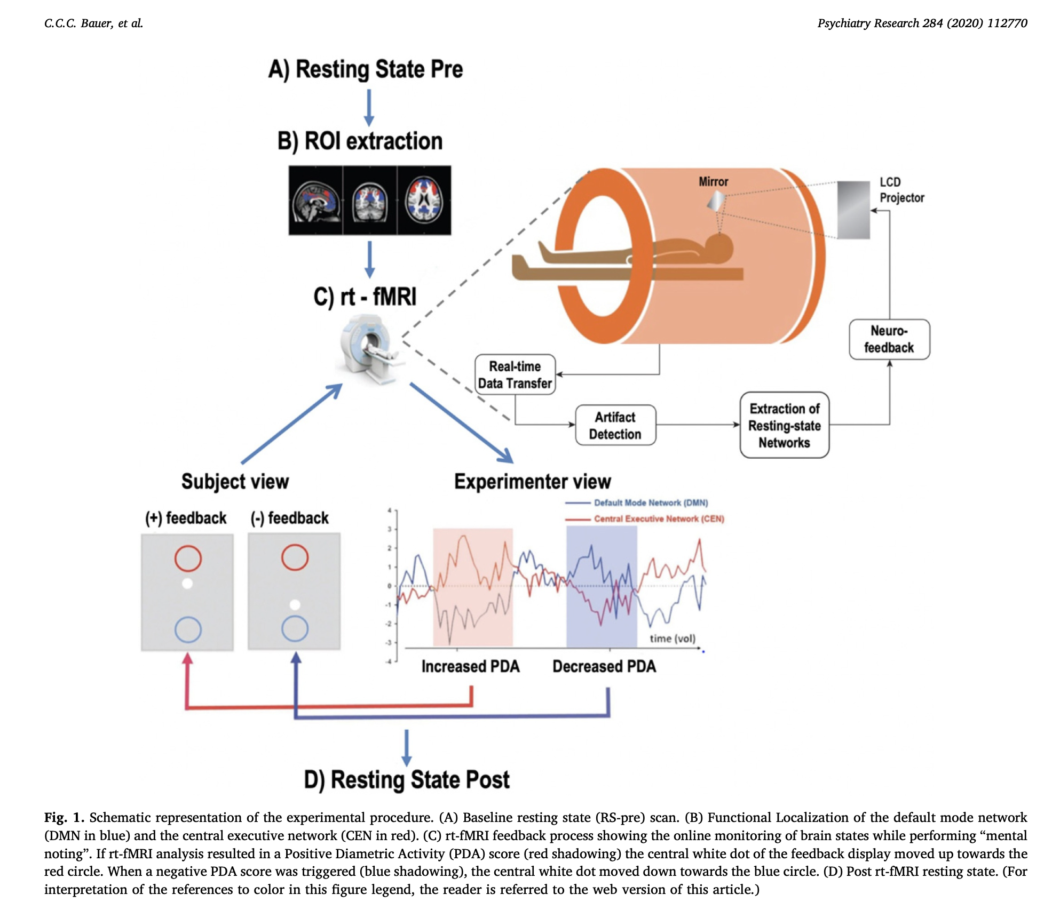
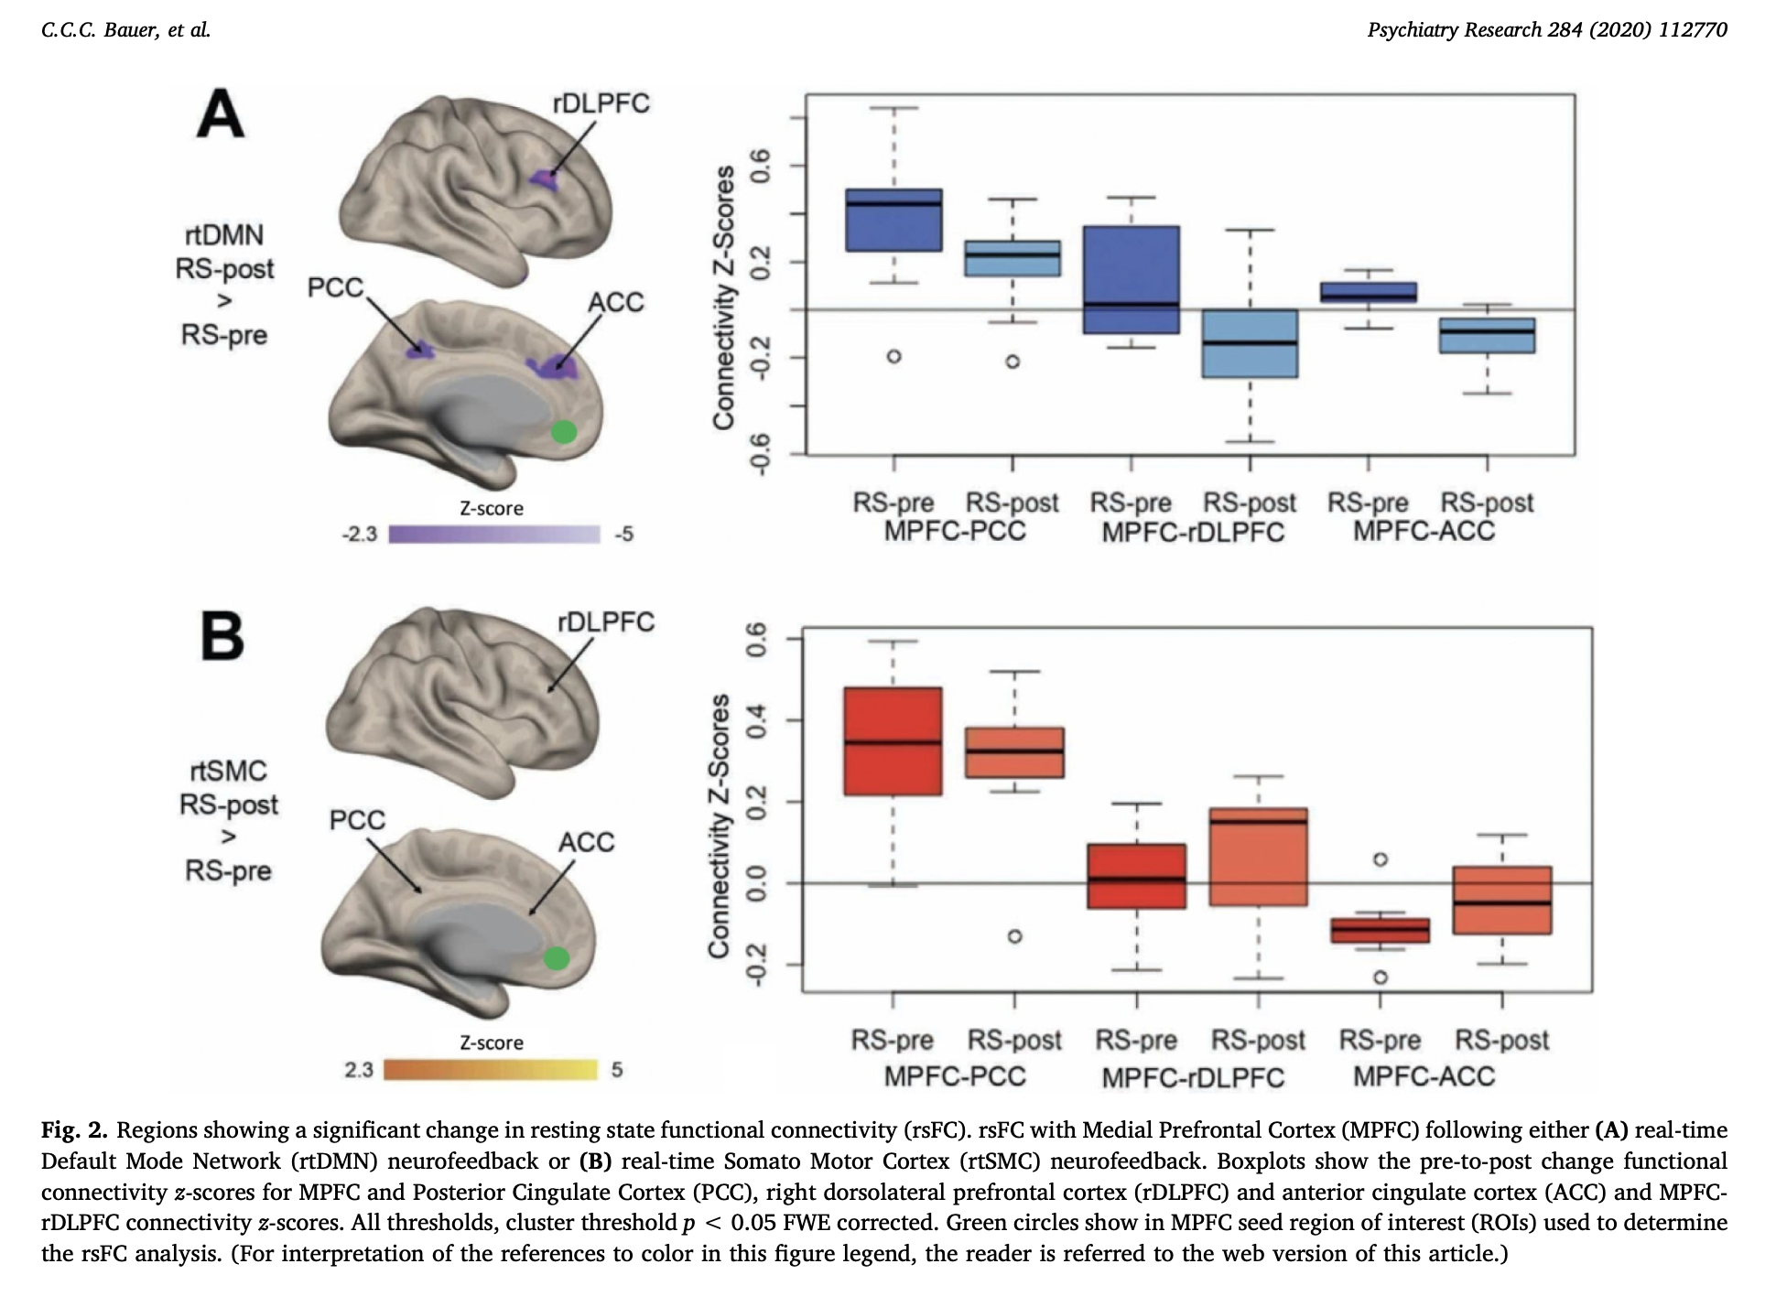
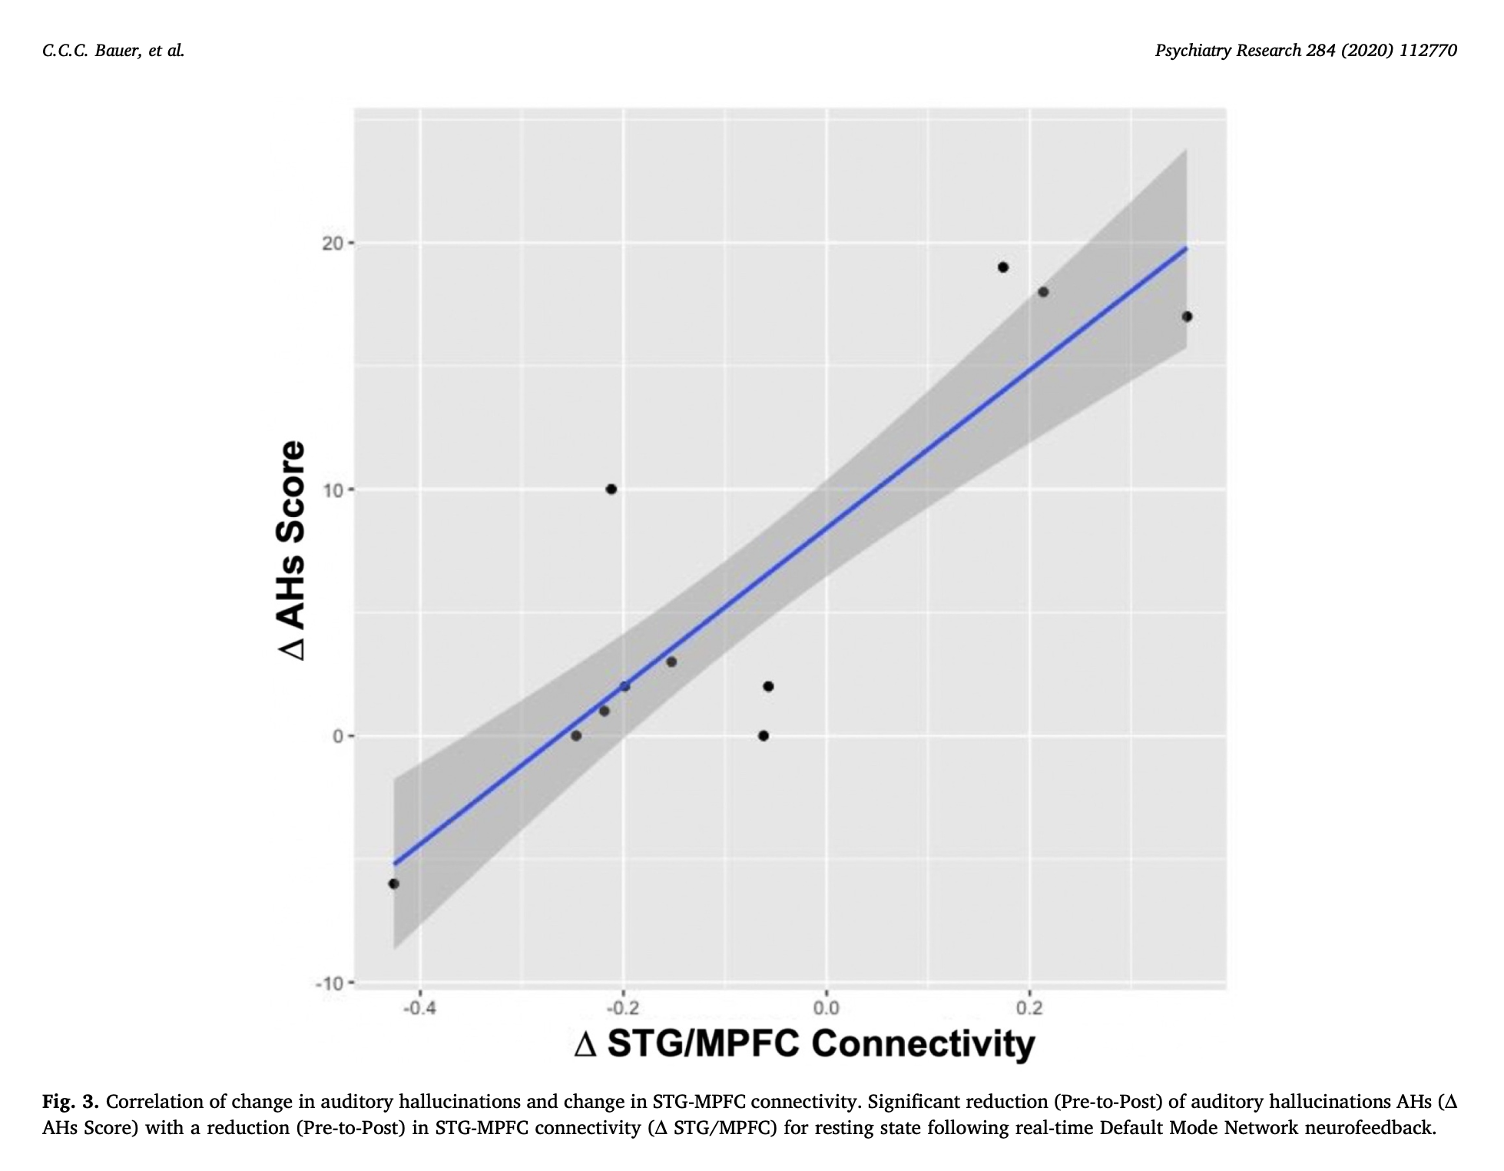
Where the ball task and PDA metric came from
Bauer et al. (2019/2020). Psychiatry Research 284:112770. "Part 2: Default Mode Network"
• 11 schizophrenia/schizoaffective patients with auditory hallucinations; real-time fMRI neurofeedback targeting the DMN-CEN differential -- the FIRST use of PDA = CEN activation - DMN activation and the white-dot/red-circle/blue-circle visual mechanic used throughout this whole talk and in mindwear.
• A single session reduced hallucination severity (p=.02, d=0.57) vs. no change with a somatomotor-cortex control feedback condition; reduced mPFC-PCC connectivity and increased mPFC-ACC/rDLPFC anticorrelation.
• Each individual's reduction in hallucination severity correlated with their own reduction in STG-mPFC connectivity -- brain-behavior evidence, from the very first study to use this paradigm.
Notes:
Bauer et al. (2019/2020), Psychiatry Research 284:112770, Part 2: DMN. This is the paper that FIRST introduced the PDA metric (CEN activation - DMN activation) and the white-dot/red-circle/blue-circle visual feedback mechanic used throughout this entire talk and in mindwear -- worth mentioning explicitly since it grounds everything shown earlier as not invented for this talk but an established, validated paradigm. 11 schizophrenia patients with auditory hallucinations; a single DMN-CEN neurofeedback session reduced hallucination severity (p=.02, d=0.57) with no change in a somatomotor-cortex control condition. Each individual's AHs reduction correlated with their own STG-mPFC connectivity reduction -- brain-behavior evidence from the very first study using this paradigm.

Slide 15
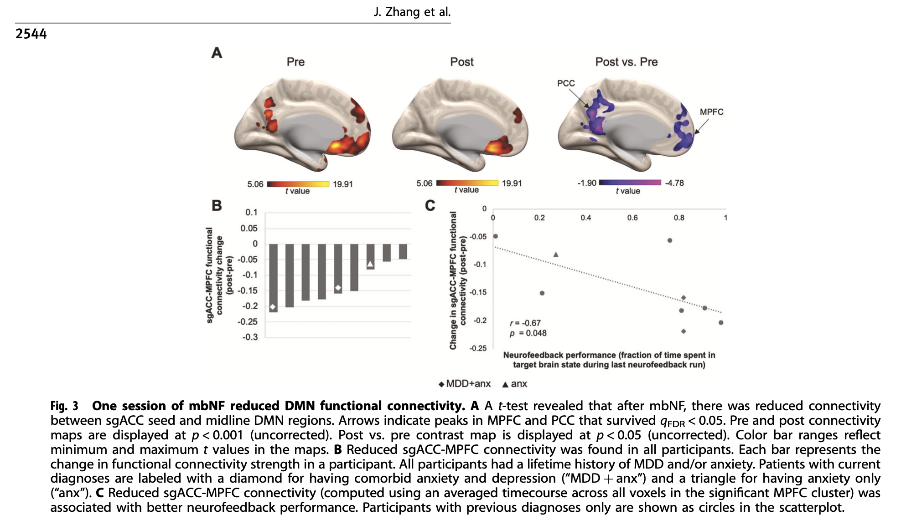
Prior fMRI evidence: this already works in the scanner
Zhang, Raya, Morfini, ... Bauer, Whitfield-Gabrieli (2023). Molecular Psychiatry.
• 9 adolescents with a lifetime history of depression/anxiety; DMN and CEN individually localized per person from a resting-state scan.
• One 15-minute mindfulness-based fMRI neurofeedback (mbNF) session: watch a dot driven by PDA = CEN activation − DMN activation move up with effective mental-noting practice — the exact same PDA metric and ball/dot mechanic used throughout this talk and in mindwear.
• Result: participants spent significantly more time in the target state (DMN < CEN) than chance (p=.038), and all 9 of 9 adolescents showed reduced within-DMN connectivity after just one session.
• That connectivity reduction correlated with increased state mindfulness (r=−0.88, p=.002), and statistically mediated the link between neurofeedback performance and the mindfulness gain — i.e., quieting the DMN is plausibly the mechanism, not just a correlate.
• This is the evidence base motivating scaling the same paradigm outside the scanner.
Notes:
Zhang, Raya, Morfini, ... Bauer, Whitfield-Gabrieli (2023), Molecular Psychiatry. 9 adolescents with a lifetime history of depression/anxiety; DMN/CEN individually localized per person. One 15-minute mbNF session, using PDA = CEN activation - DMN activation -- the exact same metric and dot/ball mechanic used throughout this talk and in mindwear. Result: participants spent significantly more time in the target state than chance (p=.038); ALL 9 of 9 adolescents showed reduced within-DMN connectivity after just one session; that reduction correlated with increased state mindfulness (r=-0.88, p=.002) and statistically mediated the performance-to-mindfulness link. This is the evidence base that motivates scaling the same paradigm outside the scanner.

Slide 16
The scaling problem
• fMRI neurofeedback works, but an MRI scanner is expensive, immobile, and inaccessible for repeated, at-home, or scalable clinical use.
• If we want this to reach people beyond a single research scanner, we need the SAME signal, decodable from something portable.
• EEG is cheap, wearable, and real-time — but scalp EEG doesn't measure DMN/CEN BOLD activity directly. It has to be decoded.
• That decoding problem is what the rest of this talk is about.
Notes:
fMRI neurofeedback works, but a scanner is expensive, immobile, and inaccessible for repeated/at-home/clinical use. If this is going to reach people beyond one research scanner, we need the SAME signal decodable from something portable. EEG is cheap and real-time but doesn't measure DMN/CEN BOLD directly -- it has to be decoded. That decoding problem is the rest of the talk.

Slide 17
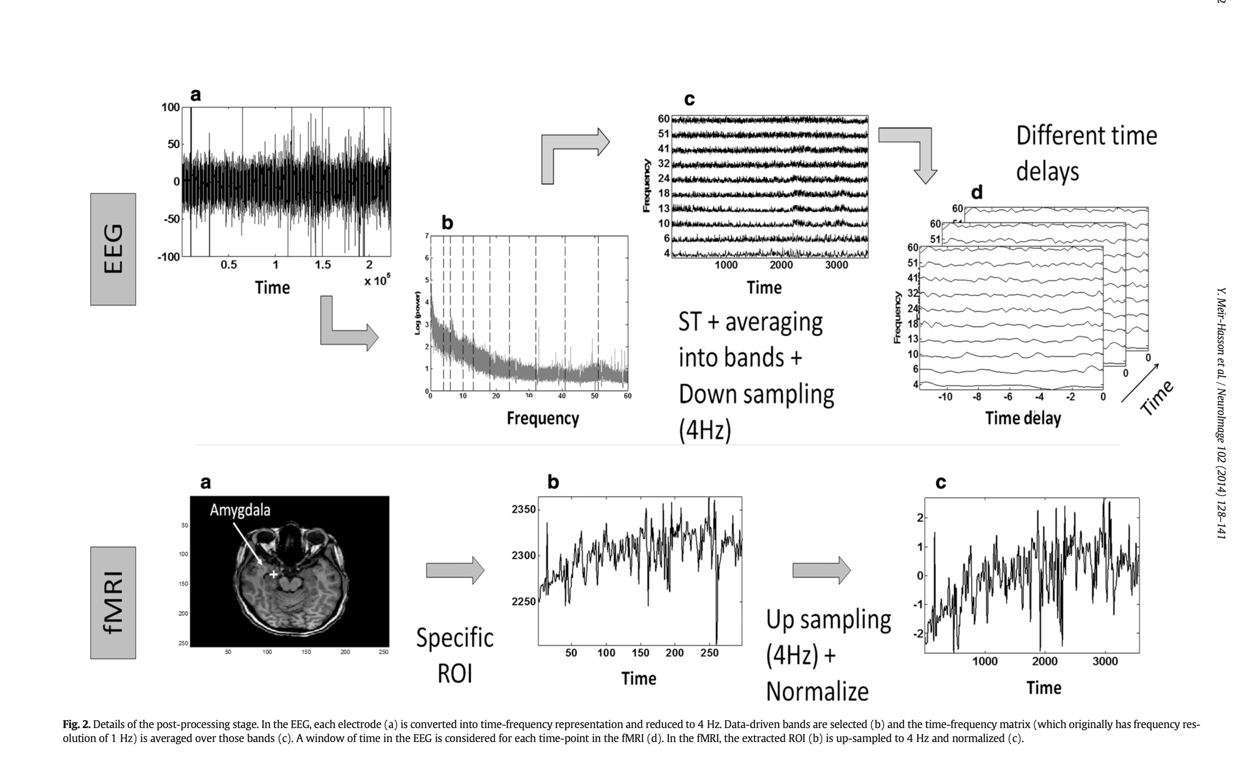
Meir-Hasson et al. (2014) — the EEG Finger-Print
NeuroImage 102:128–141 · [insert the paper's Fig. 1/Fig. 2 schematic here if desired]
• Goal: predict fMRI BOLD activity in a specific ROI — especially hard-to-reach subcortical regions like the amygdala — from simultaneous EEG, well enough to eventually let portable EEG stand in for the scanner during neurofeedback.
• Core method (what we replicate): single electrode -> Stockwell time-frequency transform -> 10 data-driven equal-energy frequency bands (not fixed alpha/theta) -> ridge regression on a [band x sliding time-delay] design.
• Key innovation: NO fixed hemodynamic delay. Each frequency band gets its own data-driven delay, per subject and electrode — because the true EEG-to-BOLD lag varies by all three.
• Validated with double cross-validation (outer block CV for honest test scores, inner CV for the ridge regularization strength) — the same discipline our own replication follows.
• Tested on two datasets: eyes-open/closed alpha modulation -> visual cortex (n=4), and real-time theta/alpha relaxation neurofeedback -> amygdala and dmPFC (n=20).
Notes:
Meir-Hasson et al. (2014), NeuroImage 102:128-141. Goal: predict fMRI BOLD in a specific ROI (they focused on the amygdala) from simultaneous EEG, well enough to eventually let portable EEG stand in for the scanner. Core method we replicate: single electrode -> Stockwell time-frequency transform -> 10 data-driven equal-energy frequency bands (not fixed alpha/theta) -> ridge regression on a [band x sliding time-delay] design. Key innovation: no fixed hemodynamic delay -- each frequency band gets its own data-driven delay, per subject and electrode. Validated with double cross-validation (same discipline our own replication follows).

Slide 18
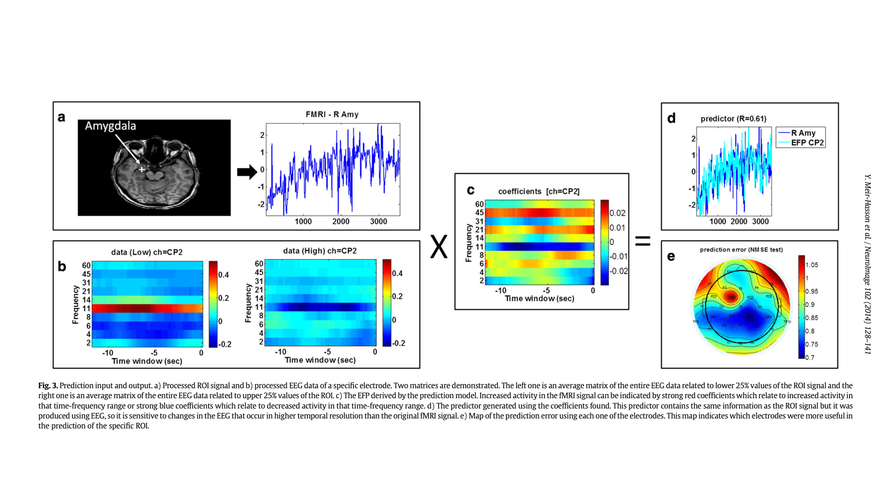
Meir-Hasson et al. (2014) — results
[insert the paper's Fig. 4/6/7 bar charts and amygdala EFP maps here if desired]
• Visual cortex (n=4): their EFP beat a traditional alpha-power predictor in ALL subjects, and beat a fixed-delay (HRF) predictor in all subjects (75% significantly).
• Amygdala (17/20 subjects cleared their validation threshold): EFP beat the traditional theta/alpha predictor in 95% of subjects (significant), and the fixed-delay predictor in 90% (35% significant). 85% of subjects reached r > 0.6.
• Best electrode for amygdala was P3 (theta/alpha/beta/gamma all contributed); the dmPFC control region was best predicted by a DIFFERENT electrode (Fz) with a different frequency pattern entirely — evidence the fingerprint is region-specific, not a generic global signal.
• The delay between EEG and BOLD varied by subject, electrode, AND frequency band — directly justifying the sliding per-band delay design our own EFP inherits.
Notes:
Their results: visual cortex (n=4) -- EFP beat a traditional alpha-power predictor in ALL subjects, beat a fixed-delay predictor in all subjects (75% significantly). Amygdala (17/20 subjects cleared their validation threshold) -- EFP beat theta/alpha in 95% (significant), beat fixed-delay in 90% (35% significant); 85% of subjects reached r>0.6. Best electrode for amygdala was P3; the dmPFC control region was best predicted by a DIFFERENT electrode (Fz) with a different frequency pattern -- evidence the fingerprint is region-specific, not a generic global signal. Delay varied by subject, electrode, AND frequency band -- direct justification for the sliding per-band delay design.

Slide 19
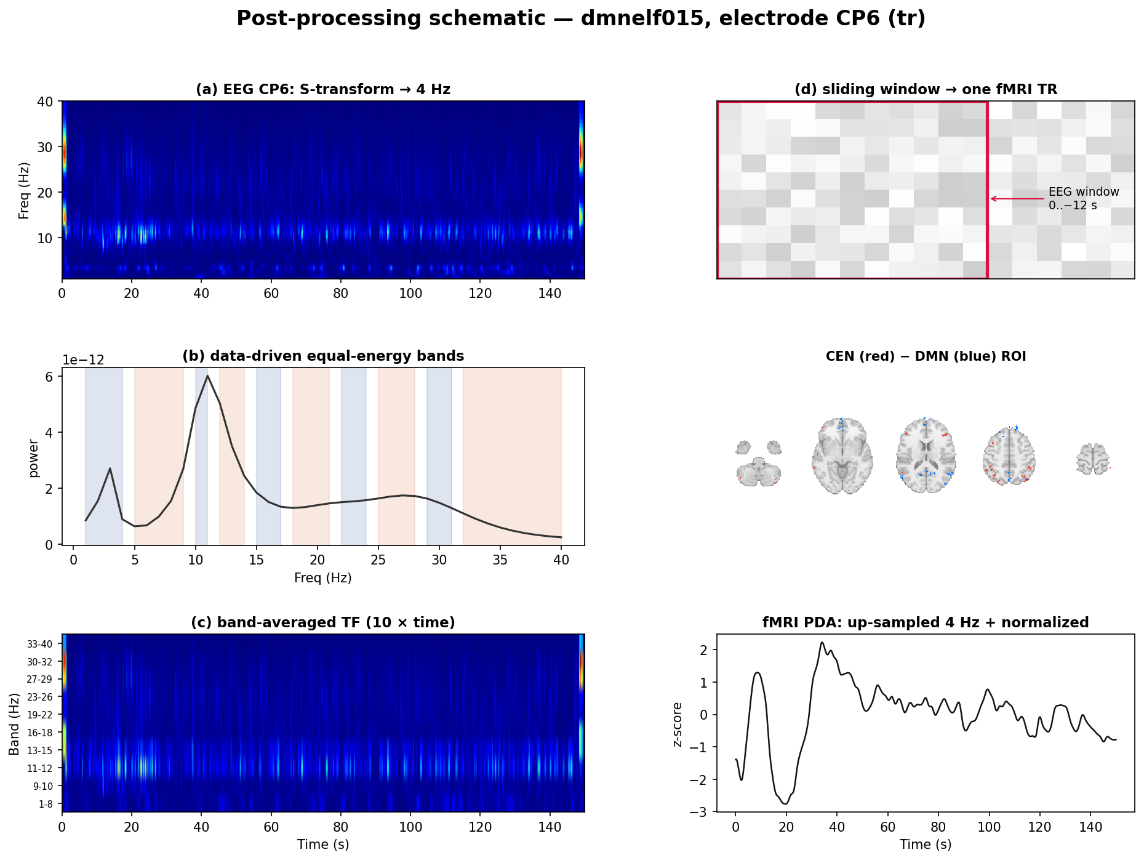
Our method: the EEG Finger-Print (EFP)
Replicating and extending Meir-Hasson 2014 for DMN, CEN, and PDA (CEN−DMN)
• In plain terms: for each electrode, break the EEG into 10 frequency bands, look at how each band's power over the last ~12 seconds predicts the fMRI signal right now, and let a regression model learn a separate best lag PER frequency band — no assumed fixed delay.
Notes:
Explain in plain language (you'll get asked about this, know it cold): for each electrode, break the EEG into 10 frequency bands, look at how each band's power over the last ~12 seconds predicts the fMRI signal right now, and let a regression model learn a separate best lag PER frequency band -- no assumed fixed delay. Why this is legit: fit and evaluated with double cross-validation (outer loop holds out blocks of time, inner loop picks the regularization strength) -- the numbers on the next slides are not fit-and-report-the-same-data results.

Slide 20
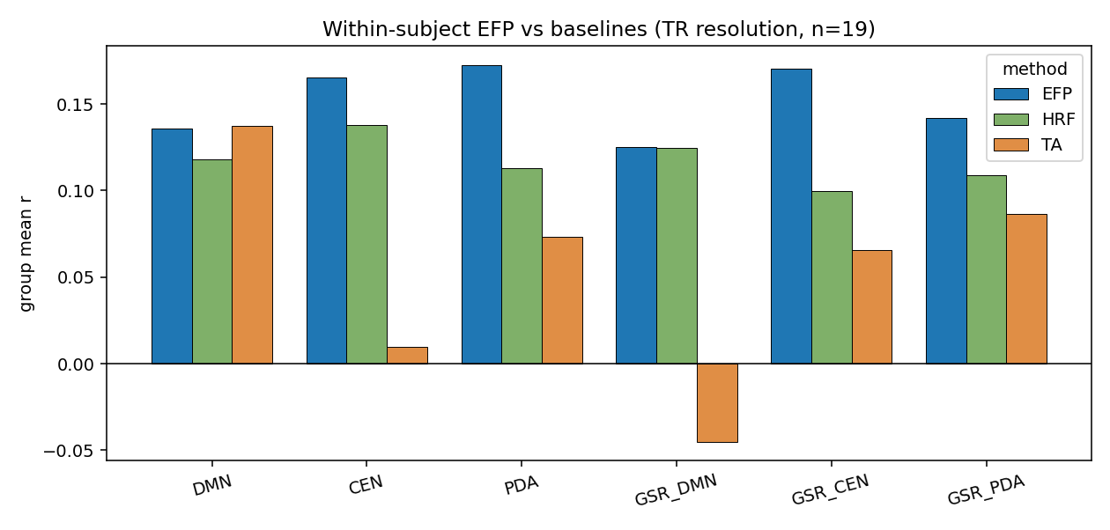
It works within-subject
n=19, single best electrode per subject
• EFP beats both a fixed-HRF baseline and the traditional theta/alpha ratio across every target — strongest for CEN, PDA, and their global-signal-controlled variants (r≈0.14–0.18).
Notes:
n=19, each subject's own single best electrode. EFP beats both a fixed-HRF baseline and the traditional theta/alpha ratio across every target -- strongest for CEN, PDA, and their global-signal-controlled variants (r~0.14-0.18). Say these as correlations between predicted and actual signal, not accuracy percentages.

Slide 21
It generalizes to a NEW subject within our own cohort
Leave-one-subject-out (LOSO): train on 18, predict the 19th, never seen
• CEN: r=+0.114 (p=0.001)
• DMN: r=+0.107 (p=0.001)
• PDA: r=+0.157 (p=0.002)
• This is a single, general fingerprint (not personalized) — evidence the EFP captures a real, shared EEG-to-BOLD mapping, not subject-specific overfitting.
Notes:
Leave-one-subject-out: train a single GENERAL model on 18 subjects, predict the 19th, who was never seen -- a harder, more honest test than the within-subject slide (there, each subject had their own fitted model). CEN r=+0.114 (p=.001), DMN r=+0.107 (p=.001), PDA r=+0.157 (p=.002). This is evidence the EFP captures a real, shared EEG-to-BOLD mapping, not subject-specific overfitting.

Slide 22
Adding 2 more subjects only helped
sub-dmnelf002/003 recovered via R128 trigger-marker reconstruction
• 3 targets moved from non-significant/marginal at n=17 to clearly significant at n=19.
• Several other targets got stronger (tighter p-values); nothing regressed meaningfully.
• Net effect of the 2 recovered subjects: real, if modest, improvement across the board.
Notes:
sub-dmnelf002/003 were recovered via R128 fMRI trigger-marker reconstruction, growing the cohort from 17 to 19. 3 targets moved from non-significant/marginal to clearly significant; several others got stronger; nothing regressed meaningfully. Useful if asked about sample size: the signal is getting cleaner as the cohort grows, not noisier.

Slide 23
It replicates in a completely independent cohort
DMNELF-trained fingerprint, tested on rtBPD — zero rtBPD data used in training
• CEN (electrode CP6)
– Session 1 (nf1, n=19): r=+0.165, p=0.000
– Session 2 (nf2, n=11): r=+0.161, p=0.002
• DMN (electrode O1)
– Session 1 (nf1, n=19): r=+0.084, p=0.001
– Session 2 (nf2, n=11): r=+0.077, p=0.008
• Two independent replications, in a cohort the model never saw during training — this is the strongest evidence that the fingerprint is a general EEG-to-BOLD mapping, not an artifact of one dataset.
Notes:
THE HEADLINE SLIDE. The DMNELF-trained fingerprint, applied with ZERO retraining, to a completely different study's participants (rtBPD) -- CEN r=+0.165 (nf1, p<.001) / +0.161 (nf2, p=.002); DMN r=+0.084 (nf1, p=.001) / +0.077 (nf2, p=.008). Two independent replications in a cohort the model never saw during training. This answers 'does this generalize beyond your own dataset' -- say so explicitly. Note (only if asked): PDA also replicates here (nf1 p=.017, nf2 p=.007) in this classic research-cap method -- but that is a SEPARATE finding from mindwear's deployed portable decoder, where PDA specifically has no out-of-sample validity. Don't conflate the two. The slide leads with CEN/DMN because those are the targets that transfer most consistently across every version of this analysis.

Slide 24
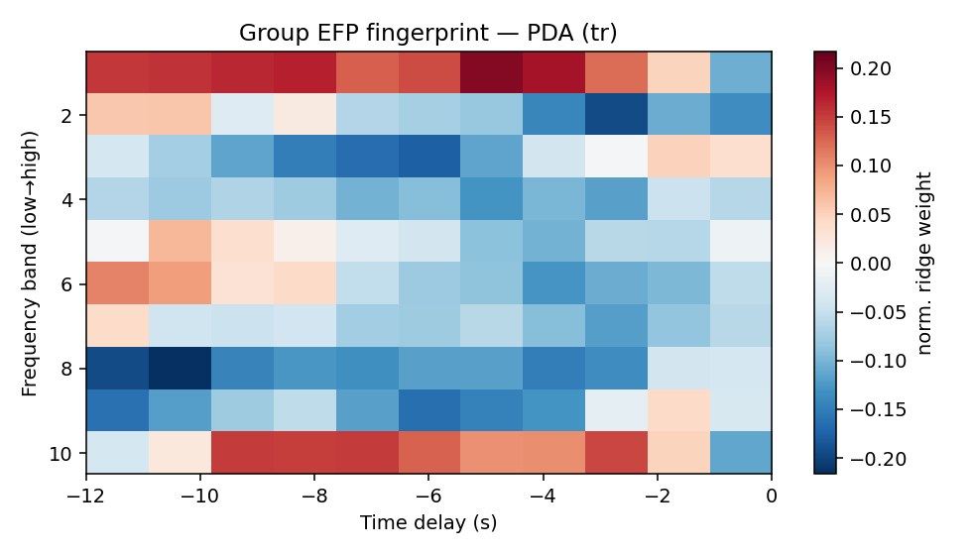
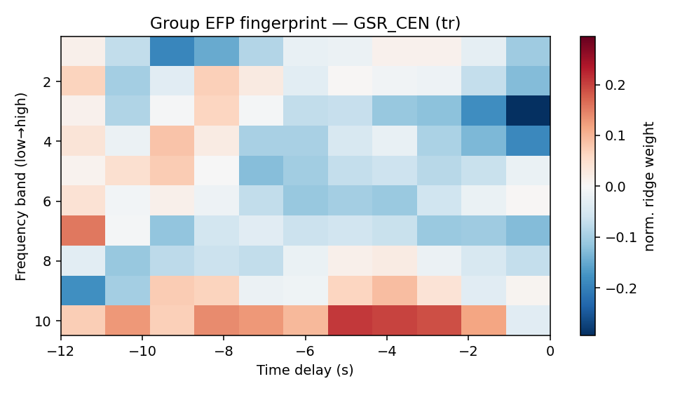
Interpretable, not a black box
• The learned [frequency × delay] weights peak at ~4–7 second lags — matching the known hemodynamic delay — even though the model was never told this. It re-discovered an HRF-like structure on its own, differing across frequency bands.
Notes:
The model was never told anything about hemodynamics, yet the learned [frequency x delay] weights peak at physiologically plausible 4-7 second lags, differing across frequency bands. Good 'this learned something real, not noise' visual if anyone's skeptical about a black-box model.

Slide 25
From a validated fingerprint to a usable tool
• We now have a general, cross-cohort-validated EEG fingerprint for CEN and DMN.
• That's enough signal to build something a person could use outside the scanner — not with a 31-channel research cap, but with a consumer-grade, 12-channel portable headset.
• That tool is mindwear.
Notes:
Pivot from science to product: we now have a general, cross-cohort-validated EEG fingerprint for CEN and DMN -- enough signal to build something usable outside the scanner, not with a 31-channel research cap but a consumer-grade 12-channel portable headset. That tool is mindwear.

Slide 26
mindwear: portable DMN/CEN neurofeedback
• Runs the same visual ball-feedback task as our scanner protocol, driven by a portable 12-channel EEG headset instead of an MRI scanner.
• The EEG-to-network decoder is the same EFP approach just shown — trained on our DMNELF cohort, montage-restricted to the portable headset's 12 channels.
• Includes a built-in comparison mode: replay a recorded session and watch the EEG-decoded ball run side by side with the scanner ground truth, on the same run.
• [Insert a mindwear screenshot / architecture diagram here]
Notes:
mindwear runs the identical visual ball-feedback paradigm, driven by the same EFP approach, montage-restricted to the portable headset's 12 channels. Built-in comparison mode: replay a recorded session and watch the EEG-decoded ball run side by side with the scanner ground truth, on the same run. Add a screenshot/architecture diagram here if you have one.

Slide 27
Let's try it live
• Demo on myself first — a short live feedback run, so you can see the ball move in real time.
• Then: any volunteers? (headset fit takes ~1–2 minutes; keep a spare pair of alcohol wipes and the fit-quality checklist within reach)
• What to watch for: it will be noisier than an fMRI signal — that's expected and is exactly what the earlier results characterized. Watch the overall trend over the run, not moment-to-moment jitter.
Notes:
Demo on yourself first so the room sees the ball move before any volunteer. Headset fit takes ~1-2 minutes; keep alcohol wipes + fit-quality checklist within reach. Framing while it runs: 'This is noisier than the fMRI data you saw earlier -- that's expected, exactly what we spent the whole talk characterizing. Watch the trend over the run, not moment-to-moment jitter.' Pre-empts the obvious 'it's jittery' reaction.

Slide 28
Takeaways
• A single-electrode EEG fingerprint, replicating Meir-Hasson 2014, decodes DMN/CEN/PDA within-subject, generalizes to new subjects (LOSO), and replicates in a fully independent cohort (rtBPD) for CEN and DMN.
• That validated fingerprint now powers mindwear, a portable, scanner-free neurofeedback tool.
• Next: scaling access to DMN-targeted self-regulation training beyond the scanner — to the clinic, and eventually, the living room.
Notes:
One sentence each: replication succeeded (within-subject, LOSO, and cross-cohort for CEN/DMN) -> that validated fingerprint now powers mindwear, a portable scanner-free tool -> next is scaling access to DMN-targeted self-regulation training beyond the scanner.

Slide 29
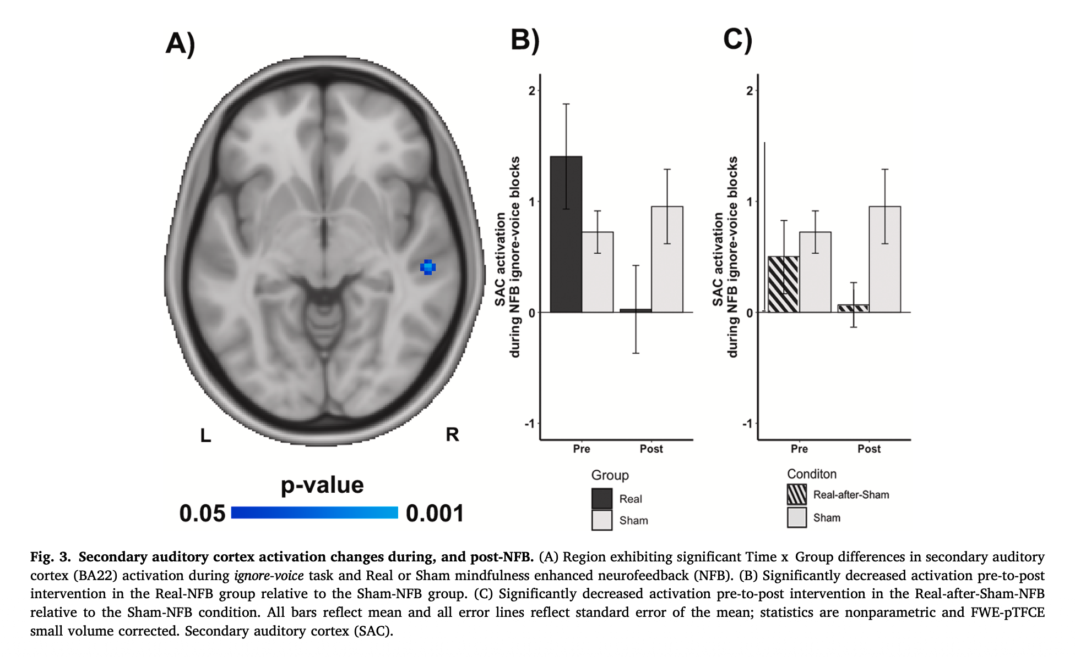
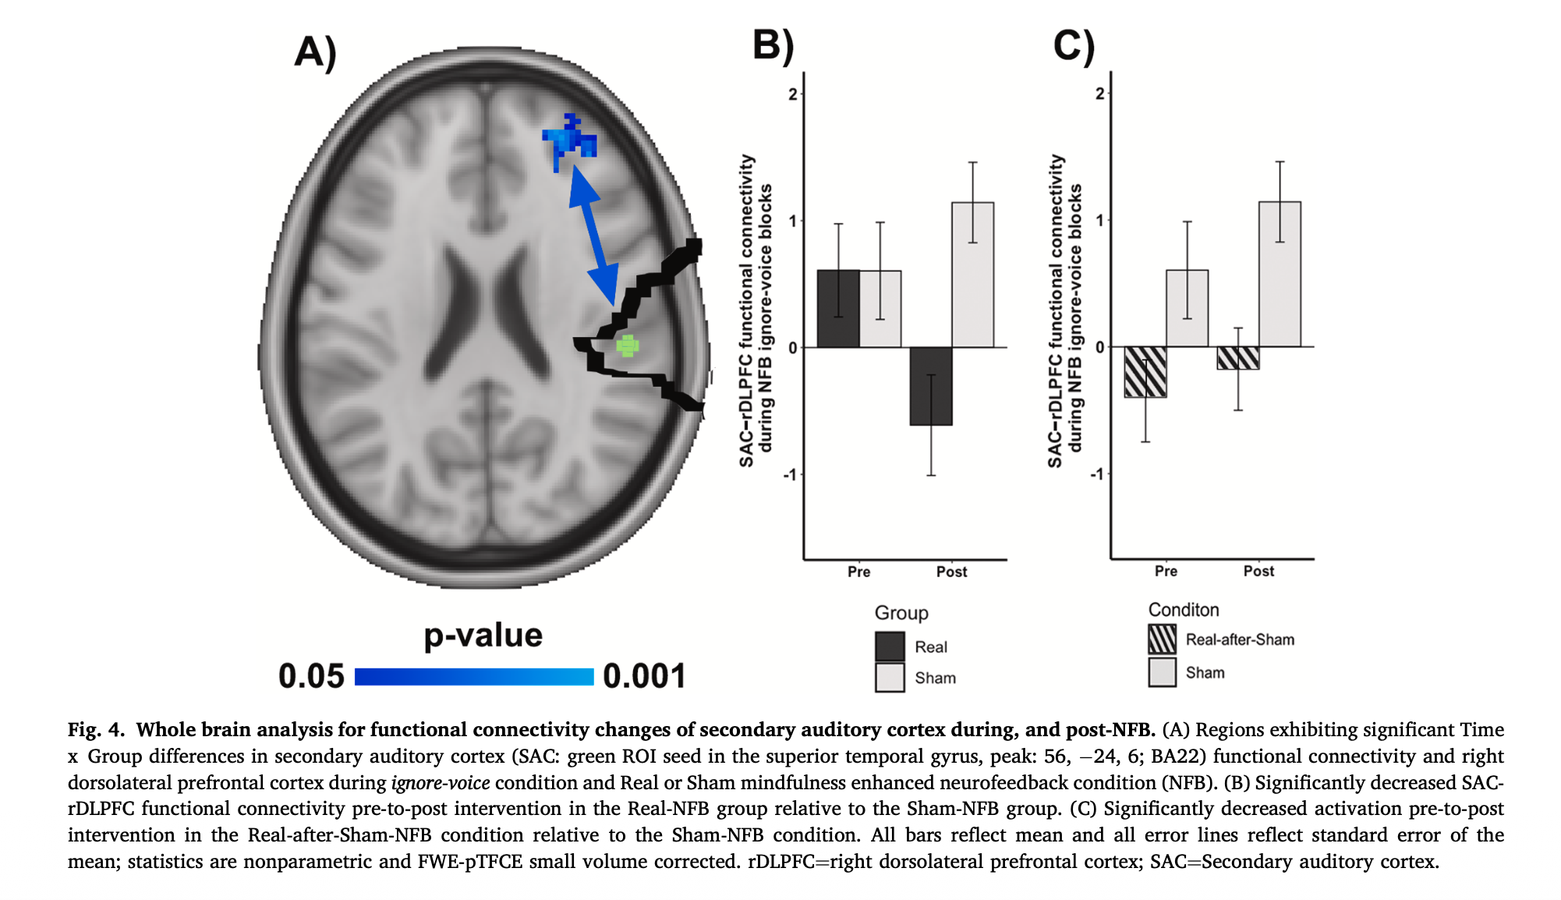
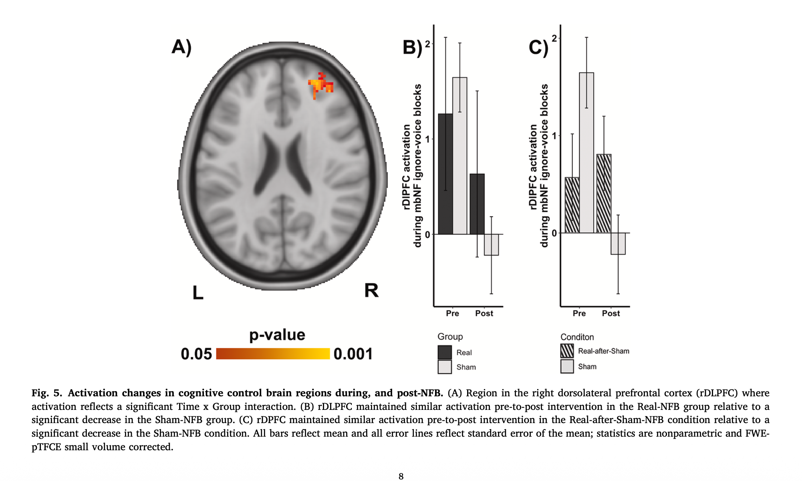
The broader paradigm: mindfulness + targeted neurofeedback
Bauer et al. (2025). Psychiatry Research: Neuroimaging 353:112050 · [insert poster/slide graphics here]
• Same recipe — real-time fMRI neurofeedback delivered from a symptom-relevant region, paired with the same "mental-noting" mindfulness technique — also tested in schizophrenia patients with treatment-resistant auditory hallucinations, targeting superior temporal gyrus (STG) instead of DMN/CEN.
• Randomized, sham-controlled (n=23): STG-targeted neurofeedback produced significantly greater reductions in secondary auditory cortex activity and its connectivity to prefrontal cognitive-control regions than sham feedback from an unrelated region.
• Auditory hallucination severity dropped in both groups (consistent with mindfulness itself contributing), but only real, region-specific feedback changed the underlying circuit — the same logic underlying why targeting DMN/CEN specifically (not a generic relaxation signal) should matter here.
• Together with the mbNF result on slide 7, this is a second, independent population and target region where the same mindfulness-plus-neurofeedback framework produced measurable brain change — this approach is not a one-off.
Notes:
Bauer et al. (2025), Psychiatry Research: Neuroimaging 353:112050. Same recipe -- real-time fMRI neurofeedback from a symptom-relevant region + the same 'mental-noting' mindfulness technique -- tested in schizophrenia patients with treatment-resistant auditory hallucinations, targeting STG instead of DMN/CEN. Randomized, sham-controlled (n=23): real feedback produced significantly greater reductions in secondary auditory cortex activity and its connectivity to prefrontal control regions than sham. Hallucination severity dropped in both groups, but only real region-specific feedback changed the underlying circuit -- same logic for why targeting DMN/CEN specifically (not generic relaxation) should matter. Together with slide 7, this is a second independent population/region where the same framework produced measurable brain change.

Slide 30
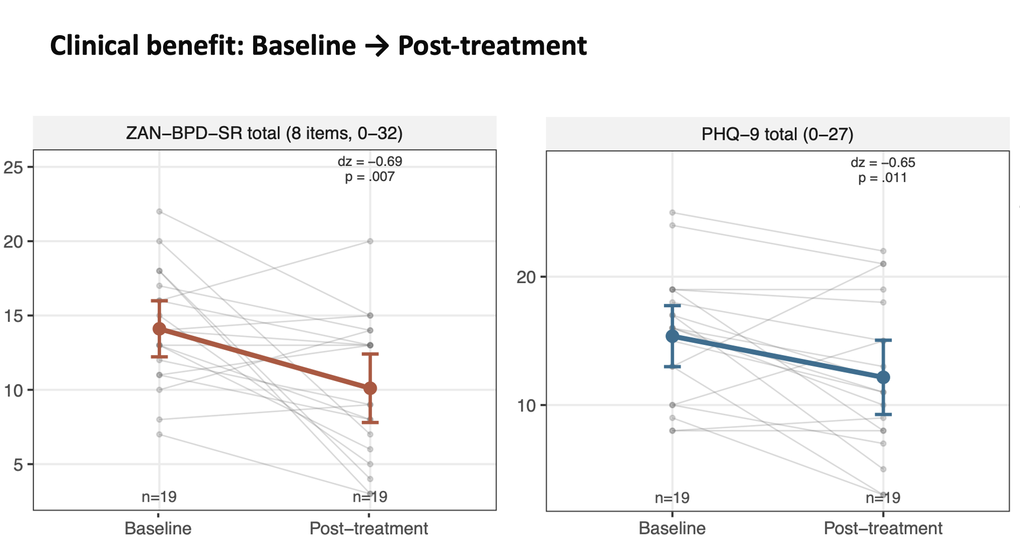
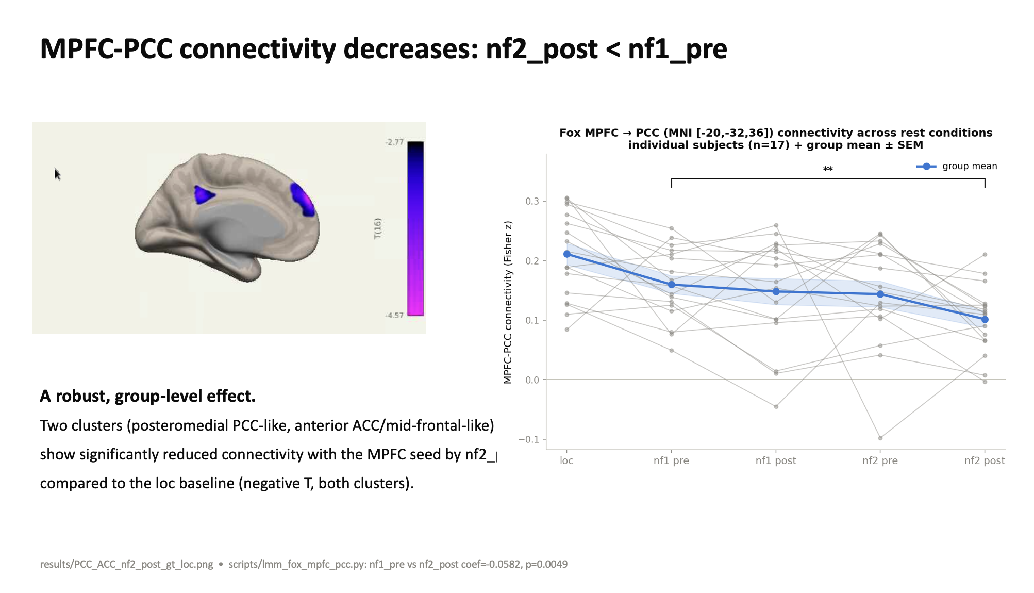
Clinical outcome: rtBPD (Bauer et al., 2026, in prep)
Real-time fMRI neurofeedback + 1 month of daily mindfulness practice, n=19
• ZAN-BPD-SR total (borderline personality disorder symptom severity, 8 items, 0-32) dropped significantly from baseline to post-treatment (dz=-0.69, p=.007, n=19).
• PHQ-9 (depression severity) also dropped significantly over the same period (dz=-0.65, p=.011, n=19).
• This is a real clinical (not just neural) outcome, in a different patient population than the DMNELF replication cohort.
Notes:
Bauer et al. (2026, in prep) -- rtBPD cohort, real-time fMRI neurofeedback plus 1 month of daily mindfulness practice. ZAN-BPD-SR (BPD symptom severity) dropped significantly baseline to post-treatment (dz=-0.69, p=.007, n=19); PHQ-9 depression severity also dropped (dz=-0.65, p=.011, n=19). This is a genuine clinical outcome, not just a neural one, in a different patient population than the DMNELF replication cohort discussed earlier.

Slide 31
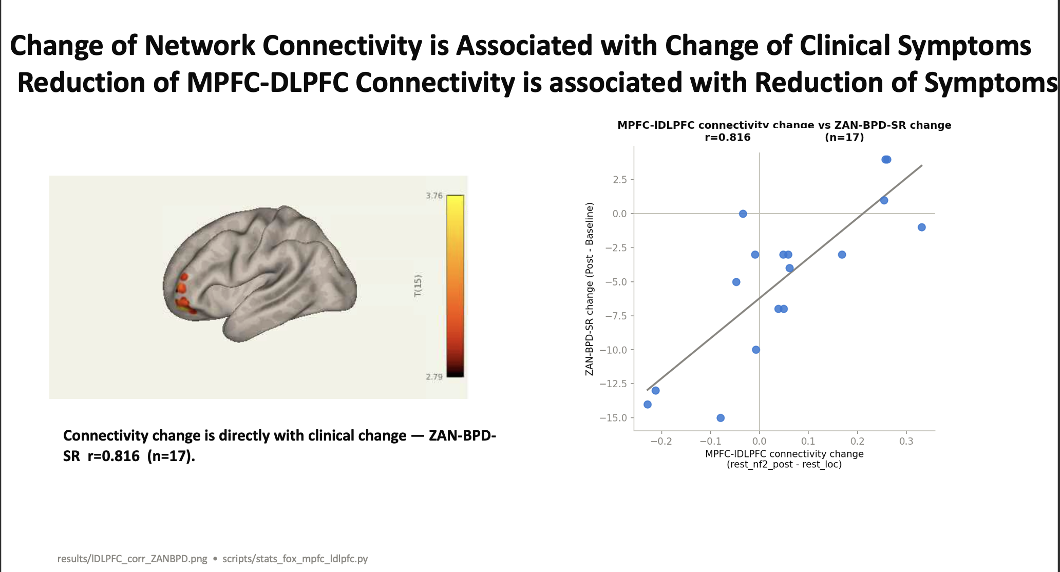
Connectivity change tracks clinical change
mPFC-PCC connectivity decreases with treatment, and the decrease predicts symptom improvement
• Left: mPFC-PCC connectivity -- a core DMN hub-to-hub connection -- decreased across the treatment course (nf2-post < nf1-pre), a robust group-level effect across two clusters (posteromedial PCC-like, anterior ACC/mid-frontal-like).
• Right: the amount of reduction in mPFC-left DLPFC connectivity correlates with the amount of reduction in ZAN-BPD-SR score (r=0.816, n=17) -- more connectivity change tracks with more clinical improvement.
• Together with the clinical outcome on the previous slide, this is brain-behavior evidence that targeting this network with neurofeedback + mindfulness produces changes that matter clinically, not just statistically in the brain.
Notes:
Continuing the rtBPD results: mPFC-PCC connectivity (a core DMN hub-to-hub connection) decreased across the treatment course (nf2-post < nf1-pre), a robust group-level effect across two clusters. Critically, the amount of reduction in mPFC-left DLPFC connectivity correlates with the amount of ZAN-BPD-SR score reduction (r=0.816, n=17) -- brain-behavior evidence, not just a brain-only or behavior-only finding. This closes the case that targeting this network with neurofeedback + mindfulness produces changes that matter clinically.

Slide 32
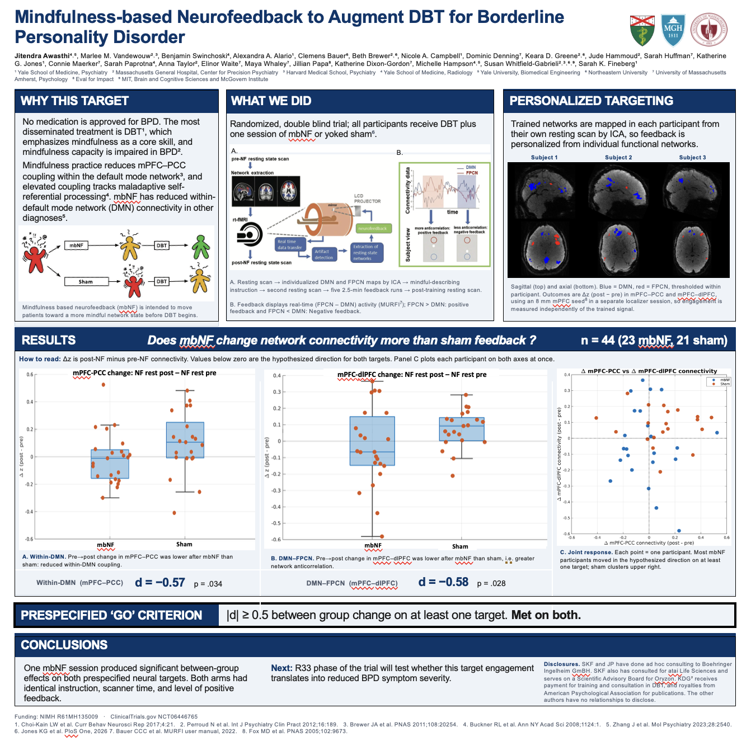
An even more rigorous test: randomized, sham-controlled, n=44
Awashti et al. R61 MINDBPD (NIMH R61MH135009, NCT06446765) -- Mindfulness-based Neurofeedback to Augment DBT for BPD
• Randomized, double-blind: all participants get DBT; one session of real mbNF (n=23) or yoked SHAM feedback (n=21) -- identical instructions, scanner time, and level of positive feedback in both arms.
• Personalized targeting: DMN and CEN/FPCN mapped per-participant from their own resting-state scan via ICA, same method family used throughout this talk.
• Met BOTH prespecified 'GO' criteria (|d|>=0.5): mbNF produced significantly greater within-DMN (mPFC-PCC) reduction (d=-0.57, p=.034) and DMN-FPCN (mPFC-dlPFC) anticorrelation increase (d=-0.58, p=.028) than sham.
• Next (R33 phase): test whether this target engagement translates into reduced BPD symptom severity -- directly connects to the rtBPD clinical outcome just shown.
Notes:
Awashti et al., R61 MINDBPD (NIMH R61MH135009, NCT06446765) -- a real, currently-running, randomized double-blind sham-controlled trial (n=44: 23 mbNF, 21 sham), all participants also receiving DBT. Personalized DMN/CEN targeting via individual resting-state ICA, same method family as everything else in this talk. Met BOTH prespecified GO criteria: mbNF produced significantly greater within-DMN (mPFC-PCC) reduction and DMN-FPCN (mPFC-dlPFC) anticorrelation increase than sham (d=-0.57/p=.034 and d=-0.58/p=.028). This is the most rigorously controlled evidence in the whole talk for the core mechanism, and its planned R33 phase -- testing whether this engagement reduces BPD symptom severity -- connects directly to the rtBPD clinical outcome slides just shown.

