Slide 1
From the Scanner to the Living Room:
Scaling Default Mode Network Neurofeedback with a Portable EEG Fingerprint
[Your name] · [Lab/Department] · [Date]

Slide 2
Before we begin: a 3-minute experiment
• Close your eyes (or soften your gaze). We'll do this together, in silence.
• Part 1 — 30 seconds: just breathe. Notice your breath, nothing else.
• Part 2 — 2.5 minutes: bring to mind something unresolved — a decision you're unsure about, an interaction that didn't go the way you wanted, something still bothering you. Don't try to solve it. Just let your mind go there, and stay with it.
• (Speaker: keep time silently — e.g. phone timer, screen turned away from the room. Don't narrate the timing out loud once part 2 starts; let the room sit in it.)

Slide 3
What did you notice?
• Ask the room: racing thoughts? Replaying the scenario? Judging yourself? Losing track of the breath entirely?
• That drift — away from the present moment and into self-referential, evaluative, looping thought — has a name in neuroscience: the Default Mode Network (DMN).
• You didn't choose to ruminate just now. For most people, without training, that network runs the show the moment there's nothing else to do.

Slide 4
Why this matters
• The DMN is most active exactly when we're NOT engaged in an external task — mind-wandering, self-referential processing, autobiographical memory.
• Excessive, hard-to-disengage DMN activity — rumination — is a transdiagnostic feature of depression, anxiety, and chronic stress, not just an occasional annoyance.
• [Add your specific citations/prevalence stats here]
• The question this line of work asks: can people learn to quiet this network on demand?

Slide 5
Why mindfulness
• Experienced meditators show reduced DMN activity and altered DMN connectivity, both at rest and during tasks, compared to non-meditators.
• Mindfulness training is, in effect, DMN self-regulation training — learned gradually, through sustained practice.
• [Cite your preferred primary sources here — e.g. Brewer et al. 2011 PNAS]
• The catch: this normally takes months to years of practice before it generalizes.

Slide 6
Why neurofeedback
• Real-time neurofeedback gives someone a direct, immediate readout of their own brain state — turning an invisible, internal process into something they can see and steer.
• The hypothesis: if people can SEE their DMN/CEN balance moment to moment, they can learn to shift it far faster than through practice alone — training a muscle you couldn't previously feel.
• Our approach: a visual "ball" task — the ball rises toward a Central Executive Network (CEN) target when task-focused attention dominates, and toward the DMN target otherwise.

Slide 7
PLACEHOLDER — Prior & current fMRI neurofeedback results
• Insert your lab's own prior/ongoing DMN/CEN fMRI-neurofeedback study results here (e.g. rtBPD, DMNELF outcome data) — behavioral/clinical effects of the scanner-based version.
• This is the evidence base that motivates scaling the same paradigm outside the scanner.

Slide 8
The scaling problem
• fMRI neurofeedback works, but an MRI scanner is expensive, immobile, and inaccessible for repeated, at-home, or scalable clinical use.
• If we want this to reach people beyond a single research scanner, we need the SAME signal, decodable from something portable.
• EEG is cheap, wearable, and real-time — but scalp EEG doesn't measure DMN/CEN BOLD activity directly. It has to be decoded.
• That decoding problem is what the rest of this talk is about.

Slide 9
PLACEHOLDER — Meir-Hasson et al. 2014 — background (slide 1 of 2)
• Insert a summary of the original paper's approach and headline figure(s).
• This is the method our own pipeline replicates and extends to DMN/CEN/PDA.

Slide 10
PLACEHOLDER — Meir-Hasson et al. 2014 — results (slide 2 of 2)
• Insert the original paper's key result figure(s)/numbers for comparison against our replication on the following slides.

Slide 11
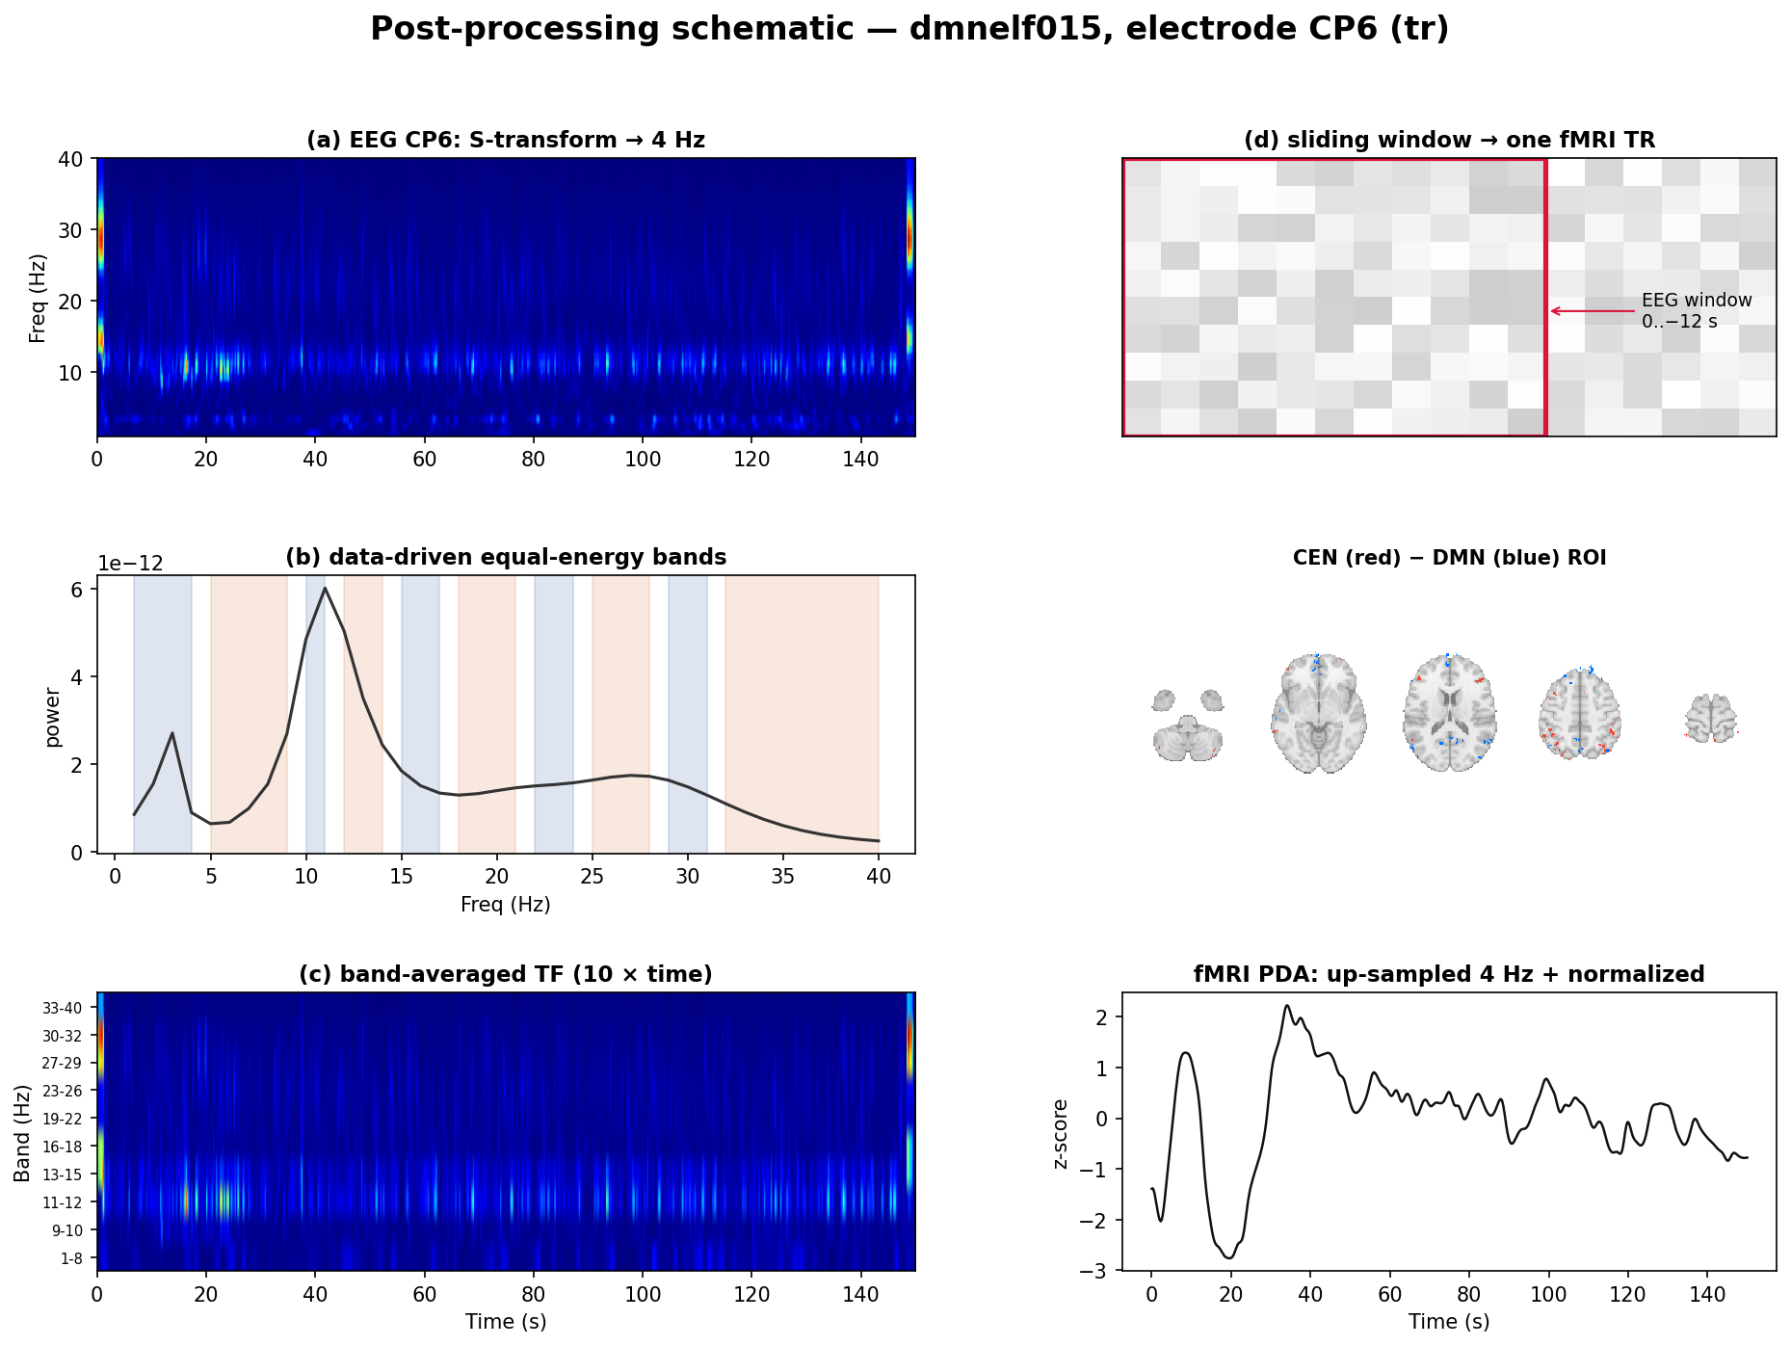
Our method: the EEG Finger-Print (EFP)
Replicating and extending Meir-Hasson 2014 for DMN, CEN, and PDA (CEN−DMN)
• In plain terms: for each electrode, break the EEG into 10 frequency bands, look at how each band's power over the last ~12 seconds predicts the fMRI signal right now, and let a regression model learn a separate best lag PER frequency band — no assumed fixed delay.

Slide 12
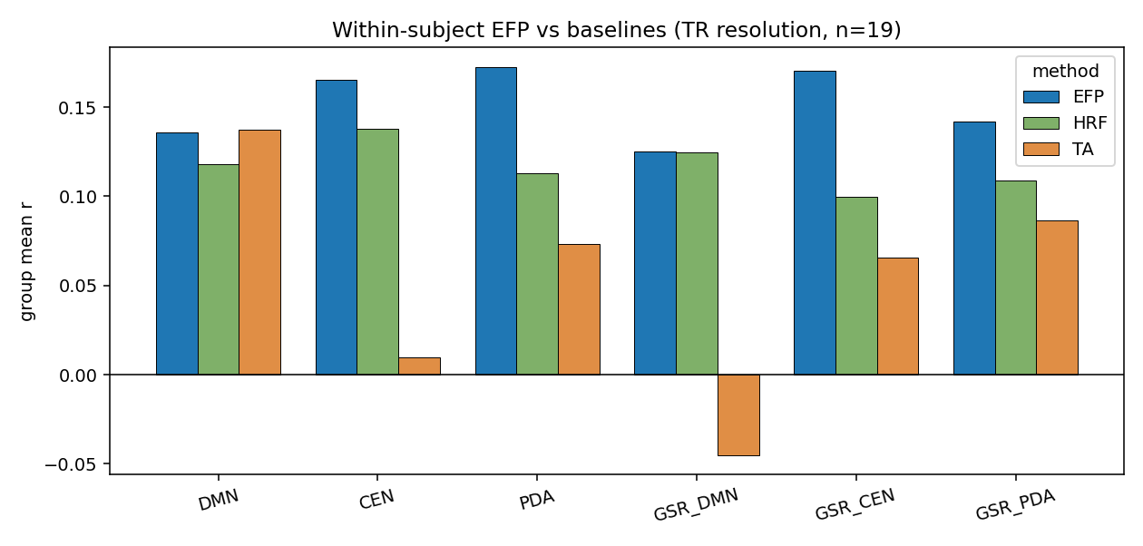
It works within-subject
n=19, single best electrode per subject
• EFP beats both a fixed-HRF baseline and the traditional theta/alpha ratio across every target — strongest for CEN, PDA, and their global-signal-controlled variants (r≈0.14–0.18).

Slide 13
It generalizes to a NEW subject within our own cohort
Leave-one-subject-out (LOSO): train on 18, predict the 19th, never seen
• CEN: r=+0.114 (p=0.001)
• DMN: r=+0.107 (p=0.001)
• PDA: r=+0.157 (p=0.002)
• This is a single, general fingerprint (not personalized) — evidence the EFP captures a real, shared EEG-to-BOLD mapping, not subject-specific overfitting.

Slide 14
Adding 2 more subjects only helped
sub-dmnelf002/003 recovered via R128 trigger-marker reconstruction
• 3 targets moved from non-significant/marginal at n=17 to clearly significant at n=19.
• Several other targets got stronger (tighter p-values); nothing regressed meaningfully.
• Net effect of the 2 recovered subjects: real, if modest, improvement across the board.

Slide 15
It replicates in a completely independent cohort
DMNELF-trained fingerprint, tested on rtBPD — zero rtBPD data used in training
• CEN (electrode CP6)
– Session 1 (nf1, n=19): r=+0.165, p=0.000
– Session 2 (nf2, n=11): r=+0.161, p=0.002
• DMN (electrode O1)
– Session 1 (nf1, n=19): r=+0.084, p=0.001
– Session 2 (nf2, n=11): r=+0.077, p=0.008
• Two independent replications, in a cohort the model never saw during training — this is the strongest evidence that the fingerprint is a general EEG-to-BOLD mapping, not an artifact of one dataset.

Slide 16
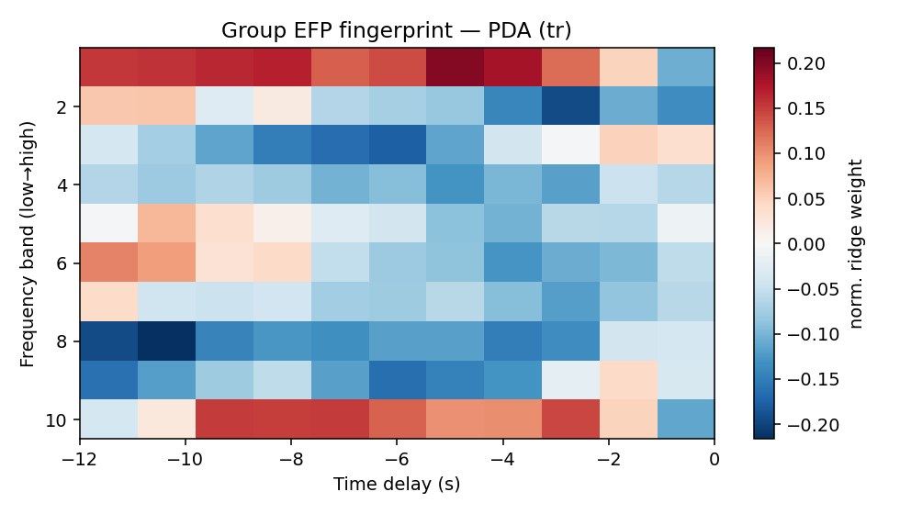
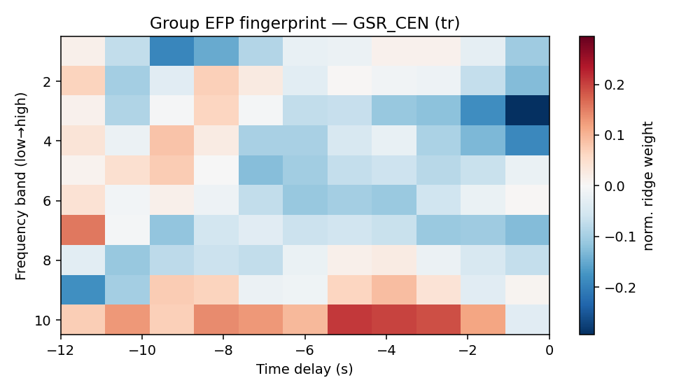
Interpretable, not a black box
• The learned [frequency × delay] weights peak at ~4–7 second lags — matching the known hemodynamic delay — even though the model was never told this. It re-discovered an HRF-like structure on its own, differing across frequency bands.

Slide 17
From a validated fingerprint to a usable tool
• We now have a general, cross-cohort-validated EEG fingerprint for CEN and DMN.
• That's enough signal to build something a person could use outside the scanner — not with a 31-channel research cap, but with a consumer-grade, 12-channel portable headset.
• That tool is mindwear.

Slide 18
mindwear: portable DMN/CEN neurofeedback
• Runs the same visual ball-feedback task as our scanner protocol, driven by a portable 12-channel EEG headset instead of an MRI scanner.
• The EEG-to-network decoder is the same EFP approach just shown — trained on our DMNELF cohort, montage-restricted to the portable headset's 12 channels.
• Includes a built-in comparison mode: replay a recorded session and watch the EEG-decoded ball run side by side with the scanner ground truth, on the same run.
• [Insert a mindwear screenshot / architecture diagram here]

Slide 19
Let's try it live
• Demo on myself first — a short live feedback run, so you can see the ball move in real time.
• Then: any volunteers? (headset fit takes ~1–2 minutes; keep a spare pair of alcohol wipes and the fit-quality checklist within reach)
• What to watch for: it will be noisier than an fMRI signal — that's expected and is exactly what the earlier results characterized. Watch the overall trend over the run, not moment-to-moment jitter.

Slide 20
Takeaways
• A single-electrode EEG fingerprint, replicating Meir-Hasson 2014, decodes DMN/CEN/PDA within-subject, generalizes to new subjects (LOSO), and replicates in a fully independent cohort (rtBPD) for CEN and DMN.
• That validated fingerprint now powers mindwear, a portable, scanner-free neurofeedback tool.
• Next: scaling access to DMN-targeted self-regulation training beyond the scanner — to the clinic, and eventually, the living room.

Slide 21
PLACEHOLDER — Related work / ongoing projects
• Insert posters/papers for other current lab projects you want to reference or cross-promote.

