Slide 1
Real-Time DMN Detection with a Time-Delay Embedded HMM
Replicating Cooray et al. (2024) on the DMNELF simultaneous EEG–fMRI cohort
K=12 TIDE-HMM · 17 subjects · validated against concurrent fMRI (their design could not)

Slide 2
Background & question
• Cooray et al. 2024 used a Time-Delay Embedded HMM (osl-dynamics) to detect a DMN state from EEG in real time (LEMON dataset).
– They had NO simultaneous fMRI — the DMN state was identified purely by its spectral signature (posterior alpha + frontal delta/theta).
• DMNELF advantage: simultaneous EEG–fMRI lets us validate the HMM's DMN state DIRECTLY against concurrent fMRI DMN — a stronger test.
• Questions:
– 1. Does a DMN-like HMM state exist, and does it track real fMRI DMN?
– 2. Does the spectral heuristic pick the same state as fMRI validation?
– 3. Is single-state occupancy a useful real-time decoder vs our DWT+stats regression?

Slide 3
Methods
• EEG: resting-state, 1–45 Hz, 250 Hz; 31 channels; 17 subjects × 2 runs (33 rest runs, ~3.5M samples).
• Feature prep: time-delay embedding (n=7) + PCA→80 components (99.8% variance), whitened & standardized.
• Model: HMM, K=12 states, learn_covariances (osl-dynamics); random-subset initialization ×10, 20 epochs.
• DMN-state identification (our contribution): bin each state's occupancy to TR (1.2 s), HRF-convolve, correlate vs simultaneous fMRI DMN / CEN / PDA (+ GSR'd).
• Cross-check: per-state multitaper spectra → posterior-alpha / frontal-theta signature (paper's method).
• Feedback validation: apply trained HMM (same PCA transform) to 67 feedback runs; correlate State-7 occupancy vs fMRI; compare to regression benchmark.

Slide 4
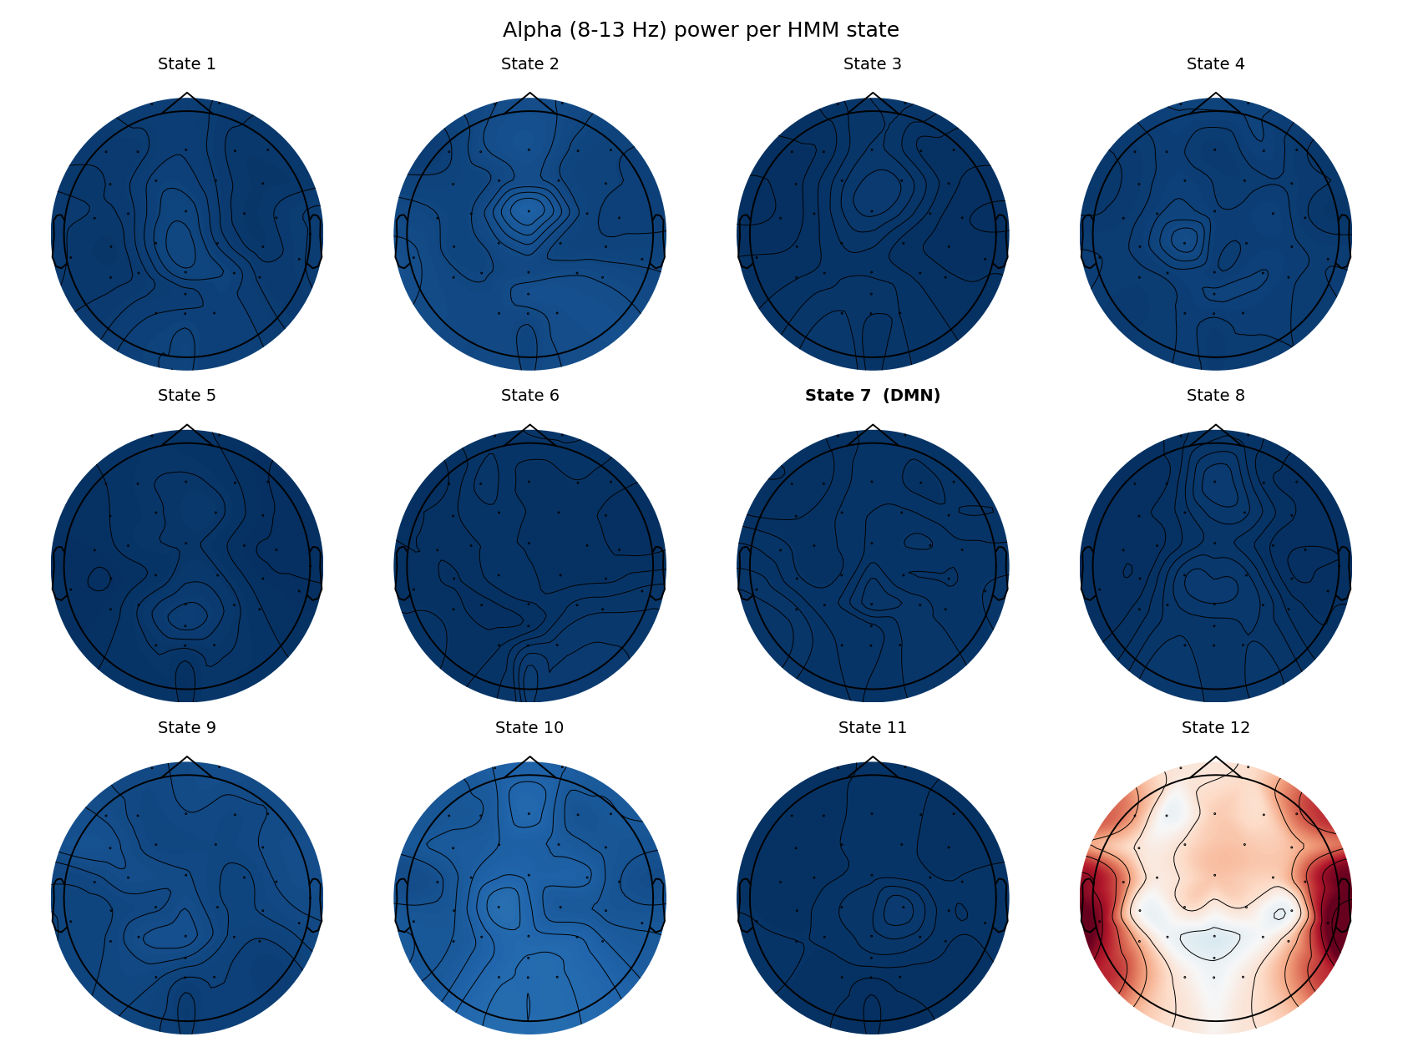
The HMM fits cleanly — 12 healthy states
• All 12 states used (fractional occupancy 0.03–0.12); 100% of timepoints confidently assigned (max-alpha > 0.5).
• Distinct state covariances (pairwise Frobenius 5.8–83); transition stickiness 0.50–0.97.
– State 12 = high-amplitude artifact/movement state (covariance trace 694 vs ~30–77) — excluded from interpretation.
– Note: an early 'degenerate occupancy' printout was a reporting bug (one-hot vs integer), not model collapse.

Slide 5
State 7 = DMN state in rest — but weak
• State 7 is the DMN state across all three fMRI criteria (rest, 33 runs):
– +corr with raw fMRI DMN: r = +0.050
– +corr with GSR'd DMN: r = +0.056
– −corr with PDA (CEN−DMN): r = -0.037
• Internally consistent (DMN-positive, PDA-negative) → a real DMN-like state exists.
• BUT weak: r ≈ 0.05–0.06, vs multivariate DWT+stats regression GSR_DMN r≈0.12 / GSR_CEN r≈0.17.
• A single state's occupancy is a weaker DMN readout than continuous multivariate regression.

Slide 6
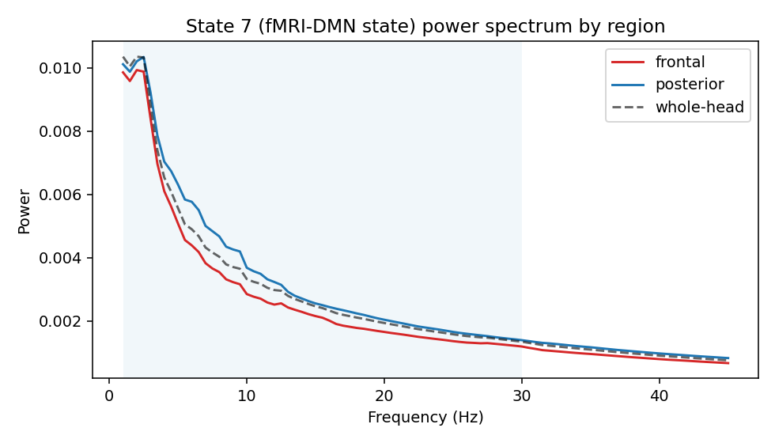
The spectral heuristic disagrees with fMRI
• Paper's DMN signature = posterior ALPHA high + frontal DELTA/THETA high.
– State 7 (the fMRI-DMN state) has LOW alpha: frontal rank 11/12, posterior rank 9/12.
• The classic posterior-alpha state (State 10) is slightly NEGATIVE with fMRI DMN (r≈−0.05) — consistent with the known alpha↔DMN-BOLD anticorrelation.
• → In our data the spectral heuristic would pick the WRONG state.
• Only detectable because we have simultaneous fMRI — the caveat the original design could not see.

Slide 7
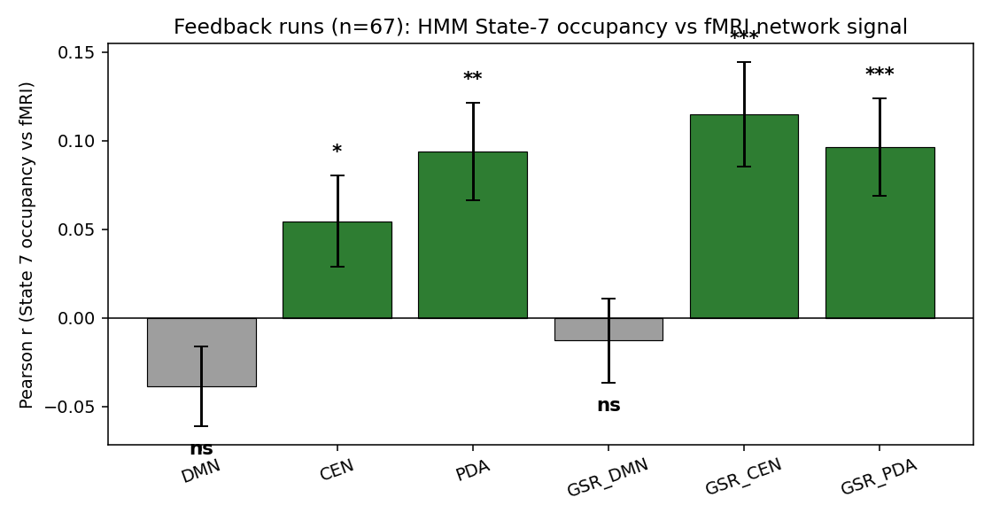
Feedback: the DMN label shifts — State 7 tracks CEN/PDA
Across 67 feedback runs, State-7 occupancy:
GSR_CEN r = +0.115 (p<0.001)
GSR_PDA r = +0.096 (p=0.001)
PDA r = +0.094 (p=0.001)
DMN / GSR_DMN ≈ null-to-negative
The state that was DMN-positive in REST tracks CEN/PDA in FEEDBACK — its identity is task-dependent.
PDA (CEN↑/DMN↓) is the neurofeedback target: a single interpretable, real-time-friendly state decodes it significantly.

Slide 8
Verdict
• What worked
– TIDE-HMM fits cleanly on 17 subjects; a DMN-like state exists and was validated against concurrent fMRI.
– In feedback, State-7 occupancy significantly decodes GSR_CEN (r=0.115***) and PDA (r=0.096**) — the neurofeedback target.
• What simultaneous fMRI revealed (novel vs the paper)
– The spectral heuristic picks the wrong state — the fMRI-DMN state is not the posterior-alpha one.
– The 'DMN state' identity is task-dependent (rest→DMN-ish, feedback→CEN/PDA).
• Recommendation
– DWT+stats multivariate regression remains the primary decoder (stronger, task-stable).
– HMM is a valuable complementary / interpretability tool and a candidate real-time single-state readout, with the task-shift caveat.

