Slide 1
The mindwear EEG→BOLD decoder: what actually transfers
Auditing the deployed decoder's real generalization, and everything tried to improve it
efp_pooled investigation, Aug 31 – Sep 1 2026

Slide 2
Why we looked at this
• The Compare-mode demo shows two balls side by side — one driven by observed fMRI BOLD, one by the portable EEG decoder — meant to visually track each other.
• They don't line up well in practice. Tried display-only fixes first (EMA smoothing, outlier winsorizing/median filtering) — reverted or inconclusive.
• Root cause was NOT display noise: simulating the real ball physics against real BOLD data showed the visible "whips" line up with genuine, large swings in the underlying signal.
• That redirected the question from "how do we smooth the display" to "how accurate is the decoder, really" — which had never been honestly, out-of-sample tested before.

Slide 3
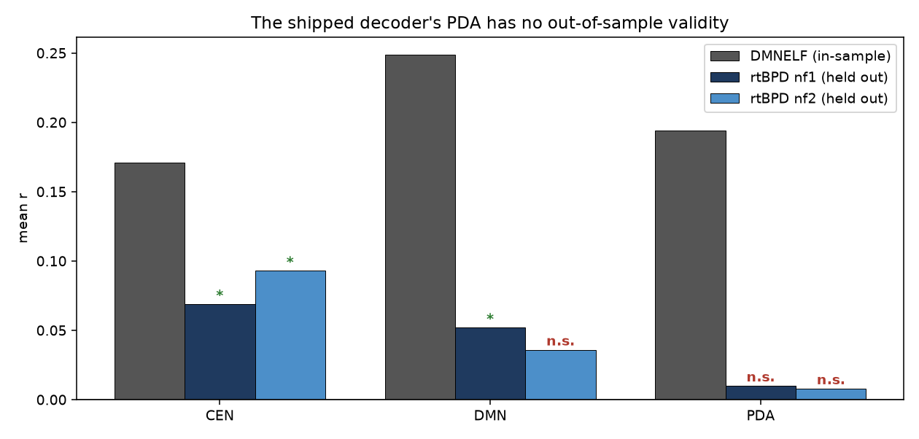
The quoted accuracy number was in-sample
• The r≈+0.22 quoted for the decoder was scored on dmnelf005 — a subject IN the training set, and the cohort's single best performer. Never scored on a truly new subject before.
• Scored honestly on rtBPD subjects (never in training): PDA r=+0.010 (p=0.43) — a coin flip. CEN and DMN individually transfer significantly; their difference (PDA) does not.

Slide 4
Why PDA specifically fails, and what we kept
• The EEG-decodable component is largely shared/global (consistent with an arousal-type signal, see eeg_bold_coupling analysis) — real, but not network-specific.
• PDA = CEN − DMN differences away exactly that shared component, leaving nothing transferable behind. Fitting PDA directly instead of deriving it (obvious fix) does not recover it either — tested and negative.
• Decision: keep the shipped two-model architecture (CEN and DMN each fit independently, PDA = their difference downstream), and focus improvement efforts on CEN/DMN — the targets that actually transfer.

Slide 5
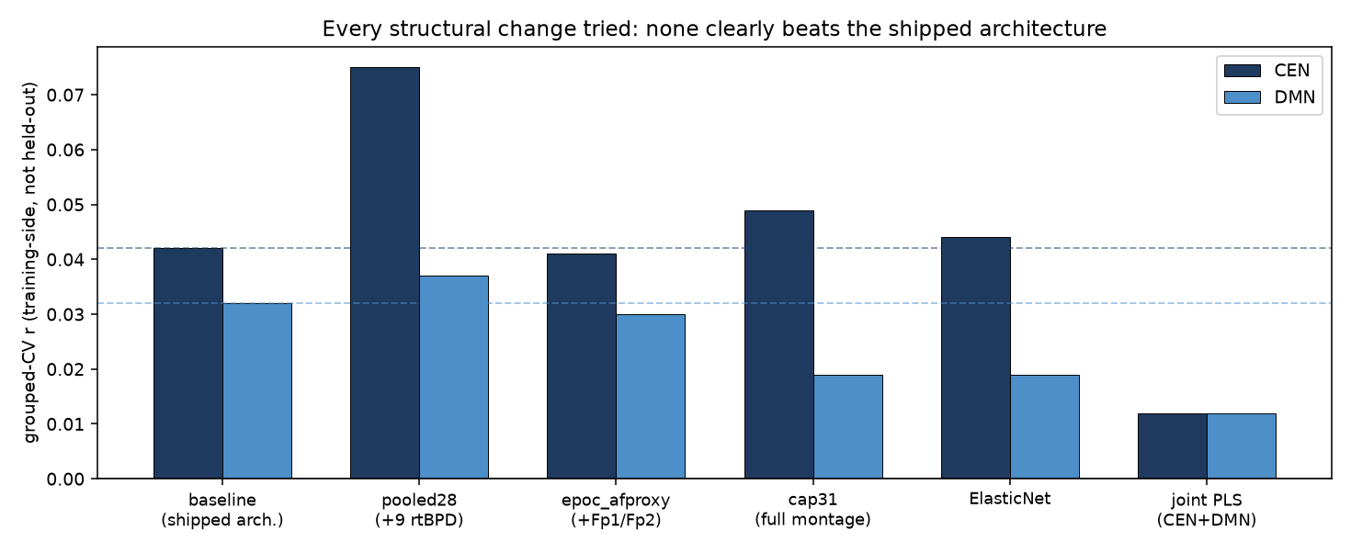
What we tried to improve CEN/DMN transfer
• pooled28's CEN bar looks like a clear win here (this is training-side grouped-CV) — it did NOT hold up on the locked external test (CEN p worsened 0.038→0.117). Grouped-CV overstated transfer; the chart above is a training diagnostic, not a performance claim.
• cap31 (full research montage) is the only other real effect — but it trades a small CEN gain for a real DMN loss, not a net win. epoc_afproxy and ElasticNet are flat-to-worse.
• The joint CEN+DMN fit (motivated by the shared-component finding) is the WORST arm despite having the HIGHEST in-sample r — a clean overfitting signature.

Slide 6
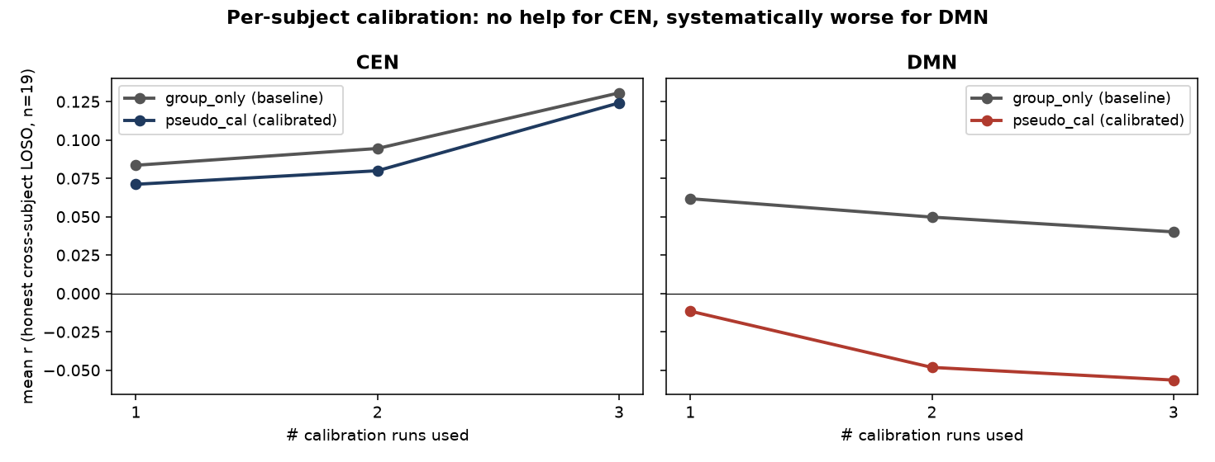
Per-subject calibration — the most promising lever — also negative
• Calibrate on the subject's own run-1 task design (no fMRI needed — the deployable scenario), test on their remaining real fMRI, honest cross-subject LOSO (n=19).
• CEN never significantly improves; DMN gets systematically WORSE, and more so with more calibration data. (PDA/GSR_PDA do improve — but that's not the kept target.)

Slide 7
Conclusion
• Six independent approaches tried — pooling, direct-PDA-fit, wider montage, ElasticNet, joint multi-task fitting, per-subject calibration — none improves CEN/DMN transfer beyond the currently-shipped model.
• The ceiling looks set by how much EEG-decodable signal exists at all (largely shared/global), not by any modeling choice tried so far.
• Recommendation: keep the shipped efp_epoc_model.npz as-is. If a single, most-defensible target is needed for messaging, DMN transfers most consistently across every arm tested.
• Expectation-setting for demos: dual-ball direction agreement needs r≈0.59 for 70%; the validated ceiling here is r≈0.15–0.25. A visually "convincing" side-by-side demo isn't reachable by any decoding fix on the table — this was never really a display problem.

