Slide 2
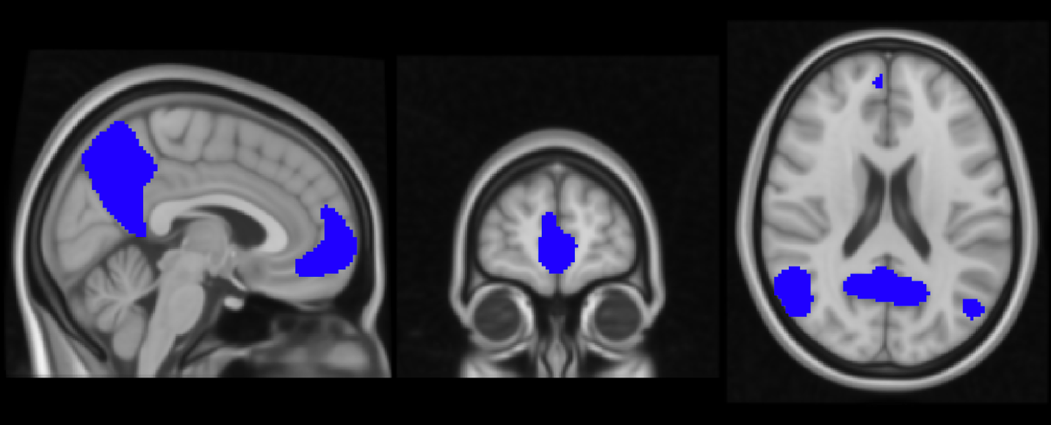
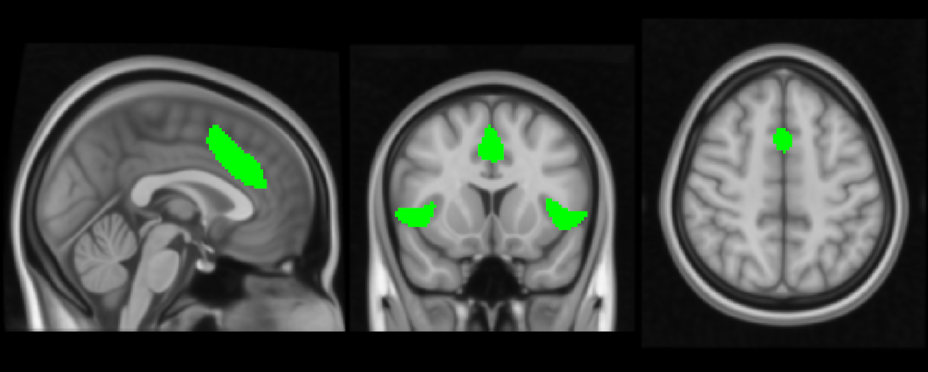
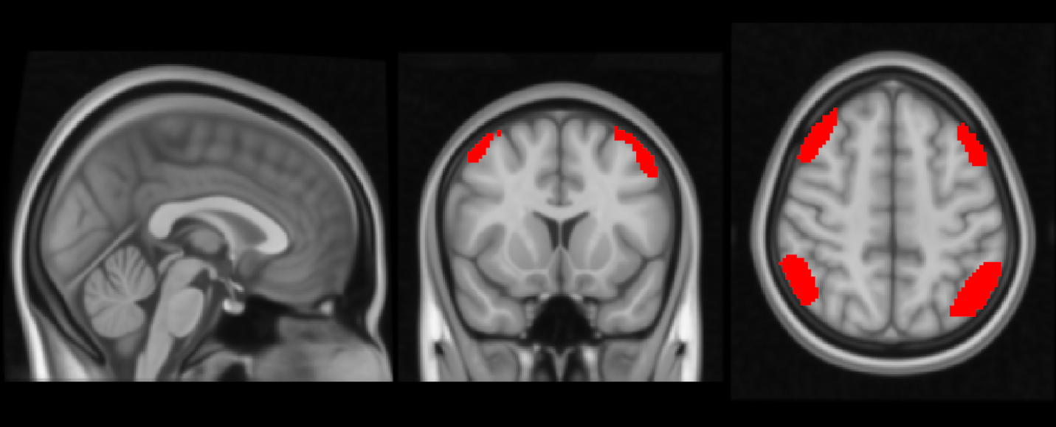
Brain Networks involved in Mindfulness Meditation
Triple Networks Model
Consist of:
Default Mode Network (DMN)
Salience Network (SN)
Central Executive Network (CEN
Fox et al., 2005, Buckner et al., 2008, Christoff et al., 2009,
Menon et al. 2011, Hellyer et al., 2014.
Triple networks. Default-mode network, in blue; Salience network, in green, Central executive network, in red;
Notes:
In this section, we delve into the intricate world of the triple brain networks, which play a crucial role in our understanding of brain function:
The triple brain networks comprise three significant large-scale networks in the brain: the Default Mode Network (DMN), the Salience Network (SN), and the Frontoparietal Network (FPN), also known as the Central Executive Network (CEN). These networks consist of distributed brain regions that exhibit strong intercorrelations during periods of rest (Buckner et al., 2008; Christoff et al., 2009; Fox et al., 2005; Hellyer et al., 2014).
The DMN, or Default Mode Network, is particularly fascinating. It is associated with mind-wandering and inattention to the present moment. When attention-demanding tasks are at hand, the DMN is typically deactivated. Core hubs of the DMN, such as the precuneus, posterior cingulate cortex (PCC), inferior parietal lobule, and ventromedial prefrontal cortex (vMPFC), consistently activate during narrative self-processing and introspection (Raichle et al., 2001; Gusnard & Raichle, 2001; Kelley et al., 2002; Northoff et al., 2006; Sajonz et al., 2010).
The FPN, or Frontoparietal Network, also known as the CEN, is responsible for externally focused, goal-directed attention. This network encompasses lateral frontal and parietal brain areas (Seeley et al., 2007).
Now, let's move forward and explore the roles of these networks in more depth and their implications for mindfulness research.

Slide 3
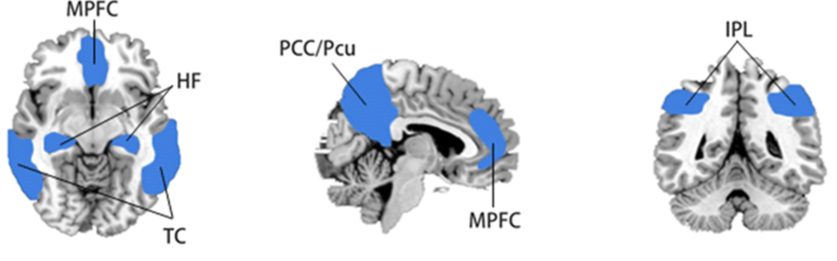
Default Mode Network (DMN)
Associated with mind-wandering and inattention to the present moment
Deactivated during attention-demanding tasks
Key regions include
Precuneus/posterior cingulate cortex (PCC)
inferior parietal lobule
medial prefrontal cortex (MPFC)
Hippocampal formations
Temporal cortices
Raichle et al., 2001; Gusnard & Raichle, 2001; Kelley et al., 2002; Northoff et al., 2006; Sajonz et al., 2010
Notes:
In this section, we delve into the intricate world of the triple brain networks, which play a crucial role in our understanding of brain function:
The triple brain networks comprise three significant large-scale networks in the brain: the Default Mode Network (DMN), the Salience Network (SN), and the Frontoparietal Network (FPN), also known as the Central Executive Network (CEN). These networks consist of distributed brain regions that exhibit strong intercorrelations during periods of rest (Buckner et al., 2008; Christoff et al., 2009; Fox et al., 2005; Hellyer et al., 2014).
The DMN, or Default Mode Network, is particularly fascinating. It is associated with mind-wandering and inattention to the present moment. When attention-demanding tasks are at hand, the DMN is typically deactivated. Core hubs of the DMN, such as the precuneus, posterior cingulate cortex (PCC), inferior parietal lobule, and ventromedial prefrontal cortex (vMPFC), consistently activate during narrative self-processing and introspection (Raichle et al., 2001; Gusnard & Raichle, 2001; Kelley et al., 2002; Northoff et al., 2006; Sajonz et al., 2010).
The FPN, or Frontoparietal Network, also known as the CEN, is responsible for externally focused, goal-directed attention. This network encompasses lateral frontal and parietal brain areas (Seeley et al., 2007).
Now, let's move forward and explore the roles of these networks in more depth and their implications for mindfulness research.

Slide 4
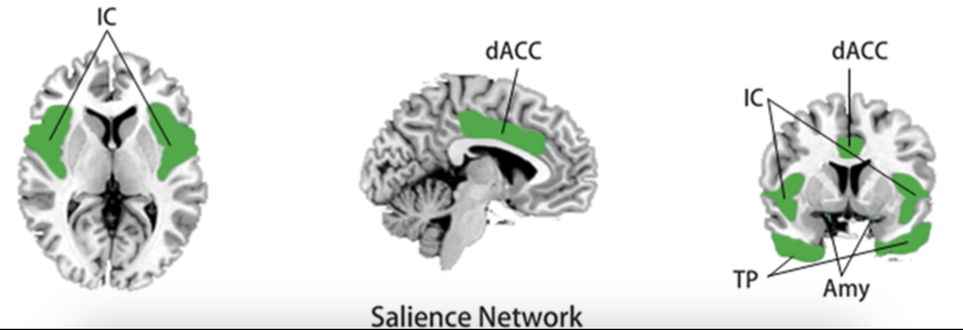
Salience Network (SN)
Involved in stimulus-driven attention and salience detection
Thought as a switch between:
internally focused attention
mediated by the DMN
and externally focused attention
mediated by the CEN
Composed of
Insula
mid-dorsal-cingulate regions
Amygdala
Temporal poles
Seeley et al., 2007; Corbetta et al., 2008
Notes:
Our exploration of brain networks continues with a closer look at the Salience Network (SN), a pivotal player in our understanding of brain function:
The Salience Network, or SN, is primarily responsible for stimulus-driven attention and detecting salient cues in the environment (Seeley et al., 2007). It consists of key regions like the insula and mid-cingulate regions.
One intriguing perspective on the SN is that it operates as a 'switch' between different modes of attention. It acts as a mediator between internally focused attention, which is characteristic of the DMN, and externally focused attention, governed by the FPN. This dynamic role makes the SN a central hub in regulating our attentional processes.
Additionally, it's worth noting that there are other networks, such as the dorsal and ventral attention networks, which share regions of overlap with both the FPN and SN (Corbetta et al., 2008). These networks collectively contribute to our understanding of the brain's intricate attentional systems.
As we continue our journey, we'll explore how these brain networks interact and their relevance to mindfulness research.

Slide 5
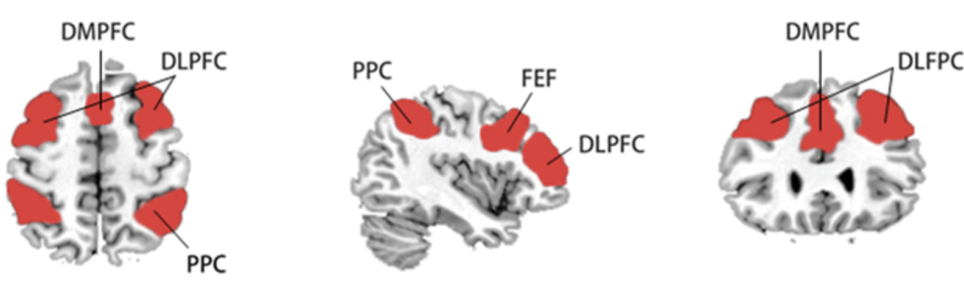
Central Executive Network (CEN)
Involved in sustained externally focused and goal-directed attention
Composed of
Dorsomedial and lateral prefrontal cortices
Posterior parietal cortices
Frontal eye field
Seeley et al., 2007
Notes:
In this section, we delve into the intricate world of the triple brain networks, which play a crucial role in our understanding of brain function:
The triple brain networks comprise three significant large-scale networks in the brain: the Default Mode Network (DMN), the Salience Network (SN), and the Frontoparietal Network (FPN), also known as the Central Executive Network (CEN). These networks consist of distributed brain regions that exhibit strong intercorrelations during periods of rest (Buckner et al., 2008; Christoff et al., 2009; Fox et al., 2005; Hellyer et al., 2014).
The DMN, or Default Mode Network, is particularly fascinating. It is associated with mind-wandering and inattention to the present moment. When attention-demanding tasks are at hand, the DMN is typically deactivated. Core hubs of the DMN, such as the precuneus, posterior cingulate cortex (PCC), inferior parietal lobule, and ventromedial prefrontal cortex (vMPFC), consistently activate during narrative self-processing and introspection (Raichle et al., 2001; Gusnard & Raichle, 2001; Kelley et al., 2002; Northoff et al., 2006; Sajonz et al., 2010).
The FPN, or Frontoparietal Network, also known as the CEN, is responsible for externally focused, goal-directed attention. This network encompasses lateral frontal and parietal brain areas (Seeley et al., 2007).
Now, let's move forward and explore the roles of these networks in more depth and their implications for mindfulness research.

Slide 6
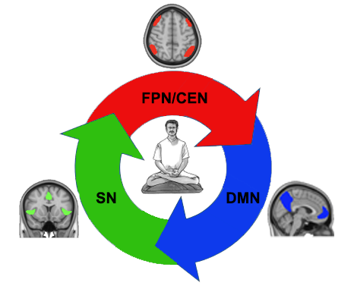
Mechanistic model of mindfulness involving the triple networks
During an active mindfulness meditation practice:
CEN:
sustaining attention to the object of focus
breath, sensations, thoughts, etc.
DMN:
when the mind wanders from the object of attention
SN:
when the participant becomes aware of mind-wandering
Reengagement of the CEN:
to shift attention back to the object of practice
Hasenkamp et al.,2012
Notes:
In this section, we set the stage for our exploration of the roles of brain networks during mindfulness meditation:
Mindfulness, as we've defined it, encompasses a family of attention regulatory strategies with a central focus on the present moment. One of the most common mindfulness practices involves breath awareness, where practitioners direct their attention to their breath and continually return to it whenever their focus drifts (Lutz et al., 2008).
Mindfulness practice engages several key brain networks, including the Default Mode Network (DMN), Frontoparietal Network (FPN) or Central Executive Network (CEN), and the Salience Network (SN), each with its own role in attentional processes. We'll delve into a mechanistic model of mindfulness proposed by Hasenkamp and colleagues (2012), which sheds light on how these networks work together during mindfulness meditation.
As we move forward, we'll explore the intricate dance of these brain networks during mindfulness and how they contribute to the practice.

Slide 7

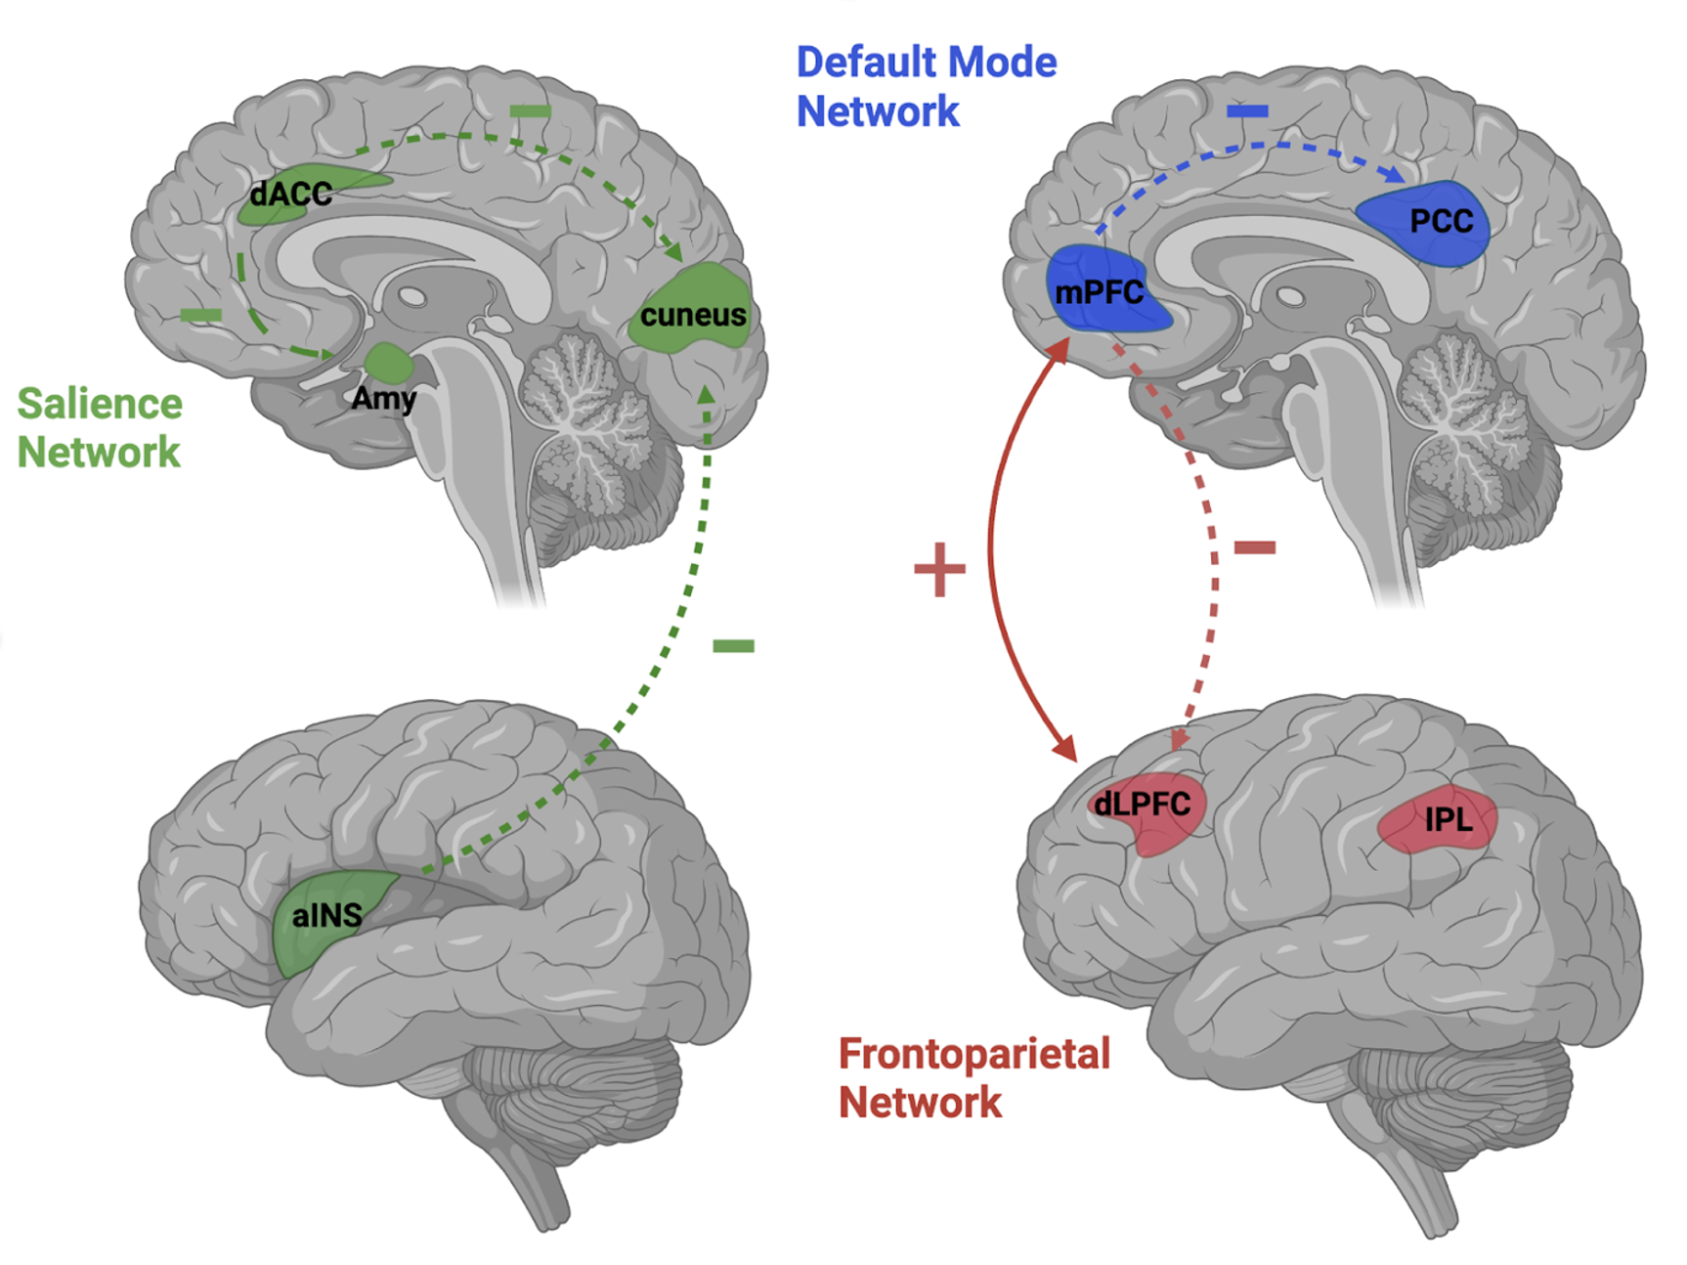
Toward a brain network science of mindfulness
Changes in rs-FC
Reduced within-DMN connectivity
across intervention designs, trait designs, and long-term meditator designs
Increase DMN-CEN connectivity
Interventions and active meditation
DMN-CEN more anticorrelated
More mindful individuals
likely a nonlinear phenomenon related to expertise
Decreased SN connectivity
between rostral anterior cingulate cortex region and amygdala & insula
Isaac Treves
Central Executive Network
Treves et al. 2023 Toward a brain network science of mindfulness in Ostafin, Robinson, Meier (Eds), The Handbook of Mindfulness and Self-Regulation: Cognitive Neuroscience, Social Personality, Clinical, and Applied Perspectives: 2nd Edition
Treves et al. 2023, Rahrig et al., 2022, Sezer et al., 2022
Notes:
In summary, mindfulness may involve a process of shifting, refocusing, and sustaining attention involving the SN and CEN networks, and it may involve suppressing mind-wandering through downregulation of the DMN. As individuals practice mindfulness and engage these brain networks, the networks may show enduring changes. These changes may be present during mindfulness meditation, but also in a wakeful, resting-state condition. To investigate this possibility, researchers have compared resting-state functional connectivity before and after mindfulness interventions. Two recent reviews comprehensively examined changes in rsFC as a result of mindfulness training (meta-analysis, Rahrig et al., 2022; systematic review, Sezer et al.,

Slide 8
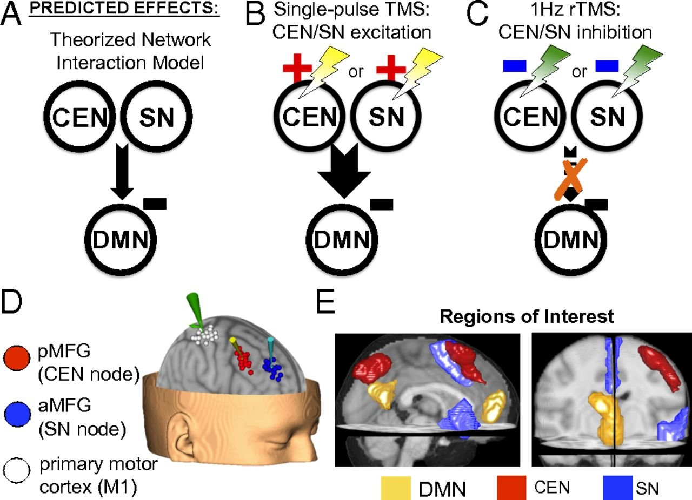
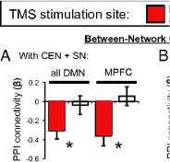
Enhancement of Mindfulness Learning
Positive Diametric Activity CEN>DMN
Triple networks. Central executive network, in red; Default-mode network, in blue; Salience network, in green.
Fox et al., 2005
Chen et al., 2013

Slide 9
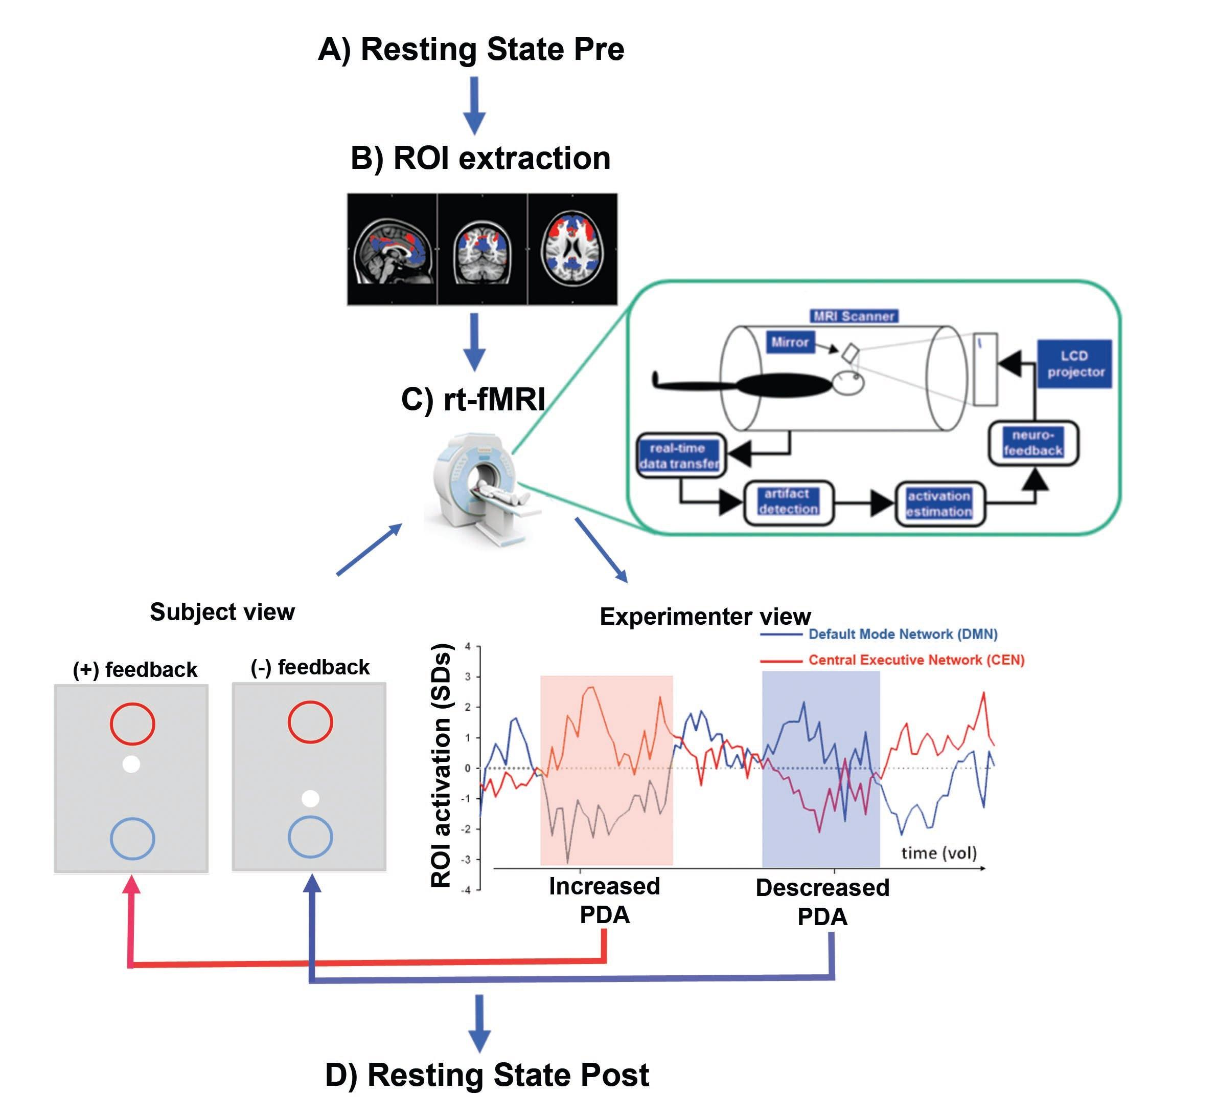

Positive Diametric Activity FPN>DMN
Bauer et al. 2020

