Slide 1
An EEG f-SNR that matches the BOLD neurofeedback target
Two streams: (A) fit an EEG decoder to the fMRI f-SNR/PDA vs (B) a PURE EEG f-SNR matched to it
The prize: a calibration-free, interpretable, portable EEG 'clarity' index that tracks PDA
DMNELF (n=17) within/LOSO + rtBPD (nf1 n=19, nf2 n=11) cross-cohort

Slide 2
The idea — align f-SNR across modalities, don't just decode
• fMRI phase: the f-SNR ≈ a normalized restatement of PDA regulation (signal channel).
• Instead of only fitting EEG→BOLD, compute an f-SNR in EACH modality and MATCH them — signal/noise 'clarity' in EEG vs in BOLD.
• Stream A (benchmark): EFP / band-power decoder fit to the fMRI f-SNR / PDA (the ceiling).
• Stream B (the prize): a PURE EEG f-SNR (no per-subject fitting) — if it matches PDA and TRANSFERS, we get a calibration-free NF marker.
• EEG f-SNR flavors searched: band power (running mean/std + quench) and oscillatory÷aperiodic (specparam 1/f).

Slide 3
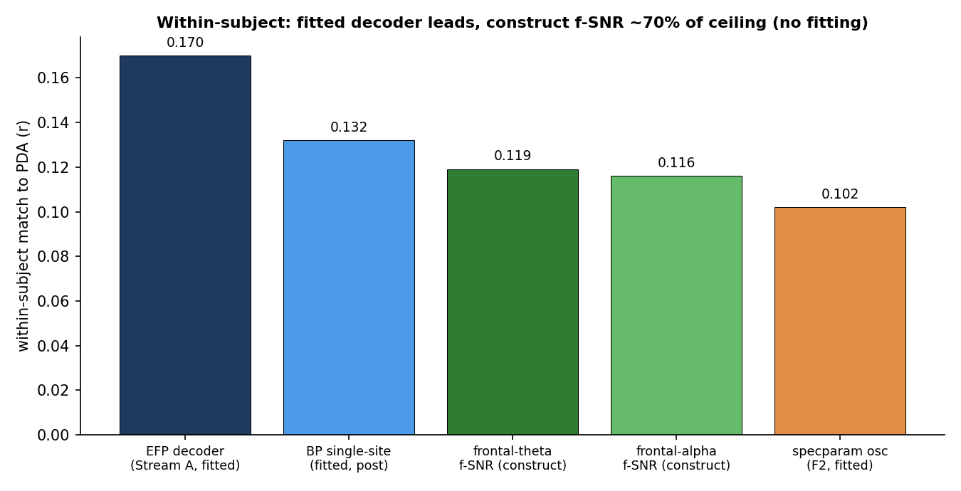
Within-subject head-to-head — construct reaches ~70% of the fitted ceiling
Leak-free match to PDA. Fitted decoder leads; the zero-fitting construct f-SNR is close behind.
• Fitted EFP ~0.17; construct frontal-theta f-SNR 0.119 (NO fitting). specparam osc/aperiodic is weaker (0.10) — per-TR FOOOF adds noise, simpler band power wins.

Slide 4
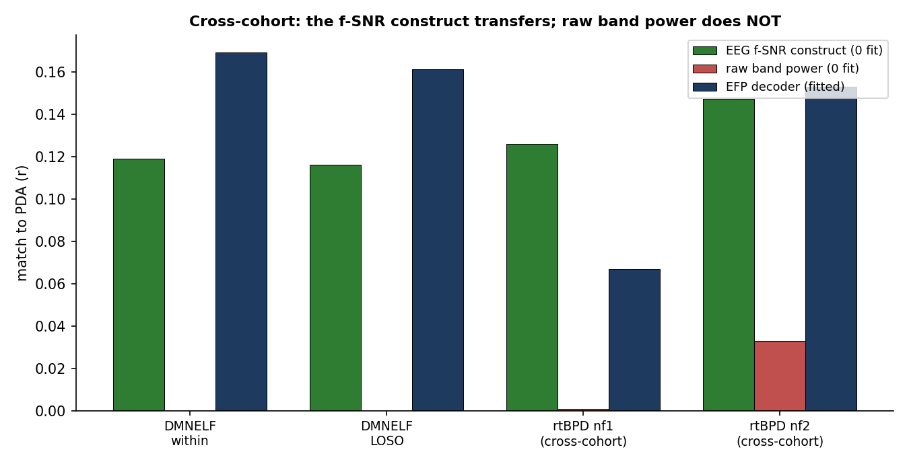
The payoff — the pure EEG f-SNR TRANSFERS across cohorts; raw power does not
Fixed frontal-theta f-SNR construct, zero fitting, applied to an independent cohort (rtBPD)
• rtBPD nf1 r=+0.126 (p=5e-4, 79% subj+), nf2 r=+0.147 (p=5e-3, 91%+). Raw band power collapses (r≈0, ns) — noise-normalization removes cohort-specific gain. Matches/beats the fitted EFP.

Slide 5
Why the f-SNR transfers when raw EEG doesn't
• Raw band power carries the PDA signal (|r|≈0.12 within-cohort) but its scale/gain is cohort-specific → r≈0 cross-cohort.
• The f-SNR = signal/noise DIVIDES OUT that gain → a dimensionless 'clarity' that is cohort-invariant. This is exactly the framework's claim, borne out.
• Frontal montage works (portable headset); frontal-theta is physiologically apt for DMN↔CEN control. The f-SNR normalization specifically helps the noisier frontal channels.
• A zero-fitting construct that matches/beats a per-cohort-fitted decoder cross-cohort is the ideal NF marker: interpretable, calibration-free, deployable.

Slide 6
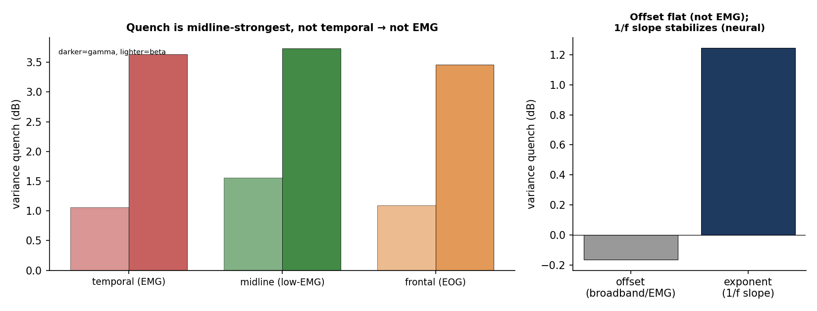
Secondary — EEG decluttering during regulation (EMG control: it's neural)
beta/gamma power-variance drop in feedback; tested against EMG by topography + aperiodic split
• Not EMG: quench is MIDLINE-strongest not temporal (beta midline +1.56 vs temporal +1.06 dB); broadband offset flat (ns); 1/f exponent stabilizes (+1.2 dB, p=8e-4). Novice noting-practice wouldn't reduce EMG vs rest anyway. → reduced high-freq variability + stabilized 1/f = the stability/criticality face of f-SNR.

Slide 7
Bottom line
• A PURE EEG f-SNR (frontal-theta, band power, zero fitting) matches the BOLD PDA the neurofeedback trains — within-subject 0.12, and it TRANSFERS to an independent cohort (rtBPD nf1 0.126, nf2 0.147).
• It generalizes where raw EEG and even the fitted decoder struggle cross-cohort, because noise-normalization removes cohort-specific gain.
• Practical NF implication: a calibration-free, portable-frontal EEG clarity index — no per-subject/per-cohort training — can serve as an EEG-only proxy for the fMRI NF target.
• The fitted EFP decoder still wins within-subject (0.17) — use it when calibration is available; use the construct f-SNR when it isn't (new subjects/sites).

