Slide 1
EEG Finger-Print (EFP) for DMN / CEN / PDA
Replicating Meir-Hasson et al. 2014 on the DMNELF simultaneous EEG–fMRI cohort
Single electrode · Stockwell time-frequency · data-driven bands · sliding-delay ridge · n=19

Slide 2
The EFP method (what makes it different)
• Single electrode (data-driven best, by validation NMSE) — not multivariate.
• Stockwell (S-)transform time-frequency at 1 Hz (implemented from scratch, FFT-based).
• 10 data-driven equal-energy frequency bands (not fixed delta/theta/alpha).
• KEY: a [frequency × sliding time-delay] design (0..−12 s) → ridge learns a SEPARATE delay for each frequency. No assumed HRF shape.
• Double cross-validation: outer m-k-fold block CV (k=5,m=2) + inner RidgeCV for λ.
• Baselines on same folds: Theta/Alpha ratio (traditional) and fixed-HRF predictor.
• Built at both native-TR and 4 Hz-upsampled resolution to test the paper's up-sampling claim.

Slide 3
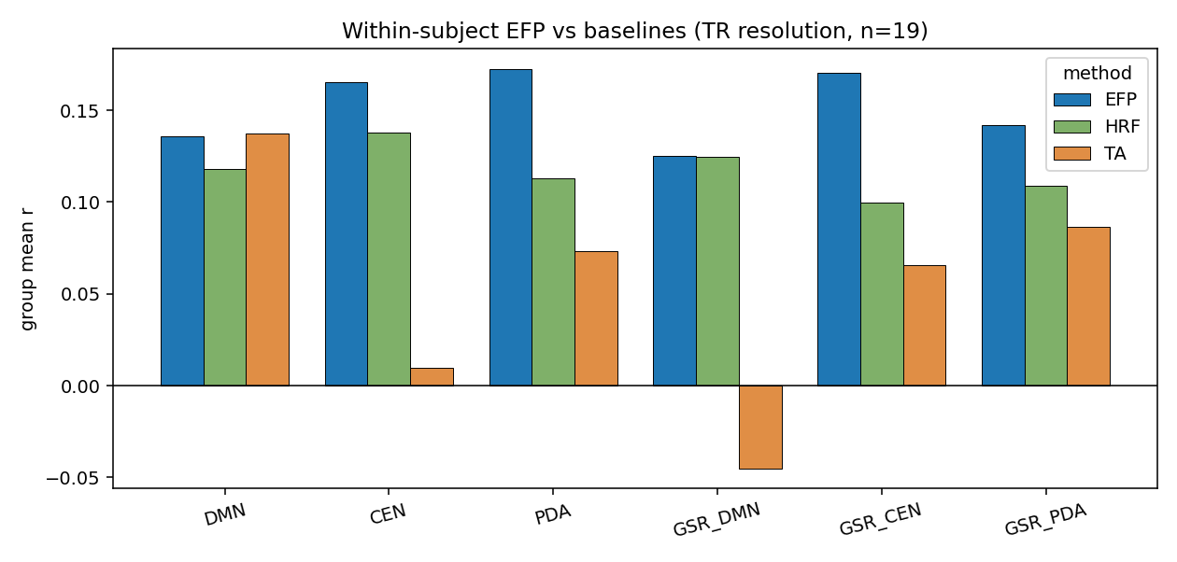
Within-subject: EFP beats both baselines (EFP ≥ HRF ≥ T/A)
• Replicates the paper's ordering across every target; strongest for CEN, PDA, GSR_CEN, GSR_PDA (r≈0.14–0.18, TR & 4Hz). GSR_DMN weakest (r≈0.13–0.16), consistent with our other pipelines.

Slide 4
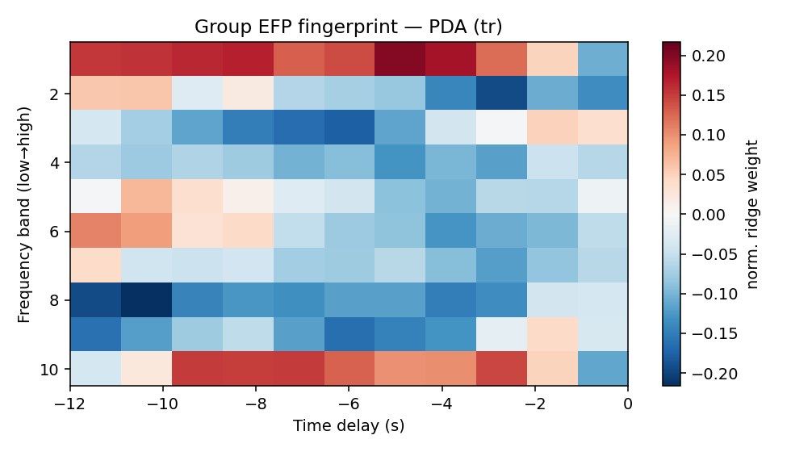
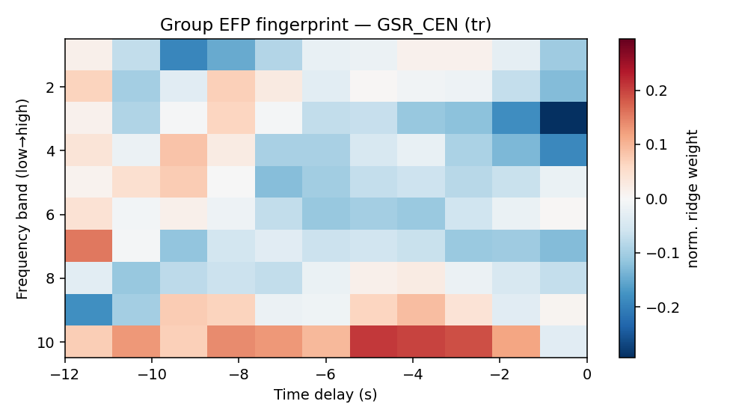
Interpretable fingerprints — a learned HRF per frequency
• Group-averaged [band × delay] EFP. Weights peak at ~−4 to −7 s delay — an HRF-plausible lag learned data-drivenly, differing across frequency bands.

Slide 5
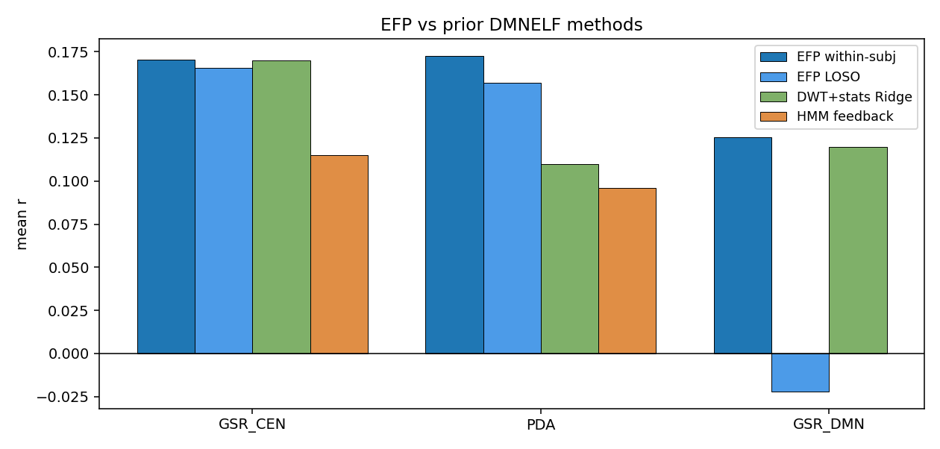
EFP vs our prior methods — a clear improvement
• Within-subject EFP roughly matches or beats PDA decoding (r=0.17 vs DWT 0.11, HMM 0.10) and GSR_CEN (0.17 vs DWT 0.17 — on par, not an improvement there).
• Even cross-subject (LOSO) EFP transfers for PDA (r=0.16, p=0.002) — a general fingerprint.

Slide 6
Cross-subject generalization & TR vs 4 Hz
• LOSO general fingerprint (train N−1, predict held-out), TR resolution:
– PDA: r=+0.157 (p=0.002, ch Pz)
– CEN: r=+0.114 (p=0.001)
– DMN: r=+0.107 (p=0.001)
– GSR_CEN and GSR_PDA transfer significantly across subjects too (p<.01) — only GSR_DMN remains non-significant.
• TR vs 4 Hz up-sampling: comparable within-subject accuracy — confirms the paper's finding that up-sampling adds temporal detail but not correlation.

Slide 7
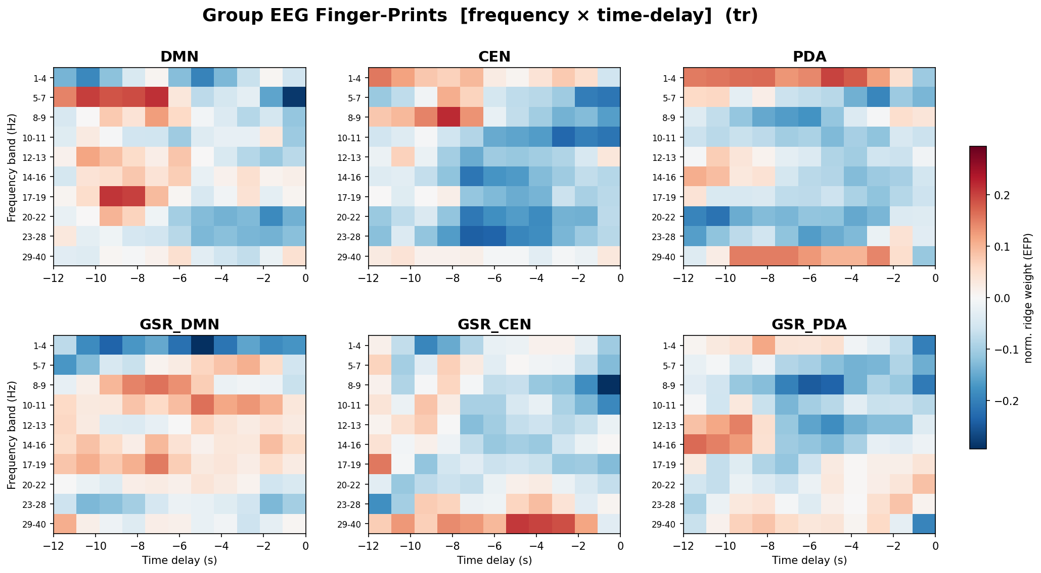
Paper-style figures I — EFP fingerprints
Meir-Hasson Fig 5c/7c analog: [frequency × time-delay] per target

Slide 8
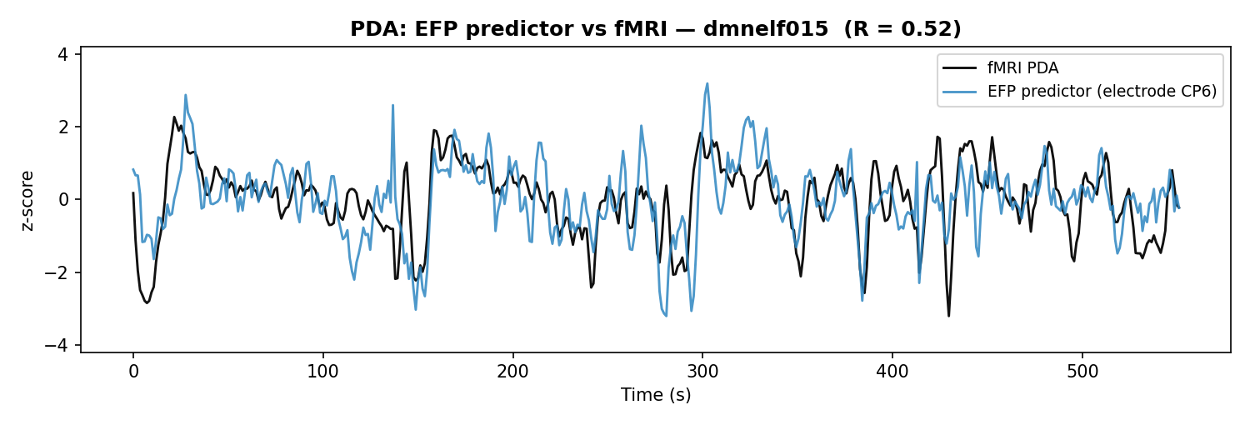
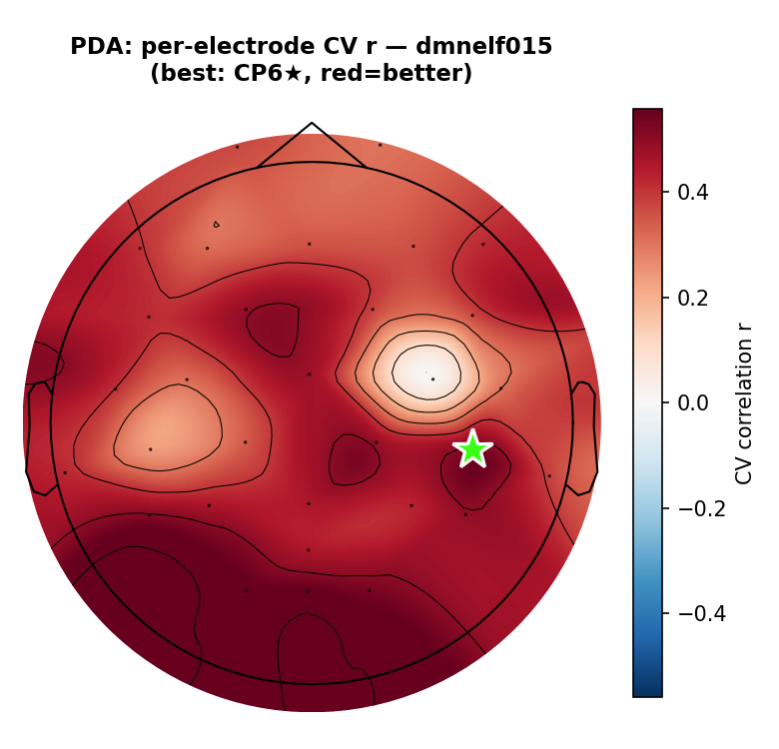
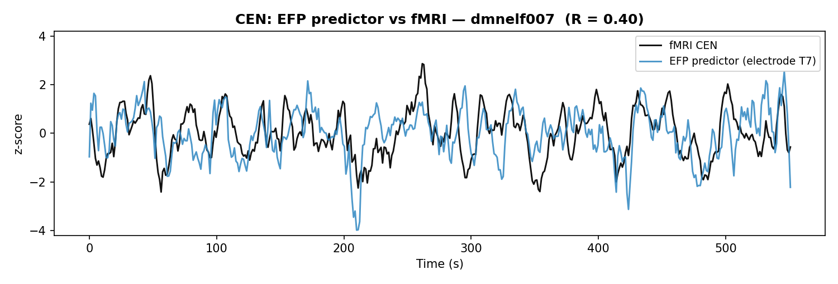
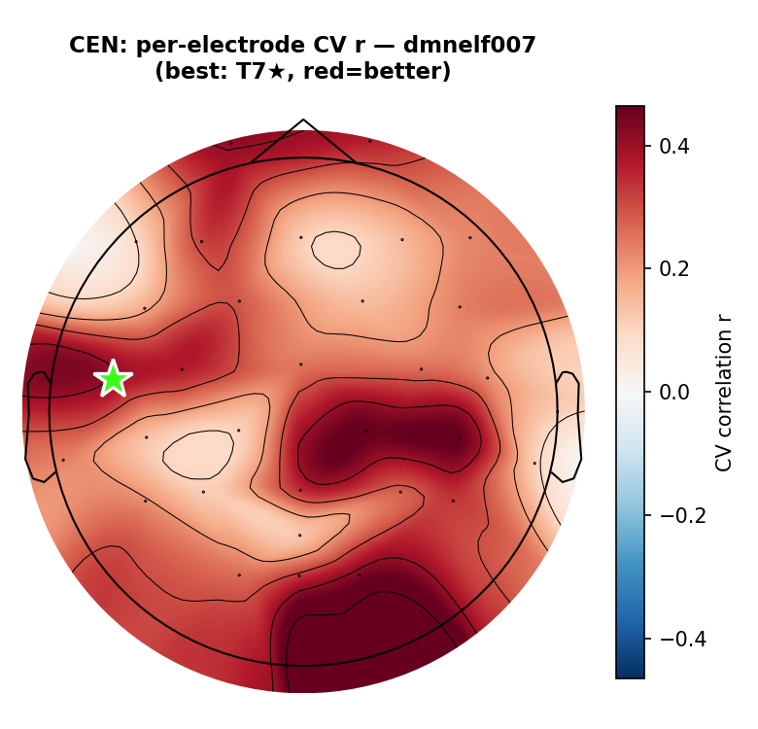
Paper-style figures II — predictor overlay & electrode topography
Fig 3d (predictor vs fMRI) and Fig 3e/5b (per-electrode CV correlation r; red=better)
• Each row is its own best-performing subject + electrode for that target — not the same subject/electrode across rows. Single electrode per target is the method's design (Meir-Hasson): PDA here is sub-dmnelf015 @ CP6 (r=0.37); CEN is sub-dmnelf007 @ T7 (r=0.44).

Slide 9
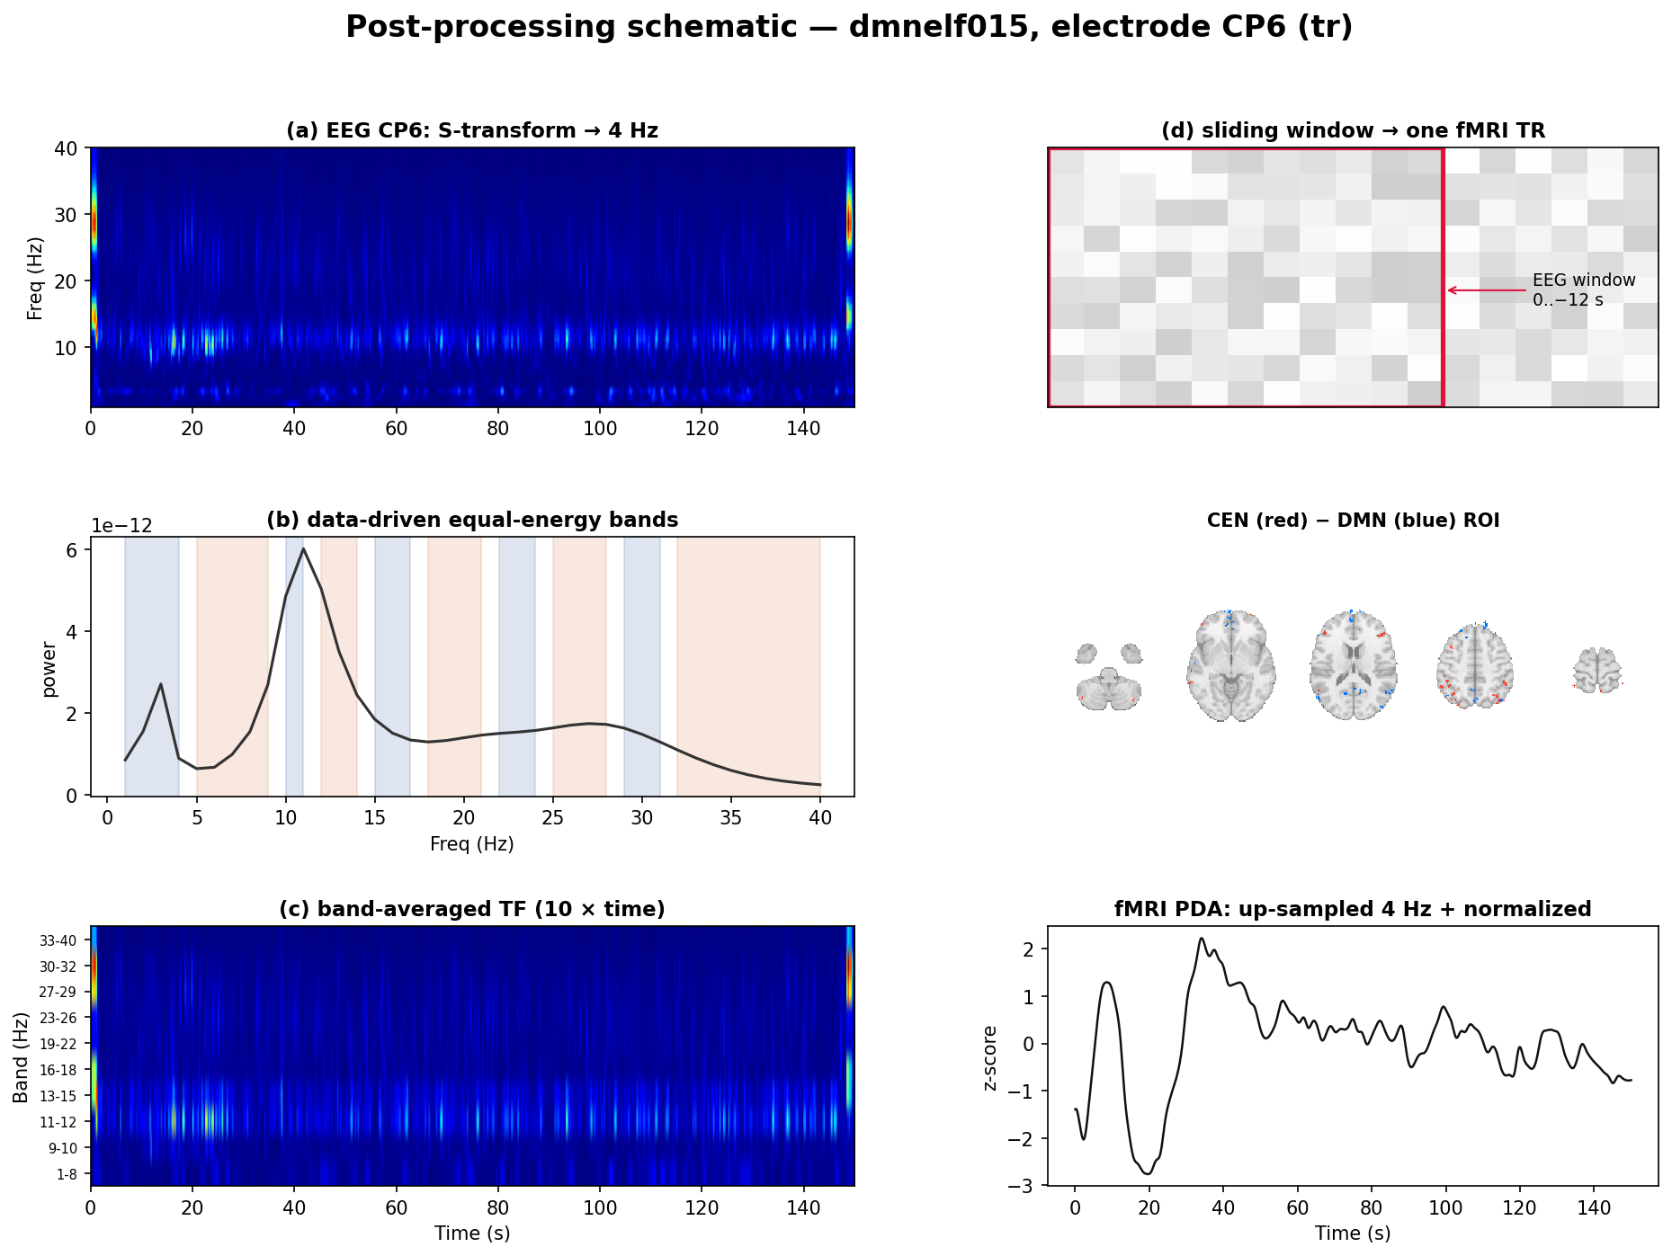
Paper-style figures III — post-processing (Fig 2 analog)
EEG → S-transform → 4 Hz → data-driven bands → band-averaged TF → sliding window; fMRI ROI → 4 Hz + normalized

Slide 10
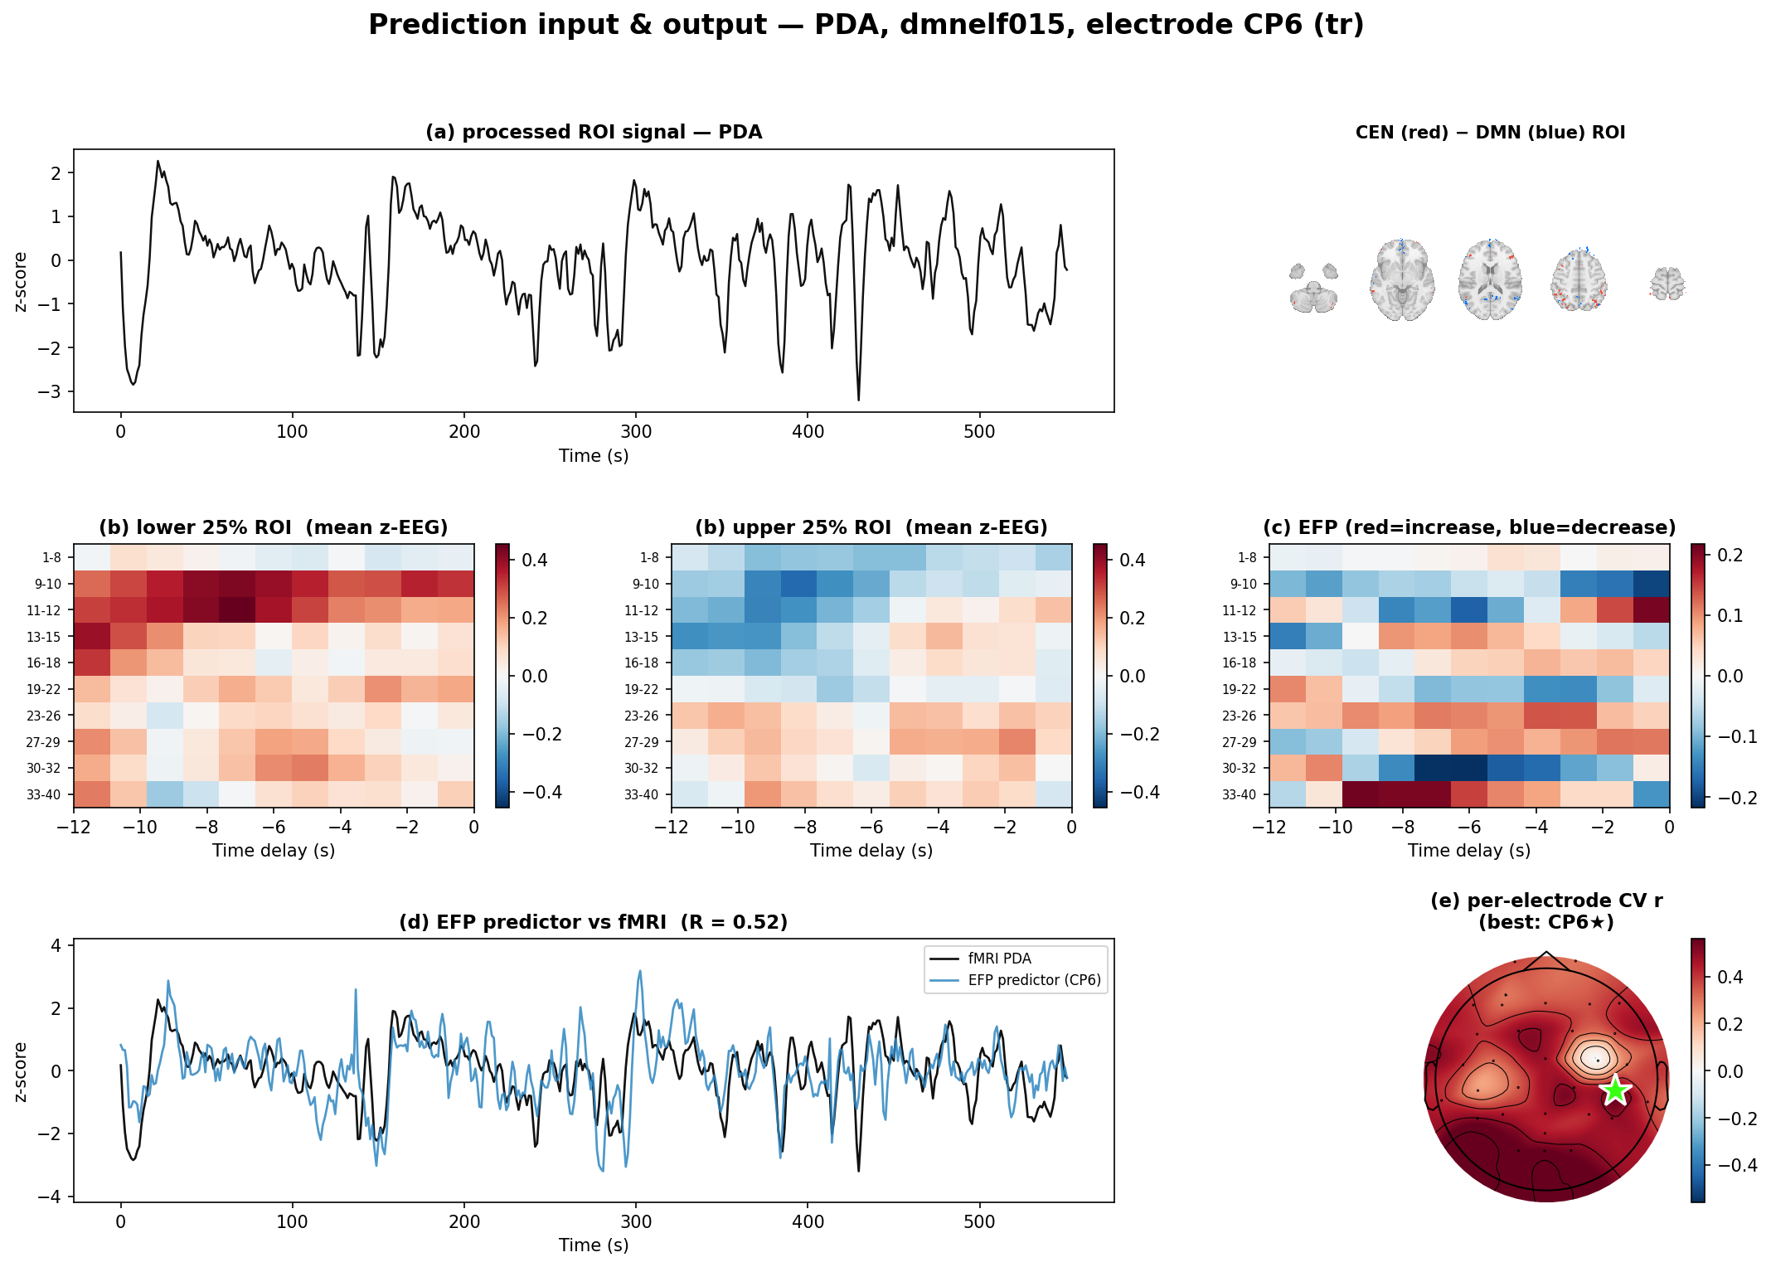
Paper-style figures IV — prediction I/O, PDA (Fig 3 analog)
a) ROI signal + ROI mask b) bottom/top-25% EEG TF c) EFP d) predictor vs fMRI e) per-electrode r

Slide 11
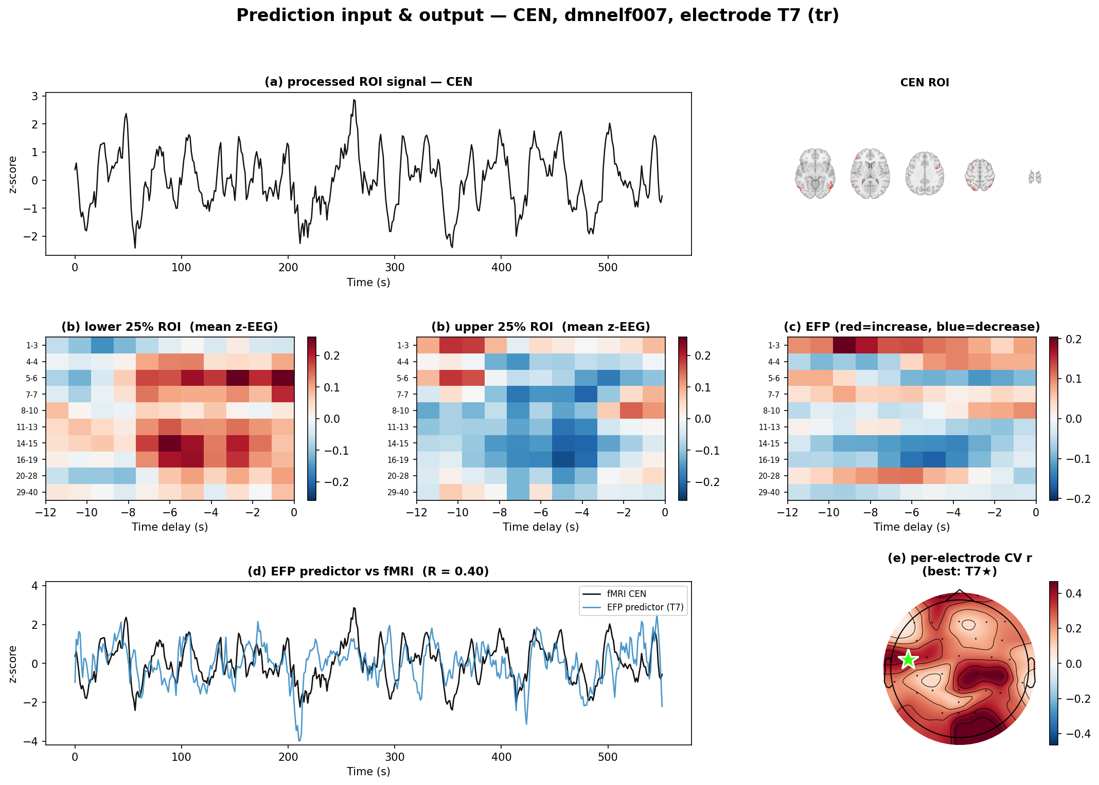
Paper-style figures IV — prediction I/O, CEN (Fig 3 analog)
a) ROI signal + ROI mask b) bottom/top-25% EEG TF c) EFP d) predictor vs fMRI e) per-electrode r

Slide 12
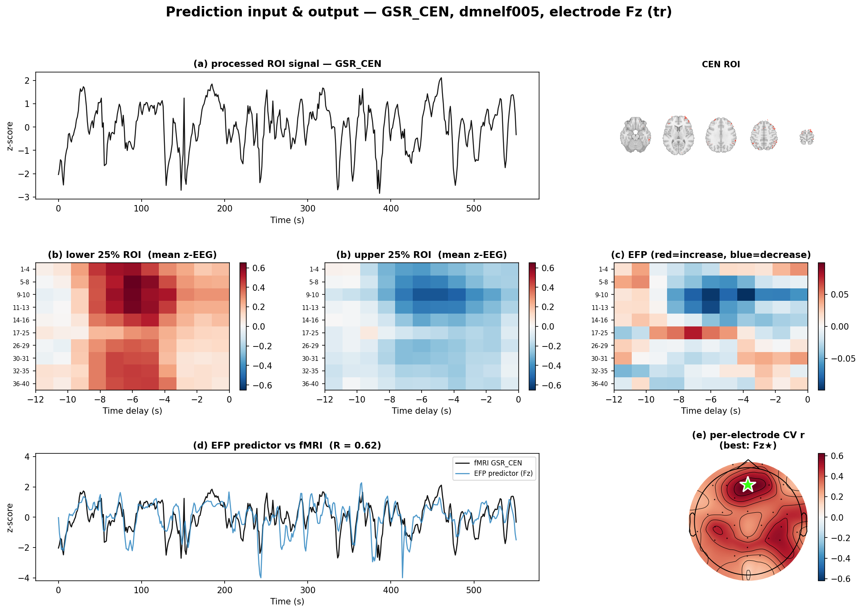
Paper-style figures IV — prediction I/O, GSR_CEN (Fig 3 analog)
a) ROI signal + ROI mask b) bottom/top-25% EEG TF c) EFP d) predictor vs fMRI e) per-electrode r

Slide 13
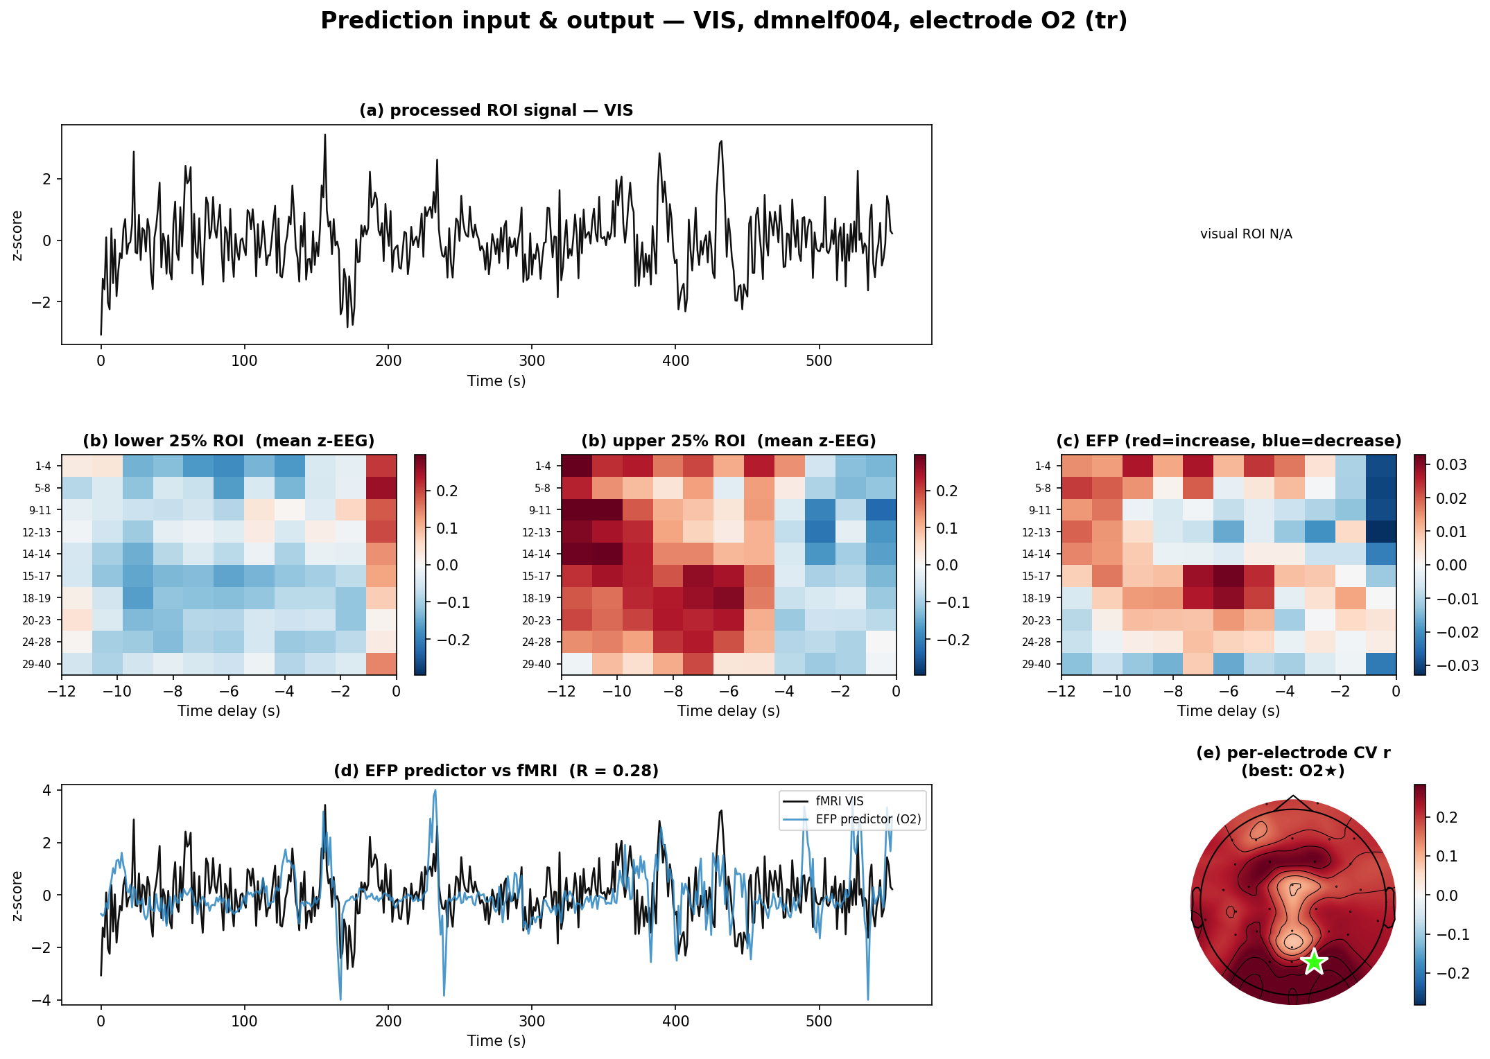
Positive control — visual cortex (Fig 5 analog)
Blind EFP on an early-visual ROI should recover occipital electrodes + alpha band — validates the method

Slide 14
Verdict
• Faithful EFP replication succeeds on DMNELF (n=19).
– The sliding-delay single-electrode fingerprint is our best DMN/CEN/PDA decoder to date, within-subject (PDA r≈0.17, CEN r≈0.17).
– A general (LOSO) PDA fingerprint transfers across subjects (r≈0.16, p=0.002) — promising for EEG-only neurofeedback.
– Interpretable [freq × delay] fingerprints show HRF-plausible per-frequency delays — good paper figures.
• Caveats
– GSR_DMN remains hard (within and across subjects).
– LOSO uses band-index alignment across per-subject data-driven bands (approximation); a fixed-band group model is the natural next step.

