Slide 1
NLP Lab 3: Grammatical Error Correction using Neural Machine Translation
Due Date: 12/26

Slide 2
Goal
Use Seq2seq Neural Network architecture in machine translation to perform grammatical error correction.
word embedding: pre-trained word embedding
Analyze the effect of cleaning data
Incorrect:
I learn a lot with it .
Correct:
I learn a lot from it .

Slide 3
Seq2seq Example
Character-based NMT
https://keras.io/examples/lstm_seq2seq/
Keras pre-trained word embedding
https://blog.keras.io/using-pre-trained-word-embeddings-in-a-keras-model.html

Slide 4
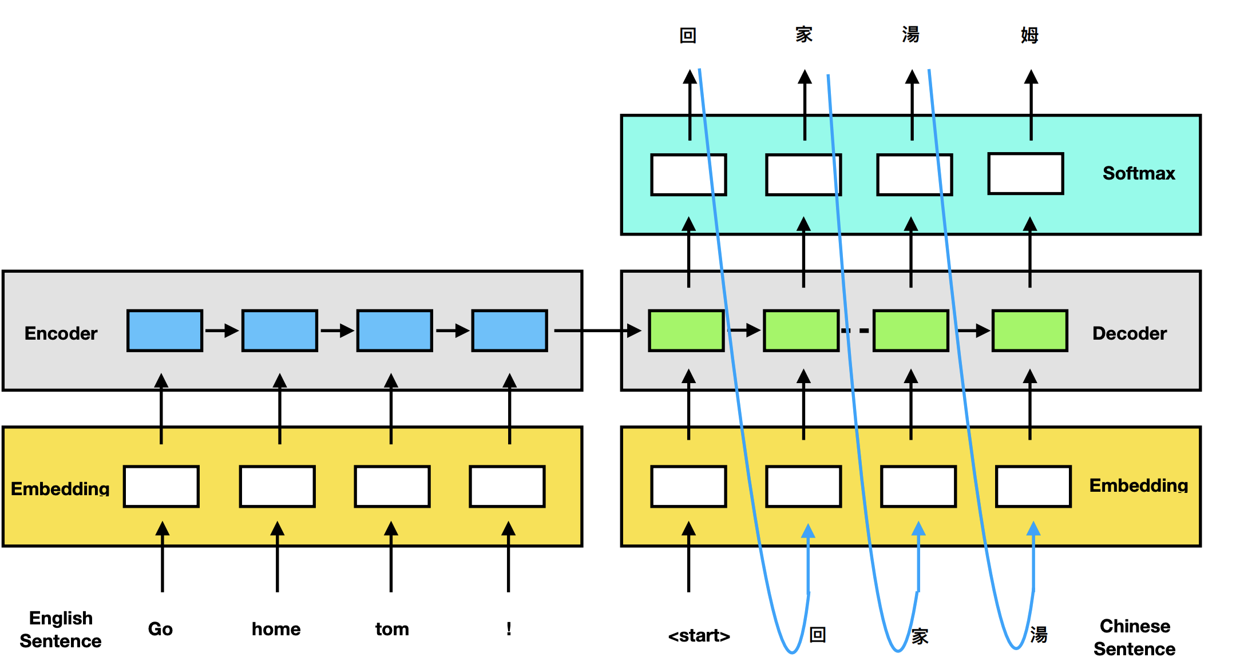
Neural Network Structure

Slide 5
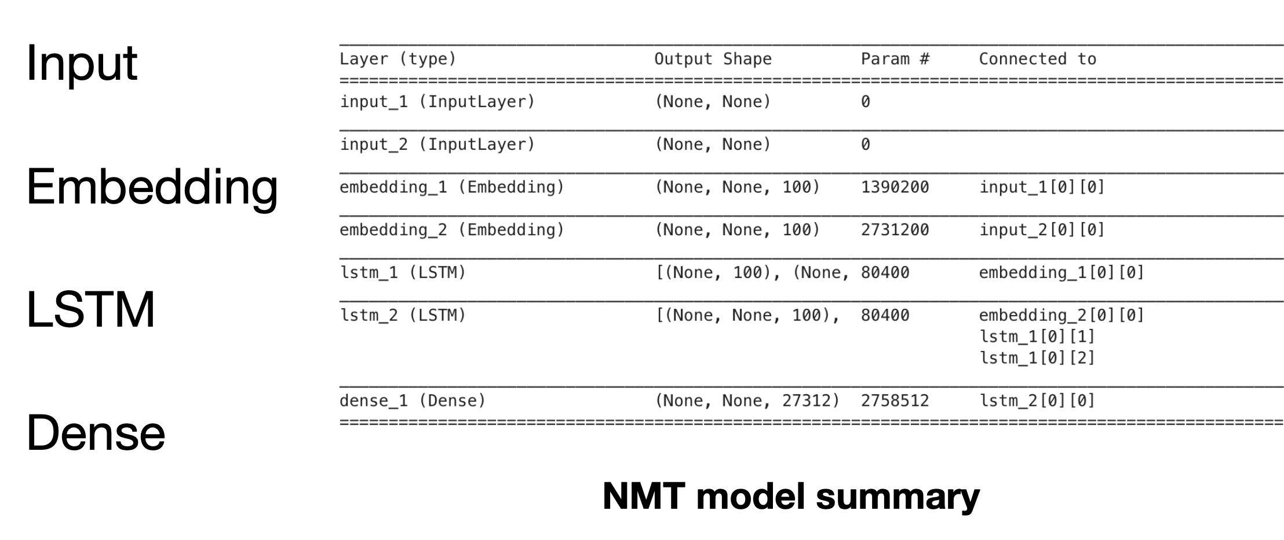
Keras Layers

Slide 6
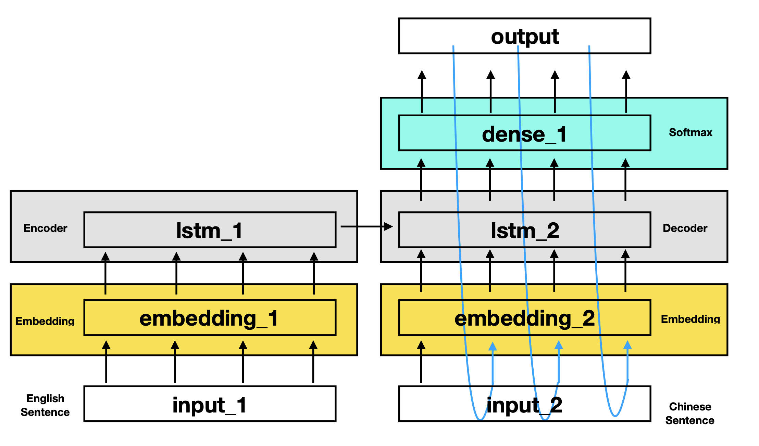
Incorrect
Correct

Slide 7
Dataset
Incorrect \t Correct
I 'm fond to reading and dressing up myself . I 'm fond of reading and dressing up myself .

Slide 8
Data Processing
1. Raw Data
‘I learn a lot with it . ‘
2. Tokenize Data
[’I’, ‘learn’, ‘a’, ‘lot’, ‘with’, ’it’, ‘.’]
3. Build Vocab Dictionary
[85, 10, 32, 25, 76, 23, 4]
4. Pad Data
Word | Index
I | 85
learn | 10
a | 32
lot | 25
with | 76
it | 23
. | 4

Slide 9
Data Padding
• <Start> : 句子的開始
• <End> : 句子的結束
• <Pad> : 維持句子長度⼀致
word | Index
<Pad> | 0
<Start> | 1
<End> | 2
Encoder Sentence(input)
[10, 17, 23, 4] [10, 17, 23, 4, 2, 0, 0, 0]
Decoder Sentence(input)
[5, 18, 38, 40, 44, 4] [1, 5, 18, 38, 40, 44, 4, 0]

Slide 10
Embedding Layer
Embedding(input_dim, output_dim, weights= [embedding_matrix], trainable=[True | False])
input_dim : vocabulary size
output_dim : output size, dim of word vector
weights : pre-trained weights
trainable : 如果是False, freeze the layer

Slide 11
LSTM Layer
LSTM(units, return_sequences=[True | False], return_state=[True | False])
units：hidden dimension (output size)
return_sequences：如果是True，回傳全部字的 output，反之，回傳最後字的output。
return_state：是否回傳最後⼀個cell state。

Slide 12
Dense Layer
Dense(units, activation=)
units：num of decoder tokens
activation：softmax

Slide 13
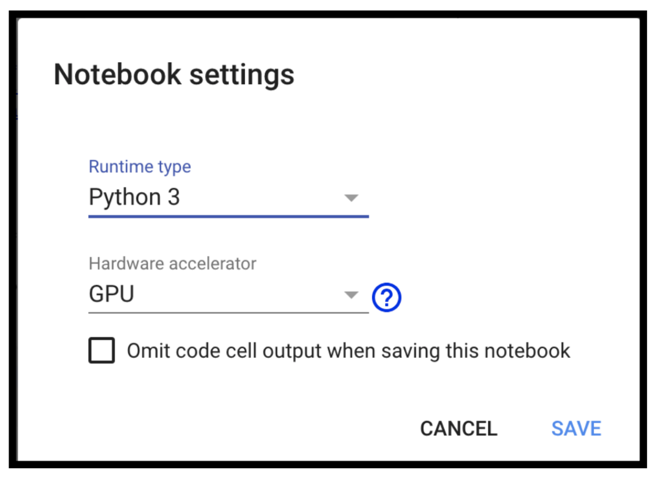
Colab
沒有gpu的同學可以使用colab
https://colab.research.google.com/
選擇使⽤GPU去跑你的程式。
使⽤⽅法Runtime >> Change runtime type， 下⾯的⼩視窗Hardware accelerator選擇⽤GPU。

Slide 14
Dirty Data
Our ‘correct’ data is dirty
‘To discuss about private problems…’
False Positive | Correct
discuss about | discuss
explain about | explain
mention about | mention
describe about | describe

Slide 15
Effect of Cleaning Data
Clean every occurrence of false-positive data
{‘discuss about’, ‘explain about’, ‘mention about’, ‘describe about’}
Train a new model
Analyze the result of the two models

Slide 16
Grading
Code: 50 %
Report: 30 %
Leaderboard: 20 %

