Slide 1
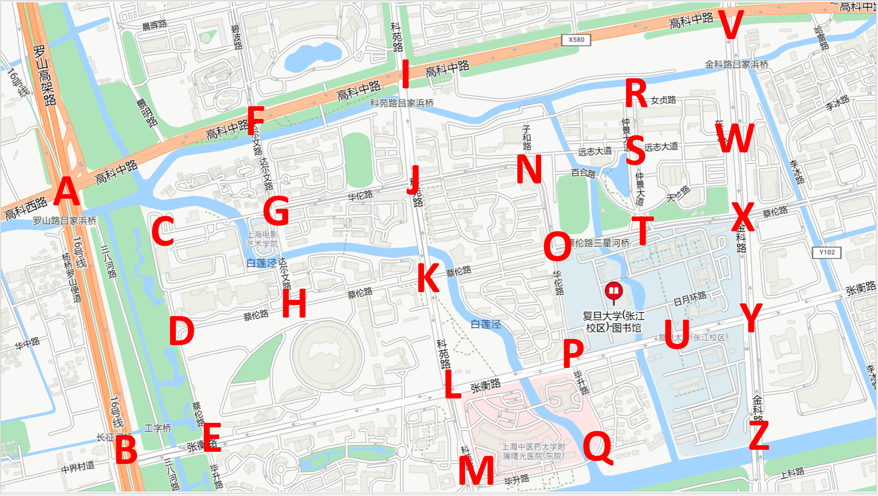
🚍
11.04,Middle Gaoke Rd.
🚍
3.10,
Nuzhen Rd.
2.76,Jinke Rd.
🚍
4.39,Middle Gaoke Rd.
2.32,
Keyuan Rd.
0.84,Zhongjing Avenue
2.46,
Yuanzhi Avenue
5.43,Middle Gaoke Rd.
2.91,
Yuanzhi Avenue
1.50,
Darwin Rd.
3.23,Huatuo Rd.
1.43,
Jinke Rd.
3.94,Huatuo Rd.
🚍
1.43,Zhongjing Avenue
🚍
1.40,
Huatuo Rd.
🚍
2.32,
Keyuan Rd.
2.77,
Cailun Rd.
3.19,Huatuo Rd.
🚍
1.79,
Cailun Rd.
2.01,
Darwin Rd.
3.82,Cailun Rd.
2.04,Jinke Rd.
2.36,Cailun Rd.
2.18,
Riyue Ring Rd.
3.94,Cailun Rd.
🚍
🚍
2.13,
Huatuo Rd.
7.00,Luoshan Rd.
2.88,Cailun Rd.
1.67,
Zhangheng Rd.
2.32,
Keyuan Rd.
🚍
2.47,
Zhangheng Rd.
🚍
2.54,Cailun Rd.
3.69,Zhangheng Rd.
2.52,Jinke Rd.
🚍
2.20,
Bisheng Rd.
8.17,Zhangheng Rd.
1.93,
Keyuan Rd.
2.28,
Zhangheng Rd.
3.08,Bisheng Rd.

