Slide 1

Notes:
National Instruments Leadership Seminar
April, 2002
National Instruments CONFIDENTIAL

Slide 2
Improving Memory Management in LabVIEW Real-Time
John Stanhope
Senior Software Engineer
Tuesday, August 8 Rm.19A 2:15 PM
Notes:
National Instruments Leadership Seminar
April, 2002
National Instruments CONFIDENTIAL

Slide 3
Overview
LabVIEW and memory management
  LabVIEW allocates memory automatically
Types of problems
  Out of memory, jitter, fragmentation
Finding problems
  Tools and techniques for finding problems
Fixing problems
  Solved by understanding when and why LabVIEW allocates memory
Notes:
National Instruments Leadership Seminar
April, 2002
National Instruments CONFIDENTIAL
Managing Memory in LabVIEW – Even though a LabVIEW programmer cannot directly allocate and free memory LabVIEW is performing memory allocation, as I’m sure you are all aware.
Find problems – Before you can fix a problem you need to find the problem. Finding memory usage problems is generally a little harder than finding speed problems since it is hard to associate the amount of memory allocated with a region of code.
Fixing problems – Some solutions to problems that affect memory usage.

Slide 4
Managing Memory in LabVIEW
Value semantics
  Data is copied between primitives and subVIs
Controlled by LabVIEW
  Copies are automatically made by LabVIEW
Affected by programmer
  The optimizer in LabVIEW can reduce copies
Strongly tied to branching
Notes:
National Instruments Leadership Seminar
April, 2002
National Instruments CONFIDENTIAL
Value semantics – LabVIEW moves all data around a program by value semantics. Each wire and SubVI call get a copy of the data. Data is passed by value to avoid aliasing problems that cause race conditions in multi-threaded applications or overwriting when passing data to a SubVI. A naïve implementation of LabVIEW would always make a copy of data whenever a wire is split or a subVI called. However, LabVIEW is not so naively implemented to do this.
Controlled by LabVIEW – LabVIEW employs an algorithm called the “inplace” algorithm to determine when copies of data need to be made in order to ensure value semantics. The algorithm traverses all the VI in an application to determine the best strategy for allocation data.
Affected by programmer – The “inplace algorithms” ability to reduce copies is affected by the VIs. There are a number of ways to design loops, array indexing, subVI calls, and other features that can affect the “inplace” algorithm’s effectiveness.

Slide 5
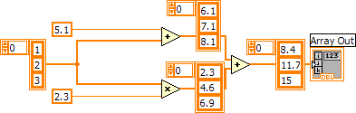
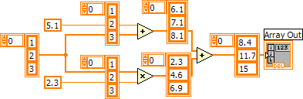


Value Semantics
Branches create copies
Changes create copies
Notes:
National Instruments Leadership Seminar
April, 2002
National Instruments CONFIDENTIAL
The value semantics of LabVIEW dataflow programming model mean each wire operates on its own copy of the data. SubVIs and built-ins also create copies of their data. The benefit of making copies is that two branches of code can operate independently on data. No locks required.

Slide 6

Reference Semantics
Data shared between concurrent threads complicates the implementation
Notes:
National Instruments Leadership Seminar
April, 2002
National Instruments CONFIDENTIAL
In programming language like C/C++ or Java data can be shared across threads using references or pointers. Each thread can read and write data at the same time. The only to get consistent results is to use locks. In some cases, as in our previous example, the algorithm requires at least one copy of the array since to branches of the program want to operate on the array in different ways and then combine the results. In a language with references you will also need to create copies. Now you, as a developer, need to figure out when you need locks and when you need copies.

Slide 7
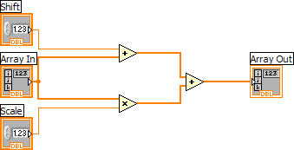
Optimizations by LabVIEW
  The theoretical 5 copies becomes 1 practical copies
Copy
Output is “inplace” with input
Notes:
National Instruments Leadership Seminar
April, 2002
National Instruments CONFIDENTIAL
Our previous example for value semantics indicated there could be as many as 5 copies of the array. In actuality LabVIEW examines the code and discovers two branches of code. The top branch is marked as needing a copy since it will destructively modify the array coming into the + operation. The bottom branch is optimized to use the same array for the output from the * operator and the + operator. LabVIEW has optimized the 5 copies down to 1 copy. The ideal solution because you would need to make a copy of the array regardless of the language since both branches want to write back into the array.

Slide 8
Managing Memory in LabVIEW Real-Time
Memory Contention
  Memory is a resource protected by locks
  Waiting on a lock can cause a thread switch
  Thread switching is CPU intensive
Memory Fragmentation
  Allocating and freeing memory creates small gaps between allocations
Notes:
National Instruments Leadership Seminar
April, 2002
National Instruments CONFIDENTIAL
The previous slides discussed making copies that could result in a low/no memory situation. In cases where memory consumption is not the problem the act of allocating memory from multiple threads can cause jitter. The jitter comes from the threads acquiring and releasing the locks to the memory manager and the memory manager attempting to allocate memory. The memory manager’s allocation algorithm is not constant time and can be affected by the state of the machine. One thing that can affect the memory manager’s ability to allocate memory is fragmentation. Fragmentation can occur when memory is allocated and freed in various sequences that result in small gaps between allocation. Fragmentation wastes memory and causes the allocate to spend more time looking for usable memory.

Slide 9
Threads and LabVIEW
LabVIEW distributes concurrent clumps of code across a bounded set of threads
LabVIEW Real-Time will create a new thread for each timed loop
  20 timed loops means 20 threads
Notes:
National Instruments Leadership Seminar
April, 2002
National Instruments CONFIDENTIAL

Slide 10

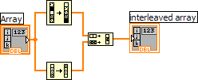
Parallelism Affects Memory Management
LabVIEW is a highly parallel language
  Each wire branch establishes concurrent sections of code
  The LabVIEW compilers decides how to execute code
  Branches may require copies
May become…
Notes:
National Instruments Leadership Seminar
April, 2002
National Instruments CONFIDENTIAL
The parallelism in LabVIEW comes from the ability to branch wires into different paths of code. Each branch represents the opportunity for LabVIEW to run the branches of code concurrently. LabVIEW doesn’t always schedule code to run in concurrently. The LabVIEW compiles uses heuristics to determine which code should be run in concurrently and which code can be transformed into sequential operations. In general the algorithm’s goal is to group code together that would not benefit from running in concurrently. The algorithm that serializes code will not change the semantics of the program and will attempt to order the code so as to reduce copies. But whenever there is a branch in the code there is a chance a copy will need to be made of the data on the wire.

Slide 11
The “Inplace” Algorithm
Determines when a copy needs to be made
  Weights arrays and clusters higher than other types
Algorithm runs before execution
  - Doesn’t know the size of an array or cluster
Relies on the sequential aspects of the program
  Branches might require copies
Notes:
National Instruments Leadership Seminar
April, 2002
National Instruments CONFIDENTIAL
The algorithm that determines when a copy needs to be made is called the “inplace” algorithm. The algorithm traverses the VI and tries to find the best way in which the code can be arranged to reduce the copying of arrays and clusters. The inplaceness is determined before execution and therefore doesn’t know if one array is larger than another.

Slide 12
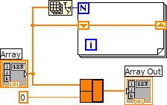

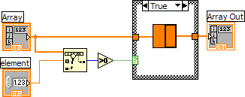

Bottom Up
Inplace information is propagated bottom up
No copies
Copy because
of increment
Increments array inplace
Notes:
National Instruments Leadership Seminar
April, 2002
National Instruments CONFIDENTIAL
The algorithm that determines when a copy needs to be made is called the “inplace” algorithm. The algorithm traverses the VI and tries to find the best way in which the code can be arranged to reduce the copying of arrays and clusters. The inplaceness is determined before execution and therefore doesn’t know if one array is larger than another.

Slide 13
Finding Problems
Profile a working program for problem areas
  Tools » Real-time » System Manager…
  Tools » Execution Trace Tool...
  Tools » Profile » Performance and Memory…
  Tools » Profile » Show Memory Allocations...
Probes
Code Reviews
Notes:
National Instruments Leadership Seminar
April, 2002
National Instruments CONFIDENTIAL
Profiling – Before you start getting to worked up about optimizing memory you should make sure your program is functionally correct. Once the program is correct you can start profiling it for “hotspots” that need optimization. Along with the tools you should use code reviews to help find problem areas. Talking someone through your code is a good way to find problems.

Slide 14
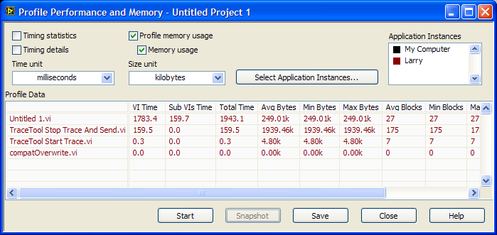
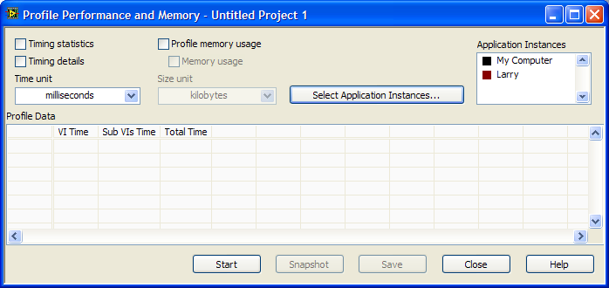
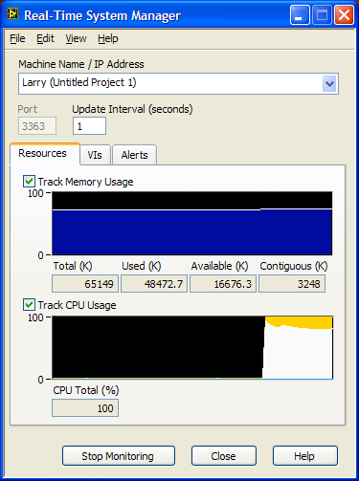
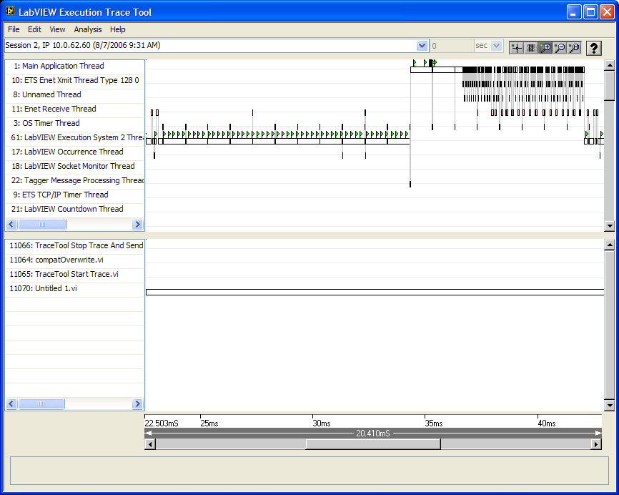
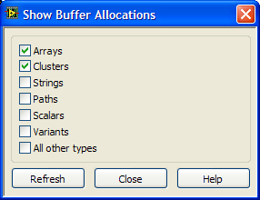
Tool Scope
Target Level
VI Level
Diagram level
Notes:
National Instruments Leadership Seminar
April, 2002
National Instruments CONFIDENTIAL
Use the system manager monitor the memory and CPU/jitter of an application. If you see problems you can use the trace tool to find out more about areas causing jitter because of memory allocation. The “Memory and Performance…” profiler can be used to find which VIs in your application are using the most memory or CPU. Last and certainly not least you can use “Show Memory Allocations…” to find particular places in your VIs that are making copies.

Slide 15
Fixing Problems
The following features affect memory
  Type coercion
  Clusters
  Parameters
  Shift registers
  Arrays and strings
  Calling libraries
Notes:
National Instruments Leadership Seminar
April, 2002
National Instruments CONFIDENTIAL
The following are areas of a VI that can have affect the memory performance of your application.

Slide 16

Type Coercion
Changing the data type of a wire to match the required data type
  Dots indicate automatic coercion
    Default color is red in 8.20
  Requires a copy
Coercion Dot
Keep graphics below the text and to the right.
Notes:
National Instruments Leadership Seminar
April, 2002
National Instruments CONFIDENTIAL

Slide 17
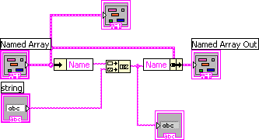
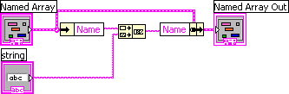
Cluster Bundling and Unbundling
The “magic” pattern prevents an allocation
  Branches can break pattern matching
Bad
Bad
Notes:
National Instruments Leadership Seminar
April, 2002
National Instruments CONFIDENTIAL

Slide 18
Parameters
SubVI doesn’t have to make a copy
Best when …
  Inputs are required
  Inputs and outputs not in structures
  Inputs and outputs are “inplace”
Notes:
National Instruments Leadership Seminar
April, 2002
National Instruments CONFIDENTIAL

Slide 19
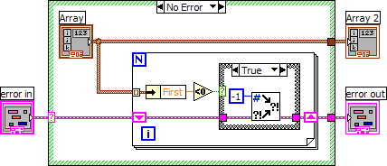
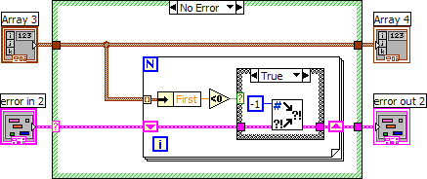
Parameters
Parameters within structures cause more memory allocations
Indicator allocates a copy
Move
Notes:
National Instruments Leadership Seminar
April, 2002
National Instruments CONFIDENTIAL

Slide 20
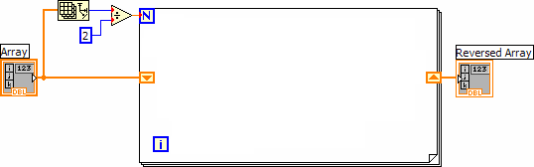
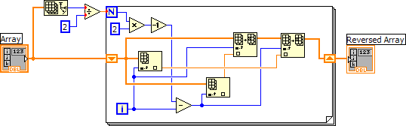
Shift Registers
Single left input always inplace with right output
  Even better when body inplace
Inplace
Always Inplace
Notes:
National Instruments Leadership Seminar
April, 2002
National Instruments CONFIDENTIAL

Slide 21
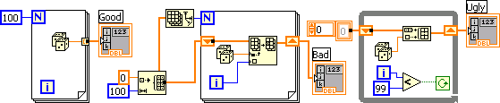
Building Arrays
There are a number of ways to build arrays and some are better than others
Best
Good
Bad
Keep graphics below the text and to the right.
Notes:
National Instruments Leadership Seminar
April, 2002
National Instruments CONFIDENTIAL
The “good” can allocate the array at load time which is even better for RT. Doesn’t have to be a constant.

Slide 22
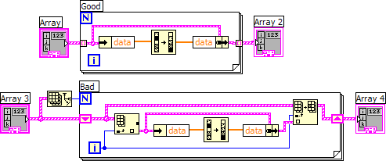
Accessing Arrays
Loops with indexing can avoid copies
Copies Cluster
Keep graphics below the text and to the right.
Notes:
National Instruments Leadership Seminar
April, 2002
National Instruments CONFIDENTIAL
When updating an array element you can use auto indexing to avoid a copy.

Slide 23
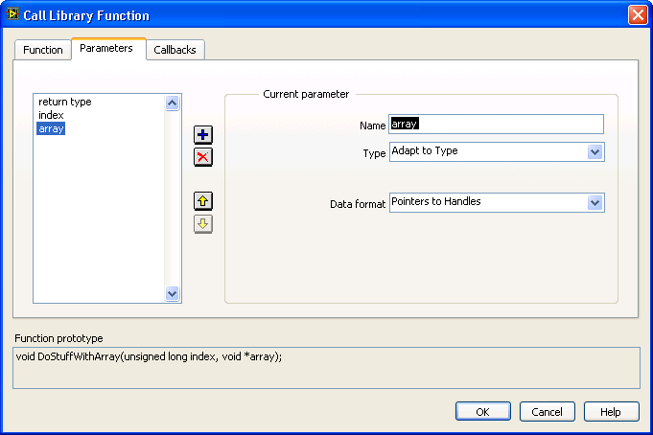

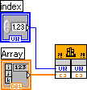
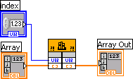
Call Library Node
Call a function in a DLL or shared library
  Configure to accept handles
  Unwired output means reader
  Wired output means writer
Notes:
National Instruments Leadership Seminar
April, 2002
National Instruments CONFIDENTIAL
Any branching on the input to a Call Library Node will create a copy before the call.
Warning: If the output is not wired then no copy will be made on input since we assume that the function is a reader.

Slide 24
Conclusion
Find problems areas with tools
Remove the dots from the bottom up
  Separate code into sections that read and write data
  Use sequence structures to control parallelism
  Select auto-indexing or shift registers based on situation
Notes:
National Instruments Leadership Seminar
April, 2002
National Instruments CONFIDENTIAL

