Slide 1
Airbnb Exploration
DS440 Final Project

Slide 2
Topic
Airbnb Listings
Goal 1: Understand causal relationships in Airbnb listings
Goal 2: Forecast listing performance metrics and classify properties

Slide 3
Tools
Language: Python 3
Editor: Jupyter Notebooks
Packages: Scikit-Learn, Pandas, Numpy, and Seaborn

Slide 4
Data Summary
Pre-scraped off of Airbnb irregularly between 2015 - present
Listing and calendar data
Listing data is pooled data from roughly every 3-4 months
Calendar data is panel data collected daily

Slide 5
Data Collection
InsideAirbnb.com
Just Boston for now
Aggregated scrapes from different dates

Slide 6
Data Cleaning
Removed features when many missing values
Removed rows with missing values (might impute instead)
Normalization

Slide 7
Data Cleaning
Resulting dataset:
22460 observations
40 features

Slide 8
Data Engineering
Feature engineering
Dimensionality Reduction

Slide 9
Feature Engineering
Occupancy Rate
Number of amenities
Is a professional
Host duration
Number of price changes
Daily revenue increase change (after a price change)

Slide 10
Data Exploration
View distributions
Investigate relationships

Slide 11



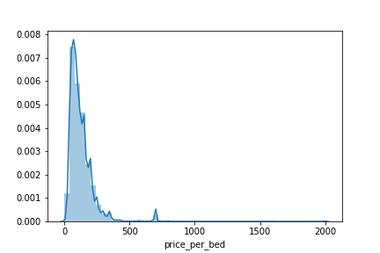


Price Per Bed Distribution

Slide 12
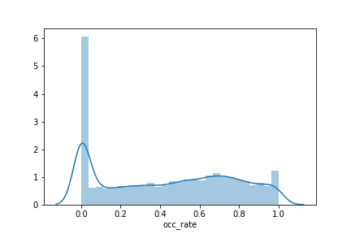
Occupancy Rate Distribution

Slide 13
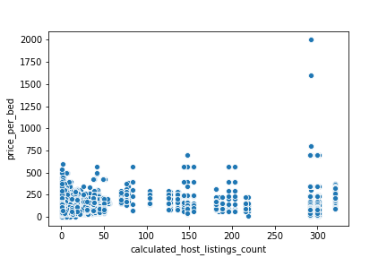
Price vs. Host Listing Count

Slide 14
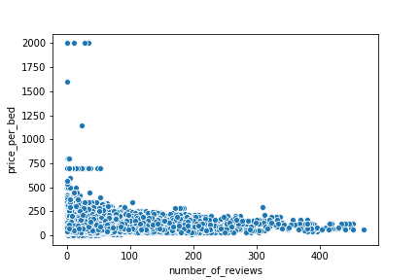
Price vs. Number of Reviews

Slide 15
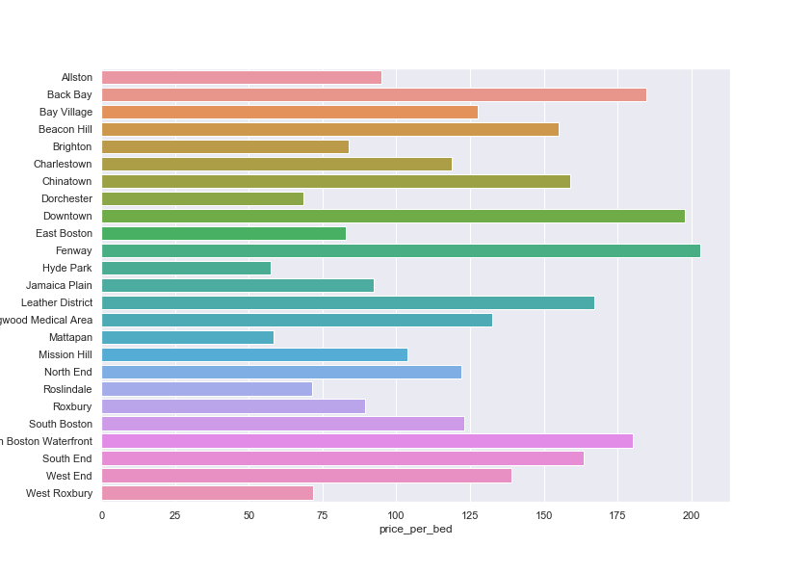
Price by Neighborhood

Slide 16
Data Exploration
https://cccdenhart.github.io/apt-visuals

Slide 17
Evaluation Metrics
Accuracy
Error
Precision
Recall
ROC AUC

Slide 18
Predicting Review Score and Price
Linear Regression
Support Vector Regression
Bin and Classify with Linear SVM

Slide 19
Classifying Professional Status
Logistic Regression
Decision Tree
AdaBoost

Slide 20
Classifying Neighborhood
kNN
Random Forest
Feed-Forward Neural Network

Slide 21
Classifying City
Naïve Bayes
Random Forest
Convolutional Neural Network

Slide 22
Optimal Pricing
Find average daily revenue after ever price change
Determine if the price change increased or decreased average daily revenue
Predict if a price change will increase or decrease average daily revenue

