Slide 1
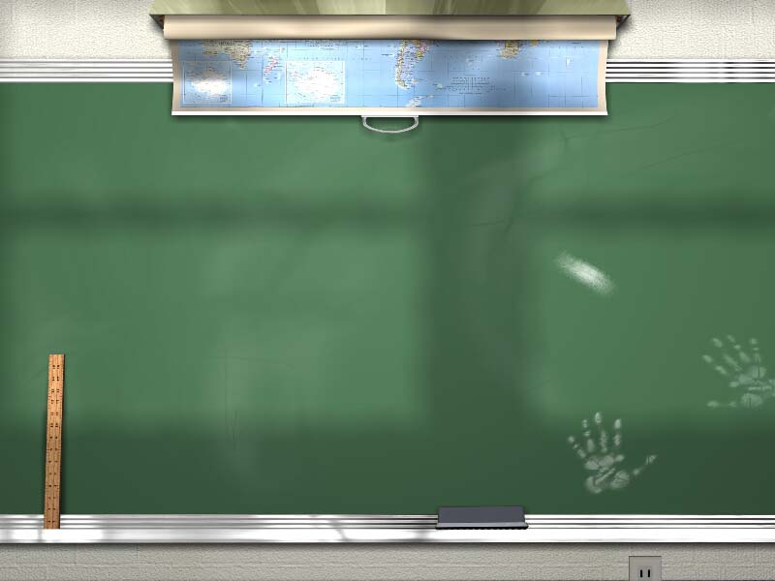
Humor and games in the foreign language classroom.
Jeff Brown
Spanish instructor, Orange Coast College

Slide 2
Why humor?

Slide 3
Why humor?
Humor adds the grease that opens up students minds and allows them to be more open to produce.

Slide 4
No matter what you do, if you make a fool of yourself, it will be funny!!!
Trying to be funny, in a foreign language is funny!

Slide 5
There’s only one thing students like more than seeing there peers make fools of themselves.

Slide 6
Watching there teachers make fools of themselves.

Slide 7
Today’s Humorous Agenda
A. Humor
Exaggeration
Charades/TPR
Unbelievable stories
B. Games
Slap
Famous names game
Lie detector

Slide 8
It’s not rocket surgery.
It’s okay to make mistakes.

Slide 9
Exagger- ation

Slide 10
Rather than explain exaggeration, I’ll model it.

Slide 11
Summary of how to exaggerate
Exaggerate any and all new vocabulary
Use lots of sounds effects to drive home your message.
Ham it up. Whoop it up. You can’t fail.
Think of it as acting.

Slide 12
Charades/T.P.R.
There is no limit to what you can teach using charades and or T.P.R.

Slide 13
Charades=gestures

Slide 14
Consider the following expressions:
How fun!
How interesting!
How boring!
I don’t believe it!
Me too!
Me neither!
What a great idea!

Slide 15
How about teaching them using charades?
How fun!
How interesting!
How boring!
I don’t believe it!
Me too!
Me neither!
What a great idea!

Slide 16
Summary of Charades
Model the charades
Have students charade together.
Have a student charade for the class.
Laugh hysterically.

Slide 17
T.P.R

Slide 18
T.P.R. is not just giving commands.

Slide 19
Read the following story to your partner, as he/she acts it out.

Slide 20
You’re in on a deserted island in the South Pacific. You’re there with your best friends Selma Hayek and George Clooney. It’s hot, it’s so hot. You, George, and Selma are really hungry. You’ve got an idea. You see palm trees with ripe coconuts. They’re everywhere. Quickly, machete in your mouth, you climb up the tallest palm tree with biggest fattest coconuts. You climb and climb and climb, quickly. Holding on, you take the machete out of your mouth, and start cutting coconuts. They fall easily to the ground. One of them hits George Cloony on the head. You yell, “sorry about that George.” You climb down. There’s at least a dozen coconuts. You pick one up, cut the top off with your machete, you drink the coconut milk. You reach in and take out the meat from the coconut. You eat the coconut. You say outloud, “ohhhhhhh, that is sooooooooooo good. Oh my God, that is the best coconut in the world.” You smile, Selma smiles, George can’t smile, because he’s still unconscious.

Slide 21
Unbelievable stories

Slide 22
What’s this man doing?

Slide 23
It’s obvious

Slide 24
He was about to propose to his girlfriend (Tara) when he accidentally ate the engagement ring. Luckily his Dad is a pediatrician and has a ultrasound machine at home. He’s showing Tara what the ring looks like, assuring her it’s real, and waiting for an answer.

Slide 25
Games

Slide 26
Slap
Slap can be used with almost any vocabulary, new or old.
After you play this, students will beg to play and will ask you over and over again, “when are we going to play slap again?”

Slide 27
The rules of slap are simple.
Make/photocopy pictures of any new vocabulary words you want to teach/review.
Cut the pictures out or have students carefully tear the pictures into individual pieces.
Keep one copy for yourself and don’t cut out the pieces.
Students sit in a circle/group of 4 and as you call out each word, students try to grab the piece before the other students.
Repeat 3 times so students hear the words over and over.
Laugh
Repeat

Slide 28
Famous names game

Slide 29
Rules for the famous names game.
Beforehand, get a number of nametags equal to the amount of students you have.
Write different names of famous people on each tag.
Put the names into a paper bag.
Students reach into the bag, pull out a name, and put it on their partner’s back.
Students have to ask questions (in the target language, of coure) to find out who they are.

Slide 30
Consider using target language names for the students.
For example, Spanish names in a Spanish classroom or Japanese names in a Japanese classroom.

Slide 31
Lie detector

Slide 32
Rules for lie detector.
On paper, students write down 4 facts about themselves.
One must be false while the others must be true. (Exactly 3 true and 1 false.)
The students must ask questions of their partner (in the target langauge of course) to find out which is the lie.

Slide 33
Other simple things you can do that add fun and humor to any classroom.
Consider having students use target language names.
Have the students in the class choose names for their peers.
Assign seats and partners randomly.
Change seats and partners at least after every exam.

