Slide 1

La presencia del
en el internet...

Slide 2
La presencia del
en el internet...
Democratization of Information in the
Spanish-Speaking World

Slide 3
Vamos a hablar de...
Online Presence of Spanish-Speakers
Growth: Presence and Engagement
Online Presence of Spanish Language
Online Behavior of Spanish-Speakers
Initiatives

Slide 4
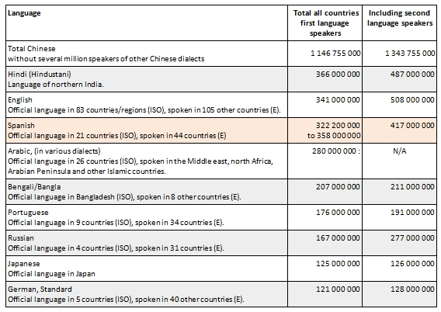
Most Widely Spoken Languages in the World

Slide 5
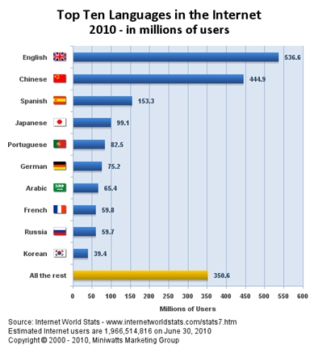
Online Presence of Spanish-Speakers

Slide 6
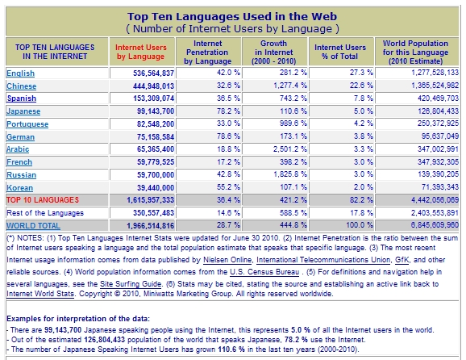
Online Presence of Spanish-Speakers

Slide 7
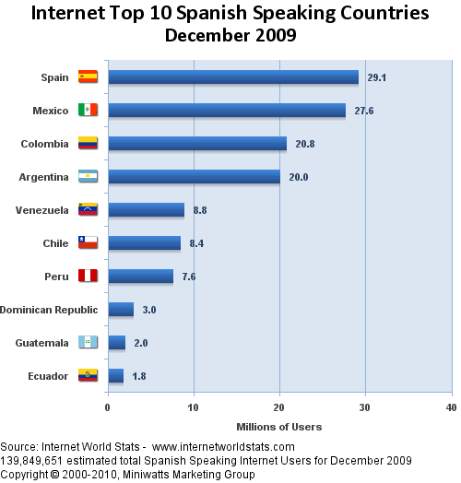
Online Presence of Spanish-Speakers

Slide 8
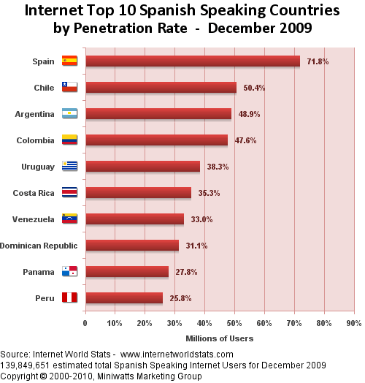
Online Presence of Spanish-Speakers

Slide 9
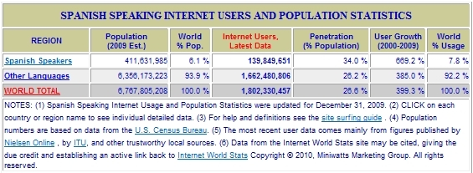
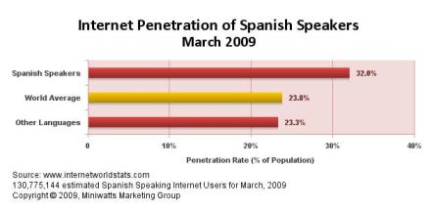
Online Presence of Spanish-Speakers

Slide 10
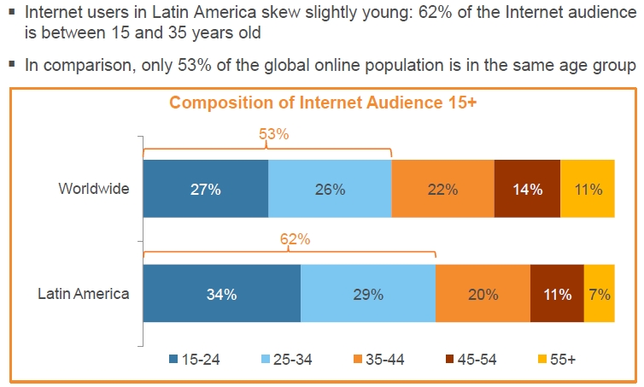
Online Presence of Spanish-Speakers

Slide 11
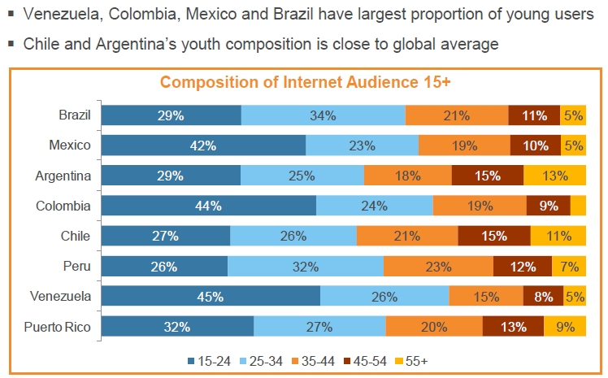
Online Presence of Spanish-Speakers

Slide 12
Growth

Slide 13
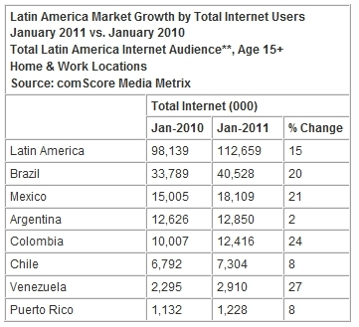
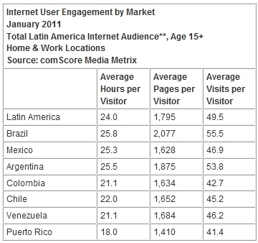
Growth

Slide 14
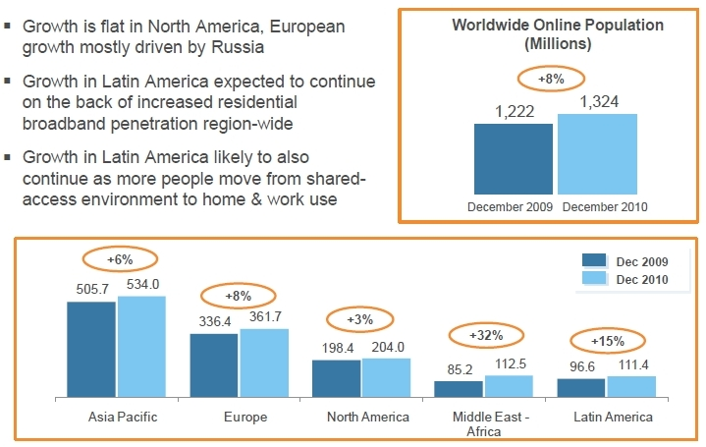
Growth

Slide 15
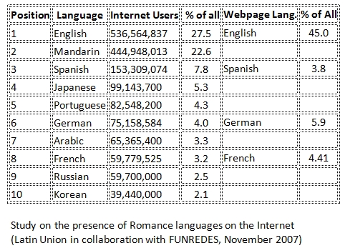
Online Presence of Spanish Language

Slide 16
Online Behavior of Spanish-Speakers
Language Preference:
U.S. Hispanics – Sites in English preferred: 55%
U.S. (18-34) – Sites in Spanish preferred: 39%
U.S. females: 42% vs. U.S. males: 29%

Slide 17
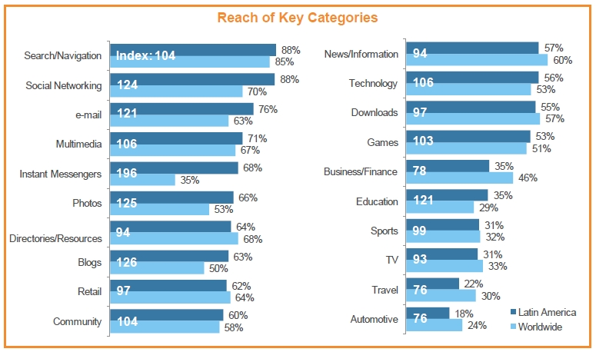
Online Behavior of Spanish-Speakers

Slide 18
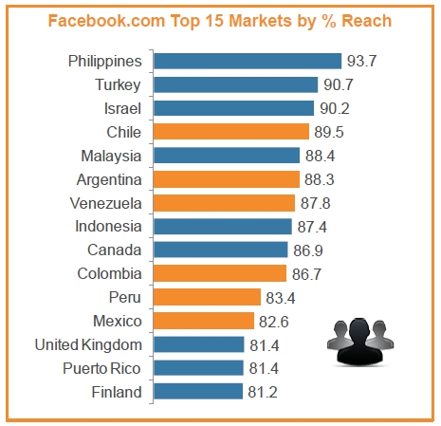
Online Behavior of Spanish-Speakers

Slide 19
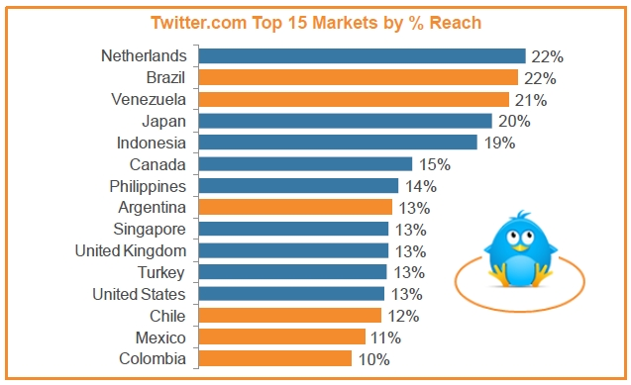
Online Behavior of Spanish-Speakers

Slide 20
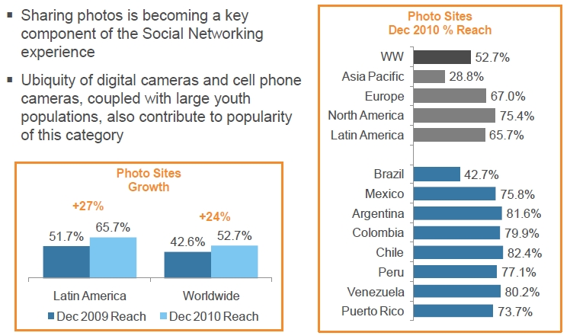
Online Behavior of Spanish-Speakers

Slide 21
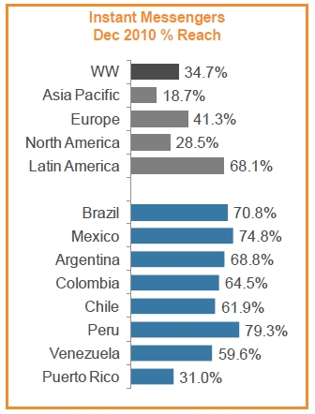
Online Behavior of Spanish-Speakers

Slide 22
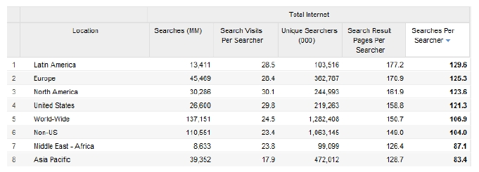
Online Behavior of Spanish-Speakers

Slide 23
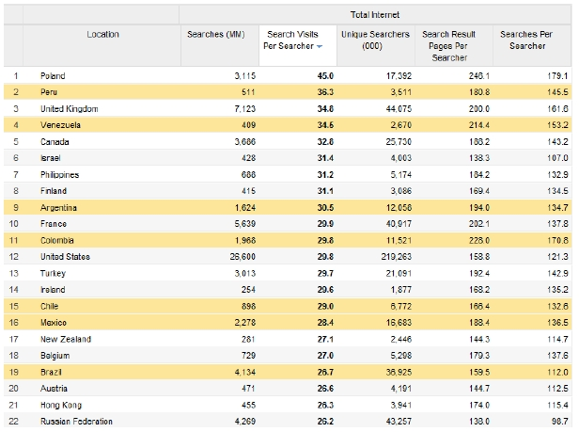
Online Behavior of Spanish-Speakers

Slide 24
Initiatives:
Internet Access as a Human Right
United Nations (2003)
International Telecommunications Union (ITU)
Finland (2009)
Spain (2009)
Estonia
France
Greece
Chile? - Brazil ?

Slide 25

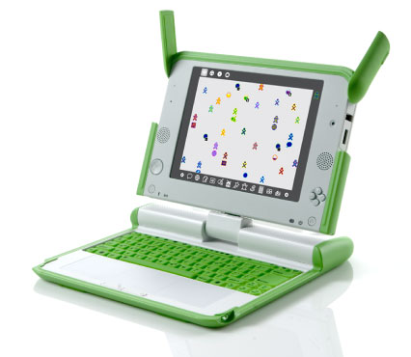
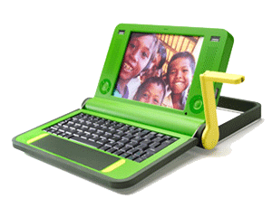
Initiatives:
One Laptop per Child
Nicholas Negroponte
Rodrigo Arboleda

Slide 26
Initiatives:
One Laptop per Child
Laptops have been delivered to the following countries:
Americas
  Argentina (60,000 laptops ordered)
  Colombia (4,000 laptops ordered)
  Haiti (13,000 laptops received from G1G1 program)
  Mexico (50,000 laptops ordered by businessman Carlos Slim)
  Peru (870,000 laptops ordered, most recently in December 2010)
  United States of America (15,000 laptops ordered by Birmingham, Alabama)
  Uruguay (380,000+ given to 1-6 students and teachers, completing the initial objective. 90,000 ordered in 2010 for high-school students).

Slide 27
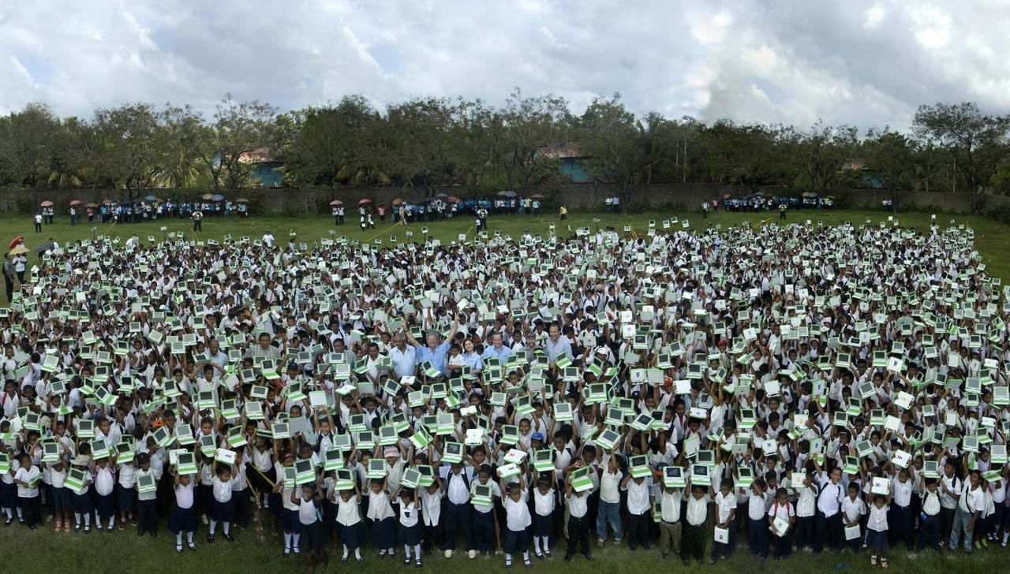
Initiatives:
One Laptop per Child
Nicaragua:

Slide 28
El fin
☺

Slide 29
Denise Cabanel-Bleuer
dcabanel@occ.cccd.edu
(If sources aren’t included in this version and you need them, please feel free to e-mail me)

