Slide 1
Teaching Heritage Language Learners: Approaches and Tools for a New Age in Language Teaching CCCFLC, 2015 Conference
Maria M. Carreira, Ph.D.
Professor of Spanish,
California State University, Long Beach
Co-director,
National Heritage Language Resource Center, UCLA

Slide 2
Focus of this presentation
The aboutness of heritage language (HL) teaching:
Why it matters;
How it differs from second language (L2) teaching;
The big ideas or essence of HL teaching;

Slide 3
Overview of this presentation
Why HL teaching matters
Demographics, research on institutional practices;
How HL teaching differs from L2 teaching
Heritage language learners;
The big ideas or essence of HL teaching;
General principles and some specific tools
Closing: The possibilities

Slide 4
Demographics
Since 1980, the number of people who speak a language other than English at home has exploded (23M -> 60M). (Ryan, 2013);

Slide 5
Demographics (cont.)
Language | 1980 | 2010 | Percent change
Spanish | 11,116,194 | 36,995,602 | 232.8
Chinese | 630,806 | 2,808,692 | 345.3
French | 1,550,751 | 2,069,352 | 33.4
Tagalog | 474,150 | 1,573,720 | 231.9
Vietnamese | 197,588 | 1,381,488 | 599.2
Korean | 266,280 | 1,137,325 | 327.1
German | 1,586,593 | 1,067,651 | -32.7
Russian | 173,226 | 854,955 | 393.5
Italian | 1,618,344 | 725,223 | -55.2
Portuguese | 351,875 | 688,326 | 95.6
Ryan, C. 2013. www.census.gov, ACS -22

Slide 6
Children who speak a language other than English at home
California: 46% Florida: 28%
Texas: 36% Illinois: 24%
Nevada: 33% Massachusetts: 22%
New Mexico: 32% Rhode Island, Washington: 22%
New York: 29% Oregon: 20%
Arizona: 29%
Source: http://datacenter.kidscount.org

Slide 7
School demographics
Percent of children (5-17) in the U.S. who spoke a language other than English at home (2011) | 22%
Percent of children in NYC public schools who spoke a language other than English at home (2010-2011) | 40%
Percent of children in LA Unified who spoke a language other than English at home (2010-2011) | 58%
www.childstats.gov

Slide 8
What about Higher Education?
Research on institutional practices

Slide 9
15 most commonly studied languages | Higher Education Enrollments in 2009 (MLA report, 2010)
Spanish | 864,986
French | 216,419
German | 96,349
ASL | 91,763
Italian | 80,752
Japanese | 73,434
Chinese | 60,976
Arabic | 35,083
Latin | 32,606
Russian | 26,883
Greek, Ancient | 20,695
Hebrew, Biblical | 13,807
Portuguese | 11,371
Korean | 8,511
Hebrew, modern | 8,245

Slide 10
Let’s compare this information on institutional practices to the demographic data we looked at earlier…

Slide 11
Recall: Demographics
Language | 1980 | 2010 | Percent change
Spanish | 11,116,194 | 36,995,602 | 232.8
Chinese | 630,806 | 2,808,692 | 345.3
French | 1,550,751 | 2,069,352 | 33.4
Tagalog | 474,150 | 1,573,720 | 231.9
Vietnamese | 197,588 | 1,381,488 | 599.2
Korean | 266,280 | 1,137,325 | 327.1
German | 1,586,593 | 1,067,651 | -32.7
Russian | 173,226 | 854,955 | 393.5
Italian | 1,618,344 | 725,223 | -55.2
Portuguese | 351,875 | 688,326 | 95.6
Ryan, C. 2013. www.census.gov, ACS -22

Slide 12
Demographic information Most commonly spoken | Institutional information Most commonly studied
1. Spanish | Spanish
2. Chinese | French
3. French | German
4, Tagalog | ASL
5. Vietnamese | Italian
6. Korean | Japanese
7. German | Chinese
8. Russian | Arabic
9. Italian | Latin
10. Portuguese | Russian

Slide 13
Missing from the “studied/taught” column
Tagalog – 4th most spoken language in the US
Vietnamese – the 5th most spoken language in the US
Korean – the 6th most spoken language in the US
Portuguese – the 10th most spoken language in the US

Slide 14
Also missing from this study…
Heritage language learners;

Slide 15

The upshot of demographics and institutional information
A new age of language teaching is upon us;
In this age, HL issues occupy center stage;
The language teaching profession is not quite ready;

Slide 16
What do we, as language educators, need to know about HL learners?

Slide 17
HL teaching and learning
Why it matters
Demographics + institutional reserach;
How it differs from L2 teaching
Heritage language learners;

Slide 18
Definitions + linguistic studies
Sources of information on the domains

Slide 19
Definitions: Who is a heritage language learner?
Narrow definitions – based on proficiency
Broad definitions – based on affiliation

Slide 20
Example of a narrow definition
“An individual who is raised in a home where a non-English language is spoken, who speaks or merely understands the heritage language, and who is to some degree bilingual in English and the heritage language” (Valdés, 2001, p. 38)

Slide 21
Example of a broad definition
Heritage language learners are individuals who “…have familial or ancestral ties to a particular language and who exert their agency in determining whether or not they are HLLs (heritage language learners) of that HL (heritage language) and HC (heritage culture) (Hornberger and Wang, 2008, p. 27)

Slide 22
Why this matters
While researchers have looked quite extensively at the language exposure we need to learn a new language, a second set of factors that are equally important has received far less attention. These factors relate to “group membership,” or the allegiances we feel with particular-language-speaking groups and the attitudes and feelings that flow from being associated with them.
(Tse, 2001, 60)

Slide 23
Learners who fit the narrow definition also fit the broad definition
Broad definition
Narrow definition

Slide 24
Broad + narrow definitions = two domains to HL teaching
Linguistic needs
(narrow definition)
Affective needs
(broad definition)

Slide 25
http://youtu.be/39d6Lb2f2Aw

Slide 26
Specific Needs stemming from broad definition

Slide 27
In high school I was one of very few Latinos. My friend and I were called the "Mexican kids". This was always funny to me because my Dad's family always told me I was American. In school I was labeled Mexican, but to the Mexicans, I am an American. I am part of each, but not fully accepted by either. In high school, I was considered Mexican because I spoke Spanish but I was considered "Pocho" by my Dad's family because my Spanish was not up to their standard. It's this weird duality in which you are stuck in the middle. Latinos are often told that they are not Americans but also that they are not connected to their heritage. You take pride in both cultures and learn to deal with the rejection. You may never be fully embraced by either side. That's why you seek out other people like yourself. Socializing with people who share a common experience helps you deal with this experience.

Slide 28
Broad + narrow definitions = two domains to HL teaching
Linguistic needs
(narrow definition)
Affective needs
(broad definition)
Find identity
Navigate two worlds
Connect to others (find community)
Deal with rejection

Slide 29
This is about student engagement
Classroom practices;
Syllabus and curriculum development;
Materials selection and use;

Slide 30
Some tools for attending to HL learners’ affective needs and promoting engagement

Slide 31
The text-to-self connection;
The text-to-world connection;
The exit card;
T-charts/Y-charts

Slide 32
The text-to-self connection (Harvey and Goudvis 2000:266)
Passage from the text
This reminds me of…
Passage from the text
I agree or disagree because…
Expression from the text
I find this interesting because…

Slide 33
Text-to-world connection (Harvey and Goudvis 2000:267)
Passage from the text
This reminds me of…
Character from the text
This character reminds me of…
A theme of the text
This reminds me of…

Slide 34
The exit card
Describe something about this reading/movie, etc. that you would like to explore further;
Describe a comment or observation made by a classmate that caught your attention;
Formulate a question that you would like to ask the author of this text.

Slide 35
A T-chart (Deveraux, 2015, p. 131)
Familiar English
I wouldn’t think nuffin
He say he went to see her yesterday
Formal English
I wouldn’t think nothing
He says he went to see her yesterday

Slide 36
T-charts are used for contrastive analysis
Contrastive analysis: The rules of one language or dialect are contrasted and analyzed against another.

Slide 37
An adaptation: A cultural T-chart
Latino practices or beliefs about marriage and gender roles
Mainstream American practices or beliefs about marriage and gender roles

Slide 38
It even works in really hard cases
Little Red Riding Hood

Slide 39
A cultural T-chart
Latino practices or beliefs surrounding older relatives
Mainstream American practices or beliefs surrounding older relatives

Slide 40
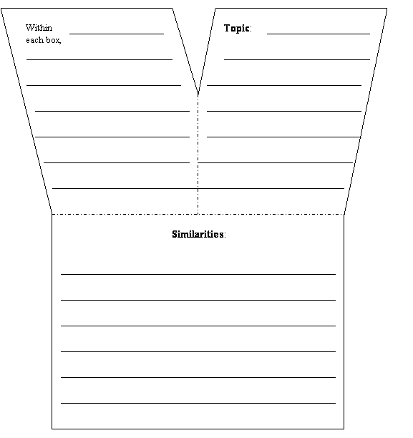
Another option: The Y chart
Differences
Similarities

Slide 41
Returning to…

Slide 42
Broad + narrow definitions = two domains to HL teaching
Linguistic needs
(narrow definition)
Affective needs
(broad definition)

Slide 43
HL learners’ linguistic needs are a function of:
The context of learning
The timing of learning
The amount input
The type of input

Slide 44
These variable give us insight as to what HL learners’ know
The context of learning: primarily, home
→ informal, home register, perhaps non-standard
The timing of learning: early years, diminished or discontinued upon starting school
→ features learned early in life (e.g. pronunciation, canonical gender)
The amount input: limited, relative to natives
→ incomplete knowledge of the HL (missing features are
those acquired later in life, e.g. subordination, academic registers)
The type of input: oral, informal, spontaneous,
→ implicit knowledge of the HL

Slide 45
Language Use | Native Speakers | Heritage Language Learners
Context | Full range of interaction outside the home | Typically confined to the home
Timing | Throughout childhood, life-long | Typically diminished in childhood
Amount | Abundant/sufficient | Limited
Type | Formal and informal, oral and written | Typically informal, oral

Slide 46
What this means for teaching: List of language topics to target
Features learned by native-speaking children later in life (e.g. structures associated with subordination, non-canonical gender, some aspectual features);
The formal/academic registers;
Literacy;
Vocabulary;
However, HL learners are not deficient native speakers.

Slide 47
These variables also are also predictive of proficiency
The context of learning;
The timing of learning;
The amount of input;
The type of input
Student A: Speaks Spanish at home to both parents, has traveled to his HL country and studied the HL in the US.
Student B: Spoke Spanish only to his mom and only until age 5, has not studied the HL.

Slide 48
What this means for teaching: Diagnostic assessment
Background questionnaires that probe these variables can help us sort students for purposes of placement and instruction.
Background questionnaires are an important tool for dealing with issues of diversity in classes that enroll HL learners.

Slide 49
Because life experiences vary from one individual to another…

Slide 50
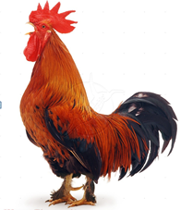
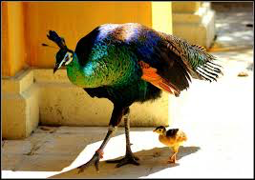
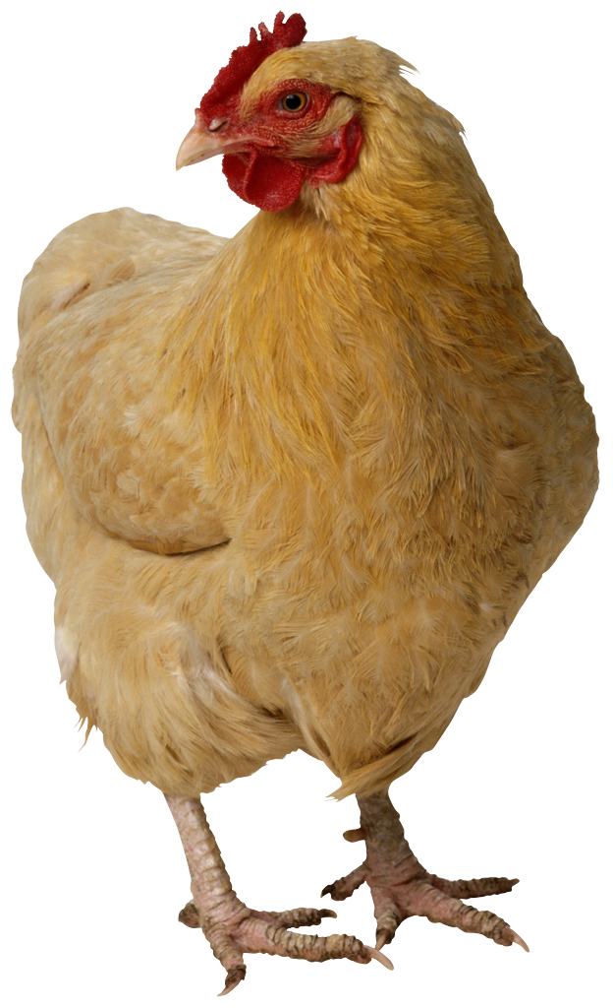
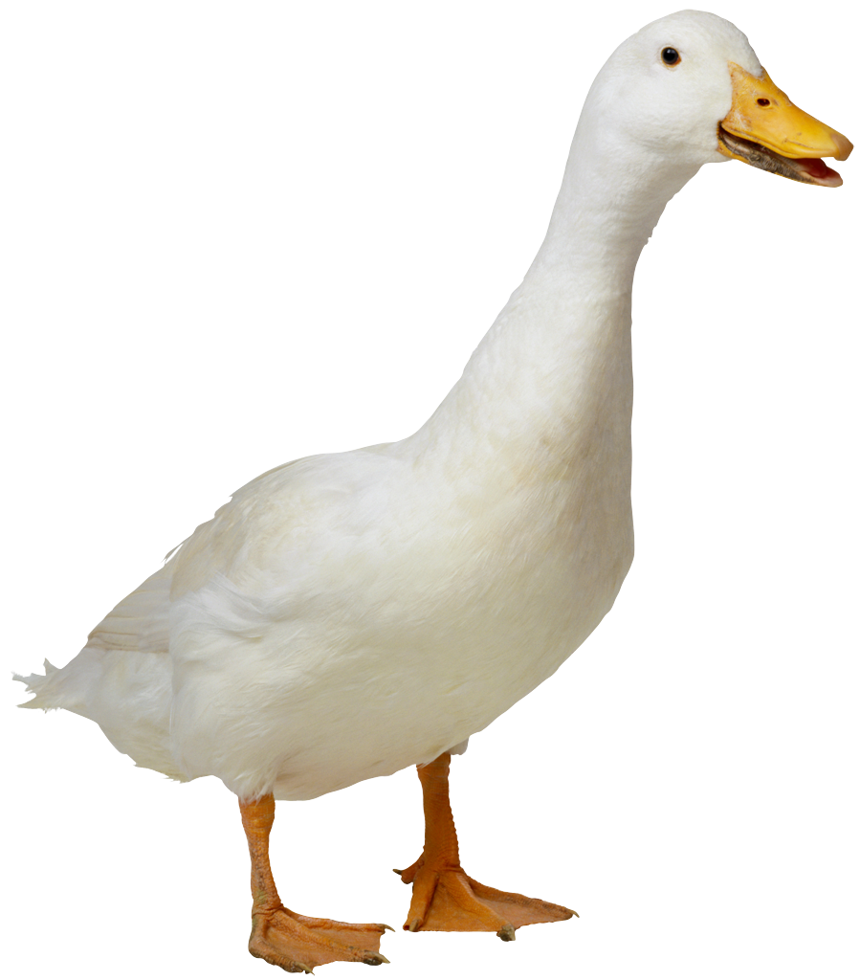

HL learners are a really diverse flock...

Slide 51
Problem: Many departments have fewer courses than needed
Course y
HLL
(intermediate+)
HLL
(novice+)
HLL
(intermediate-)
HLL (novice)

Slide 52
We need…
Classroom tools for responding to variation (be it in an HL class or a mixed class):
The mini-lesson for targeted assistance (+ agendas, anchoring activities)
Grouping for reciprocal learning

Slide 53

The mini-lesson
The teacher meets with a subset of the class to provide targeted instruction and practice.

Slide 54

But what about the rest of the class?
This is what we want them to do.

Slide 55

This is what they will do unless we manage them…

Slide 56
Tools for managing mini-lessons
Agendas
Anchoring activities

Slide 57
Agendas
What it is: A to-do list;
What it does:
Make it possible to vary pacing
Support mini-lessons / flexible grouping

Slide 58
Sample agenda from my class (an HL class)
Date due: (usually in 1-2 weeks)
Work to be completed:
• Workbook # 7, 8, 9, 10 (HOMEWORK)
• Textbook, read “xxxxx” and answer questions
1-7. Use a spell check. (HOMEWORK)
• Prepare a “Sum it up” card for this unit. (HOMEWORK)
• Blackboard, #1, 2. Must be completed with a
grade of 90% or better. (ONLINE EXERCISES, CENTER)

Slide 59
Agendas
What it is: A to-do list;
What it does:
Make it possible to vary pacing
Support mini-lessons / flexible grouping

Slide 60
Tools for managing mini-lessons
Agendas
Anchoring activities

Slide 61
Anchoring activities
What it is: A multi-step project or assignment that students work on over a period of time, individually or in small groups.
What it does:
Respond to learner interest.
Support mini lessons / flexible grouping

Slide 62
Anchoring activities
What it is: A multi-step project or assignment that students work on over a period of time, individually or in small groups.
What it does:
Respond to learner interest.
Support mini lessons / flexible grouping

Slide 63
We need…
Classroom tools for responding to variation:
The mini-lesson (+ agendas, anchoring activities)
Grouping for reciprocal learning

Slide 64
Mixed classes: Classes with HL and L2 learners
What we know about them (Carreira, 2014):
Are more common than HL classes for teaching HL learners;
Are designed and run like L2 classes
Instructional topics and tasks are selected with L2 learners in mind

Slide 65
Mixed classes are more common than HL classes
Disconnect: Most efforts in the field of HL languages (research, books, assessment tools, materials, etc.) are directed at HL classes, not mixed classes.

Slide 66
Mixed classes are designed and taught like L2 classes
• I did not give particular consideration to
HL—they are usually a very small segment of the
class.
(Name of book) does not address the needs of HL but it does a good job at the beginning level where the majority of our students take the (name of language) as a general language requirement and where we have less HL (15%) than at more advanced levels.

Slide 67
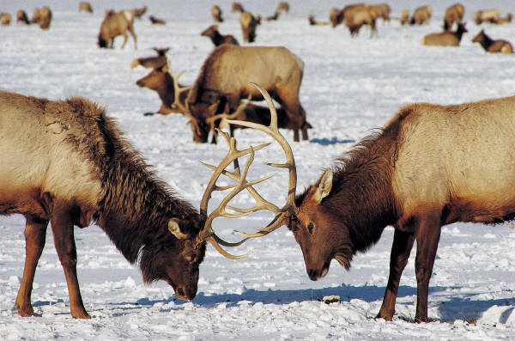
Mixed classes, as currently configured

Slide 68
Why this happens

Slide 69
Recall: What HL learners’ know
The context of learning: primarily, home
→ informal, home register, perhaps non-standard
The timing of learning: early years, diminished or discontinued upon starting school
→ features learned early in life (e.g. pronunciation, canonical gender)
The amount input: limited, relative to natives
→ incomplete knowledge of the HL (missing features are
those acquired later in life, e.g. subordination, academic registers)
The type of input: oral, informal, spontaneous,
→ implicit knowledge of the HL

Slide 70
Compare with what L2 learners know
• The context of learning: school
-> formal, standard, academic, rehearsed, controlled
• The timing of learning: adolescence, early adulthood
-> adult-like with respect to certain features
• The amount input: limited (relative to native speakers and HL
learners)
-> incomplete with respect to certain features (those acquired early in life)
• The type of input: formal, focused on form
-> explicit knowledge of rules

Slide 71
HL and L2 learners tend to have complimentary skills and needs
HL language
L2 language
• The context of learning: primarily, home
-> informal, home register, non-standard, spontaneous
• The timing of learning: early years, diminished or discontinued upon starting school
-> similar to the language of children
• The amount input: limited, relative to
natives
-> incomplete knowledge of the HL
(late-acquired items)
• The type of input: oral, informal, spontaneous
-> implicit knowledge of the HL
• The context of learning: shool
-> formal, standard, academic, rehearsed, controlled
• The timing of learning: adolescence, early
adulthood
-> adult-like with respect to certain
features
• The amount input: limited (relative to
native speakers and HL
learners)
-> incomplete with respect to certain
features (early acquired features)
• The type of input: formal, focused on
form
-> explicit knowledge of rules

Slide 72

Two perspectives of complimentary nature of HL and L2 learners’ knowledge

Slide 73
Two studies bring these perspectives into focus
Understanding heritage language learners

Slide 74
Two studies of paired interactions between HL and L2 (Bowles 2011, 2012)
HL and L2 learners were matched for proficiency;
They worked together on an information gap activity;
In the first study learners benefited more from the activity than HL learners;
In the second study, both types of learners benefited equally from the activity.

Slide 75
First study: L2 learners benefited more from the activity

Slide 76
Second study: Both learners benefited from paired interactions

Slide 77
What made the difference?
Material + task
HL learners are better at tasks that tap into intuitive use of language, L2 learners, on the other hand, do better at tasks that require meta-linguistic knowledge (knowledge of rules);
HL learners are more familiar with home vocabulary; L2 learners, on the other hand, are more familiar with academic vocabulary

Slide 78
First study: Only L2 learners benefitted
Information gap activity with a picture of a kitchen (home vocabulary)
All tasks were oral;
HL learners already knew this, so they did not gain new knowledge. L2 learners benefitted from HL learners’ expertise.

Slide 79
Second study
Information gap activity with a picture of an office; Oral and written tasks.
Vocabulary was unknown to both learner types, so both benefitted.
Oral task benefitted L2 learners. Written task benefitted HL learners.

Slide 80
Take home lesson about HL + L2 pairings
Take advantage of complimentary strengths of HL and L2 learners
Mix tasks that require intuitive knowledge (hard for L2Ls), and tasks that require meta-linguistic knowledge (hard for HLLs);
Hold both students accountable for contributing to the task (assign the harder task to each type of learner);

Slide 81
Two examples of activities that take advantage of HL and L2 learners’ complimentary skills

Slide 82
Example 1: A cloze activity with HL-L2 learner groupings
My great-grandmother. I ______liked to have known her, a wild, horse of a woman, so wild she ________ marry. Until my great-grandfather _________ a sack over her head and ________ her off. Just like that, as if she ________a fancy chandelier. That's the way he did it. And the story goes she never forgave him. She _________ out the window her whole life, the way so many women sit their sadness on an elbow. I wonder if she _______the best with what she got or was she sorry because she ________be all the things she wanted to be.
Say it | Write it

Slide 83
Example 2: An anchoring activity
The Abuelos Project (Roca and Alonso, n.d.);
Interviewing an older person and preparing a written version of the interview;
Step 1: The HL and L2 learners work on the questions together;
Step 2: The L2 learner conducts the oral interview and the HL learner takes notes;
Step 3: The HL learner transcribes the interview.
Step 4: The learners work together to edit the final version.

Slide 84
In sum: Flexible grouping is a powerful tool for responding to variation
Homogeneous groupings
The mini-lesson (agendas, anchoring activities)
Heterogeneous groupings
Reciprocal/collaborative learning

Slide 85
Why it matters
Demographics;
How it differs from L2 teaching
Heritage language learners;
The big ideas or essence of HL teaching;
General principles and some specific tools
Closing: The possibilities

Slide 86
Before looking at the possibilities
The big ideas or essence of HL teaching;
Two domains of HL teaching: Language and socio-affective issues (text connections, exit cards, T-charts);
Life experiences are predictive of proficiency (linguistic autobiographies and surveys);
Because life experiences vary, HL learners can be very linguistically diverse;
Tools to attend to diversity: Homogeneous groupings for mini-lessons, (agendas, anchoring activities), heterogeneous groupings for reciprocal learning.

Slide 87
Why it matters
Demographics;
How it differs from L2 teaching
Heritage language learners;
The big ideas or essence of HL teaching;
General principles and some specific tools
Closing: The possibilities

Slide 88
Possibilities: The payoff
Youth from immigrant backgrounds who know both English and their HL are more likely to
graduate from high school
go on to college
enter higher status occupations
have more social networks
(Patricia Gándara, 2015, http://onlinelibrary.wiley.com/doi/10.1002/ets2.12054/full)

Slide 89
Children of immigrants today are coming of age in a majority-minority era. Their linguistic and cultural caché is becoming normative, and employers increasingly prefer employees who can reach a wider client base and work collaboratively with colleagues across racial, ethnic, and cultural lines. The new economy calls for a multilingual approach to educating America's children, and the evidence now suggests that these young multilingual individuals will be well rewarded in the future for this human capital that they bring to school and to the labor market. (Gándara, n.p.)

Slide 90
Against this backdrop, HL teaching and learning emerge as singularly important to immigrant youth, The future of the US, Our profession

Slide 91
Gracias! Maria.carreira@csulb.edu

Slide 92
Stop here

Slide 93
Curriculum Design and Classroom Applications for Teaching Heritage Languages
Maria M. Carreira, Ph.D.
California State University, Long Beach
National Heritage Language Resource Center, UCLA

Slide 94
Overview of this workshop
Managing and leveraging learner diversity;
Formative assessment;
Curriculum and syllabus design; sequencing instruction;
Scaffolding

Slide 95
Warm up activity: Choose from one of the following
Write up one or two questions/concerns that you have about HL teaching.
Answer the following Text-to-self connection:
One idea that caught my attention from the
last presentation was:
Post your contributions on your designated wall space.

Slide 96
What was the point of that?

Slide 97
Attending to issues of diversity
Flexible grouping;
Creating a community of learners;
Other uses?

Slide 98
Other tools
Visual checks for understanding;
The KWL chart

Slide 99

Checks for understanding
What it is:
All students respond to a prompt using hand signals (e.g. thumbs up/down) or flashing a sign (e.g., true/false; a,b,c,d)

Slide 100
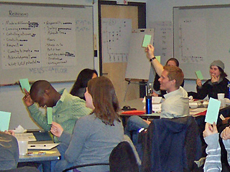
Tips
Give students time to prepare their answer;
On the count of three, ask them all to respond.

Slide 101
Checks for understanding
What it is:
All students respond to a prompt using hand signals (e.g., thumbs up/down) or flashing a sign (e.g., true/false; a,b,c,d).
What it does:
Engages all learners in answering questions and provides immediate and comprehensive feedback to the instructor and individual learners.

Slide 102
The KWL chart
What I know about the (fill in a grammar topic, or a chapter objective):
What I want to learn about (the above grammar topic or chapter or chapter objective):
What I have learned about (the above grammar topic or chapter or chapter objective):

Slide 103
The KWL chart
What it does:
For the instructor:
Functions as a diagnostic tool to guide instruction;
For the students:
Helps them reflect on their own learning needs and goals for a given instructional topic;
For the class:
Fosters learner independence and inter-dependence;

Slide 104
checks For understanding and the KWL Chart are a FORM of formative assessment

Slide 105
Overview of this workshop
Managing learner diversity;
Formative assessment;
Curriculum and syllabus design; sequencing instruction;
Scaffolding

Slide 106
Assessment
Diagnostic (pre-instruction)
Placement tests
Formative (during instruction)
Assessment for learning
Summative (post instruction)
Assessment of learning

Slide 107
What is formative assessment?
 | Formative assessment | Summative assessment
Purpose | To improve instruction and provide feedback to students | To measure student competency
When administered | Ongoing, throughout unit | End of unit or course
How teachers use results | To check for understanding, modify their own teaching to enhance learning | For grades, promotion
How students use results | To self-monitor understanding; Identify gaps in understanding and strengths | To monitor grades and progress toward benchmarks
How programs use results | To modify the curriculum and program | To report to external entities
Adapted from Checking for Understanding. Formative Assessment Techniques for Your Classroom by Douglas Fisher and Nancy Frey, ASCD, 2007

Slide 108
How to do formative assessment
Almost any pedagogical activity can function as
formative assessment… What makes it formative is HOW you use it.
Exit cards
e.g. Use the information obtained from exit cards to group students by needs/review a point

Slide 109
How to do formative assessment (cont.)
Checks for understanding
e.g. Use the information obtained to adjust the pacing of instruction.
Quizzes, Homework
Debriefing: reviewing tests and quizzes in class to identify effective study strategies, debating the merits of different answers, or making specific connections between the material and the larger goals of instruction.

Slide 110
How Formative Assessment enhances the potential for learning

Slide 111
Formative assessment: Instructors
Makes it possible for instructors to revise their teaching as needed to attend to the needs of all learners;
Sample remedial actions teachers can take from the information obtained through formative assessment:
If the whole class is not understanding ➔ provide additional instruction and/or practice to all
If only some of the students are not understanding ➔ give those students a mini-lesson while the rest of the class works on their agenda or on center activities

Slide 112
Formative assessment: Students
Teaches students to manage their own learning by helping them answer the following questions:
where am I going?
where am I now?
how can I close the gap?
In so doing, students acquire a roadmap of learning
(Black and Jones, 2006)

Slide 113
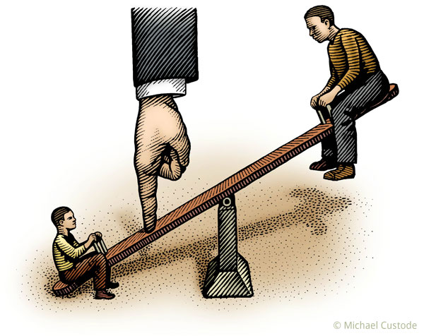
Formative assessment
Addresses issues of fairness and access arising from institutional conditions

Slide 114
Recall: Many departments have fewer courses than needed
Course Y
L2L
(novice+)
HLL
(novice+)
HLL
(intermediate-)
HLL
(novice)

Slide 115

Discussion: How do you assign a grade to these students and
• Maintain standards
• Address issues of fairness

Slide 116
Formative assessment: Fairness
For instructors: Enables them to respond to the needs of all learners, particularly those who are struggling with the material;
For students: Encourages metacognition and independence; previews summative assessment, thereby improving their chances of performing well;
For programs: Provides the knowledge base for effective curriculum and program design.

Slide 117
Overview of this workshop
Managing learner diversity;
Formative assessment;
Curriculum and syllabus design; sequencing instruction;
Scaffolding

Slide 118
The general idea

Slide 119

Don’t…

Slide 120
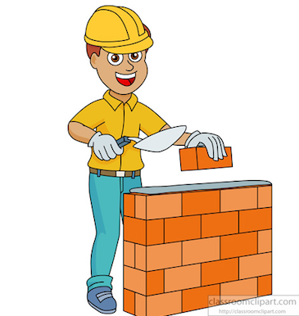
Do…build on what they know

Slide 121
The Five “FROM-TO” Principles (Kagan, 2015)
listening | ➔ | reading
speaking | ➔ | writing
home-based register | ➔ | general/academic register
everyday activities | ➔ | in-class activities
motivation + identity | ➔ | content

Slide 122
The “From-To” principles and Vygotsky’s theory of learning.
Learning takes place when learners are in their Zone of Proximal Development (Vygotsky, 1978).
The ZPD is the difference between what a learner can do independently and what he or she is capable of doing with targeted assistance (scaffolding).

Slide 123
ZPD: The Goldilocks effect
Aiming too high: Overwhelm students
LEARNING
Aiming too low: Underwhelm (bore) students

Slide 124
Let’s practice

Slide 125
The Five “FROM-TO” Principles (Kagan, 2015)
listening | ➔ | reading
speaking | ➔ | writing
home-based register | ➔ | general/academic register
everyday activities | ➔ | in-class activities
motivation + identity | ➔ | content

Slide 126
1. Listening ➔ Reading
Listening to a news story ➔
Reading a newspaper account of same event
Listening = scaffolding for the reading activity by providing the necessary content knowledge & vocabulary

Slide 127
2. Speaking ➔ Writing
Telling a friend what you plan to cook for dinner ➔
Write a shopping list

Slide 128
3. Home-based register ➔ General/academic register
Describe your career goals to a friend ➔
To your parents;
To a school counselor
In an application to college;

Slide 129
4. Everyday activities ➔ In-class activities
Watching a television show or participating in a cultural event ➔
In-class activity that requires writing a formal review of the show or event.

Slide 130
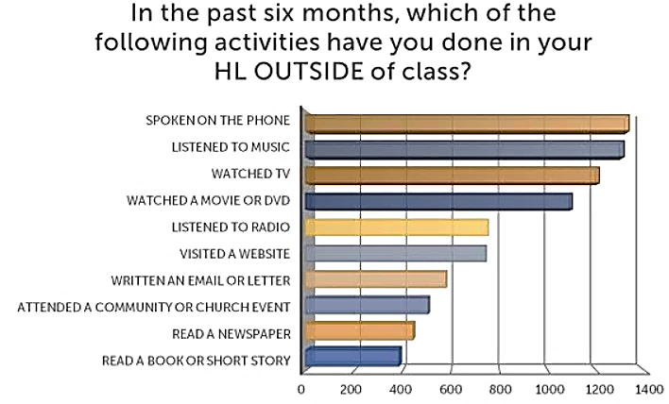
4. Everyday activities ➔ In-class activities

Slide 131
Does this mean that very difficult tasks such as reading technical or literary pieces or giving a formal presentation are not to be attempted?

Slide 132
Overview of this workshop
Managing learner diversity;
Formative assessment;
Curriculum and syllabus design; sequencing instruction;
Scaffolding

Slide 133
As a general rule, the more difficult the task, the greater the need for scaffolding.
Scaffolding tasks for reading;
Scaffolding tasks for speaking;
Scaffolding tasks for writing;

Slide 134
Scaffolding for grammar?

Slide 135
How many times has this happened to you?
You want to practice the past tense…
You ask students…What did you do last night?
The L2 learner answers…
I studied, I had dinner, I talked to my mom…
The HL learner answers…
Oh, I don’t know – not much, I’m always tired in the evening. I prefer to work early in the morning.

Slide 136
HL and L2 learners approach learning tasks in very different ways
A study by Julio Torres found that:
HL learners are oriented primarily to the content of the task – i.e. are concerned with interpreting the meaning of the prompts rather than learning language ( grammar).
L2 learners focus on form. In this particular study, they recognized that the task presented contrasting forms of the subjunctive and indicative.

Slide 137
In short:
“HLLs processed the input provided by the task as authentic content rather than directing their attention to establishing new form-meaning connections” (Torres, 2013).

Slide 138
Put differently: HL learners have performative competence
They ”…adopt a functional orientation to communication and meaning. They focus more on the functions performed through communication…What is important …is the ability to perform (Canagarajah, 2014)

Slide 139
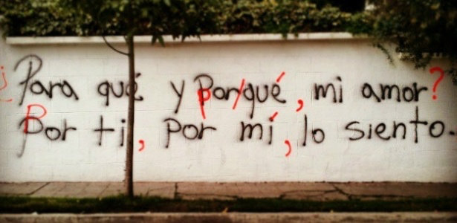
A picture is worth a thousand words

Slide 140
Why does this happen?
HL and L2 learners approach classroom instruction differently;
HL learners approach language like “normal” people;
L2 learners approach language like language teachers and textbooks. They are experienced learners.

Slide 141
What does this mean for HL teaching?
We need to scaffold grammar instruction for HL learners…
Give HL learners a map of learning: Point out what you’re doing and why you’re doing it;
Give HL learners the grammatical terminology they will need to follow instruction.

Slide 142
A map of learning: Unpack the learning objectives
In this unit, you should focus on the past tense (preterit and imperfect).
In particular, I will need to know how to (1) conjugate irregular verbs, (2) spell the verbs on the list, and (3) understand the rules that govern the use of the preterit and the imperfect.

Slide 143
Teaching grammatical terminology
Two ways of talking about the past
Preterit
(comí, hablé,viví)
Imperfect
(comía, hablaba, vivía)

Slide 144
In short…
This kind of “form-focused scaffolding” makes it possible for HL learners in a mixed class to derive benefit from traditional form-focused instruction and to work alongside L2 learners.

Slide 145
Overview of this workshop
Managing learner diversity (flexible grouping, checks for understanding, the KWL chart);
Formative assessment;
Curriculum and syllabus design; sequencing instruction (the 5 From-to Principles, Vygotsky’s ZPD);
Scaffolding (scaffolding form-focused instruction)

Slide 146
Closing activity
Remove your post-it, if your question has been answered.

Slide 147
New questions?
Comments?
Suggestions?

Slide 148
Gracias!

