Slide 1
Study Abroad and the Community College
Dr. Mary Ellen Eckhert
and
Dr. Lynn Vogel-Zuiderweg

Slide 2
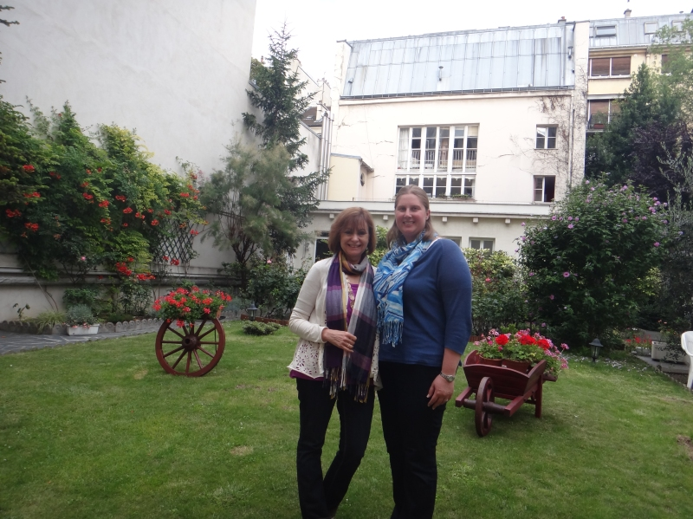




Whether spending a summer in glorious Paris…,
East Los Angeles College

Slide 3

…or tripping the light fantasic in fabulous Madrid…,
Plaza Mayor

Slide 4
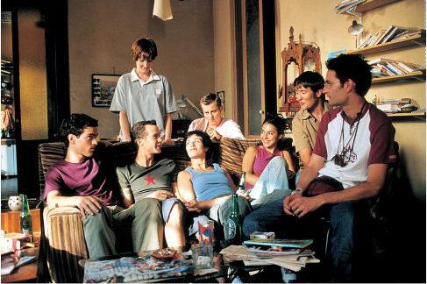


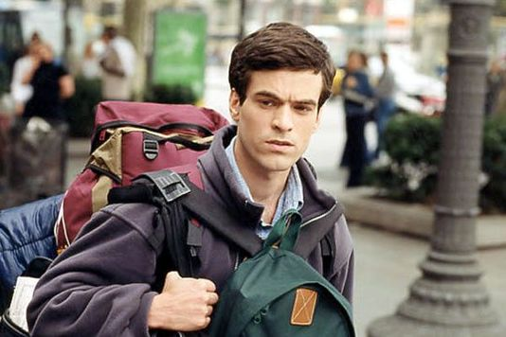
…or living together in Barcelona in “una casa de locos”…,
L’auberge espagnole
L’auberge espagnole

Slide 5



…or perhaps venturing to Japan, China or Vietnam…,
Vietnam
China

Slide 6
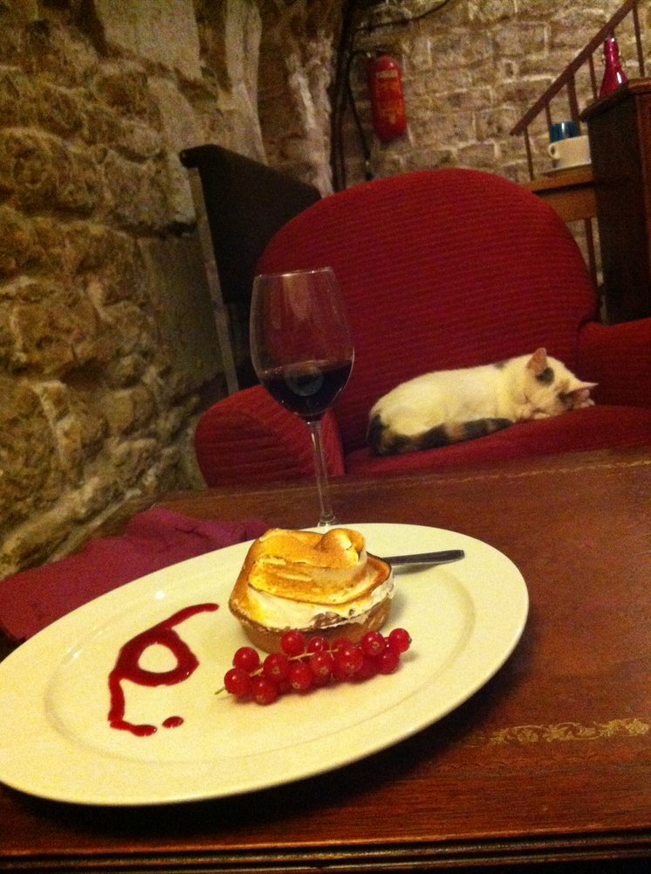

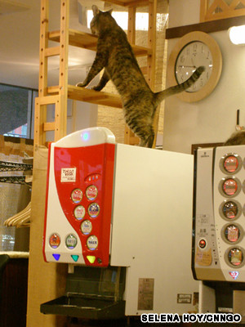




…or just following that dream….,
Paris
Tokyo

Slide 7


What language teachers know better than anyone else is that nothing changes lives like living and studying abroad.

Slide 8

The East Los Angeles College Experience
2007: Study abroad, as we understand it, is not happening on our campus; a few brave teachers are leading EF study tours to France, Spain and Italy, but there are no programs for college credit.
2008: An adjunct instructor convinces the department chair to launch a program in Paris – something our college had given over to Pierce College in 1998 when the LACCD lost its Institute of International Programs due to budget cuts.
July 2008: Three students accompany the instructor to Paris with ESA. (Oh, by the way, our dean is not very happy about paying an instructor to lead three students to Paris – those elitist French teachers, you know….)

Slide 9

Is this a bust or a beginning???
2009: Miraculously, our dean lets us try again. This time, our hard-working adjunct recruits 25 students. We’re off and running!
2010: The program is seriously threatened by interdepartmental grumbling about too many summer units for French, but we manage to send our adjunct again with a group of over 30 students. We’re warned, however… next year’s program will be to Japan out of fairness to our department full-timers, who now have priority over adjuncts.
2011: Japanese requests to defer their program another year, but Paris still hangs in the balance. We throw a “Hail Mary” pass to our new-hire full-timer in French and Spanish, who agrees to lead the program and evaluate it.

Slide 10




Earn credit for studying abroad!
French
Spanish
Italian
Japanese
Chinese

Slide 11

Financial Aid!
Use financial aid to help finance study abroad!
Scholarship Opportunities!

Slide 12

Be Proactive!
Study Abroad Task Force!
CCIE

