Slide 1
Classifying Scientific Paper by Text Mining & Clustering
Zihu Xu, Jingru Wang, Haimeng Wang

Slide 2
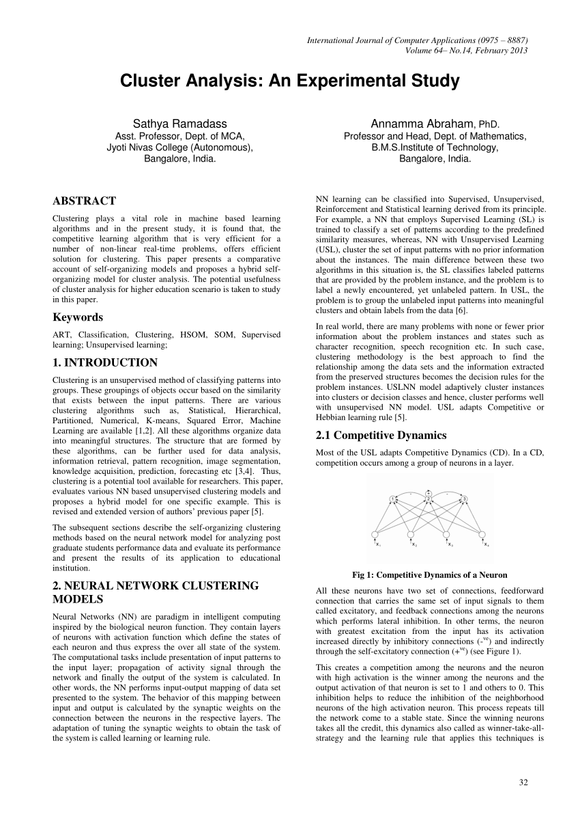
Goal of this Project
The goal of this project is to know the research trend all around world and cluster scientifical papers based on theirs abstract.
By using clustering for labelling in combination with dimensionality reduction for visualization, the collection of papers can be represented as a scatter plot. On this plot, papers of highly similar topics will share a label and will be plotted near each other.

Slide 3
We try to find meaning in the clusters by using topic modelling to find the keywords of each cluster. This can help to find publications with similar research backgrounds and to compare similar research and publications.

Slide 4
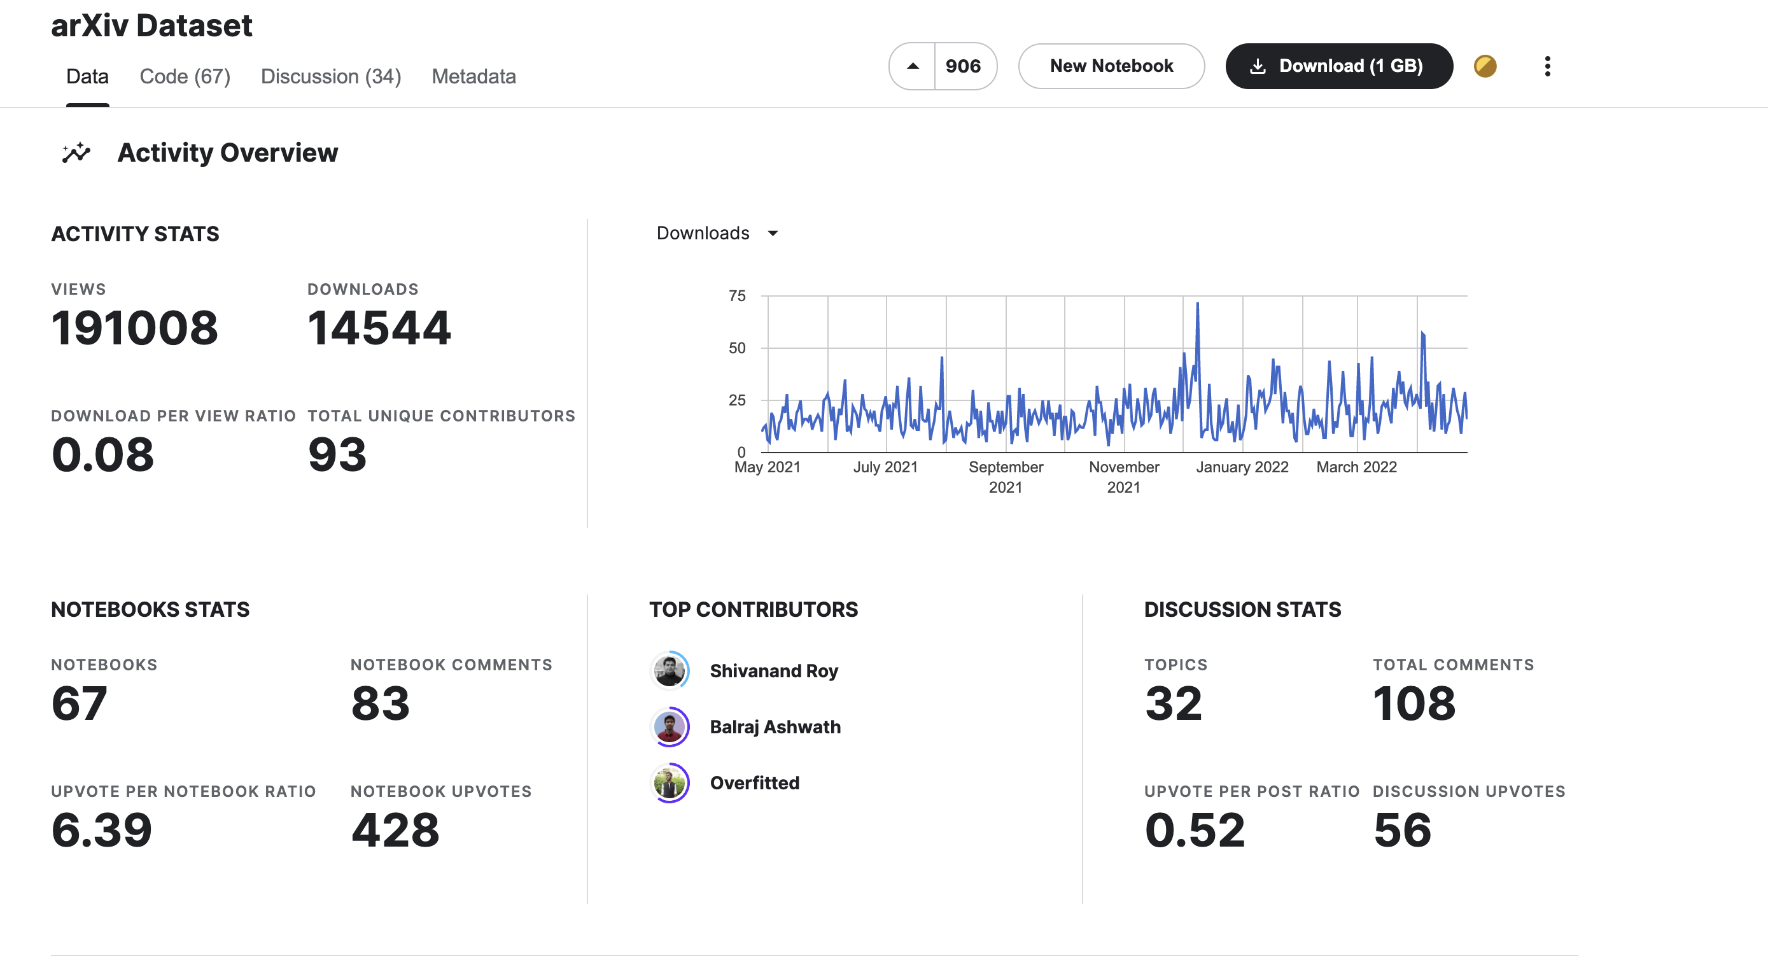
About the ArXiv dataset:
For nearly 30 years, ArXiv has served the public and research communities by providing open access to scholarly articles, from the vast branches of physics to the many subdisciplines of computer science to everything in between, including math, statistics, electrical engineering, quantitative biology, and economics. This rich corpus of information offers significant, but sometimes overwhelming depth. In these times of unique global challenges, efficient extraction of insights from data is essential.

Slide 5
Methods to be used
1. Do Exploratory Data Analysis(EDA) to the data
2. Use DocumentTermMatrix() to create word frequency matrix for text from the abstract in each document
3. Use tm to apply N-grams to the text in abstract and compare it with dtm
4. Use Principal Component Analysis (PCA) to reduce the dimension
5. Apply k-means clustering to our dataset and pick the optimal k
6. Finally visualize clusters through scatterplot

Slide 6
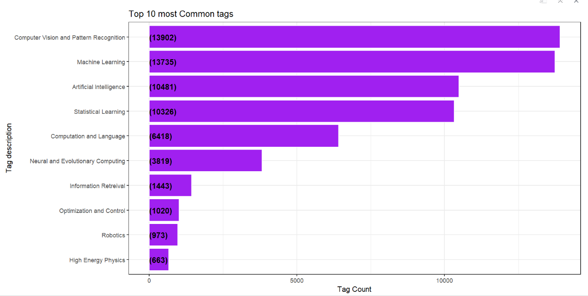
Exploratory Data Analysis
try to know the research trend in the computer science all around the world.
Top 10 Most Common Tags
Data from papers published between 1992 to 2018-Feb. (about 45,000 papers)

Slide 7
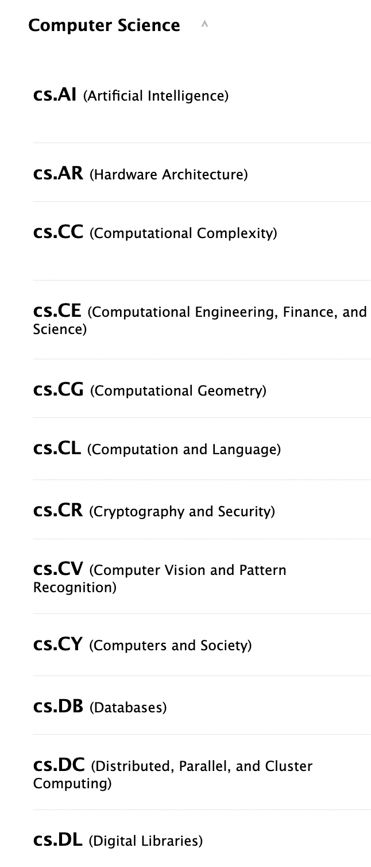
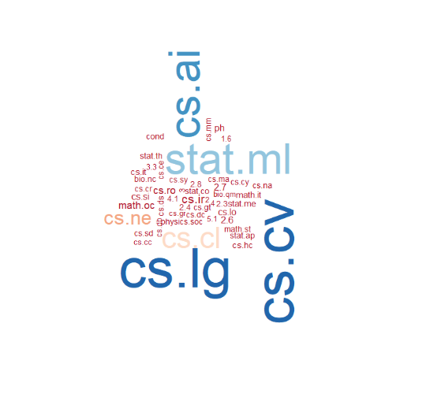
Word Cloud: top 50 common paper
https://arxiv.org/category_taxonomy

Slide 8
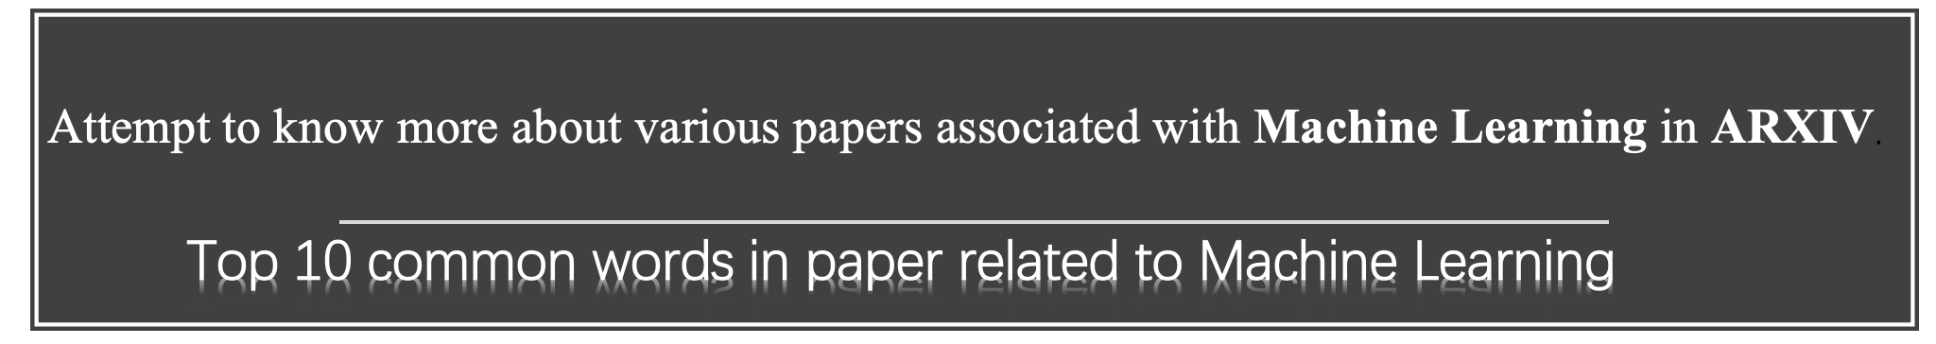
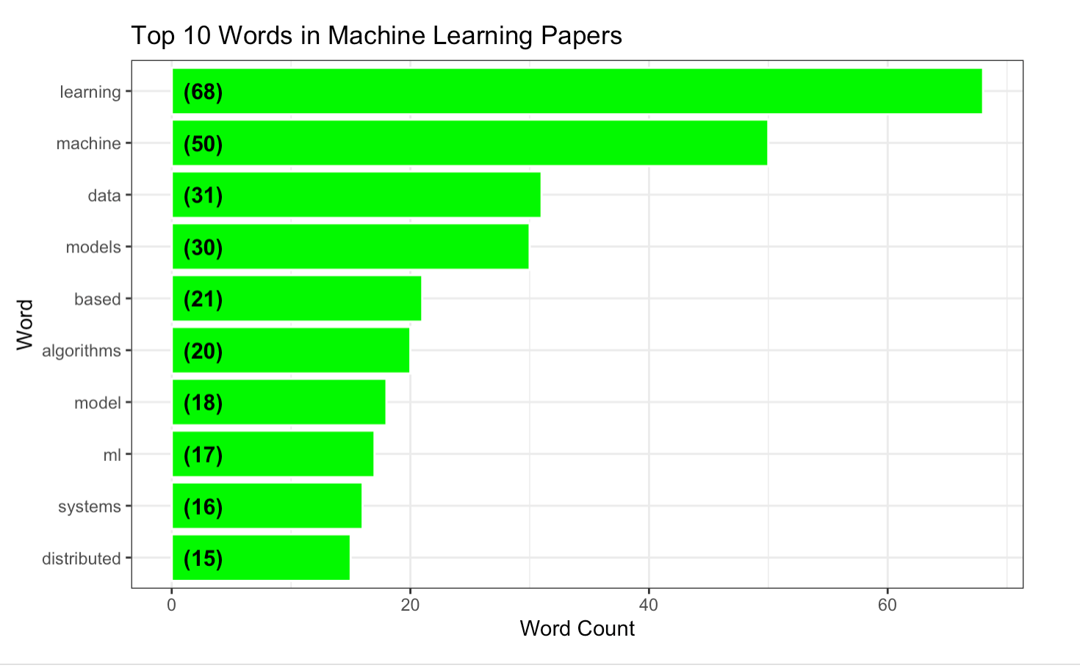
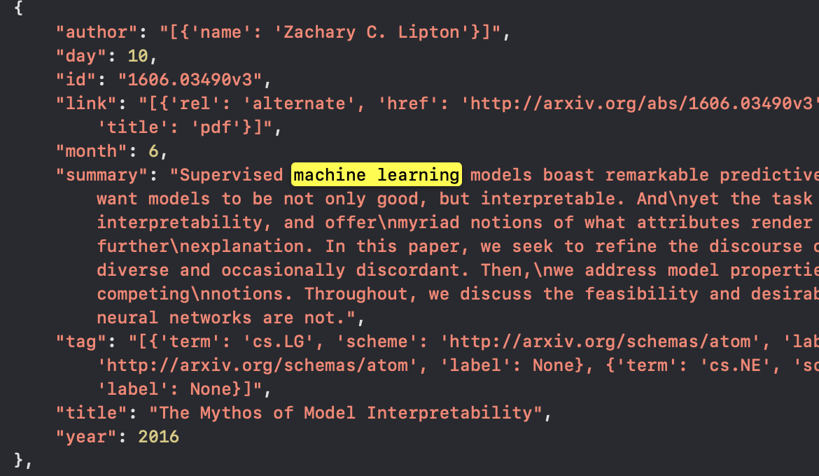
Top 10 common words in paper related to Machine Learning
Attempt to know more about various papers associated with Machine Learning in ARXIV.

Slide 9
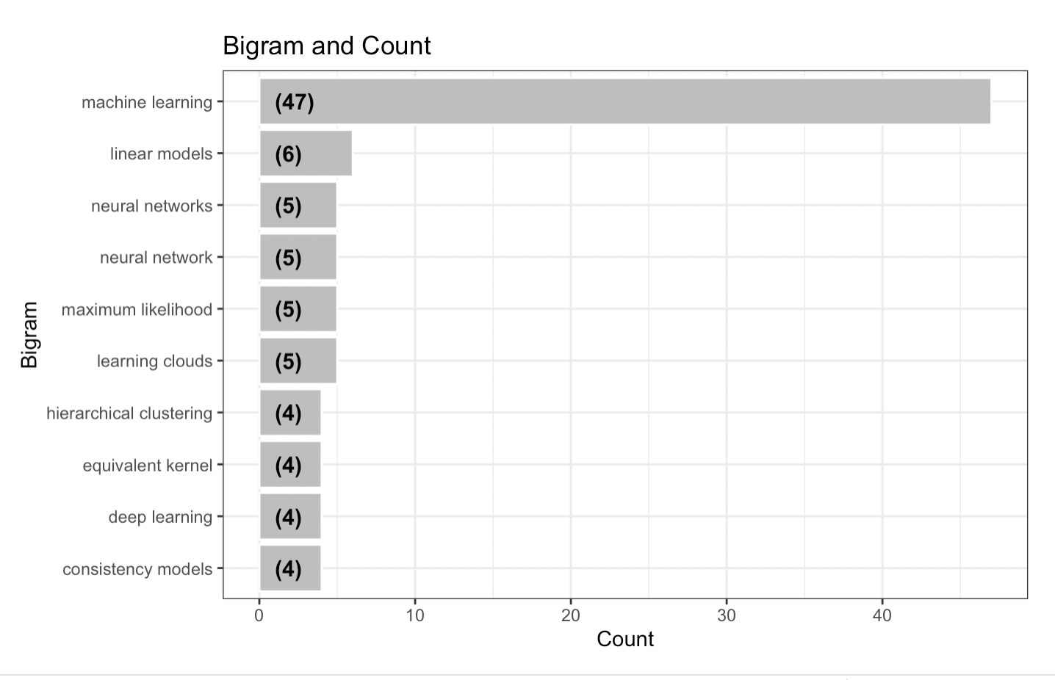
Top 10 common bigrams in paper related to Machine Learning
A Bigram is a collection of two words.
The Bigrams are investigated using the Summary of each papers in Machine Learning.

Slide 10
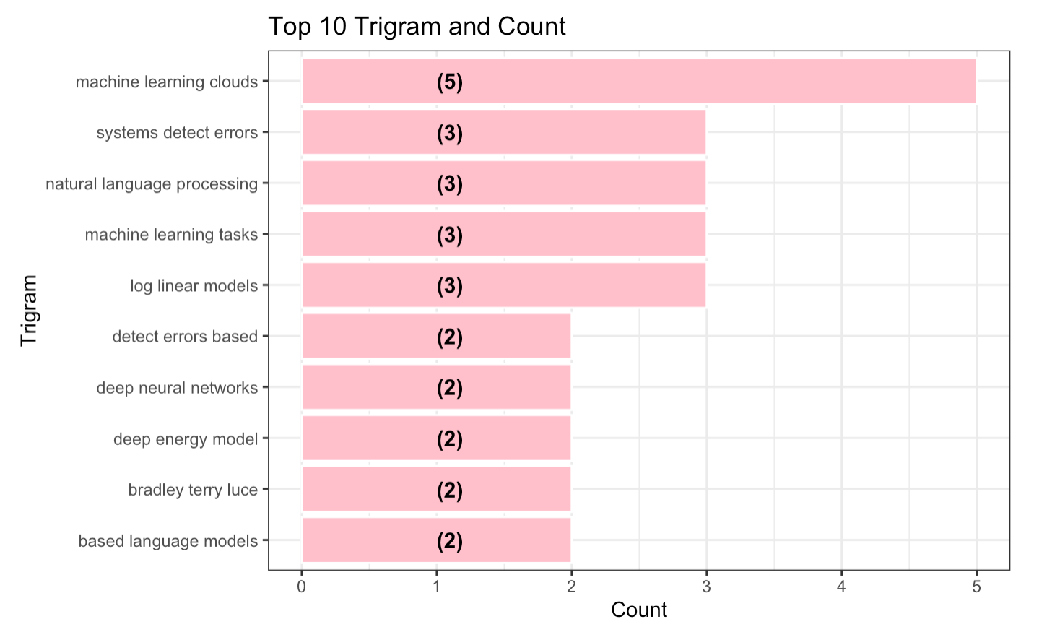
Top 10 common trigrams in paper related to Machine Learning
A Trigram is a collection of Three words.
The Trigrams are investigated using the summary of each paper in Machine Learning

Slide 11
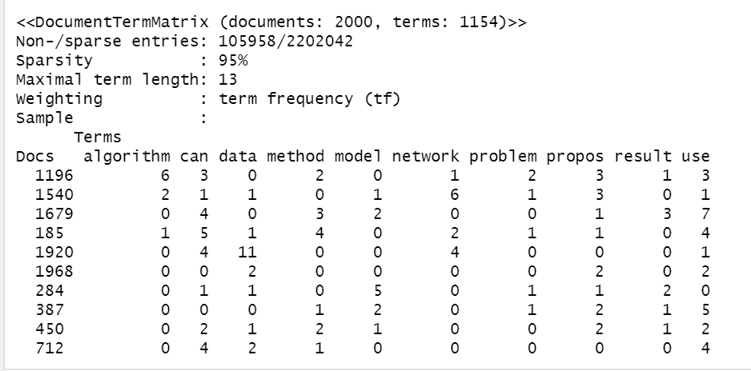
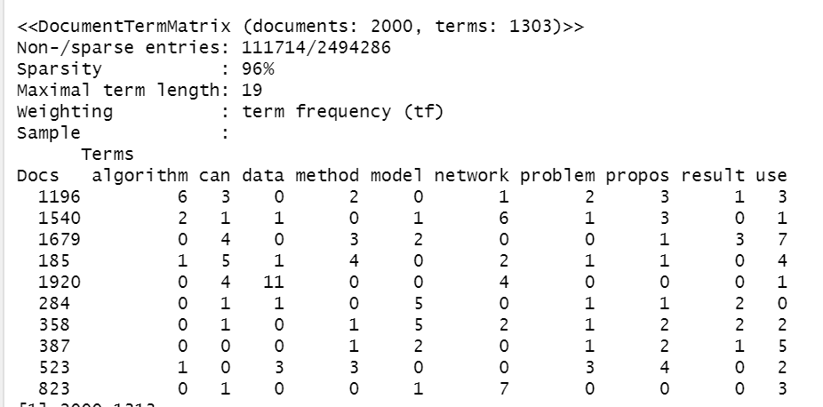
Document Term Matrix vs N-gram

Slide 12
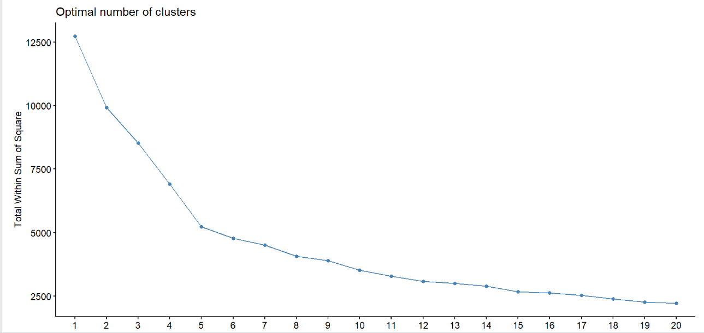
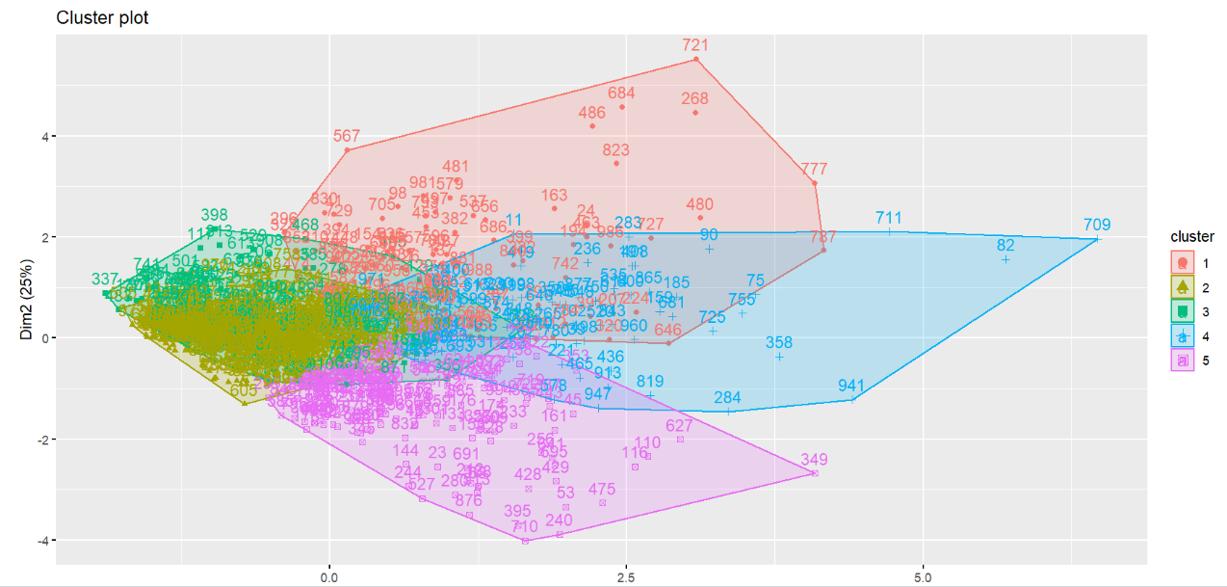
PCA and Clustering for DTM
Notes:
We first perform PCA for the tf-idf matrix. And we want to use the result of PCA to perform k mean clustering. Since we did nlp in two different method, we will perform PCA and wss method of clustering on them separately. We can see from the graph the error decline fast from 1 to 5, and then go steady. So the choose 5 as the group size.

Slide 13
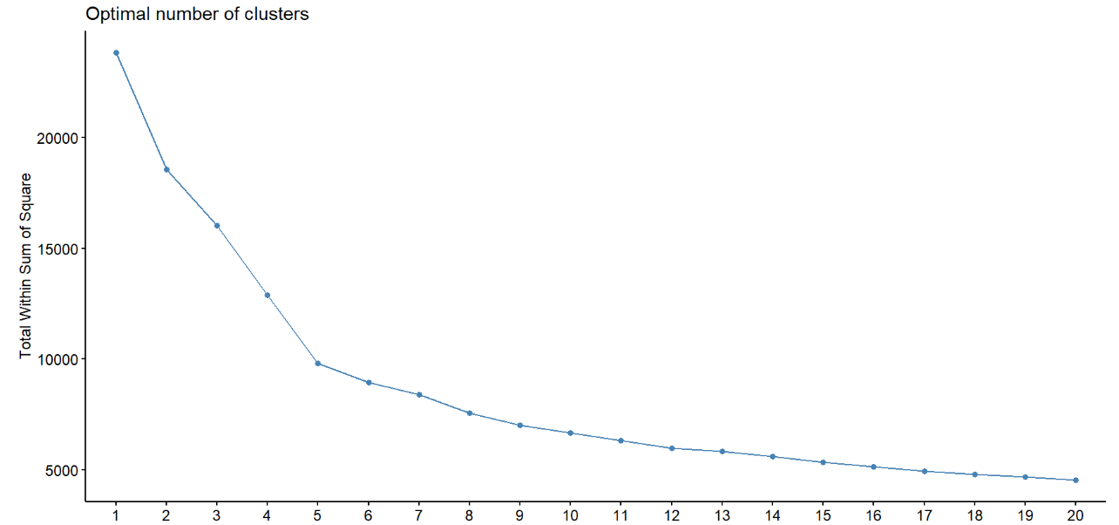
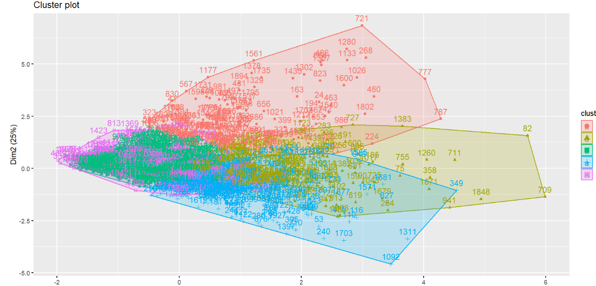
PCA and Clustering for Ngram
Notes:
We repeat the same process for ngram. Here we can see the error pattern is quite similar as the previous one. So we confirm the size of clustering is 5.

Slide 14
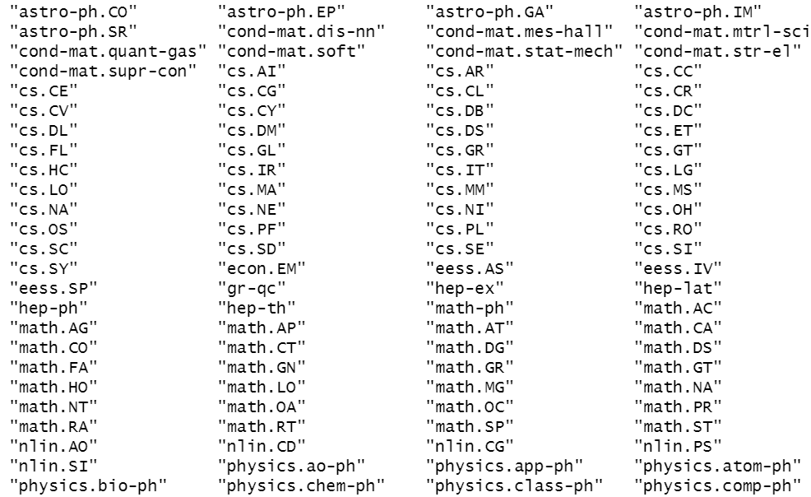
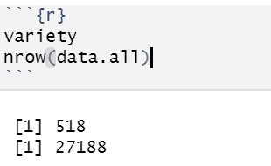
Analysis of the whole dataset

Slide 15
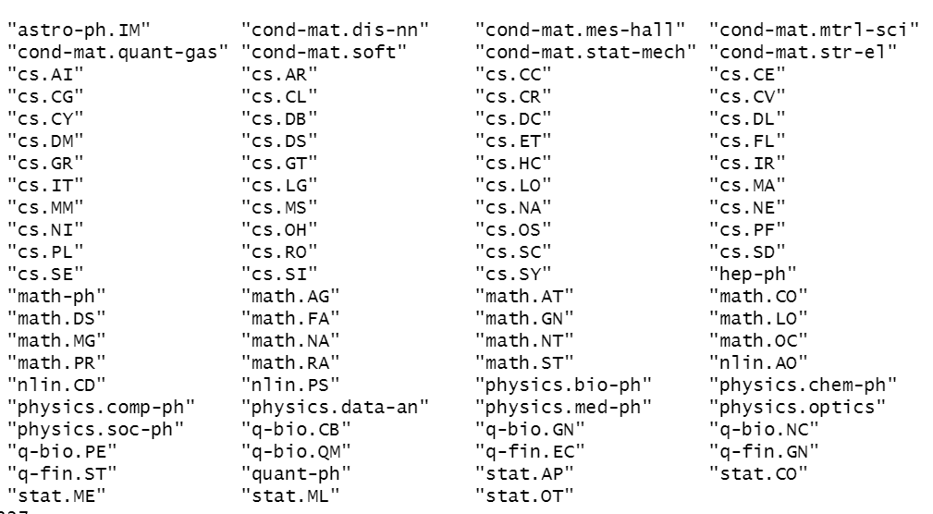
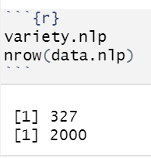
Analysis of NLP data

Slide 16
Conclusion
The labeled plot gives insights of how the papers are grouped. It is difficult to say which dimension reduction performs better for this data. The performance would have to be evaluated in further steps.
The label (colors) of each paper on the plot was determined by k-means. If we look at a particular parts of the plots, it is likely that k-means is uniform in the labeling of this cluster.
In other cases the labels (k-means) are more spread out on the plot. This means that k-means found differences in the higher dimensional data.
This could be because certain contents in the papers overlapping, so it's hard to clearly separate them. This effect can be observed in the formation of subclusters on the plot.
The algorithms may find connections that were unapparent to humans. This may highlight hidden shared information and advance further research.

