Slide 1
Stroke Prediction and Prevention
Zhuoyun Wang
Mudan Chen
Jinmeng Liu

Slide 2
Agenda
Case Background
Motivation
Goal of the case study
Data Description
Data Manipulation
Exploratory Data Analysis
Model Description and Comparison
Logistic, Logistic with Lesso, SVMs, Tree, Random Forest, XGBoosting
Summary
Model Comparison & Findings
Limitations & future improvements

Slide 3

Case Overview and Data Summary
Presenter: Zhuoyun Wang

Slide 4
Case Background
Motivation
Stroke is a disease that affects arteries leading to and within the brain
Occurs when a blood vessel that carries oxygen and nutrients to the brain is blocked
Once symptoms start, there's only a tiny window of time (around 3-4 hours) for stroke victims to get life-saving treatment
No. 5 cause of death and a leading cause of disability in the US
Goal
Given people's demographic features and medical history, find a model with the best prediction power to help with stroke prediction and prevention

Slide 5
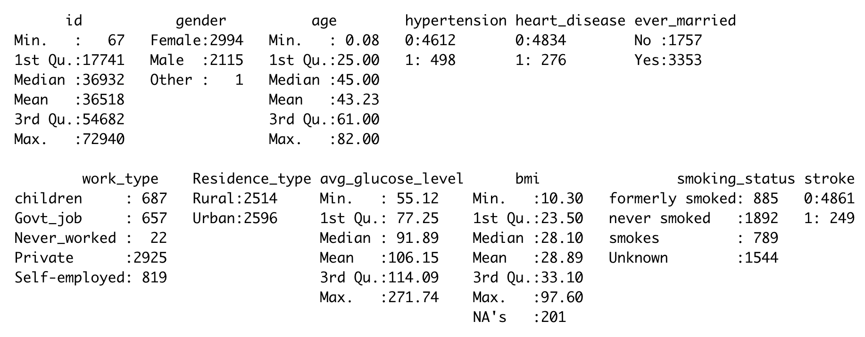
Data Manipulation

Slide 6
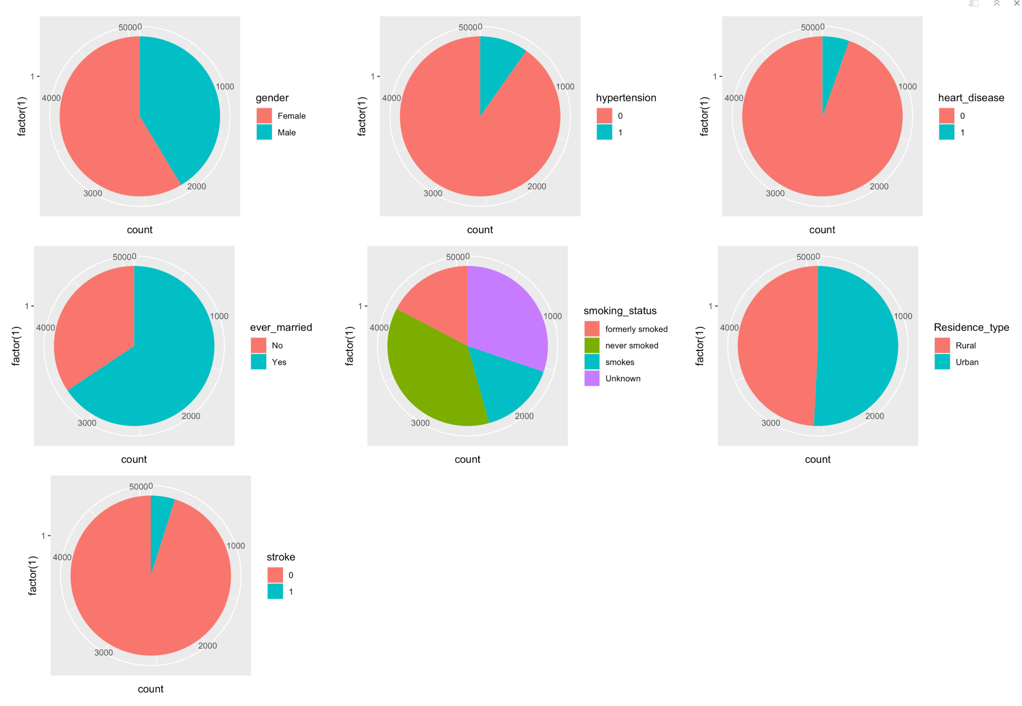
Exploratory Data Analysis

Slide 7
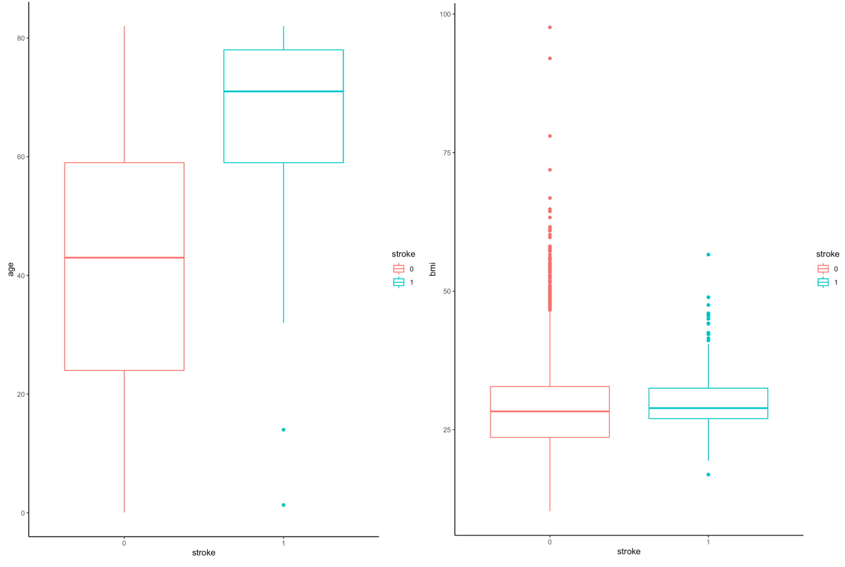
Exploratory Data Analysis
chi-square p-value
age
bmi
Stroke
Stroke

Slide 8
Model Description and Comparison
Presenters: Mudan Chen & Jinmeng Liu

Slide 9
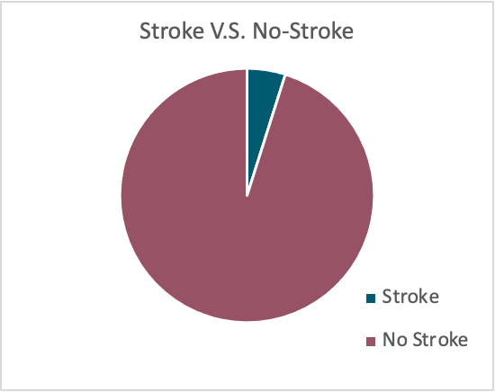
Unbalanced Response Variables
Stroke | 249
No Stroke | 4861

Slide 10
Up-Sampling V.S. Down-Sampling
Up-sampling: samples with replacement to make the class distributions equal.
Stroke | 4860
No Stroke | 4860
Down-sampling: randomly samples from the majority class to achieve the same frequency as the minority class.
Stroke | 249
No Stroke | 249

Slide 11
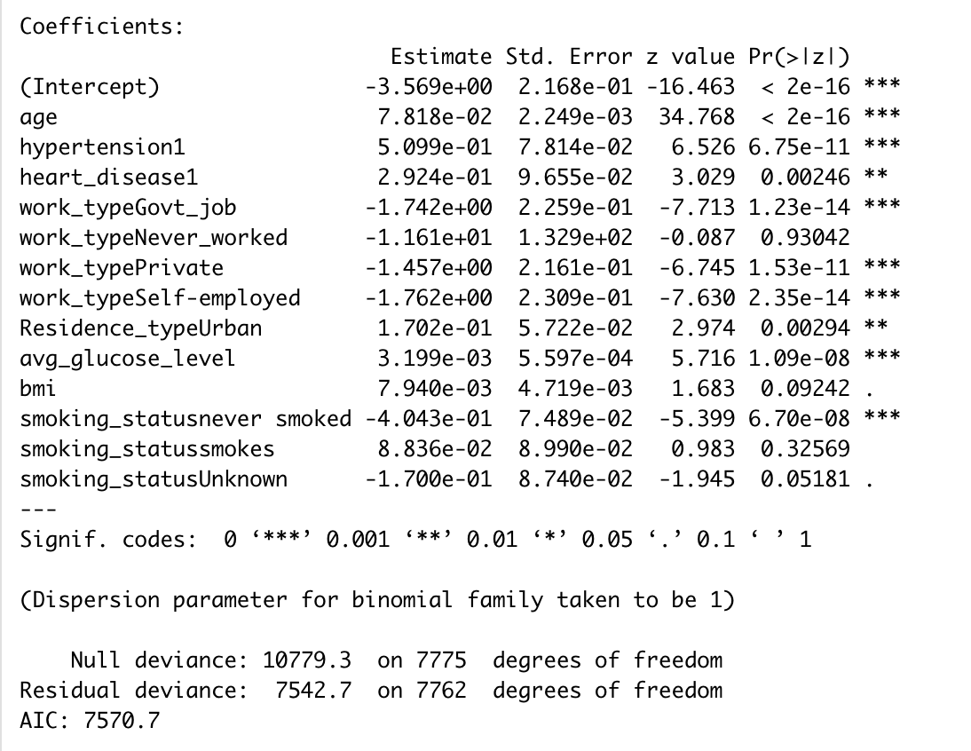
Model 1: Logistic Regression
Accuracy | F1 Scores | Kappa Scores | ROC/AUC
0.7783 | 0.7822 | 0.5575 | 0.841
Confusion Matrix | 0 | 1
0 | 739 | 167
1 | 264 | 774

Slide 12
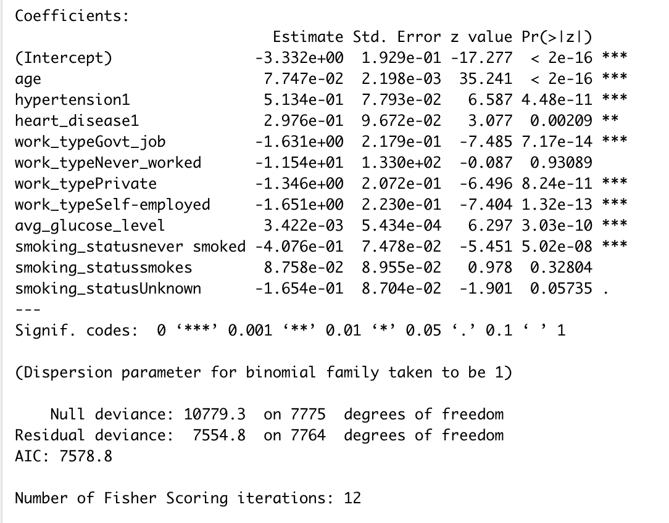
Model 2: Logistic Regression with Lasso
Accuracy | F1 Scores | Kappa Scores | ROC/AUC
0.7783 | 0.7818 | 0.5575 | 0.8406
Confusion Matrix | 0 | 1
0 | 741 | 169
1 | 262 | 772

Slide 13
Model 3: Support Vector Machines (SVMs)
In this algorithm, each data item is plotted as a point in n-dimensional space, where n is a number of features.
Classification is performed by finding the hyperplane that best differentiates the two classes.
Given labeled training data (supervised learning), the algorithm outputs an optimal hyperplane that categorizes new examples.

Slide 14
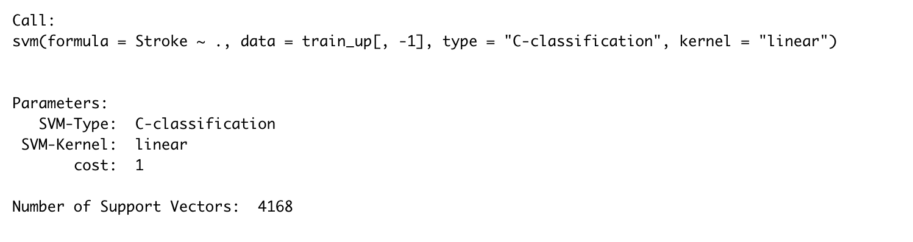
Model 3: Support Vector Machines (SVMs)
Accuracy | F1 Scores | Kappa Scores | ROC/AUC
0.7778 | 0.7851 | 0.557 | 0.766
Confusion Matrix | 0 | 1
0 | 723 | 152
1 | 280 | 789

Slide 15
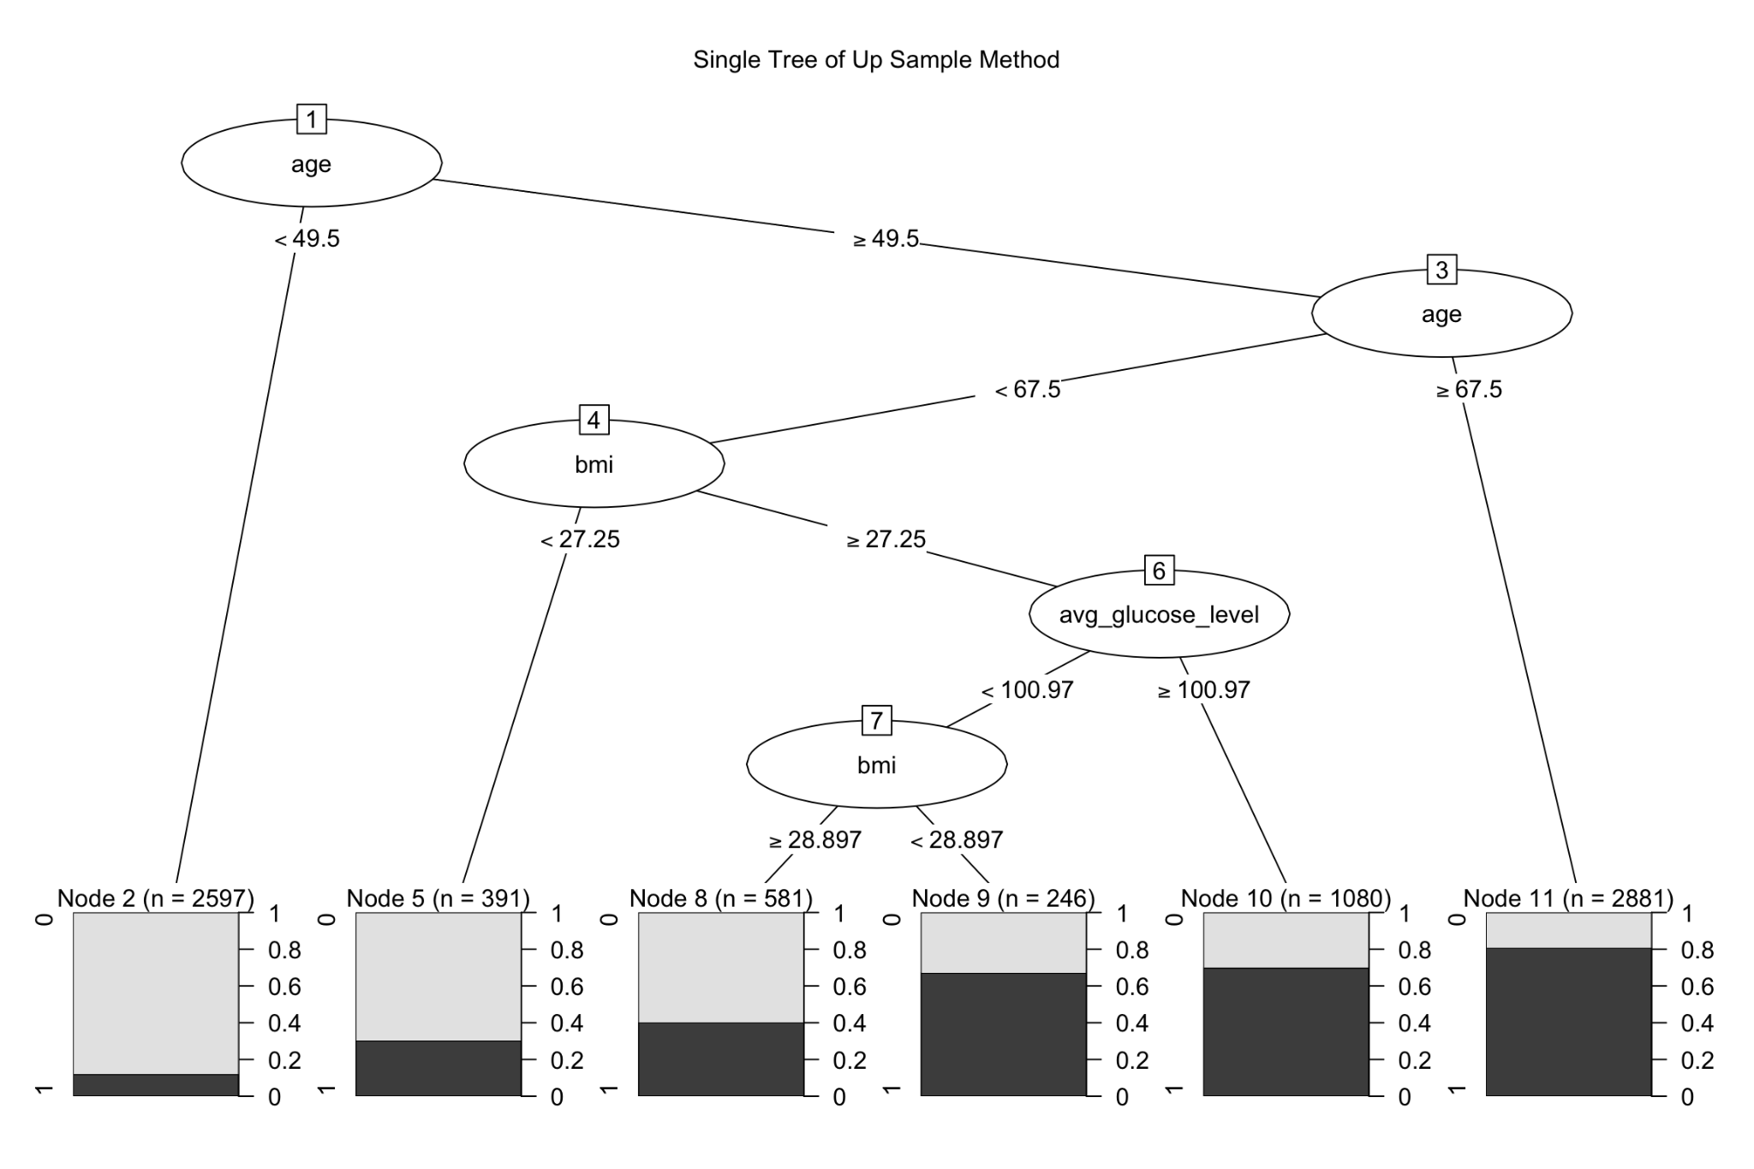
Model 4: Single Tree
Accuracy | F1 Scores | Kappa Scores | ROC/AUC
0.7884 | 0.7881 | 0.5684 | 0.8134
Confusion Matrix | 0 | 1
0 | 743 | 172
1 | 248 | 781

Slide 16
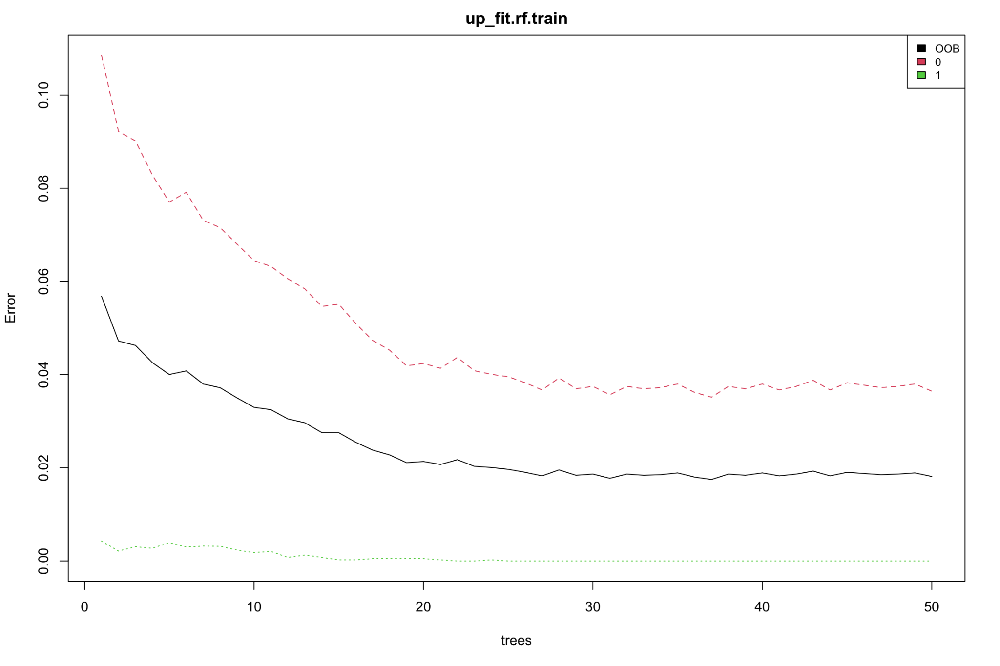
Model 5: Random Forest
Accuracy | F1 Scores | Kappa Scores | ROC/AUC
0.9877 | 0.7851 | 0.9876 | 0.9876
Confusion Matrix | 0 | 1
0 | 976 | 0
1 | 34 | 953

Slide 17
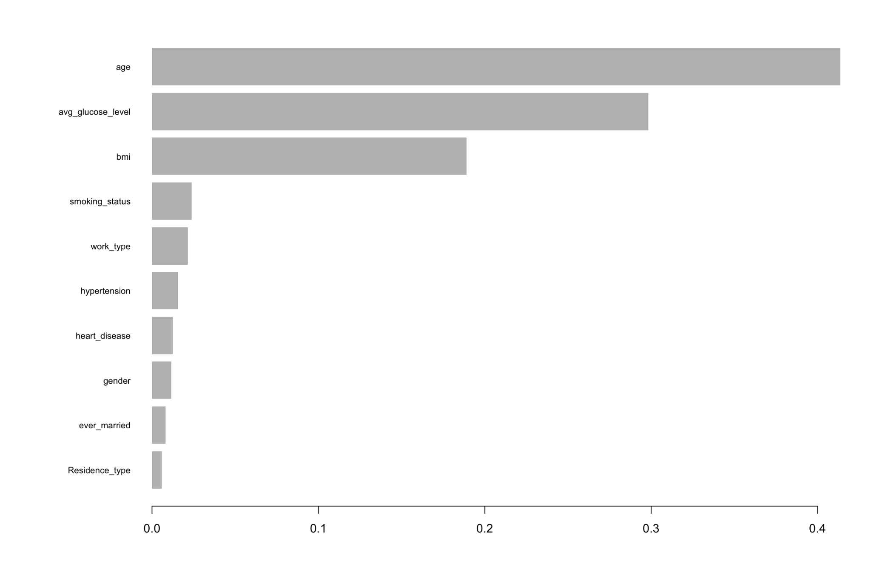
Model 6: XGBosting
Accuracy | F1 Scores | Kappa Scores | ROC/AUC
0.9697 | 0.9700 | 0.9393 | 0.9702
Confusion Matrix | 0 | 1
0 | 932 | 0
1 | 59 | 953

Slide 18
Findings and Summary
Presenter: Mudan Chen & Jinmeng Liu

Slide 19
Model Comparison: Results table
Models | Accuracy | F1 Scores | Kappa Scores | ROC/AUC
Logistic Model | 0.7783 | 0.7822 | 0.5575 | 0.841
Logistic w/ Lasso | 0.7783 | 0.7818 | 0.5575 | 0.8411
SVM | 0.7773 | 0.7851 | 0.557 | 0.766
Decision Tree | 0.7884 | 0.7881 | 0.5684 | 0.7839
Random Forest | 0.9877 | 0.7851 | 0.9876 | 0.9876
XGBoosting | 0.9697 | 0.97 | 0.9393 | 0.972

Slide 20
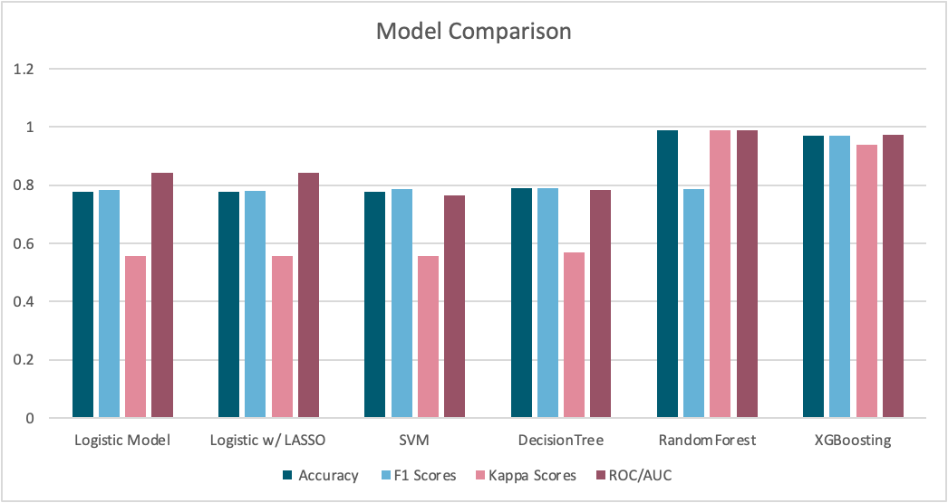
Model Comparison

Slide 21
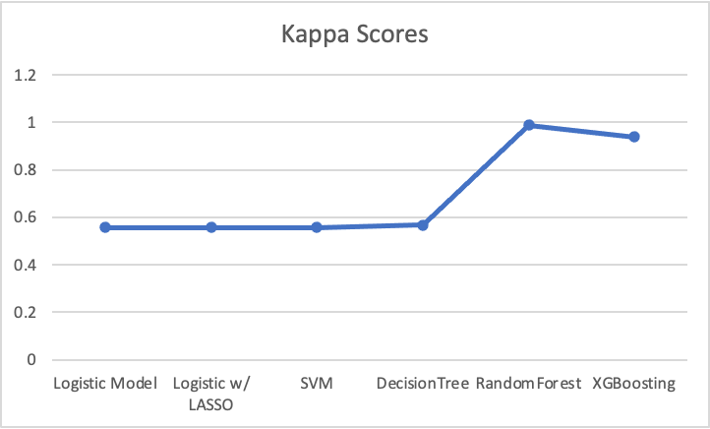
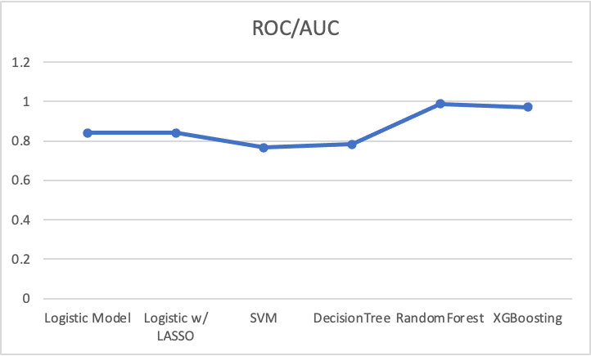
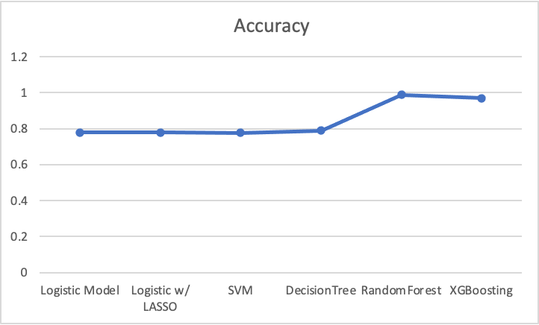
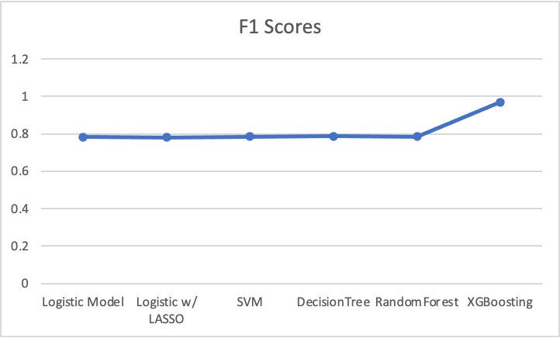

Slide 22
Summary
How to deal with unbalanced data in classification problems:
Resample : Oversampling or Undersampling
Penalizing original loss function
Rethinking Model Evaluation Criteria : kappa, ROC, F-score
Ensemble methods are very powerful! Random Forest and XGB are well-deserved number one in every indicator.
Limitation: In feature, if we have more data, we can try deep learning.

Slide 23

Summary
4. Who has the highest risk of stroke
People older than 67 years with high blood pressure, blood sugar greater than 100, and overweight.
5. How to prevent a stroke
We are inevitably getting older, but we can exercise more, eat healthy, eat less sweets, and keep our moods up!

