Slide 1
How Dog Traits and Region Affect Time to Adoption in Shelters
Public animal shelter records from Austin, Norfolk, and Sonoma County
Anya, Jack, Mason, Isha, Ronav
Wharton Global Youth Data Science Academy, July 2026

Slide 2
Executive Summary
Goal of the study
Which dog traits correlate with faster adoption
age, region, breed, size, color, sex
Can models trained on public shelter records accurately predict a dog’s length of stay based on these traits?
Significance
Shelter staff can optimize limited resources
Can allocate extra marketing or foster resources to “low-appeal” or “at risk” dogs
Will help increase adoption rates and can minimize negative outcomes such as euthanasia
2
Notes:
Anya

Slide 3
Executive Summary
Data
• Open-data portals: Austin Animal Center (TX), Norfolk Animal Care Center (VA), Sonoma County Animal Services (CA)
• 106,786 raw rows
• Shared outcome window
• May 5, 2025 to April 5, 2026
• Final sample: 2,884 adopted dogs with known sex and spay/neuter status
• Stay length = outcome date minus intake date, recomputed for every source
2
Notes:
Isha

Slide 4
Executive Summary
Key Findings
• Puppies adopted fastest everywhere
• ANOVA ranks breed family first (Partial eta^2 = 0.088; p = 6.68e-54)
• Color is not significant (p = 0.281)
• Exact days: unpredictable (Mean Absolute Error near 50)
• Adoption within intervals: predictable and accurate
2
Notes:
Anya

Slide 5
Data Collection, Cleaning, and Analysis
1. Data collection
Austin, Norfolk, Sonoma gov-data portals; 106,786 animals recorded
2. Cleaning and harmonization
Dogs only, valid dates; grouped breeds, colors, outcomes; 2,884 adopted dogs kept
3. Exploratory analysis
Right-skewed stays; age patterns differ by region
4. Regression and ANOVA
ANOVA to find significant variables for regression
5. Prediction models
Use neural network and random forest to predict
6. Conclusions
Age, region, and breed are main factors in influencing outcome
3
Notes:
Ronav
Regression
Log+1 regularizes the data set as it is right skewed and has many outliers
Prediction
When a dog will be adopted
.72 auc means model is decent at guessing when dog will be adopted
Conclusions
We predict that the dog will have this % of chances to be adopted before x# of days in shelter

Slide 6



Data cleaning
Raw sources (all animal types)
Data Cleaning
Region | Raw rows | Age information
Austin, TX | 13,571 | Date of birth
Norfolk, VA | 59,540 | Years old and months old
Sonoma County, CA | 33,675 | Approximate date of birth
• Removed only to include
• Dogs only; valid intake/outcome dates; stay > 0 days
• Breeds grouped into 7 families:
• Hound/Beagle, Retriever, Shepherd, Pitbull/Staffy, Small Companion, Working/Large, Other
• Colors grouped into 8:
• Black, White, Brown, Tan/Cream, Gray/Blue, Red/Orange, Patterned, Other
• Outcomes grouped into 6:
• Adoption, Died, Euthanasia, Return to Owner, Transfer, Other
• Adoption outcomes only; return to owner, transfer, euthanasia, death excluded
• Unknown sex or spay/neuter status dropped
• Final sample: 2,884 dogs (2,071 Austin, 486 Norfolk, 327 Sonoma)
• One outcome window for all regions: May 5, 2025 to April 5, 2026
• Age from date of birth (Austin, Sonoma) or years + months (Norfolk)
• Ages below 0 or above 25 years dropped as data errors
4
Notes:
Isha
We used three different datasets, one from austin, tx, norfolk, va, and sonoma county, ca. Since we used three different datasets we had to make sure they were comparable by choosing predictors they had in common.
We created an outcome window, calculated the age for each dataset, and eliminated any age outliers (anything below 0 or above 25.

Slide 7
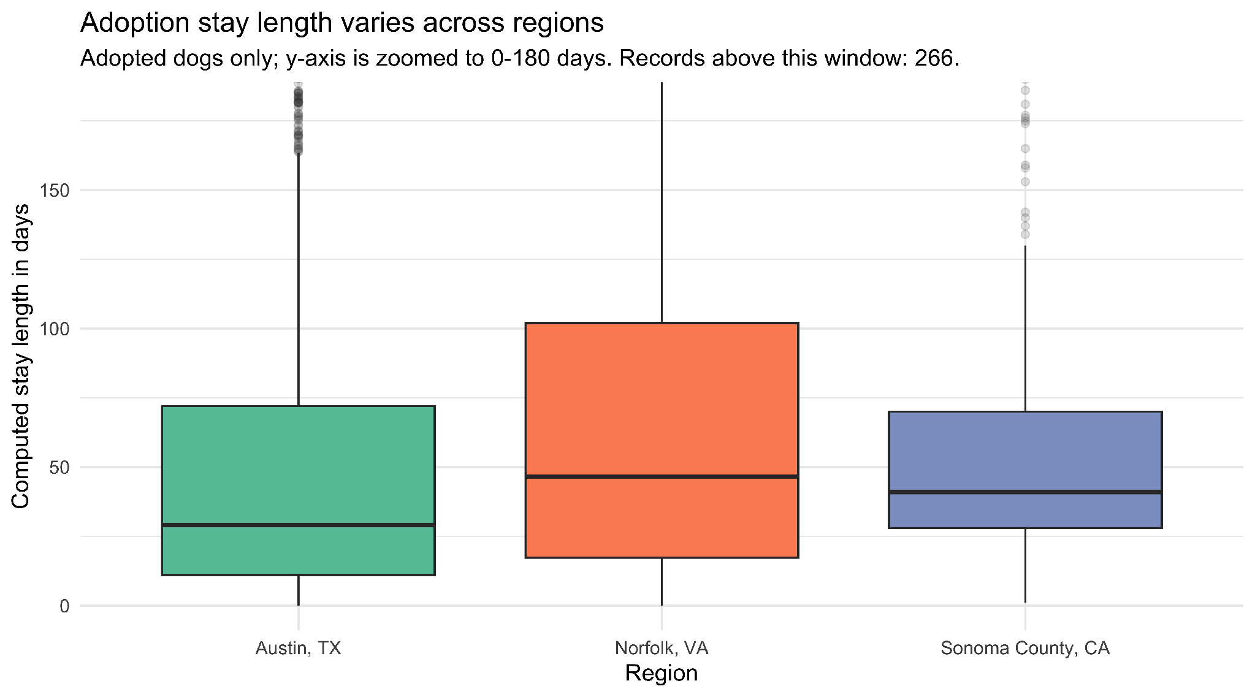
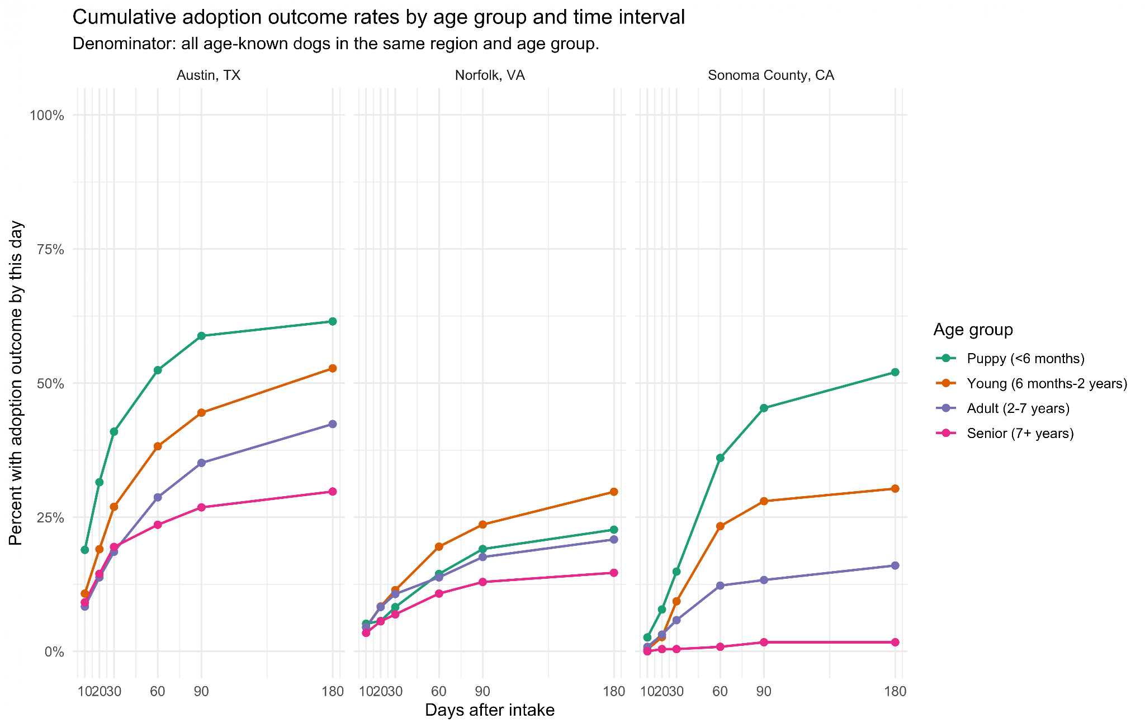
EDA: stay length by region & age groups
Adopted dogs only; y-axis zoomed to 180 days, boxes use all records.
• Medians: Austin 29, Norfolk 46.5, Sonoma 41 days
Share of age-known dogs with an adoption outcome by each day.
5
Notes:
mason

Slide 8
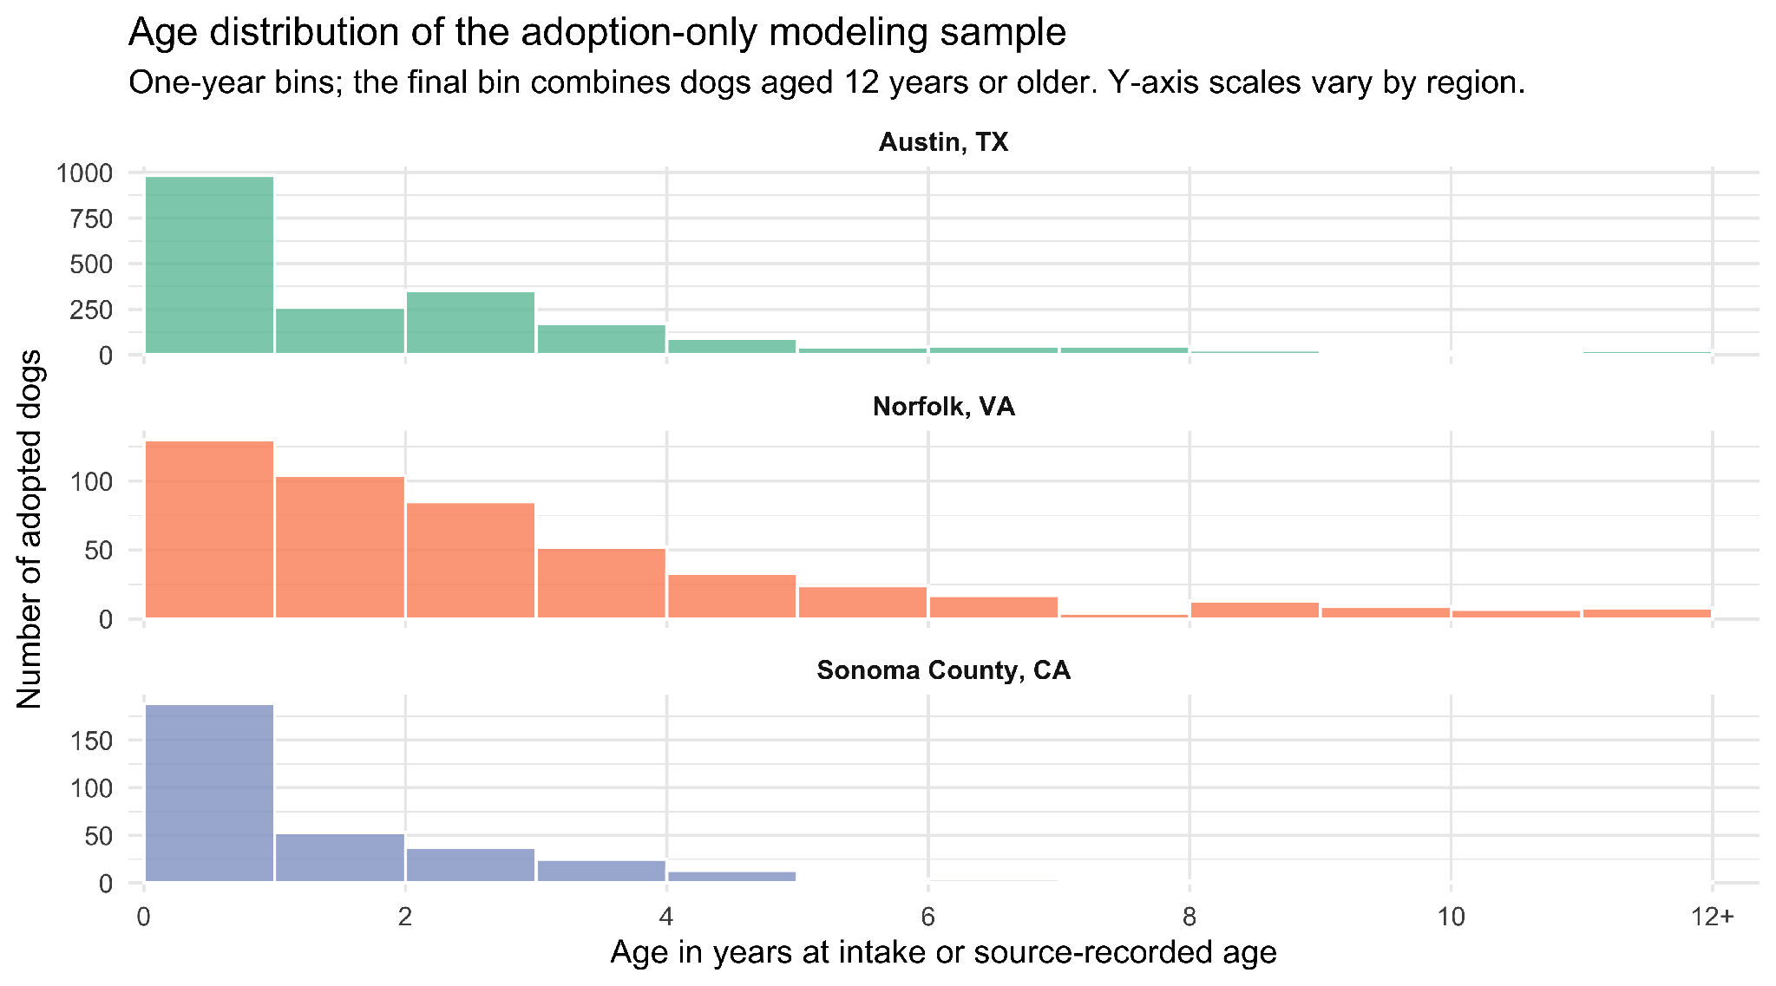
EDA: age by region
Young dogs make up most adopted dogs in all three regions.
The age distributions differ slightly between Austin, Norfolk, and Sonoma.
One-year bins; last bin pools ages 12+. Norfolk reports whole years.
6
Notes:
Ronav
Most dogs adopted young as graph is right skewed
The distributions vary by region: sonoma county adopts a higher percentage of older dogs than any other county
Demonstrates how age is an important factor in adoption patterns

Slide 9
Linear regression of log(stay days+1) result
Term
Estimate
Std. Error
t value
Pr(>|t|)
(Intercept)
age_groupPuppy
age_groupYoung
age_groupSenior
regionNorfolk
regionSonoma
sex_groupMale
fixed_statusSpayed
breedSmallCompanion
breedPit/Staffy
colorWhite
Norfolk:agePuppy
3.241
-0.765
-0.110
-0.038
-0.224
0.072
0.026
0.611
-1.038
0.234
0.032
0.827
0.237
0.060
0.065
0.109
0.105
0.129
0.041
0.211
0.087
0.073
0.060
0.190
13.67
-12.75
-1.68
-0.35
-2.13
0.56
0.64
2.90
-12.00
3.21
0.54
4.34
<2e-16
<2e-16
0.093
0.728
0.033
0.574
0.524
0.004
<2e-16
0.001
0.590
1.45e-05
***
***
.
.
*
.
.
**
***
**
.
***
Model fit: N = 2,884 | Multiple R^2 = 0.174 | F(37, 2846) = 16.23 | p < 2.2e-16
• Reference group: Austin adult female, not spayed/neutered, Retriever, Black, January intake
• Positive estimates mean longer predicted log stay; negative estimates mean shorter stay
• Full model includes intake month and all breed/color levels; selected terms shown
7
Notes:
mason

Slide 10
ANOVA Test
Ranked term | Df | Sum Sq | F | p value | eta^2 | Result
1. Breed family | 6 | 329.76 | 45.90 | 6.68e-54 | 0.088 | ***
2. Age group | 3 | 207.06 | 57.64 | 3.62e-36 | 0.057 | ***
3. Intake month | 11 | 37.13 | 2.82 | 0.0011 | 0.011 | *
4. Region x age | 6 | 36.21 | 5.04 | 3.77e-05 | 0.011 | **
5. Region | 2 | 32.53 | 13.58 | 1.34e-06 | 0.010 | **
6. Color family | 7 | 10.33 | 1.23 | 0.281 | 0.003 | .
7. Spay/neuter | 1 | 10.08 | 8.42 | 0.0037 | 0.003 | *
8. Sex | 1 | 0.49 | 0.41 | 0.524 | 0.000 | .
Residuals | 2846 | 3407.96
• Type-II ANOVA tests each term after accounting for the other model terms
• Top blocks: breed family, age group, then intake month
• Region and region x age group must be interpreted together
• Sex and color family are not detectable after controls
• Residual variation remains large, so exact-day forecasts stay weak
8
Notes:
jack

Slide 11
Ranked category effect
Breed family (reference: Retriever, n = 472)
Rank/category | n | Coef. | % diff | FDR p | Direction
1. Small Companion | 293 | -1.038 | -64.6% | 1.3e-31 | Shorter
2. Other (n<50) | 797 | -0.264 | -23.2% | 2.6e-04 | Shorter
3. Pit Bull / Staffy | 640 | +0.234 | +26.3% | 0.003 | Longer
4. Working / Large | 217 | -0.084 | -8.1% | 0.543
5. Hound / Beagle | 102 | +0.048 | +4.9% | 0.833
6. Shepherd | 363 | +0.013 | +1.3% | 0.868
• Rows are ranked by absolute adjusted coefficient within each predictor block
• % diff = exp(coefficient) - 1, on the log(1 + days) scale
• With Retriever as reference, small companions are ~65% shorter; pit bull/staffy types are ~26% longer
Reference groups: Retriever for breed and Black for color. Same multivariable regression.
9
Notes:
jack

Slide 12
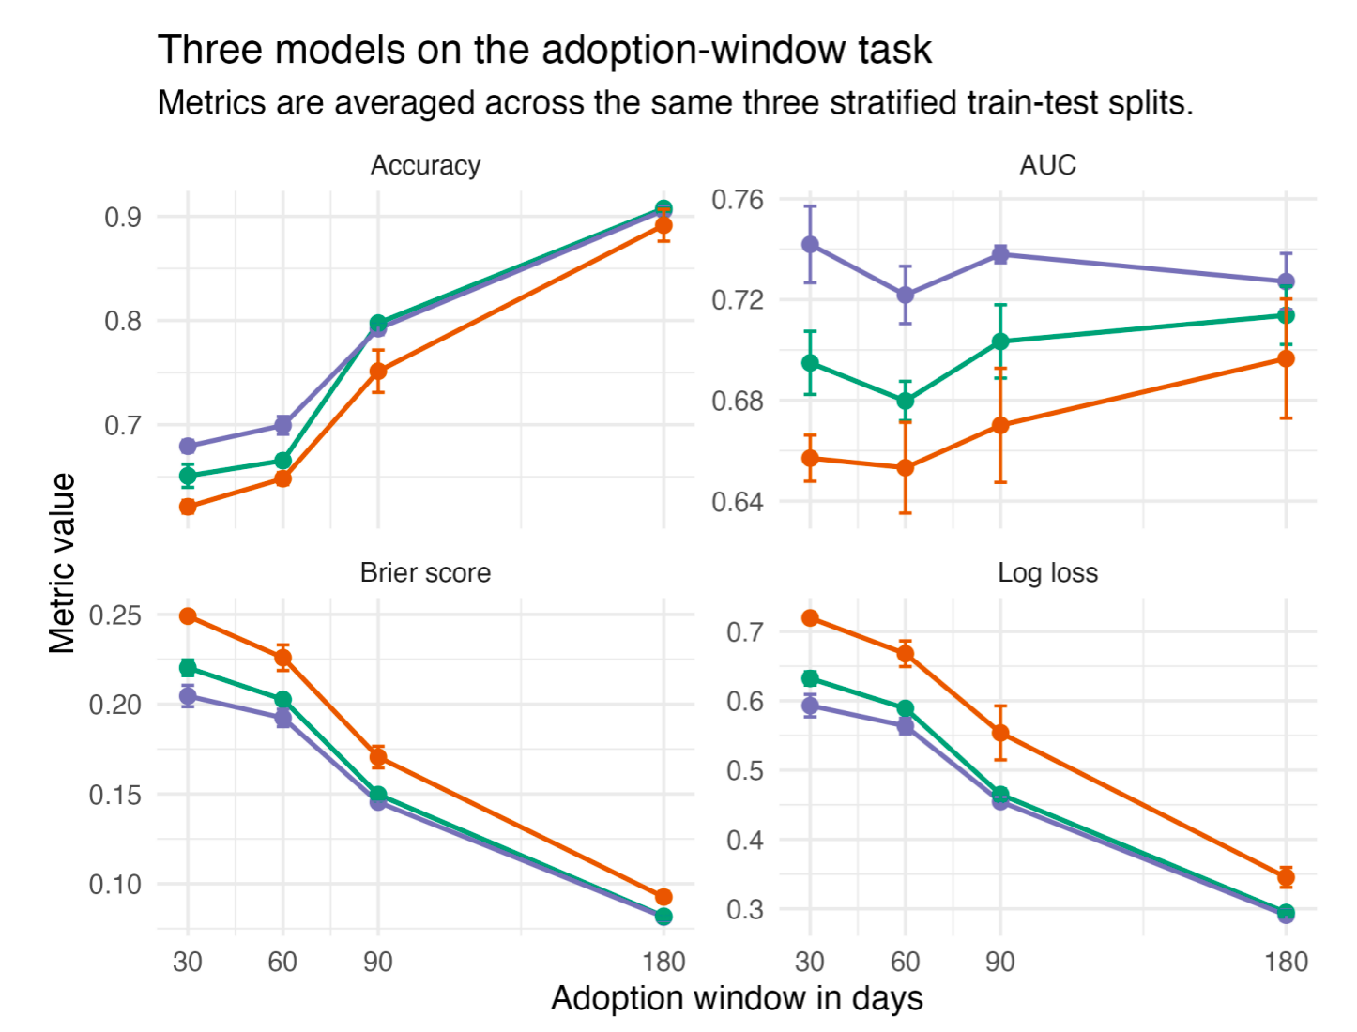
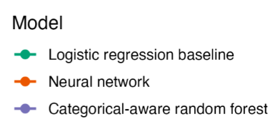
Model Comparison
Neural network - Same inputs as the regression; three stratified 70/30
Random forest - 500 trees, 3 variables per split
9
Notes:
Jack

Slide 13
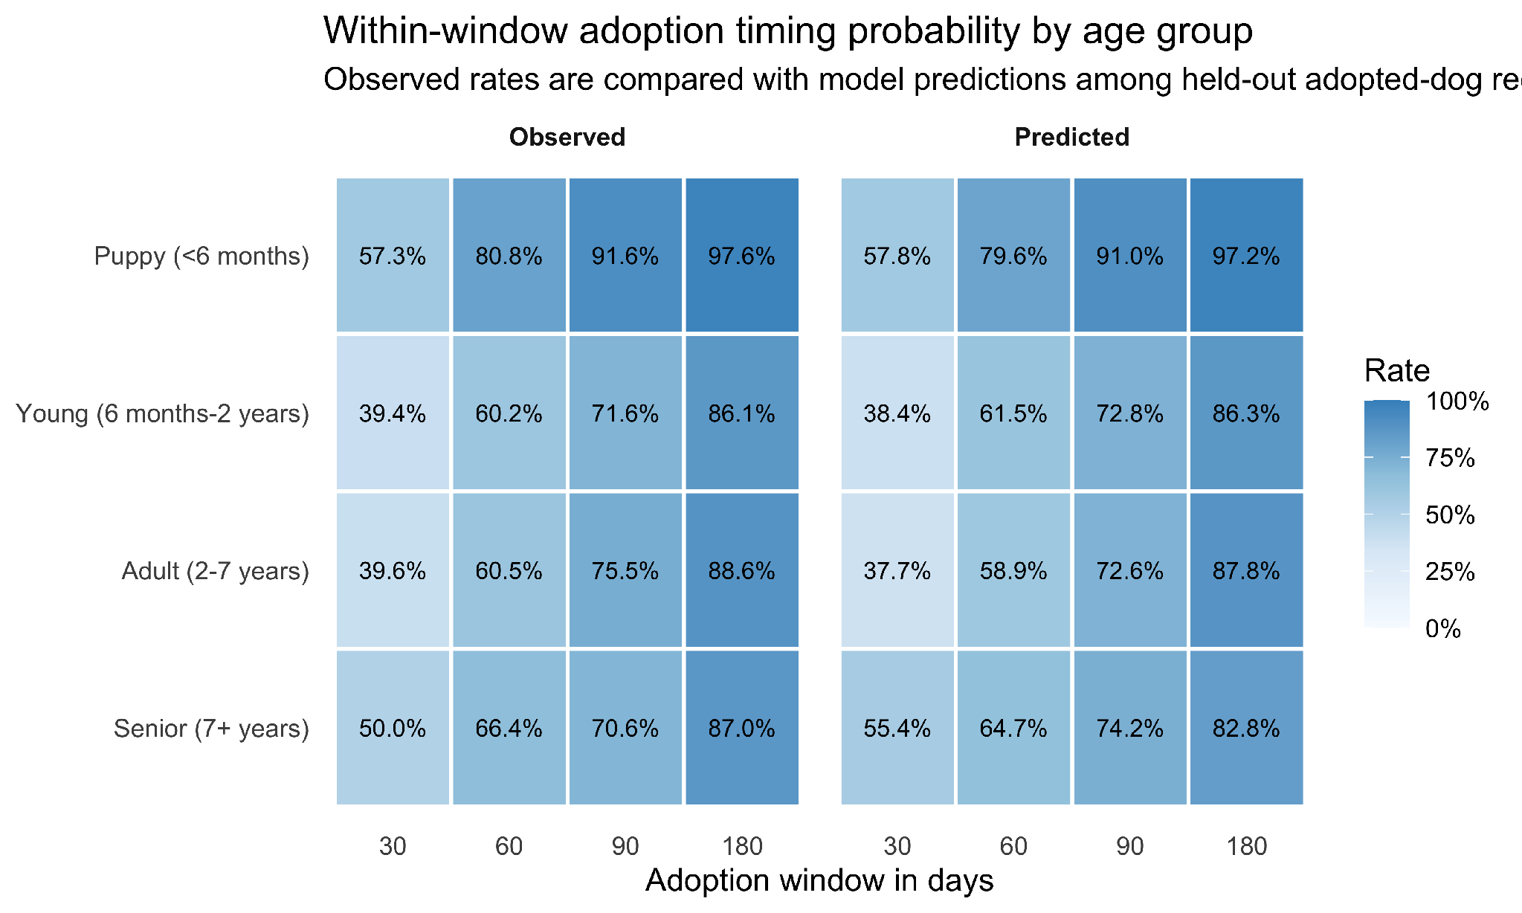
Random forest: interval predictions
10
Notes:
Jack

Slide 14
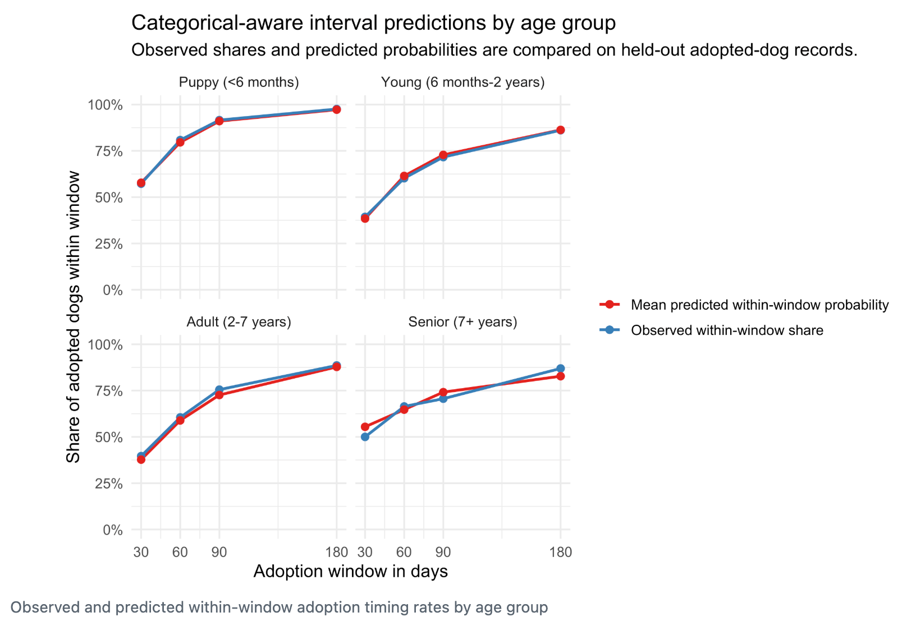
Random forest: interval predictions
10
Notes:
Jack

Slide 15
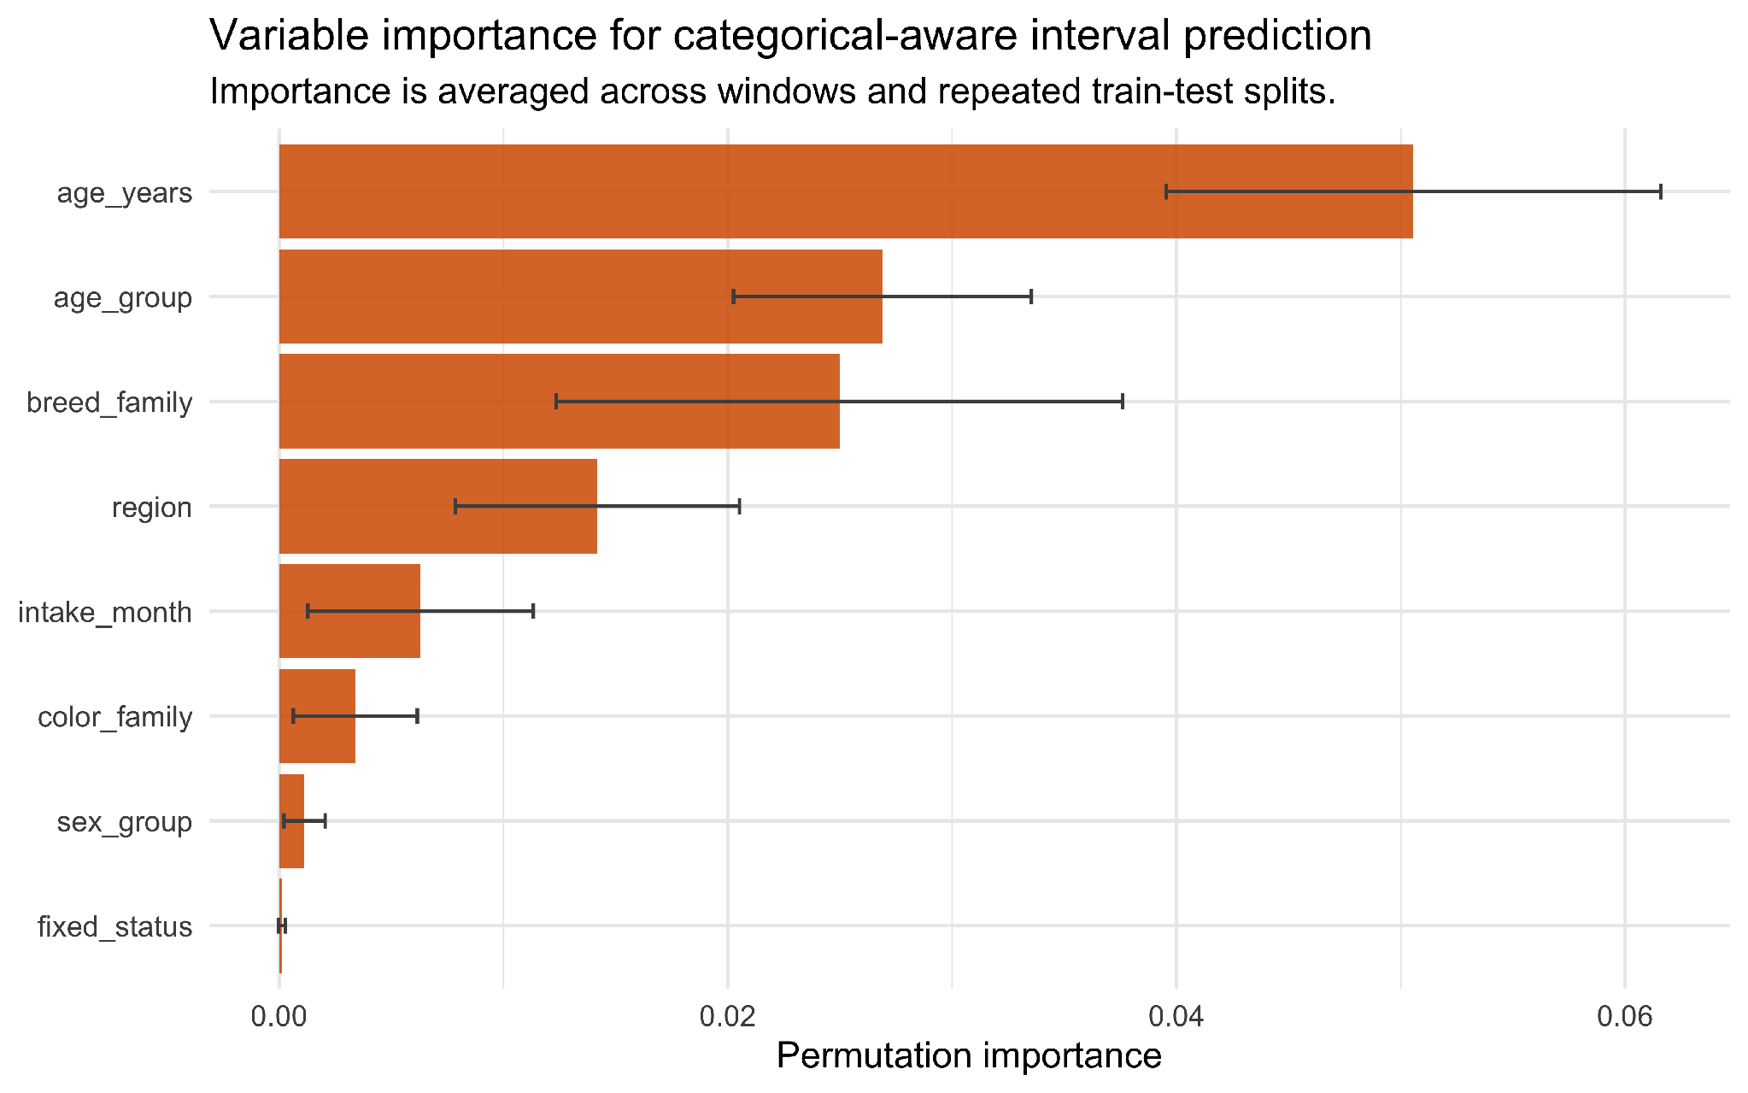
Forest calibration and variable importance
11
Notes:
Jack

Slide 16
Conclusions
What the evidence supports
Age and breed family have the strongest statistical relationship with speed of adoption
Exact-day forecasts fail; interval probabilities prove to be more accurate
Practical use of interval probabilities at intake
forecast upcoming kennel crowding
strategically plan which dogs will need foster homes
12
Notes:
Anya

Slide 17
Limitations
Observational admin records: associations, not causal effects
Limitations of data
missing variable details that halt us from deeper exploration
transfers, euthanasia reason
dogs killed or transfered are excluded from our study, because of the lack of reasoning
lack of health, behavior information
lack of foster, capacity, or marketing fields
Future Research
Impact of health & behavior
Examination of different shelter policies on marketing and euthanasia
Impact of adoption fees
12
Notes:
Anya

Slide 18
Data sources
• City of Austin Open Data Portal. Austin Animal Center Outcomes. https://data.austintexas.gov/Health-and-Community-Services/Austin-Animal-Center-Outcomes/gsvs-ypi7 (file dated June 30, 2026)
• City of Norfolk Open Data Portal. Norfolk Animal Care and Adoption Center (NACC). https://data.norfolk.gov/Government/Norfolk-Animal-Care-and-Adoption-Center-NACC-/vfm4-5wv6 (file dated July 1, 2026)
• County of Sonoma Open Data Portal. Animal Shelter Intake and Outcome. https://data.sonomacounty.ca.gov/Government/Animal-Shelter-Intake-and-Outcome/924a-vesw (file dated July 9, 2026)
13

Slide 19
Appendix A: sample dataset rows
Processed sample: adopted dogs only, valid dates, known sex and spay/neuter status, harmonized age, breed, color, and region fields.
Region Intake Outcome Stay Age Age group Breed / color
Austin, TX 2025-04-25 2025-05-06 11.5 3.0 Adult Other / Black
Austin, TX 2025-04-10 2025-05-06 26.5 3.0 Adult Other / Patterned
Norfolk, VA 2026-03-22 2026-03-31 9.0 13.0 Senior Small companion / Tan
Norfolk, VA 2026-03-17 2026-03-26 9.0 3.0 Adult Small companion / White
Sonoma County, CA 2025-10-12 2025-11-21 40.0 0.7 Young Shepherd / Black
Sonoma County, CA 2025-09-18 2025-10-28 40.0 0.1 Puppy Other / White
Final modeling sample: 2,884 adopted dogs = 2,071 Austin, 486 Norfolk, and 327 Sonoma records. Stay length is recomputed as outcome date minus intake date.
A1

Slide 20
Appendix B: testing the region x age interaction
Test logic: compare the structured no-interaction regression with a model adding one interaction block. H0 = the age-group pattern is the same across regions. A small p value supports keeping the interaction.
Candidate df dAdjR2 dAIC F p BH p
Region x age group 6 +0.00130 -26.9 5.039 3.77e-05 1.51e-04
Region x breed family 12 +0.0084 -17.0 3.393 5.95e-05 1.59e-04
Age group x breed family 18 +0.0071 -18.6 3.472 9.69e-04 7.75e-03
Region x intake month 22 +0.0009 +18.7 1.132 0.3026 0.3458
Region x color family 14 -0.0008 +16.4 0.817 0.6509 0.6509
Interpretation: the region x age group block is statistically supported and directly matches the research question. Other interactions are treated as supplementary because they answer secondary questions or add many more parameters.
A2

Slide 21
Appendix C: AI Usage
Used AI to find datasets
Used AI to do basic EDA and data cleaning - distributions, medians by region, and the boxplots
By providing the overall structure
Suggested log(1 + days) for the skewed outcome
Had it read each portal's column documentation and note the difference
A2

