Slide 1
WHARTON DATA SCIENCE ACADEMY, GROUP 3
What predicts U.S. naturalization?
An analysis of 1.77 million immigrants, focused on what predicts who becomes a U.S. citizen.
551,818
81
5
Naturalization is the legal process through which a non-citizen voluntarily becomes a citizen of a country
modeling cohort
model columns
classification models
Faisal Alsiksek · Cami Kieran · Yichen Yao · Sophia Hur · Dongchan Kim

Slide 2


MOTIVATION
Citizenship shapes a life
✓
$
!
Voting rights
Job and economic access
Policy context
Citizenship decides who has a say in elections.
Many roles and benefits require citizenship.
One of the most contested issues in the country.
We wanted a question that mattered and a dataset large enough to study carefully.
01

Slide 3

THE QUESTION
Which traits predict naturalization status?
RESEARCH QUESTION
HYPOTHESIS
Among immigrants here 6 to 20 years, which characteristics predict whether they become citizens?
People with higher education, stable employment, higher income, and better English are more likely to be naturalized.
QUESTION AND HYPOTHESIS
02

Slide 4
THE DATA
ACS data at large scale
Source: IPUMS USA, American Community Survey, 2019–2023
1.77M
Collected by the U.S. Census Bureau, nationally representative
people in the cleaned dataset
Filtered 15.9M raw responses down to 1,774,320 foreign-born, income-clean respondents
Why this source works
Large, nationally representative survey collected by the Census Bureau.
DATA SOURCE
03

Slide 5
SAMPLE CONSTRUCTION
Why we focused on 6–20 years in the U.S.
This gives us a cleaner group for studying naturalization.
6–20 years
0–5 years
21+ years
Excluded
INCLUDED: ANALYTICAL SAMPLE
Excluded
People in this window are more likely to have had enough time to naturalize. We removed a small group with low English and low income, since cost and test barriers likely hit them hardest.
Many recent immigrants may not yet have been eligible long enough to become citizens. Their non-citizenship may simply reflect limited time in the U.S.
Most immigrants in this group had already naturalized. Those who had not may face long-term or unusual barriers that our dataset does not fully measure.
551,818 people
Takeaway
This sample reduces the obvious time-barrier problem, but it cannot prove why someone remained a non-citizen. Within this group, the model controls for English, education, income, age, and state to compare similar people on measured traits.
SAMPLE CONSTRUCTION
04
Notes:
This slide explains the sample we modeled. We excluded 0–5 years because many people in that group may not have had enough time to naturalize. We excluded 21+ years because that group is harder to interpret, since most have already naturalized and the remaining non-citizens may face barriers we cannot see. The 6–20 year window gives us a cleaner comparison, but it does not prove why a person stayed a non-citizen. The ACS does not show whether they applied, were eligible, were denied, were waiting, or chose not to apply.

Slide 6
MODEL DESIGN
How we chose our variables
We started from the full survey and kept variables that were useful and interpretable.
GROUPED
RELEVELED
Education into 5 bands
English as an ordered factor
Eleven raw grade codes collapsed into Less than HS, High school, Some college, Bachelor's, and Graduate.
English was ordered from weakest to strongest so the model reads it correctly.
DROPPED
DROPPED
Occupation and industry
Age at immigration
Hundreds of categories each, which would make the model harder to interpret.
Equals age minus years in the U.S. Keeping it would double-count the same information.
What's actually in the model: 15 survey fields → 81 columns
A model column is not always a separate survey question. Categories like race or state need one column per category.
USED DIRECTLY: 10 FIELDS
EXPANDED INTO CATEGORY COLUMNS
Age · years in the U.S. · wage income · household income · poverty ratio · sex · homeownership · metro area · number of children · household size
English proficiency (4) · education band (4) · race (8) · marital status (5) · state (50)
VARIABLE SELECTION
05
Notes:
This slide shows how we turned the survey into a model. Education was grouped into five readable bands, and English was ordered from weakest to strongest. We dropped occupation and industry because they had hundreds of categories and would make the model harder to interpret. We also dropped age at immigration because it is exactly age minus years in the U.S., so keeping it would double-count the same information. The 81 columns come from expanding categories like state, race, and education, not from 81 separate survey questions.

Slide 7


HOW WE WORKED
Our analysis pipeline
EDA
→
LASSO
→
Logistic
→
Tree /
Forest
→
Neural
Net
WORKFLOW
16

Slide 8
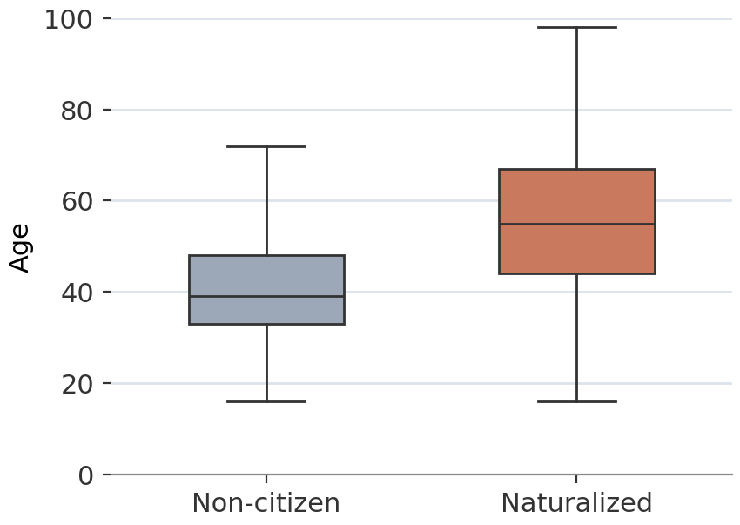
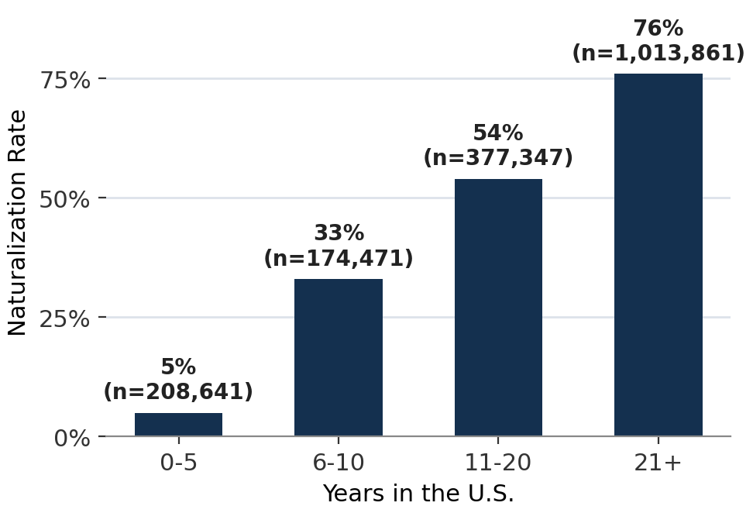
EDA: the full 1.77M-person picture
Age distribution by naturalization status
Naturalization rate rises with years in the U.S.
Naturalized citizens are older, and naturalization climbs sharply with residency time. This full view still mixes recent arrivals with people who have been in the country for decades.
EDA OVERVIEW
06
Notes:
This is the raw 1.77 million-person dataset before the 6–20 year modeling window. Naturalized citizens are older, and naturalization rises strongly with years in the U.S. The problem is that this full view mixes recent arrivals with people who have been in the country for decades. That is why the next slides focus on the narrower cohort.

Slide 9
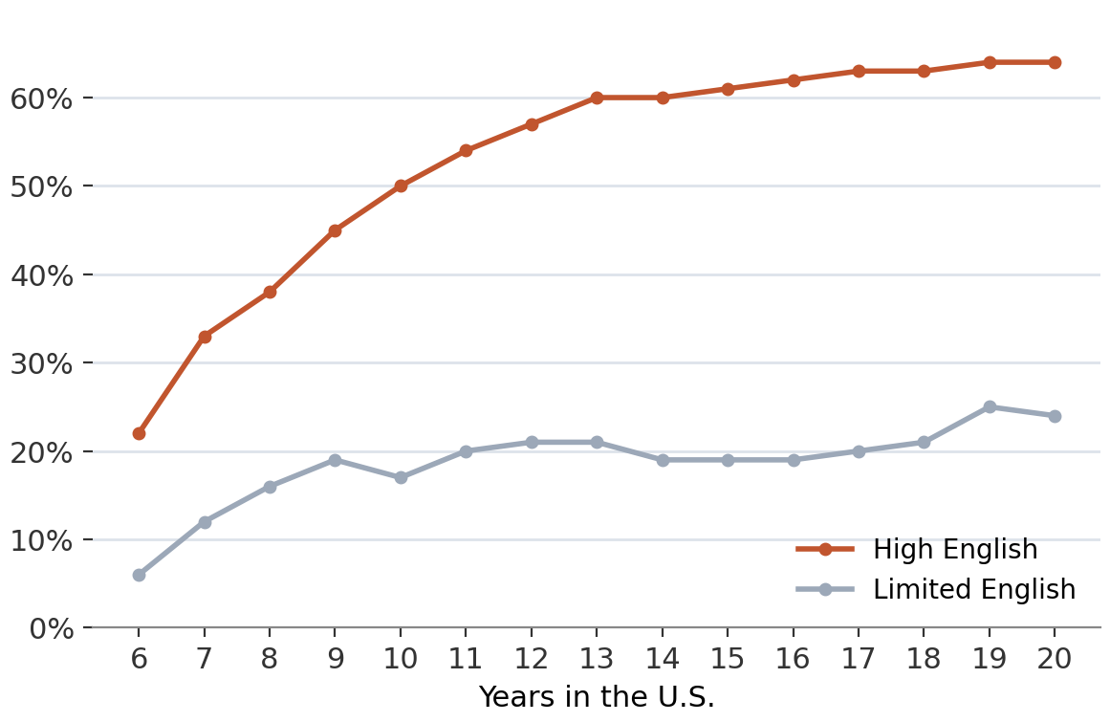
English advantage persists
The English advantage holds every year
Naturalization rate over time, by English proficiency
High-English immigrants have higher naturalization rates at each year in the window.
ENGLISH OVER TIME
09
Notes:
This graph shows that English proficiency matters at every year in the 6–20 window. People with stronger English have higher naturalization rates than people with limited English throughout the period. That helps explain why English later appears as one of the strongest personal predictors in the models.

Slide 10
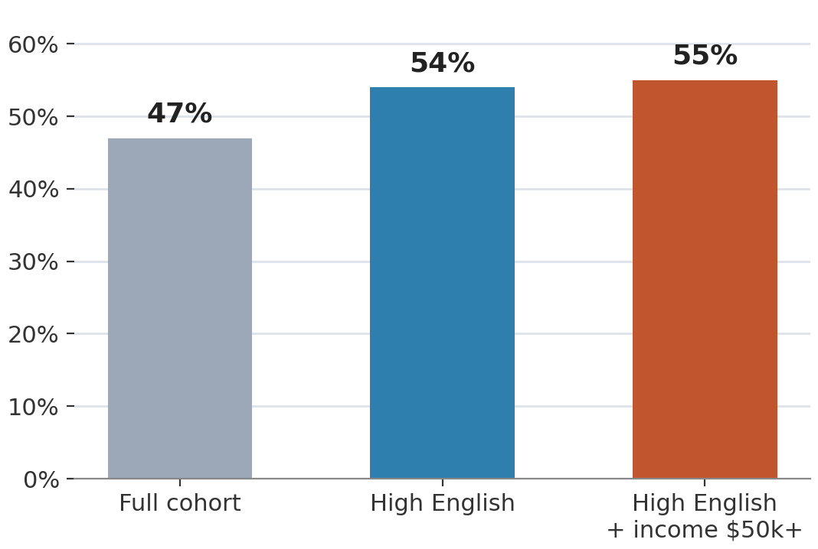
EDA, FOCUSED SUBGROUP
High English and high income only
English and income raise the rate modestly
Naturalization rate as English and income filters apply
Even the most advantaged slice, English proficient and earning $50k+, lands near 55%. Even this advantaged group is far from universal naturalization.
ENGLISH PROFICIENT, HIGH INCOME
12
Notes:
This slide asks whether English and income together explain most of the outcome. They do not. Even among people who are English proficient and earn at least $50,000, the naturalization rate is only around 55%. The sample is already limited to 6–20 years in the U.S., but the data still cannot tell us who was eligible or who applied.

Slide 11
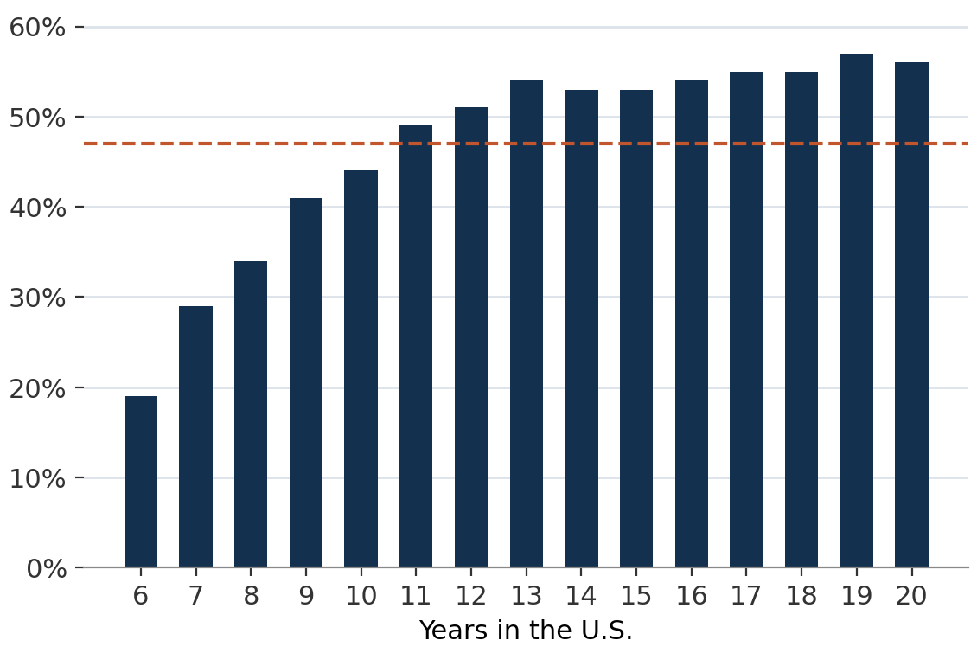
EDA, FINDING 1
Time is the dominant driver
Naturalization rises steadily with time
Share naturalized by exact years in the U.S., 6–20 year cohort
The rate climbs every year in the window, so every other finding controls for time.
YEARS IN THE U.S.
07
Notes:
This zooms into the 6–20 year sample. Even inside this narrower window, the naturalization rate rises from about 19% at year 6 to above 55% near years 19 and 20. Time is the strongest single pattern in the data, so the later models need to account for it before we interpret education, English, or income.

Slide 12
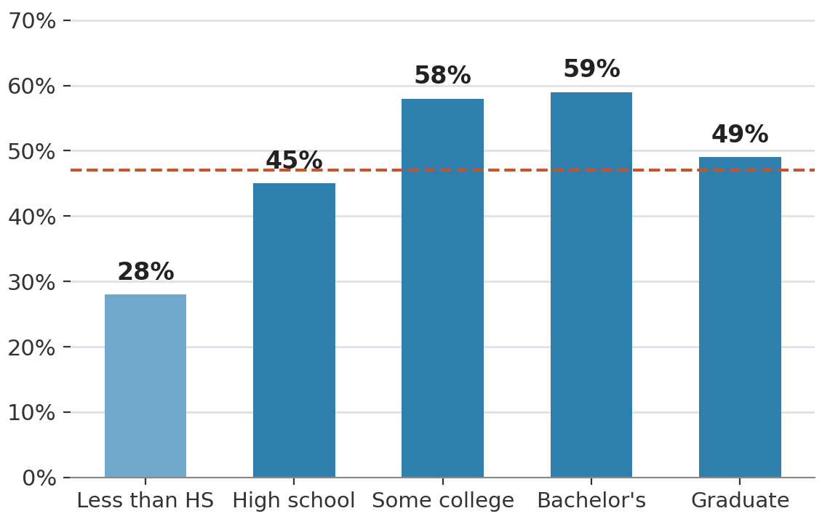
EDA, FINDING 2
Education lifts naturalization
Naturalization climbs with education
Naturalization rate by education band
A clear climb through college. The dip at graduate level may reflect recent skilled-visa arrivals not yet naturalized, a hypothesis, not something the data confirms directly.
EDUCATION
08
Notes:
Naturalization rises with education through the bachelor's level, from about 28% for less than high school to about 59% for a bachelor's degree. The graduate-degree group is lower, at about 49%. We would not read that as education hurting naturalization. It may reflect differences in immigration pathways or timing that the ACS does not fully capture.

Slide 13
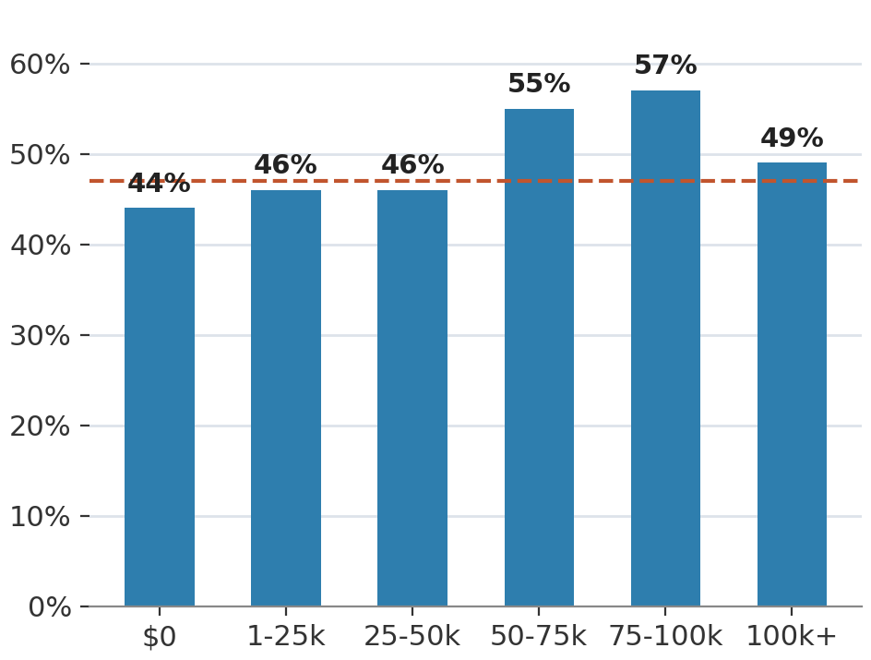
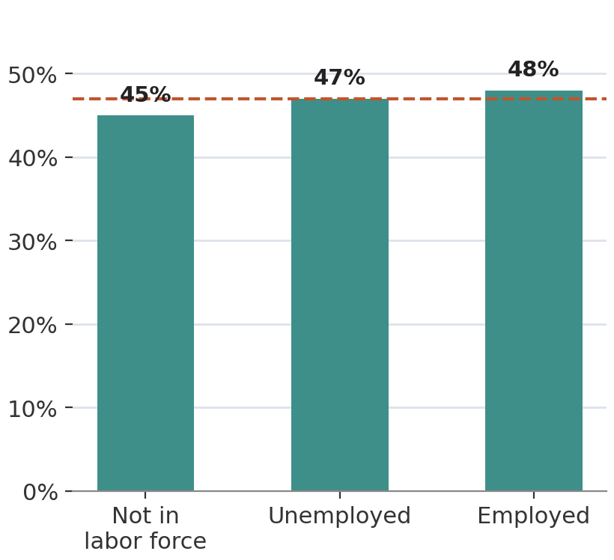
EDA, FINDING 3
Income and employment are weaker predictors
Income: mild, non-linear
Employment: essentially flat
Two of our hypothesized factors move the outcome less than expected before controls.
INCOME AND EMPLOYMENT
10
Notes:
Income and employment were weaker than we expected. Naturalization ranges only from about 44% to 57% across wage brackets, and employment status is fairly flat. This matters because our original hypothesis gave income and employment a larger role than the data supports.

Slide 14
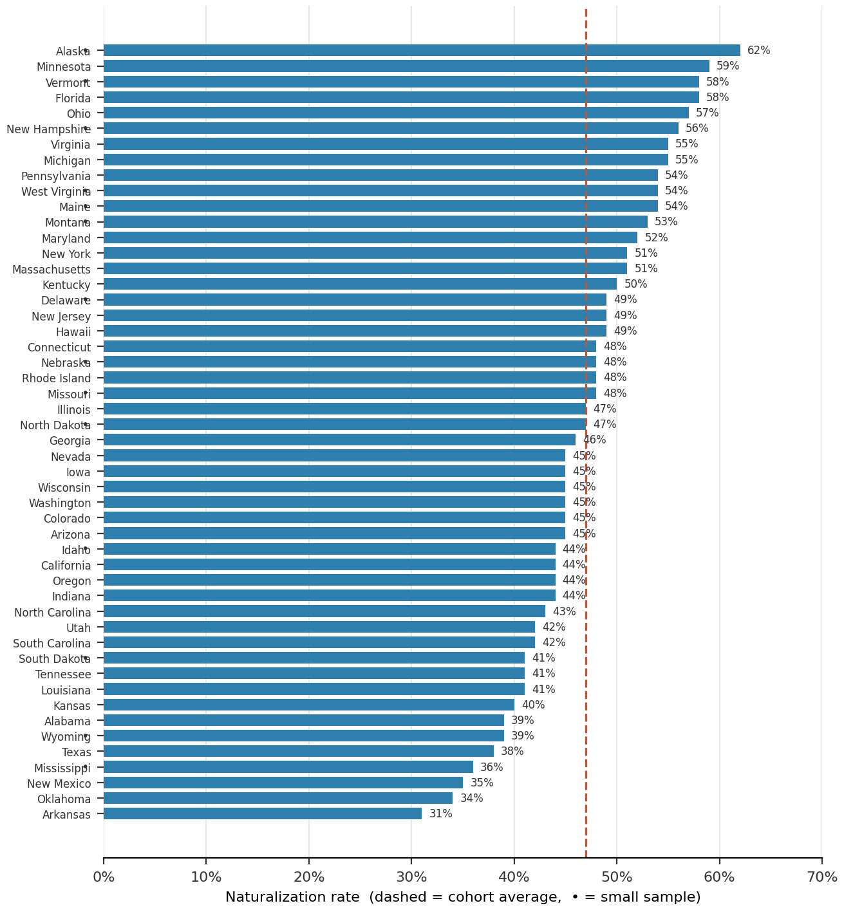
EDA, GEOGRAPHY
Naturalization across all 50 states
Every state is its own model variable. Rates run from about 34% to 62%, so we use state indicators instead of one broad region flag.
ALL 50 STATES
11
Notes:
State matters enough that we did not want to hide it inside broad regions. Naturalization rates range from about 34% to 62% across states. We therefore included state indicators (variable for each state) in the model so geography could be controlled directly.

Slide 15
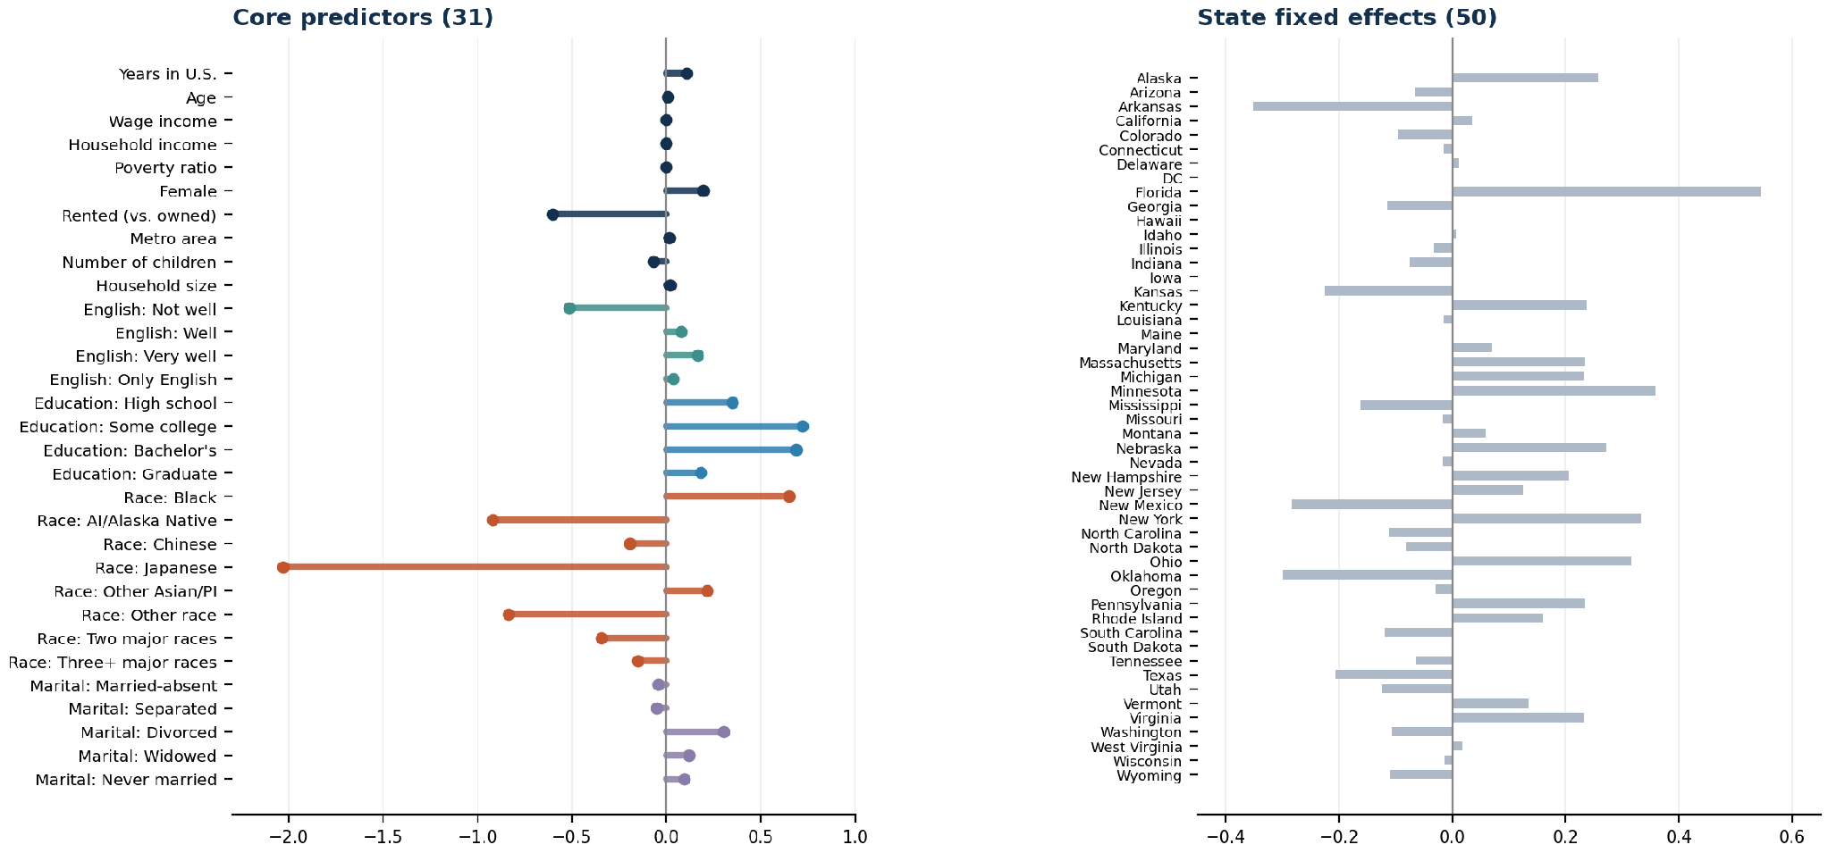
THE FULL MODEL
All 81 variables, one chart
Every category-expanded column in the model: 31 core predictors plus 50 state indicators, with LASSO-shrunk log-odds coefficients.
FULL VARIABLE SET
14
Notes:
This slide is mainly here to show exactly what the model used. The left side has the core predictors, and the right side has the state indicators. I would not try to explain every bar here. The point is that the model includes the full set of variables before the next slides summarize the results more clearly.

Slide 16
THE FULL MODEL
What each coefficient is measured against
Every log-odds coefficient for a category is relative to a baseline group. Here's what that baseline is for each one.
VARIABLE
BASELINE / REFERENCE GROUP
Sex
Male
Marital status
Married, spouse present
Homeownership
Owns home
Race
White
Education
Less than high school
English proficiency
Doesn't speak English at all
State
Alabama
Race categories: the survey's own self-reported options, not groupings we made, White, Black, American Indian/Alaska Native, Chinese, Japanese, Other Asian/Pacific Islander, Other race.
REFERENCE CATEGORIES
15
Notes:
This is the reference key for the coefficient charts. Each category is measured against a baseline. For example, the bachelor's coefficient is compared with less than high school, not with the average person. Race categories are the survey's self-reported categories, and state coefficients are compared with Alabama as the reference state.

Slide 17
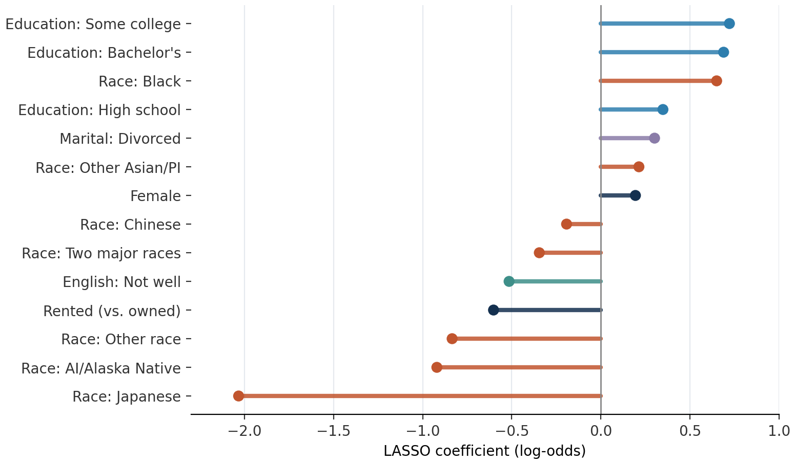
RESPONSE A, REGULARIZATION
What LASSO kept and shrank
The 14 largest coefficients by absolute size. Positive means higher odds of naturalizing.
MEASURED AGAINST
Education
Less than HS
Race
White
Marital status
Married
Sex
Male
English
None at all
Homeownership
Owns home
These are the 14 largest LASSO coefficients in absolute size. They show the strongest positive and negative associations with naturalization after controlling for the other variables. Race categories appear several times, but these are comparisons with the White reference group and should not be interpreted as causal effects. Years in the U.S. is not shown because this chart ranks the effect of a one-unit change. One additional year has a smaller coefficient, even though the effect becomes much larger across many years. LASSO retained 77 of the 81 columns, so it reduced the model only slightly rather than selecting a very small group of predictors.”
LASSO
17
Notes:
Race is strongly associated with naturalization in this model, but that should not be read as a causal effect. It may reflect other differences that the ACS does not measure. Years in the U.S. does not appear among the largest coefficients because the model measures one additional year at a time. One year is a small effect, but those effects build across the 6–20 year window. LASSO removed only four variables, which is a positive sign here because most of our selected predictors carried useful information rather than noise.

Slide 18
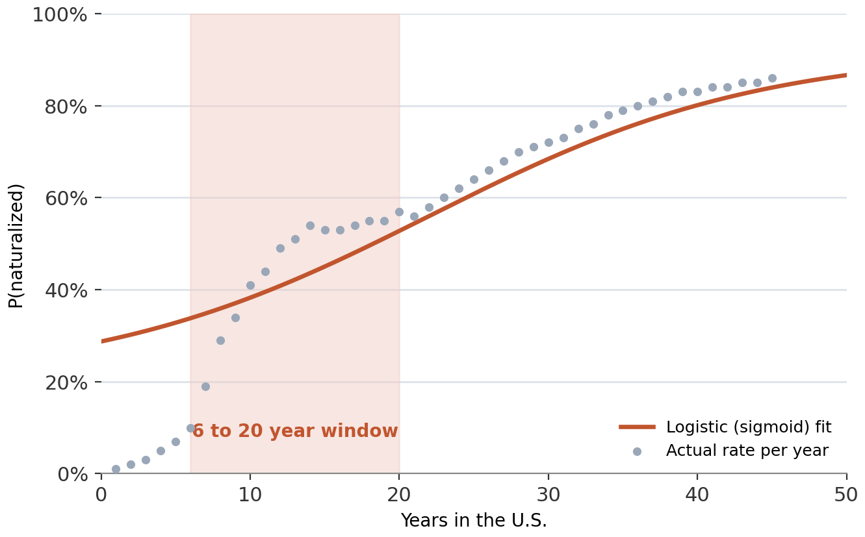
RESPONSE A, THE BASELINE
Baseline logistic regression
One predictor, years in the U.S., traced as a sigmoid. The actual rate plateaus around year 11 while the curve keeps rising, so one variable alone underfits this window.
BASELINE MODEL
18
Notes:
After around year 11, the observed naturalization rate begins to level off while the model keeps rising. One possible reason is that years in the U.S. is only one part of the outcome. After a certain point, other factors may matter more, so time alone no longer captures the pattern as well.

Slide 19
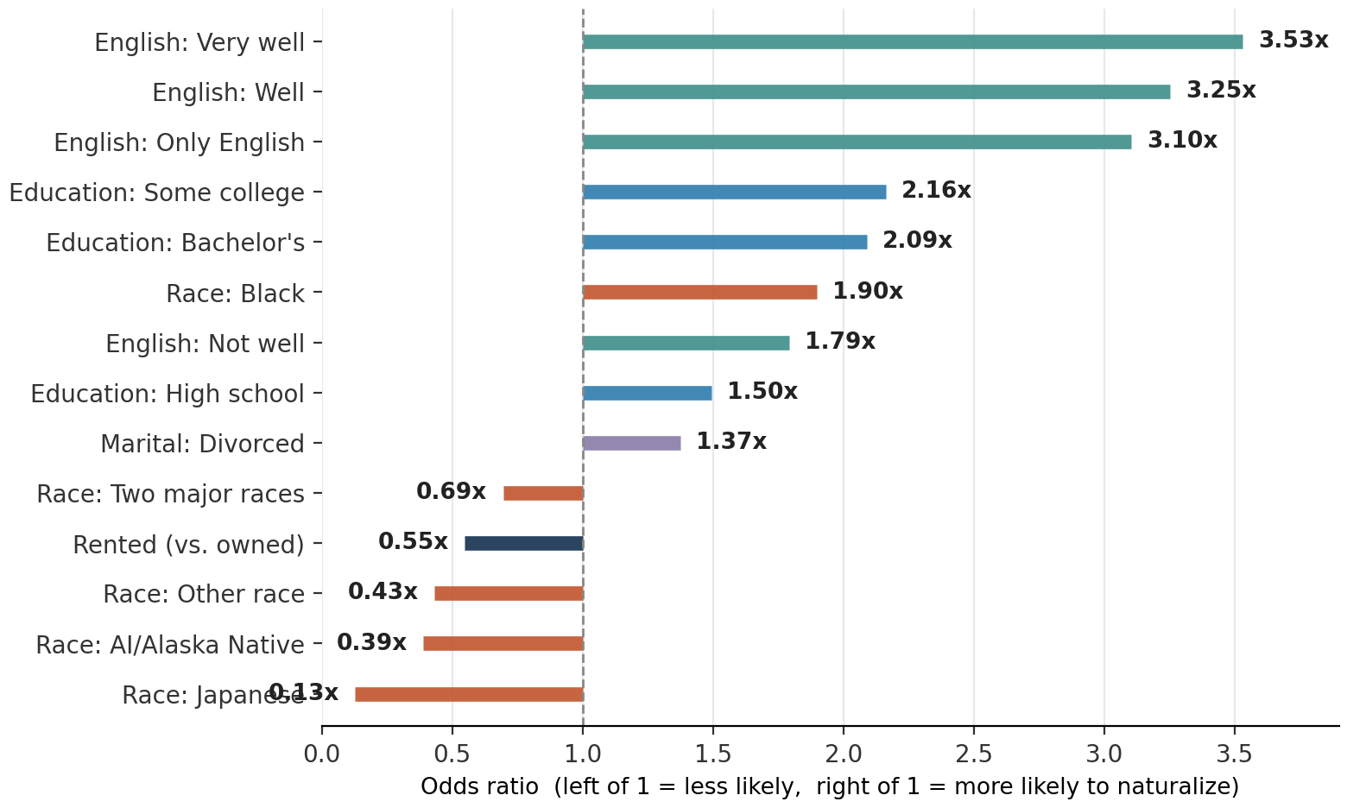
RESPONSE A, THE FULL MODEL
Relaxed logistic regression
The 14 odds ratios furthest from 1.0x, real values, not curated for the story
MEASURED AGAINST
English
None at all
Education
Less than HS
Race
White
Marital status
Married
Homeownership
Owns home
Bars past the dashed line raise the odds of naturalizing, while bars short of it lower them. English proficiency has the biggest lift in the model, up to 3.5x. Race categories also appear several times, but these are controlled associations, not causal effects, and may partly reflect unmeasured differences in legal pathways, country of origin, immigration history, or dual-citizenship rules.
FULL MODEL
19
Notes:
This chart shows odds ratios from the full logistic model. English proficiency is the largest positive result, with 'very well' at about 3.5 times the odds of the no-English baseline. Some college and bachelor's degree are also around double the odds compared with less than high school. Race categories appear several times, but these are controlled associations, not causal claims. Income and employment do not appear among the largest effects.
caveat: We removed some respondents who had both very low English and low income, that reference group is somewhat selected and may be better off than the full no-English population. This means the English odds ratios should be interpreted with some caution.

Slide 20
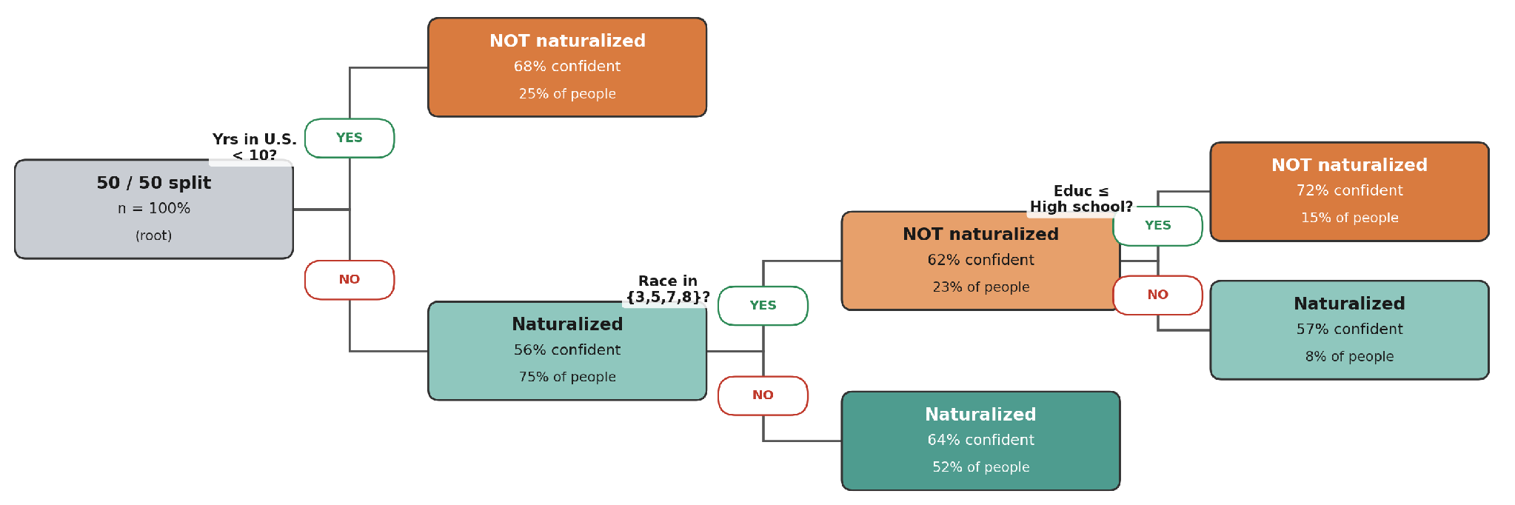
RESPONSE A, MACHINE LEARNING
The decision tree
How one tree splits the data
The first split is on years in the U.S., then it branches on race and education. Teal leans toward naturalized, orange toward not.
DECISION TREE
20
Notes:
The first split is whether someone has been in the U.S. for fewer than 10 years. That group makes up 25% of the sample, and 68% are classified as not naturalized. The remaining 75%, who have been in the U.S. for at least 10 years, lean toward naturalized at 56%. After that, race separates the outcomes further, showing that time is the strongest first divider, but it does not explain every difference.

Slide 21
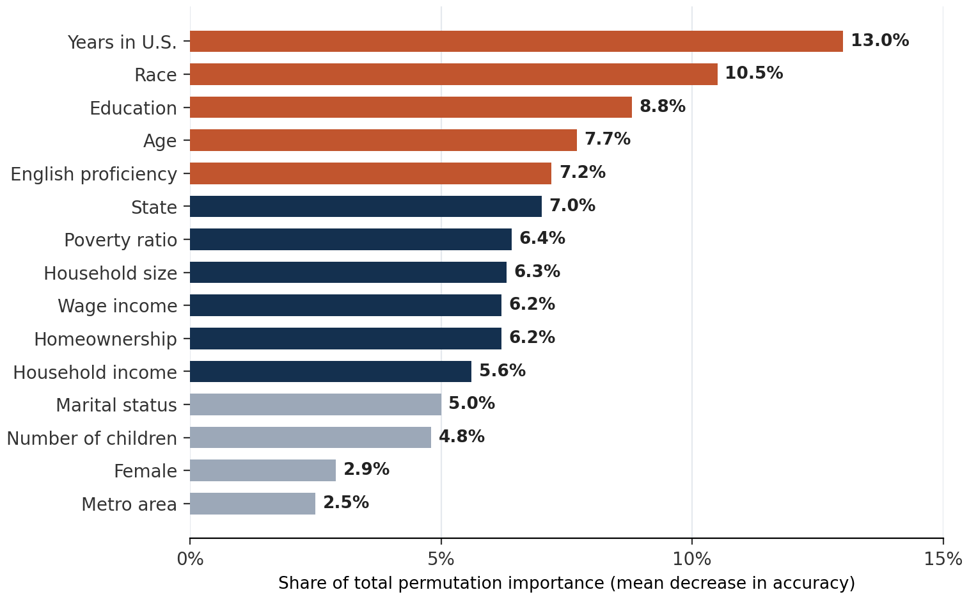
RANDOM FOREST
Which variables matter most
Random forest: permutation importance (mean decrease in accuracy)
Years in the U.S. leads, but race is the second-strongest predictor, ahead of education and English proficiency. This does not mean race causes naturalization. It may partly capture unmeasured differences in legal pathways, country of origin, immigration history, or dual-citizenship rules that our data cannot observe.
VARIABLE IMPORTANCE
21
Notes:
Years in the U.S. is the strongest predictor even within the 6–20 year sample, accounting for 13.0% of total importance. Race is second at 10.5%, followed by education at 8.8%, age at 7.7%, and English proficiency at 7.2%. Time gives the model the strongest signal, but people with similar time in the country can still have different outcomes. That is why the other variables still add predictive information. Race should be read as an association, not a causal effect.

Slide 22
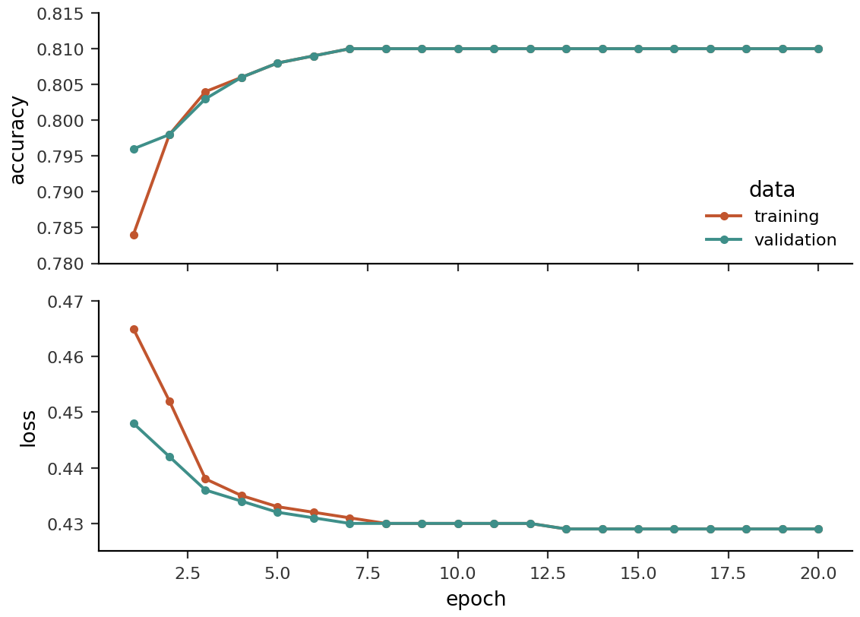
Neural network
Two hidden layers, trained over 20 epochs
80/20 train-test split; 15% validation holdout
Train and validation curves level off, with no clear overfitting
Test accuracy = 80.6%
NEURAL NETWORK
22
Notes:
“For the neural network, we used an 80/20 train-test split, and 15% of the training data was set aside for validation. The validation set was used during training while the model completed 20 epochs. The training and validation curves level off without separating much, so there is little evidence of overfitting. The final test accuracy is 80.6%, meaning the neural network correctly classified about 81% of people in data it had not seen before. This is similar to the performance of our other strongest models, so the neural network performs well but does not produce a completely different result.”

Slide 23
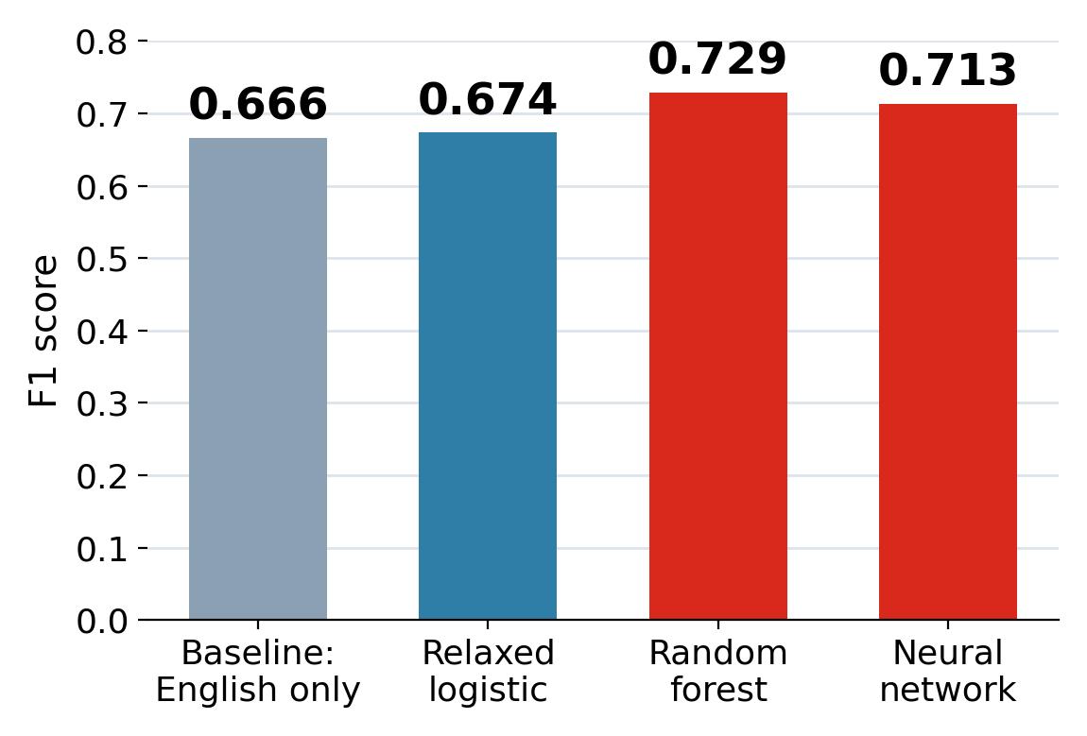
RESPONSE A, RESULTS
Model showdown by F1
All models beat the baseline. The top three are close.
Random forest performs best, with the neural net close behind. Logistic regression is lower but still competitive.
CLASSIFICATION RESULTS
23
Notes:
The model comparison shows that complexity helps, but not dramatically. The random forest has the best F1 score at 0.729, and the neural network follows at 0.713. The relaxed logistic model is lower at 0.674, but it is still close enough to show that much of the signal is already captured by the main variables. The more complex models add performance, but the gain is limited.

Slide 24
CONCLUSIONS/
What actually drives naturalization
FINDING
WHY IT MATTERS
Time in the U.S. beats everything else
Every model agrees: it's the strongest predictor, ahead of education, English, income, and race.
→
Race is the second-strongest predictor
Shows up in LASSO and random forest too, likely reflecting unmeasured legal or origin factors, not race itself.
→
English proficiency outweighs income and employment
Worth about 3.5x the odds of no English at all. Income and employment barely move the needle.
→
Model complexity helps, but modestly
Random forest and the neural net improve on logistic regression, but most signal is already in a few variables.
→
Across the models, time in the U.S. is the strongest predictor. Race and English add more signal than income or employment, and more complex models improve performance only modestly.
KEY CONCLUSIONS
24
Notes:
"So pulling it all together — four findings after running every model.
First, the headline: time in the U.S. beats everything else. Every model agreed. That's why we focused on the 6-to-20-year group in the first place.
Second, race is the second-strongest predictor — but we don't read that as race itself. It's standing in for things we can't see, like legal pathway and origin.
Third, the surprise: English matters way more than income or employment. Speaking English well is worth about 3.5x the odds, while income and employment barely moved the needle — so our hypothesis was only half right.
And fourth, the fancier models only helped a little, which means most of the signal was already in a few key variables.
Bottom line: it's mostly a story about time, with race and English adding the most on top."

Slide 25
LIMITATIONS
What our data cannot see
The biggest gaps are missing variables:
Legal pathway
Dreamers and DACA
Dual citizenship rules
Cost and backlogs
Refugees and asylees follow very different timelines.
Childhood arrivals have their own legal route, invisible here.
Some home countries discourage naturalizing.
Fees and processing delays go unmeasured.
Application and willingness
ACS records naturalization status, but not whether a non-citizen applied, was denied, was waiting, or chose not to apply.
LIMITATIONS
25
Notes:
"Last thing — we want to be honest about what our data can't tell us.
We know who became a citizen, but not the story behind it. Refugees and asylees are on different legal timelines. Dreamers and DACA arrivals have their own path that's invisible here. Some countries discourage giving up citizenship. And fees and backlogs? We just don't see them.
But the biggest gap is at the bottom: we know if someone is a citizen, but not whether they even applied. So a non-citizen might've been denied, might still be waiting, or might've just chosen not to apply — and all three look the same to us.
So we're good at predicting who becomes a citizen. We just can't fully say why someone didn't."

Slide 26

Notes:
And quickly, to be transparent about how we used AI. We used ChatGPT to help generate the images for our slides. We used Claude to help debug our code, especially the LASSO and tree models that were giving us trouble. And we used ChatGPT to sharpen our own understanding of the data so we could present it accurately. Everything — all the code and models — was reviewed and verified by at least one teammate, so nothing went in unchecked.

Slide 27
Thank you

